Slide 1
Development of an X-band Field Emission RF Gun at Tsinghua University
LY Zhou, Hao Zha, Jiaru Shi†, Huaibi Chen
Department of Engineering Physics, Tsinghua University, Beijing, China
Apr 19, 2021
Email: shij@tsinghua.edu.cn

Slide 2
Content
Advantages of field emission rf gun
Design of field emission rf gun at THU
Testing
Observation after conditioning
Plans

Slide 3
Content
Advantages of field emission rf gun
higher initial brightness
compact size
Design of field emission rf gun at THU
Testing
Observation after conditioning
Plans

Slide 4
Advantages of field emission rf gun
Brightness at cathode: $B_{e}=\frac{2I}{ε_{n}^{2}}=\frac{2J_{max}m_{e}c^{2}}{k_{B}T_{c}}$
Image charge limitation: $J_{max}∪\frac{ecε_{0}}{m_{e}c^{2}}{\left[E_{0}sin\left(φ_{0}\right)\right]}^{2}⁡$
$B_{e}$ $∪{\left[E_{0}sin\left(φ_{0}\right)\right]}^{2}$
$φ_{0}→90°$, $B_{e}↗$
To make the emission phase close to 90°, shorter length of the gun’s first cavity is needed
[REF]J. B. Rosenzweig, Next generation high brightness electron beams from ultrahigh field cryogenic rf photocathode sources, Phys. Rev. Accel. Beams 22, 023403

Slide 5
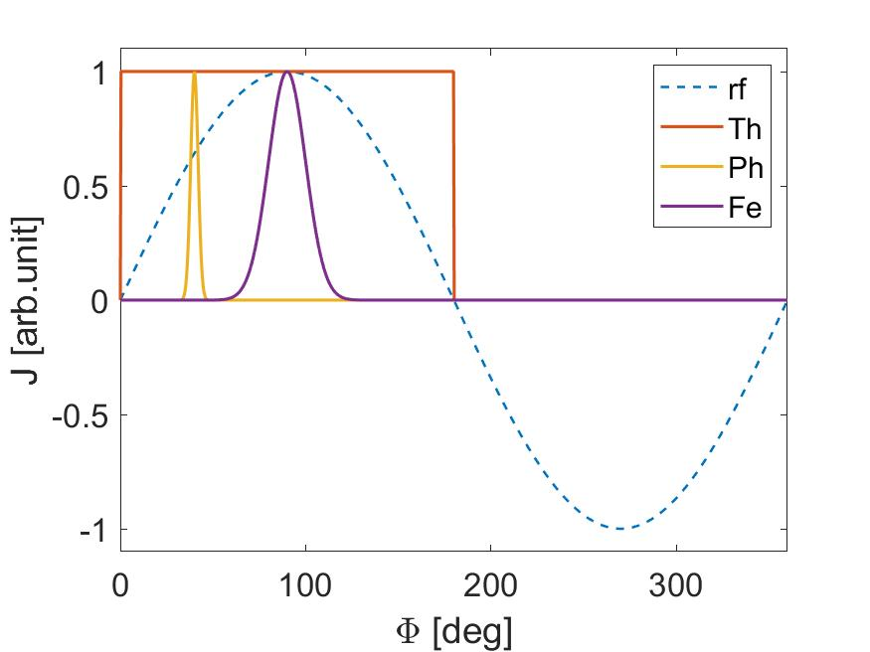
Advantages of field emission rf gun
Field emission gun naturally emits beam at 90°
The thermal emittance of field emission cathode is comparable to that of photocathode
Compact size – Laser free
cathode | condition | $$ε_{rms}/ρ_{c}$$
$$LaB_{6}$$ | 1700K | 0.268mrad
Cu | 266nm | 0.297mrad
Mo | 7e⁹V/m | 0.285mrad
$$ε_{x,rms}\left(Thermal\right)=\frac{ρ_{c}}{2}\sqrt{\frac{k_{B}T}{mc^{2}}}$$
$$ε_{x,rms}\left(Photo\right)=\frac{ρ_{c}}{2}\sqrt{\frac{ℏω−φ_{eff}}{3mc^{2}}}$$
$$ε_{x,rms}\left(Field\right)=\frac{ρ_{c}}{2}\sqrt{\frac{1}{mc^{2}}}{\left(\frac{CE_{F}I_{0}\left(\frac{CE_{F}}{2}\right)−\left(1+CE_{F}\right)I_{1}\left(\frac{CE_{F}}{2}\right)}{3C\left(I_{0}\left(\frac{CE_{F}}{2}\right)−I_{1}\left(\frac{CE_{F}}{2}\right)\right)}\right)}^{\frac{1}{2}}$$
[REF] Xiangkun Li, Study of field emission cathode rf gun, PhD dissertation, 2015, Tsinghua University

Slide 6
Content
Advantages of field emission rf gun
Design of field emission rf gun at THU
rf design
cooling and vacuum
cathode emitter
dynamics
Testing
Observation after conditioning
Plans

Slide 7
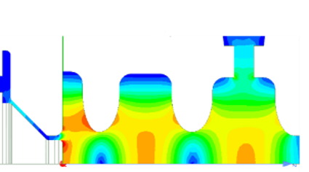
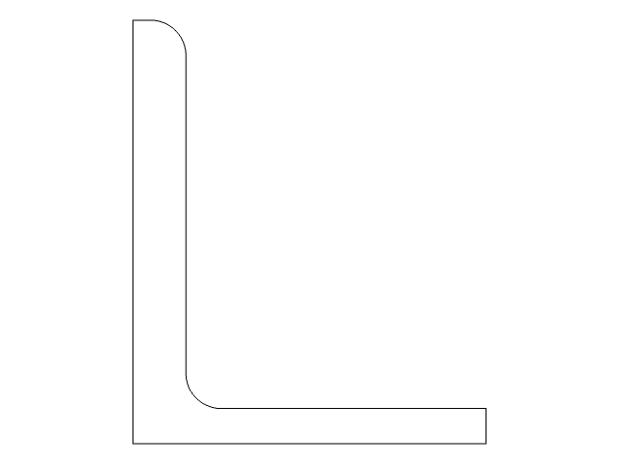
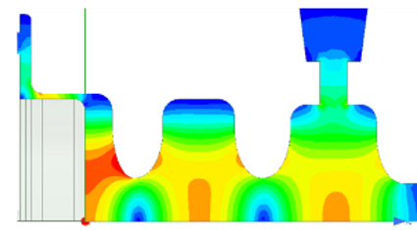
Design of field emission rf gun at THU
Frequency: 11.424GHz
Target energy: ~4MeV
Breakdown research
Gradient: ~200MV/m
Length: ~2.35Cells
Cathode pluggable
[REF] Xiaowei Wu, Design and experiment of x-band high-gradient choke-mode accelerating structure, PhD dissertation, 2017, Tsinghua University

Slide 8
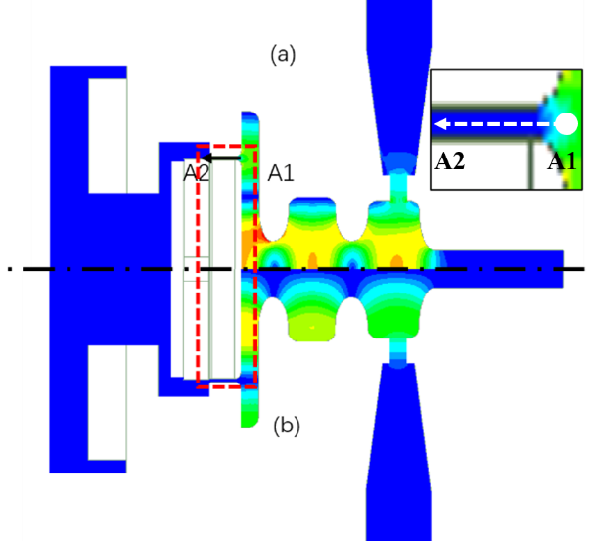
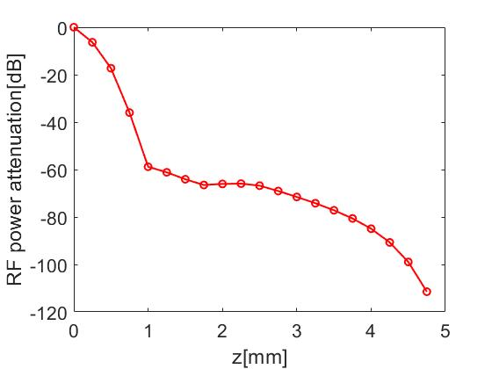
Design of field emission rf gun at THU
rf design
The first cavity is designed to work in the TM₀₂ mode, and the cathode is separated from the cavity wall at the minimal place of the magnetic field.
Electric field
Magnetic field
E_surfmax/E_axismax | 1.15
P_{100MV/m} | 2.55MW

Slide 9
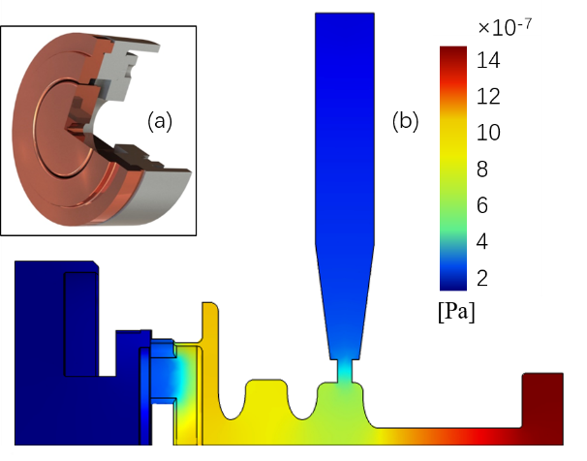
Design of field emission rf gun at THU
cooling system
4 cooling pipes
27°C, 0.6m³/h
200ns, 23MW rf
66.37°C highest
Vacuum system
6.2e⁻⁷Pa

Slide 10
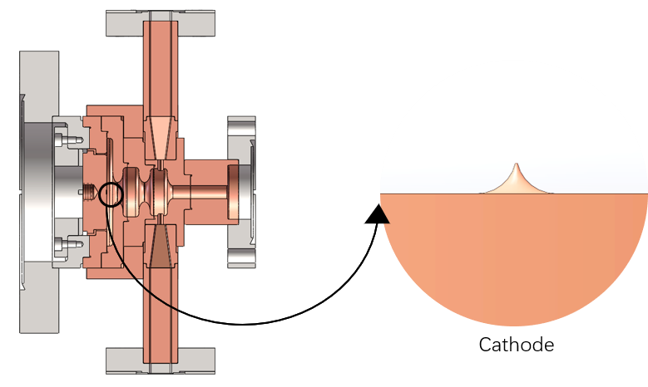
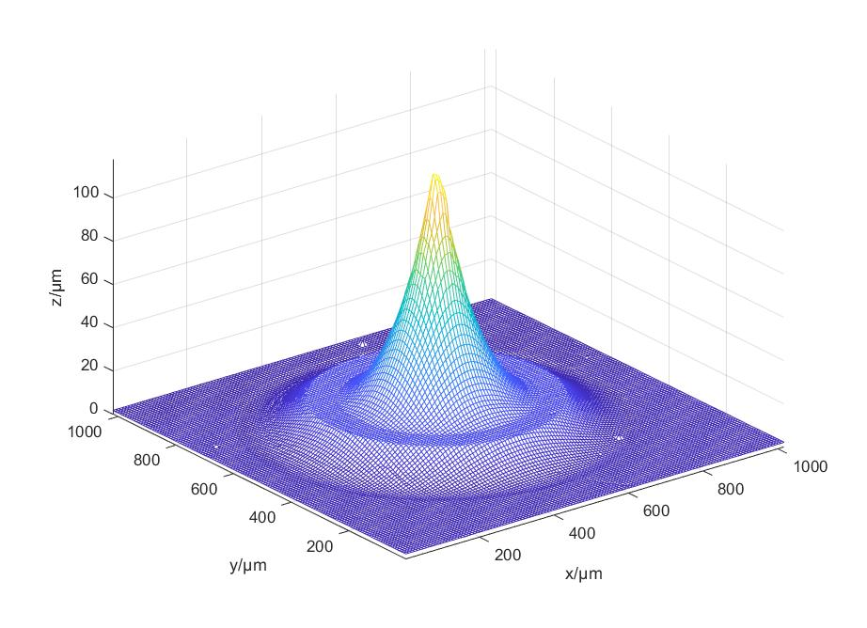
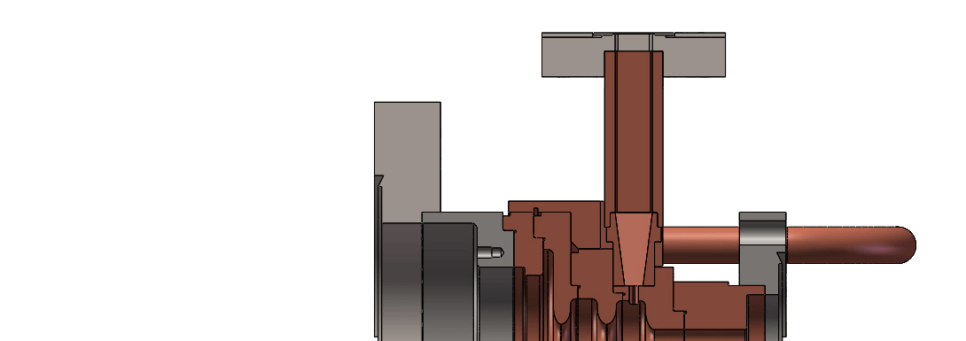
Design of field emission rf gun at THU
cathode with an emitter
surface topography
ID | h/μm | β
1 | 5±2 | 6.2
2 | 100±20 | 19.8
3 | 150±20 | 26.7
4 | 200±20 | 32.3
Process of cathode replacement

Slide 11
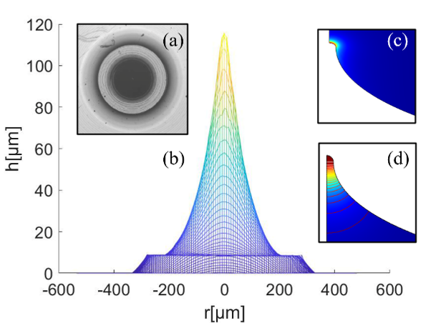
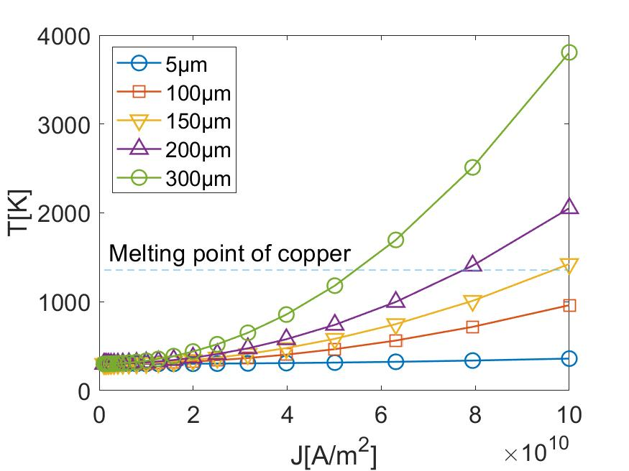
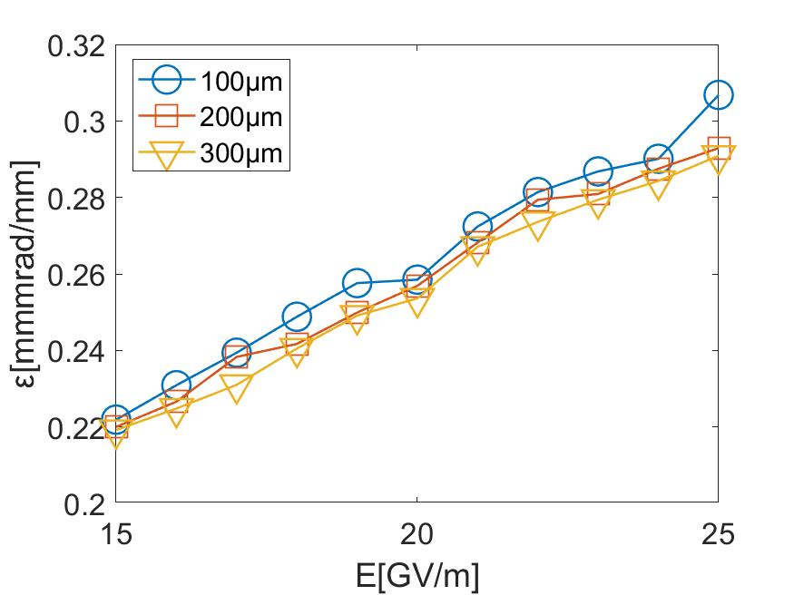
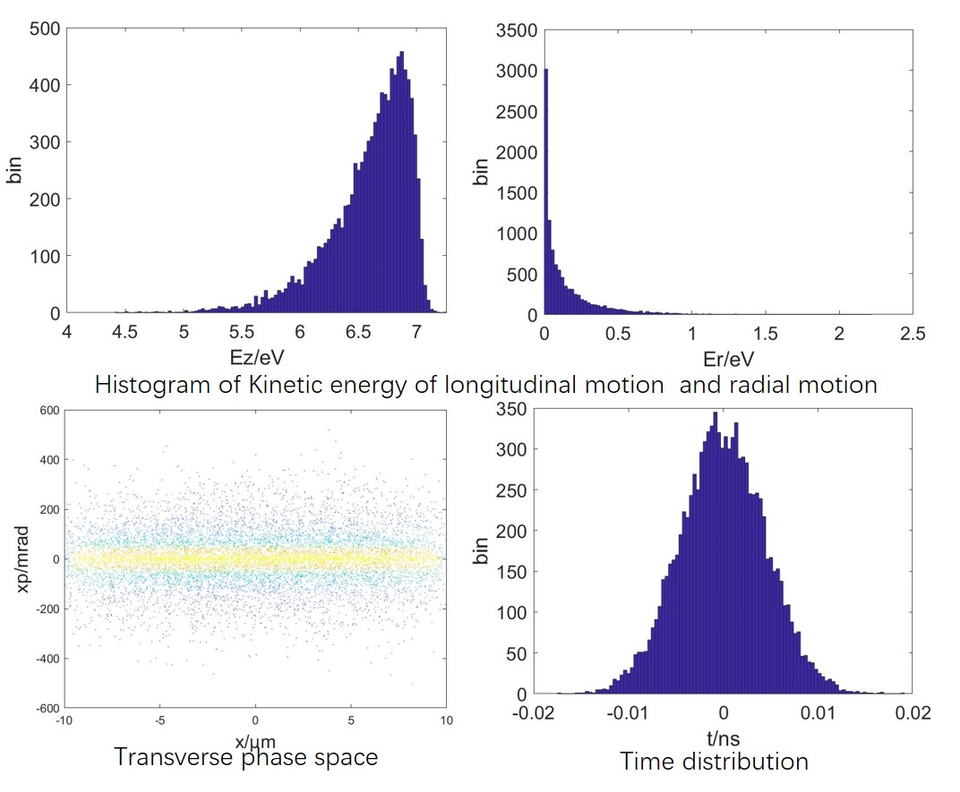
Design of field emission rf gun at THU
Joule heating effect
Due to the low resistivity and good thermal conductivity of copper, the emitter can withstand large emission current
Field emission
The process of field emission is simulated by Monte Carlo method under the following assumptions:
energy distribution
$$f=\frac{1}{exp⁡(\left(E−μ\right)/k_{B}T)+1}$$
tunneling probability
$$δ=exp⁡(−\frac{4}{3}\frac{\sqrt{(2m)}}{e\text{ћ}F}{(χ−E_{z})}^{3/2})$$

Slide 12
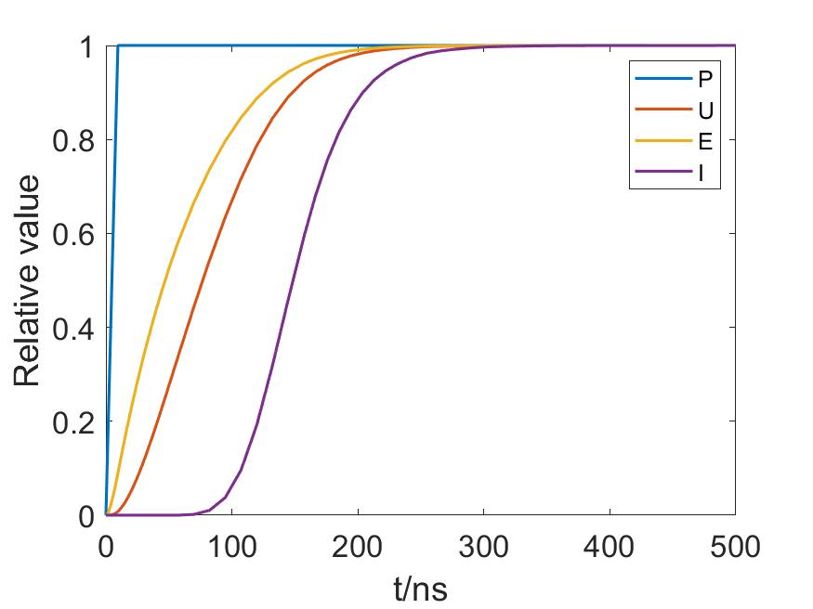
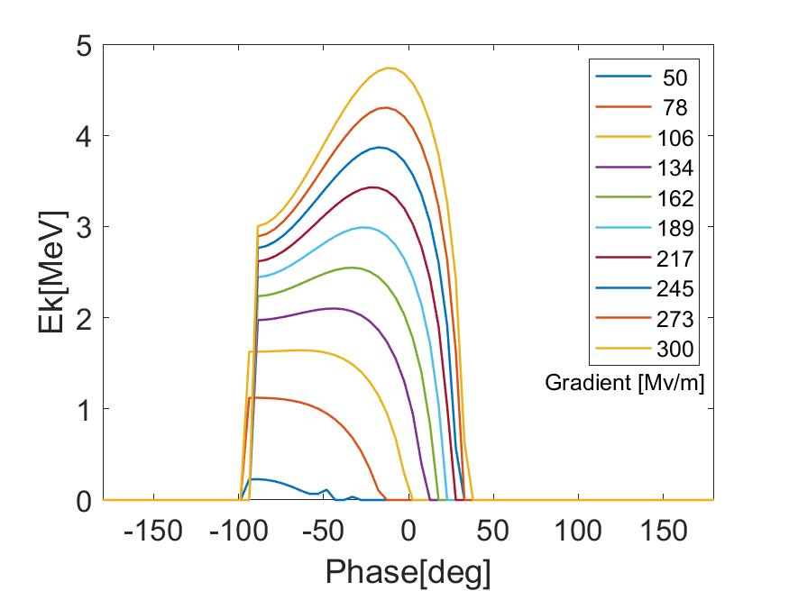
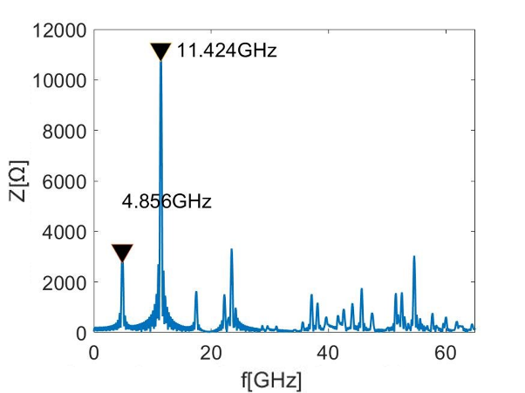
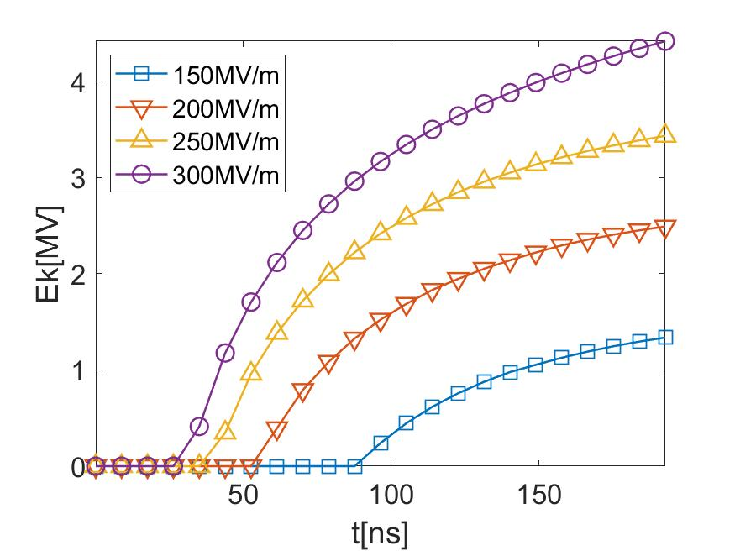
Design of field emission rf gun at THU
RF Filling process
The electron beam is emitted in each pulse
When the acceleration gradient is close to 80 MV / m, the electron beam can be detected at the exit of the gun
Wakefield
A wakefield mode (TM₀₁) at a frequency of 4.856GHz is trapped in the gun
The subsequent beam will be subjected to a decelerating force

Slide 13
Content
Advantages of field emission rf gun
Design of field emission rf gun at THU
Testing
cold testing
high power testing
Observation after conditioning
Plans

Slide 14
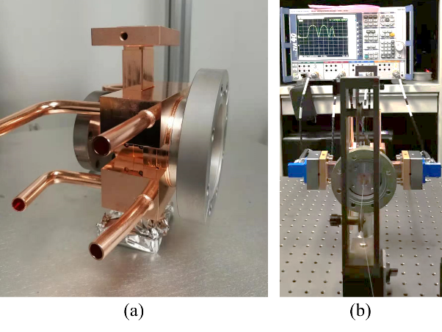
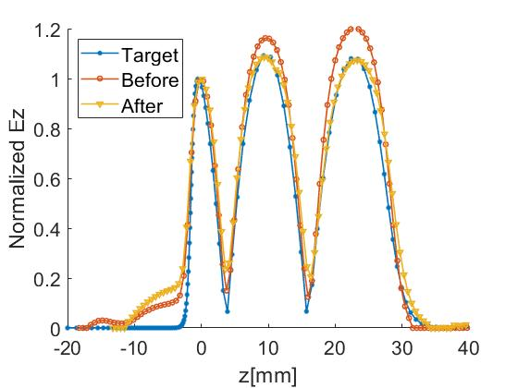
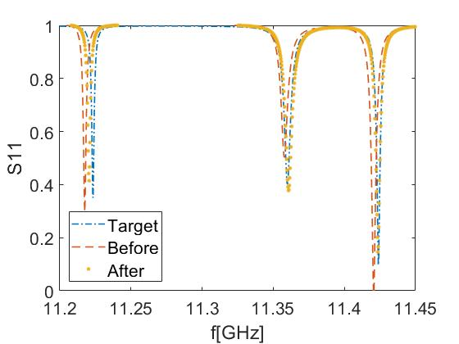
Testing
cold testing
A tuning method based on field distribution of different modes was applied
A testing cathode with an aperture of 1.5mm was used to process bead pulling
Final Parameters
Parameter | Design | Measured
f0 | 11.424GHz | 11.4232GHz
Q0 | 6870 | 6542
beta | 1.2 | 1.33
[REF] Jiaru Shi, Calculating RF Parameters of Individual Cell by Electric Field Distribution of a Coupled Cavity Chain, High Energy Physics and Nuclear Physics, 029.008(2005), pp.818-823.

Slide 15
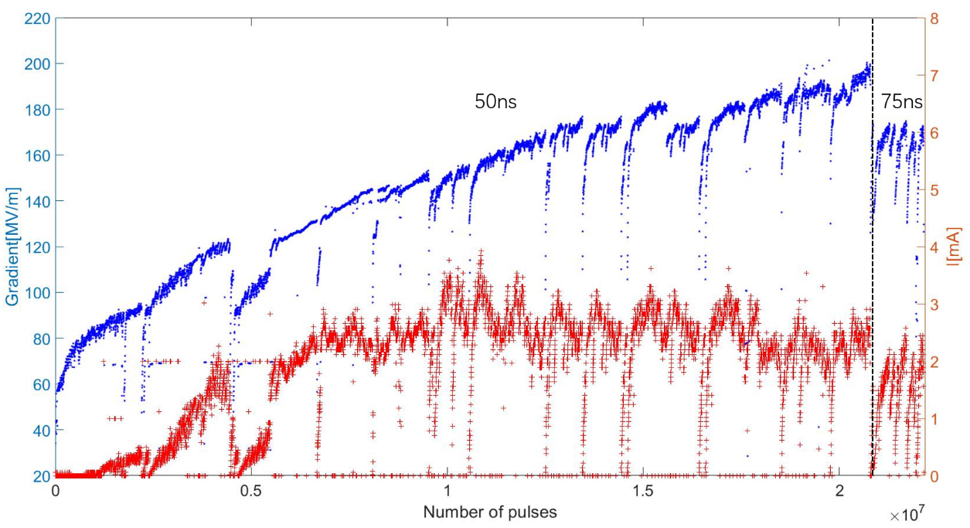
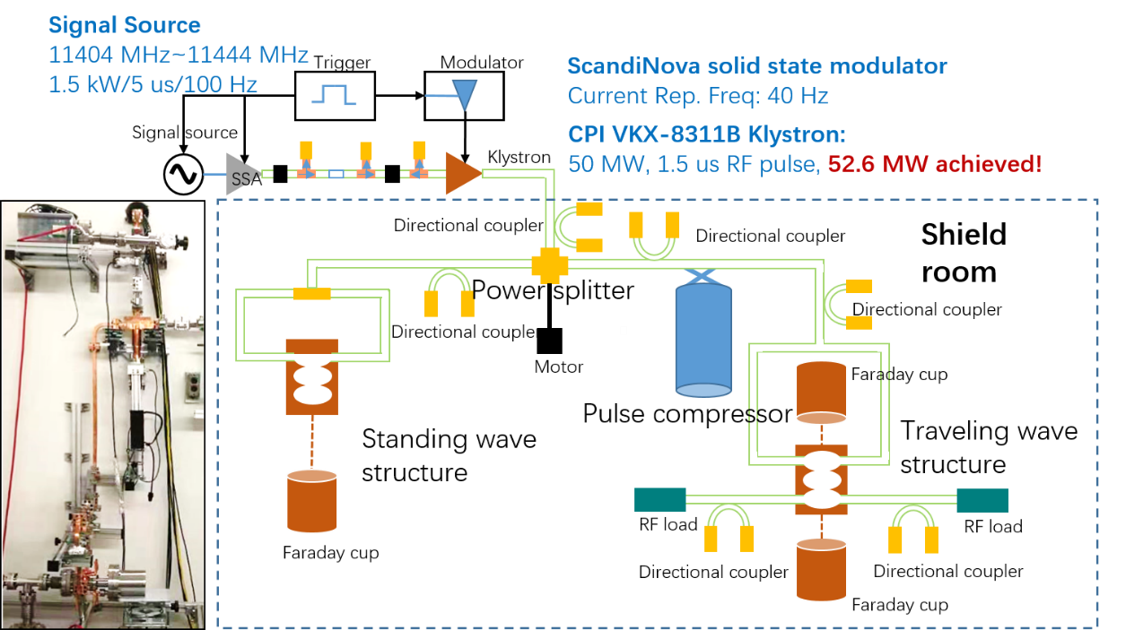
Testing
high power testing

Slide 16
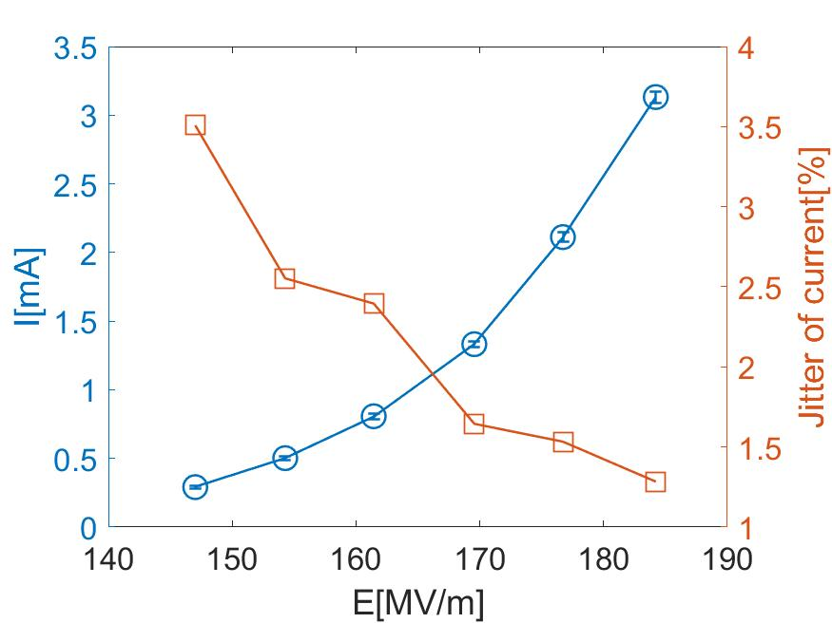
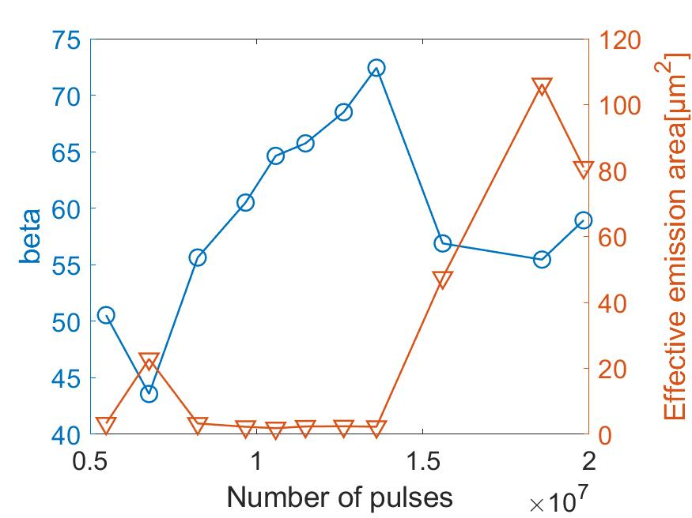
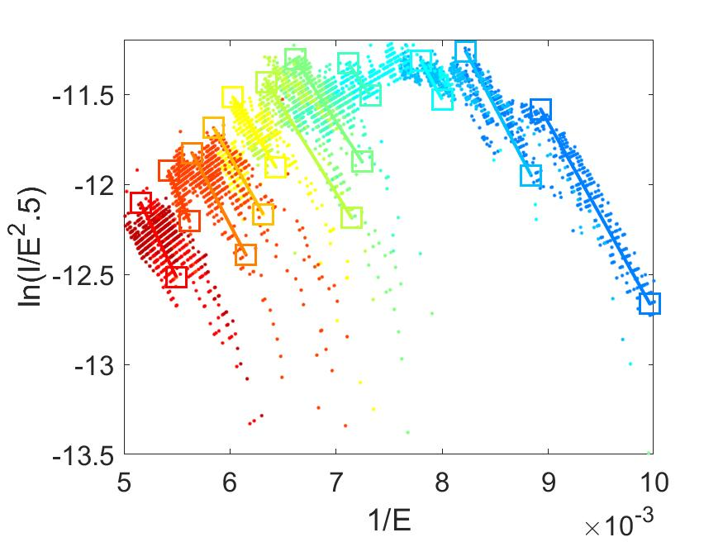
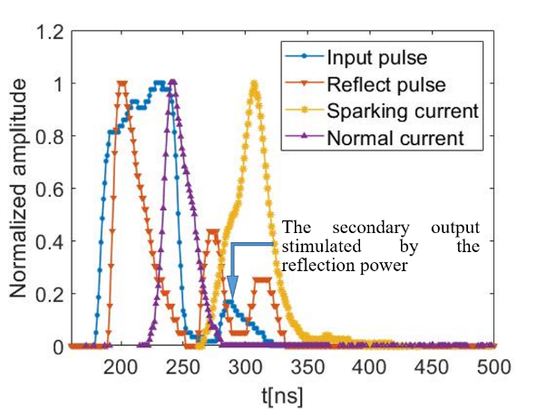
Testing
high power testing
$\overline{I}\left(E_{0}\right) ={ S}^{∗}\frac{A}{\sqrt{2πC}}\frac{{\left(βE_{0}\right)}^{5/2}}{φ^{\frac{7}{4}}}exp\left(\frac{B}{\sqrt{φ}}\right)×exp\left(−C\frac{φ^{3/2}}{βE_{0}}\right)$
$$ln\left(\overline{I}/E_{0}^{2.5}\right)=a\frac{1}{E_{0}}+b$$
$$β = −Cφ^{\frac{3}{2}}\frac{1}{a}$$
$$S^{∗}=\frac{\sqrt{2πC}φ^{7/4}}{Aβ^{5/2}}e^{b−\frac{B}{\sqrt{φ}}}$$
Breakdown signal
A part of RF breakdown signals appear after the end of microwave signal

Slide 17
Content
Advantages of field emission rf gun
Design of field emission rf gun at THU
Testing
Observation after conditioning
visual observation
white light interference
SEM
Plans

Slide 18
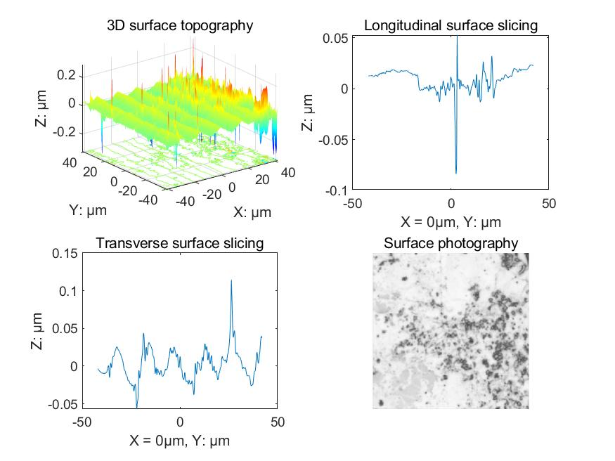
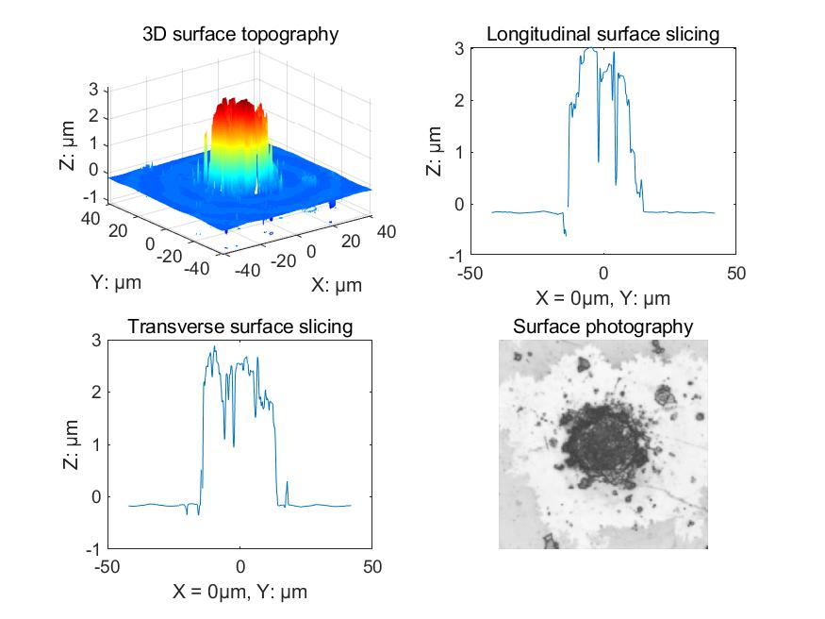
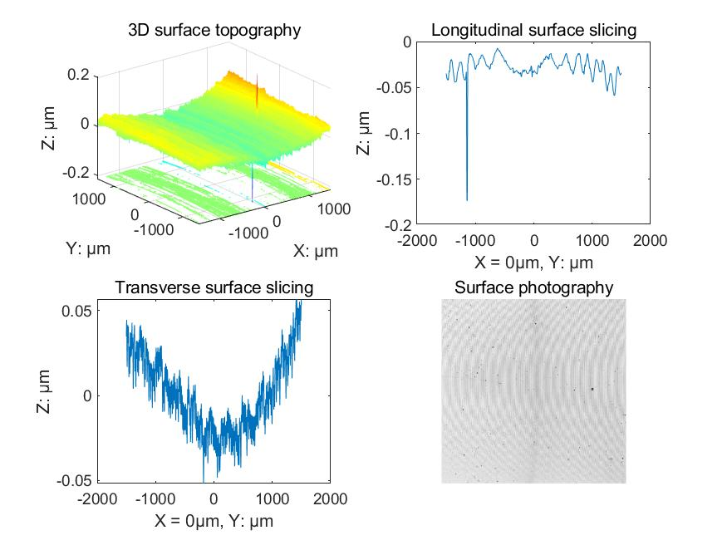
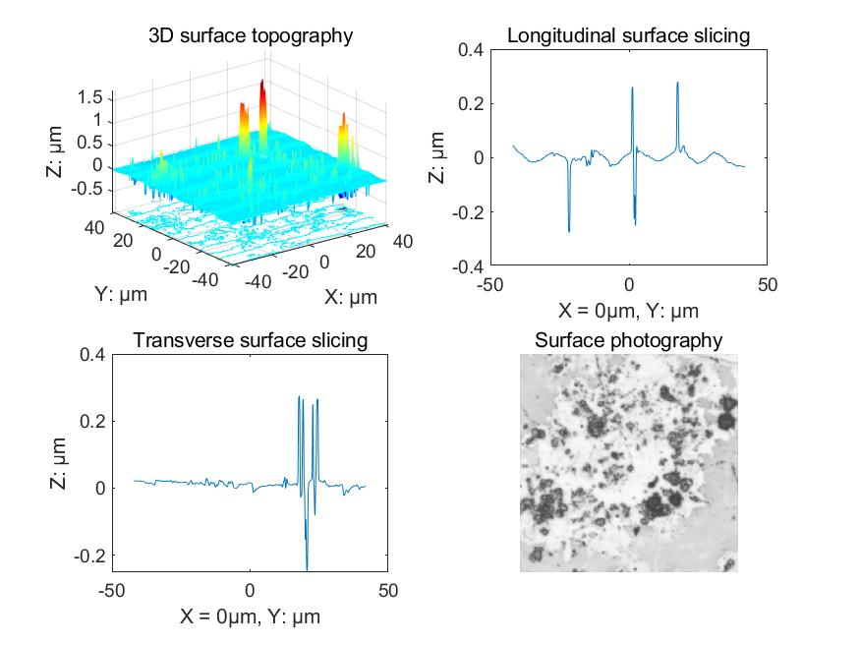
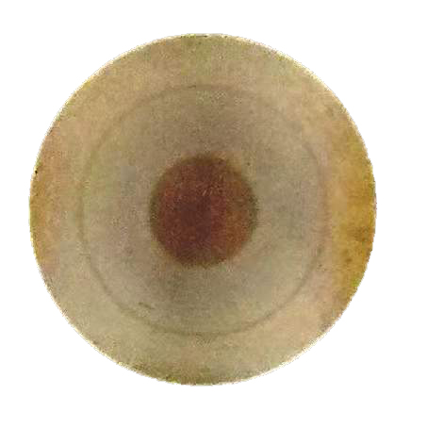
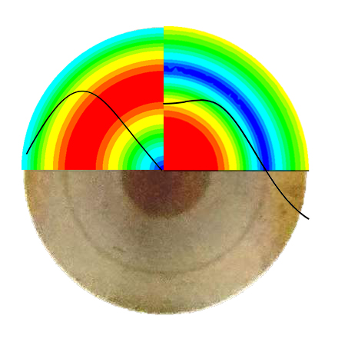
Observation after conditioning
visual observation & white light interference
A circle where electric field is 0 caved around 0.1μm
The surface damage includes protrusions and craters, They are more likely to appear on the ups of machining marks

Slide 19
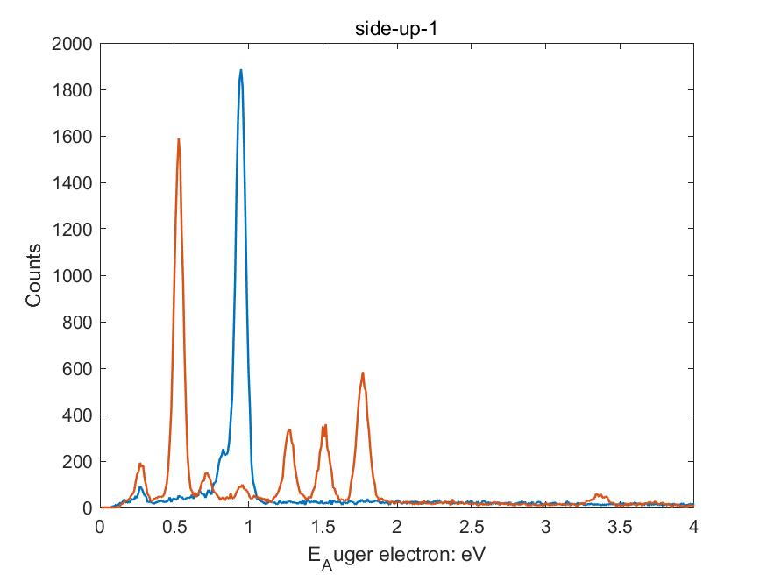
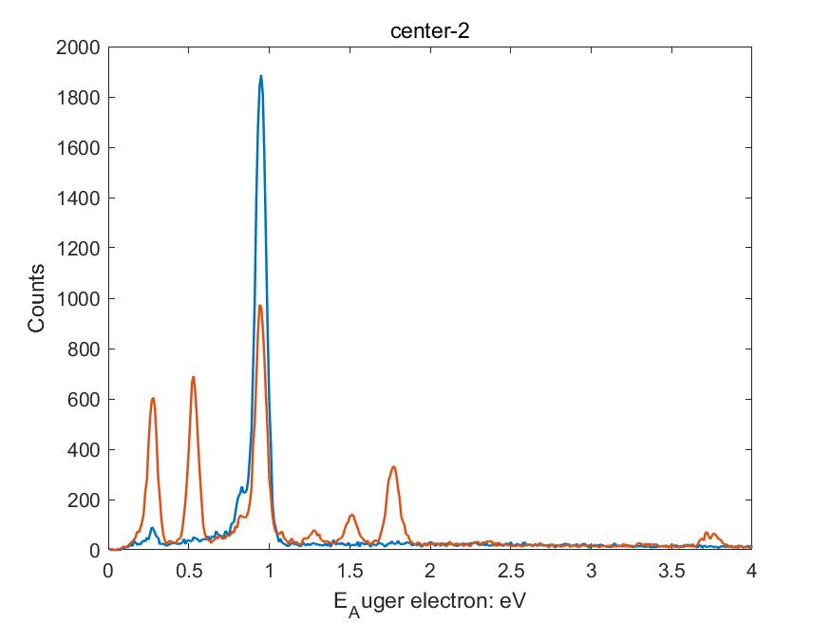
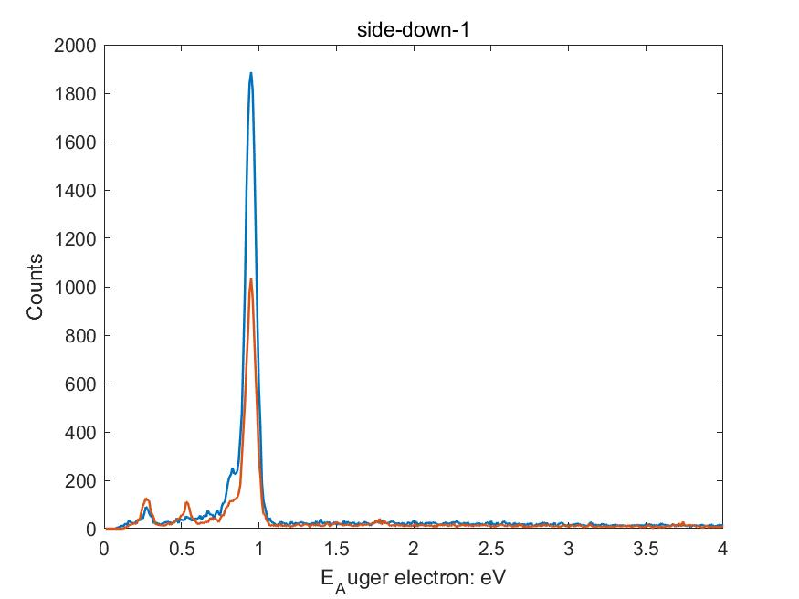
Observation after conditioning
SEM
The element contents of protrusions and craters are different
The craters are composed with cooper
The protrusions contain more impurity elements
The formation mechanism and time of these two types of damage could be different
Cu
base
measured are
C
O
Si
Al
Mg
Fe
S
Cl
Ca

Slide 20
Content
Advantages of field emission rf gun
Design of field emission rf gun at THU
Testing
Observation after conditioning
Plans

Slide 21
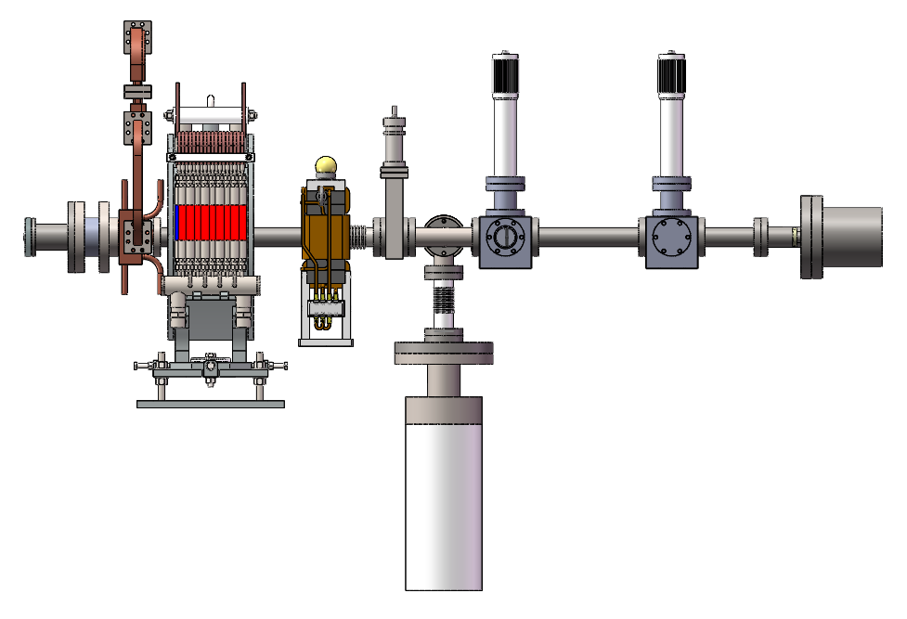
Plans
Cathode imaging system
A cathode imaging beamline will be built in this summer, to image the transformation of cathode surface during conditioning

Slide 22
Conclusion
An x-band field emission rf gun with a pluggable cathode was developed at Tsinghua University
11.424GHz, 200MV/m, 50ns
A cathode imaging beamline will be built soon

Slide 23
Thanks for your attention

