Slide 1

MW-level Gyro-klystron for Driving a Harmonic Lineariser for an X-ray FEL
Liang Zhang¹, Laurence Nix¹, Li Wang², Wenlong He³, and A.W. Cross¹
on behalf of research teams of
¹Department of Physics, SUPA, University of Strathclyde, Glasgow, G4 0NG, UK
² University of Electronic Science & Technology of China, Chengdu, 610054, China
³ Shenzhen University, Shenzhen, 518060, China

Slide 2
Outlines
Motivation
Principles of Gyroklystron
Design of the interaction circuit
Design of other components
  MIG gun
  Input coupler and input window
  Output launcher and transmission line
  Collector design
List of specifications

Slide 3
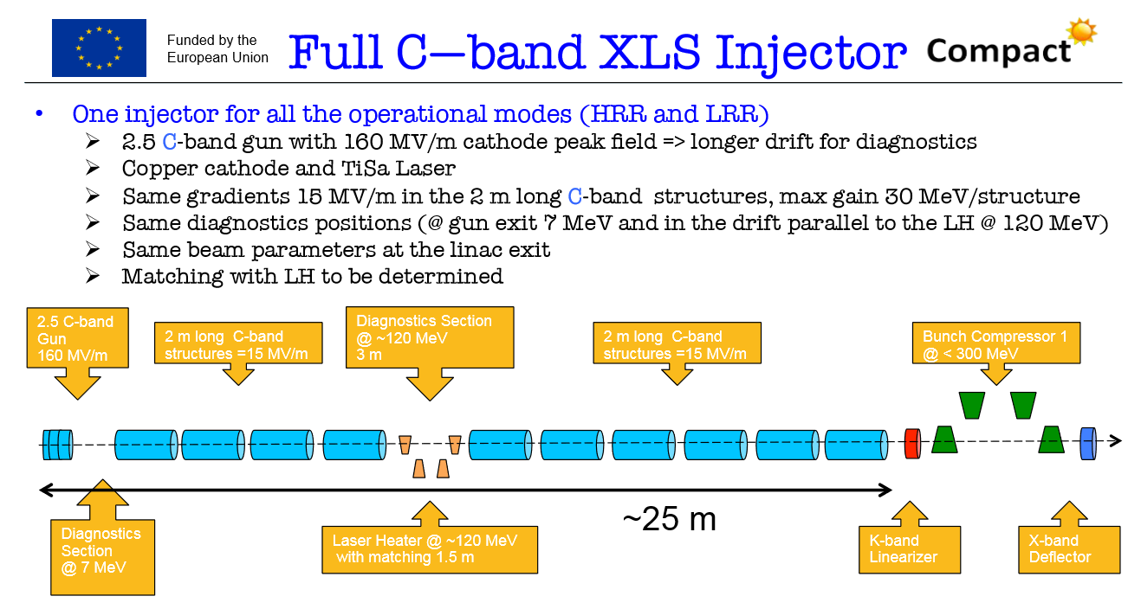
Motivation
XLS injector works at C-band (~6 GHz)
36GHz linearizer system is the baseline design, while other frequencies are also under consideration
linearizer system
*Courtesy by Massimo

Slide 4
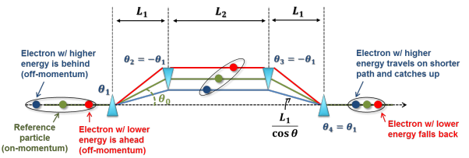
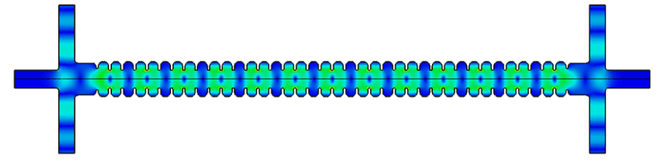
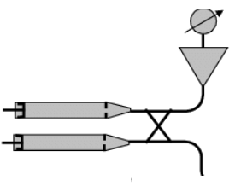
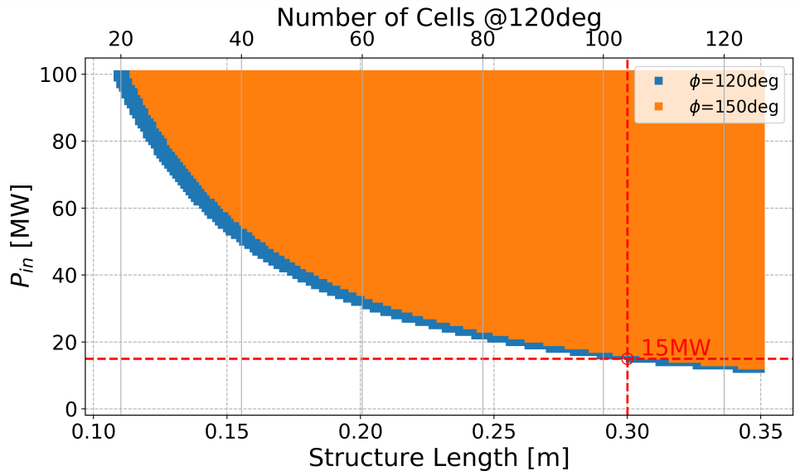
Linearizer
Linearizer is used to generate shorter electron bunches.
Ka-band Traveling Wave Structure
Phase shifter
Microwave source
15MW@30cm, more power at shorter length
SLED-II Compressor, power ratio ~ 7@1us
*Courtesy by A. Castilla, and Sergey V. Kuzikov

Slide 5
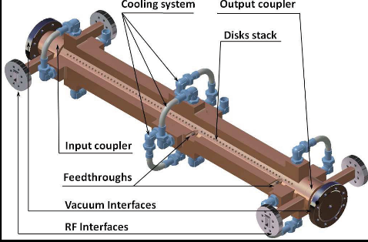
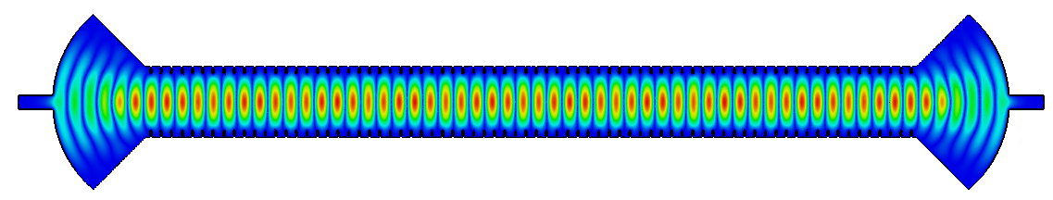
The requirements
Source type | Amplifier | Amplifier
Harmonic number | 6 | 8
Output frequency | 36 GHz | 48 GHz
Output power | 3.0 MW | 2.0 MW
Pulse repetition rate / Duration | 1000 Hz / 1.5 us | 1000 Hz / 1.5 us
Bandwidth | ~100MHz | ~100MHz
Optional driving source:
  Multiple-beam klystron
  Gyroklystron
The 36 GHz 3MW source can also be used to a Ka-band Microwave undulator.
L. Zhang, et. al, Journal of Synchrotron Radiation, vol. 26, pp. 11-17, 2019.

Slide 6
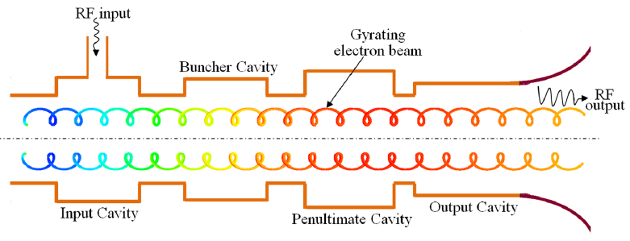
Gyro-klystron
Bunching in azimuthal direction. Interacting with TE modes.
Lower axial velocity due to the beam alpha results in larger cavity size.
Operating frequency determined by the external magnetic field.
Open output cavity, high power capability.
Schematic of a 4-cavity gyroklystron
*Courtesy by M. S. Chauhan

Slide 7
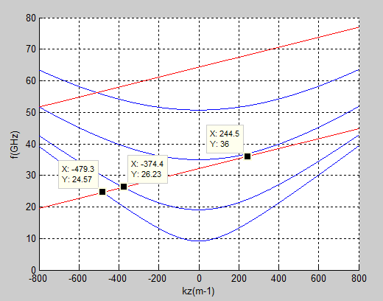

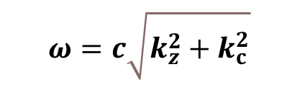
Linear gain theory
The operating mode (output cavity) is TE₀₂;
Competing modes: TE₁₁ & TE₀₁
2nd harmonic
Output power (kW) | 3200
Beam voltage (kV) | 150
Beam current (A) | 50
Magnetic field (T) | 1.5
Frequency (GHz) | 36
Drive power (W) | 400
Gain linear & sat (dB) | 48 & 39
Efficiency | 42%
Bandwidth (MHz) | 190
TE₀₂
TE₀₁
1st harmonic
TE₁₁
$$ω=c\sqrt{k_{z}^{2}+k_{c}^{2}}$$
$$ω=k_{z}v_{z}+sω_{c}$$
Based on Electron Cyclotron Maser instability,
near the waveguide cutoff frequency.

Slide 8
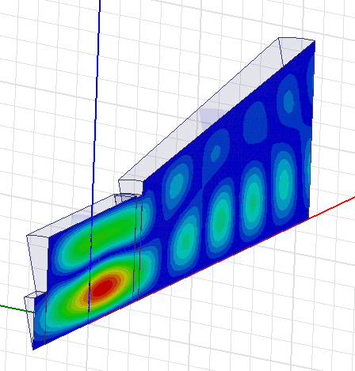
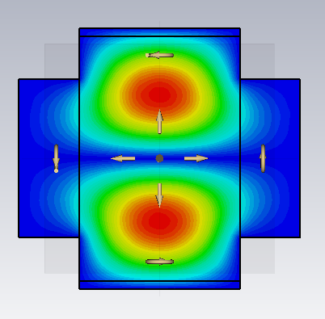
Cavity Simulation
Three-cavity structure
Selected set-up is a 3-cavity cylindrical arrangement with TE₀₁-TE₀₁-TE₀₂ cavity sequence
1
Normalized Beam guiding centre
0.8
0.6
Input cavity
Bunching cavity
Normalized coupling coefficient
Output cavity
0.4
0.2
Structure | Freq. (GHz) | Q
Cavity 1 | 35.25 | 52.6
Cavity 2 | 34.58 | 23.5
Cavity 3 | 35.79 | 78.6
0
0
1
2
3
4
Normalized cavity structure
The normalized coupling coefficient as the function of the normalized size of beam radius

Slide 9

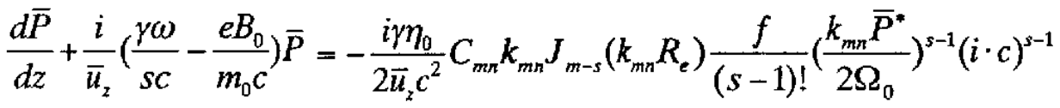
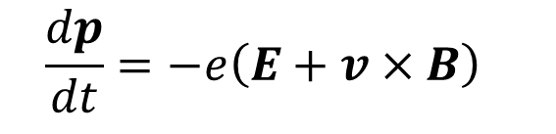
Nonlinear model
Beam-wave interaction
$$\frac{dp}{dt}=−e\left(E+v×B\right)$$
The normalized motion equation ignoring the axial momentum of the helical electron beam due to the frequency being close to cut-off.
Interaction efficiency
Fast and quickly estimate the interaction efficiency, and to determine the initial parameters.
L. Wang et al., IET Microw., Antennas Propag., vol. 12, no. 11, pp. 1752–1757, Sep. 2018.

Slide 10
Nonlinear simulation model
Input cavity
Intermediate cavity
0.6
E-field amplitude
Output cavity
The input signal slightly modulates the beam. The interaction efficiency is ~1E-5.
The intermediate cavity enhances the bunching. The efficiency is ~0.5%.
Major energy exchange in output cavity. The interaction efficiency can be ~40%.
0.5
0.4
Efficiency
0.3
0.2
0.1
Efficiency curve
0
0
5
10
15
20
z
(mm)
L. Wang et al., IET Microw., Antennas Propag., vol. 12, no. 11, pp. 1752–1757, Sep. 2018.

Slide 11
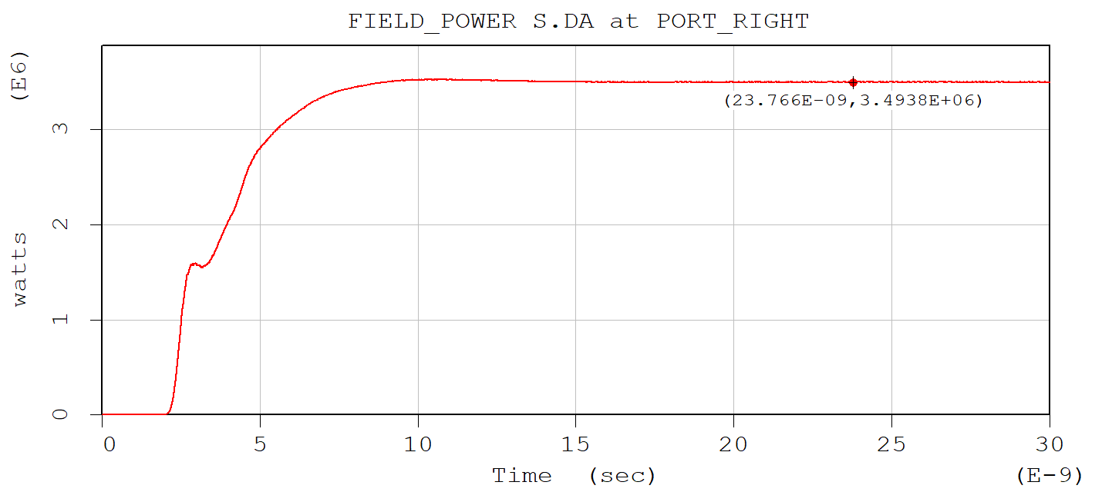
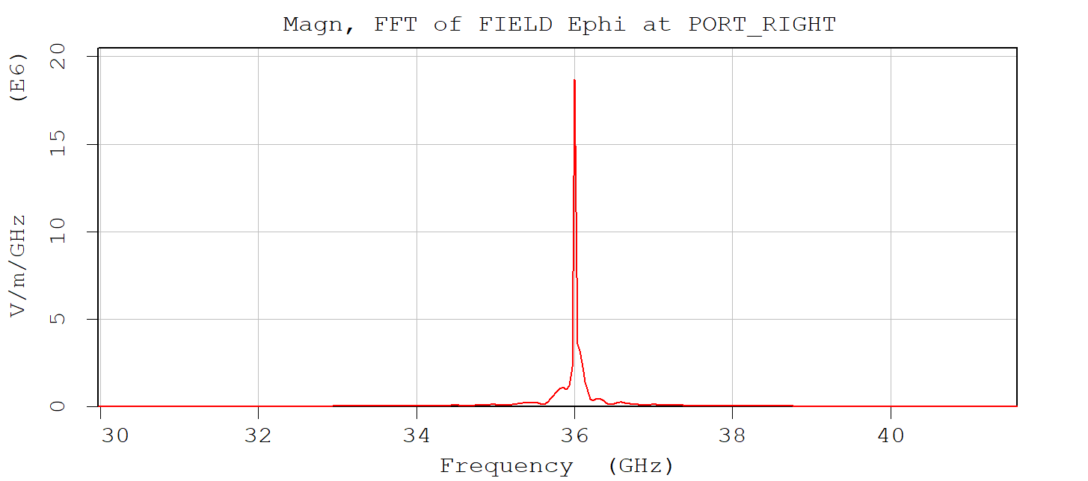
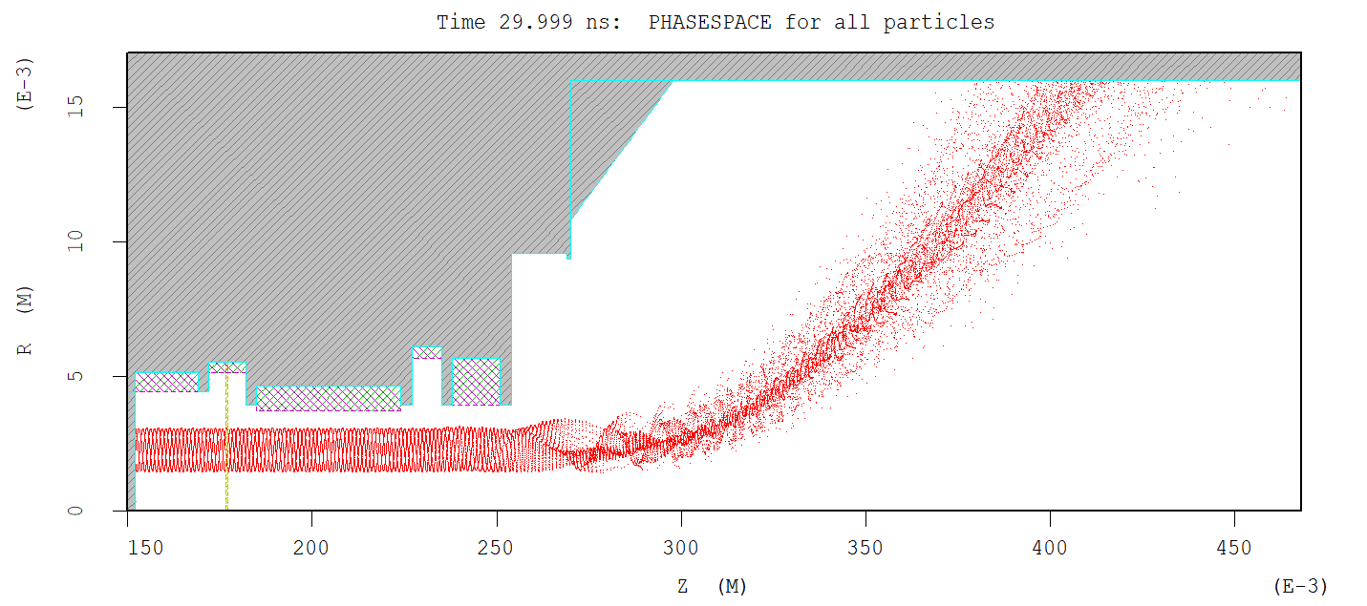
Particle-in-Cell simulations
Frequency
36 GHz
Peak power: 3.2 MW
Electron phase space

Slide 12
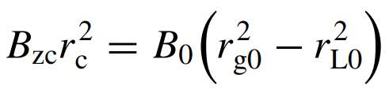
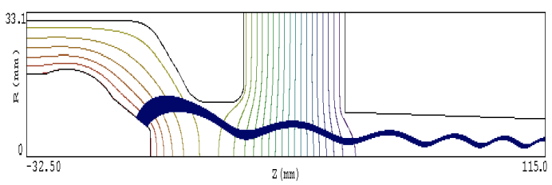
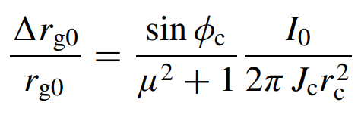

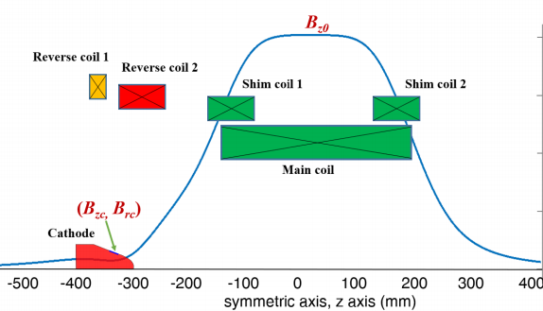
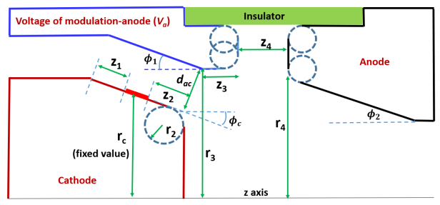
Magnetron Injection Gun
Conservation of angular momentum:
Spread in the guiding center:
Beam trajectories
synthesis method developed by Wes Lawson. Further optimization of the cathode and anode by Parameterized geometry.
Solenoid system, superconducting magnet
L. Zhang, et. al, IEEE Transactions on Electron Devices, vol. 67, no. 11, pp. 5151-5157, Nov. 2020.

Slide 13
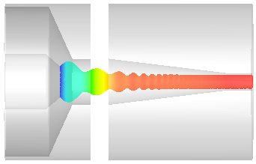
MIG-type e-gun
PARAMETERS | EGUN | MAGIC | CST
Velocity ratio α | 1.32 | 1.32 | 1.32
Velocity ratio spread Δα (%) | 7.99 | 5.74 | 7.12
Transverse velocity spread Δβ_{t} (%) | 3.06 | 2.17 | 2.78
Guiding centre radius R_{g0} (mm) | 2.36 | 2.42 | 2.41
Modulating anode voltage V_{m} (kV) | 43.2 | 46.6 | 45.45

Slide 14
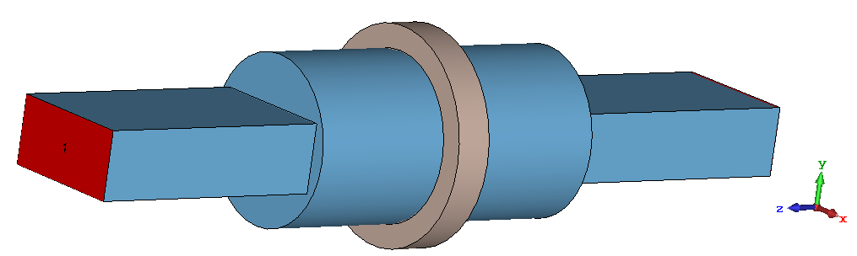
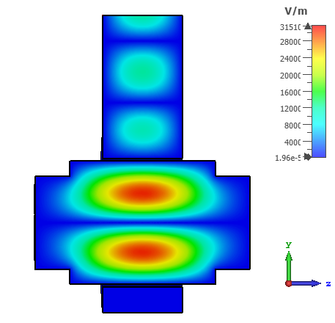
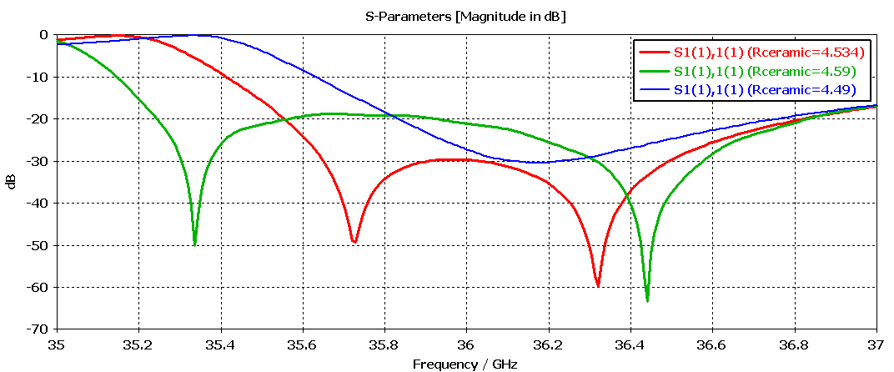
Input coupler & window
Coaxial coupler
Pillbox window
Step for brazing.
Electron
beam
Beam tunnel
-30dB reflection over the required bandwidth with the ceramic disk. Lower reflection can be achieved without step.

Slide 15
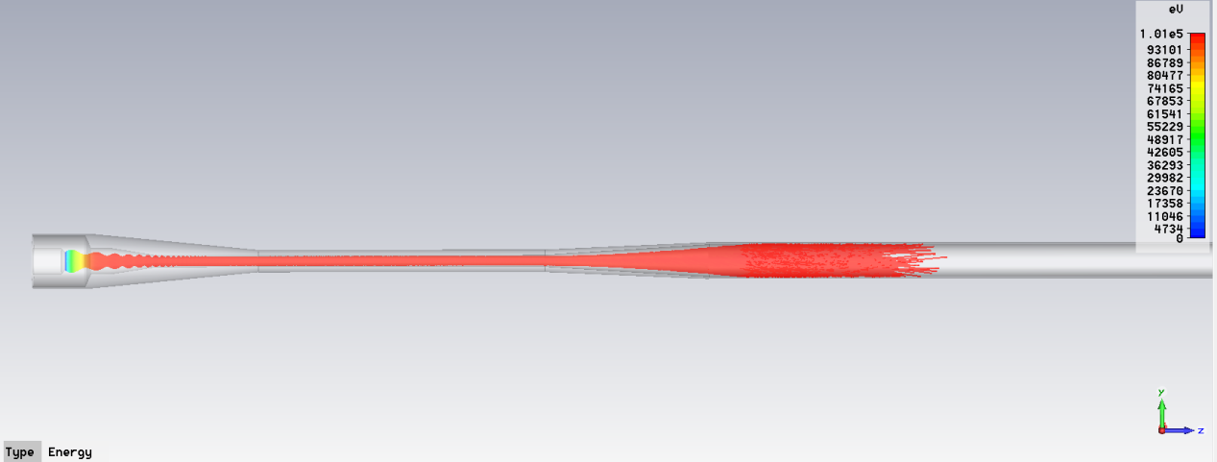
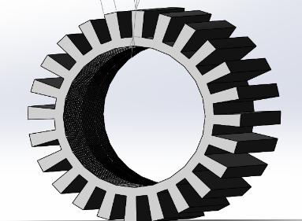
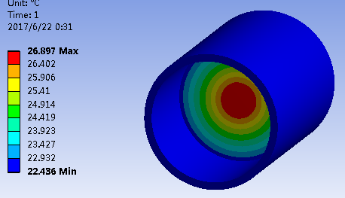
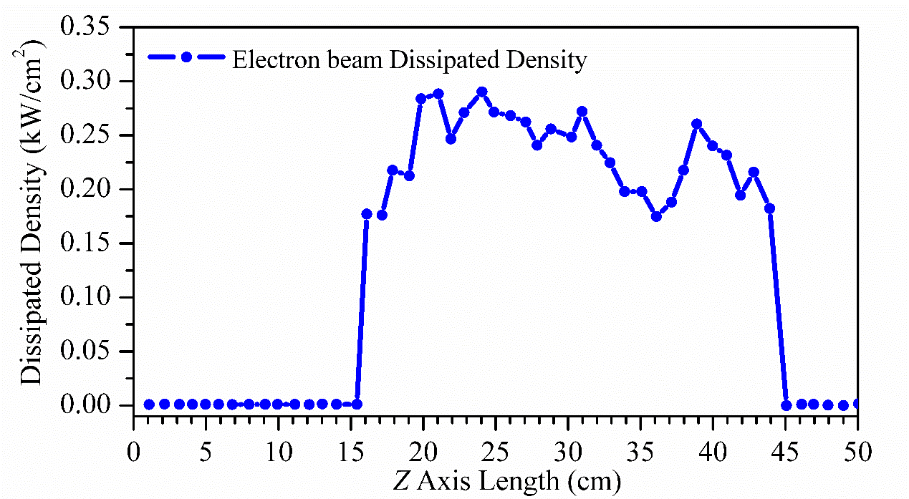
Collector Simulations
τ=1.5μs, f=1000Hz, U=150kV, I=50A, η=40%;
Electron beam power 7.5MW;
Output microwave power 3MW;
Power in the spent beam 4.5MW;
Average spent beam power, microwave on: 6.75kW;
Average spent beam power, microwave off: 11.25kW
Collector structure optimized for higher average power capability with fins added for cooling to lower the temperature on the collector.
Cooling channel
Temperature rise < 100 degree
Output Window
The temperature of window <40℃

Slide 16
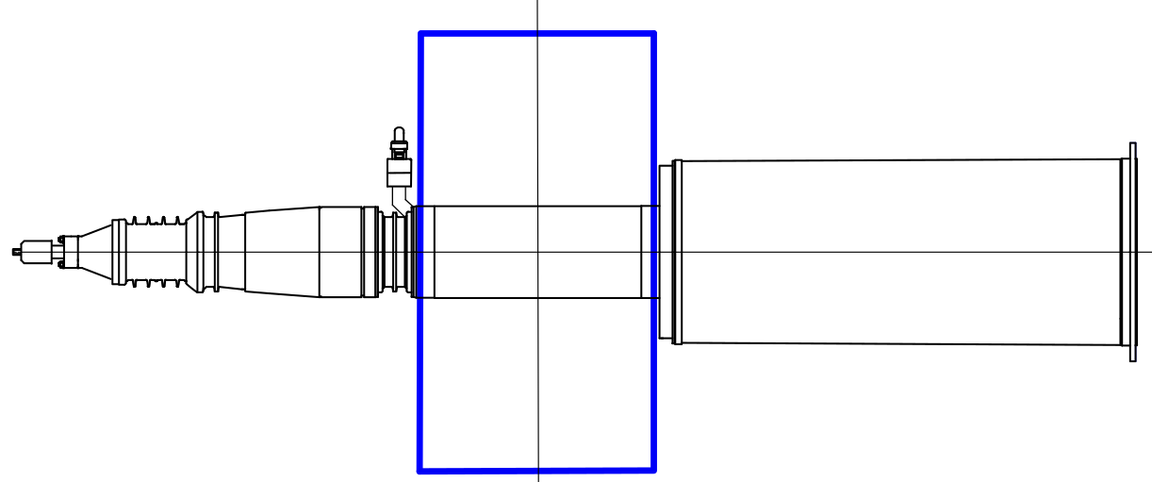
Output coupling – solution 1
Input window & coupler
Superconducting
magnet
Electron gun
60 cm
Interaction circuit
Collector
Output window
120 cm
Output from axial direction.
Output mode is TE₀₂ in circular waveguide, can be converted to TE₀₁ mode with a waveguide taper.

Slide 17
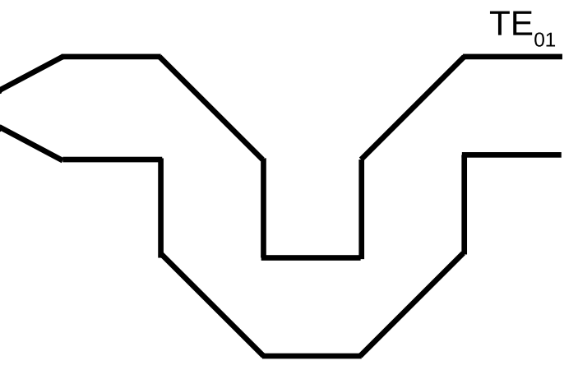
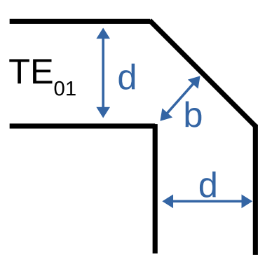
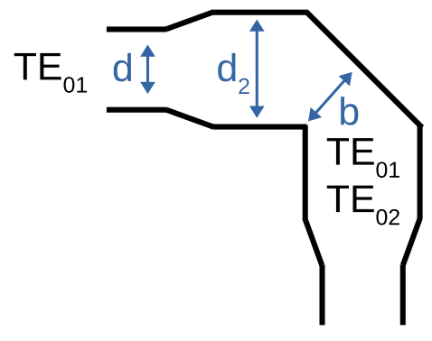
TE_{01/02} transmission line
Transmission line system is composed by:
Waveguide taper (conversion between TE₀₁ to TE₀₂)
Straight waveguide (low loss ~0.02 dB/meter)
Miter bend (Major reflection source)
Miter bend structure:
The taper section is used to convert from pure TE01 into a mixture of higher order TE0n modes, which helps to locate the wave energy more centrally. And to reduce the loss.
Taper angle (degree) | TE₀₂ content
4 | 4%
6 | 8%
8 | 14%
10 | 20%
Typical values, will change with different diameter. ~14% TE₀₂ mode is an optimal choice.
Pure TE₀₁ mode
Hybrid TE_{0n} modes

Slide 18
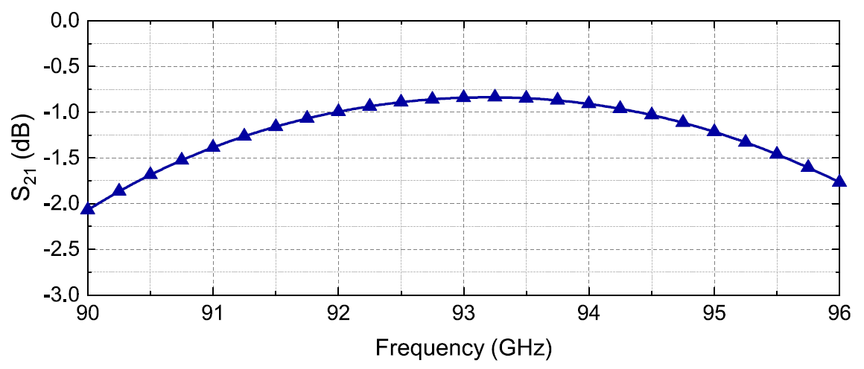
TE_{01/02} transmission line
At W-band 94 GHz with a 20m length, the transmission loss was -0.75 dB.
Lower loss can be achieved at Ka-band.
C. R. Donaldson, et. al, IEEE Trans. Electron Devices, vol. 68, no. 1, pp. 364-368, 2021.

Slide 19
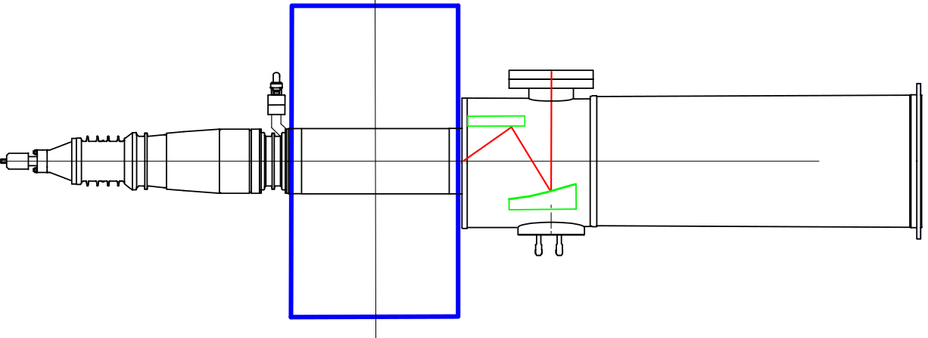
Output coupling – solution 2
Input window & coupler
Superconducting
magnet
Electron gun
Output window
Interaction circuit
Cooling
Collector
Quasi-optical launcher
60 cm
150 cm
Output in the transverse direction.
Output mode TEM00 (fundamental Gaussian mode, ~98% similarity with HE11 mode in low loss corrugated waveguide).
Better beam wave decoupling and more suitable design for depressed collector.

Slide 20
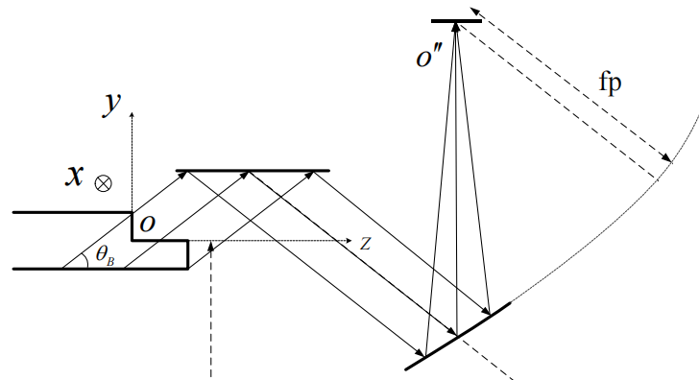
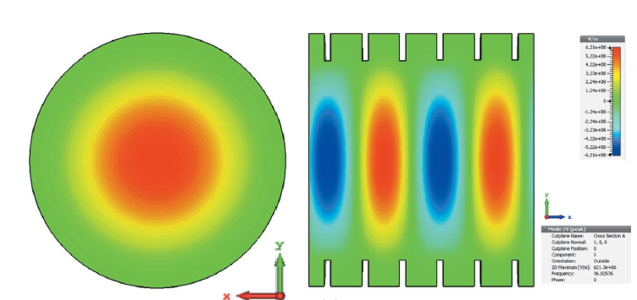
QO launcher, transmission line
window
The conversion efficiency can be 95% - 98%.
elliptical mirror
Vlasov step cut
quasi-parabolic mirror
A low loss corrugated waveguide can be used to transport the HE11 mode. The ohmic loss is similar to TE01 mode.
(1) L. Zhang, et. al, Journal of Synchrotron Radiation, vol. 26, pp. 11-17, 2019.
(2) P. McElhinney, et. al, IEEE Trans. Antennas Propag., vol. 61, no. 3, pp. 1453-1456, 2013.

Slide 21
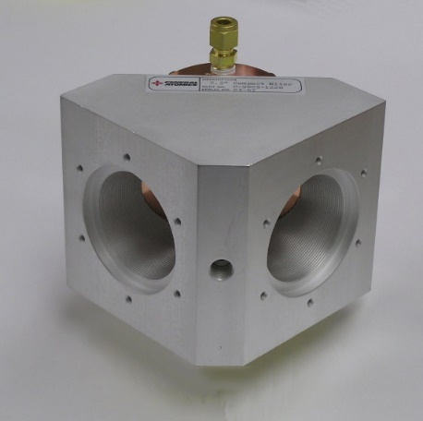
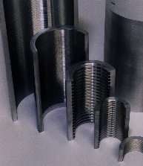
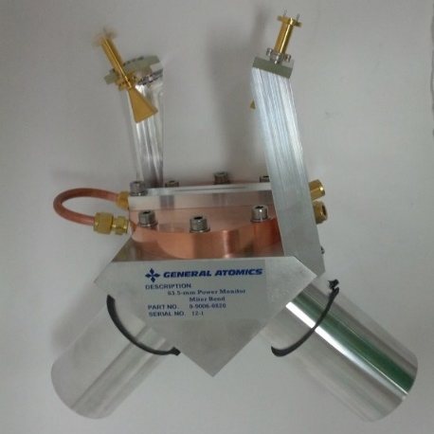
Commercially available transmission lines
Straight corrugated waveguide
Low loss HE₁₁ (as low as 1% per 100m, no mitre bends)
  Can be used with mitre bends
  High power, ~MWs in vacuum
    Higher power in vacuum, Helicoflex® vacuum seals
  Cost ~1,000 euros per m for HE₁₁ corrugated waveguide, mitre bends not included.
Non-vacuum miter bends are made with corrugated waveguides machined into a block.
Vacuum miter bends have corrugated waveguide arms machined in one piece with the miter block with microwave couplers for monitoring power.

Slide 22
36 GHz gyro-klystron design
Voltage (kV) | 150 | Current (A) | 50
Velocity ratio | 1.3 | Drive power (W) | 400
Beam guide radius (mm) | 2.3 | Magnetic field (T) | 1.46
result
Power (MW) | 3.2 | Bandwidth (MHz) | 100
Efficiency | 44% | Saturated Gain (dB) | 39

Slide 23
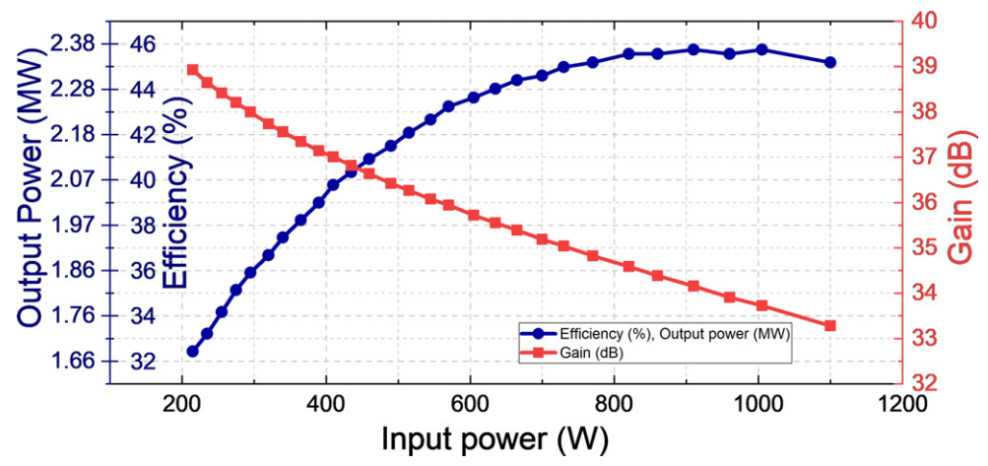
48 GHz Gyroklystron
A 48 GHz gyroklystron was designed with a similar scheme by L. Nix.
The target power is 2 MW. 36.5dB gain @ 400 W input power.
The impact of velocity spread from MIG gun was considered.
25% power drop with 10% velocity spread.
Start to oscillate

Slide 24
Summary of the design
A gyroklystron operating at 36 GHz was designed as the driving source for a 6th harmonic linearizer.
Three-cavity configuration.
Superconducting magnet of 1.5 T was used.
The major components including MIG, input coupler, input window, output window and collector have been designed.
Two output launching methods with low transmission loss were proposed to feed the power to SLED-II compressor.
A 48 GHz gyroklystron was also designed and simulated.
Full Specifications are listed in next page.

Slide 25
Specifications
Beam voltage / Beam current | 150 kV / 50 A
Output power / 2nd harmonic component | 3.2 MW / 2.3%
Output power stability | 0.4% @0.5% variation of the modulator voltage
Output frequency / 3dB bandwidth | 36 GHz / 108 MHz (0.3%)
Magnetic field and frequency drift | 1.46 T and < 1 MHz frequency drift due to the drift of magnetic field
Frequency drift due to beam voltage | 24 MHz @0.5% / 4.8MHz @0.1% variation of the modulator voltage
Pulse repetition rate / Duration | 1000 Hz / 1.5 us
Drive power / Gain | 400 W / 39 dB
Input / output waveguide mode | Input TE10 (Rect.), output TE02 (Circular)
Efficiency | 42.7% (without energy recovery), 58.0% (with single stage depressed collector)
Dimensions | 60 cm (W) * 60 cm (L) * 1200 cm (H)
Phase stability | 17.0 degree@0.5%, 3.4 degree@0.1%, 0.34 degree@0.01 variation of the modulator voltage
Average spent beam power | 6.5 kW (mm-wave on), 11.25kW (mm-wave off)

Slide 26

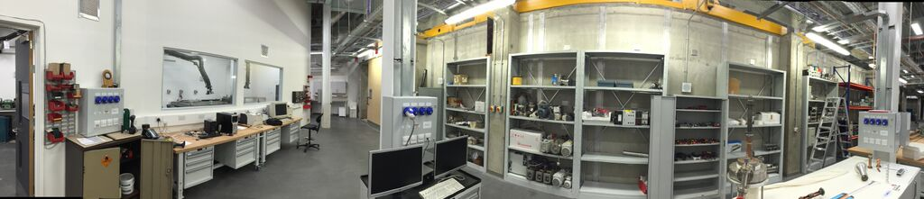
Acknowledgement
This work is supported by the European Commission Horizon 2020 Project “CompactLight” (777431-XLS), and the STFC, UK (Cockcroft Institute Core Grant)
Future work
Construct 3MW, 36GHz gyroklystron driven by a low pulse repetition frequency (1Hz) modulator
Longer term acquire a 150kV, 50A Scandinov modulator to operate at high pulse repetition frequency (1kHz)
INTEGRATED CAPABILITY from IDEA to DEMONSTRATOR
Theory
&
New concepts
Modelling
&
Simulations
Design
Construction
&
Experiments
Testing
&
Applications
Technology
Transfer to Industry
&
Manufacturability

Slide 27


