Slide 1
Development of Compact
Low-Voltage RF Power System Prototypes at SLAC
High Gradient Workshop 2021
Brandon Weatherford
Mark Kemp, Erik Jongewaard, Julian Merrick, Emilio Nanni, Chris Nantista, Alex Nguyen, Jeffrey Neilson, Ann Sy, and Sami Tantawi
Apr. 21, 2021

Slide 2
Overview
Challenge of low-cost RF power
Compact, mass-producible modulators
The Modular Array Multi-Beam Klystron
Spinoff programs with commercial uses
RF sources design & build progress
Future research directions

Slide 3
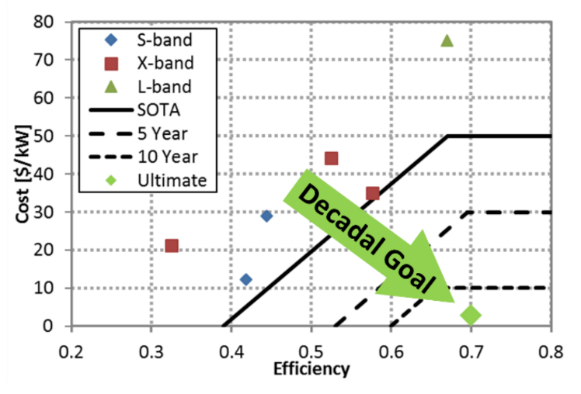
Reducing the cost of RF power
RF power is the main cost driver for most advanced accelerator facilities – over 90% in some cases. The use of pulse compressors, superconducting structures, etc., are all motivated by a need to minimize RF power costs
DOE/HEP set a decadal goal of 70% DC-to-RF efficiency at $2/kW – an extremely difficult challenge at any frequency
*Radiofrequency Accelerator R&D Strategy Report
Order of magnitude cost reduction is needed

Slide 4
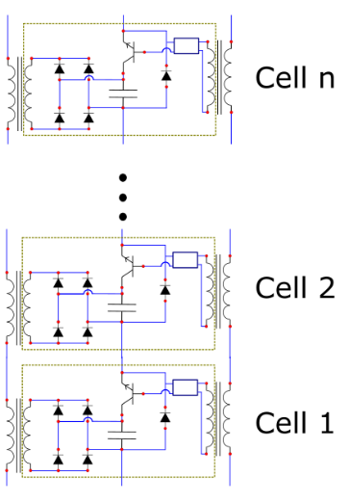
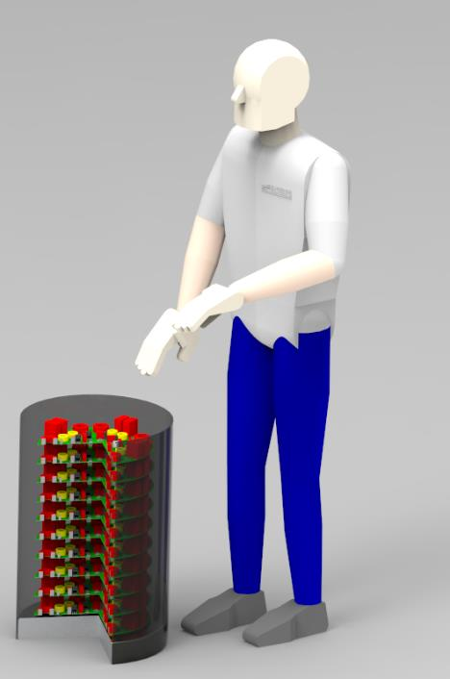
60 kV Marx Modulator Topology Embodies Low-Cost Fabrication Techniques
Only off-the-shelf, low-voltage components
>90% of fabrication accomplished with extremely high-throughput methodologies
Testing and assembly can be automated
SLAC has a heritage of delivering on high-performance Marx modulators
Voltage | 60 kV
Peak Power | 2.5 MW
Rep Rate | 1 kHz
Pulse Width | 1.5 µs
Cells | 80
Average Power | 3.8 kW
First prototype parameters chosen to drive a “4 pack” MA-MBK RF amplifier (discussed later)
2.5 MW Modulator
Kemp, Nguyen

Slide 5
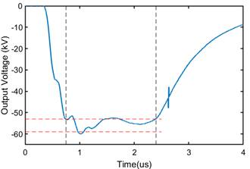
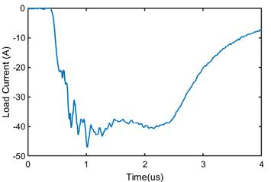
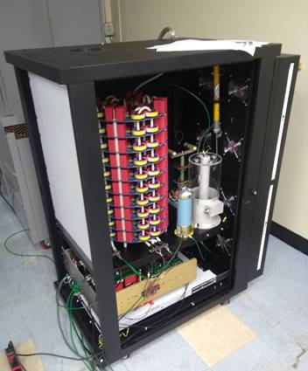
The Full Marx Has Been Fabricated and Tested
<100 ns rise time
<5% ripple, with no active compensation
Voltage | 60 kV
Peak Power | 2.5 MW
Rep Rate | 1 kHz
Pulse Width | 1.5 µs
Cells | 80
Average Power | 3.8 kW
$8/kW achieved with first prototype @ SLAC
$2/kW well within reach for qty > 1
Complete Marx modulator assembly w/ DC supply, controls, diagnostics
Kemp, Nguyen

Slide 6
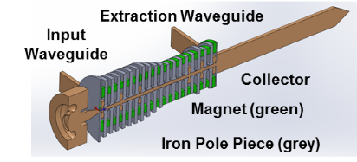
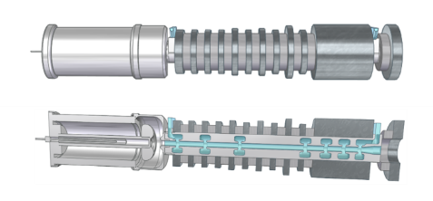
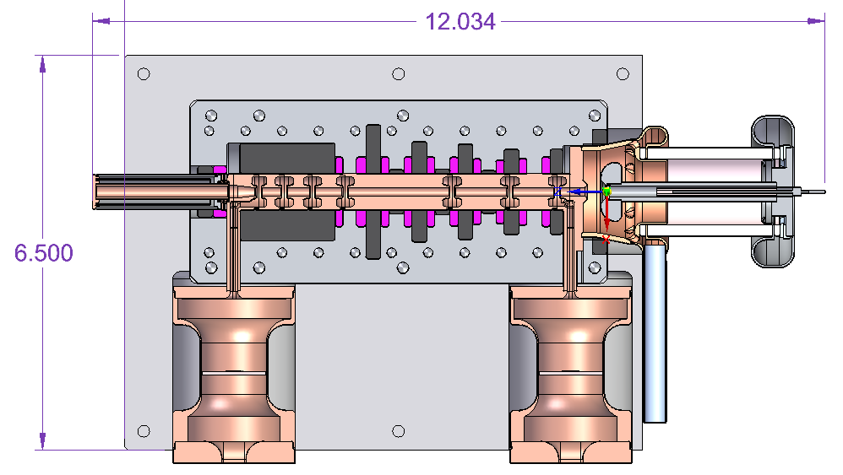
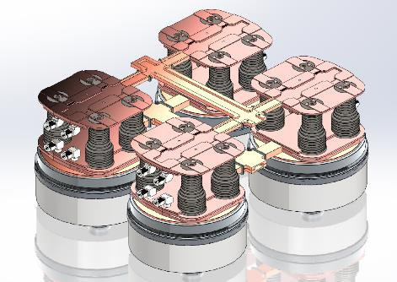
The Modular Array Multi-Beam Klystron (MA-MBK) – High volume RF sources with several uses
Compact, low-voltage “klystrinos” – one RF source topology for many situations:
  Stand-alone RF sources for low power, compact and portable systems
  High volume, distributed linac feeding
  Passive combining for higher peak power
Integrated Pole Pieces/
Long Period Halbach Arrays
Floquet output combiner
A. Jensen, “A Modular 5 MW X-Band Multi-Beam Klystron”, SLAC-PUB-15877.
16 Klystrinos
Franzi, Gamzina, Jensen, Kowalczyk, Tantawi
6

Slide 7
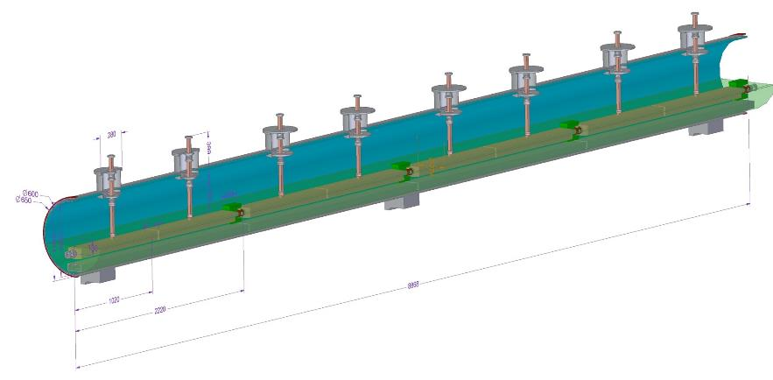
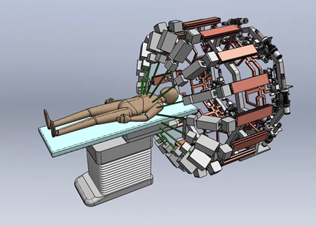
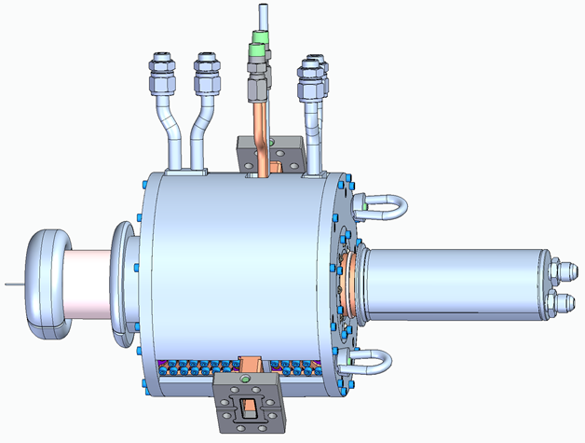
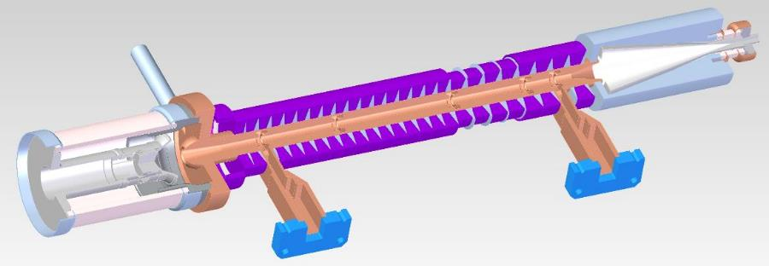
Spinoff programs using modular RF power:
New science & commercially viable applications
Cool Copper Collider (C³) – Liquid N₂-cooled C-band distributed coupling linac
Next-generation radiation therapy
16 klystrinos per system
Compact PPM-focused klystrinos –
Portable radiography for emergency response
High duty klystrino for cargo scanning

Slide 8
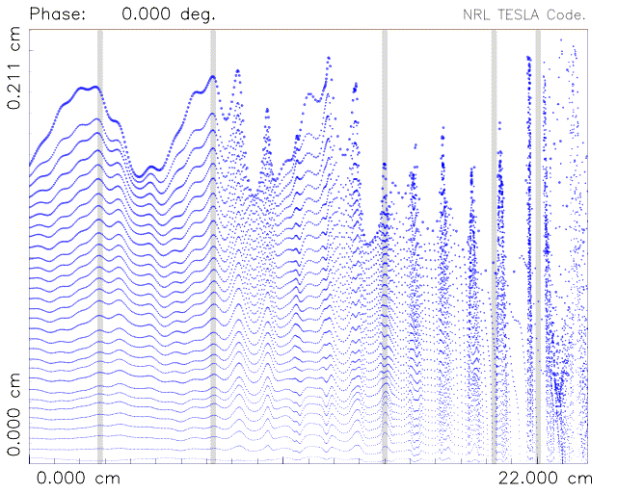
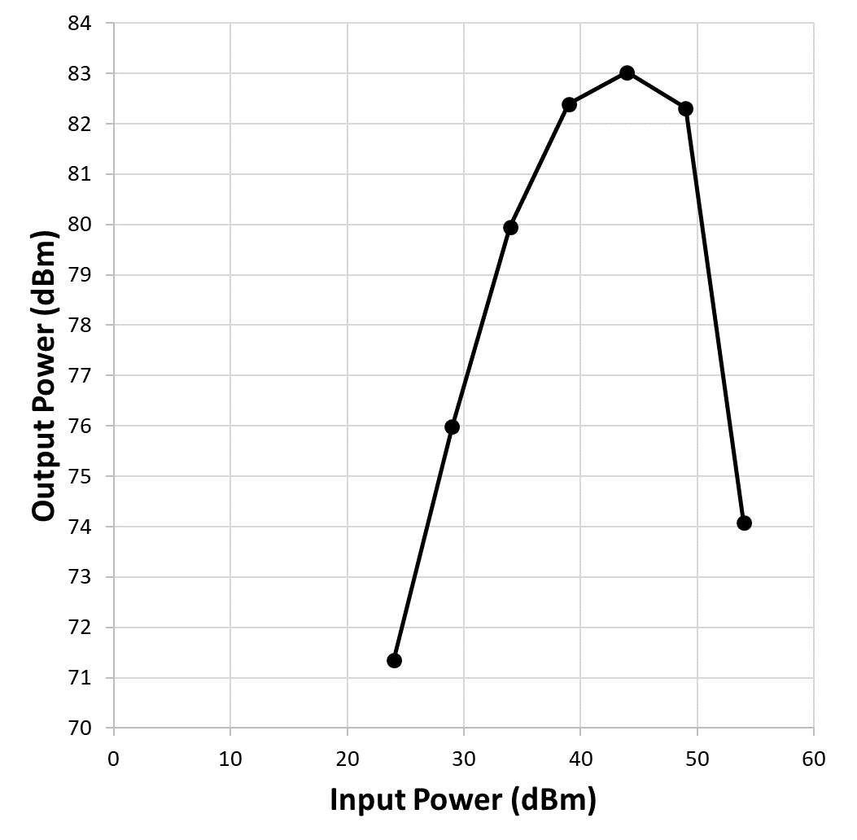
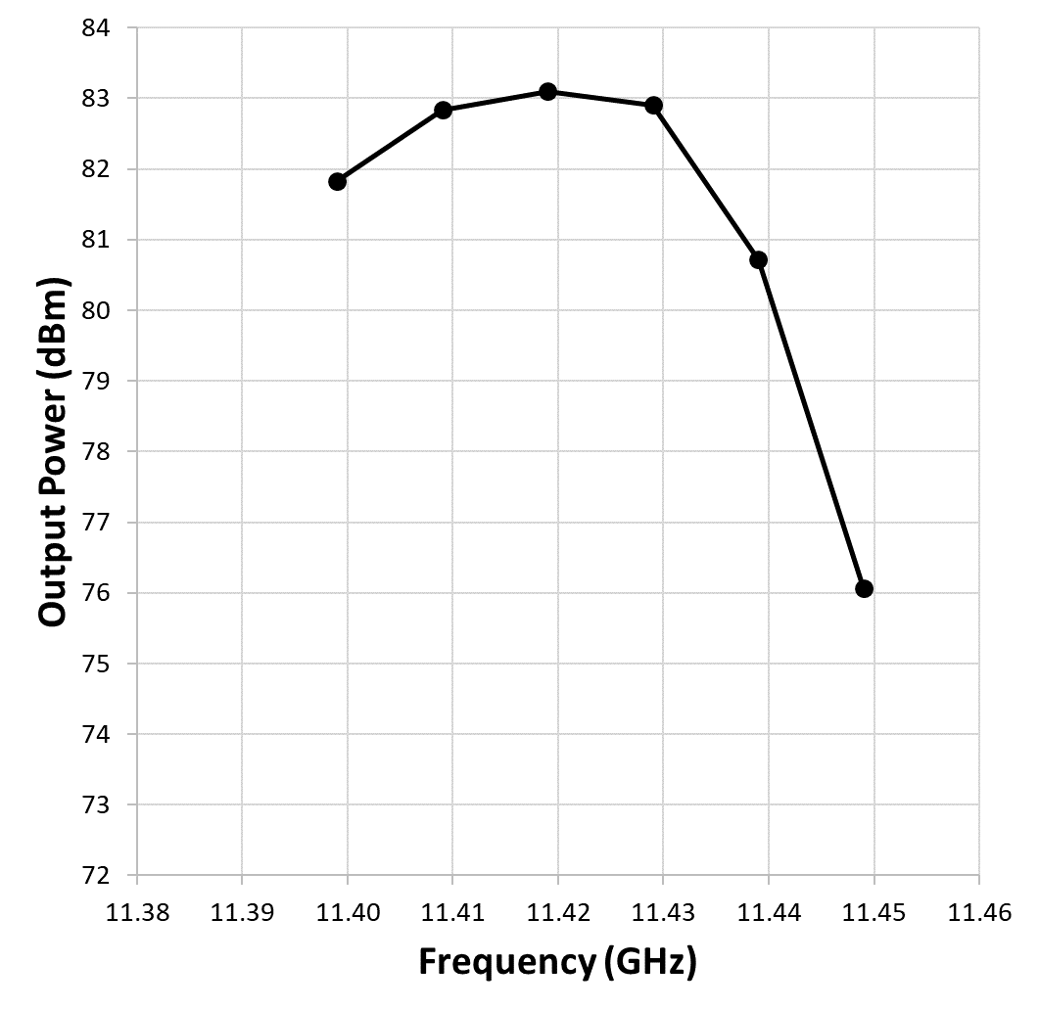
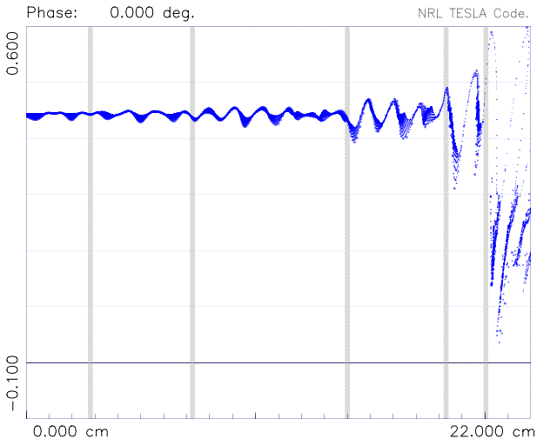


X-band Klystrino Design Process
Initial feasibility studies with KlyC (CERN)
Detailed designs with multiple codes:
  Maxwell & HFSS for RF & B-fields
  SLAC’s EGUN for electron gun design
  TESLA for large signal model w/ imported beam and fields
  MICHELLE & Ansys for collector design
Beam trajectory
Transfer curve
@ 11.424 GHz
RF Bandwidth @ fixed drive
e⁻ velocity vs. z

Slide 9
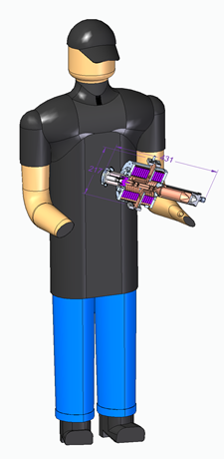
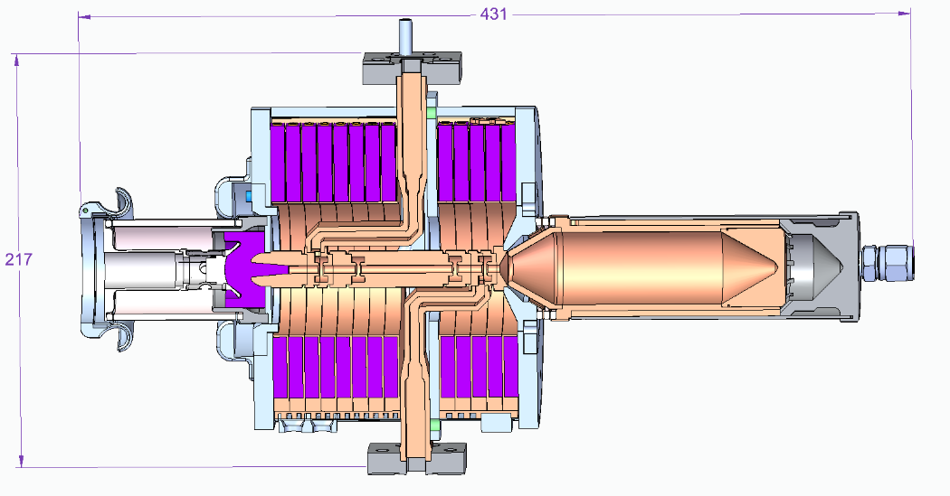
High Duty Klystrino Overview
Klystron design is complete, build in process
  310 kW peak output power, with solenoid focusing
  60 kV / 10 A electron beam
  25 W RF drive @ 11.424 GHz
  Outline dimensions: 8.5” across, 17” long
RF flange from input window
RF Cavities
Collector
Input / Output Waveguides
Electron Gun
Flange to output coupler/linac
Solenoid

Slide 10
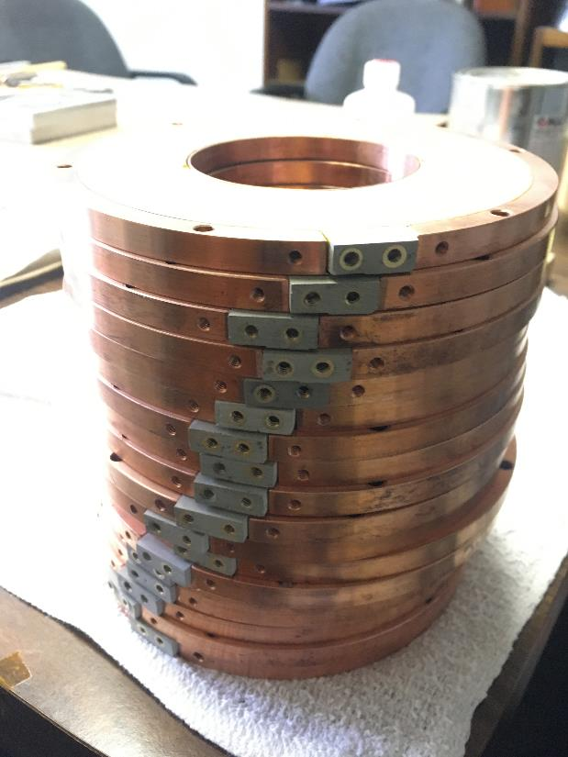
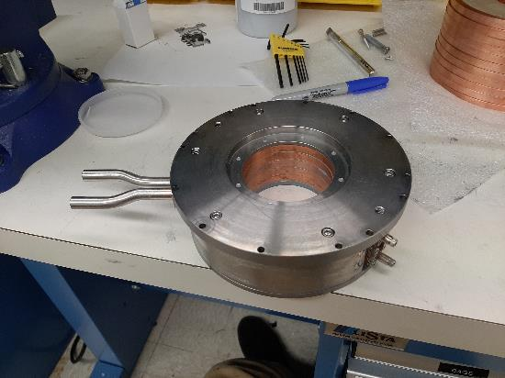
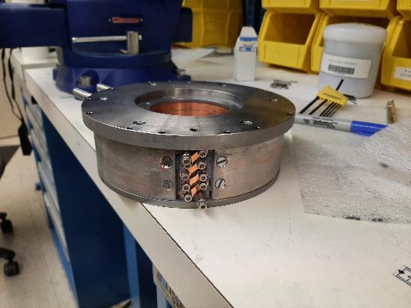
High Duty Klystrino – Solenoid Assembly
Magnet windings arrived Feb 2021, solenoid being assembled now

Slide 11
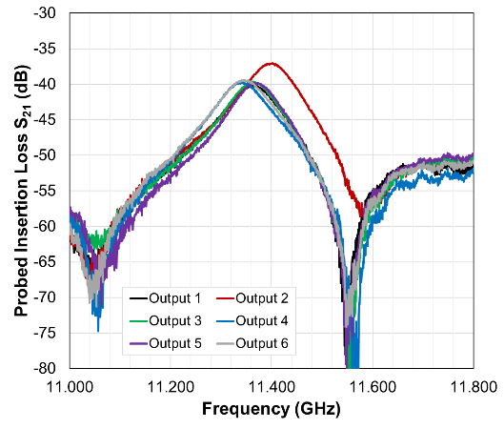
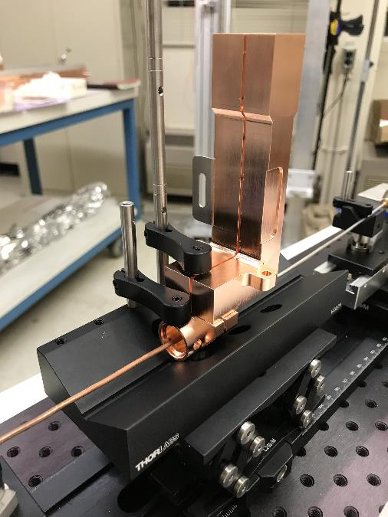
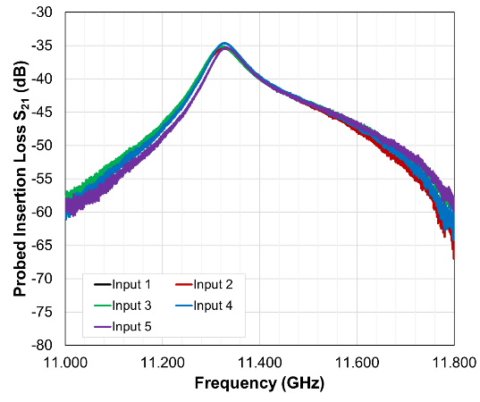
High Duty Klystrino – RF Circuit Cold Test
IP/OP cavity cold tests look good Within tuning range, and Q very close to design target. Moving forward with next brazes now.
Output
Highly repeatable frequency and Q-factor
Input

Slide 12
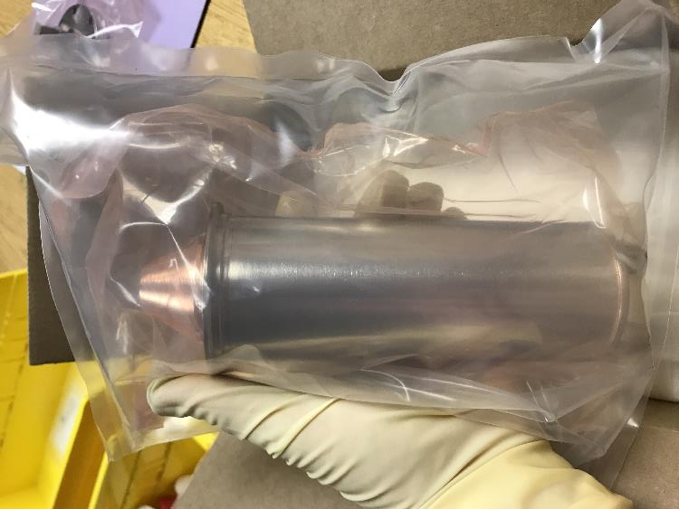
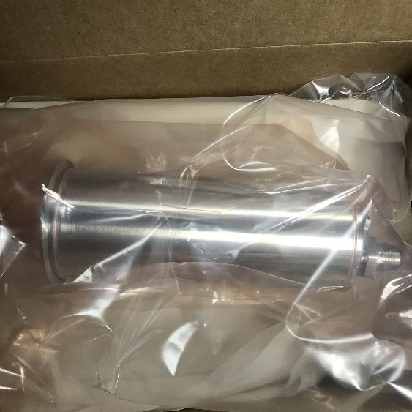
High Duty Klystrino – Collector & Final Assembly
Collector is on hand, awaiting final assembly gun, RF circuit, and low power X-band input window (existing SLAC hardware)

Slide 13
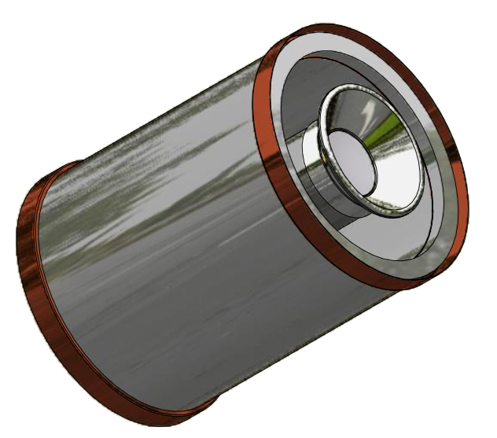
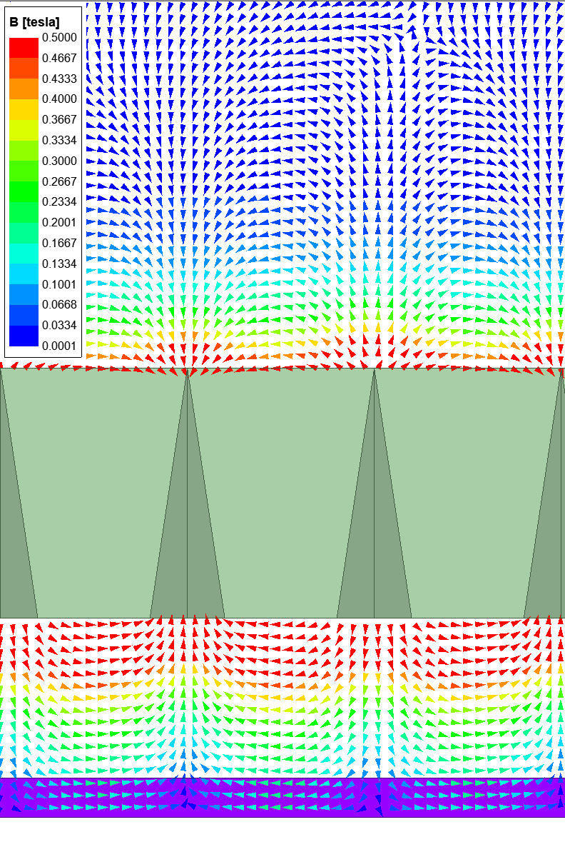
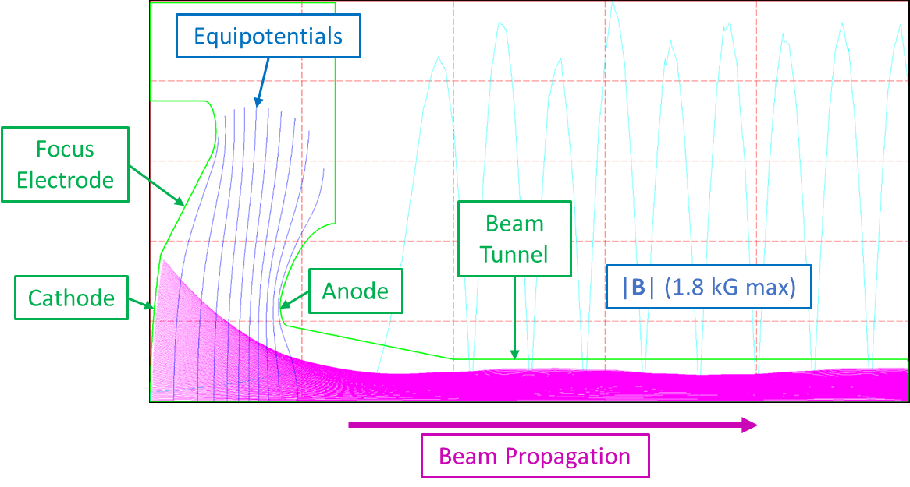
PPM Focusing for Ultralight Klystrino
Multi-period tapered PPM focusing:
Tapered, non-integral pole pieces increase focusing field by ~30%
Total klystron weight: 4.2 kg
Inexpensive 60 kV electron gun development w/ commercial partners
Magnet
Pole Piece
Beam

Slide 14
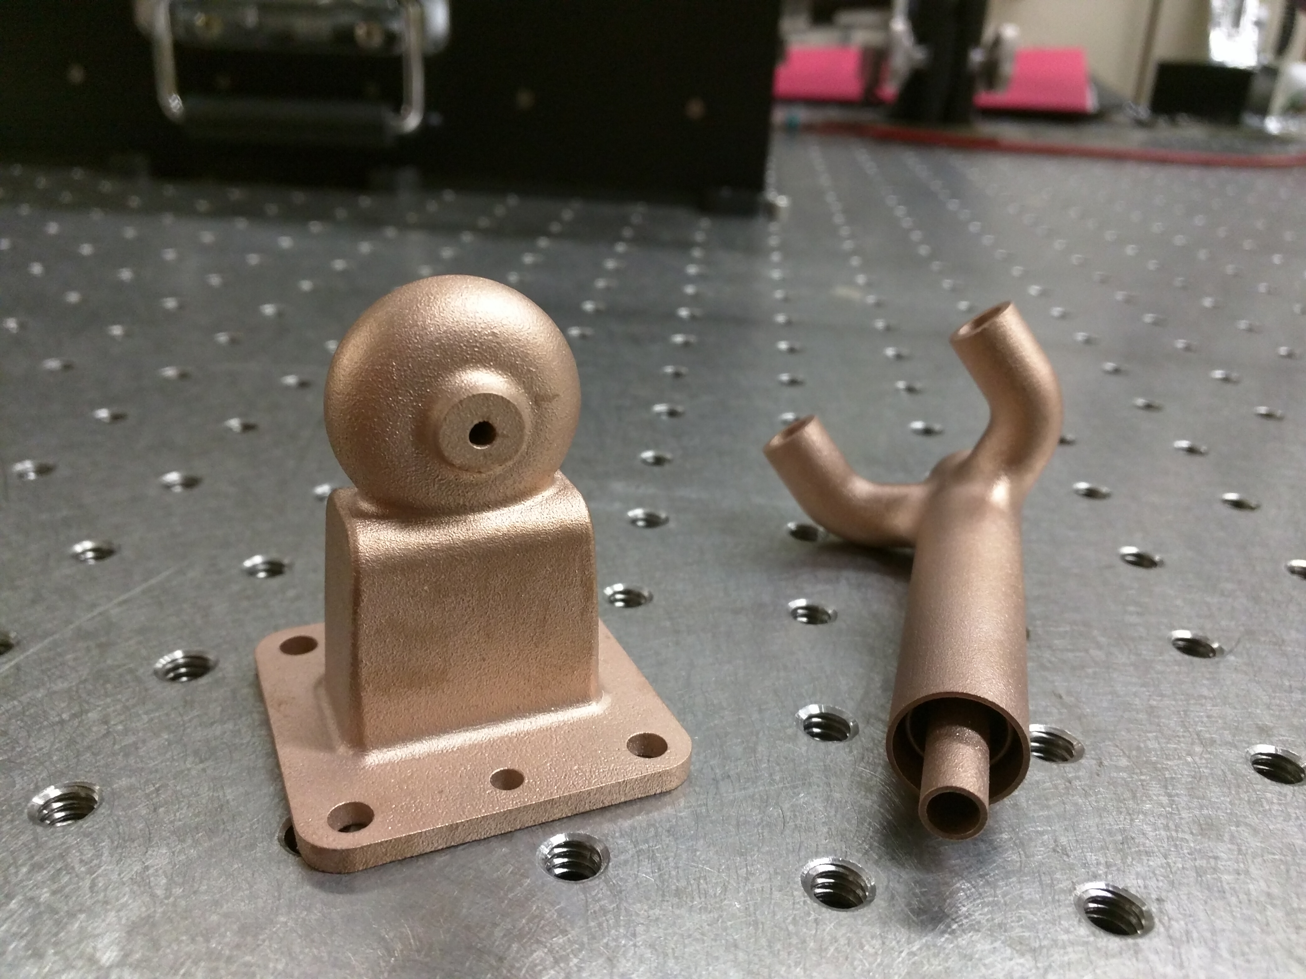
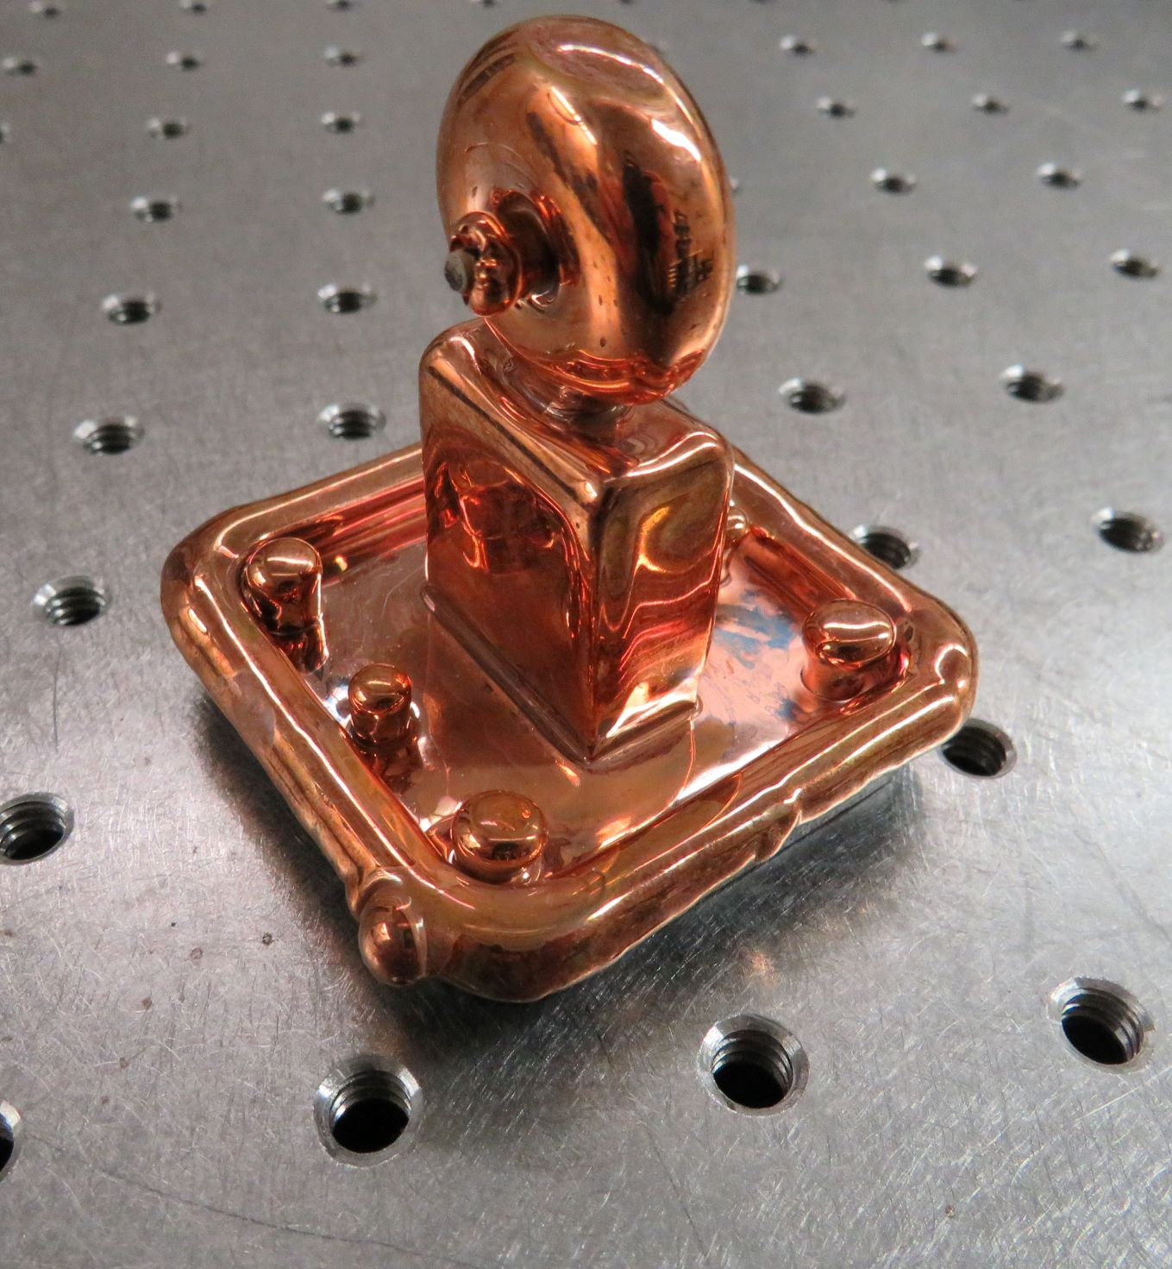
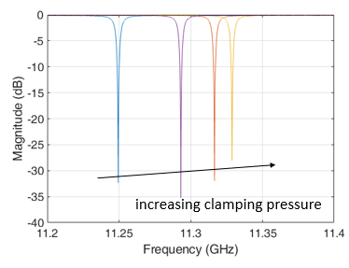
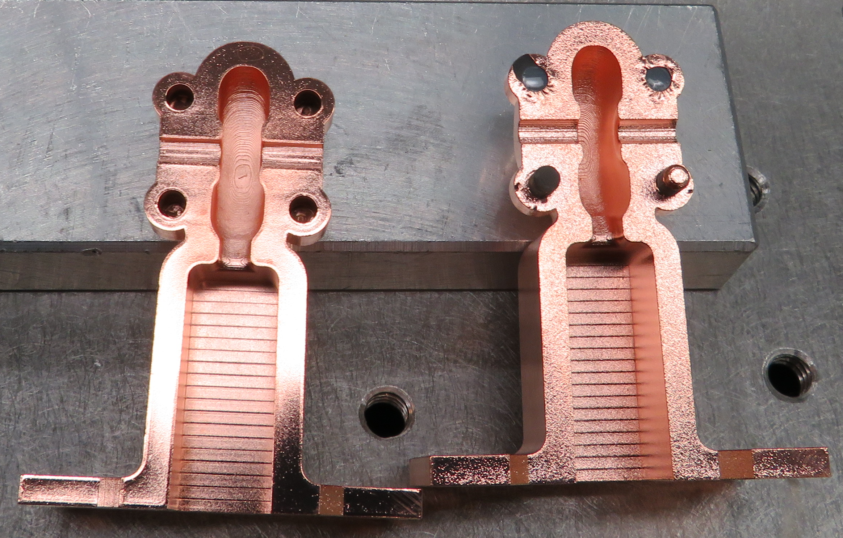
Fundamental R&D to Reduce Build Costs
Fundamental R&D is needed to truly reduce RF source costs:
Alternative e⁻ sources
Low-cost beam focusing
Novel manufacturing methods
Initial additive manufacturing tests with X-band RF cavities
  Demonstrated Q_{o}>5000
  ‘Ideal’ Q_{o} of 6700
  Meets requirements for heavily loaded cavities and RF sources
Approx. manufacturing cost:
  $300/cavity Plated Plastic
  $1.4k/cavity Laser Sintered
  $7k/cavity Traditional machining
One week turn around time
Laser Sintered Copper
Electroformed Copper
S₁₁ Copper on Plastic Cavity
Electroless Copper on Plastic
M. Othman, C. Wehner, and J. Merrick

Slide 15
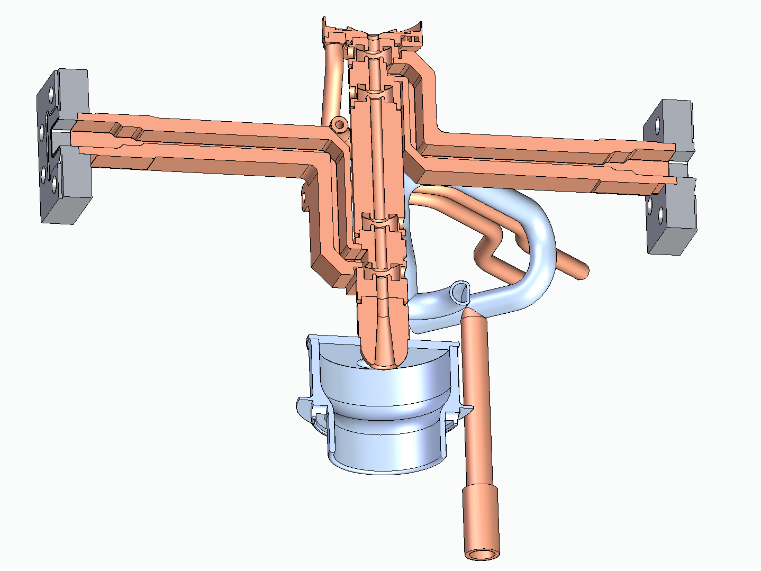
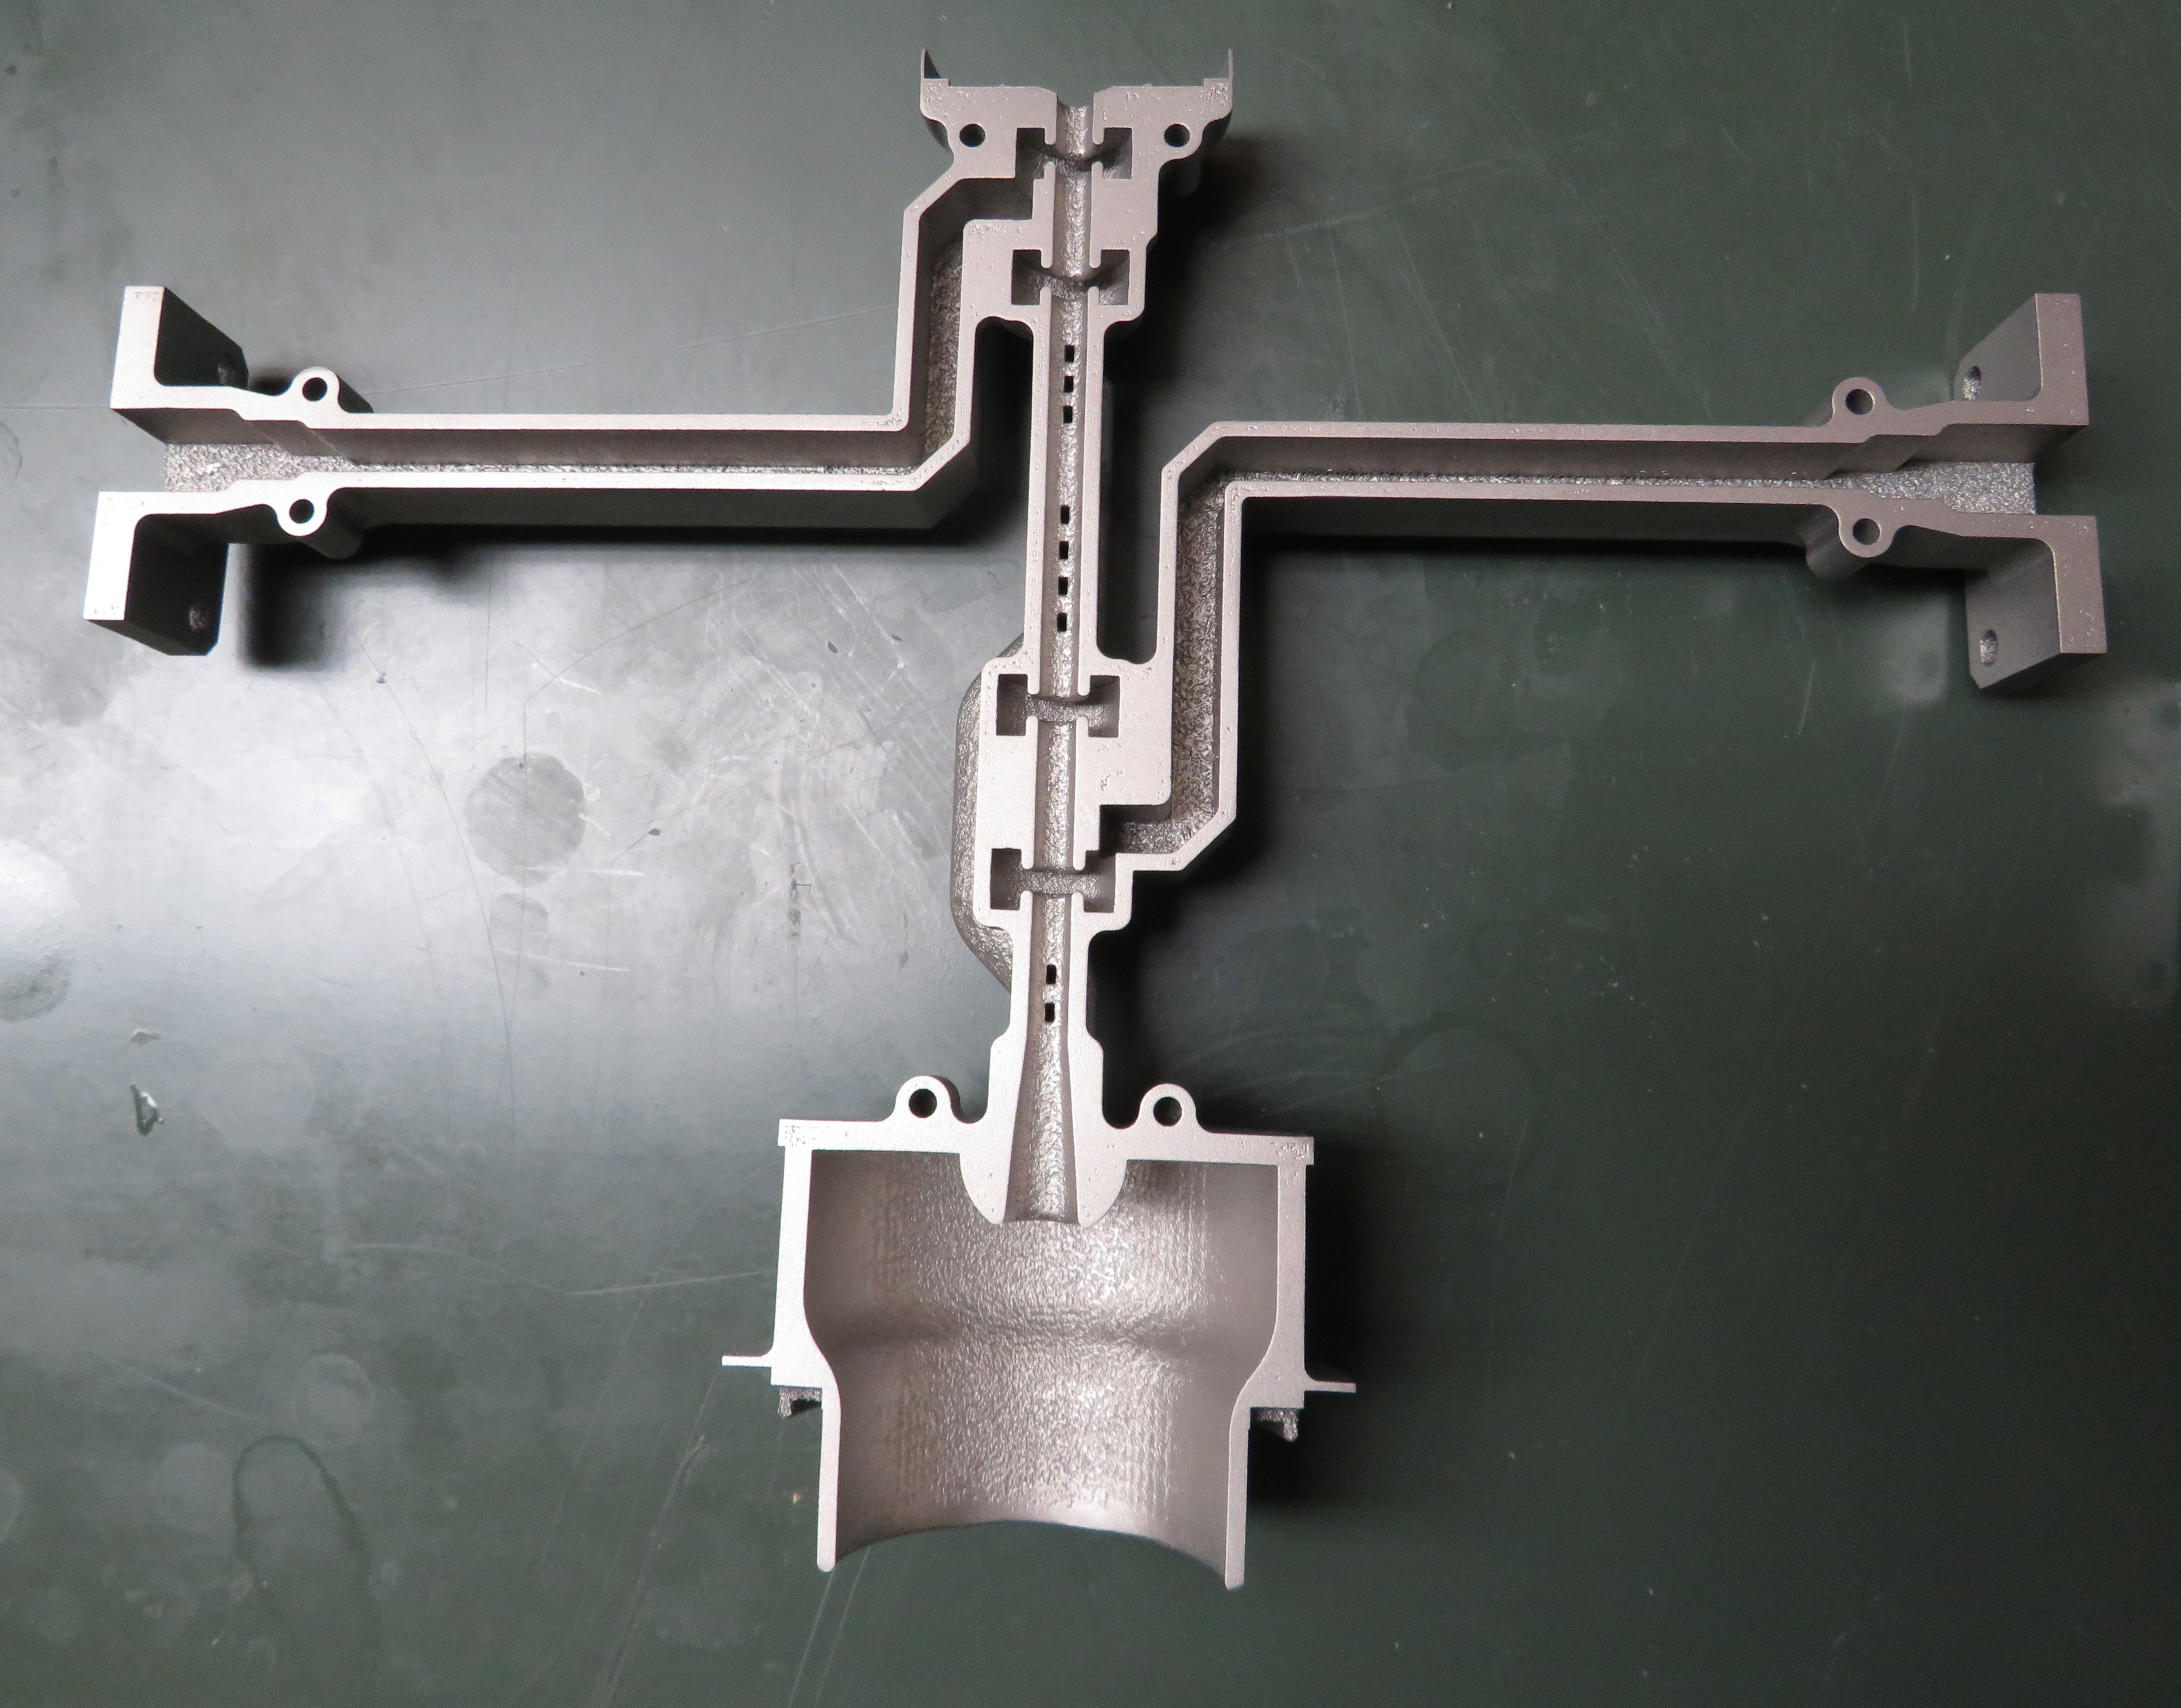
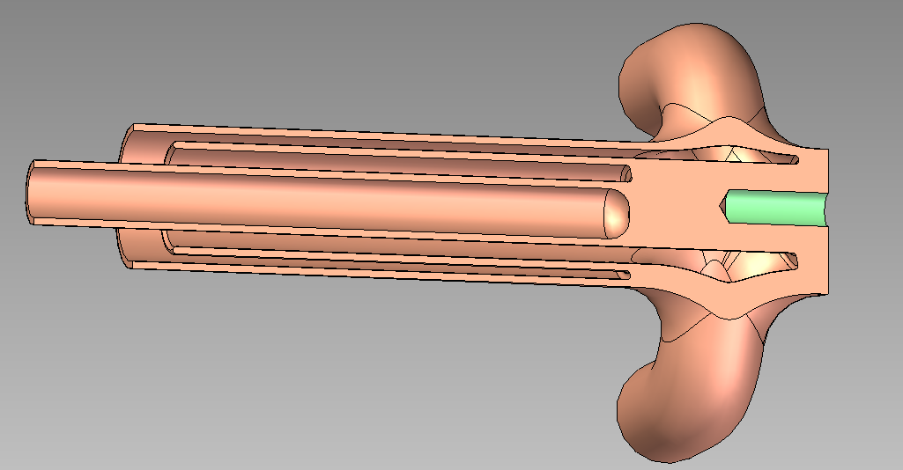
Fundamental R&D – Additive Manufacturing
Additive manufacturing is ideal for complex assemblies, but there are challenges:
RF wall losses
Porosity / vacuum compatibility
Brazing and welding
X-Band klystron test case – Laser-sintered 316L SST → electropolish → Cu plating
>20 Unique Parts
<10 Unique Parts
Laser-Sintered Copper Alloy Collector
Replaces six machined parts

Slide 16
Something Totally Different – HEIOT Preview
Last October, we started a new program with L3Harris EDD – development of a high efficiency multi-beam inductive output tube
>80% eff’y goal @ 1.3 GHz, <40 kV
Merges recent RF circuit design concepts w/ new L3Harris prototype & test capabilities
Single-beam prototype will be built & tested: 100 kW CW RF power
Conceptual design study for ten-beam, 1 MW CW device as well

Slide 17
Acknowledgements
Thank you! Questions?
You can also contact us at:
brweathe@slac.stanford.edu (Brandon)
tantawi@slac.stanford.edu (Sami)
This work was supported by the following agencies:
US Dept. of Energy – Office of Science, HEP - General Accelerator R&D Program (DE-AC02-76SF00515)
US Dept. of Energy – NNSA / NA-22 (FY18-NA-PD3Jc)
US Dept. of Homeland Security (IAA HSHQDC18ITR0004)
Stanford School of Medicine, Dept. of Radiation Oncology

