Slide 1
Update on High Gradient Research at SLAC
Emilio Nanni and Sami Tantawi for the RF Accelerator Technology Team
HG 2021
April 19, 2021

Slide 2
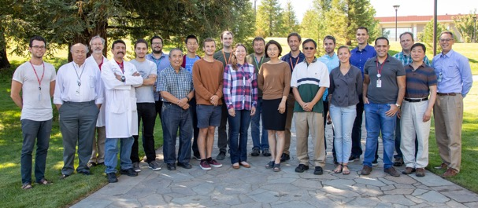

Acknowledgements
RF Accelerator Technology Team
SLAC UED Team
Renkai Li
Xijie Wang
Stephen Weathersby
Xiaozhe Shen
MIT
Sam Schaub
Julian Picard
Sudheer Jawla
Rick Temkin
INFN-LNF
Bruno Spataro
UCLA
James Rosenzweig
LANL
John Lewellen
Evgenya Simakov
Supported by:

Slide 3
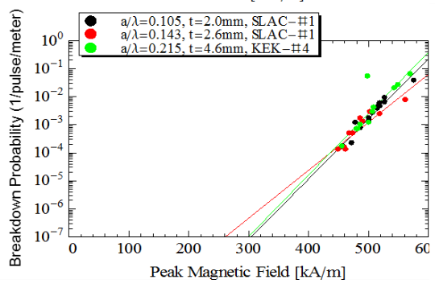
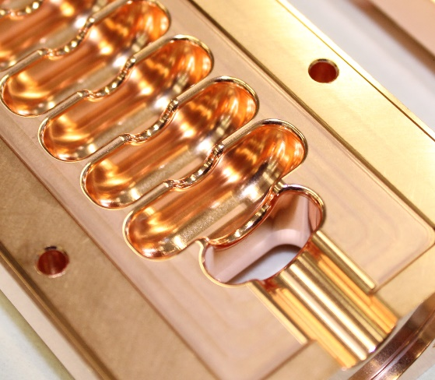

Core Areas of Research for the Advancement of RF Accelerator Technology
Physics of Breakdown
Materials Science
Discovery of Magnetic Field’s Role in Breakdown Triggered New Research Initiative
  Investigate Materials to Improve the Performance of High Gradient Accelerating Structures
Achieved through studies of surface electric and magnetic fields, processing techniques, surface finish
Enhanced performance with increasing material strength
Low temperature operation also increases the strength of materials
  Breakdown Rate Correlated with Magnetic Field
soft Cu
hard Cu
hard
CuAg
Accelerating Gradient [MV/m]
Innovative Electrodynamics
Manufacturing Engineering
Geometry of Accelerating Structures Optimized Accounting for:
Our New Understanding of the Physics of Breakdown (magnetic fields, materials etc.)
AND
The Beam Parameters Required for a Specific Application
Manufacturing Techniques that are Compatible with Superior Materials and Unique Geometries
f = 11.424 GHz,
R_{s} = 181 M$Ω$/m
Low temperature assembly with clamped structures and welding
Split-block machining for increased flexibility in fabricating advanced structures and reducing cost
Geometry optimizations for accelerator structures based on reduction of the magnetic surface field
  Novel split-block assembly for novel gap accelerator
Notes:
Shunt Z was a by product of optimizing cell for H-fiedl

Slide 4
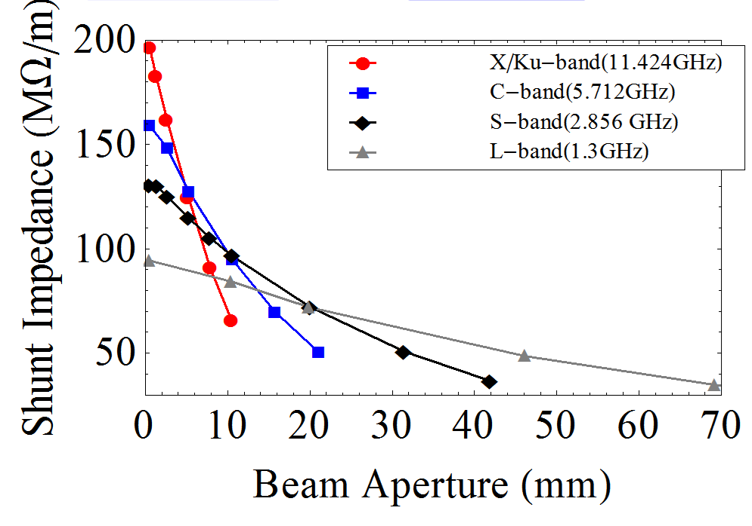
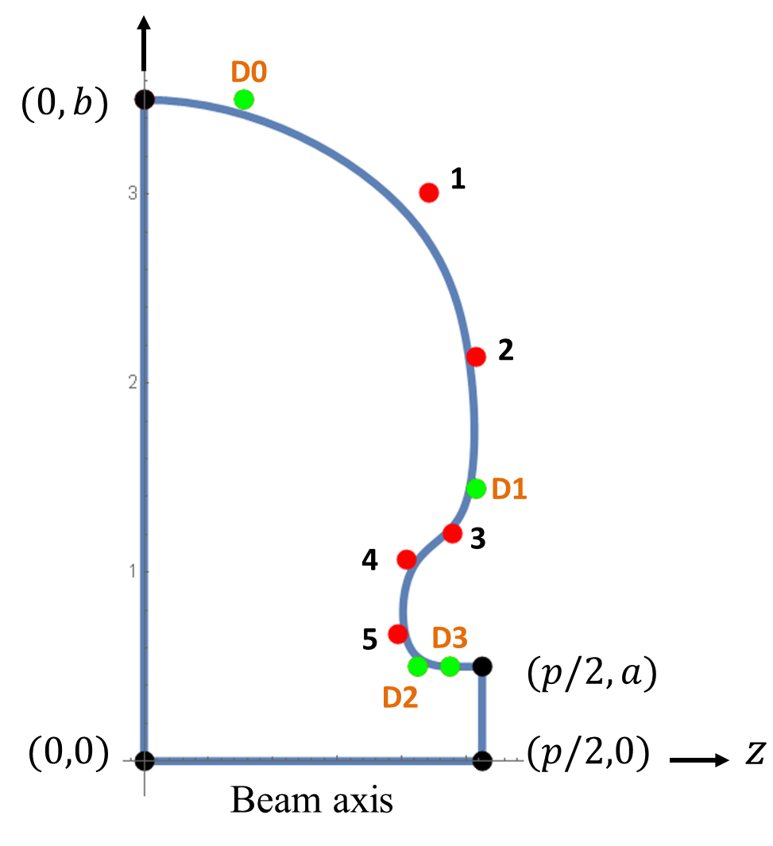
Highly Optimized Standing-Wave Structures with Distributed Feeding Allow for New Possibilities
Distributed coupling, split-block fabrication, high-shunt impedance and suppression of breakdown combine to form new architecture for future facilities
Cost effective implementation of accelerator structures capable of operating efficiently at these gradients
Advanced Optimization Tools
Variable control points for splines define the cavity shape.
M. Nasr et al., IPAC’18
20% reduction in surface electric field for same shunt impedance
New Scaling Laws Determine the Best Performance for Accelerating Structures
Scalable technology with enhanced shunt impedance capable of reaching high duty factors
Notes:
Optimizations driven with new Lagrangian solver

Slide 5
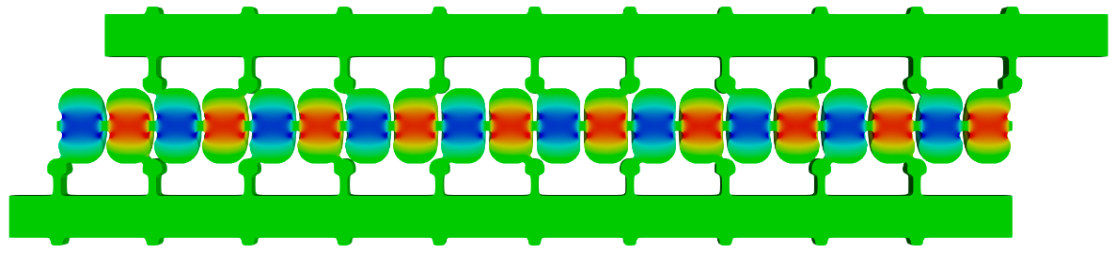

Invention of Distributed Feeding Realizes the Potential of Highly Optimized Standing-Wave Structures
Distributed coupling, split-block fabrication, high-shunt impedance and suppression of breakdown combine to form new architecture for future facilities
Cost effective implementation of accelerator structures capable of operating efficiently at these gradients
RF manifold feeds alternating cells equally
$$λ_{g}/2\sim λ$$
Tantawi et al. “Distributed coupling and multi-frequency microwave accelerators,” Jul. 5 2016, US Patent 9,386,682.
Large isolation between the manifolds and the cavities
New Scaling Laws Determine the Best Performance for Accelerating Structures
Scalable technology with enhanced shunt impedance capable of reaching high duty factors
Notes:
Highlight discovery or invention
Only possible through virtual prototyping

Slide 6
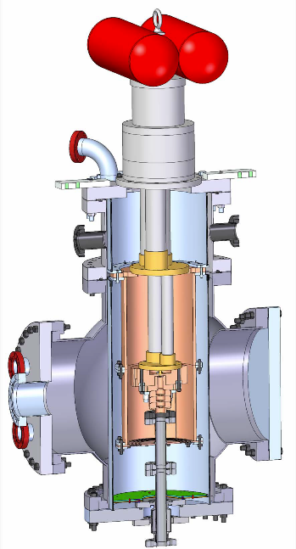
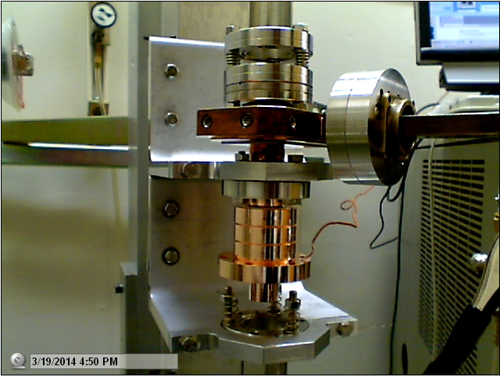
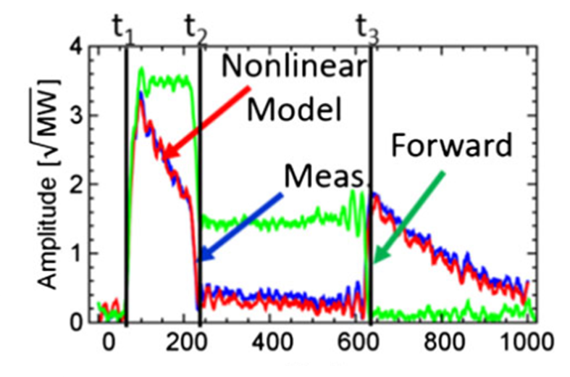
Understanding the Physics of Breakdown at High Gradients has Established the Limits of Normal-Conducting Copper Structures
Material properties determine the performance of accelerating structures
Dislocations caused by stress from fields form protrusions
Reduced in higher strength materials and at lower temperatures
Extreme surface fields (500 MV/m) require new models including emission
Bead Pull Test
Nonlinear Q Model
Hard CuAg#3
Cu@45K
Soft Cu
Hard Cu
Hard
CuAg#1
Cahill, PhD Diss., 2017
Cahill, et al. PRAB 21.6 (2018): 061301.
Rosenzweig, et al. NIMA (2018).
Cahill, et al. NIMA 865 (2017): 105-108.
Accelerating Gradient [MV/m]
Cryostat assembly
Controlling material properties produced dramatic improvements in achievable accelerating gradient → impacting accelerators and injectors
V. Dolgashev, S. Tantawi
Notes:
generation and movement of dislocations under stresses created by RF electric and magnetic fields
Stress due to mag-field driven currents
Resistance to this dislocation movement is predicted from microscopic models to be improved by use of material with greater yield strength, e.g.in copper alloys.
Strength is the key
Yield strength is enhanced at cryogenic temperatures.
Highlight experimental thesis

Slide 7
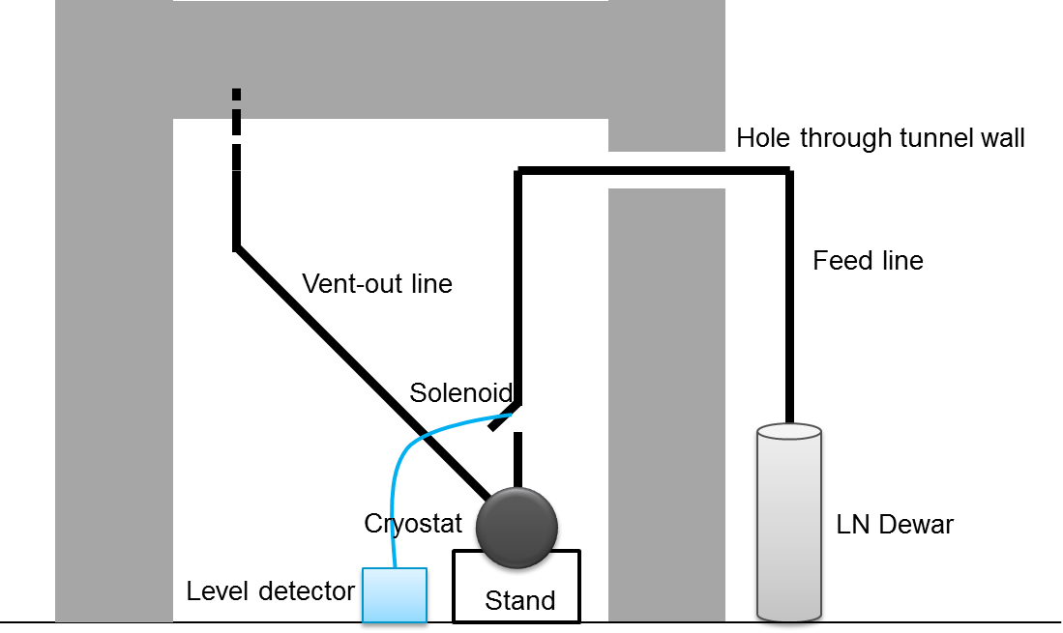
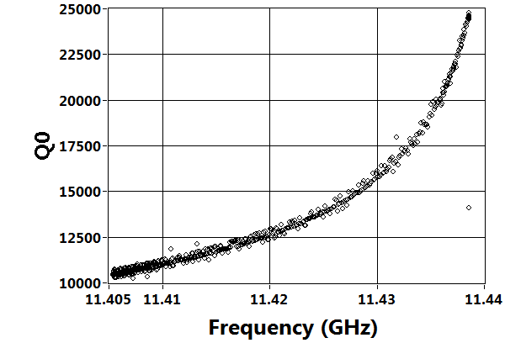
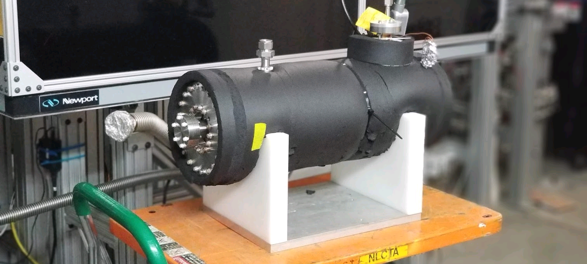
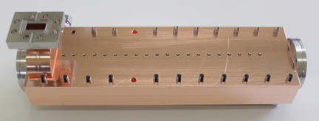
Cryogenic-Copper Accelerating Structures: New Frontier for Beam Brightness, Efficiency and Cost-Capability
Increased conductivity and hardness enables higher gradients
Dramatic reduction in cost of system including cryogenics at 77K
2.5X less power establishing gradient allows for heavy beam loading even at high gradient – improving system efficiency
M. Nasr, S. Tantawi, E. Nanni
Cryostat w/ Structure
T decrease
Increase in $Q_{0}$ by a factor of 2.5
Bane et al., ArXiv 1807.10195 (2018)
Impact of novel structures and temperatures → order of magnitude increased performance

Slide 8
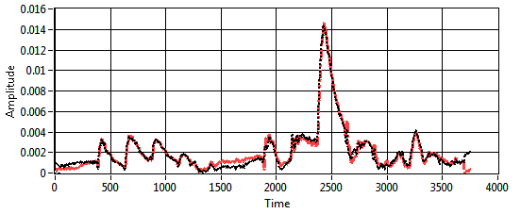
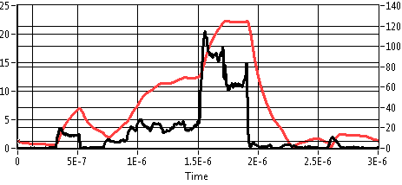
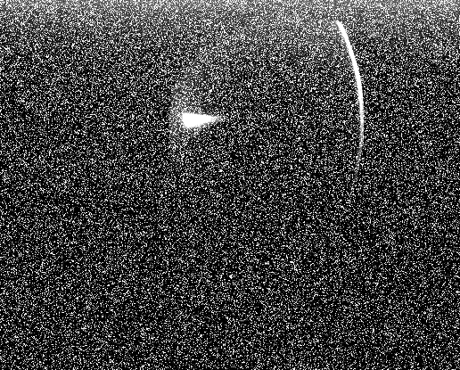
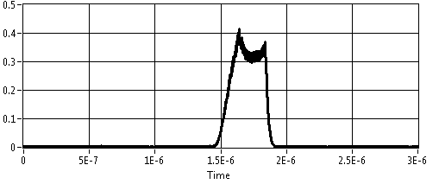
Cryogenic X-band Structure in High Power Test to Confirm RF Performance and Measure Breakdown Statistics
Reflected RF Power Matched Molded Cavity Performance
Best fit parameters
$$\frac{1−β}{1+β}=−0.3472 \\ Q_{tot}=6788.32$$
Expected parameters
$$\frac{1−β}{1+β}=−0.4286 \\ Q_{tot}=7142$$
Arbitrary Units
Modeled Structure Gradient Confirmed with Dark Current
120 MV/m
Forward Power (MW)
Gradient (MV/m)
Dark current
Energy Gain=28MeV
Gradient=107MV/m
Arbitrary Units
Nasr, et al. arXiv:2011.00391 (2020).

Slide 9
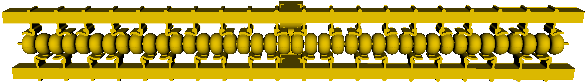
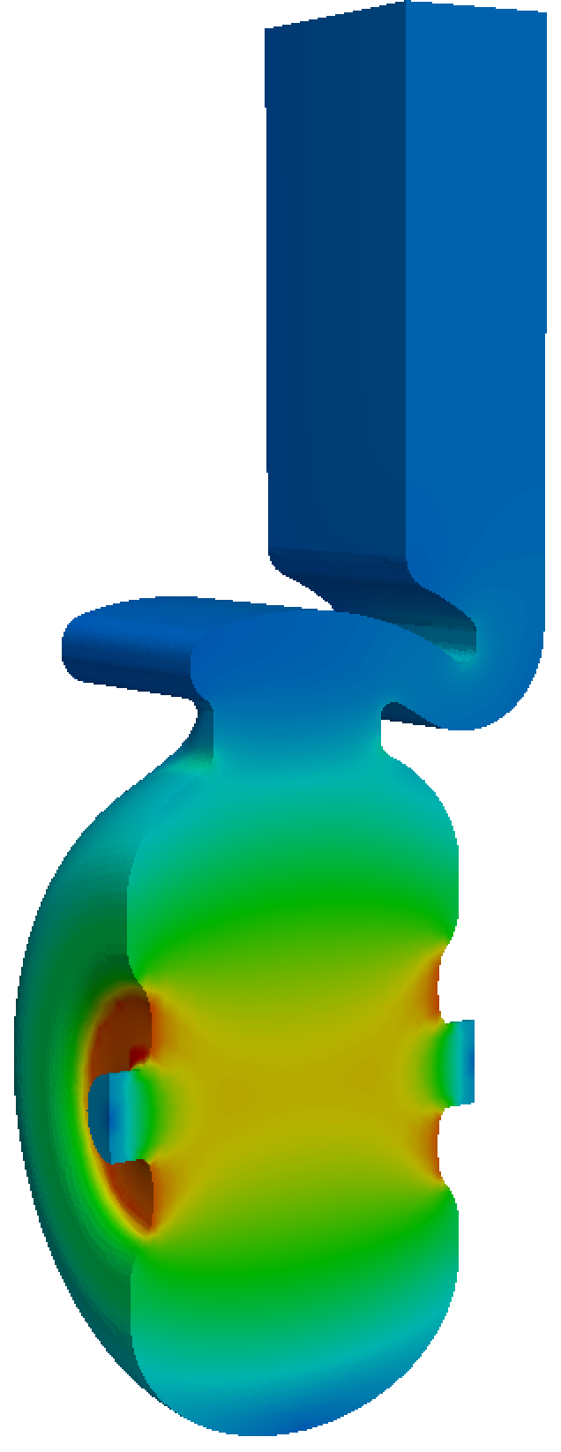
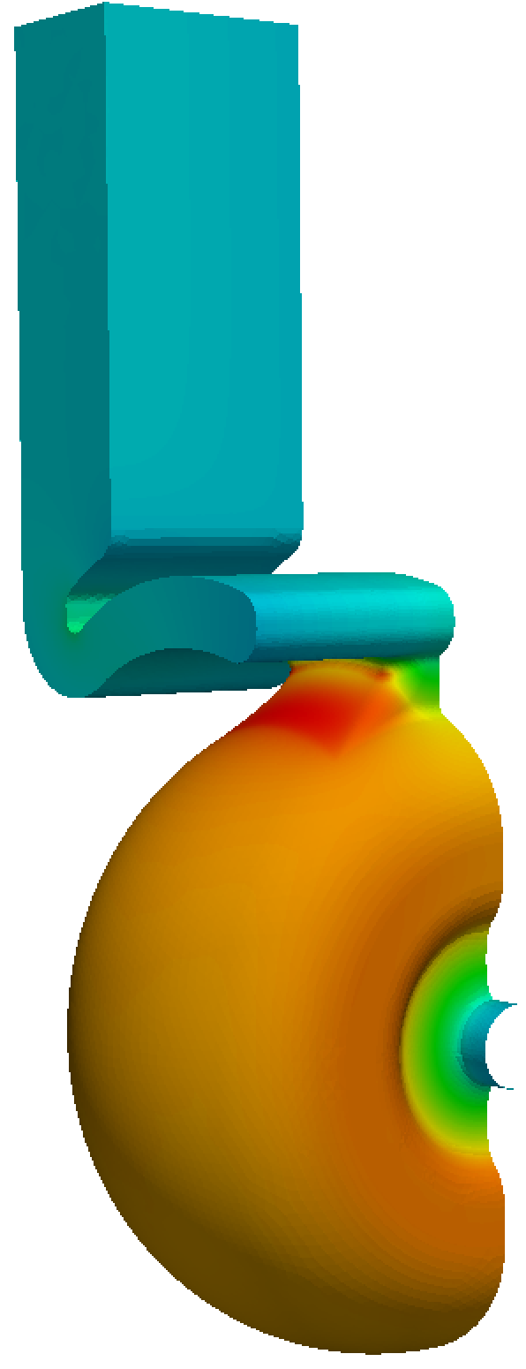
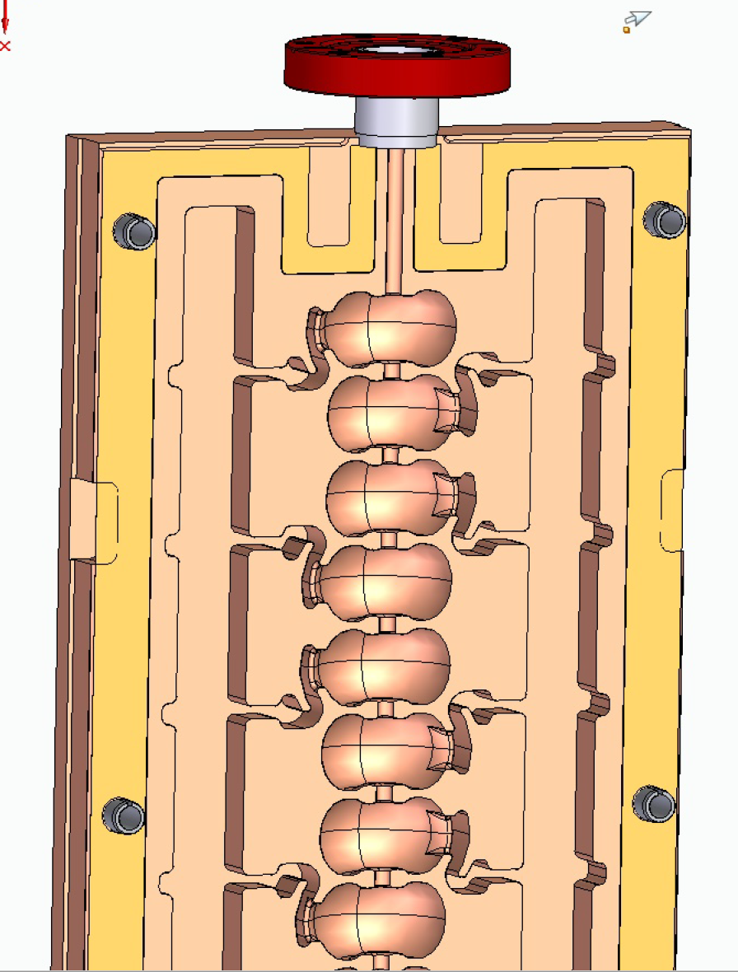
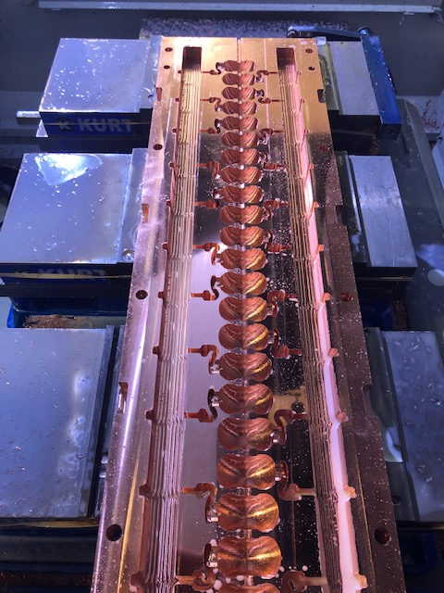
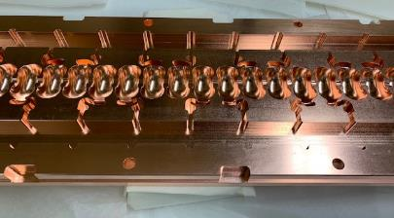
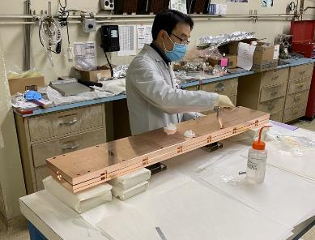
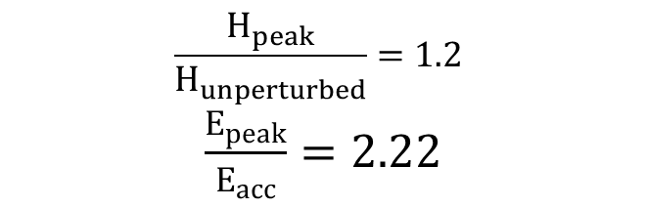
Developing as a Concept for Linear Collider – C³:
First Meter Scale Prototype in Development at C-band
Bane, Karl L., et al. "An Advanced NCRF Linac Concept for a High Energy e $^+ $ e $^-$ Linear Collider." arXiv preprint arXiv:1807.10195 (2018).
One meter (40-cell) C-band design with reduce peak E and H-field
Scaling fabrication techniques in length and including controlled gap
$$\frac{H_{peak}}{H_{unperturbed}}=1.2$$
$\frac{E_{peak}}{E_{acc}}=2.22$
S. Tantawi, and Z. Li

Slide 10
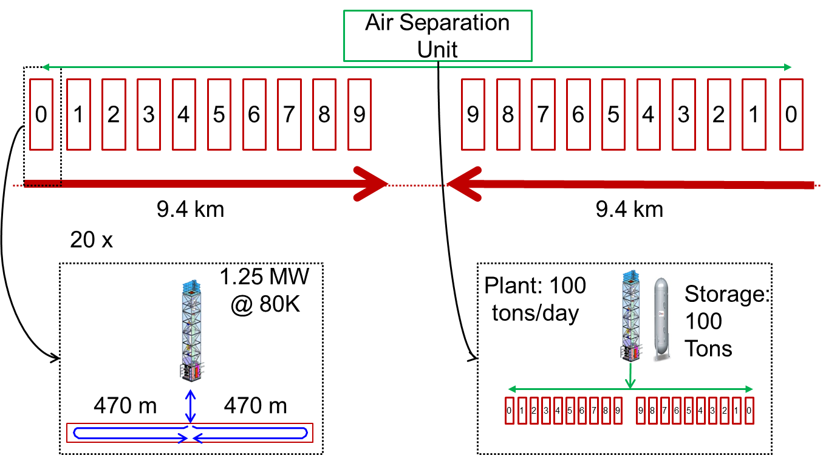
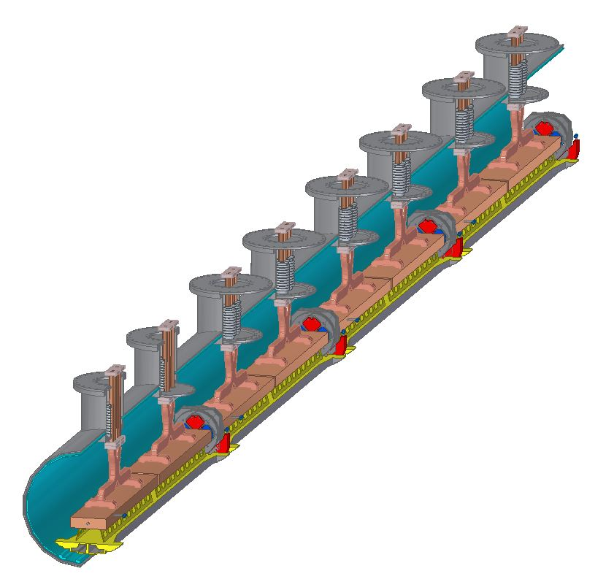
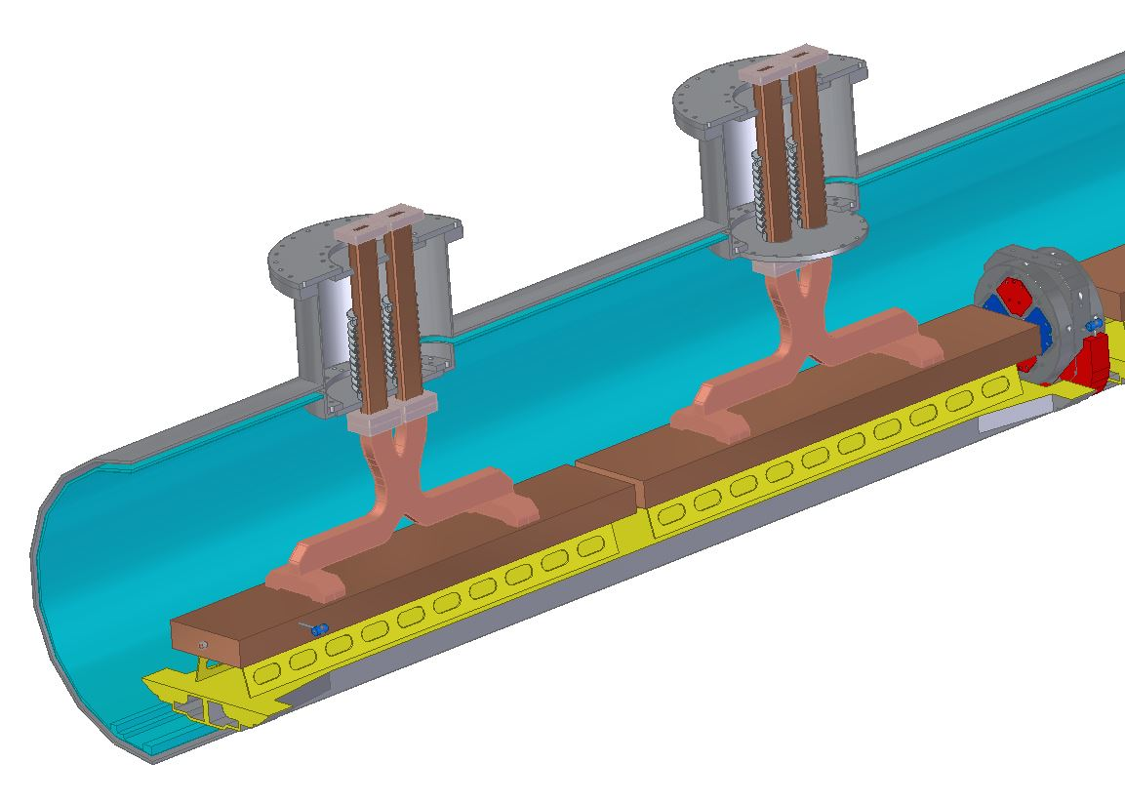
Preliminary Cryomodule Design for High Average Power Implementation with ~90% Fill Factor
X-band structure test to demonstrate full average power over short length (0.25 m)
Cryomodule design developed for cryoplant layout to cool 24 MW/linac thermal load at 77K
Shared nitrogen supply and return
~10m Cryomodule
Oriunno, Breidenbach

Slide 11
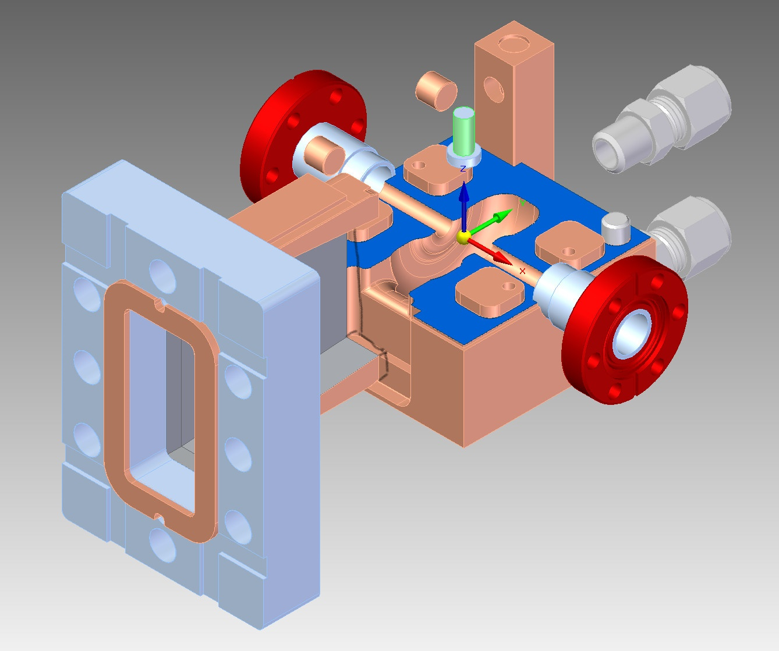
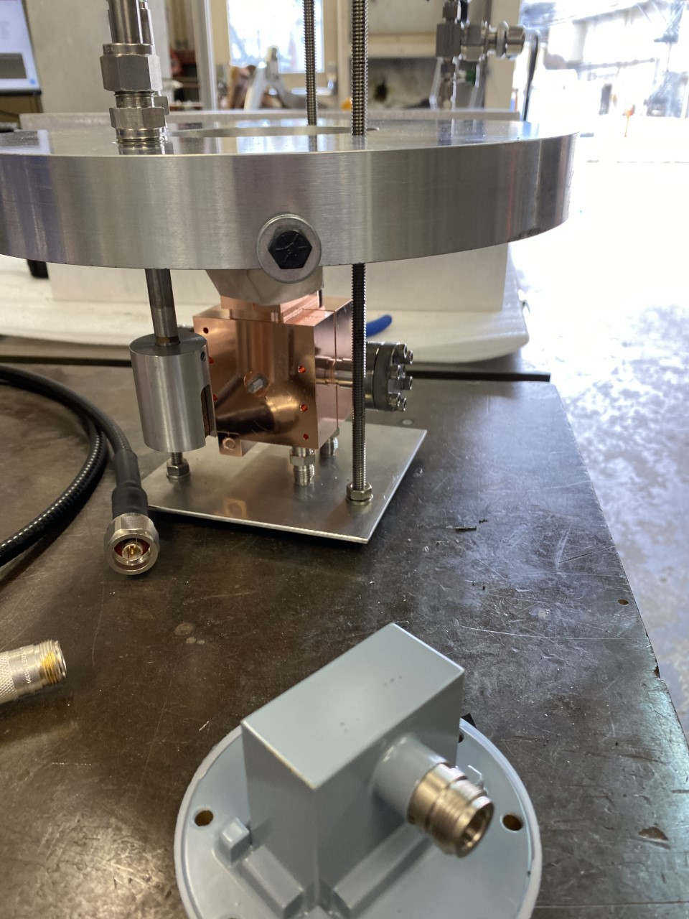
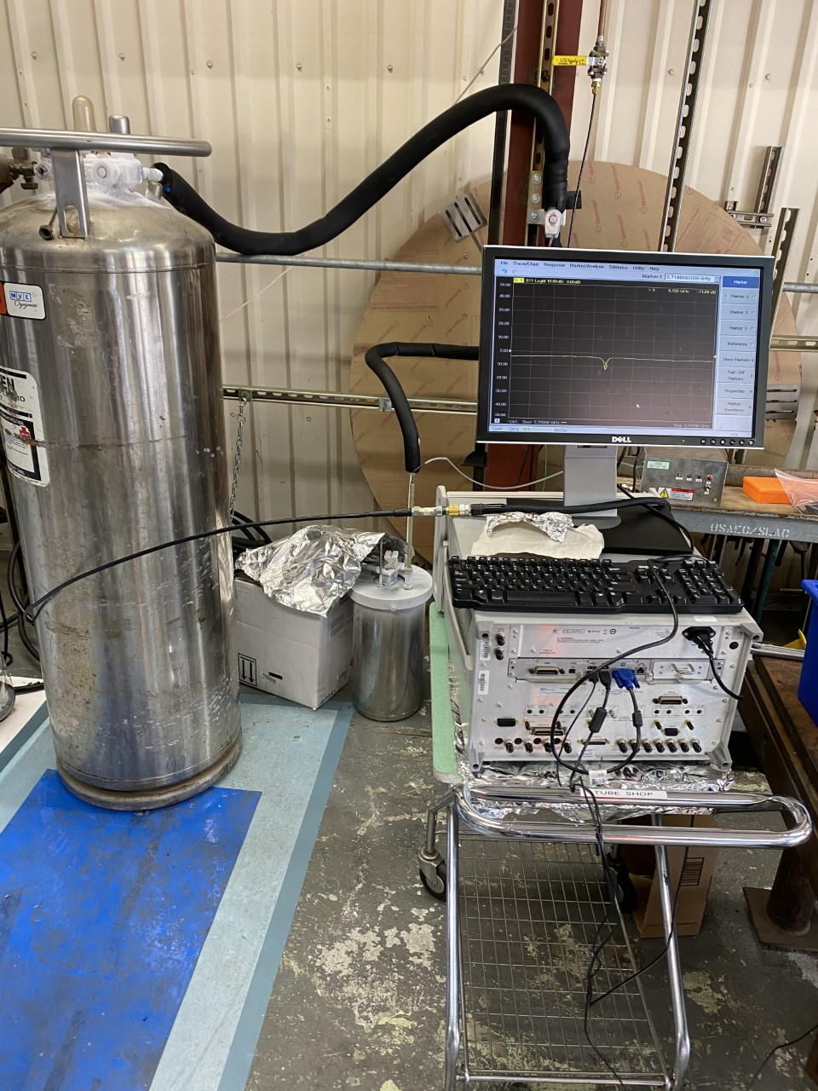
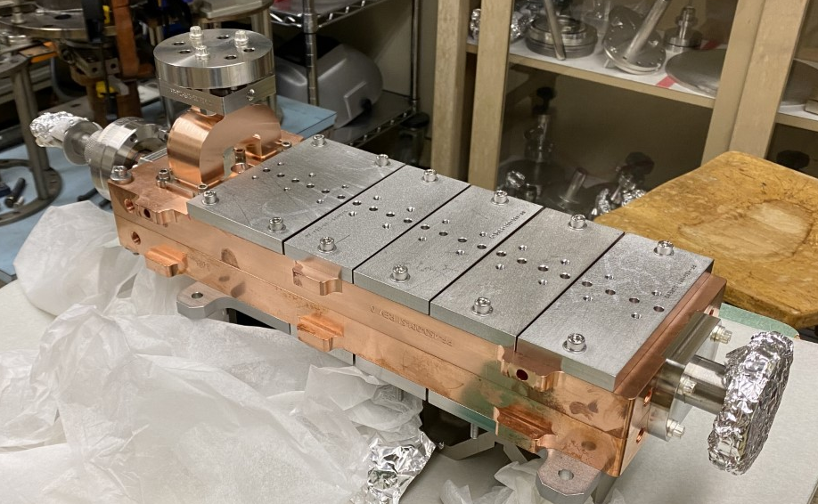
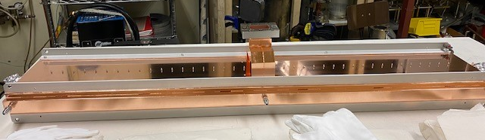
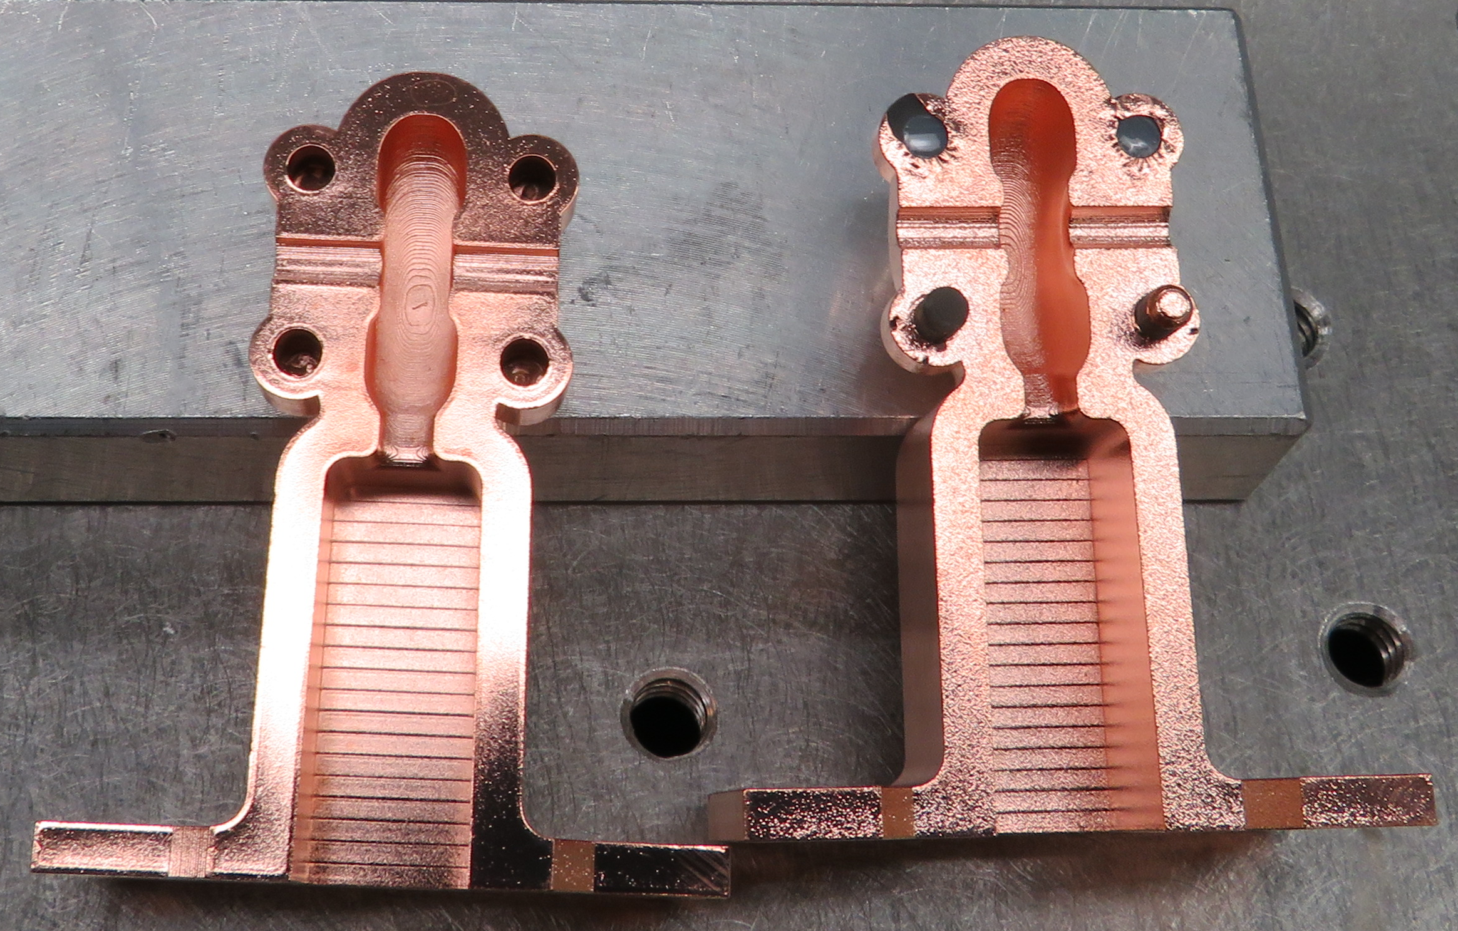
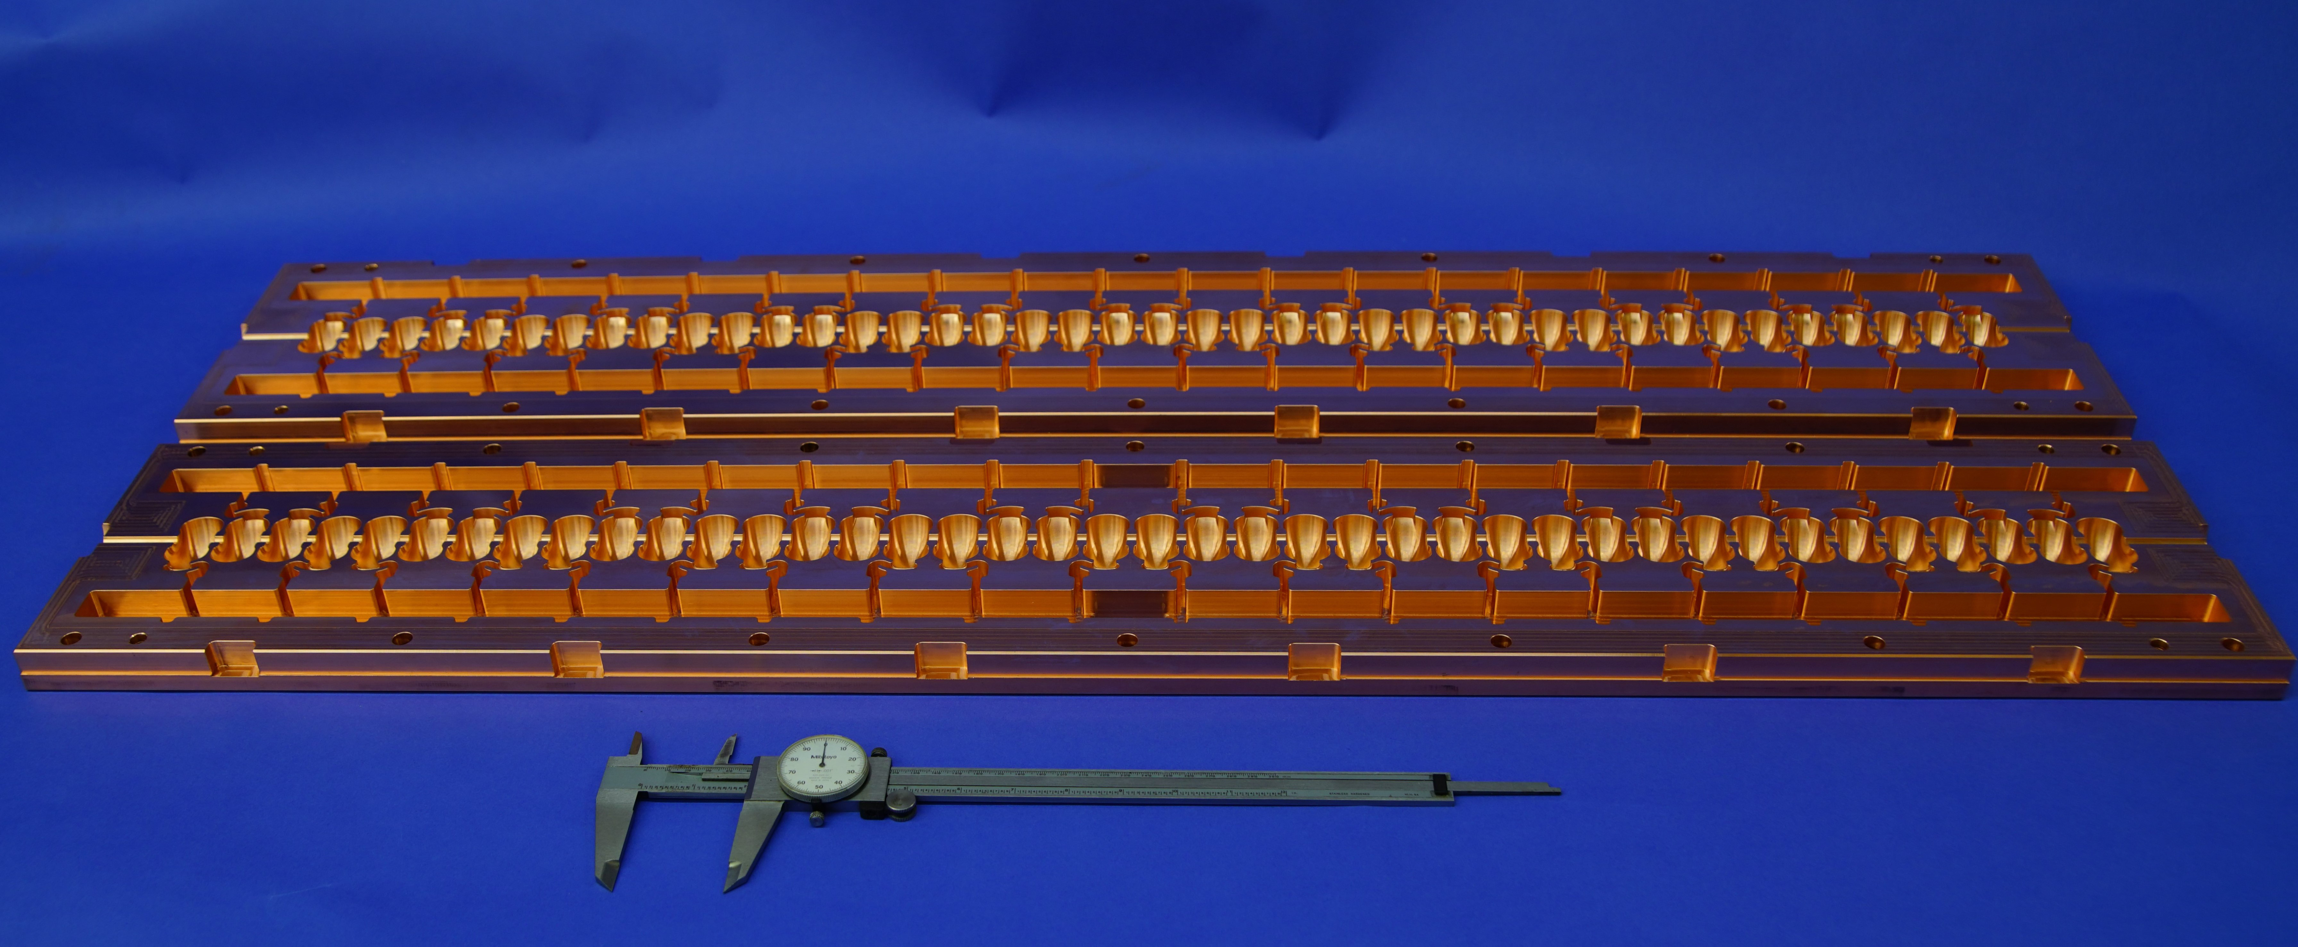
Structures and Advanced Manufacturing
Lu, et al. RSI 92.2 (2021): 024705.
Nasr, et al. arXiv:2011.00391 (2020).
Tantawi, et al. PRAB 23.9 (2020): 092001.
Completed fabrication of many structures – ready to fully utilize our facilities through FY22
  Diverse frequencies, concepts, materials, manuf. Techniques, normal and superconducting
  Additive structures, weld, tin-assisted diffusion, laser-cut braze
  Successful low power test of these structures
  Structures for SLAC and collaborators (MIT, LANL, UCLA, Radiabeam)
C-band Cavity (@LANL/@SLAC cold)
Clamped Distributed Coupling
C-band Linac
Additive Manuf. (rf source / mm-wave)

Slide 12
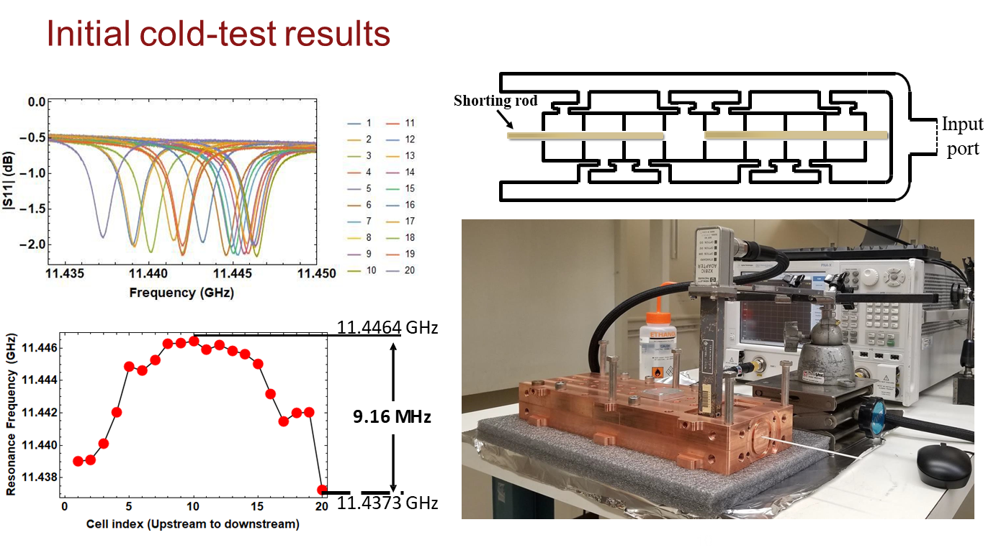
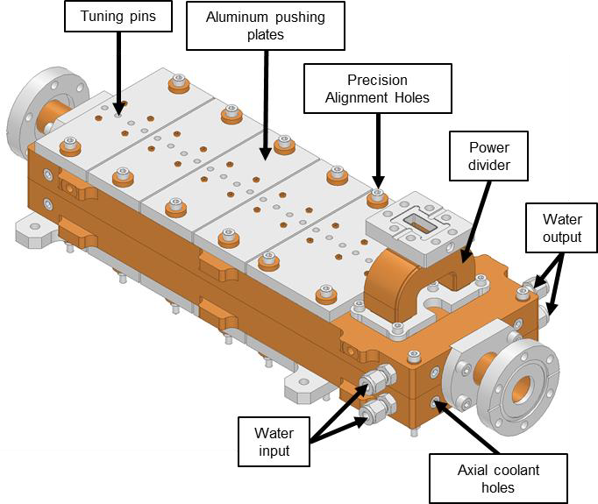
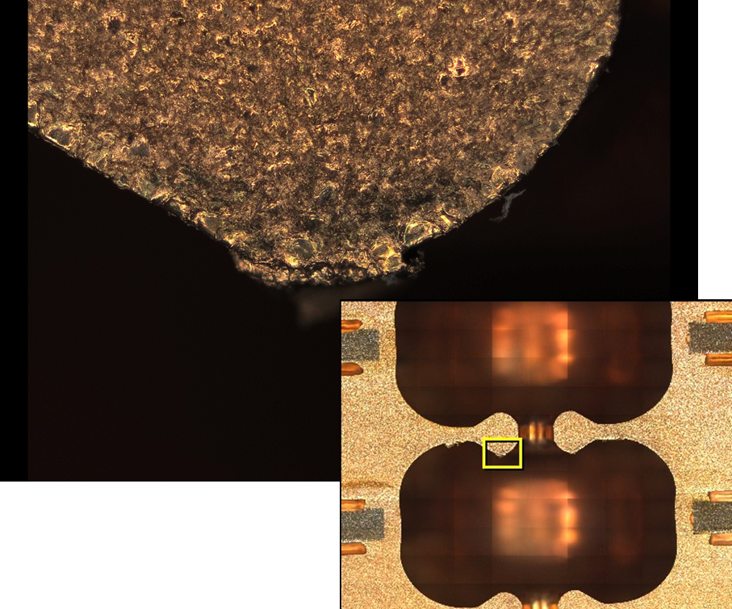
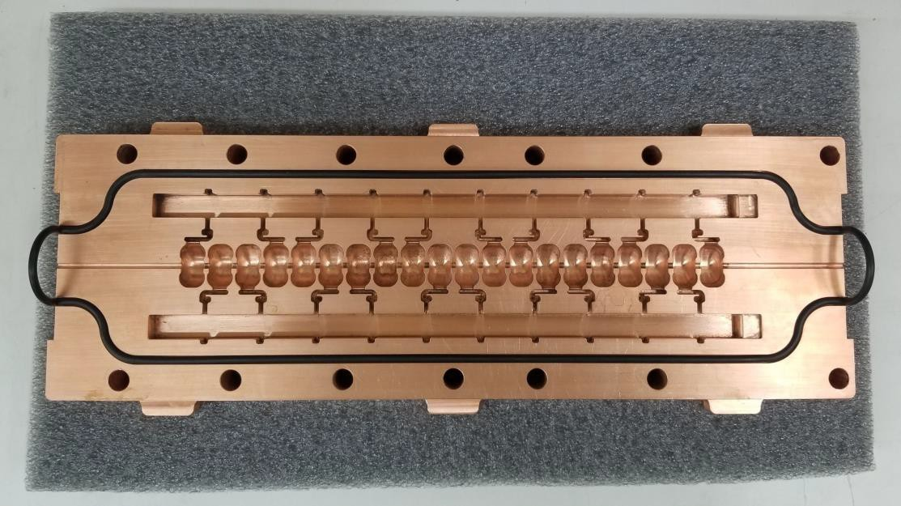
Braze-Less optimized X-band structure could achieve gradients well above 150 MV/m
Nasr, Tantawi
Old distributed coupling structure, Suface deformation happened at 300 MV/m
Previous structure had a field enhancement factor of 2.6. This structure has a field enhancement factor of 2

Slide 13
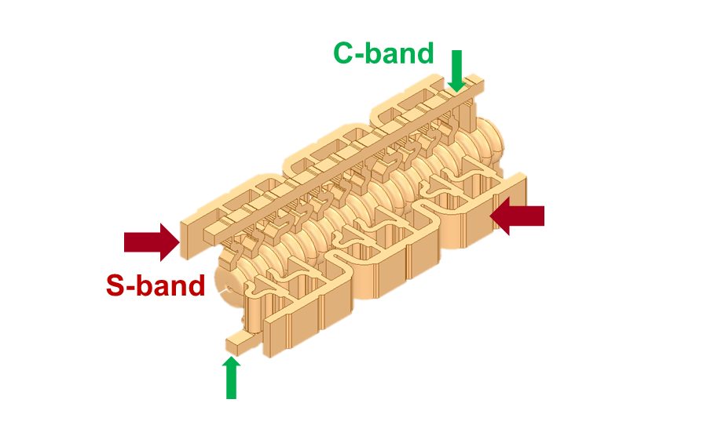
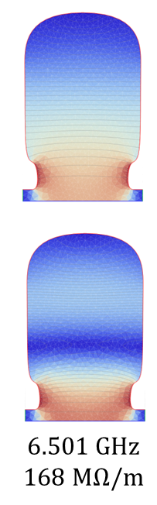


Multi-Frequency Acceleration Has Potential to Impact Efficiency and Gradient of Normal and Superconducting Structures
Typically power ~ (gradient)²
Performance improves when powered with two RF modes
  Efficiency: Linear superposition of fields adding power in two modes.
  Gradient: doubling the accelerating gradient without doubling surface fields; ~ 300 MV/m gradient at room temp
Potential for > 70 MV/m superconducting accelerators
f=11.424 GHz, R_{s}=181 M$Ω$/m
f=18.309 GHz, R_{s}=63 M$Ω$/m
Structure has total Shunt Impedance is 244 MΩ/m.
M. Nasr et al., IPAC’18
Implementable with Distributed Coupling
S. Tantawi, M. Nasr
Notes:
Not harmonic frequency!!
Reduced temporal and spatial coincidence lowers surface fields and pulsed heating

Slide 14
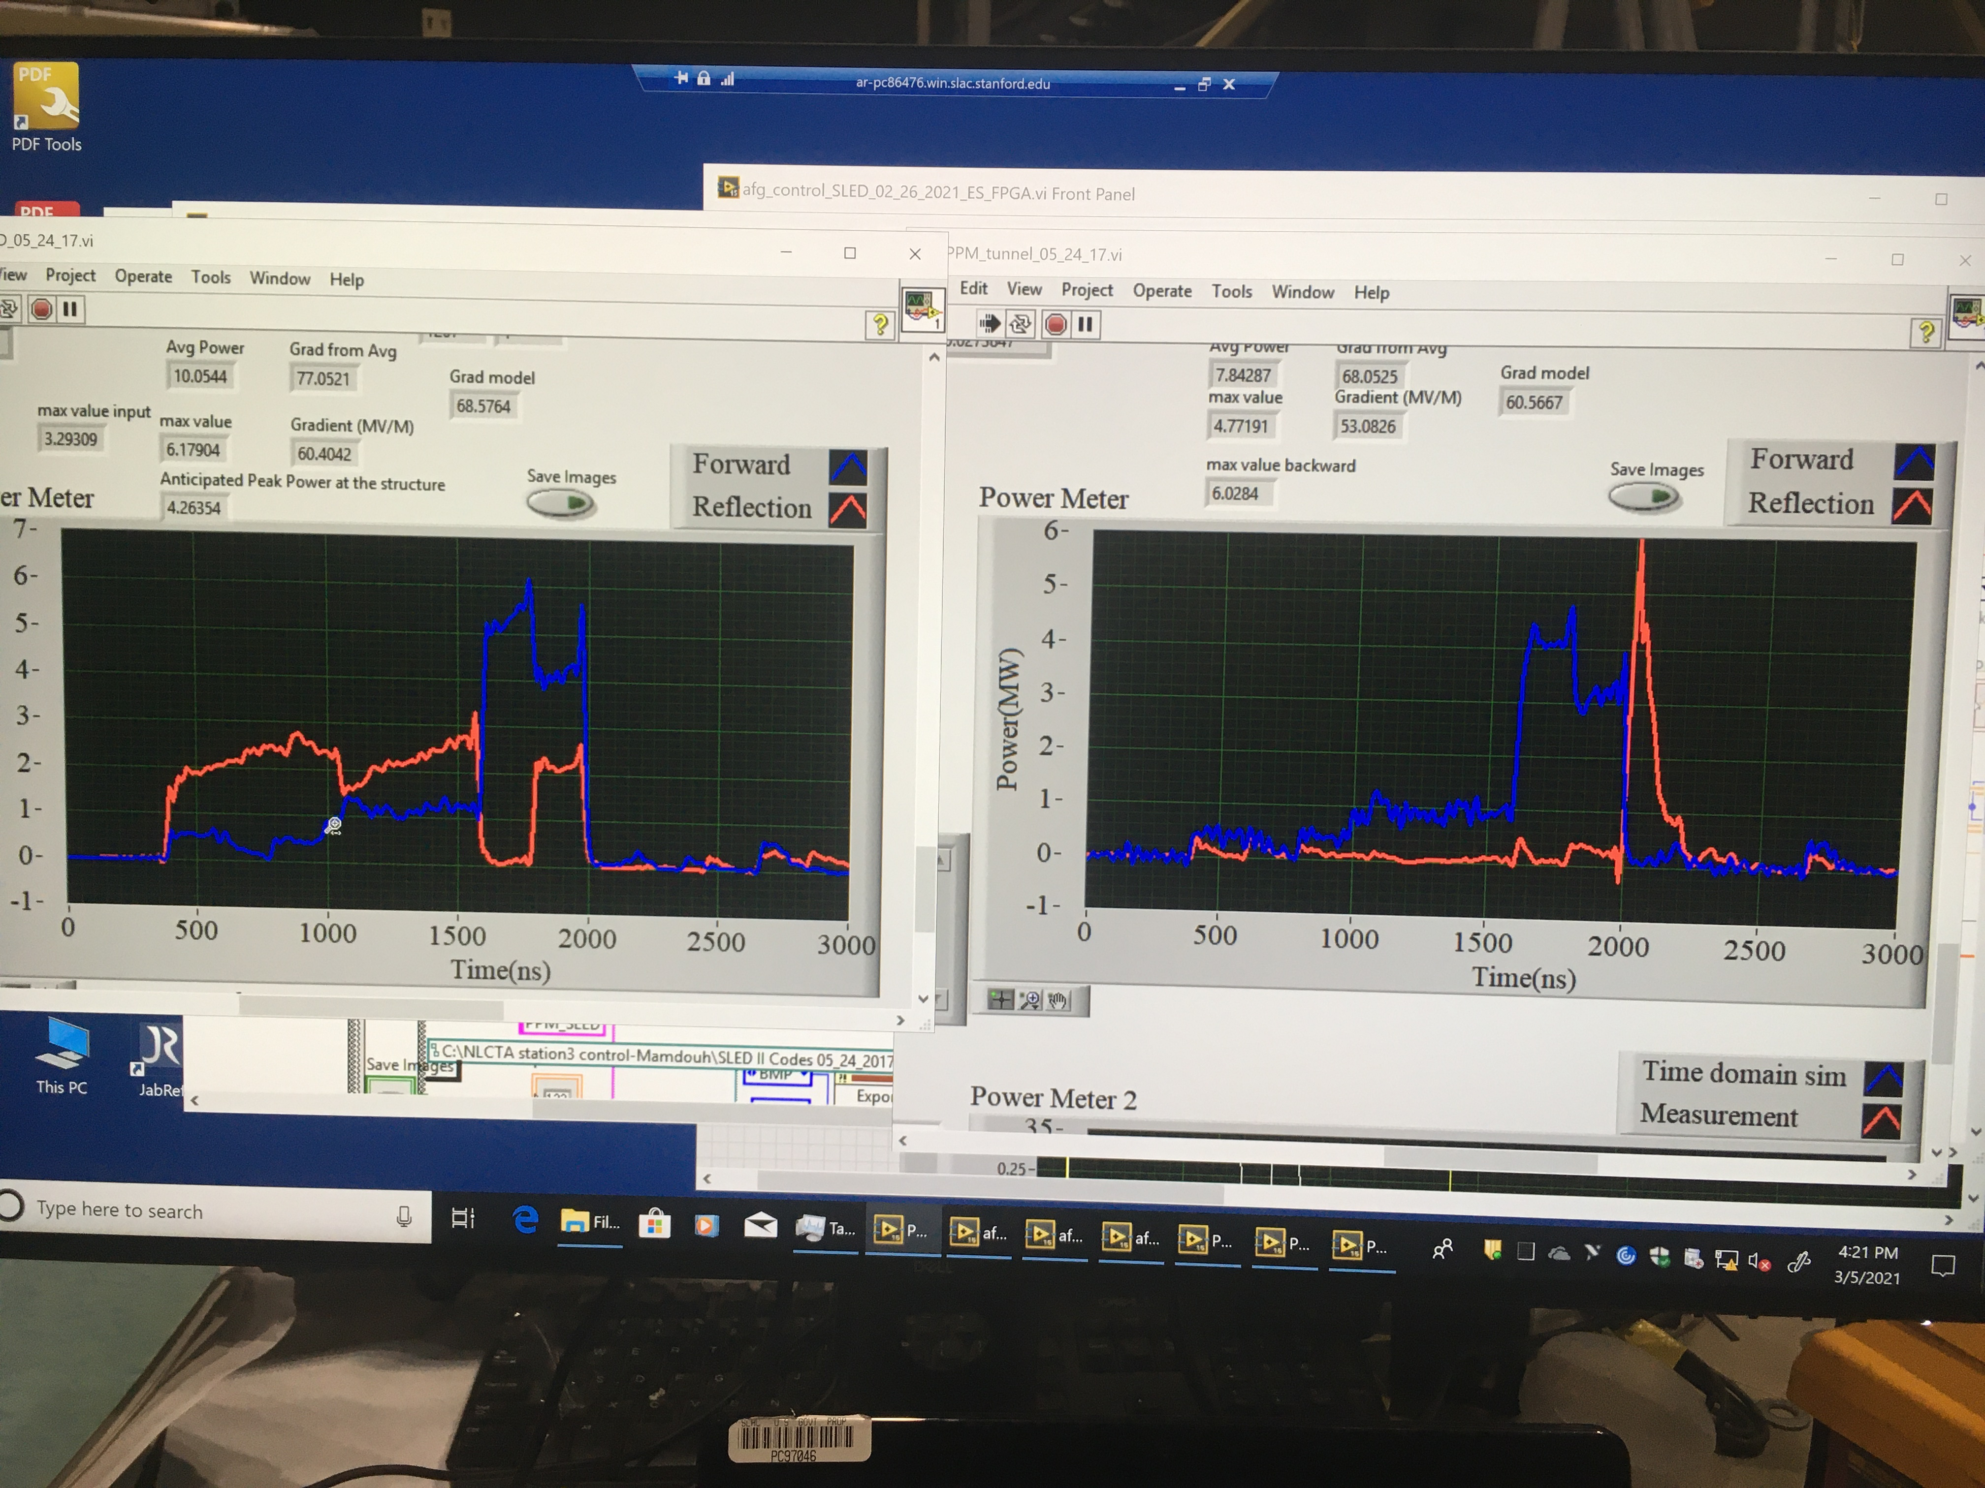
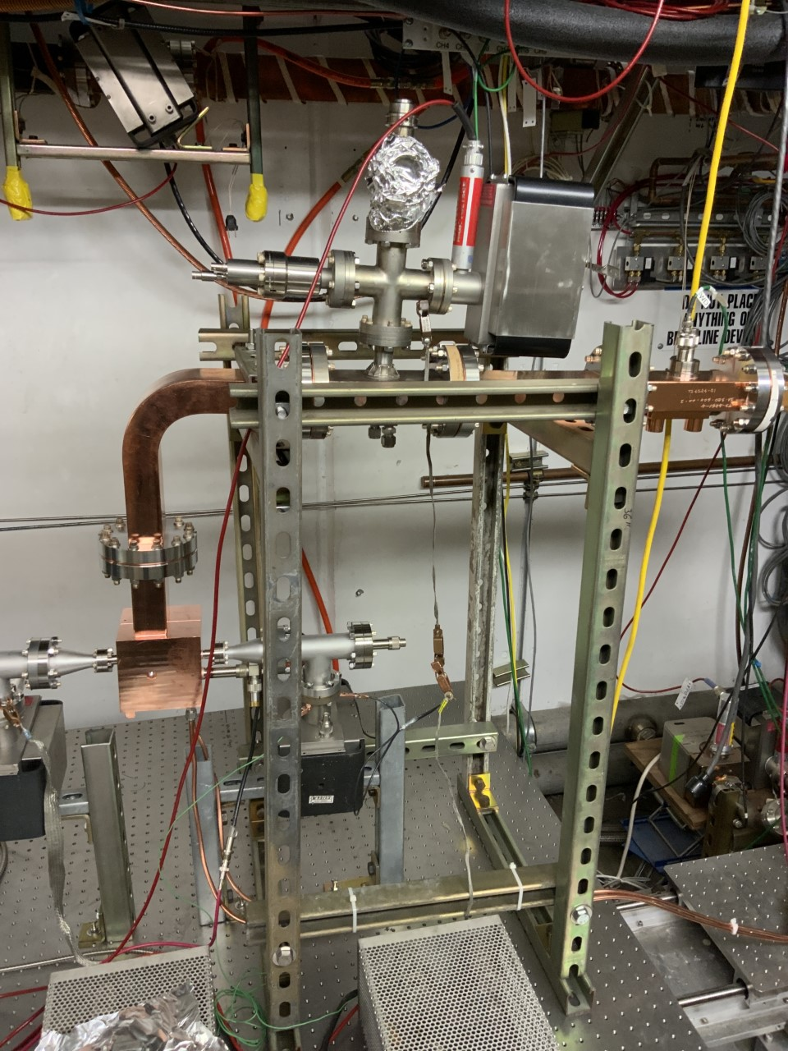
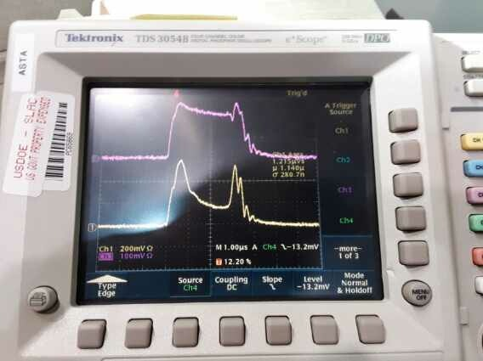
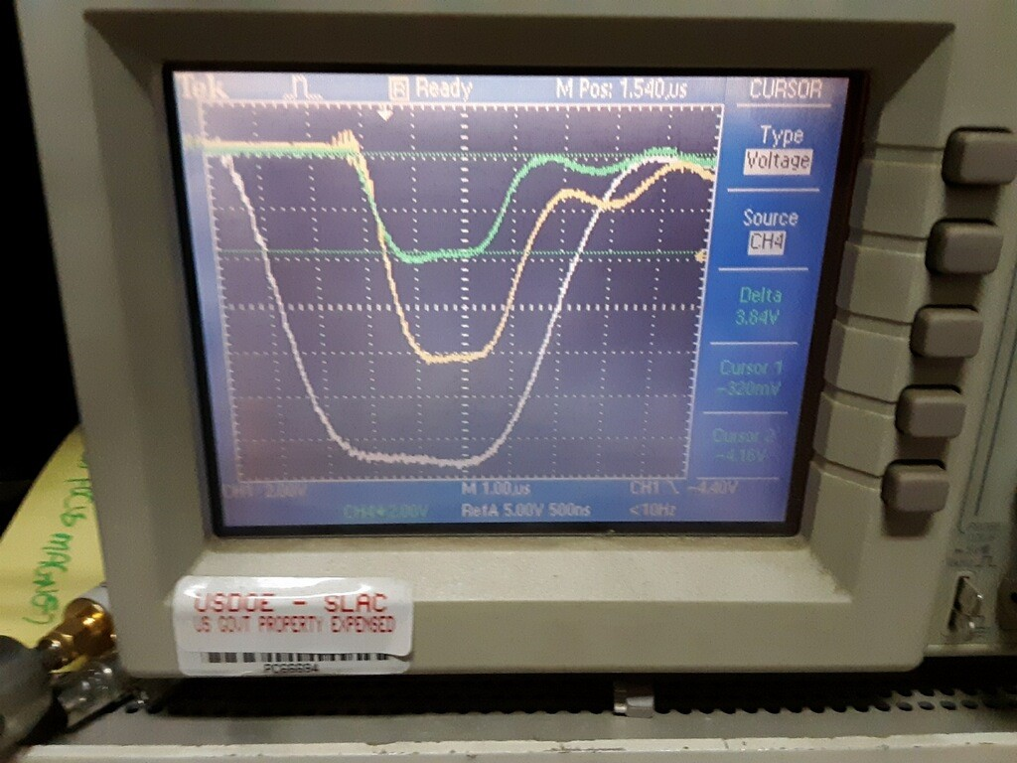
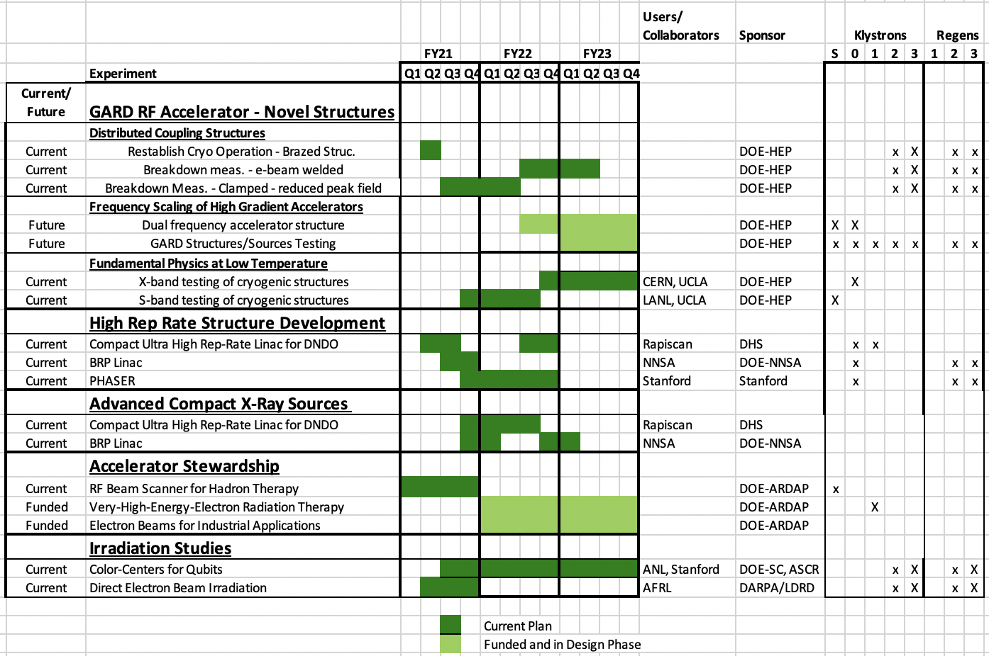
Facility Updates
NLCTA: Resumed experimental program at XTA; new operation of S-band station and Station 0
  NLCTA is GARD RF workhorse
  Worked with TF to develop 3 yr plan that fully utilizes facility
  Developing maintenance plan
Test Lab: Resumed experimental operation of Test Stand 6 (high gradient structure tests); preparing Test Stand 4 (superconducting structure)
Deposition System: Utility hookup proceeding; final acceptance summer 21
Two new cryogenic systems – one for high power, one ultra-cold
XTA Operational
S-band
X-band Station 0
TS4 V. Dolgashev
1C-SW-A2.75-T1.5-CuAg-EBW-Radiabeam-#1
NLCTA PPS down from Dec. ‘19 – Aug. ‘20
Lost one klystron in Dec. 2019

Slide 15
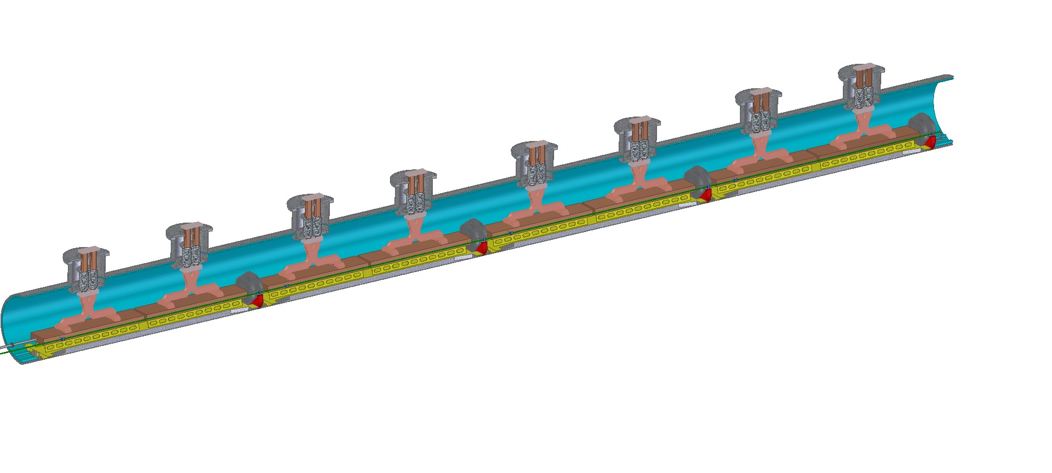
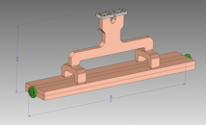
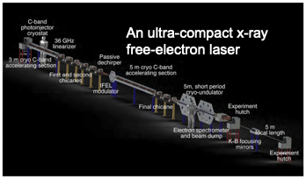
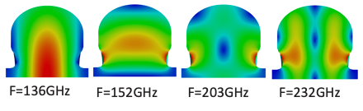



Highlights of RF Accelerator R&D Spin Offs Impacting the Broader Community
New technologies and advanced concepts for RF accelerators continue to attract community interest
  Facility concepts like C³ and XCC
  DARPA GRIT – High gradient C-band
  DARPA MABEL – THz / ACE3P/WARP
  DNDO
  BRP
  UCLA – FEL
  LANL – C-Band
  ASU NSF
CCC/XCC
HEP Facility Concepts - RF distribution and wakes
ACE3P/WARP Integration for high current linacs
UCLA
Tin-Assisted Bond – Developed on GARD, scaled to large structure
Modulators and Sources – Developed on GARD, scaled to production

Slide 16




Rapid 3-D Proton Beam Scanner for Hadron Therapy
Baseline energy of 150 MeV reaches a 15 cm depth
Energy modulator enables ±30 MeV sweep, equivalent to +6 cm to -5 cm depth range
Deflector steers over a ±10 cm range in each direction
Grid of beam positions at patient
tumor
Power per cell (kW)
Program goals to test prototypes
Single cavity energy modulator
Three cavity deflector
Notes:
A

Slide 17




Initial Results from High Power Testing of Energy Mod.
Nominal input 400 kW, 30 MV/m
Achieved 1 MW, 50 MV/m before observing breakdowns
Upgrading control system for better monitoring and long term operation
Injector Station Operational w/ Structure
S11
Dark Current Signal
 | Design | Cold Test
Frequency (GHz) | 2.856 | 2.853 Cu-Ag, 2.854 Cu
Q0 | 11936 | 12014 Cu-Ag, 12197 Cu
Coupling beta | 1.0021 | 1.04 (both)
Transmission Measurement @ High Power

Slide 18


C-band Version Fabricated
To expand testing capacity a C-band version was fabricated and sent to LANL
S-band remains leading high freq. candidate for compatibility with cyclotrons
C-band interesting for alternate proton injectors
Tested a low power and cryogenic temperatures

Slide 19





Proton Deflector Prototype
Snively, Emma, et al. "Deflector Cavity Design for Rapid 2-D Proton Beam Scanning." Bulletin of the American Physical Society 65 (2020).
Brazed Structure Cold Test
Structure is fabricated and ready for high power test
Pre and post braze cold test in agreement
All three cavities within 1 MHz before tuning

Slide 20





What is the Real Scaling in Frequency for Breakdown Physics?
Demonstrate realizable mm-wave accelerating structure
Power with stand-alone RF source – Experimental test underway at MIT with 1 MW gyrotron oscillator
Direct comparison w/ X-band breakdown studies
Gaussian Beam Input
Expanded View of Cavity
Accelerating Gradient
Standing Wave Accelerating Structure
Need to Develop High-Power High-Frequency Sources for Practical Applications

Slide 21
High-Power Testing of 110 GHz Accelerating Structures
First quasi-optical coupling for narrow-band accel. structure
Short tunable pulse lengths few-100s nanosecond at MIT
Test Started - @ 25 MV/m → Power for 100s MV/m
High power alignment in progress
(See Othman and Jawla Talk)
S-Parameters
Measured Forward and Transmitted Pulse
Accel. Mode
E. Nanni et al., IRMMW ’18

Slide 22






High Frequency Accelerators – THz Gun
THz Gun Design
Metrology of Emitter
Samantha Lewis: A THz-Drive Electron Gun
PhD Dissertation Dec. 2020; Postdoc at Fermilab
THz Gun Beamline
Tuned to Source
Key Accomplishments:
Completed THz electron with first successful fabrication and tuning of THz gun structure
Delivered experimental beamline for the THz Gun to MIT – emittance and charge diagnostics, energy spectrometer

Slide 23
High Frequency Accelerators – THz Bunch Compressor and Time Stamping for Ultrafast Electron Diffraction
Laser generated THz pulses for high precision beam manipulation with THz accelerating structures
  50X improvement over UED baseline setup demonstrated
  First THz-compression – THz time stamping with real sample (plasmon excitation in gold structure)
  5 fs timing resolution with pathway to sub-fs
Othman, arXiv:2104.05691 (2021).
Snively, et al. PRL 124.5 (2020): 054801.

Slide 24






Transformation of SRF Accelerator Technology with Distributed Coupling Topology Investigation
f = 1.3 GHz | SC-PF | TESLA
a (cm) (aperture radius) | 0.66 | 3.5
Q₀ | 0.8e10 | 1.0e10
R_{sh} (Ω/m) | 2.4e13 | 9.8e12
E_{pk}/E_{acc} | 2.05 | 1.98
H_{pk}/E_{acc} (mT/(MV/m)) | 2.41 | 4.17
R_{sh}/Q₀ (Ω/m) | 3047 | 983
P_{loss}/E_{acc}² (mW/m/(MV/m)²) | 41.1 | 101.7
Developing SRF parallel-feed accelerator structure under LDRD funding (thru FY19) for testing of bulk-Nb prototype
~2X lower peak H-field, 2.5X less dynamic thermal load
Long-term: leverage structures expertise and cryogenic high-power testing system to advance SRF accelerators
SC-PF
TESLA
E
H
P. Welandar, IPAC’18
Notes:
H_{pk}/E_{acc} (mT/(MV/m)) – Increased gradient
P_{loss}/E_{acc}² (mW/m/(MV/m)²) – reduce dynamic load

Slide 25



Distributed coupling niobium structure (should achieve 100 MV/m) gradient for the same quenching field
Unassembled
Assembled (60 lb. in torque)
bottom plate
RF
Input
C01
RF probes slots
C02
top plate

Slide 26





Highlights of Recent ACE3P Code Development
TEM3P - Transient analysis of temperature distribution
  Benchmarked against analytical solution and ANSYS
Max T = 28.4532
Min T = 23.0763
T3P - Perfectly matched layers (PML) for terminating wave propagation
  Surface impedance boundary condition for thin dielectric lossy coating
  Resistive power loss on boundary surface
Gun3P: Enabled production runs on massively parallel computers for DC gun
  Electrostatic solver
  Magnetostatic solver
  Particle tracking
  Iterative procedure for convergence
E
B
Electron
trajectories
C.-K. Ng

Slide 27





Highlights of Recent ACE3P Applications
Thermal analysis
LCLS-II RF gun thermal analysis
(new transient solver to be applied)
Parallel feed structure
(applicable to C-band linear collider)
LHC-HL (HEP)
EIC (NP)
Elettra at Trieste
Crab cavity design
C.-K. Ng

Slide 28
Outlook for Structures Program in
GARD RF Accelerator Technology
Understand and optimize the performance of distributed-coupling accelerator topologies with advanced materials
Explore frequency, multi-frequency operation and temperature to enhance the performance of accelerators
  Push towards RF Roadmap goals of >200 MΩ/m, >300MeV/m
Support laboratory mission with development new accelerator technology that drives performance:
  e.g. high-brightness injectors, CRAB cavities, innovative SRF struc.
Drive towards integrated systems demonstrating capabilities for the future of accelerators for HEP
Expanding material and structure characterization from room to cryogenic temperatures

