Slide 1
Computing Resources
Institutional Cluster and Computing Inventory
Stu Fuess / Scientific Computing Division
2019 ICAC
15 October 2019

Slide 2
Outline
Institutional Cluster Model
  Vision
  Operation
  Evolution
  Financials
Review of Resources
  HTC, HPC, Disk, Tape
  Will *not* be updating resource requests, as covered in prior ICAC
FY19 resource additions
Response to prior ICAC recommendations

Slide 3
Institutional Cluster Model - Vision
Institutional Cluster (IC) Definition:
An IC is hardware that is designed and operated by an institution, such as Fermilab, to fulfill the diverse needs of its user community. The idea is that an IC is similar to an investment portfolio which contains all types of an individual’s investments. In this case, the IC contains clusters of machines that can each serve the diverse needs of the institutions’ user community.

Slide 4
Institutional Cluster Model - Vision
The IC is thus the collection of all local resources
  High Throughput Clusters (HTC)
    Designed for the efficient execution of many loosely-coupled tasks over a long period of time
    E.g. CMS Tier-1, CMS LPC, FermiGrid clusters
  High Performance Clusters (HPC)
    A collection of many separate servers (nodes), which are connected via a fast interconnect
    E.g. LQ1 cluster, LQCD clusters (pi0, pi0g, Ds, Bc), Wilson cluster
  Storage
    CMS and Public (all else) enstore tape systems
    CMS and Public dCache instances, CMS EOS, NAS instances disk systems
  Network
    LAN and WAN portals

Slide 5
Institutional Cluster Model - Operation
Users interact with a “scientific gateway”
  Specifying workflow/job requirements, special allocations
Gateway (= HEPCloud) can direct work to local and/or remote resources
  These can be shared, owned, allocated, purchased, …
Allocations, usage, costs tracked
  Internal users == those supported by the funds used to procure & operate facility
  External users == those who “pay” to use the IC
  Opportunistic users == those who may utilize otherwise idle resources
  All of these must be accounted for in planning, e.g. by a CRSG

Slide 6
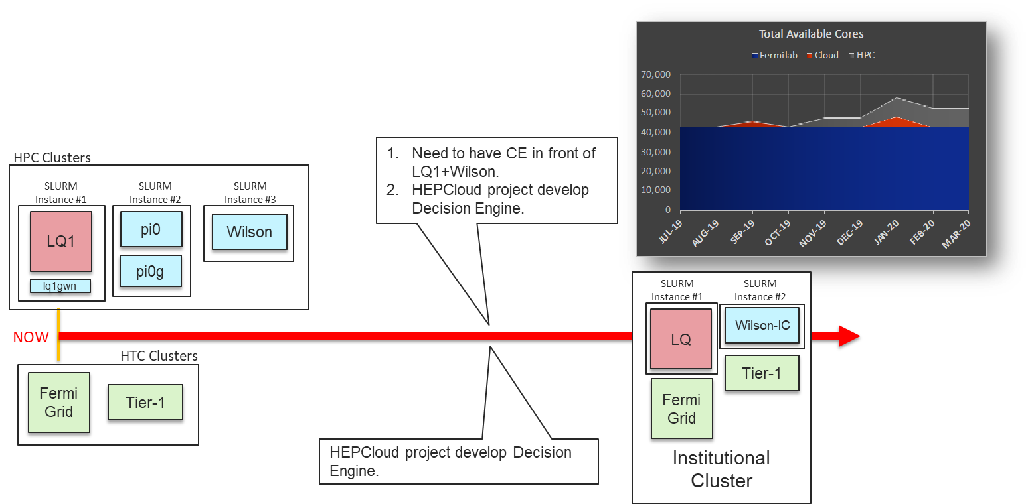
Institutional Cluster Model - Evolution

Slide 7
Institutional Cluster Model - Financials
Local resources will require a cost model
  Should encompass all costs
    Facility, hardware, maintenance, operations,…
  Needs to be flexible enough to account for hardware and job type variants
    HTC vs HPC workflows
    Cache vs static, disk vs tape, fast vs slow I/O storage classes
    QoS levels
  But not so detailed as to become unwieldy
    The “limited menu” model
  Working on this now…
    Where it’s hard:
      separating “total” from “incremental” costs
      Incorporating large “step functions”, e.g. tape technology changes
  Goal: “cost recovery” from external users, but “cost awareness” from local users

Slide 8
Review of resources - What we have now, what is new
The following slides show:
  Processing resources
    CMS Tier-1 and LPC, FermiGrid, HPC clusters
  Processing resource utilization
    CMS, FermiGrid, LQCD
      Wilson cluster, by definition, is for development so utilization is sporadic
  Storage resources
    Disk and Tape
  FY19 additions
    Showing all resource types, > 95% of entire FY19 M&S expenditures

Slide 9
Processing: Summary of current resources
CMS Tier-1 and LPC: to meet pledge and provide analysis platform, ~27K cores, 285 kHS06
FermiGrid: Intensity Frontier and other HTC usage, ~19K cores, 200 kHS06
HPC clusters: allocated, high speed interconnect (IB), some GPUs
    No longer allocated to LQCD program:
      pi0 : 314 nodes, 5,024 cores --- Will move ½ to FermiGrid, ½ to Wilson cluster
      pi0G : 32 nodes, 128 K40 GPUs --- Becomes component of Wilson cluster
      Bc : 224 nodes, 7,168 cores --- All of these are ancient
      Ds : 168 nodes, 6,272 cores | keep for LQCD opportunistic use
      DsG : 20 nodes, 80 Tesla M2050 GPUs --- Operate in a DNR mode
    Newly acquired, operated as IC component:
      LQ1 : 112 nodes (Cascade Lake) + 5 nodes with dual Voltas --- 82% LQCD allocated
Wilson cluster: development with various accelerators, small HPC
      Very old nodes to be retired

Slide 10
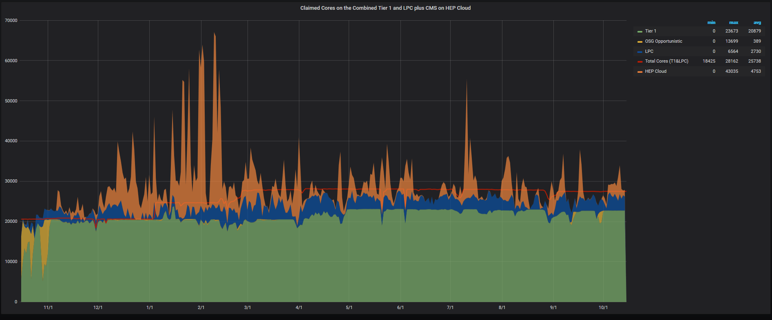
Processing: Last year utilization - CMS
Orange = NERSC
50K

Slide 11
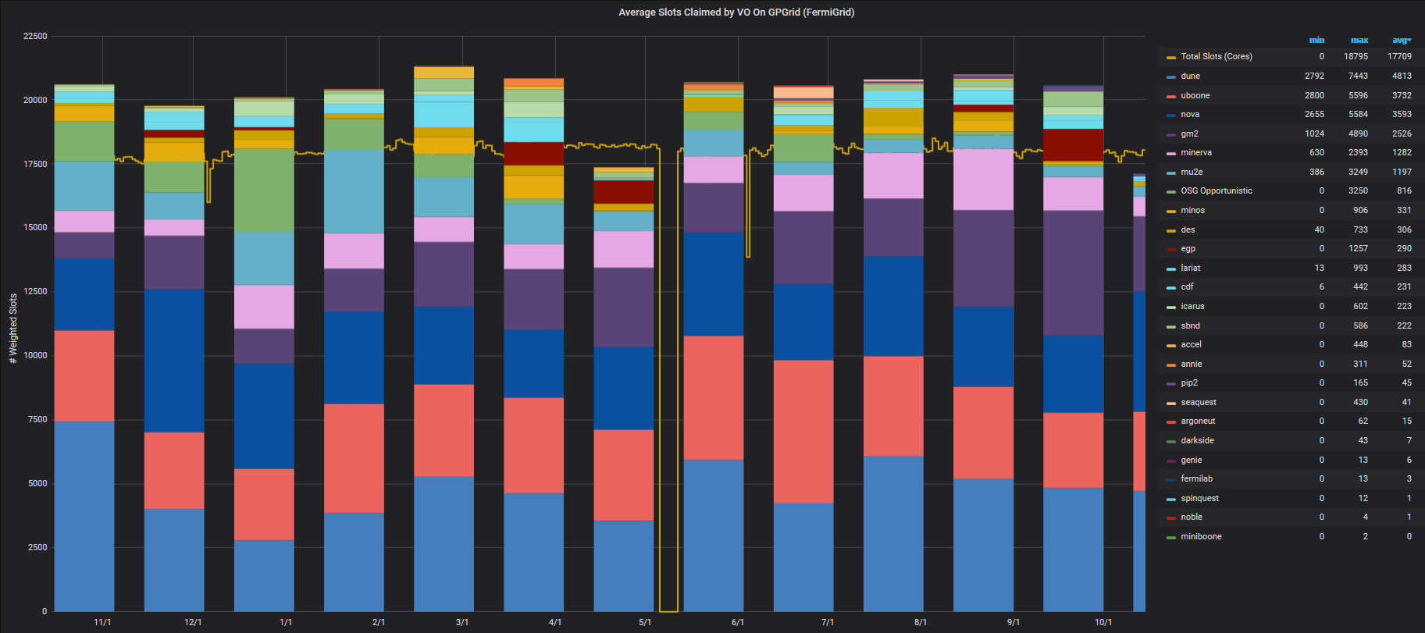
Processing: Last year utilization - FermiGrid
22.5K

Slide 12
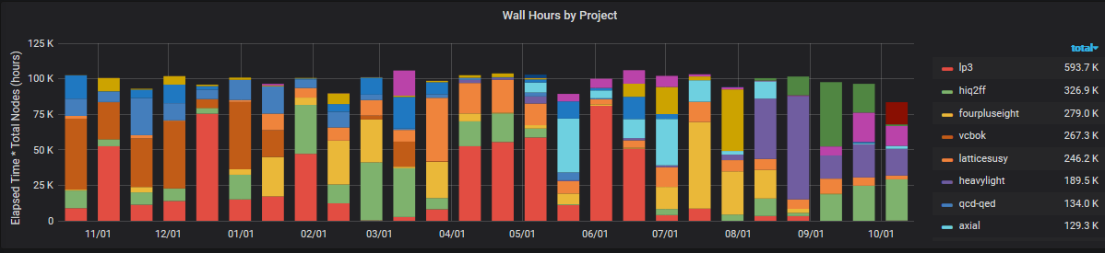
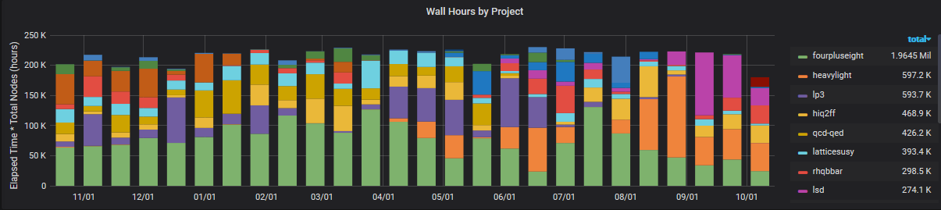
Processing: Last year utilization – HPC Clusters
pi0 314 nodes -> 105.5K node-hours/14-day bin
Pi0,Bc,Ds = 706 nodes -> 237K node-hours/14-day bin

Slide 13
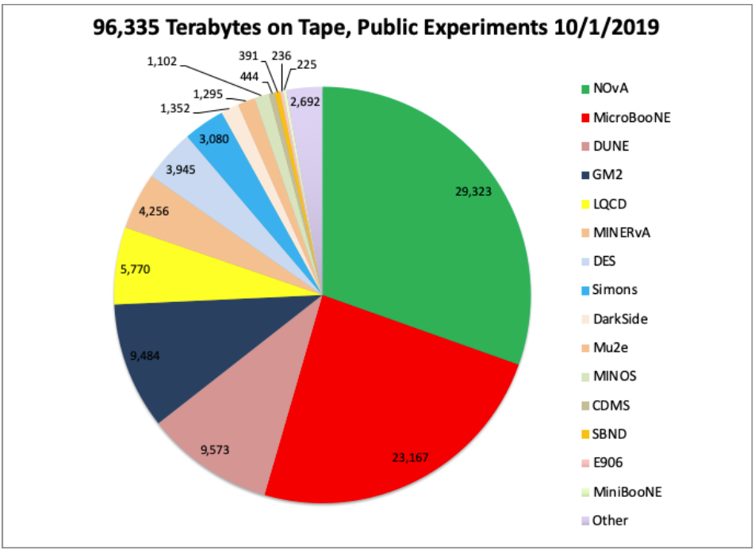
Storage: Current usage
CMS
Public
Tape 68 PB
(81 PB including copies)
Disk dCache 27 PB
Tape 109 PB
(117 PB including copies)

Slide 14
FY19 Resource Additions - Details
M&S expenditures (direct costs, add ~29% overhead)

Slide 15

FY19 Resource Additions - Highlights
CMS
  Adding ~14 PB of disk
  Purchased 32 PB of media (all M8, 9 TB/cartridge)
Neutrino/Muon (aka Detector Operations)
  Adding ~3 PB of disk
  Adding over 5K FermiGrid “slots” (42 Epyc Rome nodes)
  Commissioned 2nd IBM TS4500 100PB capacity (with LTO8) library
HPC
  Commissioned 112 node cluster
  (Cascade Lake, 100 Gb Omnipath)
R&D
  Purchasing sizable NVMe disk arrays
  (multiple sizes, net 660 TB)

Slide 16
Response to related ICAC recommendations (my paraphrasing of such…)
  Fence computing resource funding from, or within, the Detector Operations B&R
    We are still at the mercy of general DetOps budget, and especially competing demands for salary funding (as representative of needed effort)
  At least get a manageable level of funding
    Approx. $900K was redirected to hardware resources from within the sector in FY19
      Only a one-time possibility
    Allowed refresh of worker nodes and disk R&D purchases
  Avoid fencing of resources
    Institutional Cluster model addresses this, particularly local HPC resources
  Plan for system repurposing or retirement
    A large number of Lattice QCD systems are no longer allocated to the project
      Will redirect a number to FermiGrid, make others openly available on Wilson (HPC) Cluster

Slide 17
Conclusion
Additional details available if requested

