Slide 1
DUNE Host Lab Responsibilities
Stu Fuess / Scientific Computing Division
2019 ICAC
15 October 2019

Slide 2
DISCLAIMER
What is presented here is a summary of internal Fermilab discussions
Starting point for discussions with the broader collaboration
This is still a work in progress – comments welcome

Slide 3
Outline
Methodology and history
Snapshot of the details
Summary of projects w/ responsibilities
Issues?

Slide 4
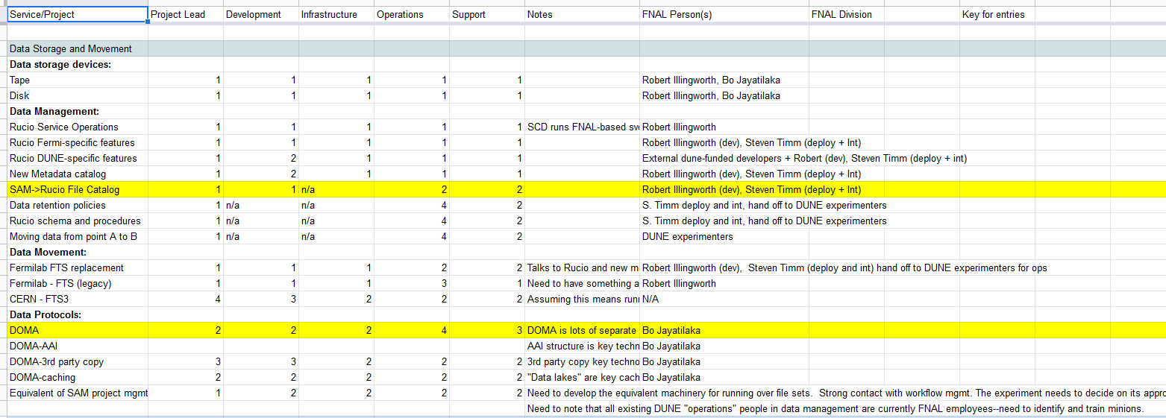
Methodology and History
The Fermilab half of the DUNE Computing Technical Coordinators (Kirby) organized a series of meetings to which all Fermilab service providers were invited
All worked on a shared spreadsheet that listed existing services and projects
Some areas expanded to great detail
Example snip of the spreadsheet:

Slide 5
Methodology and History
For each task (continuing or new) listed, looked at the responsibilities for:
Project lead
Development
Infrastructure
Operations
Support
For each task we marked the Host Lab responsibilities as:
= Mandated to do
= Want to do, but OK for others to lead
= Don’t care to do, but would participate as able
= Do NOT want to participate; must be done by others

Slide 6
Summary of Projects
Main areas (in no particular order):
User Management
DAQ and Online Computing
Data Storage and Management
Distributed Computing
Databases
Offline Software and Tools
Software Development Tools
Collaborative Tools
User Facilities

Slide 7
Host responsibilities: User Management
Host lab to lead, develop and operate:
Computer security
Federated identity mechanism
Authentication and Authorization infrastructure
Account and VO administration (FERRY)
Expect collaboration to provide:
Computer security coordinator: contact person within the collaboration to chase down issues and contact offenders

Slide 8
Host responsibilities: DAQ and Online
Host lab to lead, develop and support:
artDAQ (DAQ framework)
Network provider interface (to ESNET) for SURF
Remote control room (e.g. ROC West facility)
A number of areas still TBD on responsibilities, but aiming for collaboration to take lead roles with Fermilab consultation:
DAQ and Online system architecture
DAQ and Online system administration
DAQ and Online software management
Provisioning of DAQ (and other hardware) test stands

Slide 9
Host responsibilities: Data Storage and Management
Host lab to lead, develop and support:
“Tier-0” physical infrastructure and operations: tape, disk
Data management (e.g. Rucio) tools
Responsible for Fermilab-specific features
Responsible for core service operations
Expect collaboration to contribute to development and operations:
Metadata catalog
DUNE-specific Rucio features
DOMA functions (AAI, 3rd party copies, caching)
Fermi-FTS to FTS3 transition
Expect collaboration to manage day-to-day operations:
Data Movement

Slide 10
Host responsibilities: Distributed Computing
Host lab to lead, develop and operate:
Local resources (Institutional Cluster – e.g. FermiGrid plus other local resources)
Portal to external resources (HEPCloud)
Job submission mechanism (jobsub)
Accounting & Monitoring
Infrastructure
Services (including fifemon, elasticsearch / grafana / kibana, LHC tools)
Expect collaboration to contribute to development:
Production operations and support
Workflow management
Expect collaboration to provide user and day-to-day support:
All the above

Slide 11
Host responsibilities: Databases
Host lab to lead, develop and operate:
Beam information DB
Metadata backend DB
Collaboration membership DB
Infrastructure for some of the following…
Expect collaboration to lead, develop, and operate:
Hardware DB
Slow controls DB
Configuration / conditions DB

Slide 12
Host responsibilities: Offline Software and Tools
Host lab to lead, develop and support:
Container management
Infrastructure
Build mechanisms
POMS (workflow and production system)
Project management (e.g. sam or successor)
Job data handling utilities (e.g. ifdh)
Want strong participation, but do not necessarily need to lead:
Production and/or analysis framework (e.g. art or successor)
LArSoft (reconstruction)
Software package management (e.g. spack)

Slide 13
Host responsibilities: Software Development Tools
Host lab to lead, develop and operate:
cvmfs repositories
Software build systems
Infrastructure for CI (e.g. Jenkins)
Infrastructure for service development and integration
Expect collaboration to lead, develop, and operate:
Continuous integration
Software repository solution is likely to be github

Slide 14
Host responsibilities: Collaborative Tools
Host lab to lead, develop (if needed) and operate:
Web site, wiki
Document databases (DocDB, EDMS)
Video conference tools
Project management tools
Meeting management tools (Indico)
Mail lists
Communication tools (e.g. slack)
Expect collaboration to lead, develop, and operate:
Electronic logbook(s)

Slide 15
Host responsibilities: User Facilities
Host lab to provide:
Office facilities for on-site visitors
User support to navigate bureaucracy (embedded funded person?)
Host lab to lead, develop (if needed) and operate:
Interactive computing
LPC-like analysis computing facility
Expect collaboration to lead, develop, and operate:
Education (e.g. Data Analysis School)

Slide 16
Conclusion: Issues?
What is missing that should be a Host Lab responsibility?
Should more things be left to the collaboration / consortium?
Are leadership assignments useful in procuring funding?
Does the lab have the effort / funding to provide the items listed?
What opportunities for global collaboration (e.g. WLCG, HSF, …) should be pursued in addition to those mentioned (e.g. DOMA, Rucio)?
Would any of these reduce the Host Lab task list?

