Slide 1
Fermilab WAN Capabilities
Phil DeMar, Ray Pasetes, Andrey Bobyshev
ICAC Review
10/15/2019

Slide 2
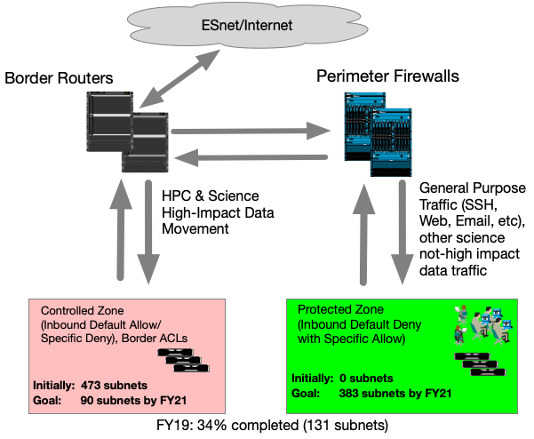
Two Perimeter Security zones

Slide 3
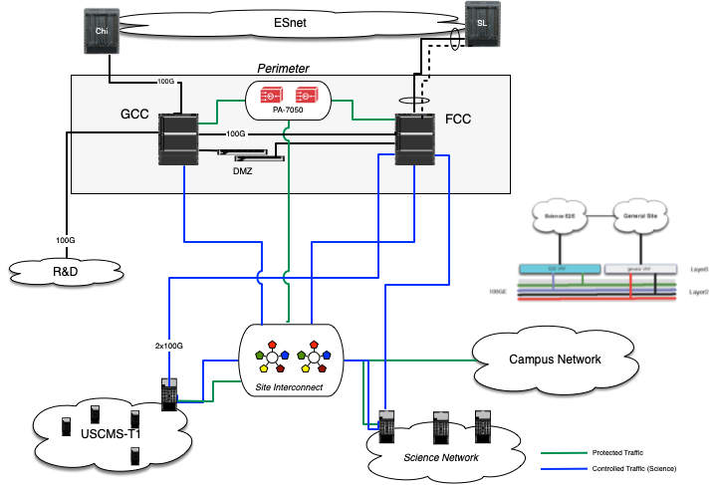
FNAL Campus LAN & Off-Site Network Paths
External
Network
Perimeter
Internal
Network

Slide 4
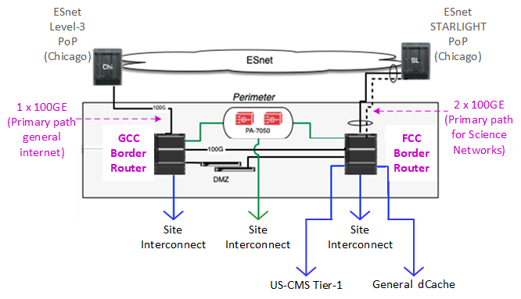
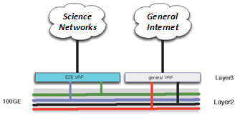
FNAL Network Perimeter
Perimeter has geographic diversity for both devices & fiber
Aggregate off-site bandwidth is currently 300Gb/s (3 x 100GE)
Virtual Routing & Forwarding (VRF) technology on border routers

Slide 5
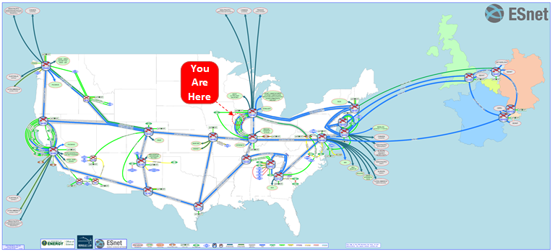
ESnet – FNAL’s ISP
ESnet is FNAL’s only offsite internet service provider
ESnet backbone is extremely capacious & highly redundant:
  Including trans-Atlantic services to CERN & GEANT
Metropolitan area network (MAN) services for last mile(s)

Slide 6
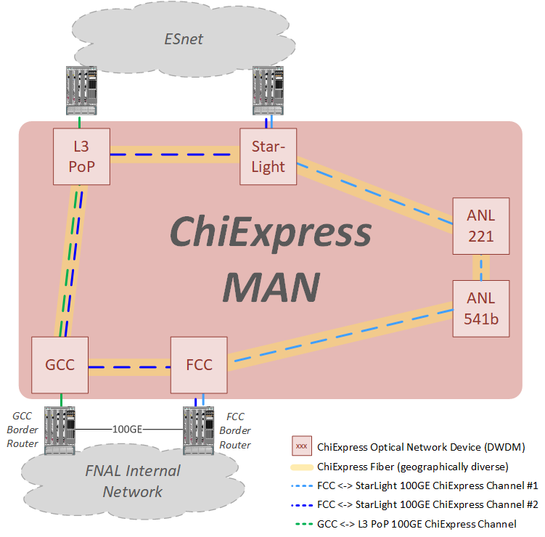
ChiExpress – FNAL’s Connectivity to ESnet’s PoPs
A local optical network operated by ESnet
Ethernet-based, not SONET-based:
  Wave reconfiguration within (O) 10 minutes
Site capacity upgrades involve only hardware

Slide 7
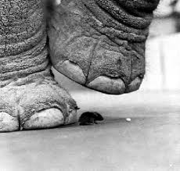
Special-Purpose Science Data Networks
General strategy – keep science data traffic logically separate, if feasible:
  Optimize performance over WAN science data network paths
  Internal LAN upgrades for high-impact science requirements easier to target
  More flexible perimeter security models
  Limit interaction with interactive traffic:
    Don’t want this to be your Zoom meeting data stream…
Examples – LHCOPN, LHCONE, NOvA Far Detector
Phil DeMar | ICAC Review – 10/15/19

Slide 8
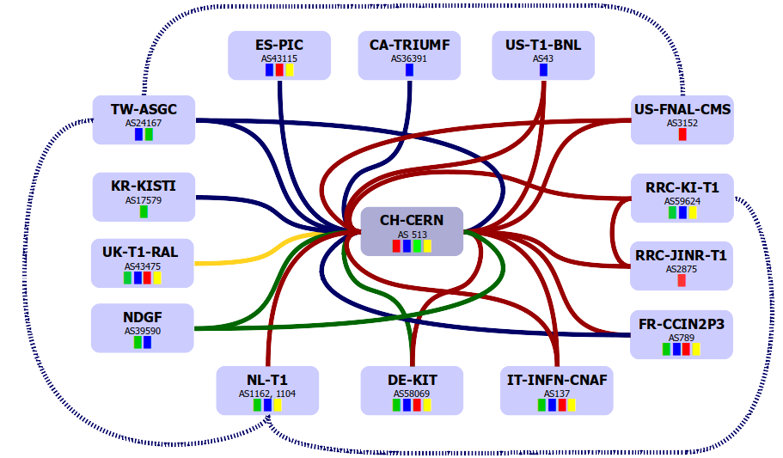
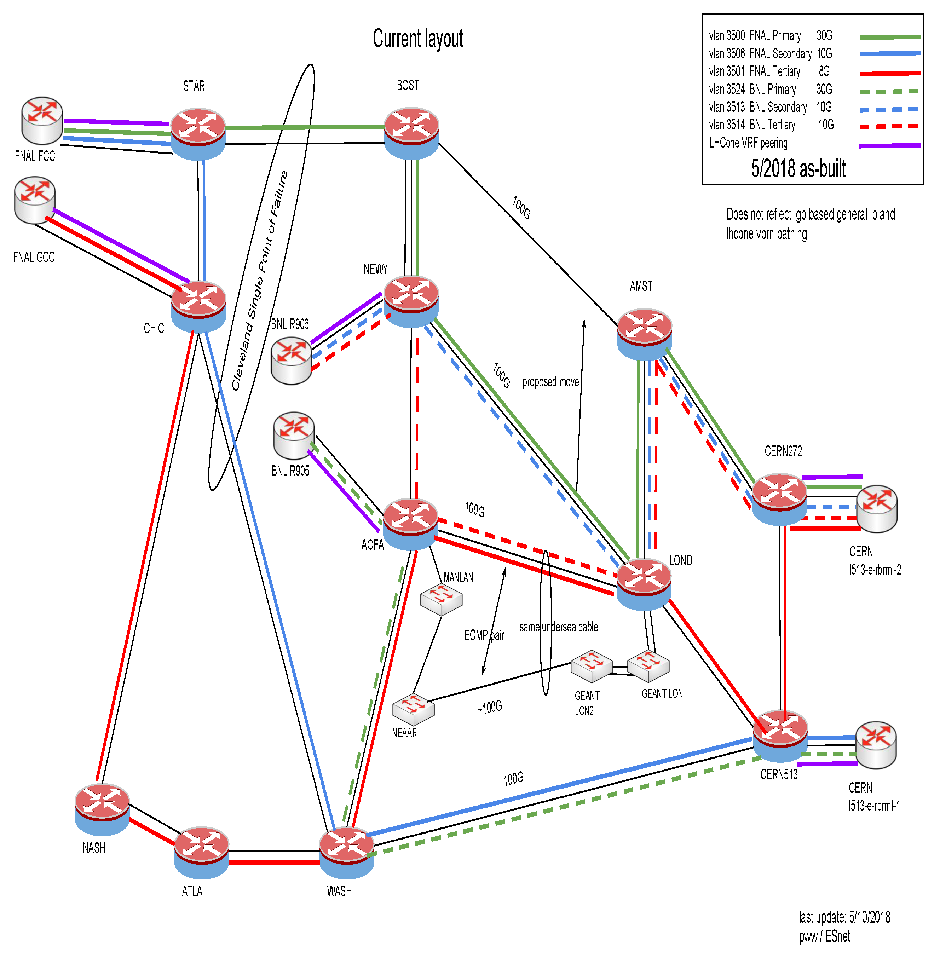
LHC Optical Private Network (LHCOPN)
Star-shaped “private” network:
  - CERN (LHC Tier-0) at the center
  “Links” to the LHC T1s
  T0 <-> T1 and (some) T1 <-> T1 traffic
FNAL LHCOPN links are virtual circuits over ESnet:
B/W guarantees
Primary, secondary, & tertiary circuits

Slide 9
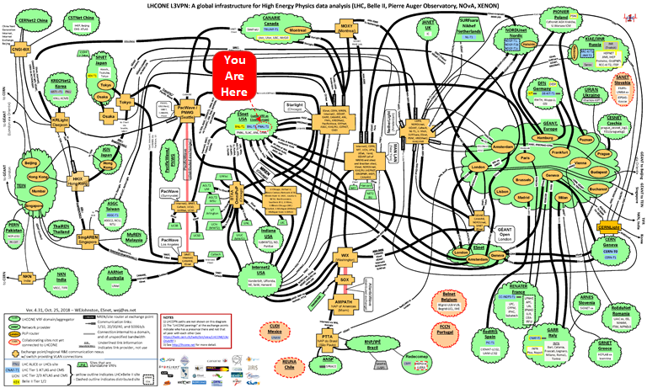
LHC Open Network Environment (LHCONE)

Slide 10
LHCONE Translated into Understandable Terms
LHCONE is an overlay network (in most places…):
  VRF technology typically used to separate routing
Logically separates LHC traffic from general R&E network traffic for traffic management purposes:
  Also can lower security risk profile at sites for LHC traffic
End sites are responsible for separating traffic:
  At FNAL, we use Policy Routing techniques to accomplish that
There (currently…) are no QoS capabilities within LHCONE
Several smaller HEP/Astro collaborations have been granted authorization to utilize LHCONE for their data movement:
  Belle-II, Pierre Auger, NOvA, XEON

Slide 11
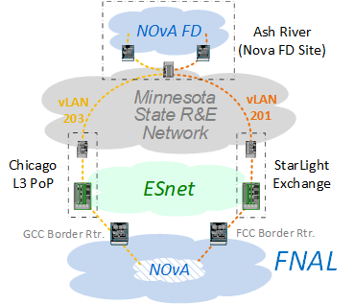
Point-to-Point Network Services
NOvA Far End Detector (FD):
  Redundant low-bandwidth pt-to-pt connection(s)
    vLANs with B/W guarantees plumbed through multiple service providers
  Logically, NOvA FD lies inside FNAL’s security perimeter
Pt-to-pt circuits to US-CMS Tier-2 facilities:
  UFL, MIT, Nebraska, Purdue, UCSD, Wisconsin
  Being phased out,; largely replaced by LHCONE

Slide 12
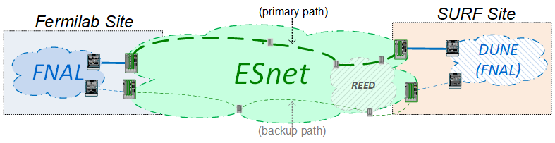
DUNE Far Detector (in South Dakota)
Far Detector (FD) connectivity to FNAL:
  FD local network will lie within FNAL security perimeter
  WAN support model currently under discussion w/ ESnet
  B/W under study; targeting 100GE path
    Redundant path expected to be much, much less
Off-line DUNE network expected to look similar to LHC:
  LHCONE-like service (but probably not an LHCOPN-like service)

Slide 13
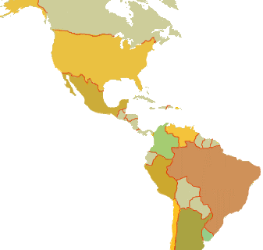
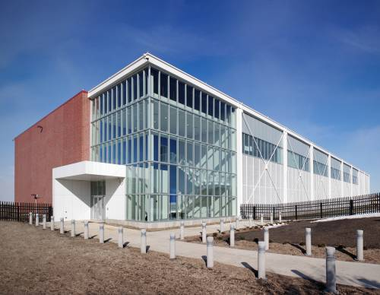
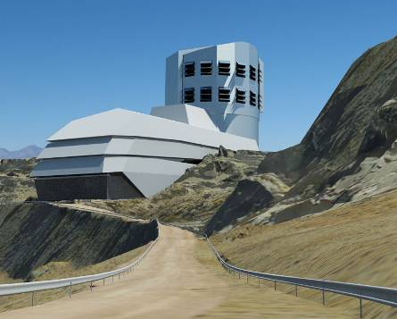
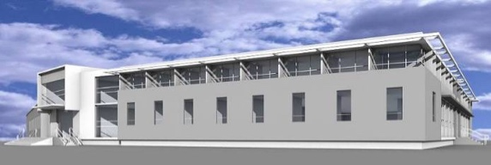
Large Synoptic Survey Telescope (LSST)
Dedicated network infrastructure from telescope (Chile) to archive site (NCSA)
FNAL working with NCSA on operational support for the long-haul network:
  Experiences from LHC networking believed to be helpful
Archive Site
Archive Center
  Alert Production
  Data Release Production
  Calibration Products Production
  EPO Infrastructure
  Long-term Storage (copy 2)
Data Access Center
  Data Access and User Services
Summit Site
Summit Facility
Telescope and Camera
Data Acquisition
Crosstalk Correction
Base Site
Base Center
Long-term storage (copy 1)
Data Access Center
  Data Access and User Services

Slide 14
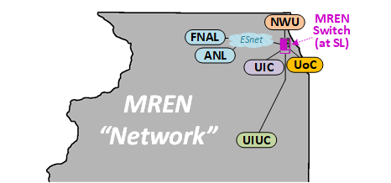
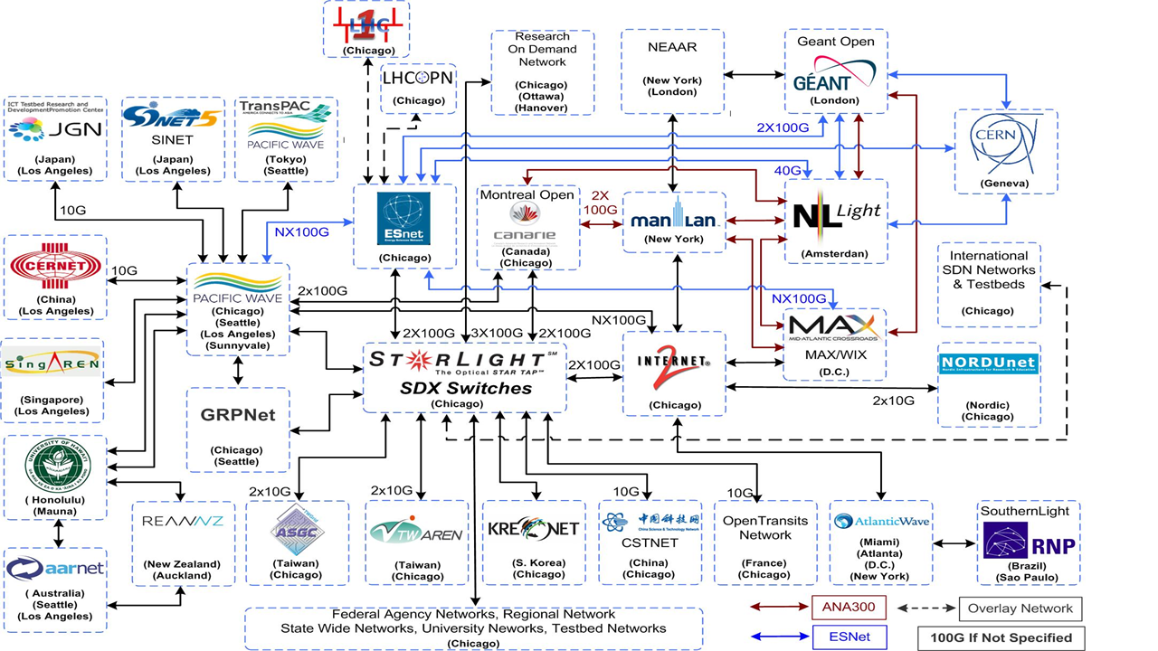
Metropolitan Research & Education Network (MREN)
Consortium of Chicago area research universities & National Labs (FNAL & ANL):
  Like a mini-regional network
  Universities directly connect
  The Labs indirectly via ESnet
Maintains network switch(es) at the StarLight International Exchange:
  Potential connectivity path to StarLight-connected networks

Slide 15
ESnet6
The next generation of ESnet:
  2021-ish
ESnet will “own” fiber, optical infra., and routers
Topology similar to ESnet5
Trans-Atlantic & intra-European links still leased services

Slide 16
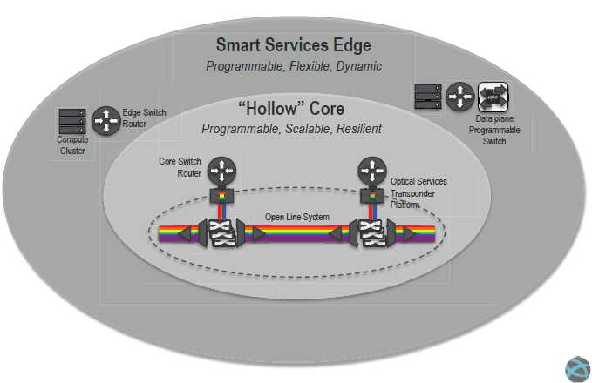
ESnet6 – New Networking Model
“Smart” edge and “hollow” core
Network services pushed to sites
  Service & path decisions made at the edge
Core’s function is packet forwarding
  One routing hop across ESnet

Slide 17
ESnet6 – Multiple Classes of Services
“No touch” services are essentially default IP routing
“Low touch” services are today’s LHCOPN & LHCONE-like services:
  More flexible, dynamic, & more automated
“High touch” services allow per packet tagging & manipulation
Service classes isolated from each other
No Touch
Services
Low Touch
Services
High Touch
Services

Slide 18
Summary
FNAL WAN services have capacious bandwidth & high levels of resiliency
  Needs for more bandwidth can be satisfied relatively easily
  But trans-Atlantic bandwidth demands present challenges
“Special” handling for science data traffic is provided:
Network Service | Service Characteristics | Example(s)
Routed IP | General internet access | ESnet base service
“Private” network | Small # of tightly-restricted sites Bandwidth guarantees | LHCOPN
Science discipline network | Large # of loosely-connected sites No bandwidth guarantees | LHCONE
Pt-to-Pt circuits | Deterministic, secure path(s) Bandwidth guarantees | NOvA FD; DUNE FD StarLight (ie., Intl. networks…)

Slide 19
Questions
?

Slide 20
Extra Slides

Slide 21
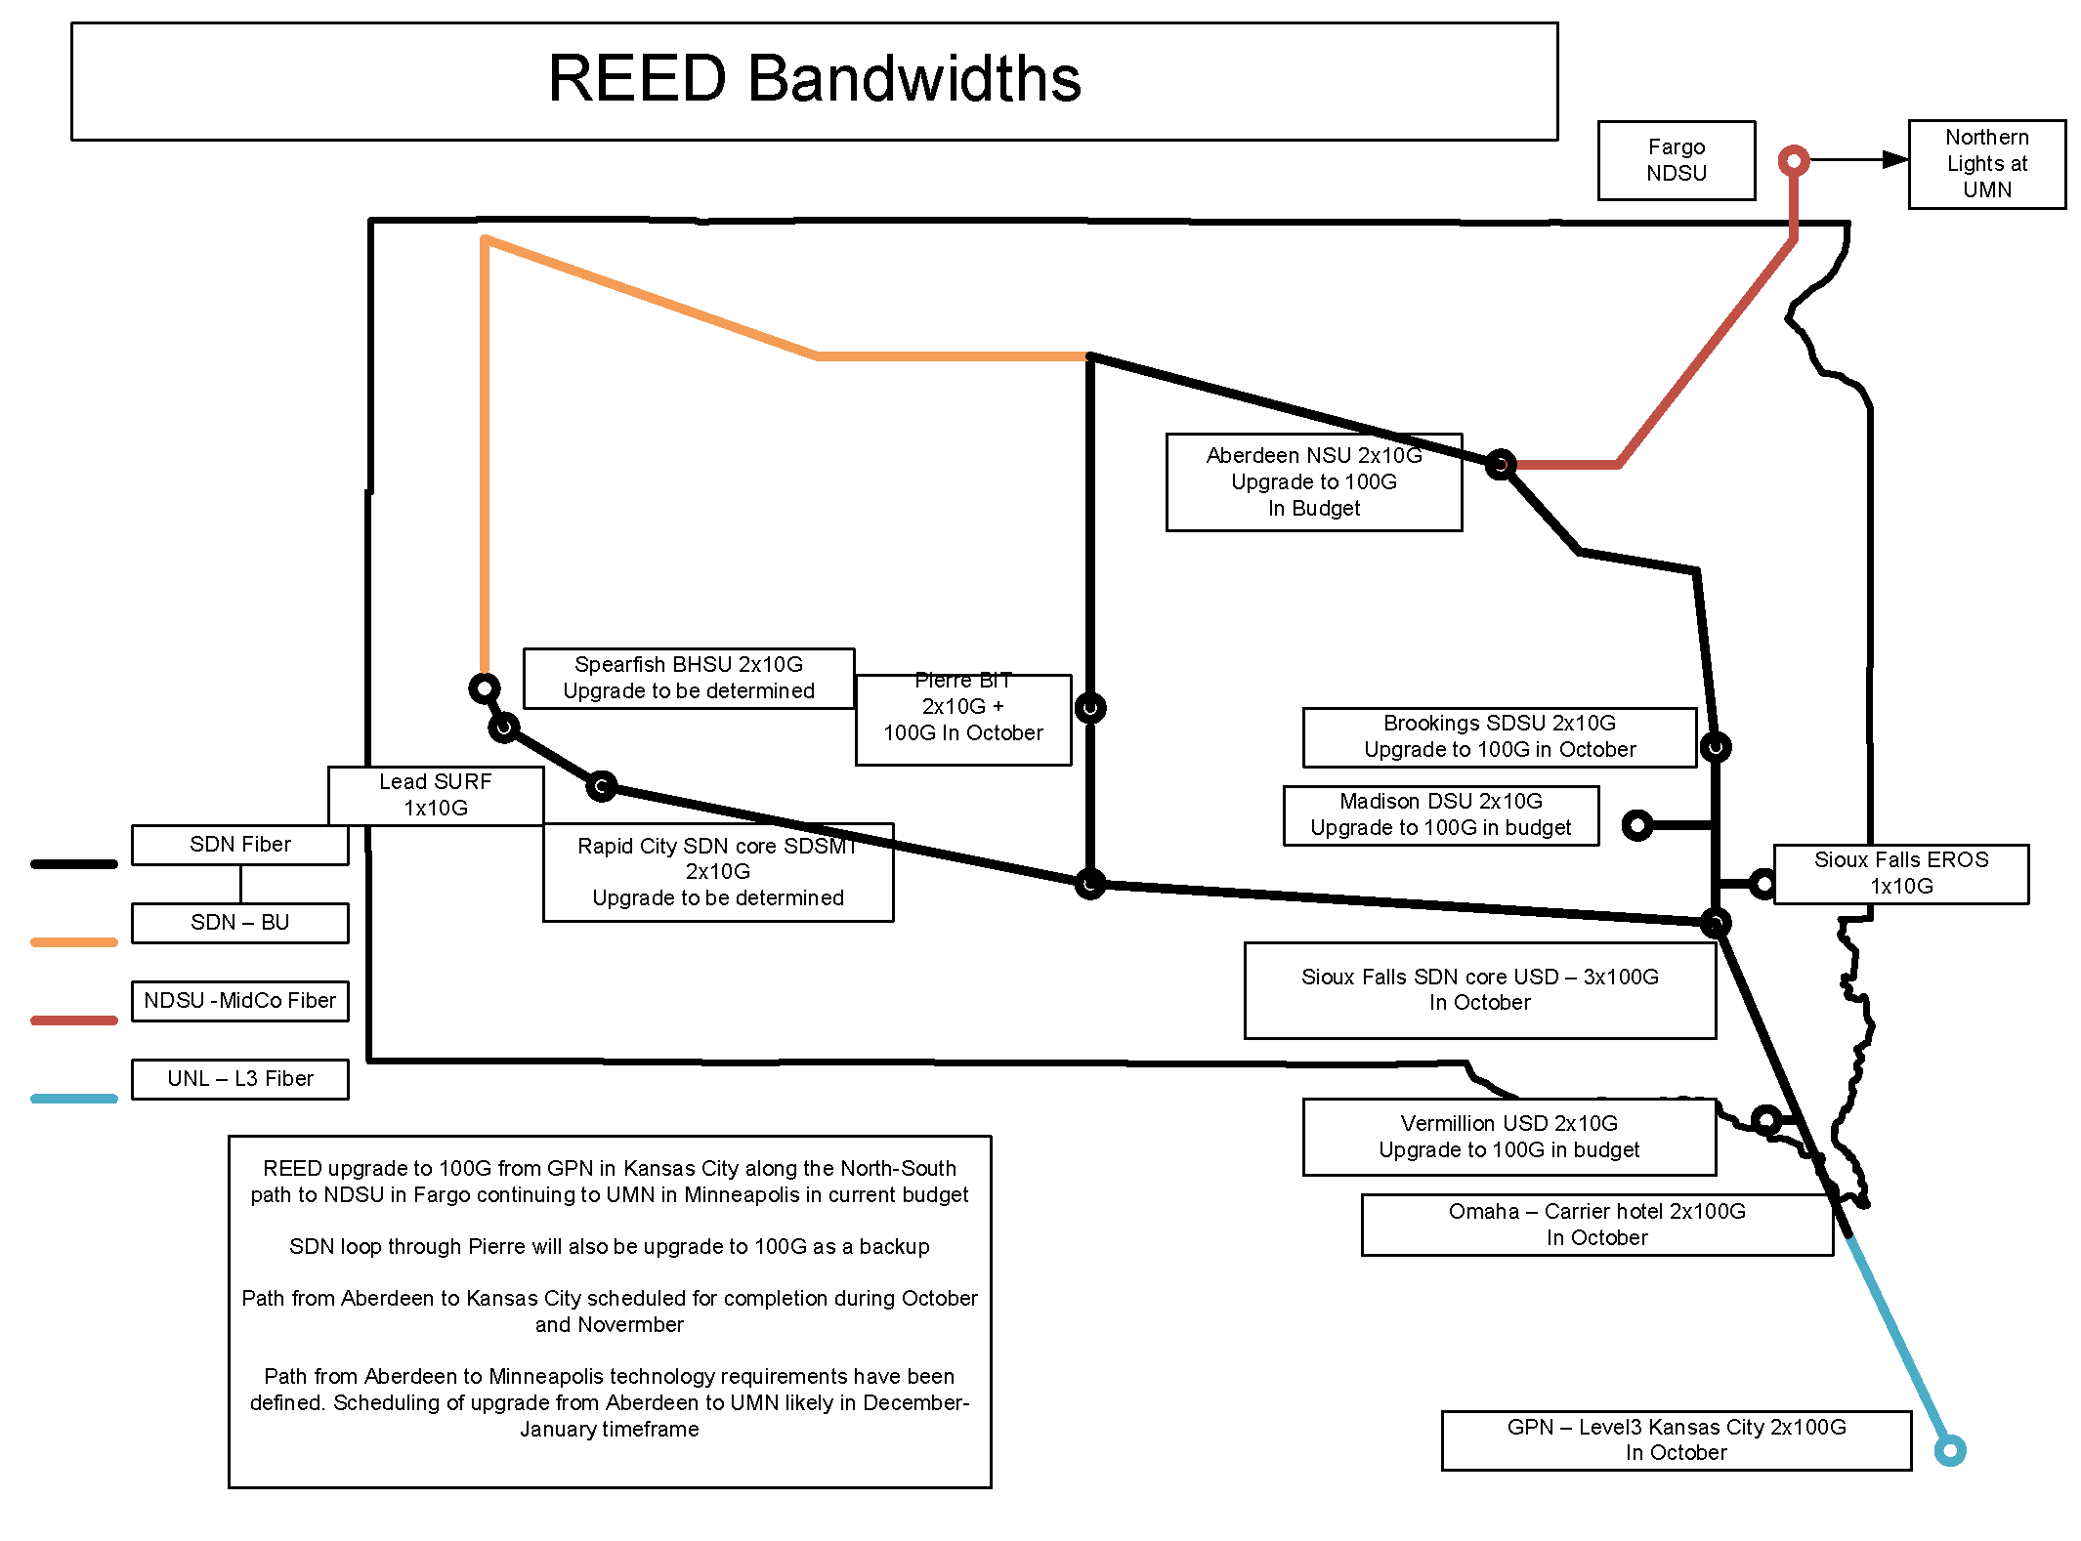
South Dakota Research Education & Economic Development (REED) network
100
100GE today
100GE planned
10GE-based
ESnet
(Minneapolis)
100
10
10
100
100
10
SURF
(DUNE)
100
100
X
10
100
100
ESnet
(Kansas City)

