Slide 1
Looking at CNN shower Tag vs Pandora shower Tag
Francesca Stocker
10.10.2019

Slide 2
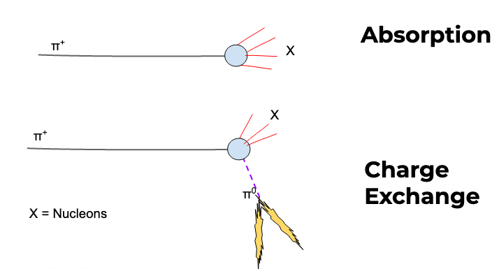
Context: Pion Charge Exchange and Absorption Channel
Primary Pion Inelastic interaction
Shower from Pi0
Pion Charge Exchange
Pion Absorption and Charge Exchange Events
No charged Pions
Pion Absorption
No Showers
Jake Calcutt:
https://indico.fnal.gov/event/21445/session/13/contribution/83/material/slides/0.pdf

Slide 3
Context: Pion Charge Exchange and Absorption Channel
Primary Pion Inelastic interaction
Shower from Pi0
Pion Charge Exchange
Pion Absorption and Charge Exchange Events
No charged Pions
Pion Absorption
No Showers
The correct identification of showers is important to separate the Absorption from the Charge Exchange Channel
Two options for showers:
Pandora Shower Tag
CNN track-like Score (Aidan Reynolds) https://indico.fnal.gov/event/20654/contribution/2/material/slides/0.pdf

Slide 4
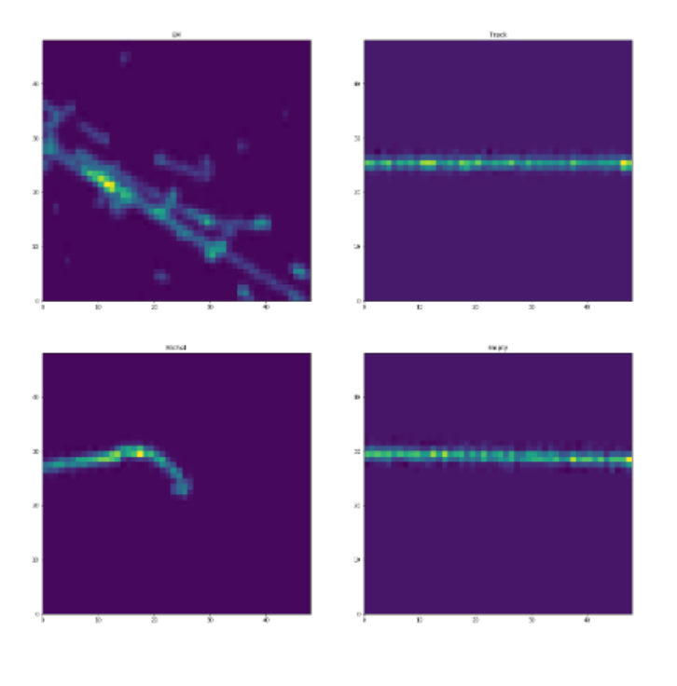
Pandora Shower Tag / CNN
Pandora Shower Tag: clustering, 2D then 3D tensor?
Haven’t found any slides with efficiencies on this, maybe someone can point me to it?
CNN: Initial goal use for calibration samples
Michel Electrons and delta ray removal for muon calibration
Takes 4 types of images for training EM, Track, Michel, Empty
Hit by hit track/shower separation
Trained on MCC11, SCE on, Fluid Flow on, All beam energies

Slide 5
Starting Point
Try to characterize how well the two work
For CNN: average over the hits in a reconstructed object to get a track-like Score (0,1)
I used MCC12 sample, 1GeV, sce-On and Jakes PionAnalyzer_MC module
True primary beam pion Inelastic interaction
Who of the daughter particles was tagged by Pandora as Shower?
What are the CNN track-like scores
True ChEx + Absorption Events
Separate two channels by shower tagging with Pandora or CNN get efficiencies and purities

Slide 6
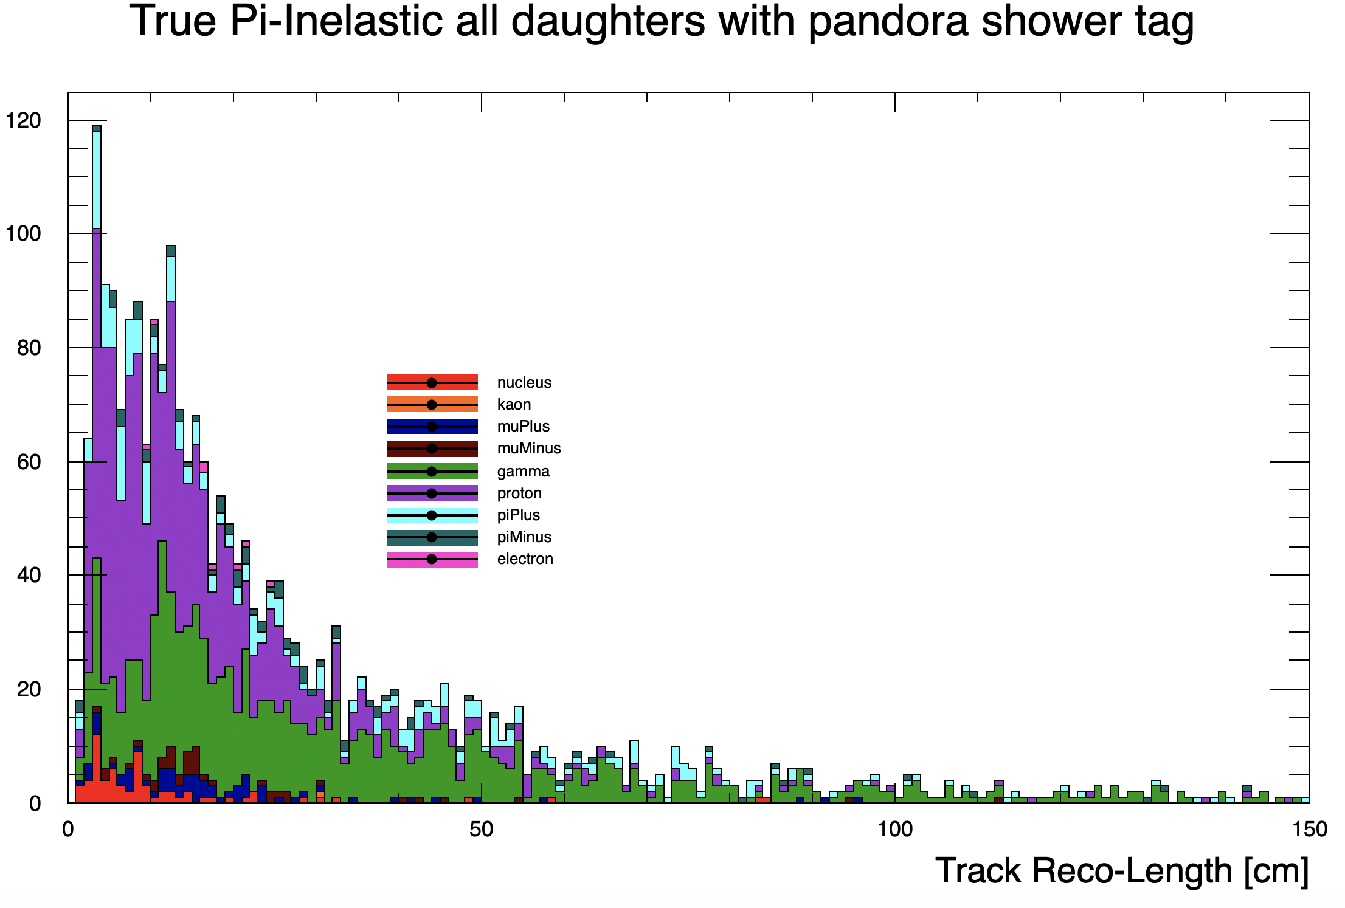
Pandora Shower Tag –who’s who
Many Protons are tagged as showers

Slide 7
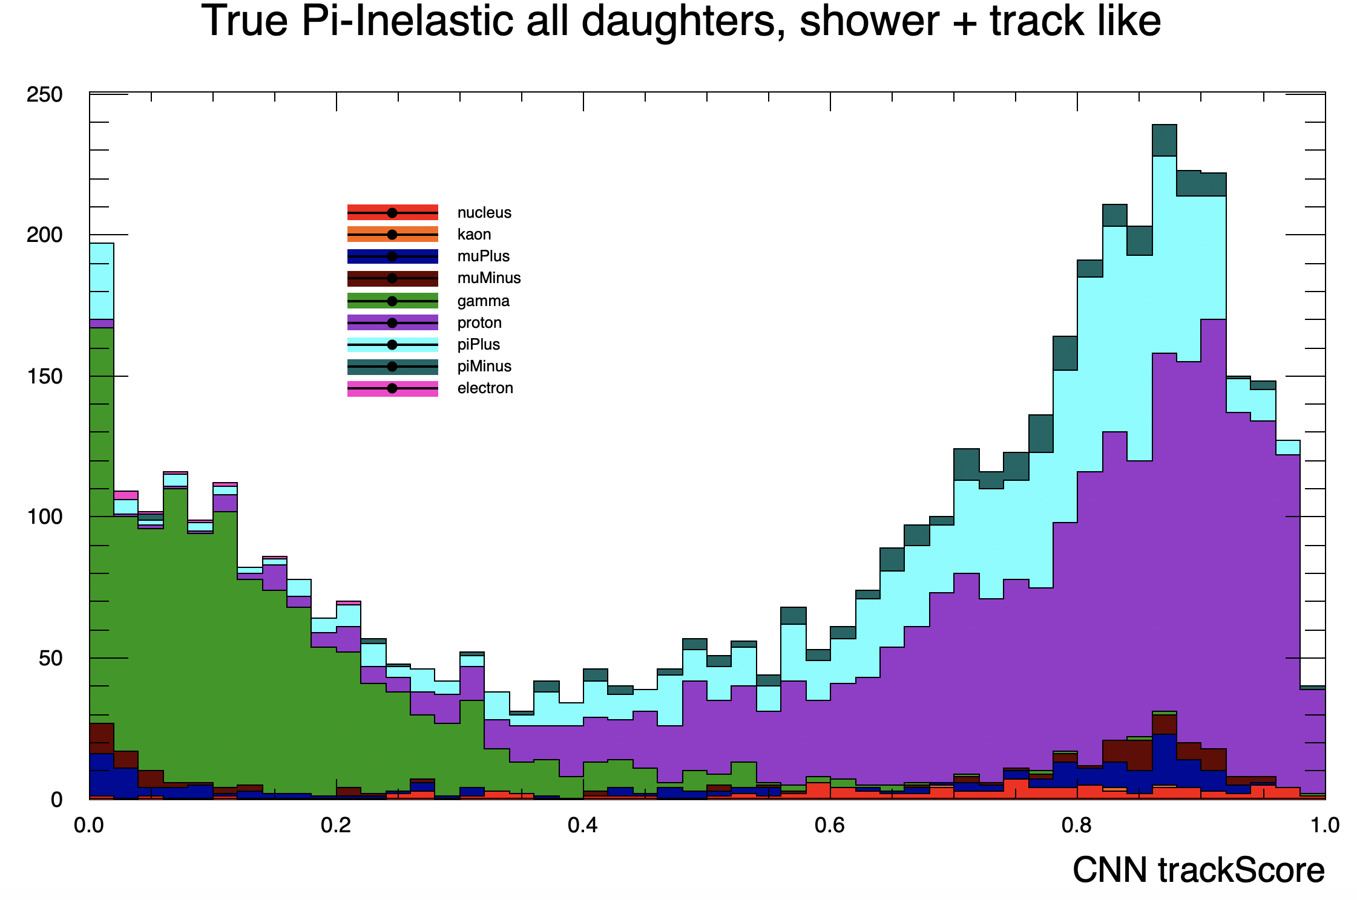
CNN track – score who’s who
Separation looks promising

Slide 8
From True ChEx + Abs Process use Shower Tag or CNN cut to separate channels
Efficiency_{Abs} = $\frac{{Match to True }_{Abs}}{{True }_{Abs}}$ Purity _{Abs} = $\frac{{Match to True }_{Abs}}{{Found }_{Abs}}$
 |  |  |  | True ChEx | True Abs
MC truth: ChEx + Abs | 1245 |  |  | 407 | 838
 | Found ChEx | Found Abs |  | Match to True ChEx | Match to True Abs |  | Efficiency ChEx | Purity ChEx | Efficiency Abs | Purity Abs
Pand Shower Tag | 679 | 544 |  | 359 | 505 |  | 0.88 | 0.53 | 0.60 | 0.93
CNN cut1 = 0.3 | 426 | 819 |  | 328 | 740 |  | 0.81 | 0.77 | 0.88 | 0.90
CNN cut2 = 0.35 | 440 | 805 |  | 337 | 735 |  | 0.83 | 0.77 | 0.88 | 0.91
CNN cut3 = 0.4 | 453 | 792 |  | 342 | 727 |  | 0.84 | 0.75 | 0.87 | 0.92
CNN cut4 = 0.45 | 472 | 773 |  | 345 | 711 |  | 0.85 | 0.73 | 0.85 | 0.92
CNN cut5 = 0.5 | 489 | 756 |  | 349 | 698 |  | 0.86 | 0.71 | 0.83 | 0.92

Slide 9
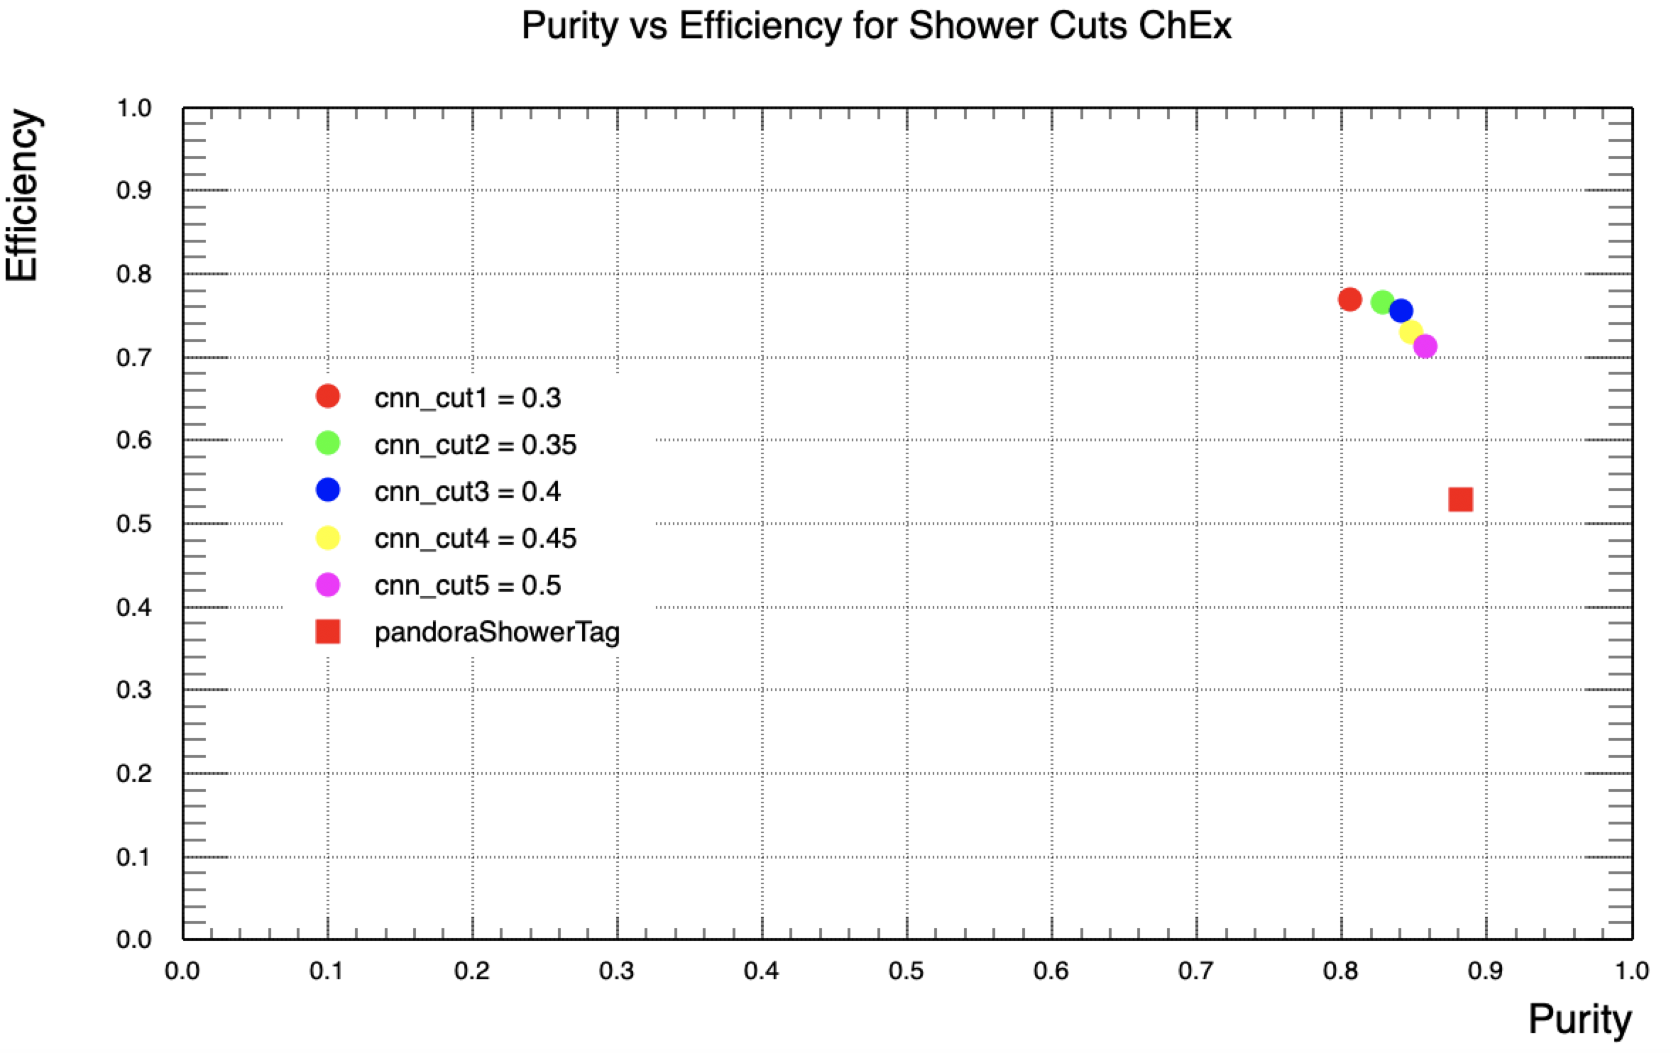

Slide 10
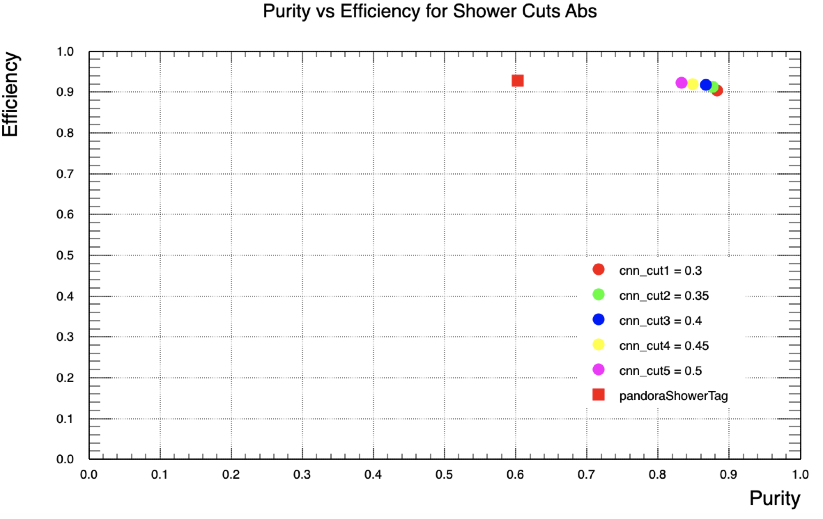

Slide 12
Pandora Tag works well for true Photons
Pandora Tag doesn’t work well for protons (~50% tagged as showers)
CNN seems to do a better job,
still 8% of the photons not shower tagged though
piPlus and Muons?

Slide 13
Conclusions
CNN looks more promising
3D graph-CNN done by Saul Monsalve and Leigh Whitehead (worth to look into those values? See how easy it is to get results from it.
https://indico.cern.ch/event/781262/contributions/3380328/attachments/1823851/2984124/ep-nu-sam-04-04-19.pdf
Why do Protons get CNN/shower Tag? How could this be worked around? Chi2? Cuts?
Go with CNN for shower tagging? What work/direction should be chosen to improve this?
Aidan: CNN was not trained with many protons
Train with more protons?
CNN was trained with MCC11 change and train with MCC12? Benefit? Workload?
Or work with the above mentioned 3D CNN? Easy/Quick?

Slide 14
OutLook
See if there are discriminative shower properties
Look at some failure event displays (photons/protons)

Slide 15
 |  |  |  | True ChEx | True Abs
MC truth: ChEx + Abs | 1245 |  |  | 407 | 838
 | Found ChEx | Found Abs |  | Match to True ChEx | Match to True Abs |  | Efficiency ChEx | Purity ChEx | Efficiency Abs | Purity Abs
Pand Shower Tag | 679 | 544 |  | 359 | 505 |  | 0.88 | 0.53 | 0.60 | 0.93
CNN cut1 = 0.3 | 426 | 819 |  | 328 | 740 |  | 0.81 | 0.77 | 0.88 | 0.90
CNN cut2 = 0.35 | 440 | 805 |  | 337 | 735 |  | 0.83 | 0.77 | 0.88 | 0.91
CNN cut3 = 0.4 | 453 | 792 |  | 342 | 727 |  | 0.84 | 0.75 | 0.87 | 0.92
CNN cut4 = 0.45 | 472 | 773 |  | 345 | 711 |  | 0.85 | 0.73 | 0.85 | 0.92
CNN cut5 = 0.5 | 489 | 756 |  | 349 | 698 |  | 0.86 | 0.71 | 0.83 | 0.92
Combined Cuts Pandora -> CNN
cut1 | 399 | 544 |  | 319 | 505 |  | 0.78 | 0.80 | 0.60 | 0.93
cut2 | 411 | 544 |  | 327 | 505 |  | 0.80 | 0.80 | 0.60 | 0.93
cut3 | 424 | 544 |  | 332 | 505 |  | 0.82 | 0.78 | 0.60 | 0.93
cut4 | 437 | 544 |  | 335 | 505 |  | 0.82 | 0.77 | 0.60 | 0.93
cut5 | 450 | 544 |  | 338 | 505 |  | 0.83 | 0.75 | 0.60 | 0.93
Combined Cuts CNN --> Pandora
cut1 | 404 | 522 |  | 322 | 489 |  | 0.79 | 0.80 | 0.58 | 0.94
cut2 | 416 | 520 |  | 330 | 488 |  | 0.81 | 0.79 | 0.58 | 0.94
cut3 | 429 | 520 |  | 335 | 488 |  | 0.82 | 0.78 | 0.58 | 0.94
cut4 | 444 | 516 |  | 335 | 488 |  | 0.82 | 0.75 | 0.58 | 0.95
cut5 | 460 | 515 |  | 341 | 484 |  | 0.84 | 0.74 | 0.58 | 0.94

