Slide 1


Magnets 302.2.02 and 03 –
Strand Procurement and Testing
Cable Fabrication
Lance Cooley – NHMFL/ASC (302.2.02 L3)
Vito Lombardo – FNAL (302.2.02 CAM)
Ian Pong – LBNL (302.2.03 L3 and CAM)

Slide 2
Outline
Cable Summary
Wire Summary
Cable and Wire Details for Coil
  Date and Lengths
  Strand and SS Core ID
  Respooling Wire Diameter
  Cable Mechanical QC
  Braiding Details
  Wire Parameters
    Extracted Strand RRR and Witness I_{C} and RRR
  SSL
Summary

Slide 3
Cable Summary
Coils used:
  203, 206, 112, 113, 115 (spare)
Corresponding cables:
  P43OL1096, P43OL1103, P43OL1100, P43OL1094, P43OL1102 (spare)
All cables are 2nd generation QXF cables with 108/127 RRP® strands procured under LARP
4 AUP cables, 1 LARP cable

Slide 4
Wire Summary
All “HiLumi” spec, procured by LARP under:
  FNAL 632982 B – Spec 0
  FNAL 632982 C – Spec 0
  FNAL 632982 D – Spec 0
0.85 mm, Ti-doped, reduced Sn
Procurement specification was US-HiLumi-Doc-40, modification to HT was applied to PO 632982, changing the final stage from 665°C for 75 h to 665°C for 50 h.
Total volume under FNAL PO 632982 is 400 km

Slide 5
Billets in the LARP production run
331 A
314 A
Supplier is conservative by 2.1% after accounting for heat treatment
2.1% is comparable to the inter-lab test uncertainty (1.6 % in 2015) and past BNL-OST comparison (3% primarily due to strain).

Slide 6
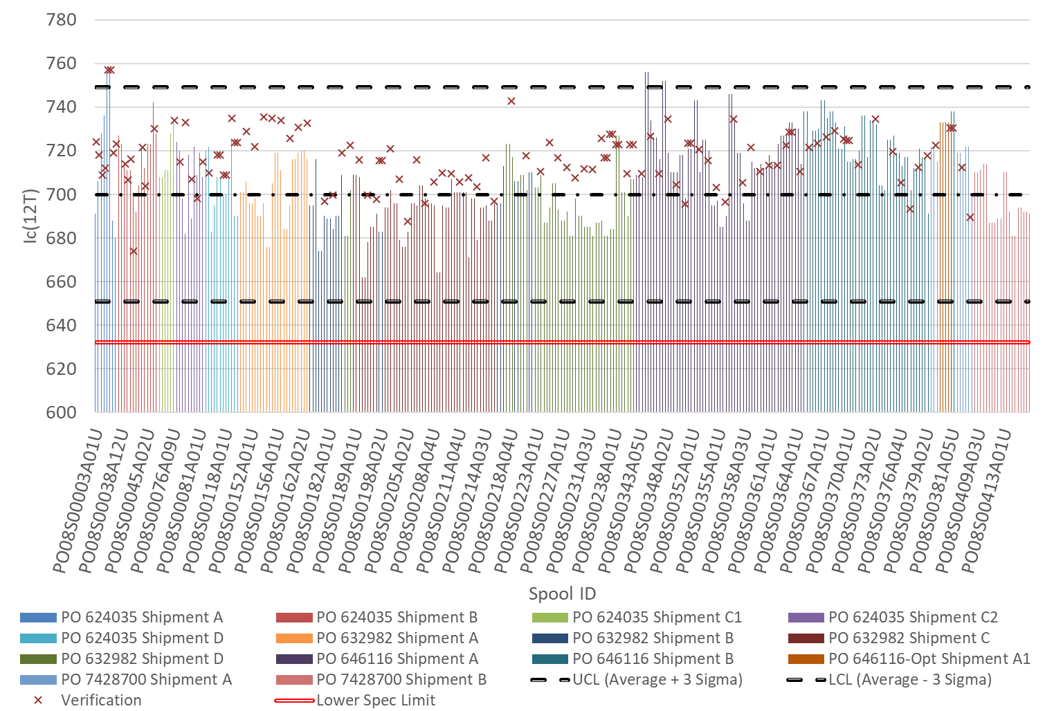
Ic@12T
3-sigma (99.7%) SPC upper
X = verification test
3-sigma (0.3%) SPC lower
SPEC
115
203
113
112
113
206
206

Slide 7
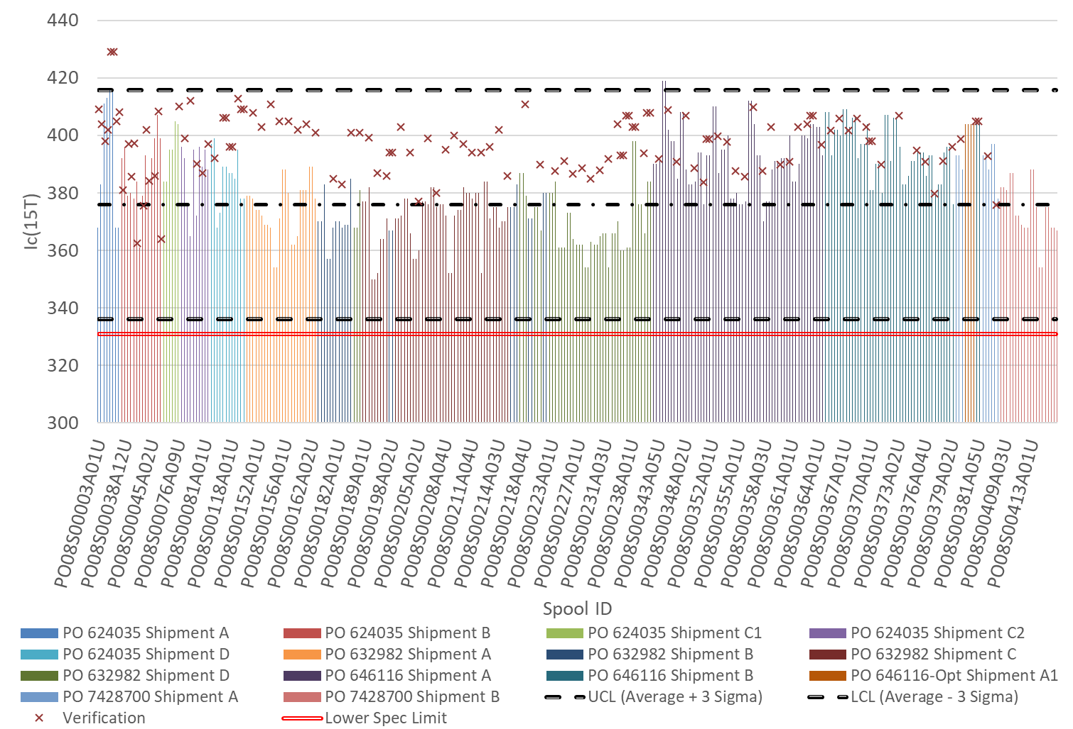
Ic@15T
3-sigma (99.7%) SPC upper
X = verification test
3-sigma (0.3%) SPC lower
SPEC
115
203
113
112
113
206
206

Slide 8
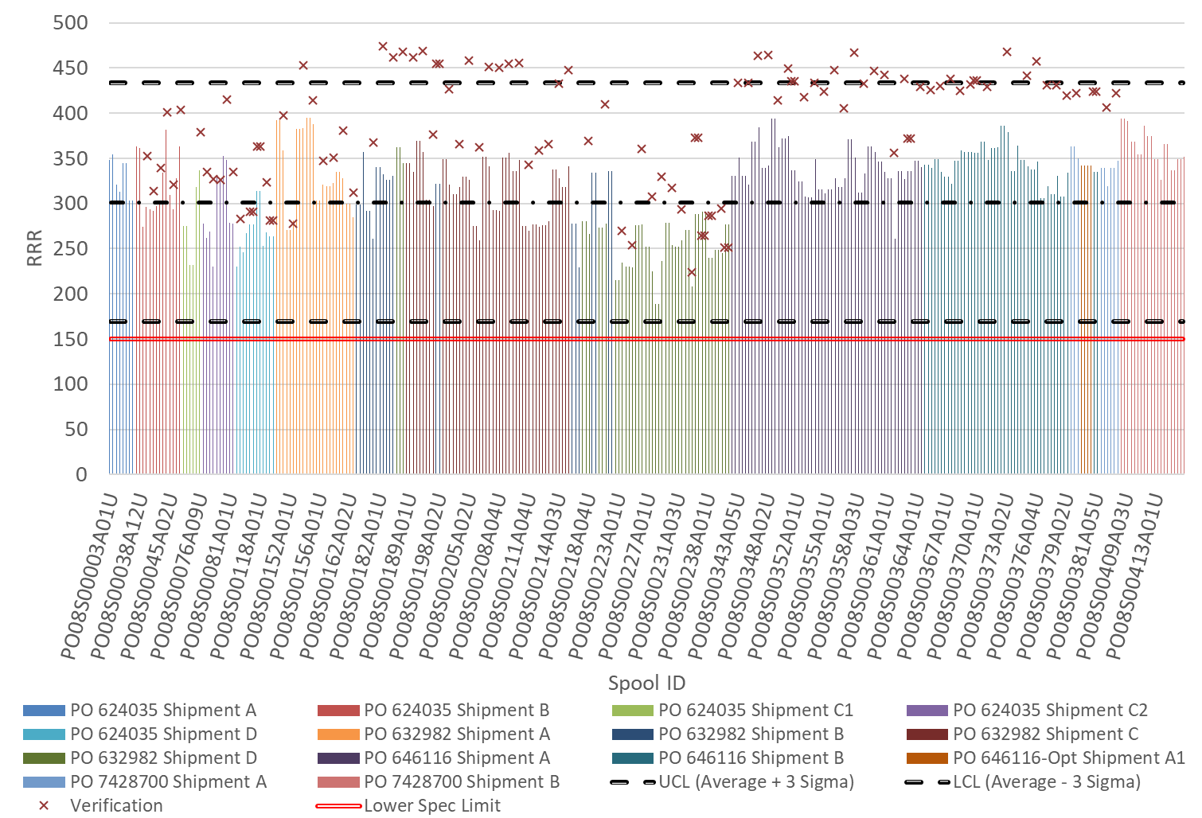
3-sigma (99.7%) SPC upper
3-sigma (0.3%) SPC lower
SPEC
RRR Round wire
115
X = verification test
203
113
112
113
206
206

Slide 9
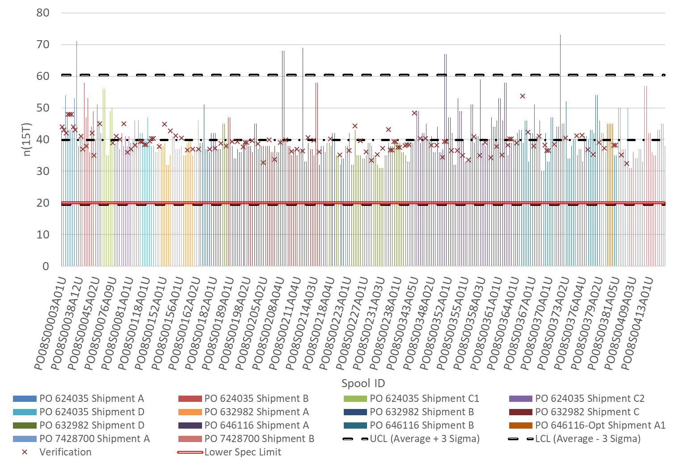
N-value at 15 T
X = verification test
3-sigma (99.7%) SPC upper
3-sigma (0.3%) SPC lower
SPEC
115
203
113
112
113
206
206

Slide 10
Strand Procured by LARP and Supplier’s QC
A change of the heat treatment was approved in 2017 → shift in data
Final step from 665C 75hr to 665C 50hr
  4.9% reduction in I_{c}(15 T) for 14.7% gain in RRR (15% rolled)
Verification testing did not receive HT change notice in time
Round
Rolled
314 A
331 A

Slide 11
Billets in the LARP production run
PO624035
PO632982
AUP
A
B
C
D
Due to HT
Due to Test
Spec (round)
331 A
314 A
Spec (15% rolled)
Supplier is conservative by 2.1% after accounting for heat treatment
2.1% is comparable to the inter-lab test uncertainty (1.6 % in 2015) and past BNL-OST comparison (3% primarily due to strain).

Slide 12
QXFA-203 / P43OL1096

Slide 13
P43OL1096 – Cable Date, Lengths
Cable Manufacture Date
  2018 02 06 (Production run)
Cable Length:
  465 m (LBNL, fabricated, including LBNL samples)
  ### m (Measured by FNAL)

Slide 14
P43OL1096 – Strand and SS Core ID
Spool:
  PO08S00182A03U x 8 ULs
  PO08S00183A04U x 10 ULs
  PO08S00183A03U x 7 ULs
  PO08S00182A01U x 4 ULs
  PO08S00217A06U x 3 ULs
  PO08S00217A07U x 3 ULs
  PO08S00182A04U x 2 ULs
  PO08S00179A03U x 1 ULs
  PO08S00217A02U x 1 ULs
  PO08S00217A04U x 1 ULs
Core:
  120L49A7322313
    Core width: 12.0 mm; material: 316L;
    Heat: 844979; Lot: 16-597;
    Chemical Properties CoT/CoC 172660-1: 0.14 wt% Co
From 4 billets

Slide 15
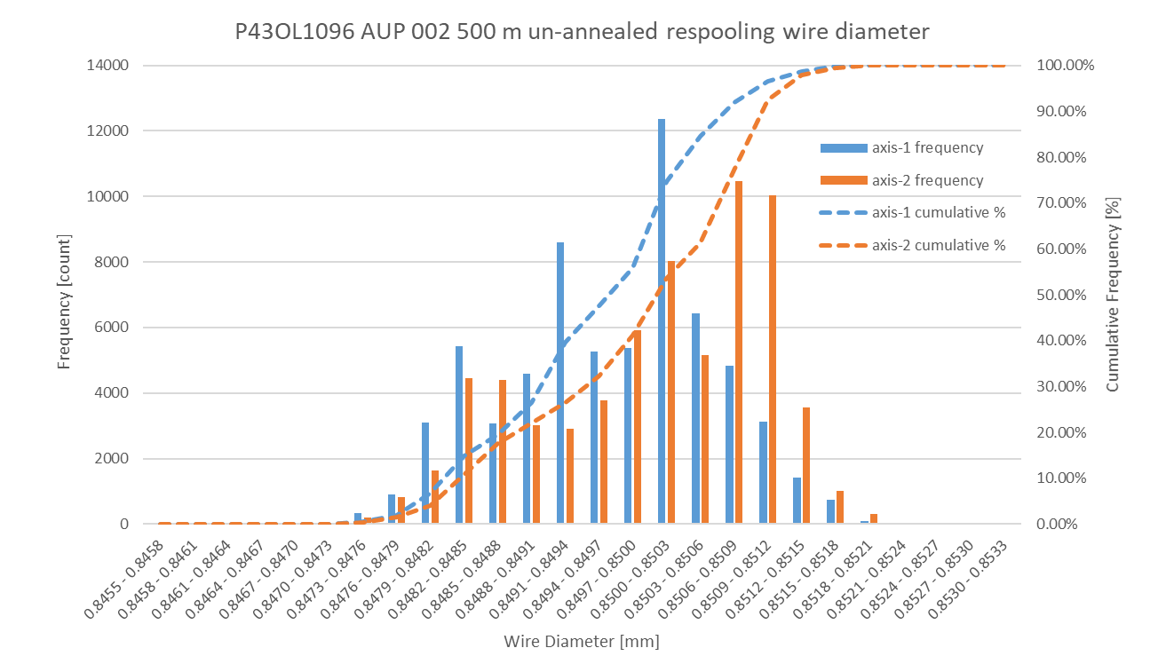
P43OL1096 Respooling Wire Diameter
Below LSL: 0.01%
Above USL: 0.00%

Slide 16
P43OL1096 – Cable QC Data Summary
CME:
Residual Twist:
  115°
10-stack:
  Qualification: 1.530 mm
  Production tail end: 1.525 mm
 | Pressure (MPa) | Angle (°) | Width (mm) | Thickness (mm)
Maximum | 17.1 | 0.455 | 18.158 | 1.530
Average | 17.0 | 0.434 | 18.144 | 1.524
Minimum | 17.0 | 0.412 | 18.139 | 1.519
Sigma | 0.01 | 0.007 | 0.003 | 0.002

Slide 17
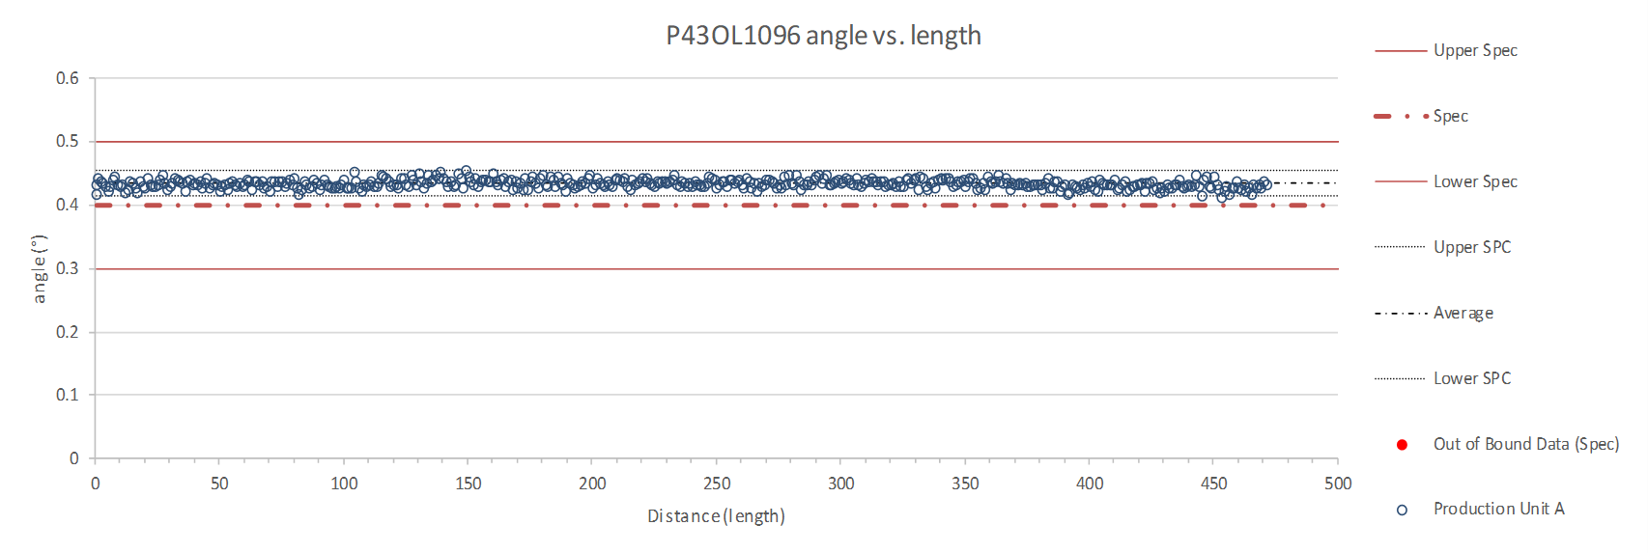
Rollers: P-91 (2017-12-08) and P-92 (2017-12-08)

Slide 18
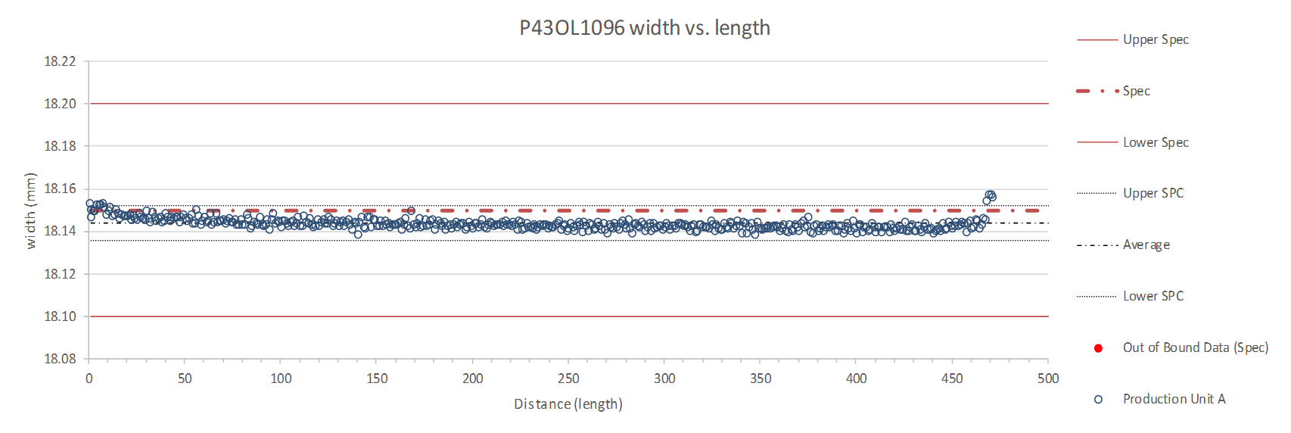
Rollers: P-91 (2017-12-08) and P-92 (2017-12-08)

Slide 19
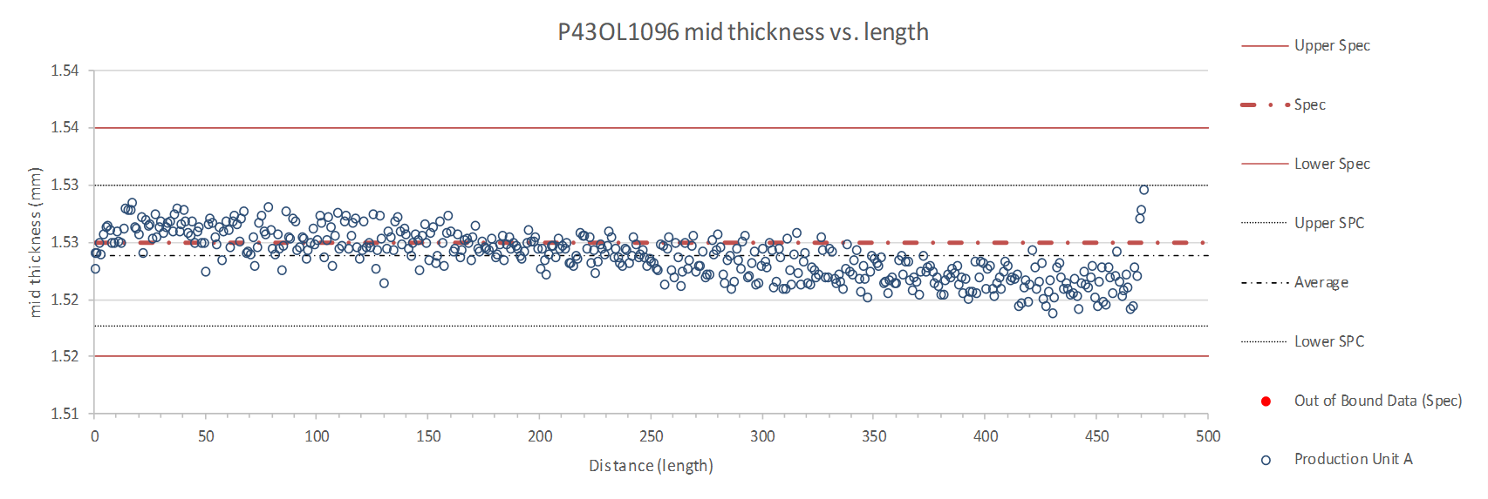
Rollers: P-91 (2017-12-08) and P-92 (2017-12-08)

Slide 20
P43OL1096 – Braiding
Fiberglass Lot #91309 & 100104
P/I: 18.0
Spool tension: 10 lbs. (payoff); 12 lbs. (takeup)
Bobbin payoff tension: 0.125 lbs. (min), 0.250 lbs. (max)
NEWT 10-stack QC:
  Cycle #1) 0.149 mm; #2) 0.146 mm; #3) 0.144 mm;
  Mean 0.147 mm
LBNL 10-stack verification QC:
  Cycle #1) 0.153 mm; #2) 0.148 mm; #3) 0.147 mm;
  Mean 0.149 mm
Vector #464342

Slide 21
P43OL1096 – Wire Parameters
Properties | Inspected Average
Wire Diameter | 0.850 ± 0.001 mm (LBNL)¹
Cu ratio ª | 53.8% (OST)
Strand twist pitch ª | 18.3 mm (OST)
RRR (RW) ª | 315 (OST)
RRR (15% rolled) ª | 236 (OST)
I_{C} (4.2 K, 15 T) ª | 370 A (OST)
I_{C} (4.2 K, 14 T) ª | 463 A (OST)
I_{C} (4.2 K, 13 T) ª | 570 A (OST)
I_{C} (4.2 K, 12 T) ª | 690 A (OST)
ª First billet averaged, then weighted average according
to the spool distribution in the cable
¹ As-received, all LBNL respooling data; mean ± 1 sigma

Slide 22
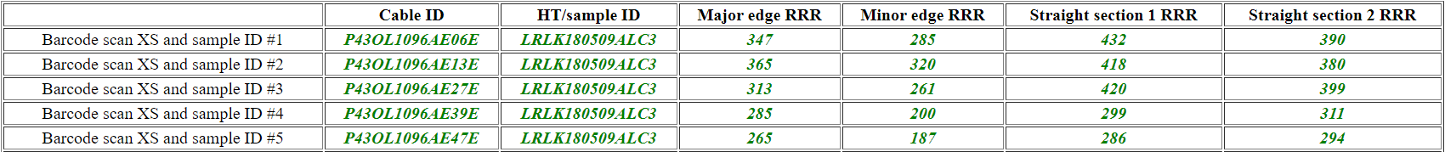
P43OL1096 – Extracted Strand RRR
Vector #464342

Slide 23
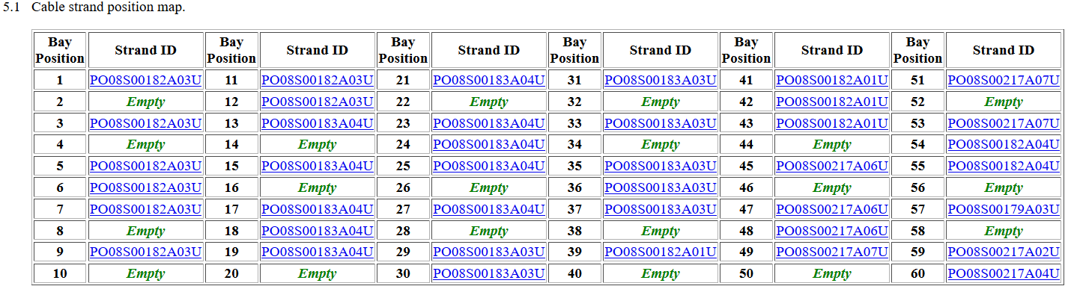
QXFA-CL-203 Cable P43OL1096
Witness extracted strand (XS)
Witness virgin strand (VS)
Tests of backup samples were required to fulfill witness sample testing requirements
  Unstable tests are shaded above

Slide 24
Coil QXFA203, cable 1096 – Witness samples
ID | RRR (293K / 20K) XS > 100 RW > 150 | Ic(12T) XS > 600 RW > 632 | Ic(13T) | Ic(14T) | Ic(15T) XS > 314 RW > 331
PO08S00183A04U | 329 | 695Q | 577Q | 471Q | 380Q
PO08S00182A03U | 327 | 711Q | 608 | 501 | 405
P43OL1096AE42E | 317 | Q | Q | 398Q | 320Q
P43OL1096AE39E | 290 | 607Q | 542Q | 462 | 369
P43OL1096AE13E | 320 | 571Q | 502Q | 452Q | 366Q
P43OL1096AE33E | 325 | 694 | 578 | 478 | 384
nnnQ denotes a critical current measurement that showed a transition but quenched before the criterion was reached
Q denotes a critical current measurement that did not show a transition before quenching

Slide 25
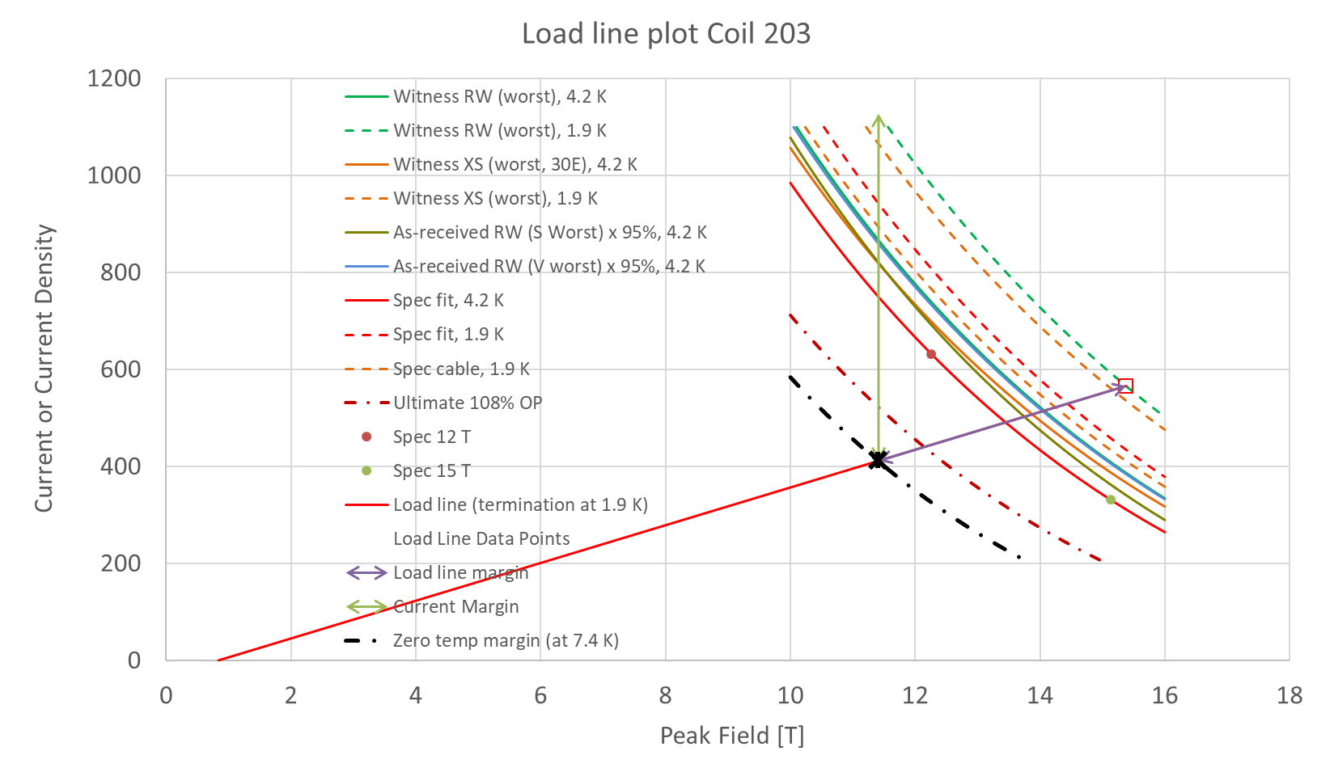
Coil 203 SSL
Margins | Margin | Operating Point (X)
Load line margin (purple arrow) | 27.3% | 72.8%
Current margin (green arrow) | 63.5% | 36.5%
Temperature margin [K] | 5.5 | 7.4

Slide 26
QXFA-206 / P43OL1103

Slide 27
P43OL1103 – Cable Date, Lengths
Cable Manufacture Date
  2018 05 29 (Production run)
Cable Length:
  470 m (LBNL, fabricated, including LBNL samples)
  ### m (Measured by FNAL)

Slide 28
P43OL1103 – Strand and SS Core ID
Spool:
  PO08S00218A01U x 5 ULs
  PO08S00224A03U x 4 ULs
  PO08S00224A05U x 1 ULs
  PO08S00225A06U x 1 ULs
  PO08S00227A01U x 4 ULs
  PO08S00227A02U x 3 ULs
  PO08S00229A02U x 5 ULs
  PO08S00238A01U x 17 ULs
Core:
  120L42A7322313
    Core width: 12.0 mm; material: 316L;
    Heat: 844979; Lot: 16-597;
    Chemical Properties CoT/CoC 172660-1: 0.14 wt% Co
From 6 billets

Slide 29
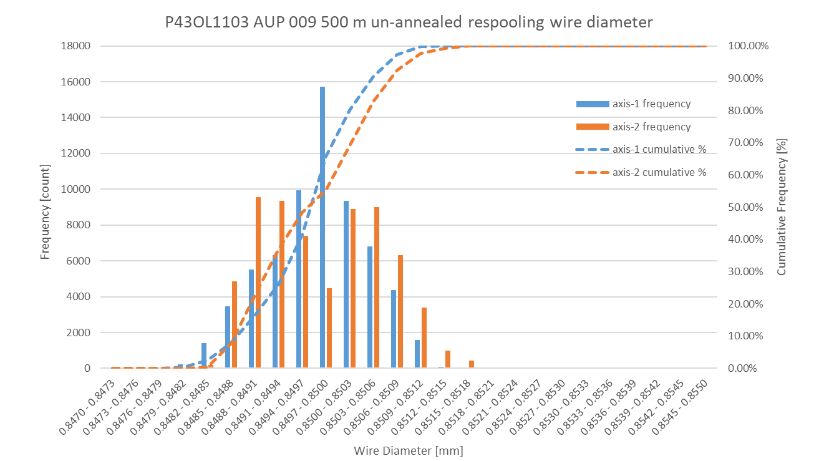
P43OL1103 Respooling Wire Diameter
Below LSL: 0.00%
Above USL: 0.00%

Slide 30
P43OL1103 – Cable QC Data Summary
CME:
Residual Twist:
  120°
10-stack:
  Qualification: 1.527 mm
  Production tail end: 1.528 mm
 | Pressure (MPa) | Angle (°) | Width (mm) | Thickness (mm)
Maximum | 17.0 | 0.442 | 18.163 | 1.530
Average | 17.0 | 0.414 | 18.151 | 1.524
Minimum | 17.0 | 0.382 | 18.143 | 1.519
Sigma | 0.01 | 0.009 | 0.003 | 0.002

Slide 31
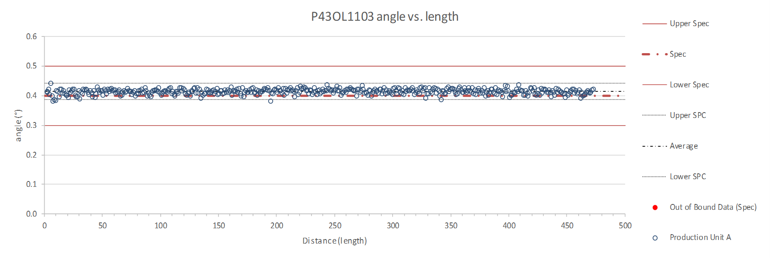
Rollers: P-91 (2017-12-08) and P-92 (2017-12-08)

Slide 32
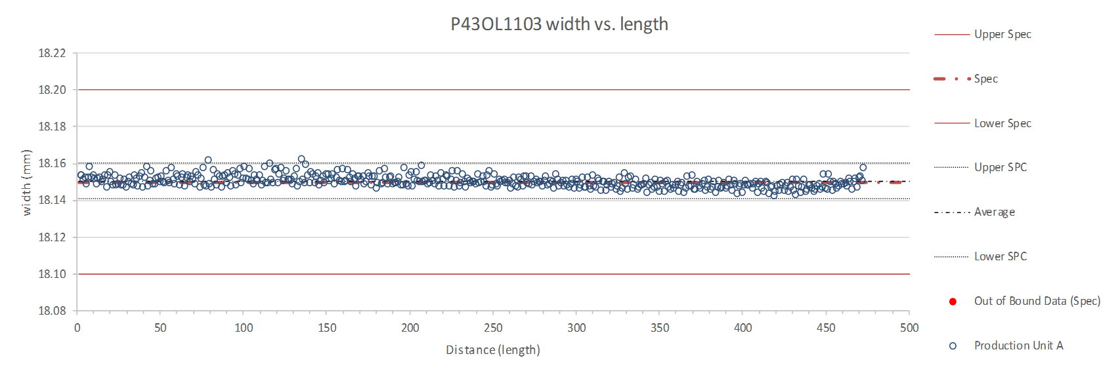
Rollers: P-91 (2017-12-08) and P-92 (2017-12-08)

Slide 33
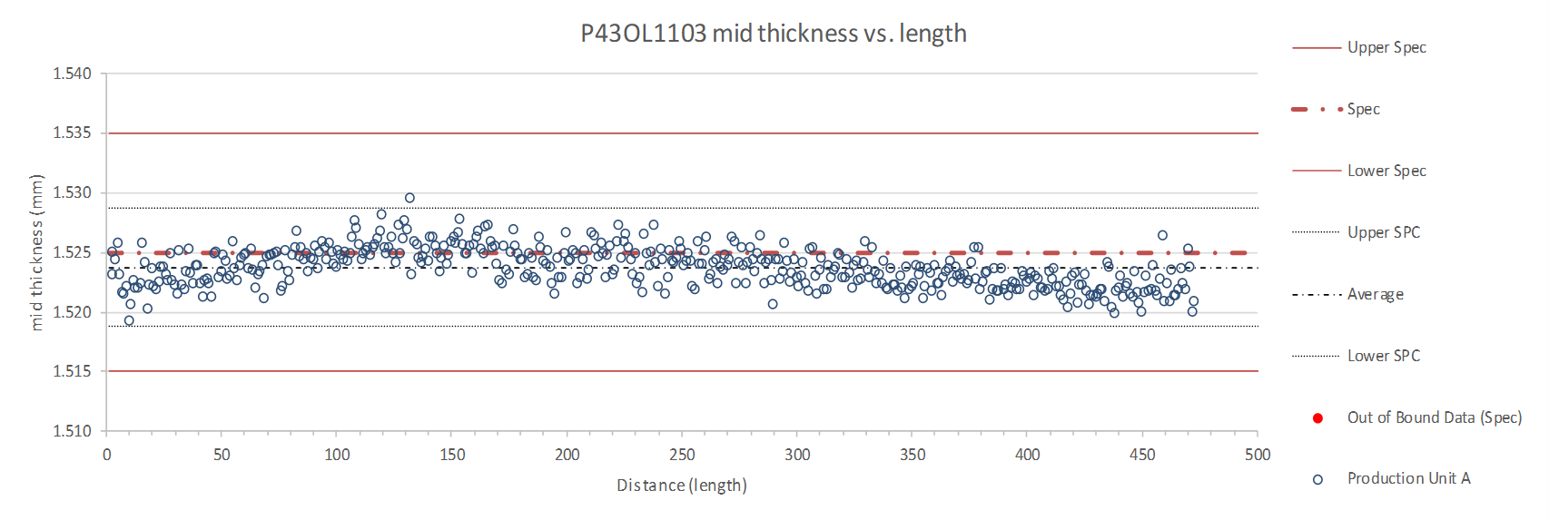
Rollers: P-91 (2017-12-08) and P-92 (2017-12-08)

Slide 34
P43OL1103 – Braiding
Fiberglass Lot #100415
P/I: 18.0
Spool tension: 10 lbs. (payoff); 20 lbs. (takeup)
Bobbin payoff tension: 0.125 lbs. (min), 0.250 lbs. (max)
NEWT 10-stack QC:
  Cycle #1) 0.149 mm; #2) 0.147 mm; #3) 0.145 mm;
  Mean 0.147 mm
LBNL 10-stack verification QC:
  Cycle #1) 0.145 mm; #2) 0.142 mm; #3) 0.140 mm;
  Mean 0.143 mm
Vector #464342

Slide 35
P43OL1103 – Wire Parameters
Properties | Inspected Average
Wire Diameter | 0.850 ± 0.001 mm (LBNL)¹
Cu ratio ª | 54.7% (OST)
Strand twist pitch ª | 18.8 mm (OST)
RRR (RW) ª | 242 (OST)
RRR (15% rolled) ª | 147 (OST)
I_{C} (4.2 K, 15 T) ª | 375 A (OST)
I_{C} (4.2 K, 14 T) ª | 472 A (OST)
I_{C} (4.2 K, 13 T) ª | 581 A (OST)
I_{C} (4.2 K, 12 T) ª | 705 A (OST)
ª First billet averaged, then weighted average according
to the spool distribution in the cable
¹ As-received, all LBNL respooling data; mean ± 1 sigma

Slide 36
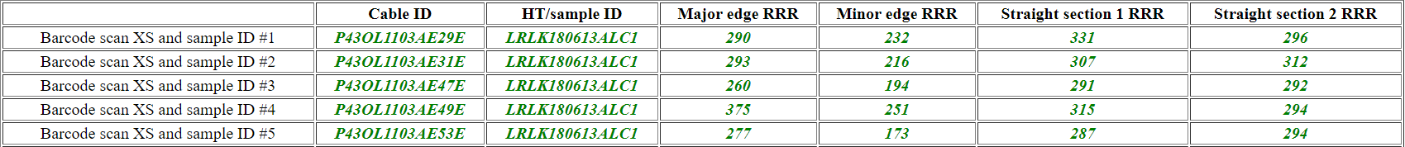
P43OL1103 – Extracted Strand RRR
Vector #464342

Slide 37
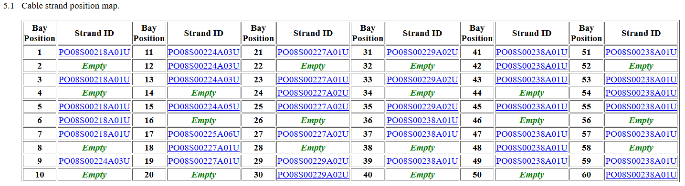
QXFA-CL-206 Cable P43OL1103
Witness extracted strand (XS)
Witness virgin strand (VS)
NO tests of backup samples were required to fulfill witness sample testing requirements
  Unstable tests are shaded above

Slide 38
Coil QXFA206, cable 1103 – Witness samples
ID | RRR (293K / 20K) XS > 100 RW > 150 | Ic(12T) XS > 600 RW > 632 | Ic(13T) | Ic(14T) | Ic(15T) XS > 314 RW > 331
PO08S00238A01U | 286 | 646 | 518 | 415 | 326
PO08S00229A02U | 304
P43OL1103AE29E | 236
P43OL1103AE31E | 241
P43OL1103AE47E | 204 | 693 | 573 | 477 | 387
P43OL1103AE53E | 217 | 687 | 569 | 464 | 369
nnnQ denotes a critical current measurement that showed a transition but quenched before the criterion was reached
Q denotes a critical current measurement that did not show a transition before quenching

Slide 39
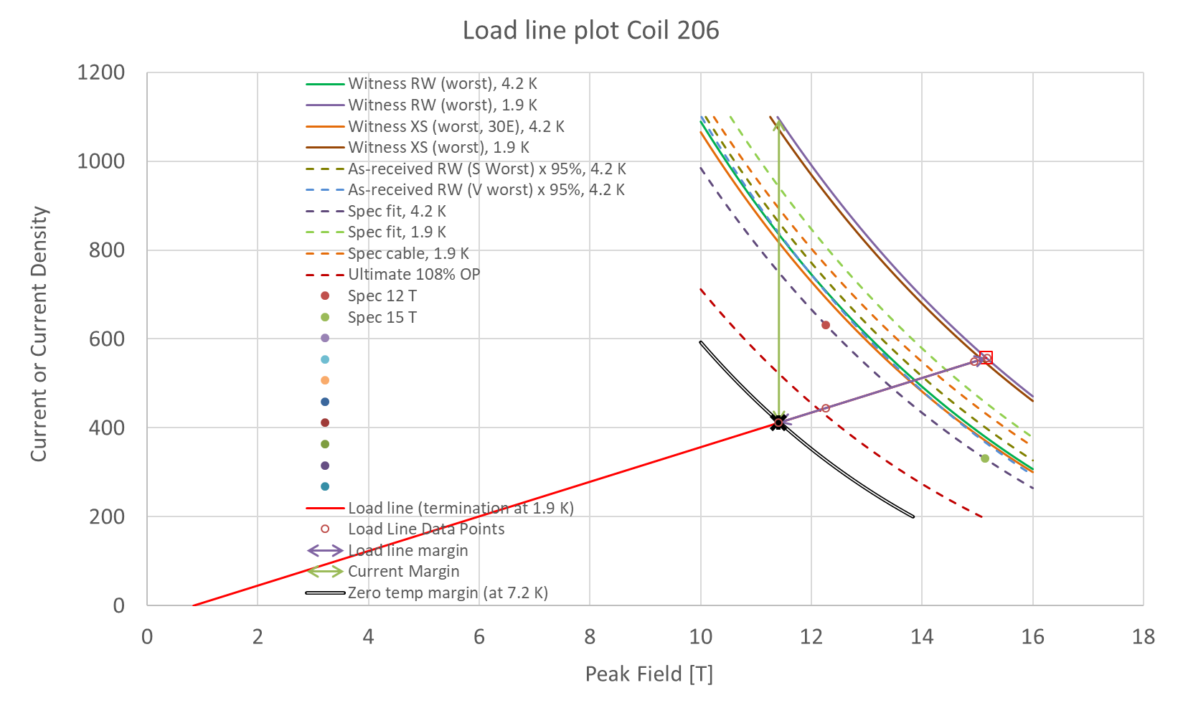
Coil 206 SSL
Margins | Margin | Operating Point (X)
Load line margin (purple arrow) | 26.2% | 73.9%
Current margin (green arrow) | 62.4% | 37.6%
Temperature margin [K] | 5.3 | 7.2

Slide 40
QXFA-112 / P43OL1100

Slide 41
P43OL1100 – Cable Date, Lengths
Cable Manufacture Date
  2018 03 30 (Production run)
Cable Length:
  464 m (LBNL, fabricated, including LBNL samples)
  449 m (Measured by FNAL)

Slide 42
P43OL1100 – Strand and SS Core ID
Spool:
  PO08S00205A02U x 8 ULs
  PO08S00213A02U x 8 ULs
  PO08S00208A04U x 13 ULs
  PO08S00213A05U x 5 ULs
  PO08S00217A05U x 5 ULs
  PO08S00214A01U x 1 ULs
Core:
  120L45A7322313
    Core width: 12.0 mm; material: 316L;
    Heat: 844979; Lot: 16-597;
    Chemical Properties CoT/CoC 172660-1: 0.14 wt% Co
From 5 billets

Slide 43
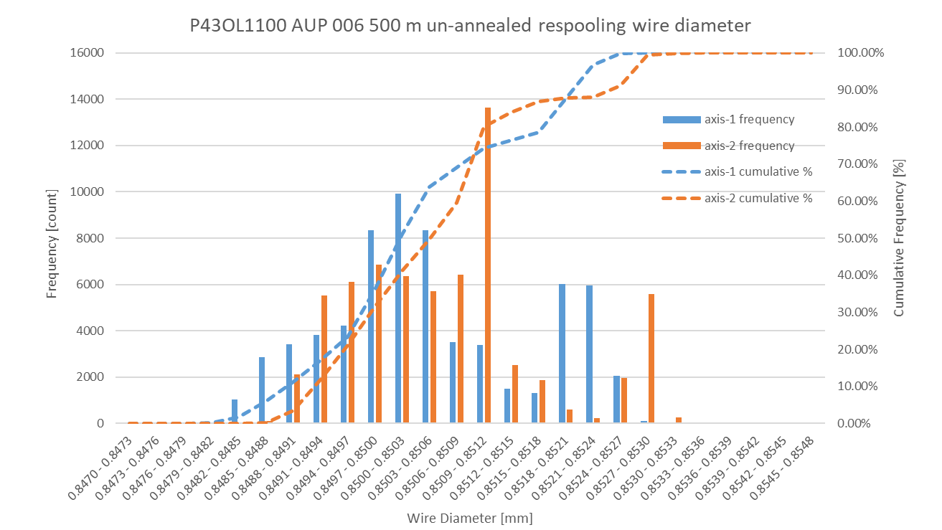
P43OL1100 Respooling Wire Diameter
Below LSL: 0.00%
Above USL: 0.05%

Slide 44
P43OL1100 – Cable QC Data Summary
CME:
Residual Twist:
  109°
10-stack:
  Qualification: 1.536 mm
  Production tail end: 1.533 mm
 | Pressure (MPa) | Angle (°) | Width (mm) | Thickness (mm)
Maximum | 17.1 | 0.423 | 18.181 | 1.532
Average | 17.0 | 0.405 | 18.164 | 1.527
Minimum | 17.0 | 0.382 | 18.151 | 1.522
Sigma | 0.01 | 0.006 | 0.006 | 0.002

Slide 45
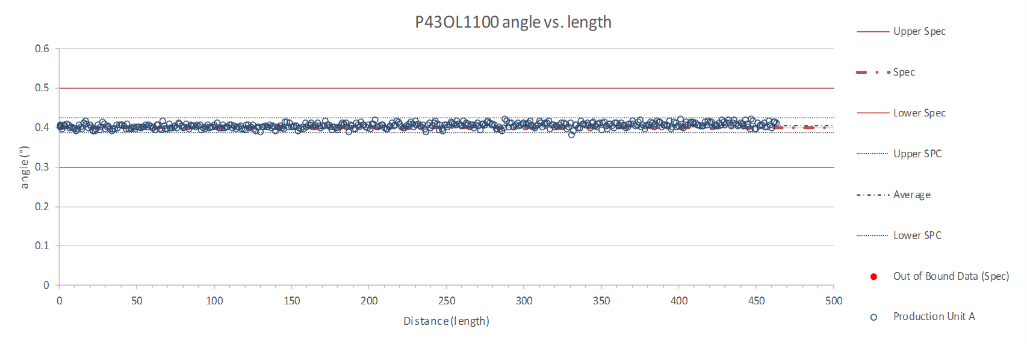
Rollers: P-91 (2017-12-08) and P-92 (2017-12-08)

Slide 46
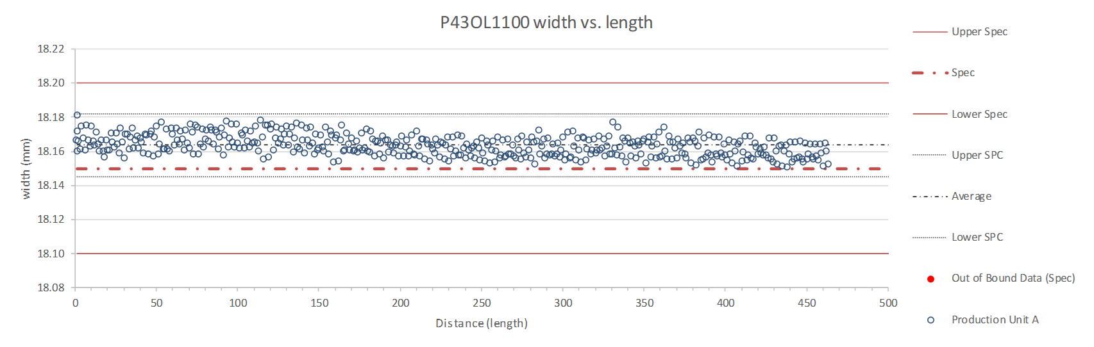
Rollers: P-91 (2017-12-08) and P-92 (2017-12-08)

Slide 47
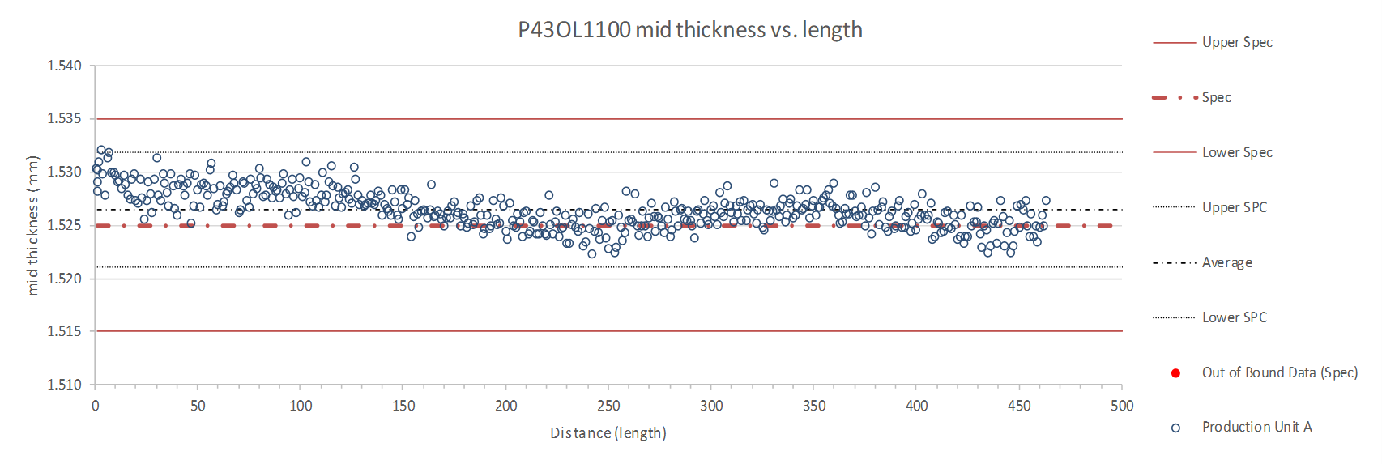
Rollers: P-91 (2017-12-08) and P-92 (2017-12-08)

Slide 48
P43OL1100 – Braiding
Fiberglass Lot #100415
P/I: 18.9
Spool tension: 10 lbs. (payoff); 12 lbs. (takeup)
Bobbin payoff tension: 0.125 lbs. (min), 0.250 lbs. (max)
NEWT 10-stack QC:
  Cycle #1) 0.150 mm; #2) 0.148 mm; #3) 0.146 mm;
  Mean 0.148 mm
LBNL 10-stack verification QC:
  Cycle #1) 0.148 mm; #2) 0.147 mm; #3) 0.143 mm;
  Mean 0.146 mm
Vector #464342

Slide 49
P43OL1100 – Wire Parameters
Properties | Inspected Average
Wire Diameter | 0.851 ± 0.001 mm (LBNL)¹
Cu ratio ª | 54.1% (OST)
Strand twist pitch ª | 18.6 mm (OST)
RRR (RW) ª | 318 (OST)
RRR (15% rolled) ª | 214 (OST)
I_{C} (4.2 K, 15 T) ª | 371 A (OST)
I_{C} (4.2 K, 14 T) ª | 464 A (OST)
I_{C} (4.2 K, 13 T) ª | 569 A (OST)
I_{C} (4.2 K, 12 T) ª | 688 A (OST)
ª First billet averaged, then weighted average according
to the spool distribution in the cable
¹ As-received, all LBNL respooling data; mean ± 1 sigma

Slide 50
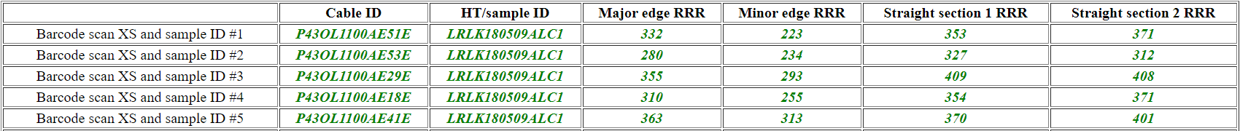
P43OL1100 – Extracted Strand RRR
Vector #464342

Slide 51
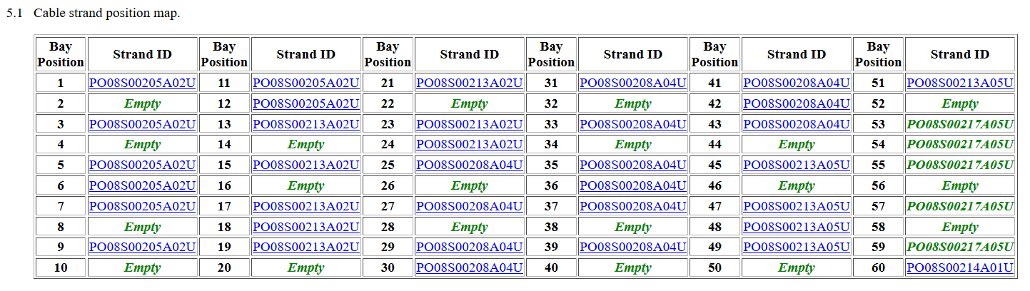
QXFA-CL-112 Cable P43OL1100
Witness extracted strand (XS)
Witness virgin strand (VS)
Tests of 1 backup sample was required to fulfill witness sample testing requirements
  Unstable tests are shaded above

Slide 52
Coil QXFA112, cable 1100 – Witness samples
ID | RRR (293K / 20K) XS > 100 RW > 150 | Ic(12T) XS > 600 RW > 632 | Ic(13T) | Ic(14T) | Ic(15T) XS > 314 RW > 331
PO08S00213A02U | 230
PO08S00208A04U | 228 | 711Q | 608 | 501 | 405
P43OL1100AE15E | 190 | 677 | 559 | 456 | 368
P43OL1100AE29E | 179 | 704 | 583 | 476 | 386
P43OL1100AE18E | 171 | 679 | 565 | 465 | 375
P43OL1100AE53E | 148
nnnQ denotes a critical current measurement that showed a transition but quenched before the criterion was reached
Q denotes a critical current measurement that did not show a transition before quenching

Slide 53
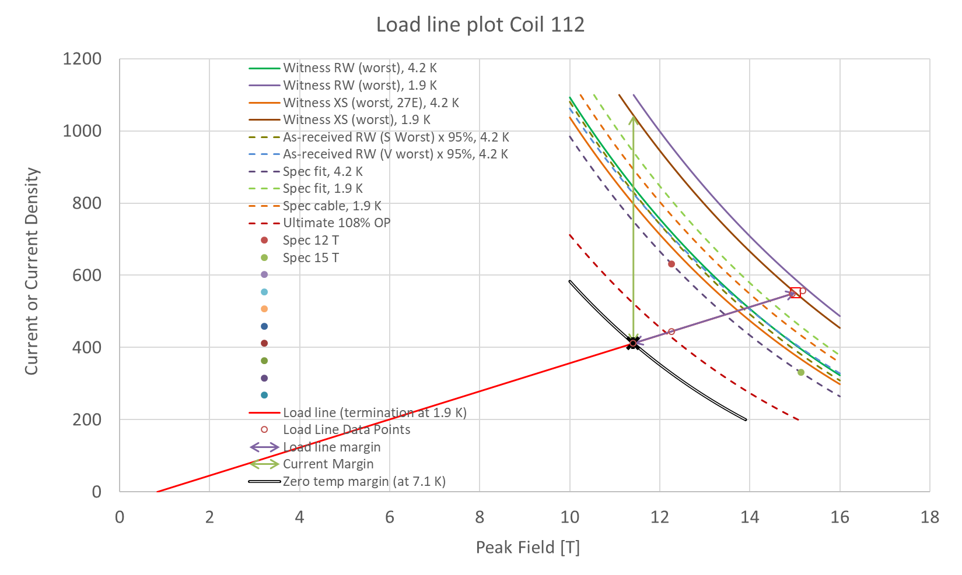
Coil 112 SSL
Margins | Margin | Operating Point (X)
Load line margin (purple arrow) | 25.4% | 74.6%
Current margin (green arrow) | 60.5% | 39.5%
Temperature margin [K] | 5.2 | 7.1

Slide 54
QXFA-113 / P43OL1094

Slide 55
P43OL1094 – Cable Date, Lengths
Cable Manufacture Date
  2018 01 18 (Production run)
Cable Length:
  466 m (LBNL, fabricated, including LBNL samples)
  444 m (Measured by FNAL)

Slide 56
P43OL1094 – Strand and SS Core ID
Spool:
  PO08S00198A02U x 18 ULs
  PO08S00219A01U x 17 ULs
  PO08S00181A06U x 3 ULs
  PO08S00181A05U x 1 ULs
  PO08S00182A05U x 1 ULs
Core:
  120L51A7322313
    Core width: 12.0 mm; material: 316L;
    Heat: 844979; Lot: 16-597;
    Chemical Properties CoT/CoC 172660-1: 0.14 wt% Co
From 4 billets

Slide 57
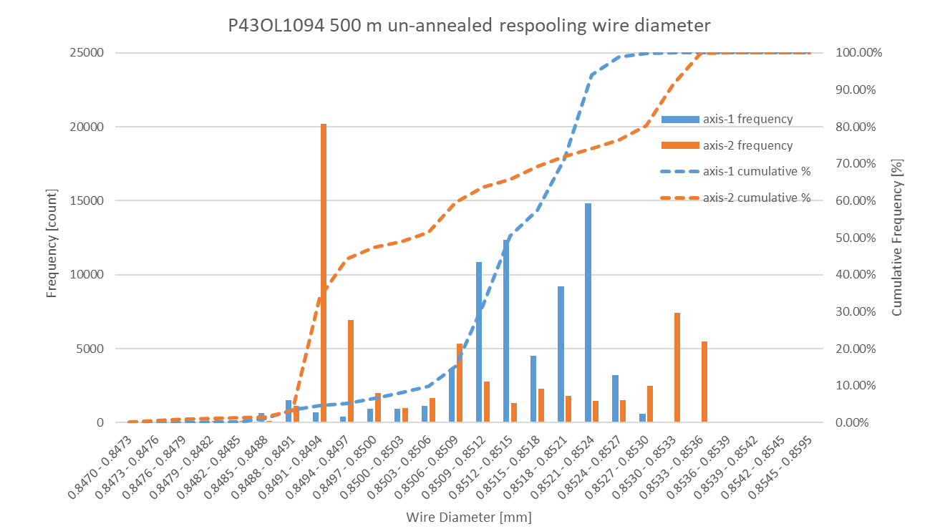
P43OL1094 Respooling Wire Diameter
Below LSL: 0.11%
Above USL: 4.27%

Slide 58
P43OL1094 – Cable QC Data Summary
CME:
Residual Twist:
  95°
10-stack:
  Qualification: 1.532 mm
  Production tail end: 1.531 mm
 | Pressure (MPa) | Angle (°) | Width (mm) | Thickness (mm)
Maximum | 17.1 | 0.437 | 18.162 | 1.528
Average | 17.1 | 0.418 | 18.149 | 1.524
Minimum | 17.0 | 0.391 | 18.143 | 1.520
Sigma | 0.01 | 0.008 | 0.003 | 0.002

Slide 59
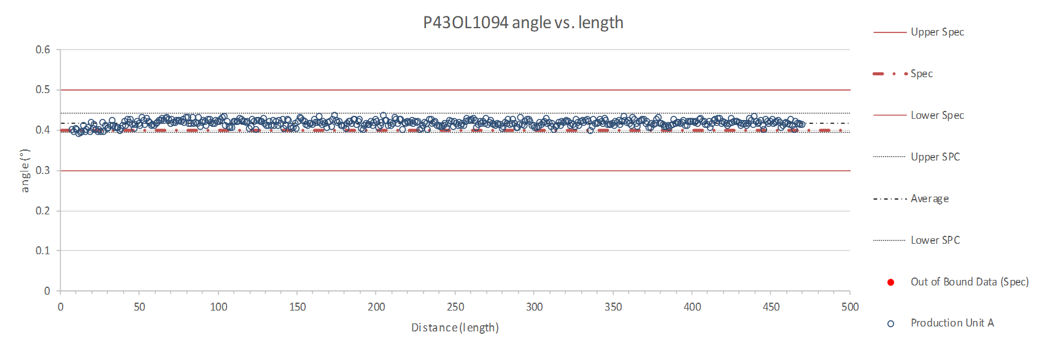
Rollers: P-91 (2017-12-08) and P-92 (2017-12-08)

Slide 60
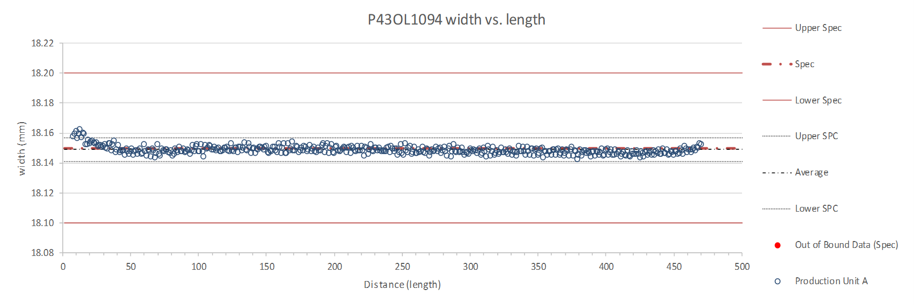
Rollers: P-91 (2017-12-08) and P-92 (2017-12-08)

Slide 61
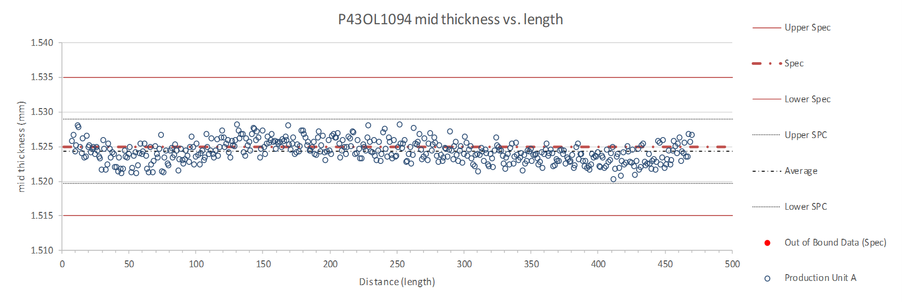
Rollers: P-91 (2017-12-08) and P-92 (2017-12-08)

Slide 62
P43OL1094 – Braiding
Fiberglass Lot #91309
P/I: 18.0
Spool tension: 10 lbs. (payoff); 12 lbs. (takeup)
Bobbin payoff tension: 0.125 lbs. (min), 0.250 lbs. (max)
NEWT 10-stack QC:
  Cycle #1) 0.151 mm; #2) 0.148 mm; #3) 0.147 mm;
  Mean 0.149 mm
LBNL 10-stack verification QC:
  Cycle #1) 0.148 mm; #2) 0.145 mm; #3) 0.143 mm;
  Mean 0.145 mm
Vector #464342

Slide 63
P43OL1094 – Wire Parameters
Properties | Inspected Average
Wire Diameter | 0.851 ± 0.003 mm (LBNL)¹
Cu ratio ª | 53.8% (OST)
Strand twist pitch ª | 18.6 mm (OST)
RRR (RW) ª | 322 (OST)
RRR (15% rolled) ª | 225 (OST)
I_{C} (4.2 K, 15 T) ª | 369 A (OST)
I_{C} (4.2 K, 14 T) ª | 464 A (OST)
I_{C} (4.2 K, 13 T) ª | 571 A (OST)
I_{C} (4.2 K, 12 T) ª | 694 A (OST)
ª First billet averaged, then weighted average according
to the spool distribution in the cable
¹ As-received, all LBNL respooling data; mean ± 1 sigma

Slide 64
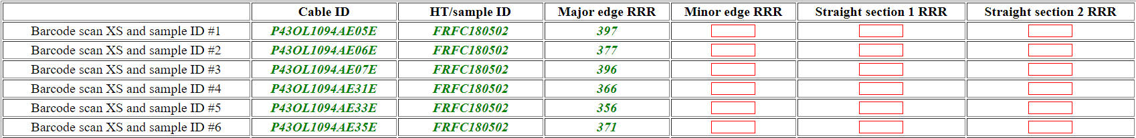
P43OL1094 – Extracted Strand RRR
Vector #464342

Slide 65
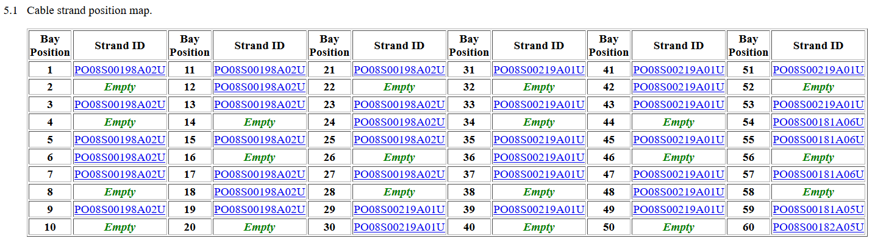
QXFA-CL-113 Cable P43OL1094
Witness extracted strand (XS)
Witness virgin strand (VS)
NO backup samples were required to fulfill witness sample testing requirements
  Unstable tests are shaded above

Slide 66
Coil QXFA113, cable 1094 – Witness samples
ID | RRR (293K / 20K) XS > 100 RW > 150 | Ic(12T) XS > 600 RW > 632 | Ic(13T) | Ic(14T) | Ic(15T) XS > 314 RW > 331
PO08S00198A02U | 225 | 723 | 600 | 491 | 397
PO08S00219A01U | 228
P43OL1094AE01E | 166 | 695 | 575 | 470 | 377
P43OL1094AE03E | 184
P43OL1094AE29E | 162 | 721 | 598 | 489 | 394
P43OL1094AE30E | 185
nnnQ denotes a critical current measurement that showed a transition but quenched before the criterion was reached
Q denotes a critical current measurement that did not show a transition before quenching

Slide 67
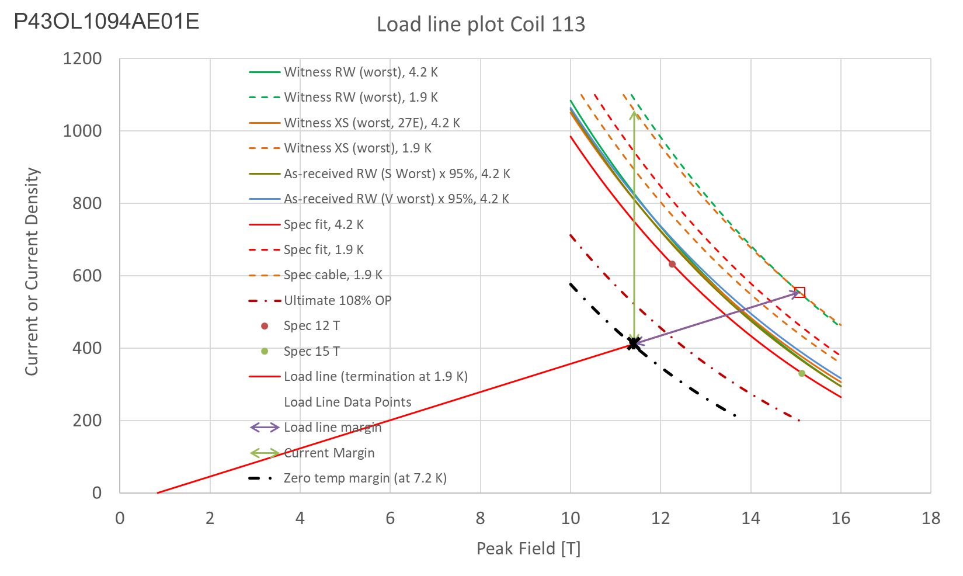
Coil 113 SSL
Margins | Margin | Operating Point (X)
Load line margin (purple arrow) | 25.8% | 74.3%
Current margin (green arrow) | 61.1% | 38.9%
Temperature margin [K] | 5.3 | 7.2

Slide 68
QXFA-115 / P43OL1102

Slide 69
P43OL1102 – Cable Date, Lengths
Cable Manufacture Date
  2018 05 18 (Production run)
Cable Length:
  470 m (LBNL, fabricated, including LBNL samples)
  449 m (Measured by FNAL)

Slide 70
P43OL1102 – Strand and SS Core ID
Spool:
  PO08S00239A05U x 2 ULs
  PO08S00220A04U x 3 ULs
  PO08S00230A04U x 3 ULs
  PO08S00239A03U x 3 ULs
  PO08S00235A01U x 12 ULs
  PO08S00237A01U x 17 ULs
Core:
  120L43A7322313
    Core width: 12.0 mm; material: 316L;
    Heat: 844979; Lot: 16-597;
    Chemical Properties CoT/CoC 172660-1: 0.14 wt% Co
From 5 billets

Slide 71
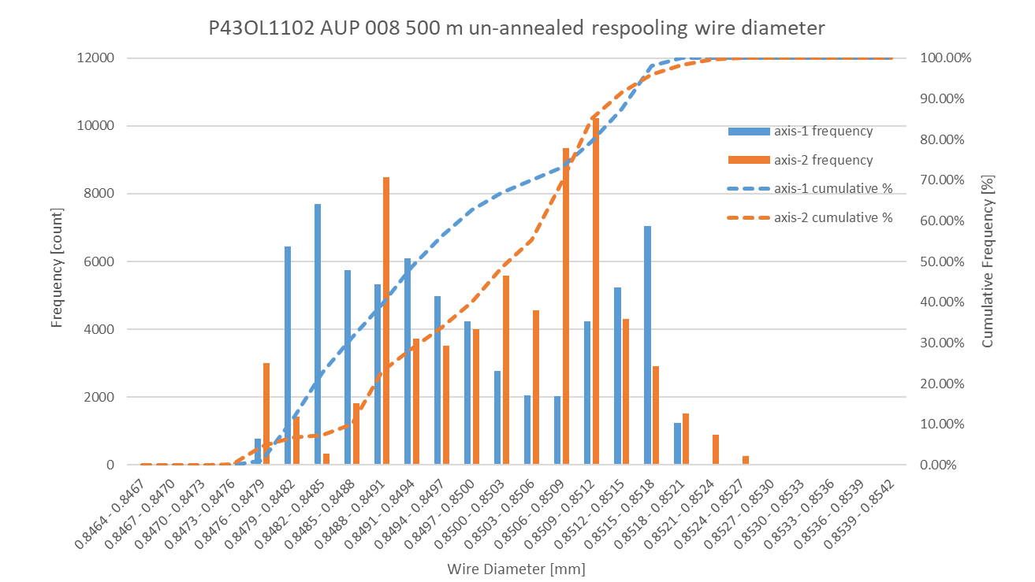
P43OL1102 Respooling Wire Diameter
Below LSL: 0.00%
Above USL: 0.00%

Slide 72
P43OL1102 – Cable QC Data Summary
CME:
Residual Twist:
  135°
10-stack:
  Qualification: 1.525 mm
  Production tail end: 1.528 mm
 | Pressure (MPa) | Angle (°) | Width (mm) | Thickness (mm)
Maximum | 17.1 | 0.451 | 18.169 | 1.530
Average | 17.0 | 0.425 | 18.153 | 1.526
Minimum | 16.9 | 0.395 | 18.145 | 1.522
Sigma | 0.01 | 0.009 | 0.004 | 0.001

Slide 73
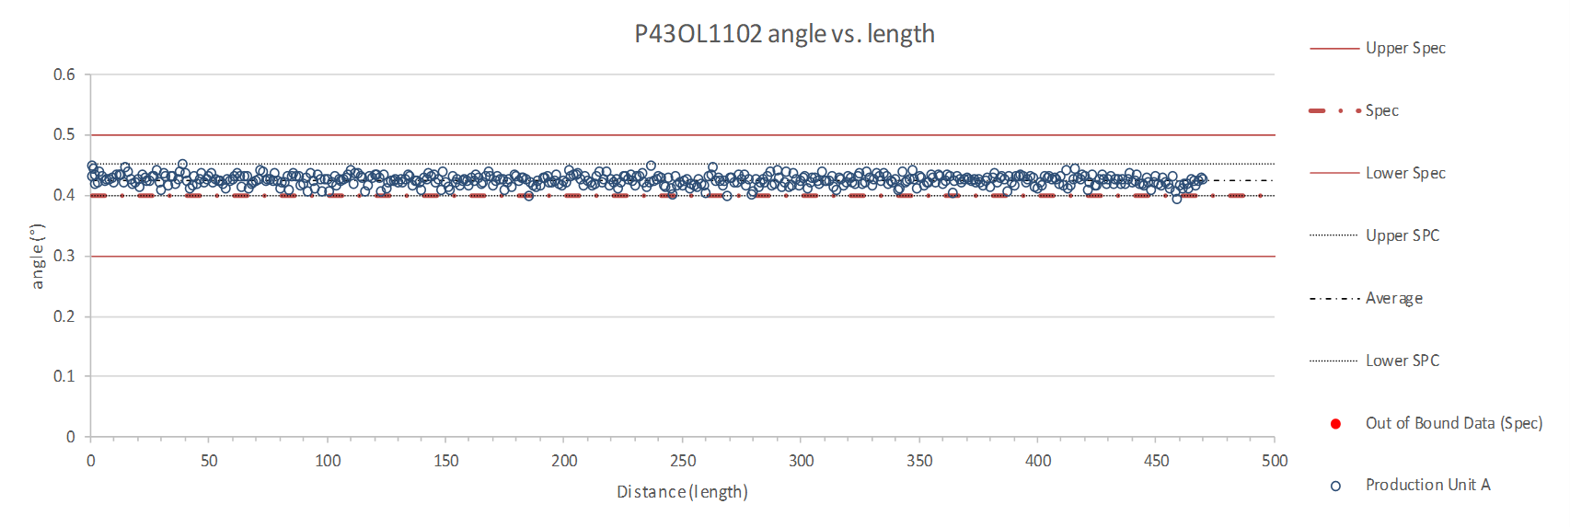
Rollers: P-91 (2017-12-08) and P-92 (2017-12-08)

Slide 74
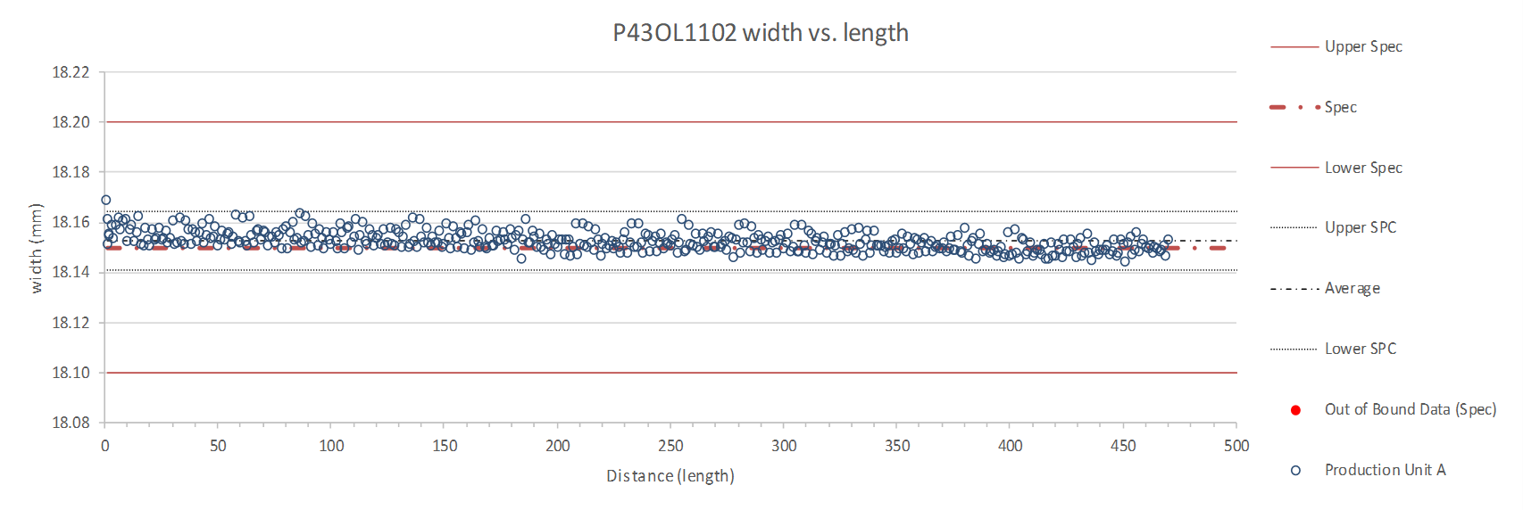
Rollers: P-91 (2017-12-08) and P-92 (2017-12-08)

Slide 75
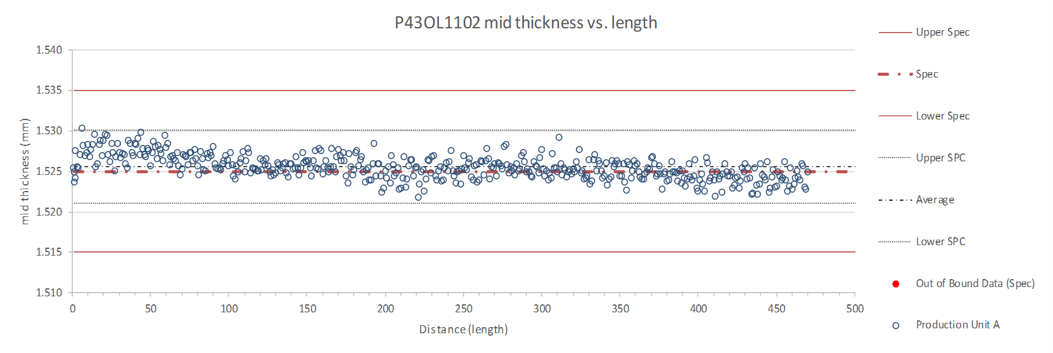
Rollers: P-91 (2017-12-08) and P-92 (2017-12-08)

Slide 76
P43OL1102 – Braiding
Fiberglass Lot #100415
P/I: 18.9
Spool tension: 10 lbs. (payoff); 20 lbs. (takeup)
Bobbin payoff tension: 0.125 lbs. (min), 0.250 lbs. (max)
NEWT 10-stack QC:
  Cycle #1) 0.150 mm; #2) 0.147 mm; #3) 0.146 mm;
  Mean 0.148 mm
LBNL 10-stack verification QC:
  Cycle #1) 0.143 mm; #2) 0.140 mm; #3) 0.137 mm;
  Mean 0.140 mm
Vector #464342

Slide 77
P43OL1102 – Wire Parameters
Properties | Inspected Average
Wire Diameter | 0.850 ± 0.001 mm (LBNL)¹
Cu ratio ª | 55.1% (OST)
Strand twist pitch ª | 18.6 mm (OST)
RRR (RW) ª | 263 (OST)
RRR (15% rolled) ª | 154 (OST)
I_{C} (4.2 K, 15 T) ª | 365 A (OST)
I_{C} (4.2 K, 14 T) ª | 459 A (OST)
I_{C} (4.2 K, 13 T) ª | 567 A (OST)
I_{C} (4.2 K, 12 T) ª | 690 A (OST)
ª First billet averaged, then weighted average according
to the spool distribution in the cable
¹ As-received, all LBNL respooling data; mean ± 1 sigma

Slide 78
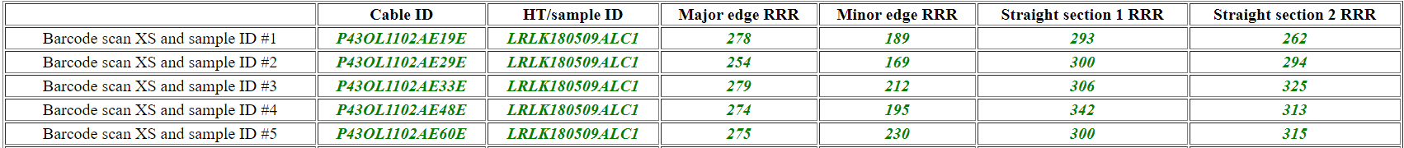
P43OL1102 – Extracted Strand RRR
Vector #464342

Slide 79
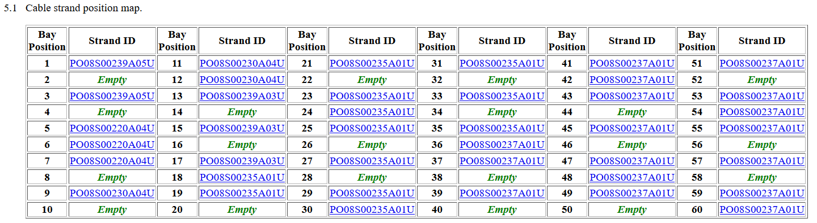
QXFA-CL-115 Cable P43OL1102
Witness extracted strand (XS)
Witness virgin strand (VS)
NO tests of backup samples were required to fulfill witness sample testing requirements
  Unstable tests are shaded above

Slide 80
Coil QXFA115, cable 1102 – Witness samples
ID | RRR (293K / 20K) XS > 100 RW > 150 | Ic(12T) XS > 600 RW > 632 | Ic(13T) | Ic(14T) | Ic(15T) XS > 314 RW > 331
PO08S00235A02U | 192 | 700 | 581 | 473 | 380
P43OL1102AE18E | 127 | 688 | 569 | 463 | 370
P43OL1102AE35E | 125 | 688 | 572 | 468 | 380
P43OL1102AE41E | 125
P43OL1102AE59E | 104
nnnQ denotes a critical current measurement that showed a transition but quenched before the criterion was reached
Q denotes a critical current measurement that did not show a transition before quenching

Slide 81

Coil 115 SSL
Margins | Margin | Operating Point (X)
Load line margin (purple arrow) | 26.2% | 73.9%
Current margin (green arrow) | 62.4% | 37.6%
Temperature margin [K] | 5.3 | 7.2

Slide 82
Summary of Data
Coil | SSL field (T) | SSL current (kA) | I_{OP}/I_{SSL} (%) | T margin (K) | Cable I_{C} (kA) | I_{OP}/I_{C} (%)
MQXFA112 | 15.0 | 22.1 | 74.6 | 5.2 | 41.7 | 39.5
MQXFA113 | 15.1 | 22.2 | 74.3 | 5.3 | 42.3 | 38.9
MQXFA203 | 15.4 | 22.6 | 72.8 | 5.5 | 45.1 | 36.5
MQXFA206 | 15.2 | 22.3 | 73.9 | 5.3 | 43.8 | 37.6
MQXFA115 | 15.2 | 22.3 | 73.9 | 5.3 | 43.8 | 37.6

