Slide 1


QXFA203 Coil Review
Jesse Schmalzle
October 30, 2019

Slide 2
Outline
Notes / photos
Reaction plots
Electrical Data
CMM
DRs

Slide 3
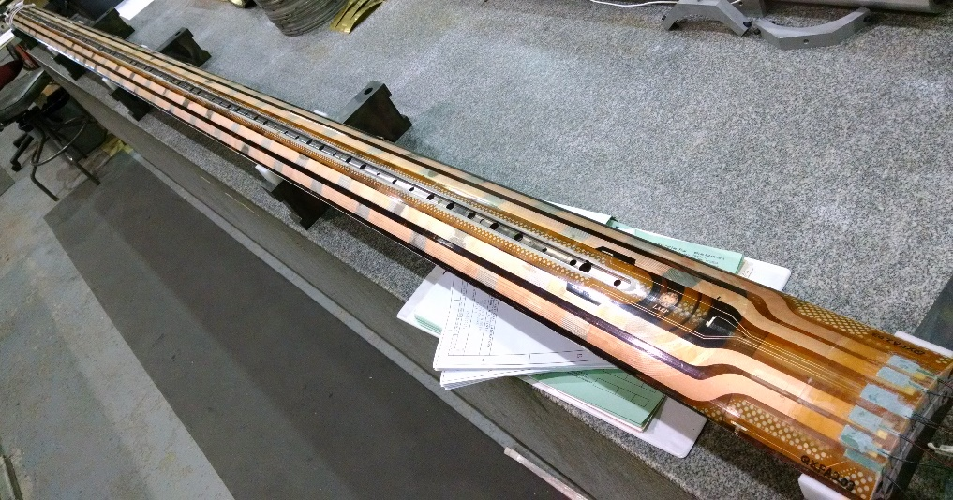
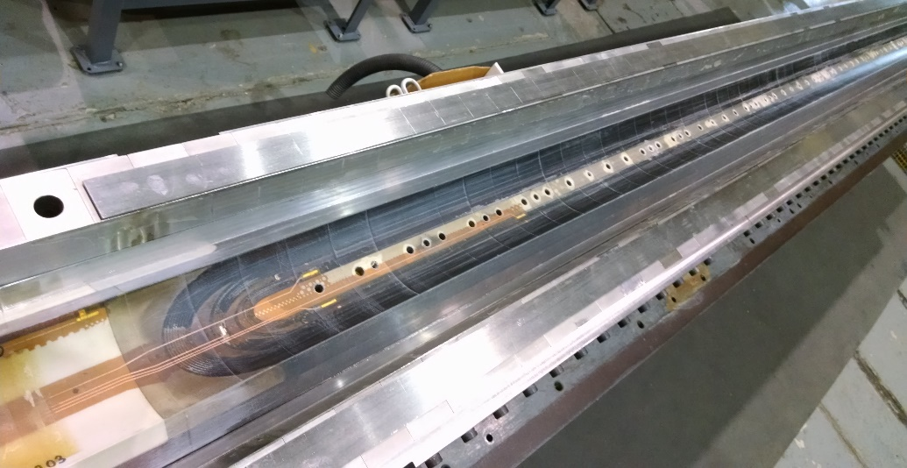
QXFA203
Cable ID P43OL1096
Prior to change for B6 adjustment
  4 layers glass on pole
  10 mil G11 shims on midplane
Pole gaps (OL)
  1.9 mm after reaction
Lead / Wire length
  2.6 m coil leads
  1 m coil tap wires
  4.5 m splice tap wires
    A01 / B01 wires are attached to the leads
    (not in wiring pocket)
  1 m quench heater wires
Coil length
  4528.7 mm overall length
Coil Fab Completed - April 2019

Slide 4
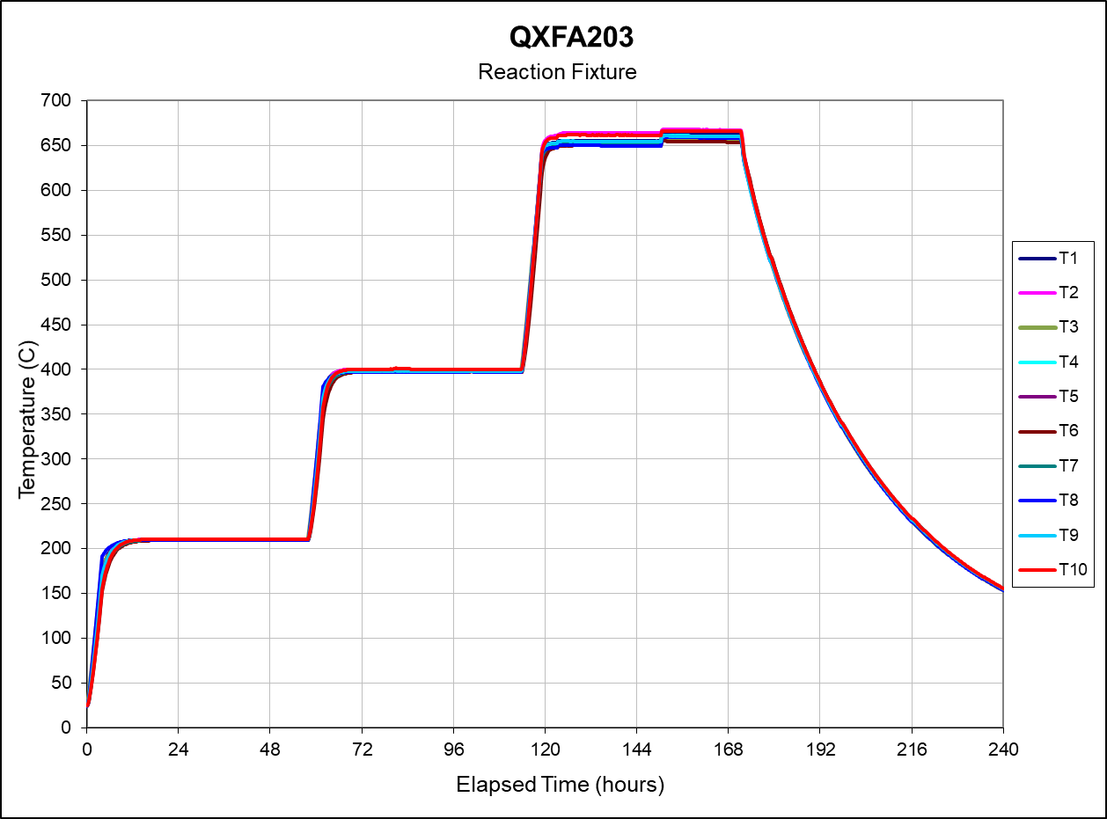
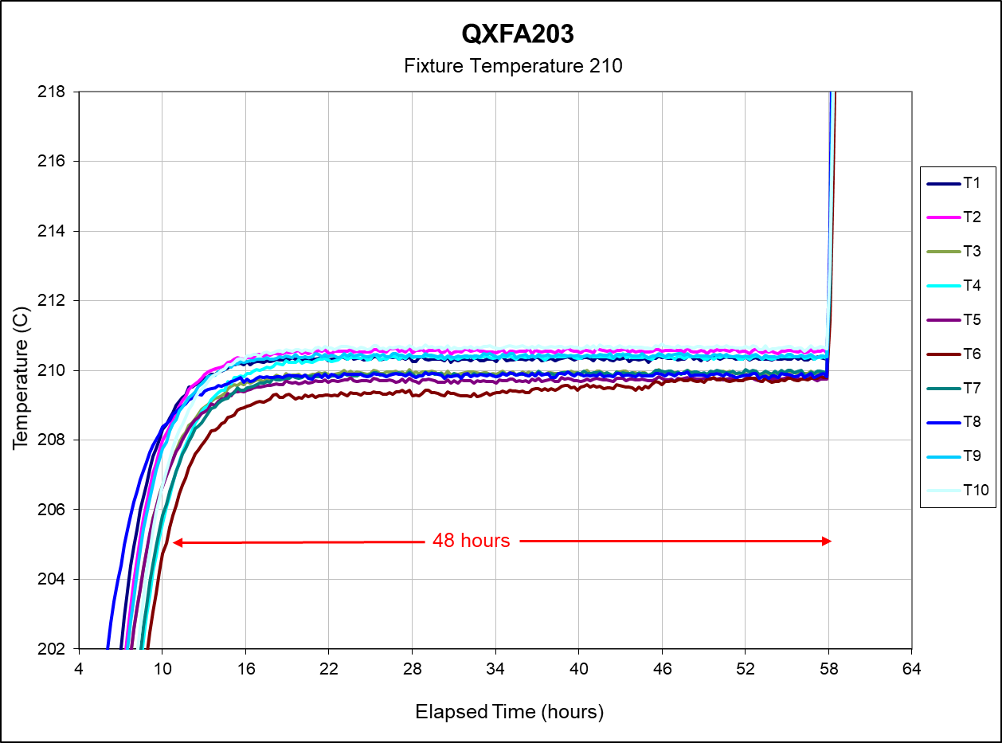
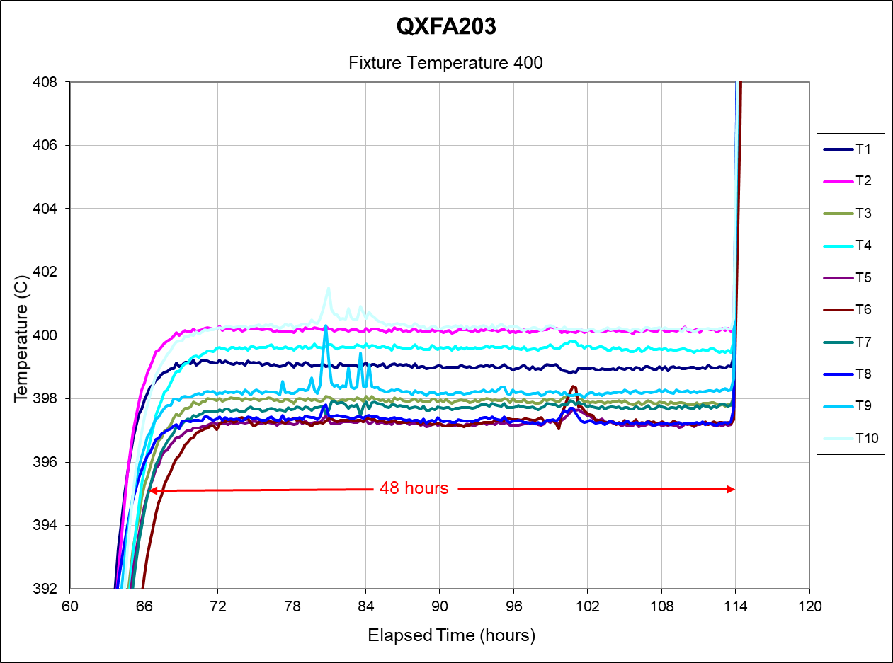
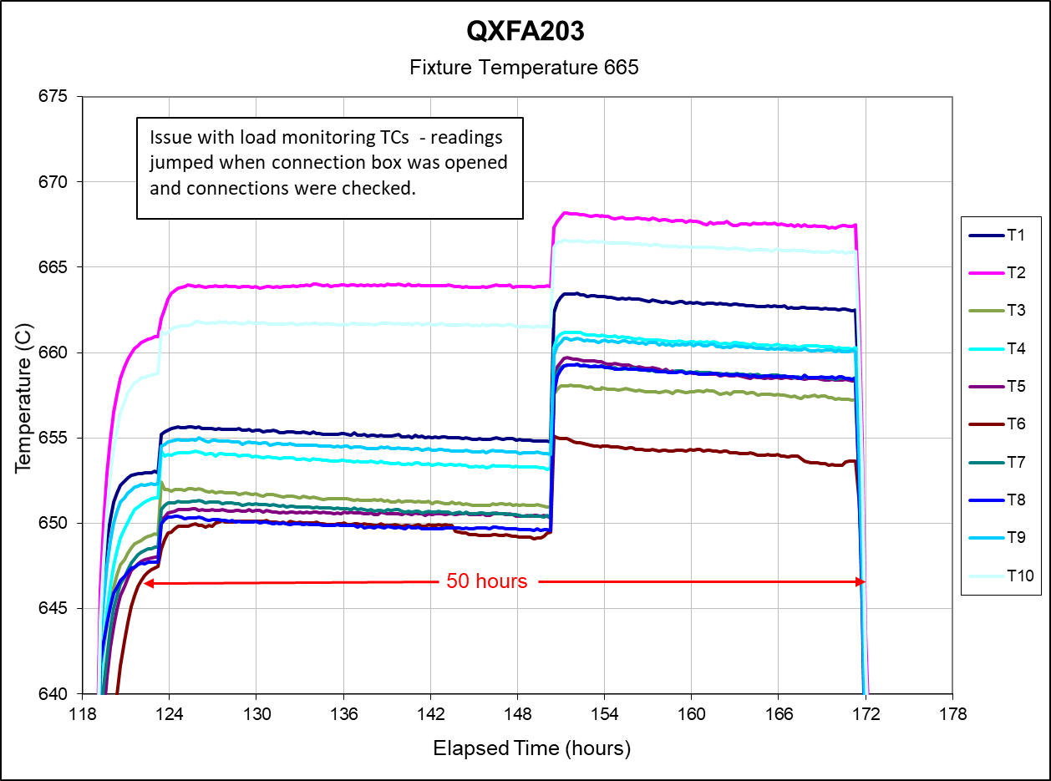
QXFA203
Reaction Cycle:
48 Hours at 210 C
48 hours at 400 C
50 hours at 665 C
Issue with load monitoring TCs during 665 step.
Oven control remained steady.
Witness samples inside reaction fixture.

Slide 5
QXFA203

Slide 6
QXFA203

Slide 7
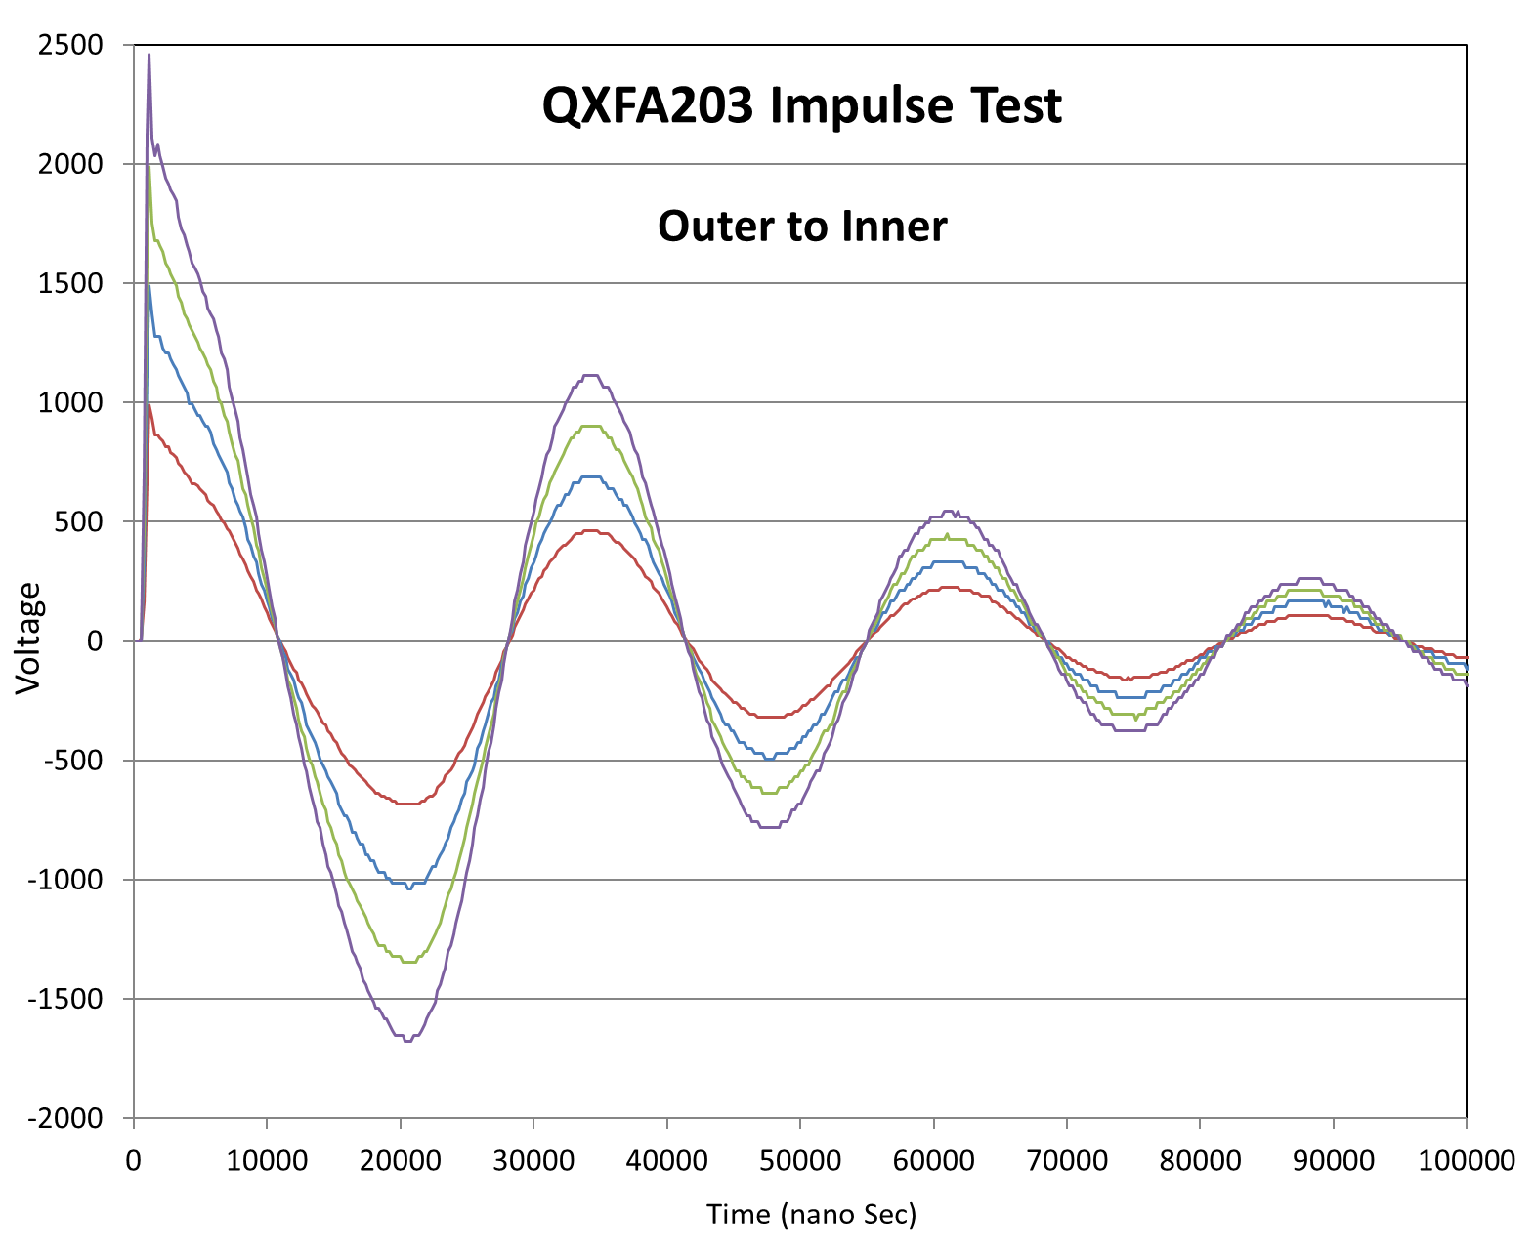
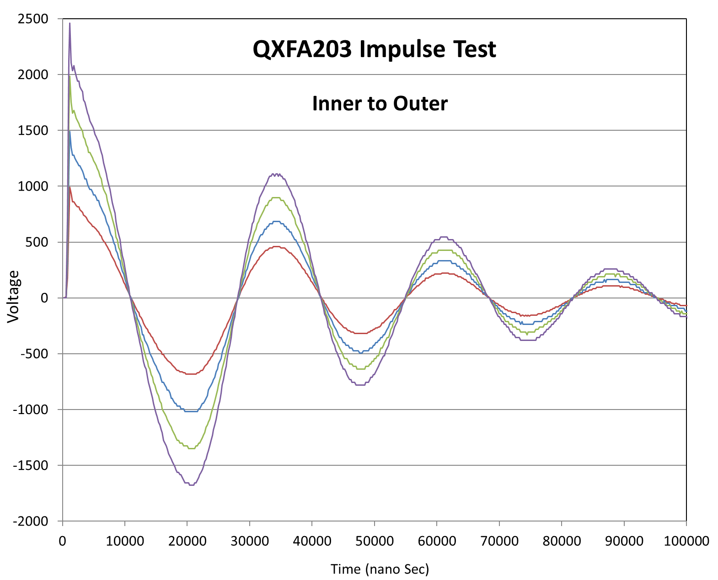
QXFA203

Slide 8
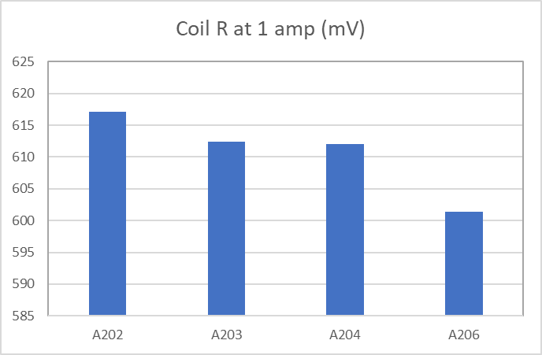
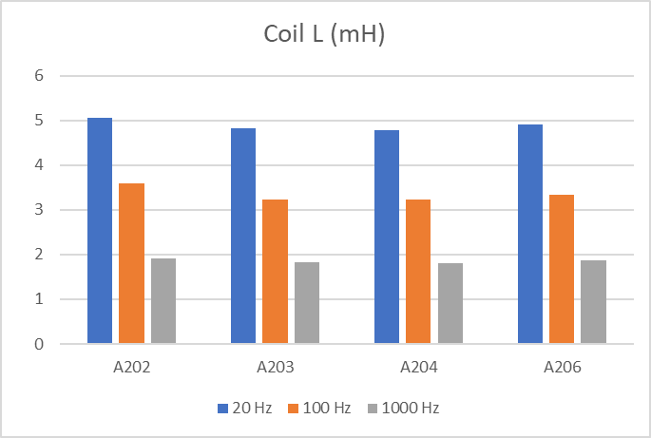
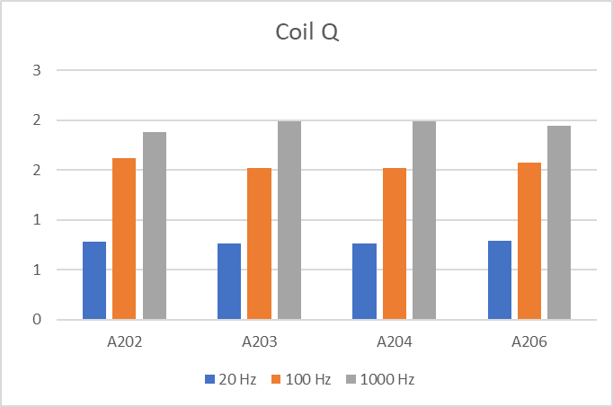
QXFA203

Slide 9
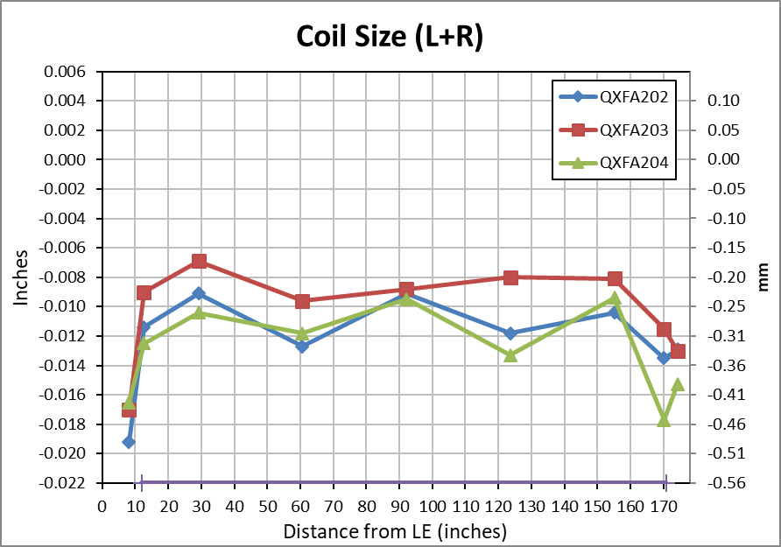
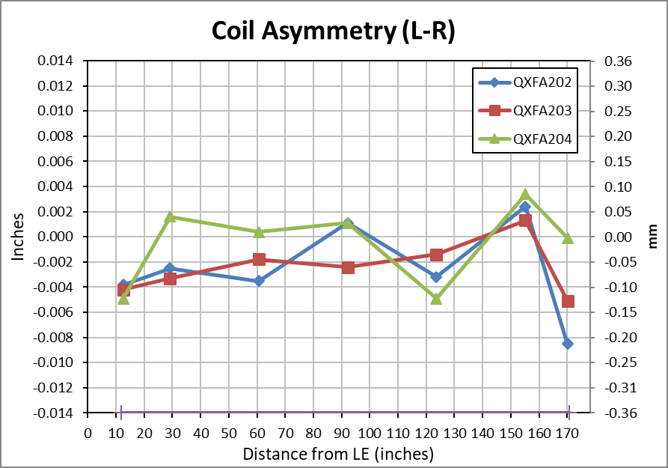
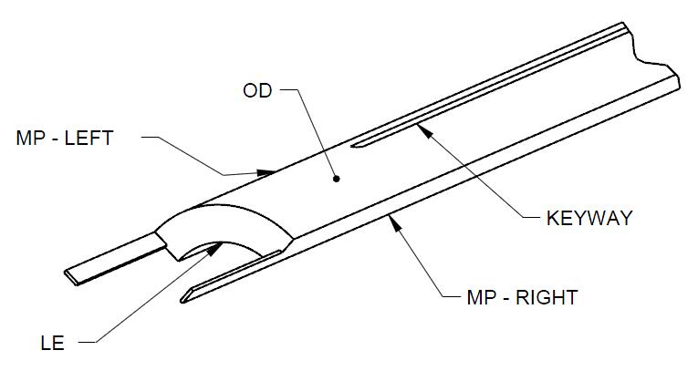
QXFA203
Faro arm coil size measurements:
  Primary best fit to coil OD, secondary to keyway (midplane where no keyway).
Nominal Coil Dimensions:
Outer Radius = 113.376 mm
Midplane offset = .125 mm
Keyway Width = 14.00 mm

Slide 10
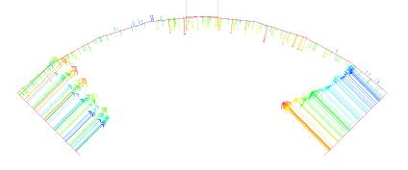
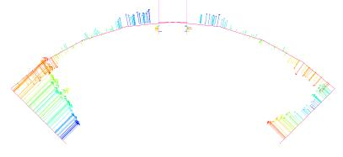
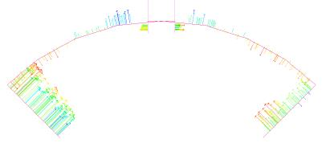
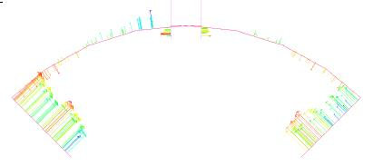
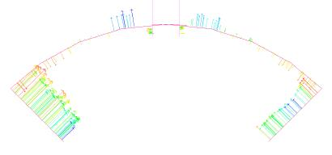
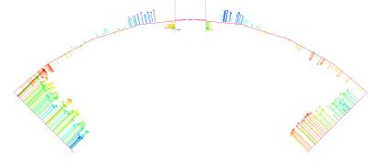
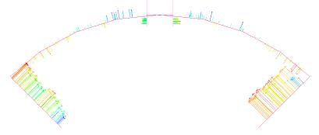
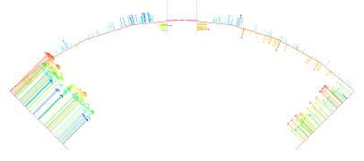
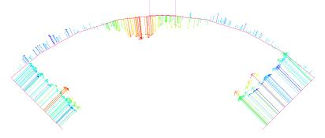
QXFA203
8 (207)
13 (320)
29 (740)
61 (1540)
92 (2340)
124 (3140)
155 (3940)
170 (4323)
174 (4426)

Slide 11
QXFA203
DRs
  Raised wire noted during respooling, along much of the cable.
  Dirt / light corrosion on wedges as received – cleaned before use.
  Small chip on saddle as received – part replaced.
  Very small chip on 2 end parts – use as is.
  Wedges too long as received – reworked.
  Popped strands at 3 locations during winding L1.
    All reworked without removing insulation sleeve.
  Reaction fixture monitoring TC readings at 665 – oven control TCs no problem.
  Small area of chipped epoxy after impreg – repaired with stycast.
  Small area of chipped ceramic coating on OL splice block near lead after impreg – repaired with Kapton / stycast
  Coil R values slightly outside range listed in doc 521 v12.

Slide 12
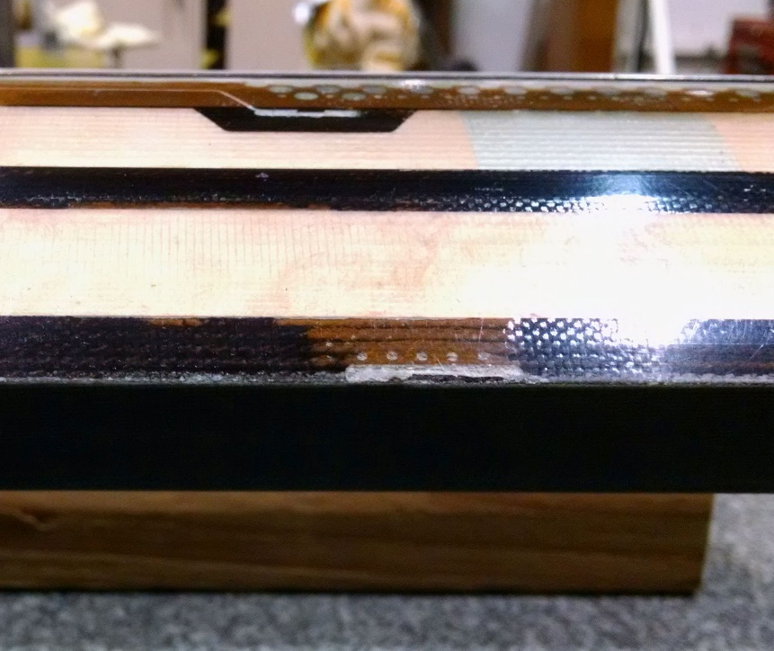
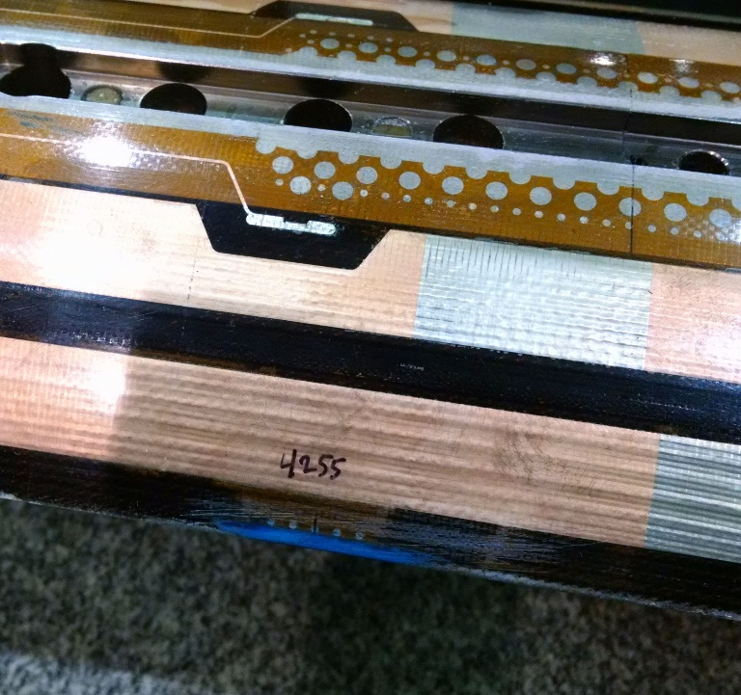
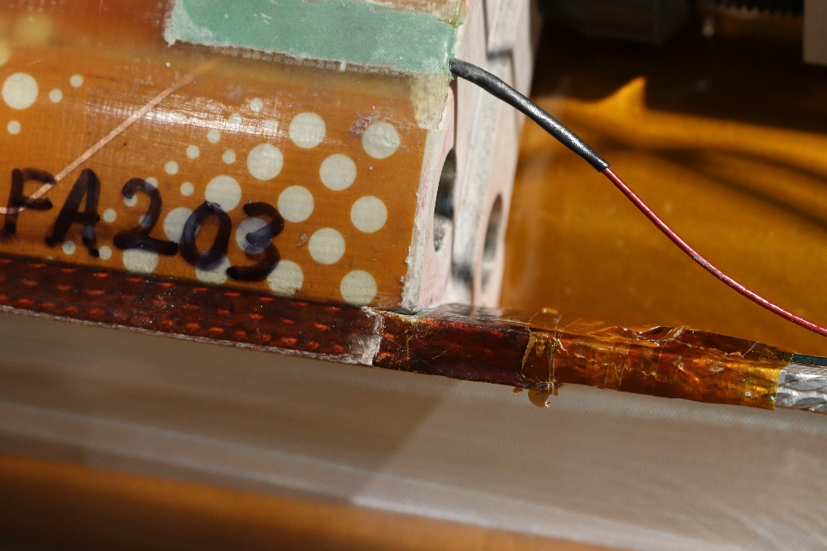
QXFA203
  DRs

