Slide 1
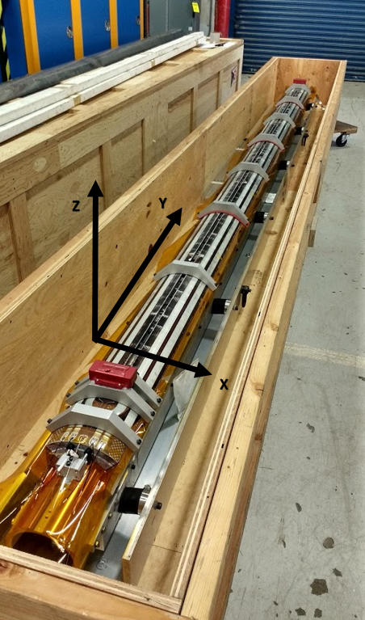
Coil 206 shipment data
Shipment:
dedicated shipping fixtures
2 accelerometers on the LE and RE
5g and 10 g shock watches
Air ride dedicated truck
No shock watch was activated
➔ Crate did not experience shocks above 5g

Slide 2
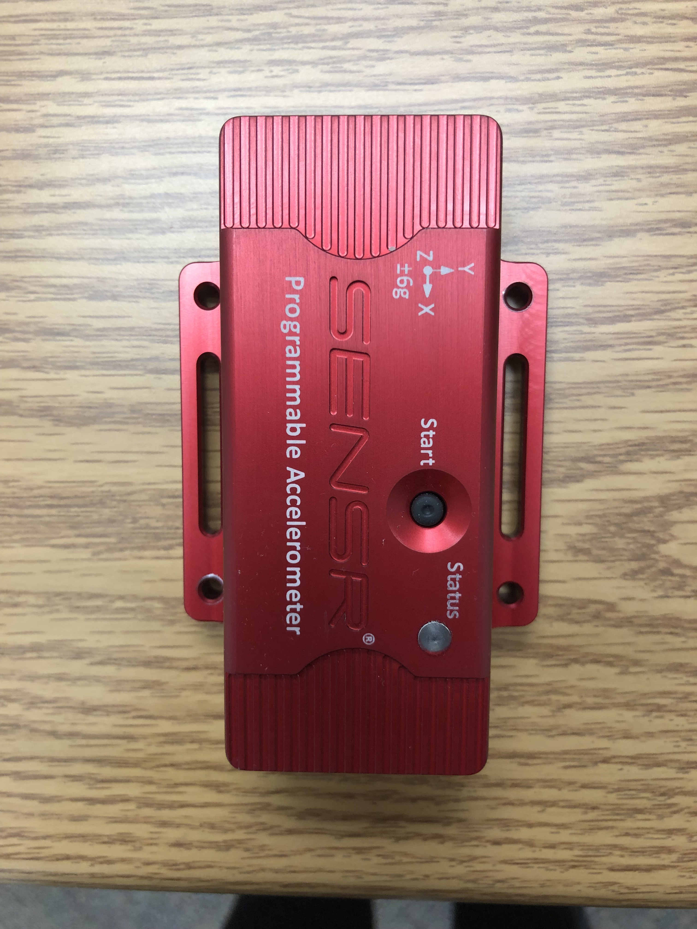
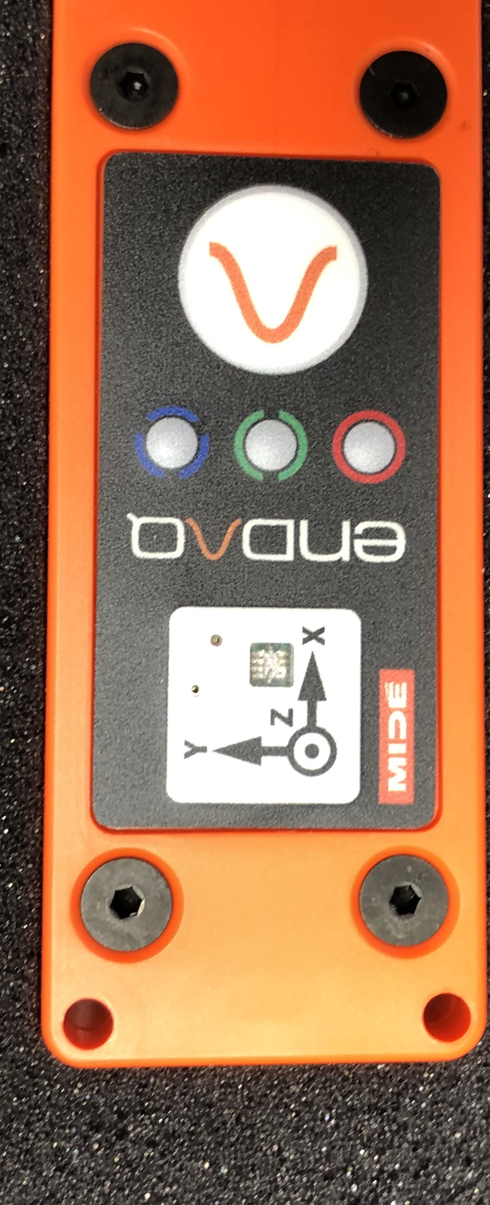
Accelerometers specs
SLAMSTICK
Range up to 16 g DC (shocks)
Up to 25 g AC (vibration)
Data recorded every sec
Trigger for g> 3g then collect for 1 h
Sample rate 800 Hz for DC
GPL1 senseware
Range up to 6.7 g
Data recorded every sec
Event recorded if > 3g
Sample rate 50 Hz
LE

Slide 3
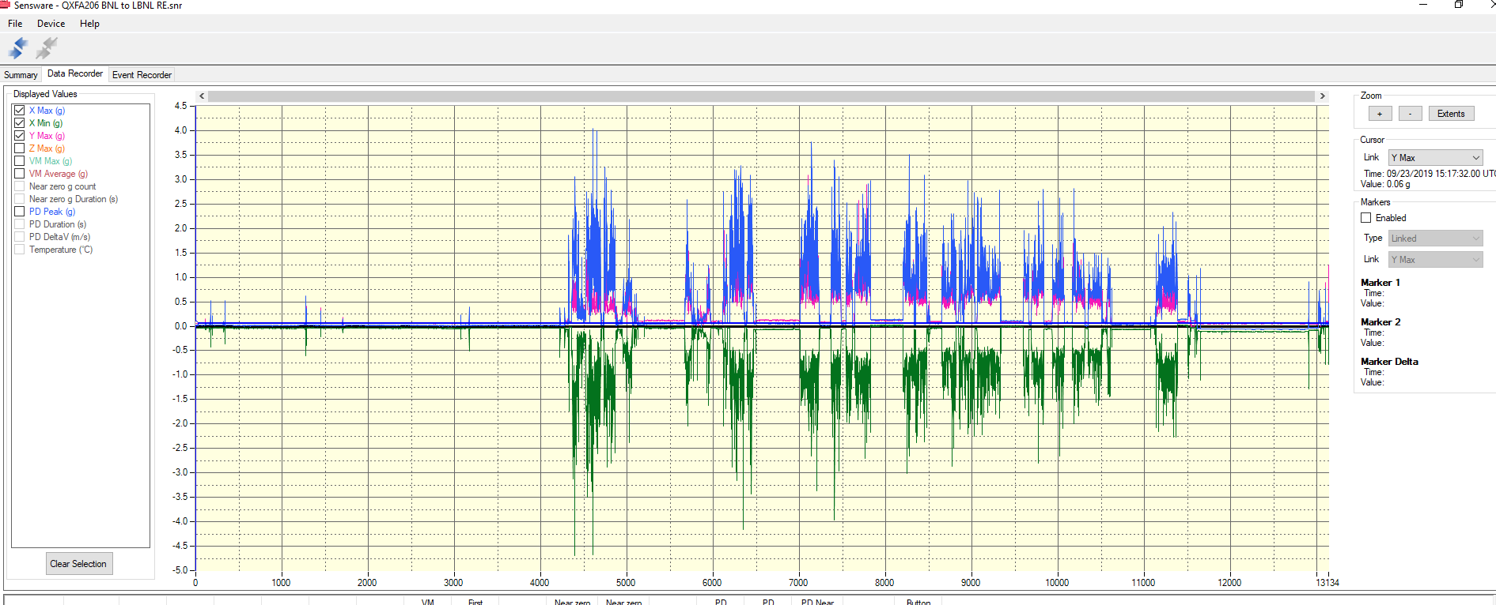
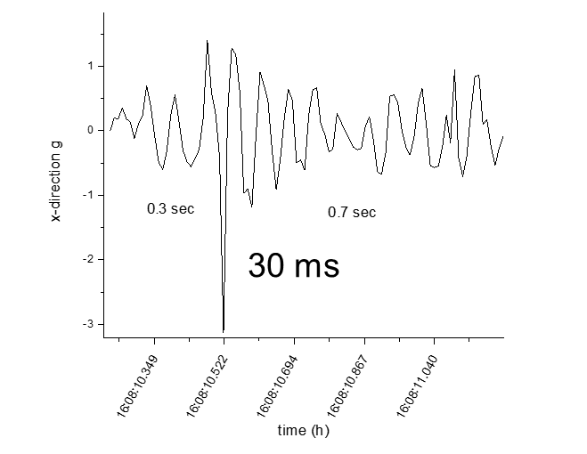
RE accelerometers
1 Oct
23 Sept
26 Sept
Max: 4.7g
Duration ~30 ms

Slide 4
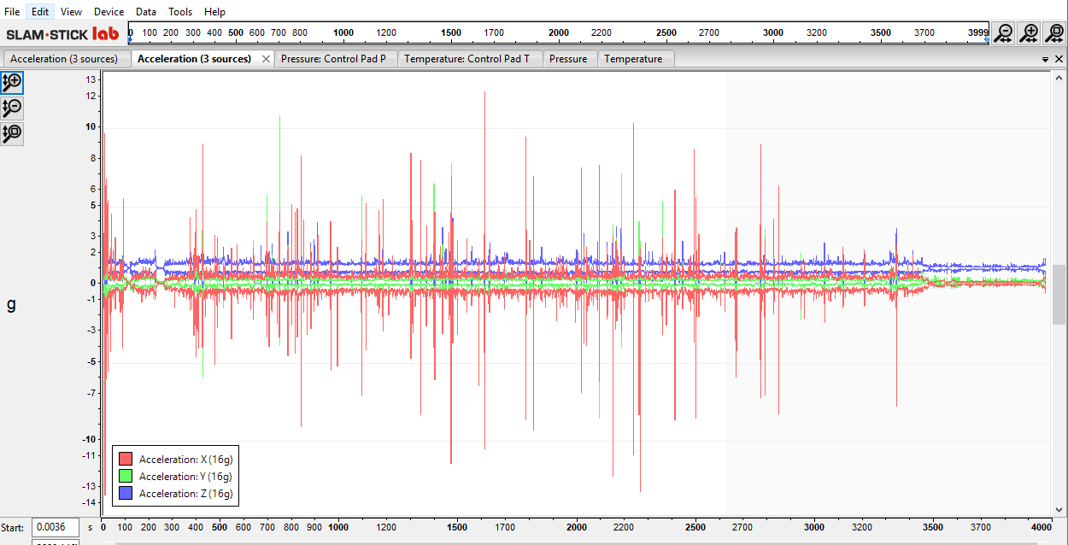
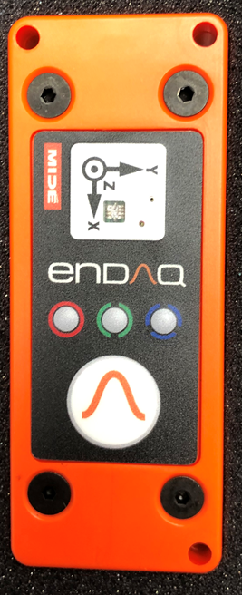
26 Sept: 4 to 5 pm
Max: 14g
Duration < 2 ms

Slide 5
Analysis
Events reconstruction:
Coil was sometimes shaking within the shipping frame: i.e. very short displacements and stops against frame/clamps
Events analysis:
Local impacts
Bending

Slide 6
Local Impact
The effect of local impacts can be evaluated by comparison with past events:
During MQXFS1 disassembly the two top coils fell. Coil 3 fell on the bottom coils, and coil 104 fell on the assembly table.

Slide 7
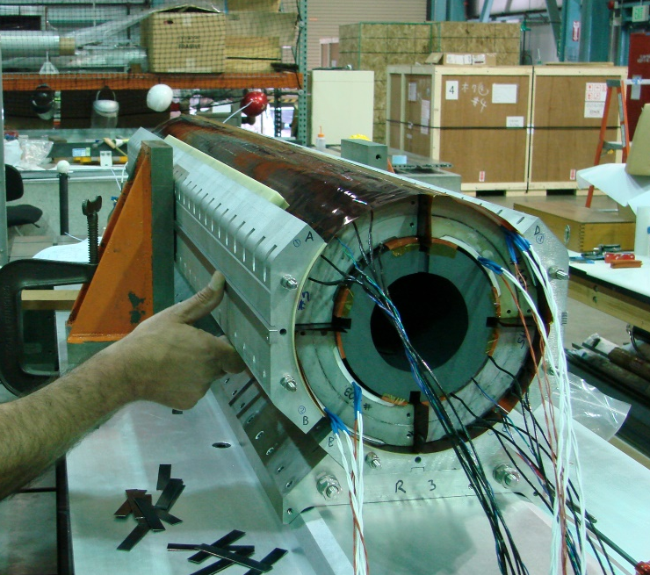
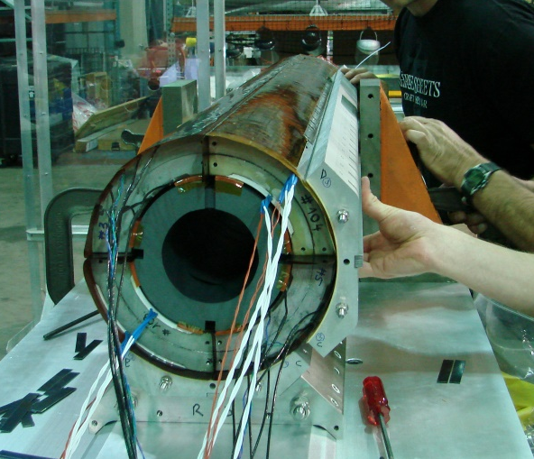
Scene Reproduction
Normal setup
In the incident
  The center coil support spud was not in place;
  The technicians were removing the side collar pack, the steel angle block was released
Disassemble the top collar stack
Disassemble the collar stack #2
Steel Angle block
Coil support spud
Return End
Return End
Assembly Table
Assembly Table

Slide 8
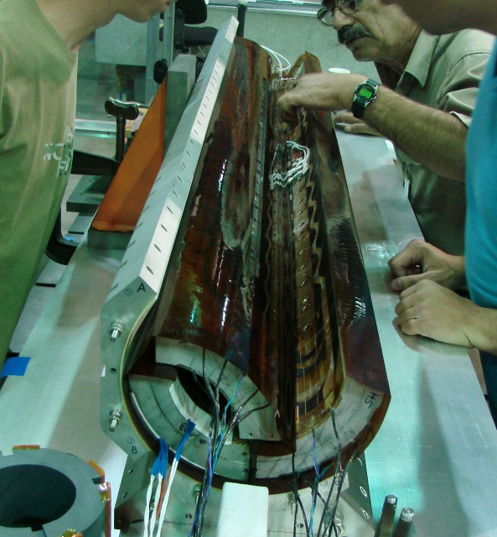
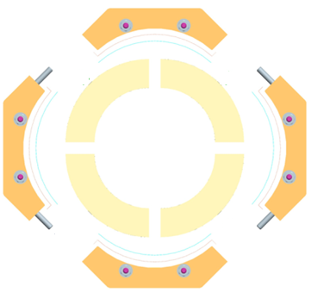

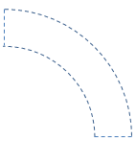


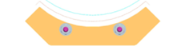
Scene Reproduction
Return end view
Coil 104 fell onto the assembly table, dented on the edge in the red circle. Strain gauge wires were damaged.
Coil 3 fell into coil 5; its edge cut off the strain gauge wires of coil 5.
03
03
104
104
104
03
03
104
103
103
05
05
103
05
103
05
103
104
104
Ready to disassemble
Removed the collars
Coils fell off
Return end view

Slide 9
Coil 206 & 104 Impact Velocity
Coil 206 velocity before impact: < 0.03 m/s
  V=at; a=15g, t=0.002 s (square function)
  Most likely V ~ 0.015 m/s (triangular function)
Coil 104 velocity before impact: ~ 1.7 m/s
  V=SQRT(2gx); x=0.15 m

Slide 10
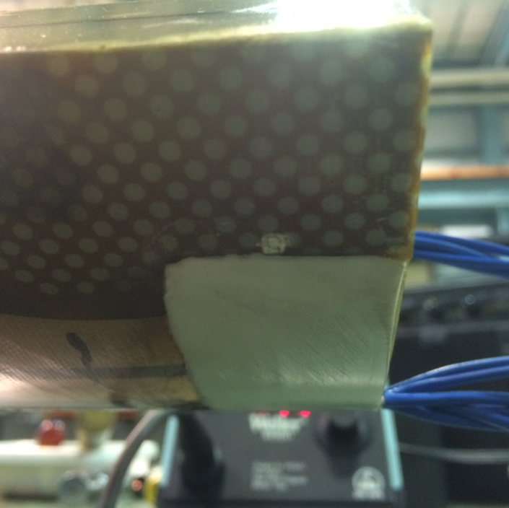
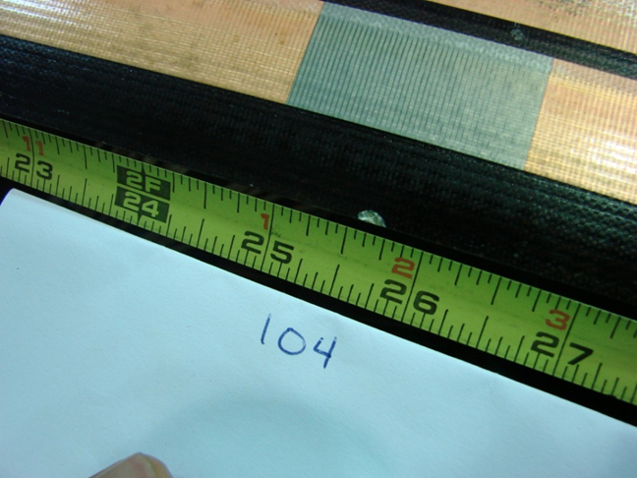
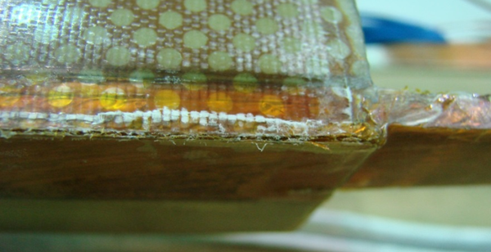
Coil 104
Coil 104 showed several marks & indentations made by impact with rigid objects on the table

Slide 11
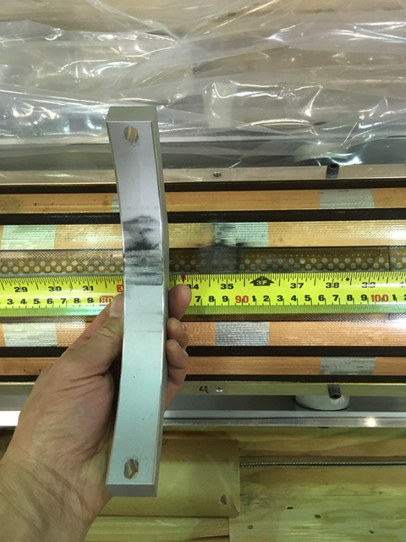
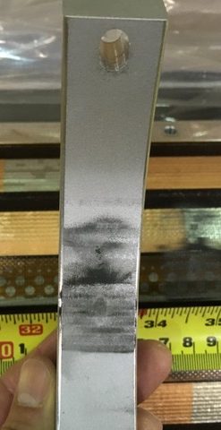
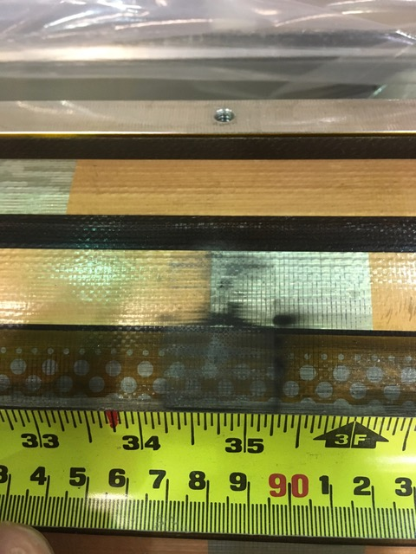
Coil 206
  Example of marks under Clamping Rib 4

Slide 12
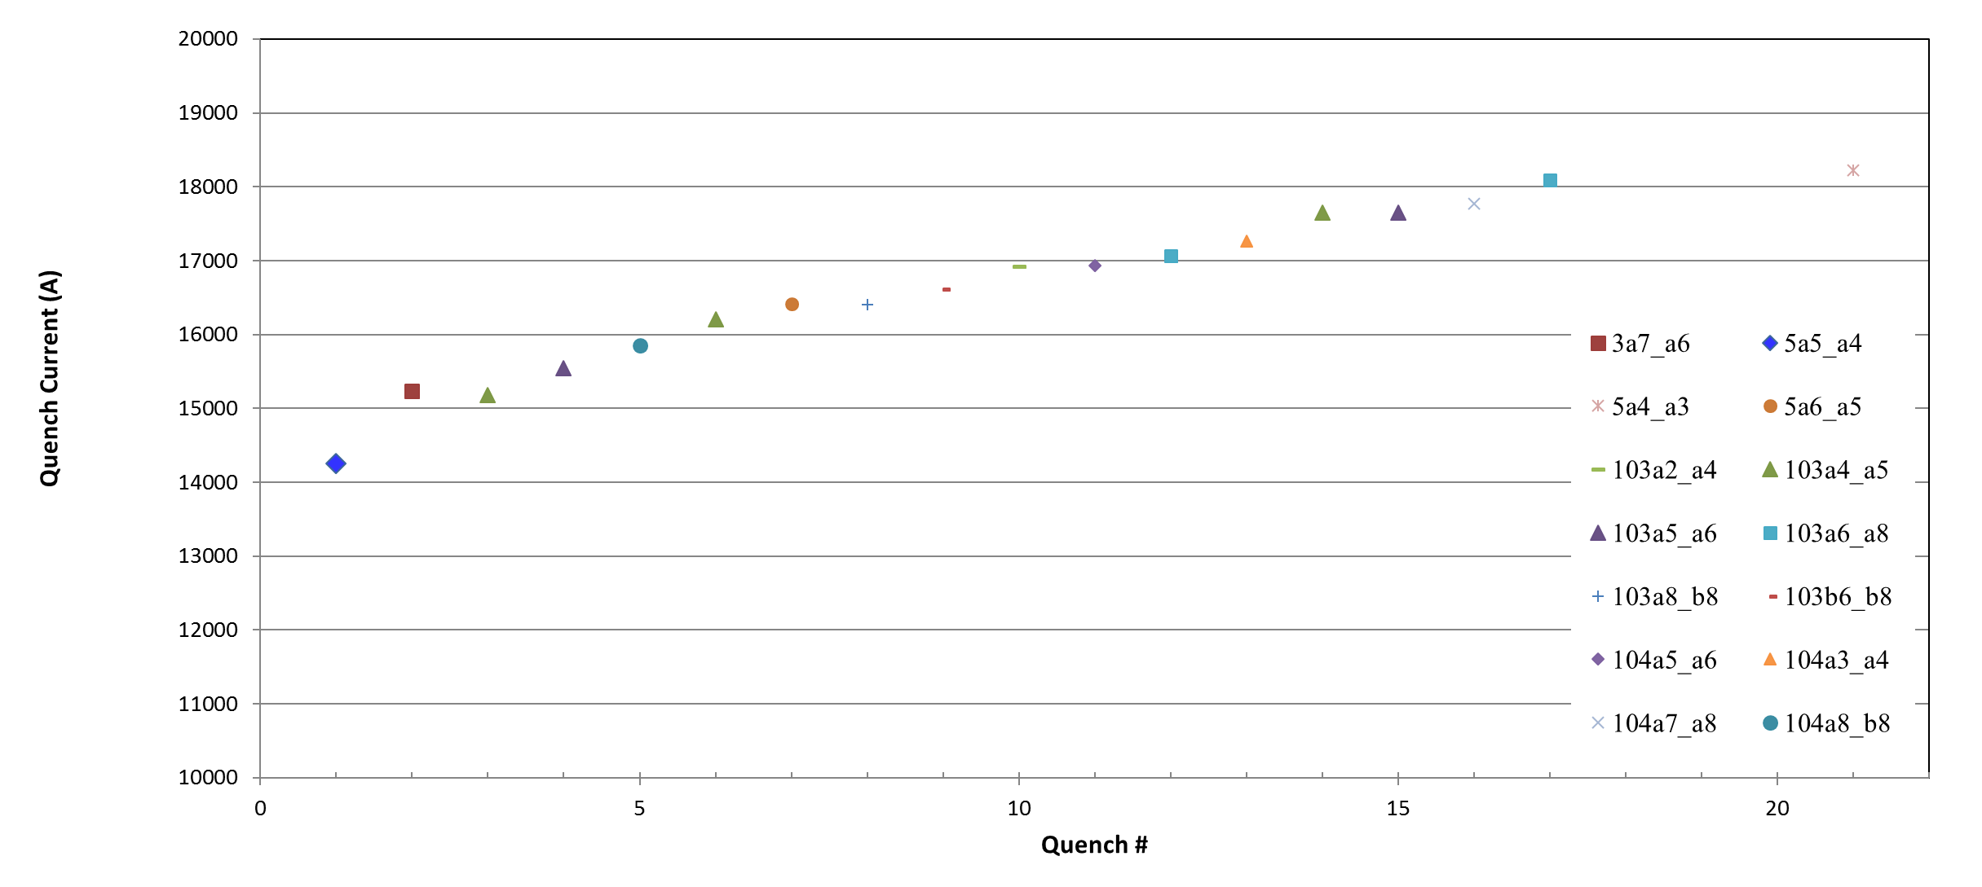
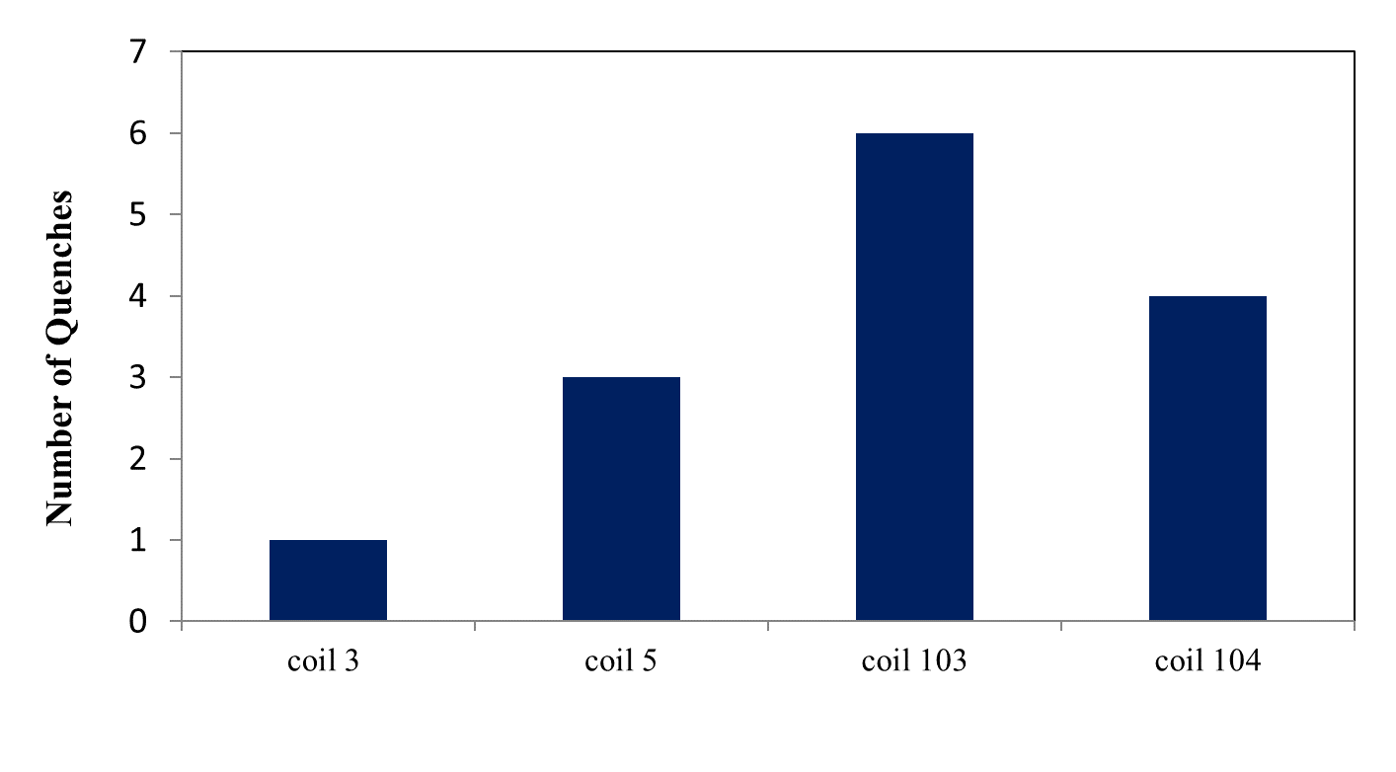
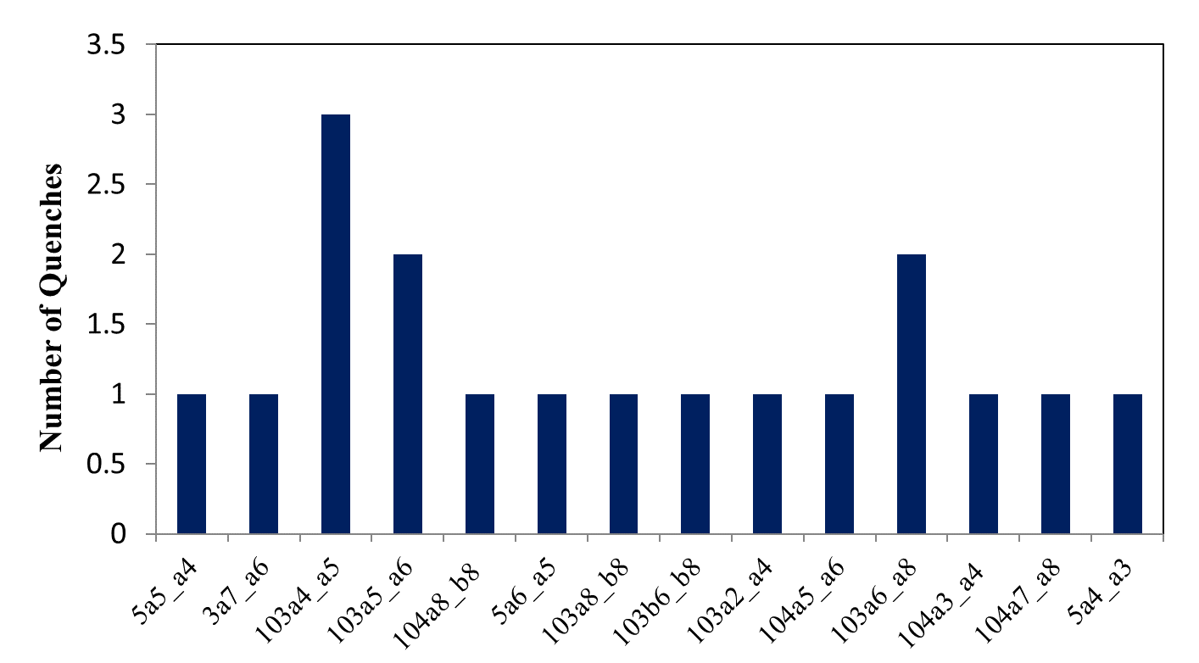
MQXFS1
Exceeded Ultimate current; healthy training

Slide 13
Local Impact Conclusion
Marks on coil 104 were significantly worse than the marks on coil 206
Impact velocity was higher for coil 104 than 206
Coil 104 performed well in MQXFS1
➔ coil 206 acceptable for use from this point of view (local impact analysis)

Slide 14


Load Analysis on the MQXFA Coil Shipping Fixture
Heng Pan
LBNL

Slide 15
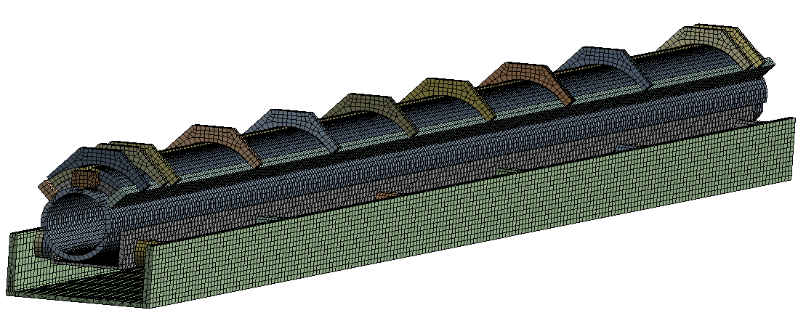
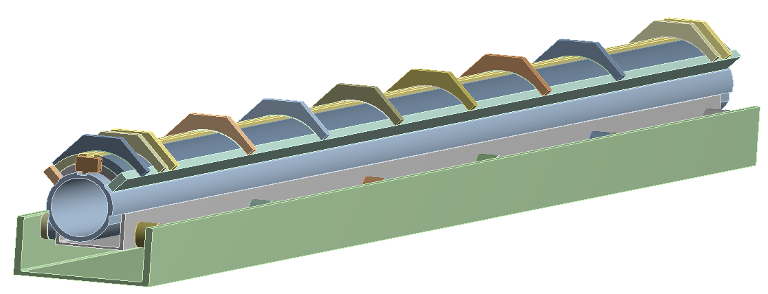
FE Model Overview
Coil Clamp
Rubber Isolator
End Stopper
Vertical inertial load
Base Channel
Side Rail
Fixed support on the bottom e surface
Support Tube
Support Channel
The material of the coil shipping fixture components is Aluminum 6061.
All components are in contact using contact elements
  Contact174 --- 3D surface-surface contact element
  Target170 --- Associated 3D target element
  Friction coefficient is 0.2
  Inside coil winding --- bonded
  Between shipping fixture components --- bonded
  Between coil and fixture --- frictional, mu=0.2

Slide 16
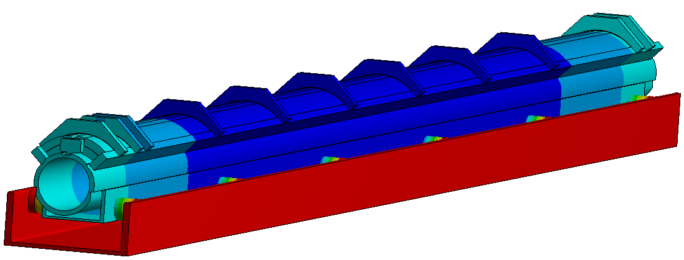
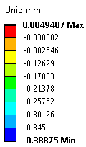
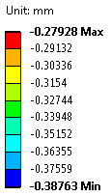
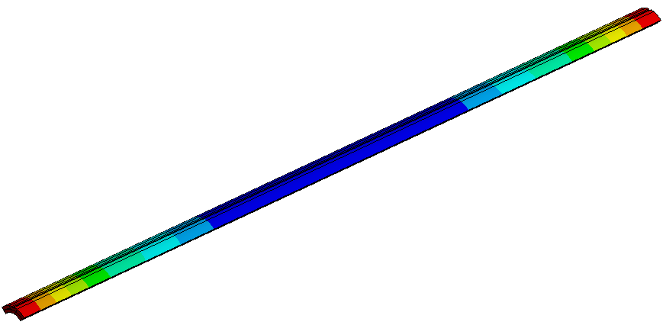
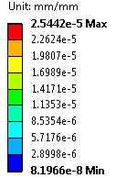
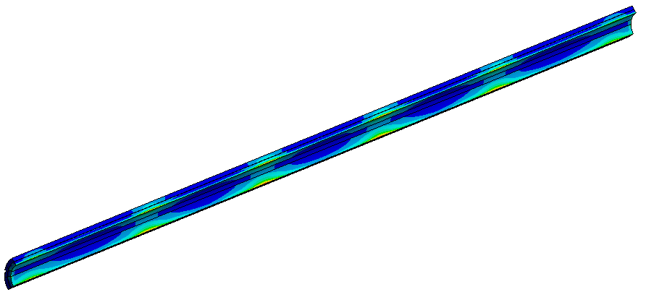
5g Vertical Inertial Load
0.5GPa Isolator modulus
0.39 mm
Vertical Deflection (mm)
Coil deformation is ~105 (µm)
Coil Equivalent Strain,
Maximum strain is ~25.4 µε
Coil Vertical Deflection (mm)

Slide 17
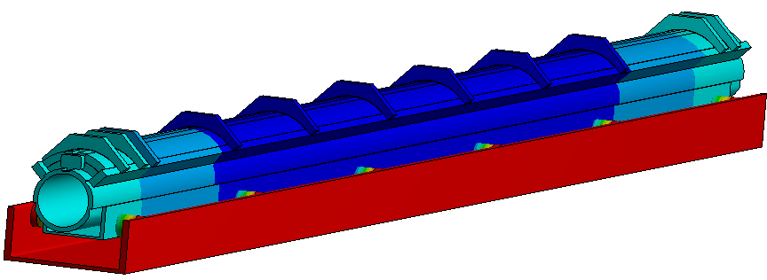
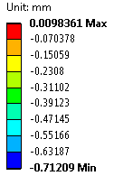
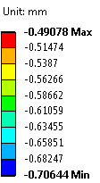
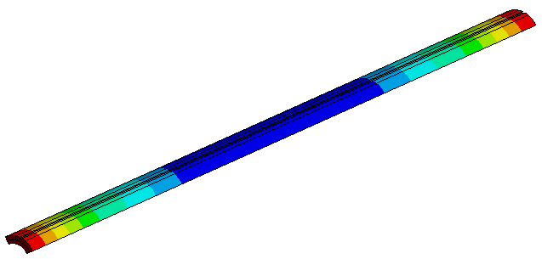
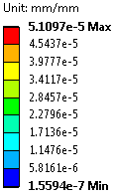
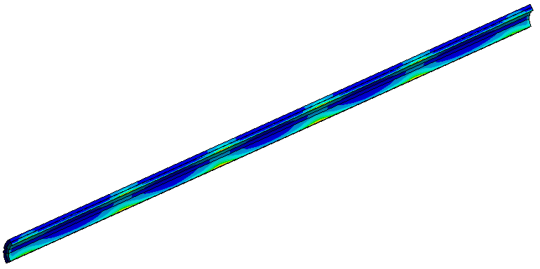
10g Vertical Inertial Load
0.5GPa Isolator modulus
0.71 mm
Vertical Deflection (mm)
Coil deformation is ~210(µm)
Coil Vertical Deflection (mm)
Coil Equivalent Strain,
Maximum strain is ~52 µε

Slide 18
To be added (10g):

