Slide 1
QXFA112, QXFA113, and QXFA115 Review for Magnet MQXFA04
Fred Nobrega, CAM/L3
Miao Yu, Deputy L3
Marcellus Parker, Electrical
Coil Fabrication at FNAL
U.S. HL-LHC Accelerator Upgrade Project
MQXFA04 Coil Selection Review
October 30, 2019

Slide 2
Outline
Coil Mechanical Measurements
Coil Pole Gaps
Cable & Coil Lengths
Coil Reaction/Impregnation Plots
Coil Size, CMM
Coil Electrical Results
Hipot Results
Impulse Test Results
Electrical Measurements
Discrepancy Reports

Slide 3
Pole Gaps

Slide 4
Cable & Coil Length
FDR Coil length = 4532 ± 3.5

Slide 5
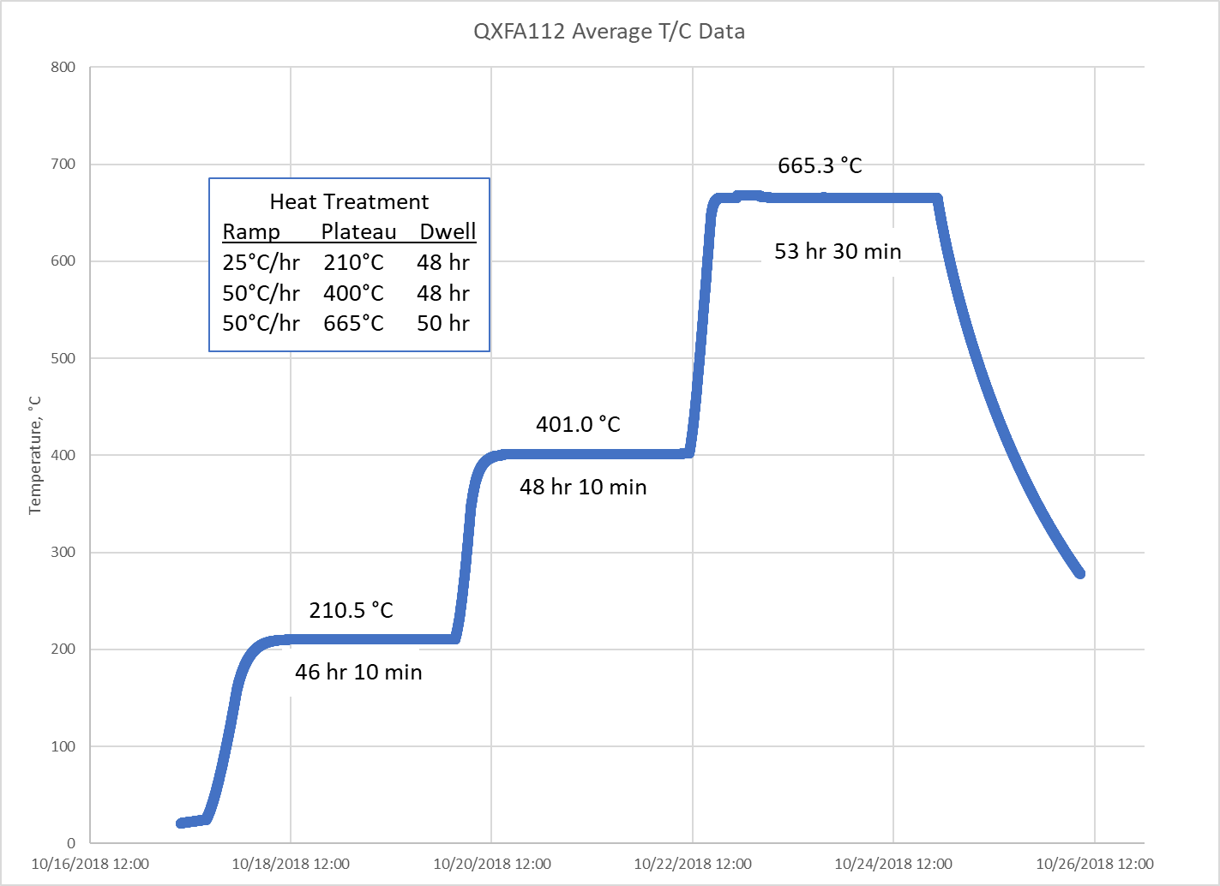
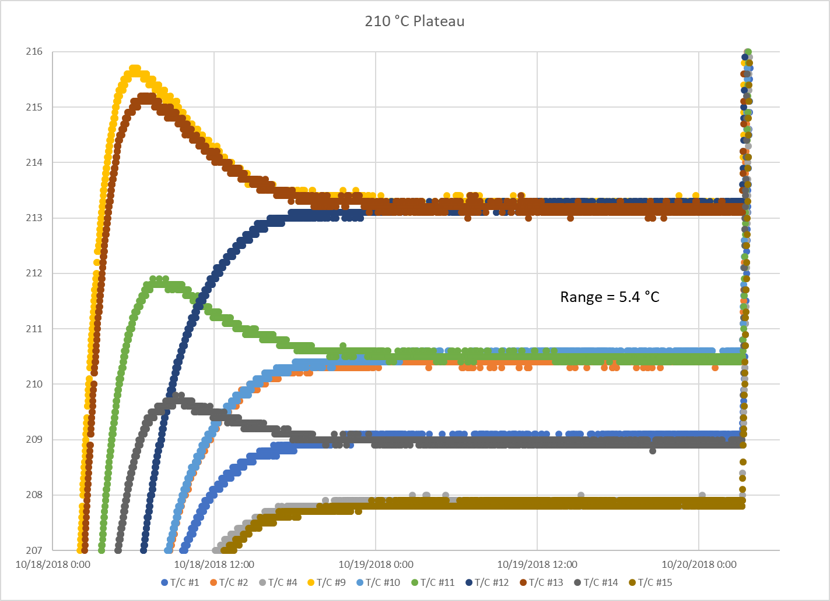
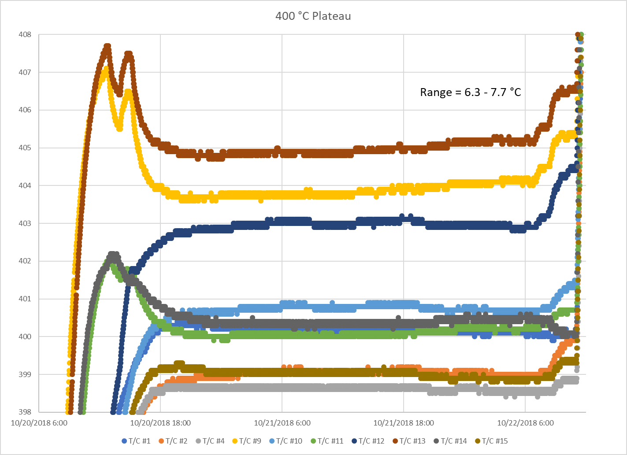
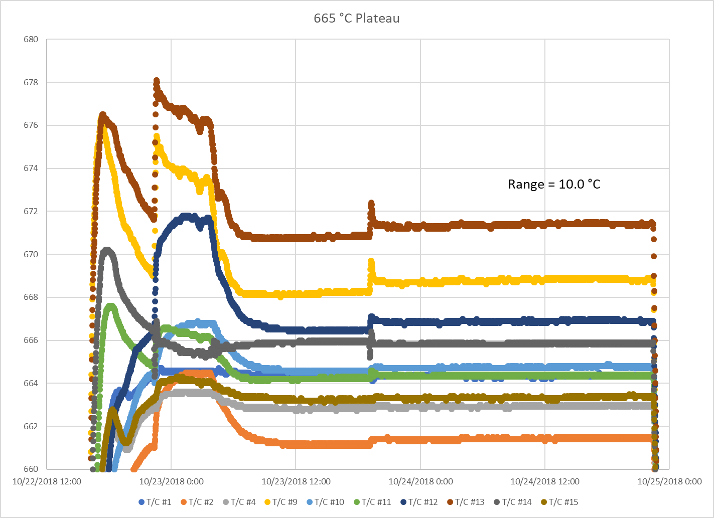
QXFA112 Reaction Plots
Driver issue

Slide 6
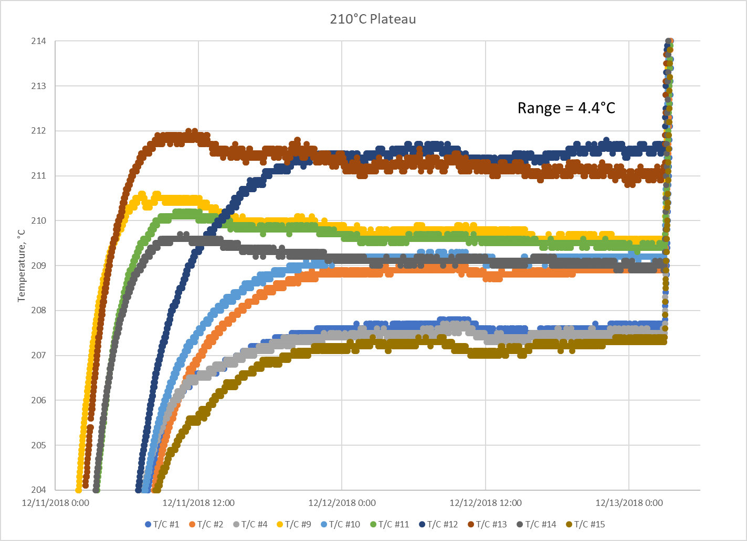
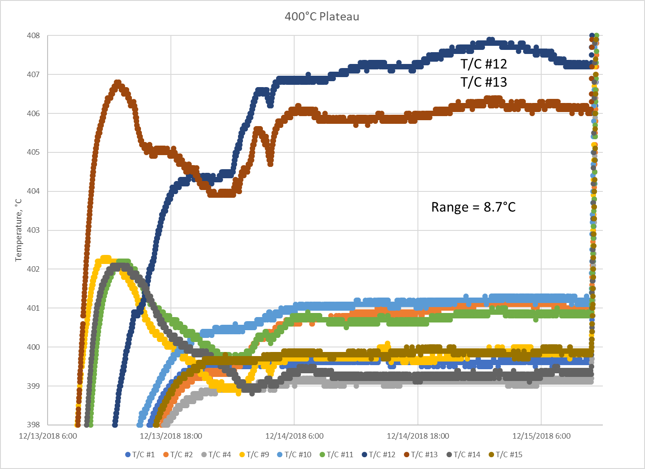
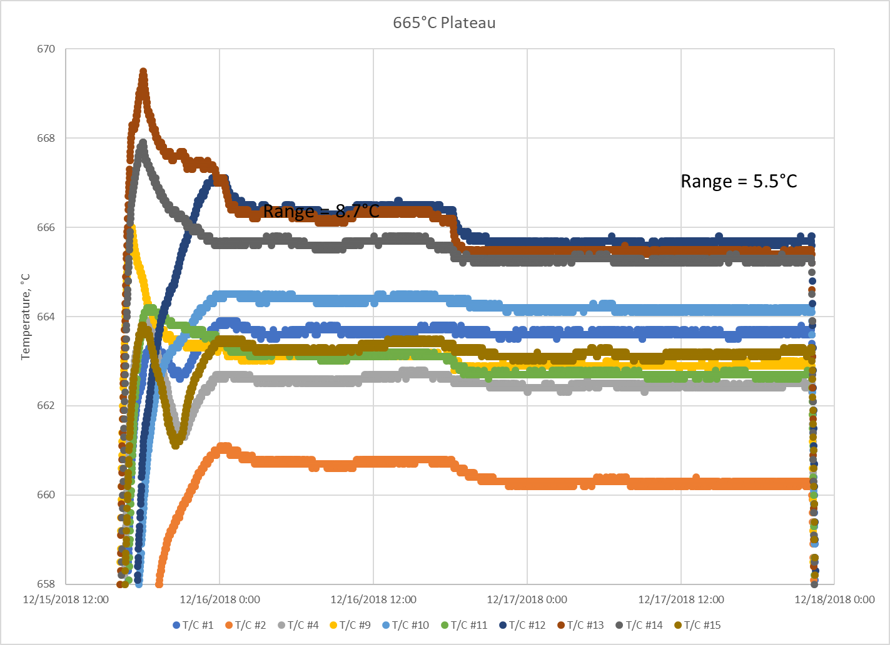
QXFA113 Reaction Plots
Heater Zone Balance and
T/C calibration issue.

Slide 7
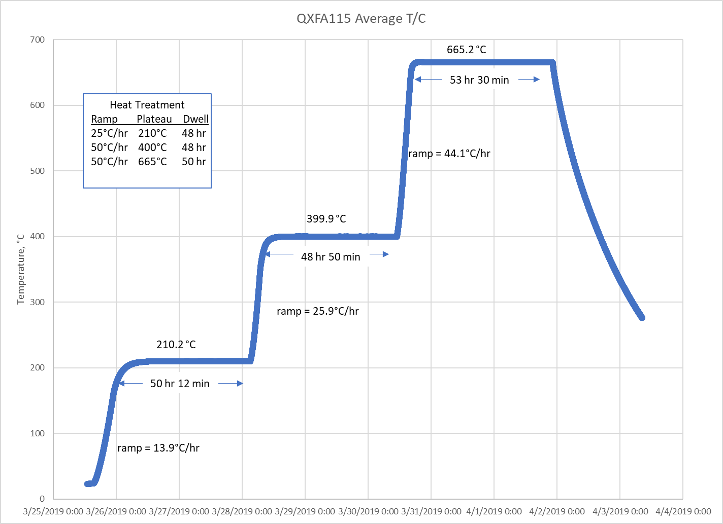
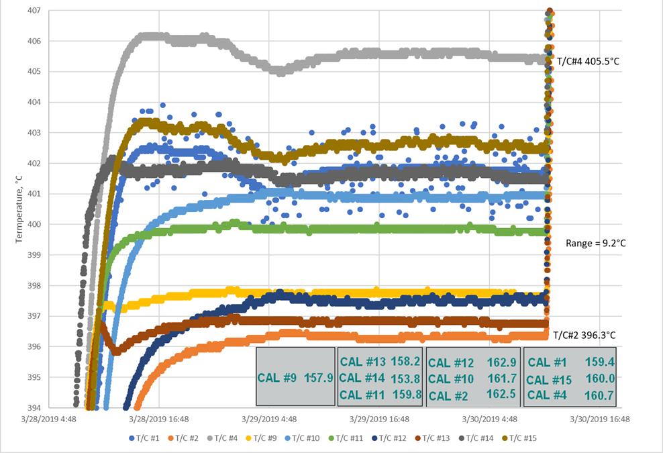
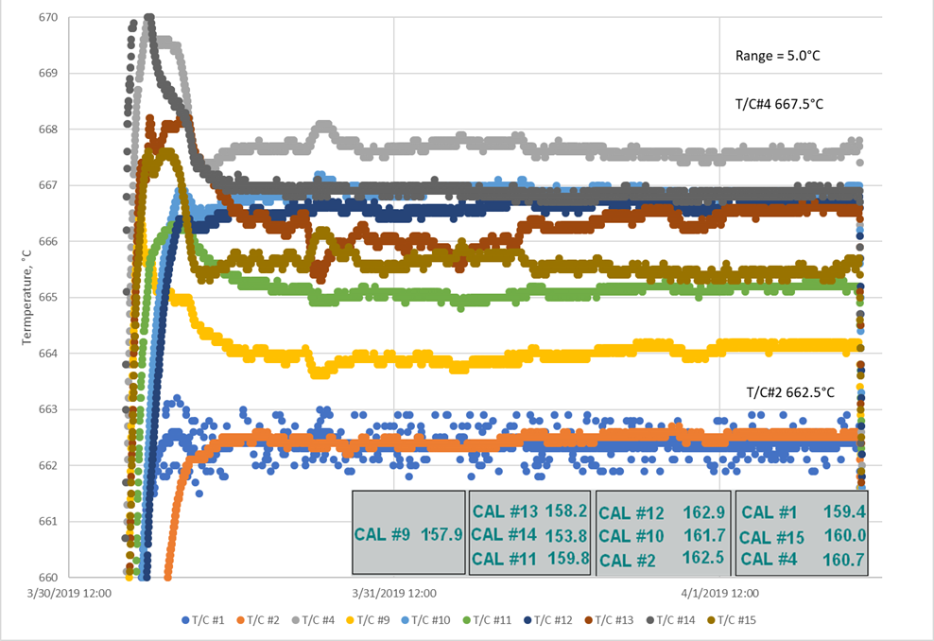
QXFA115

Slide 8
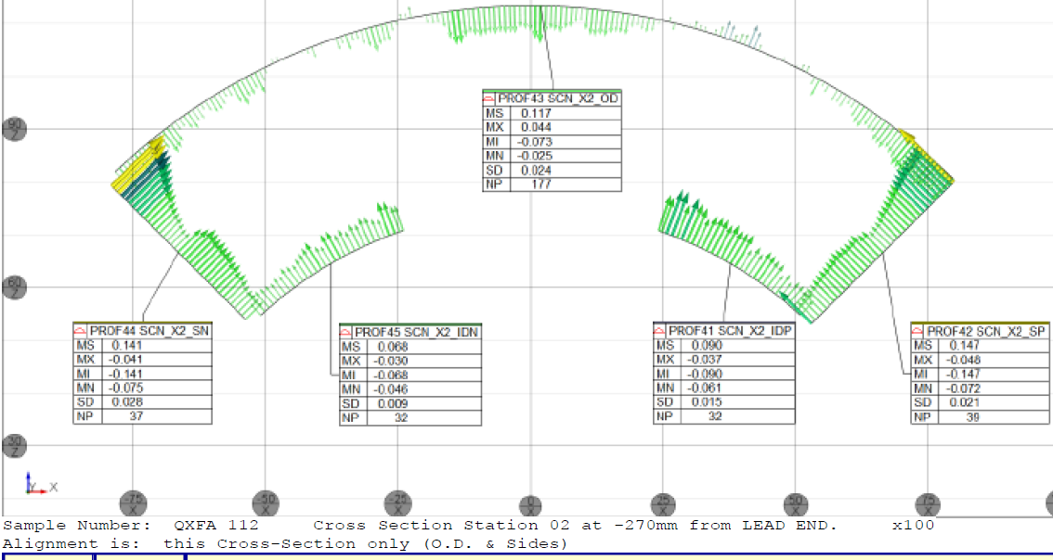
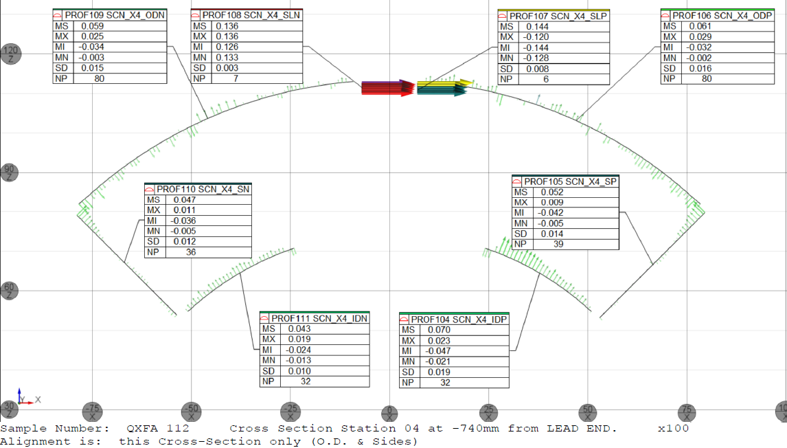
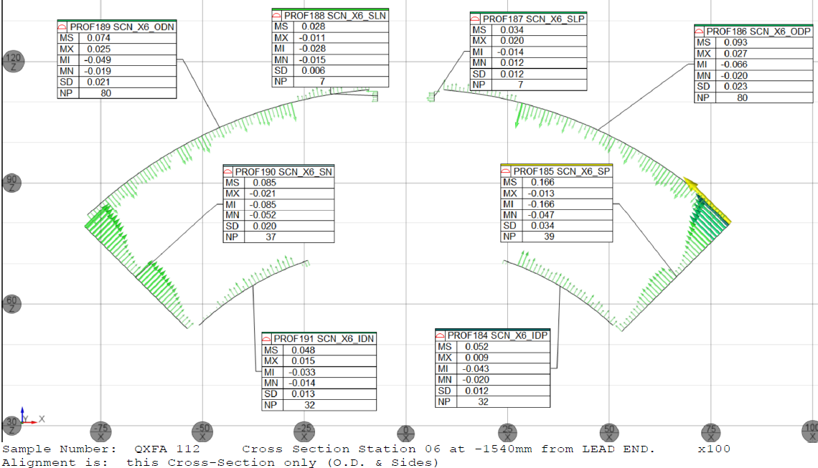
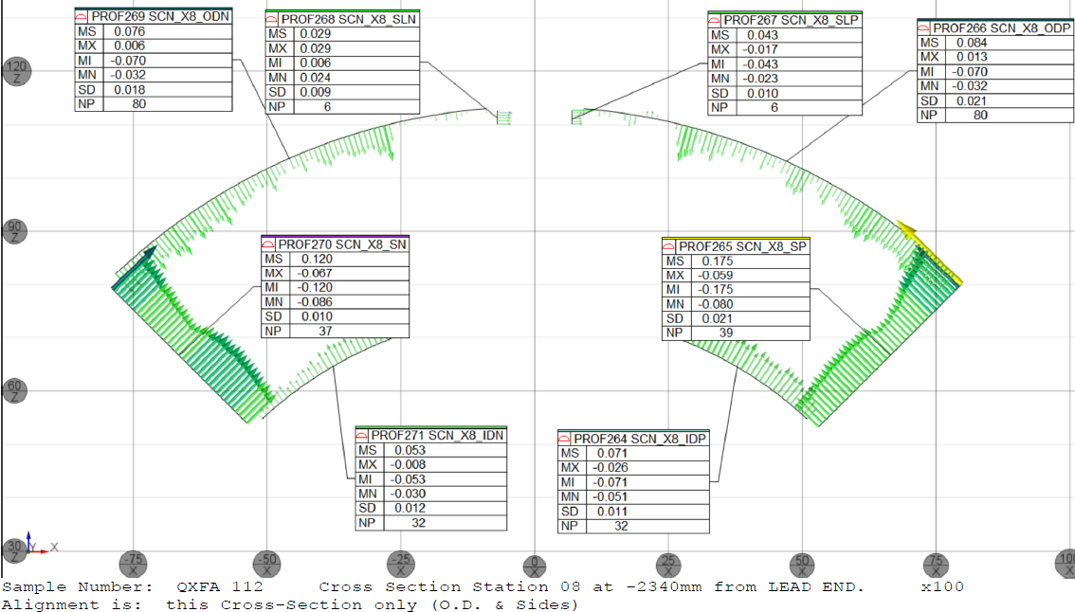
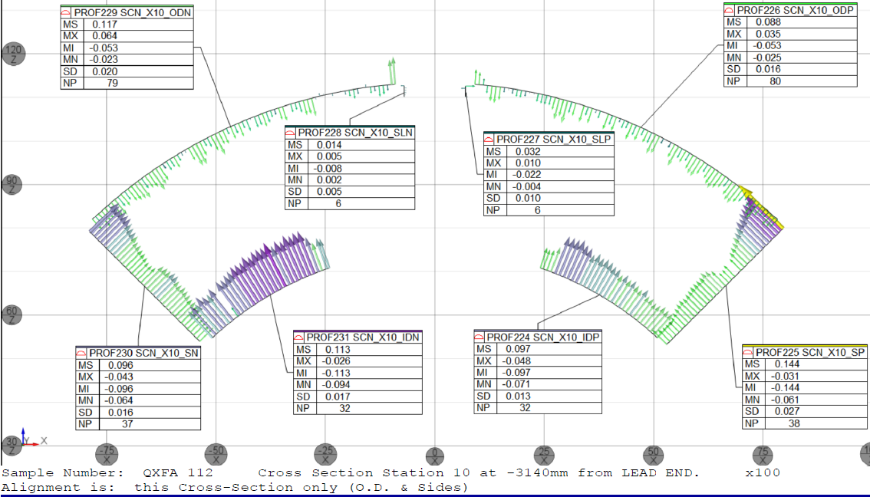
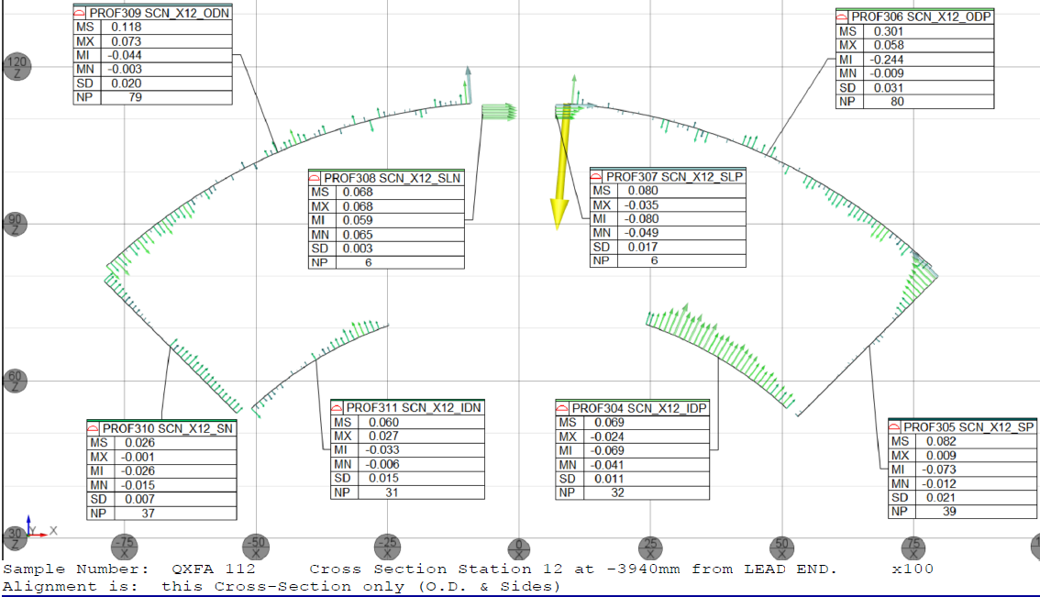
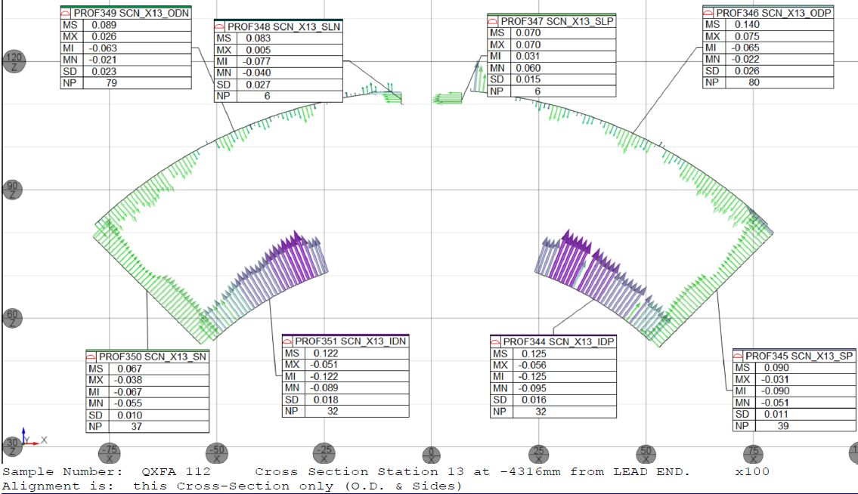
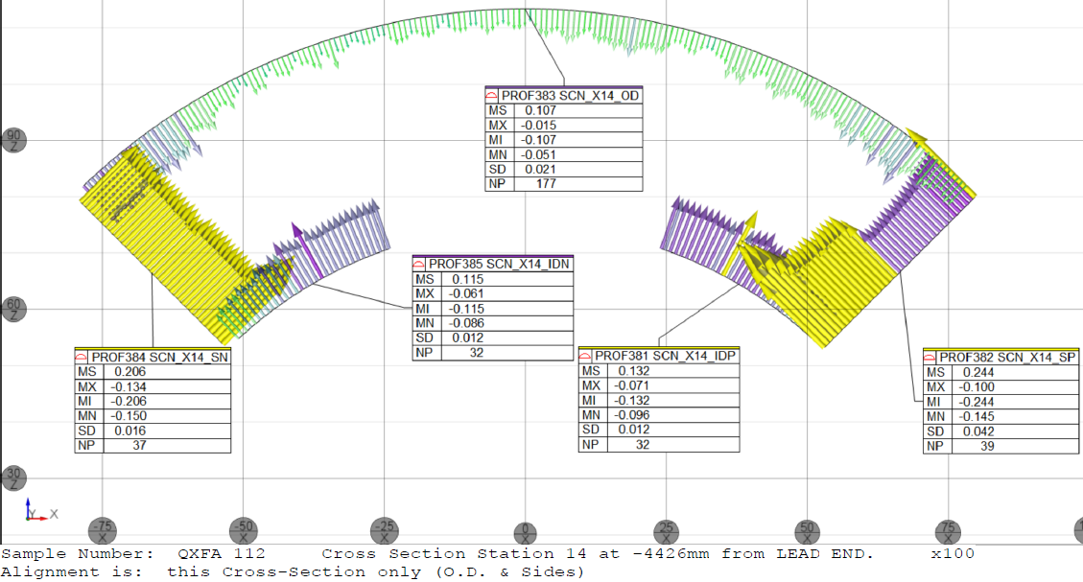
QXFA112 Coil Size, CMM
mm, from Coil LE
327
740
270
2340
1540
3140
4323
3940
4426

Slide 9
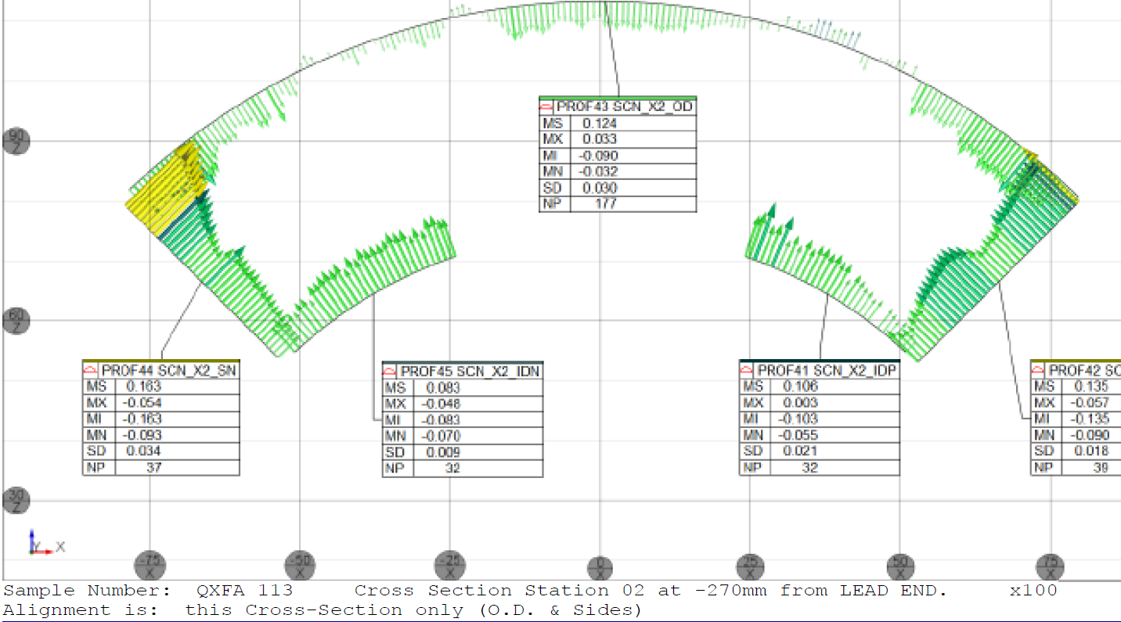
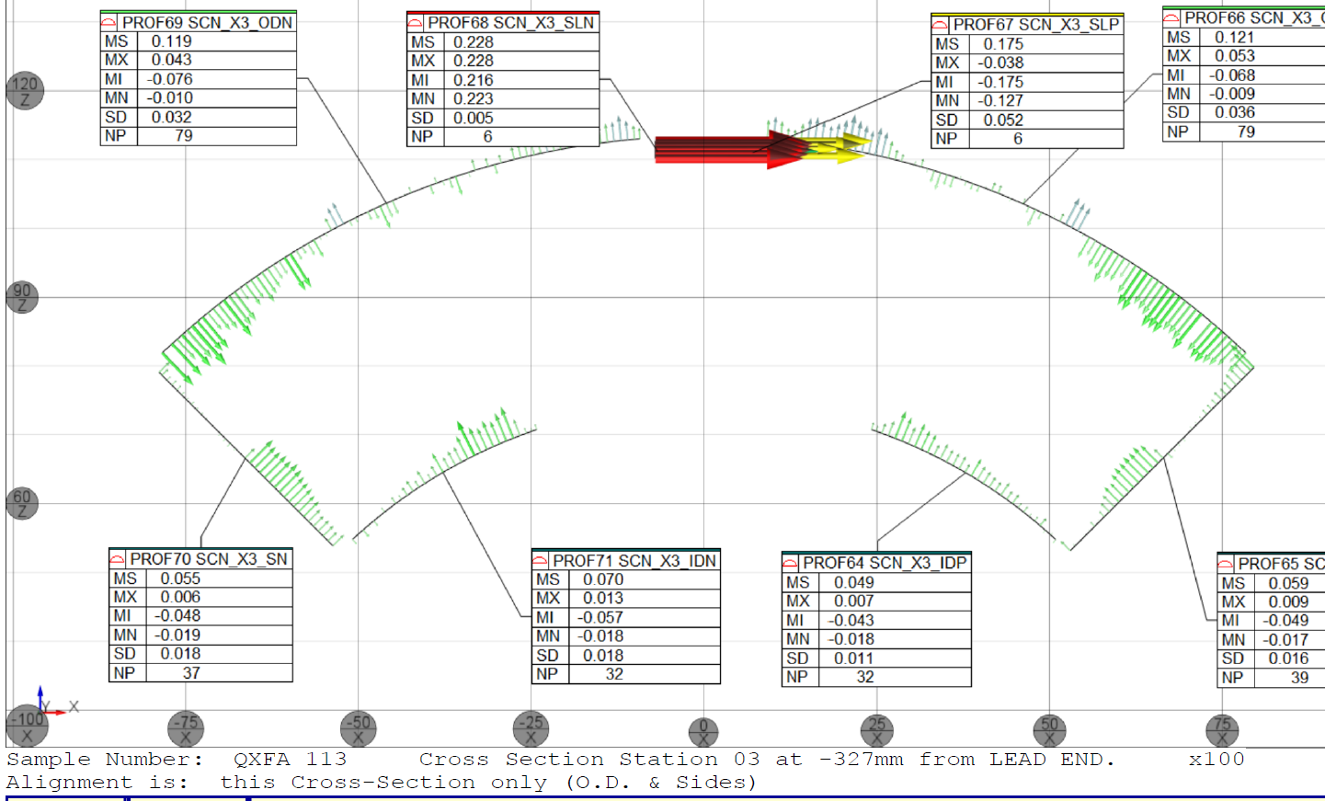
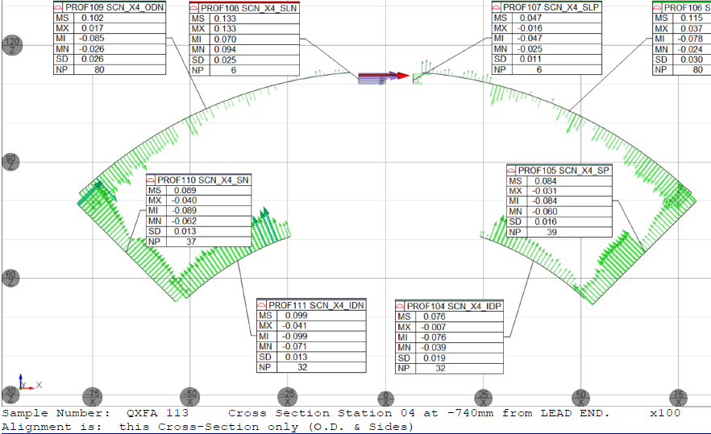
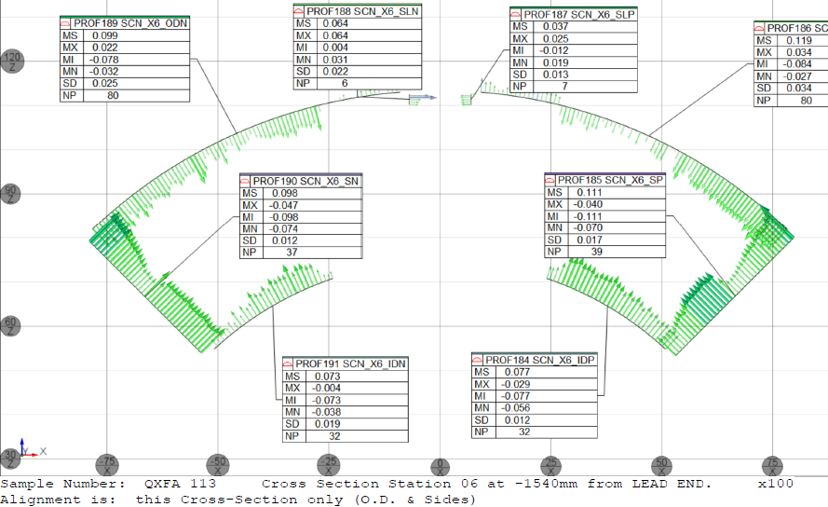
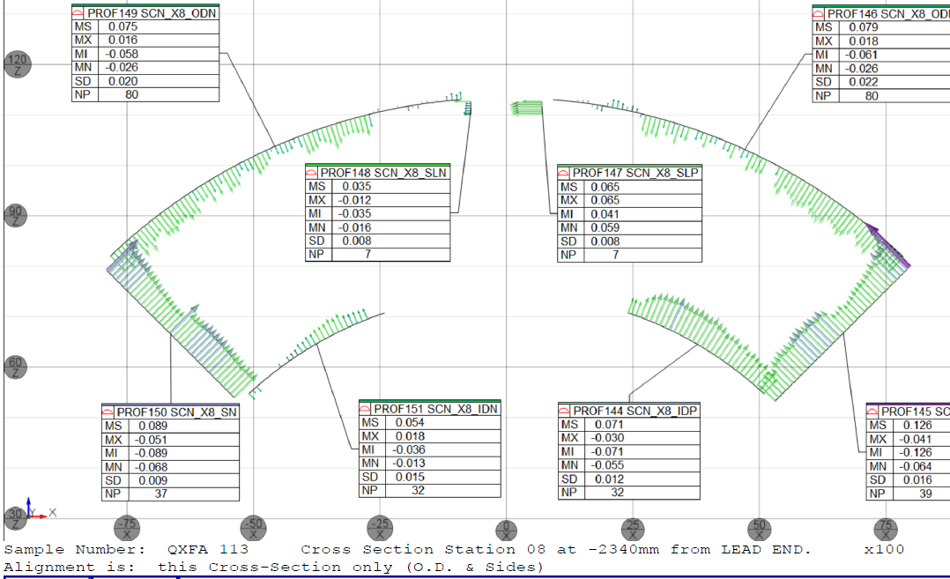
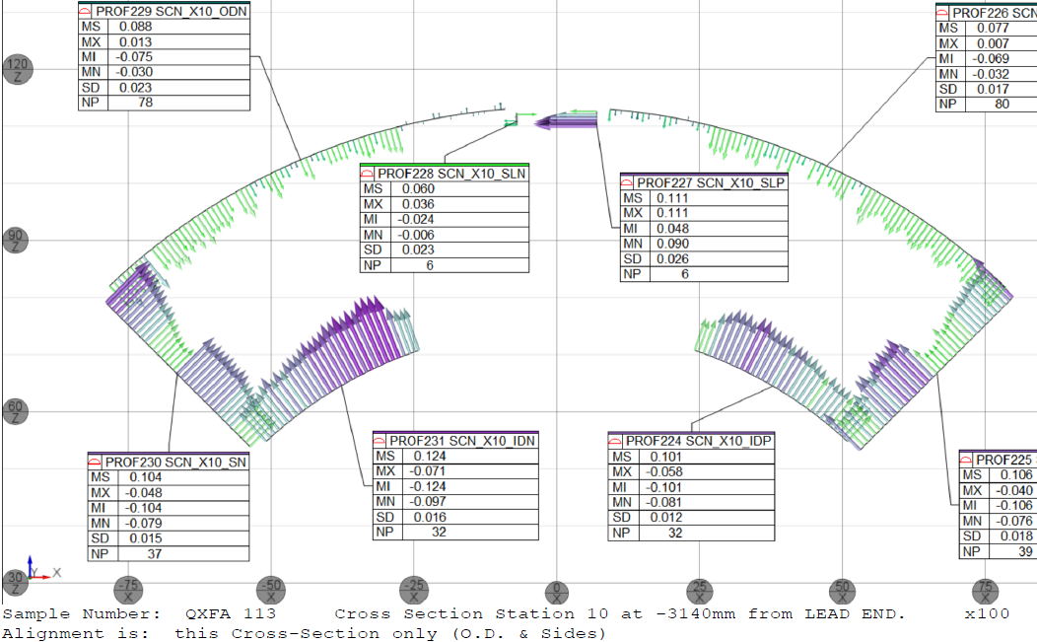
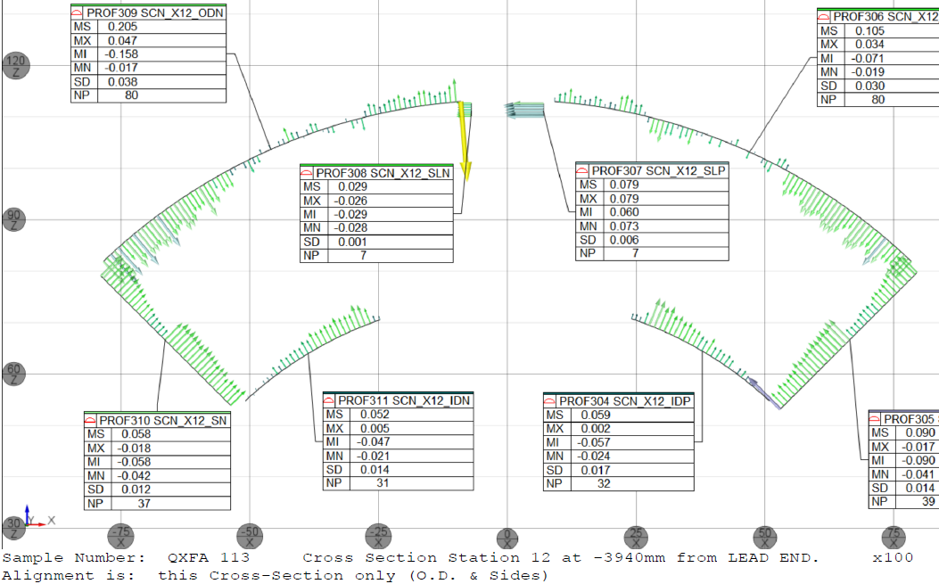
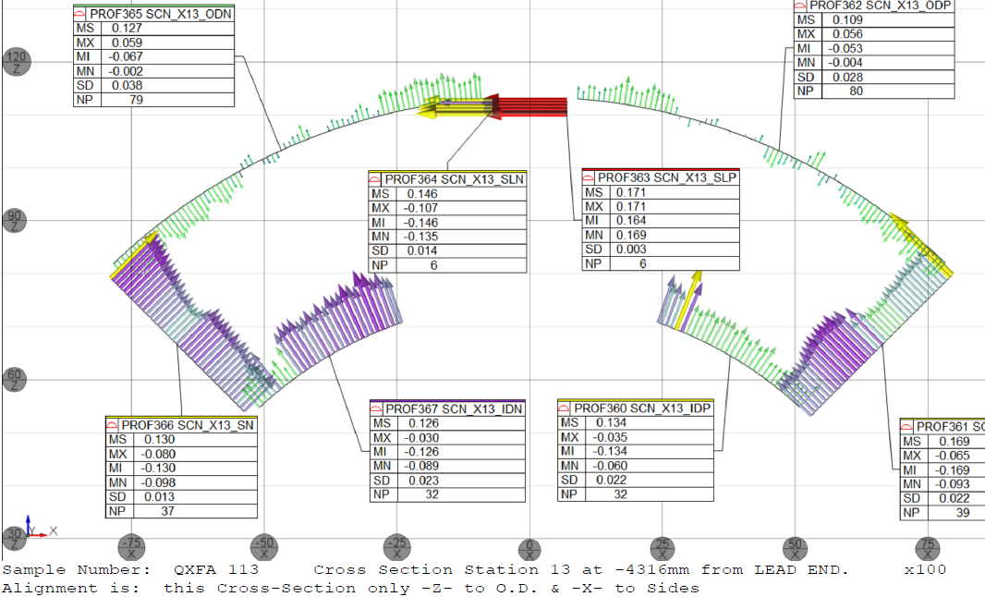
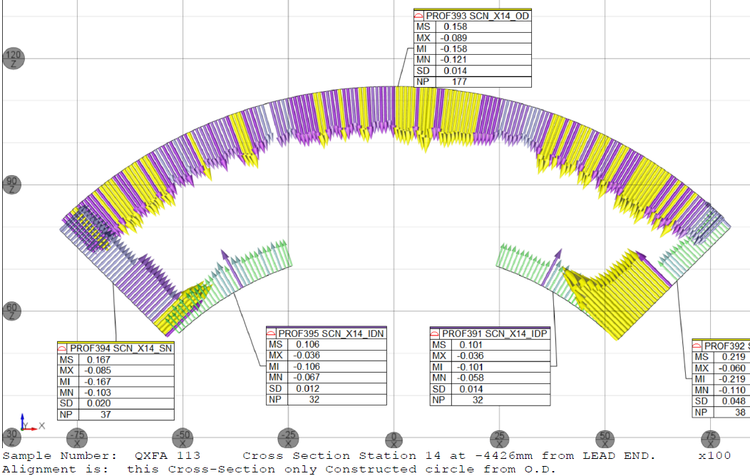
QXFA113 Coil Size, CMM
mm, from Coil LE
270
327
740
1540
2340
3140
3940
4426
4316

Slide 10
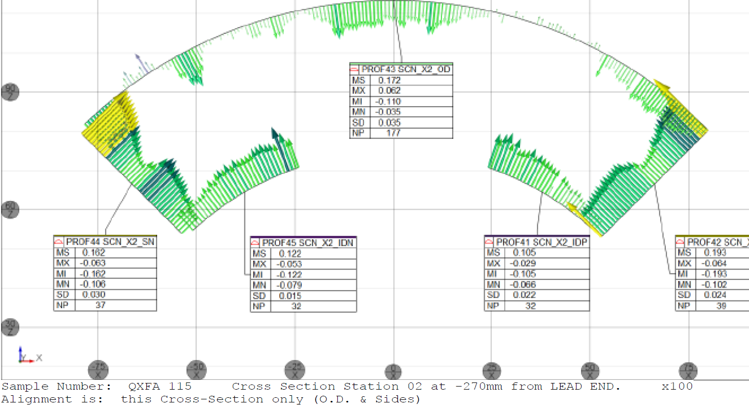
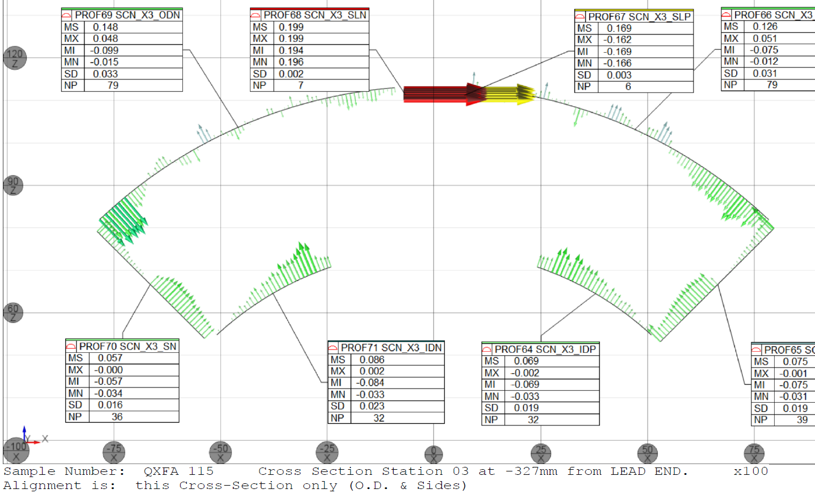
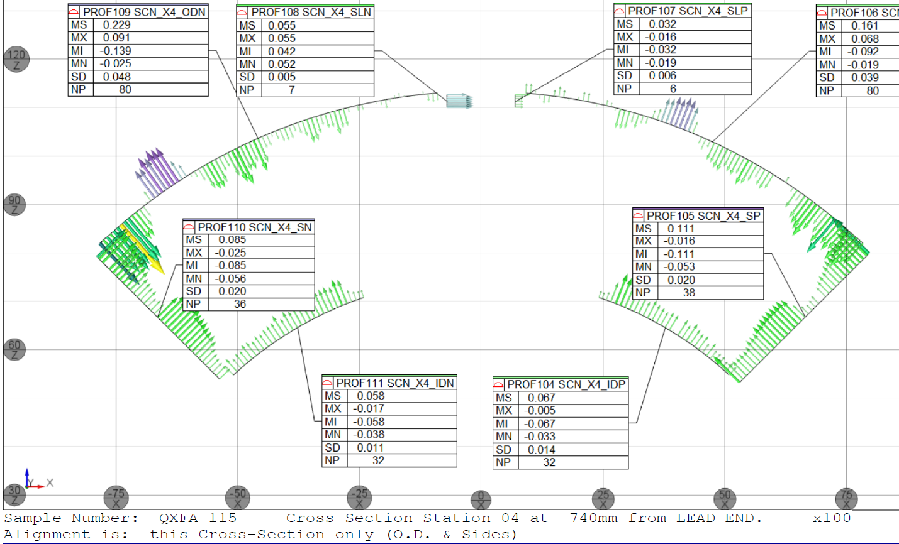
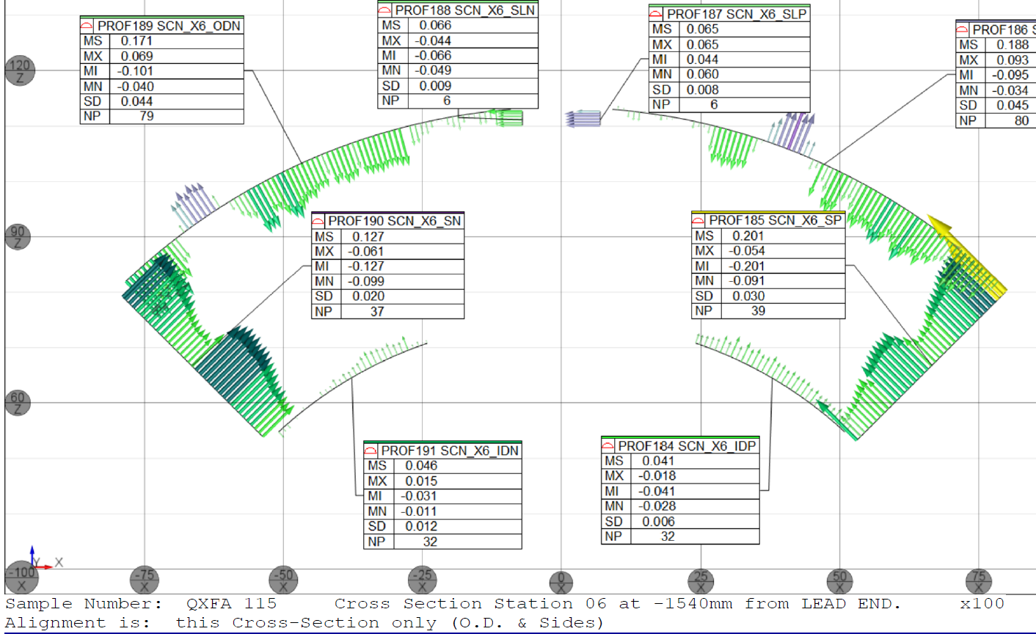
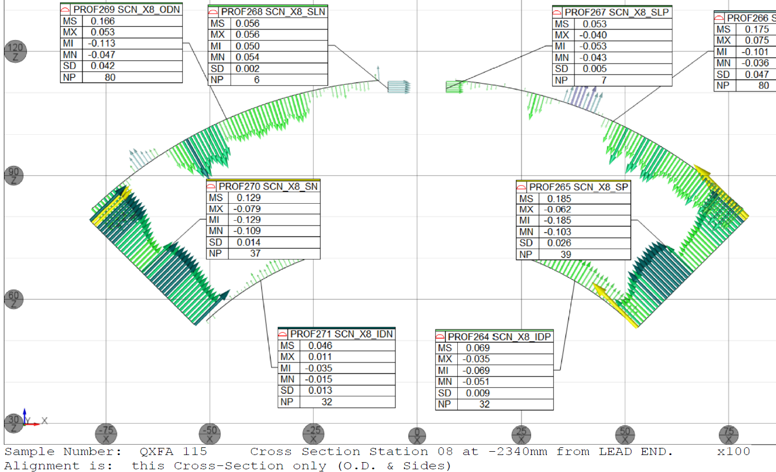
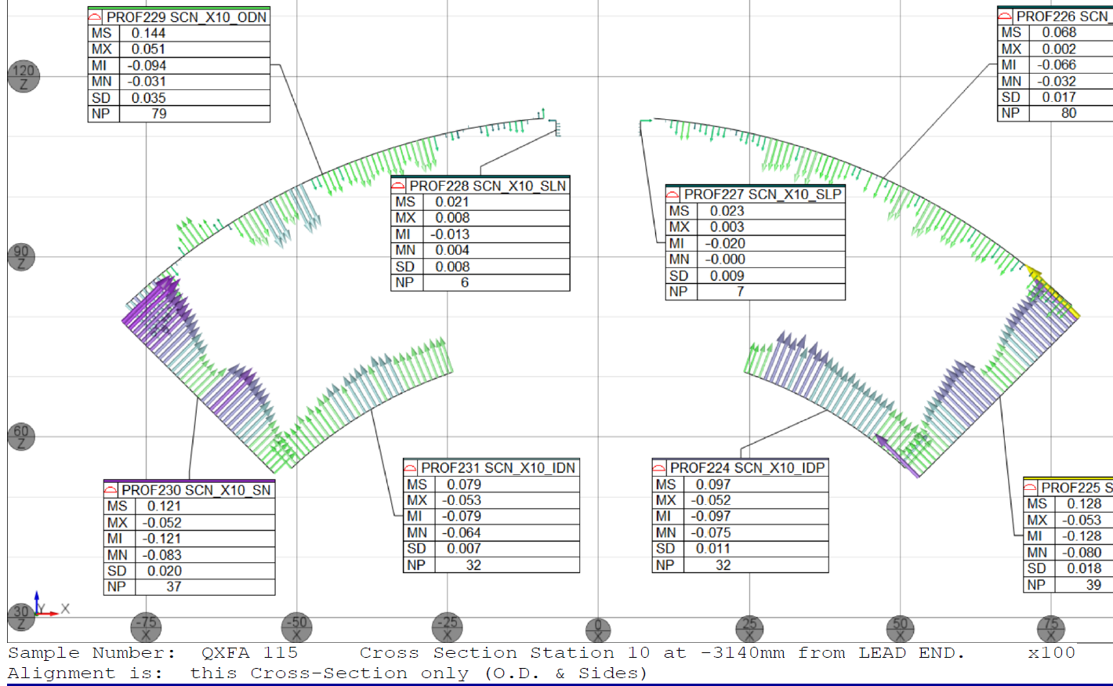
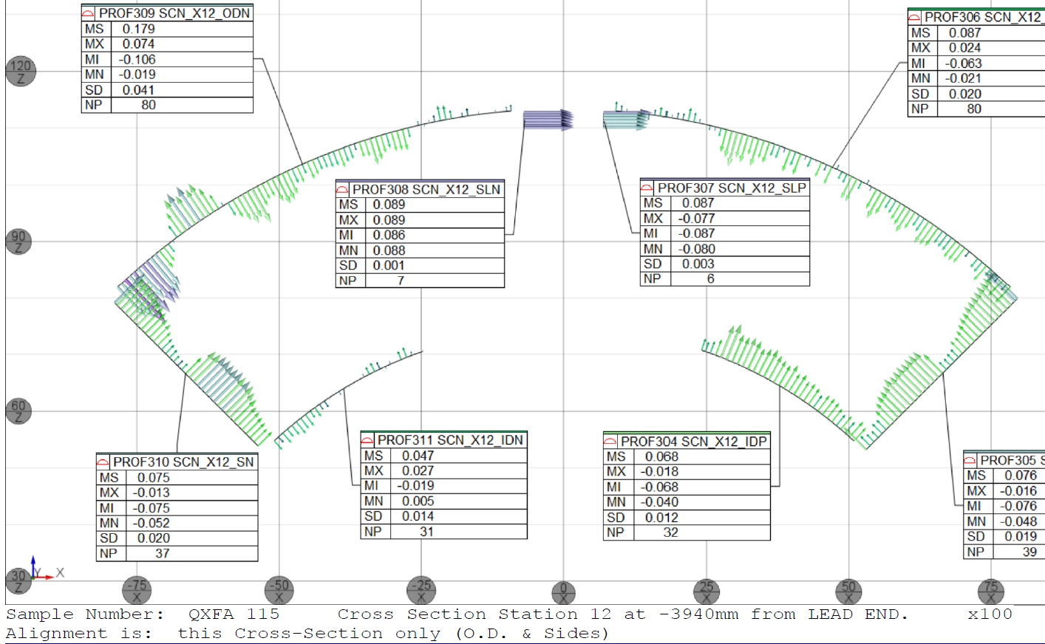
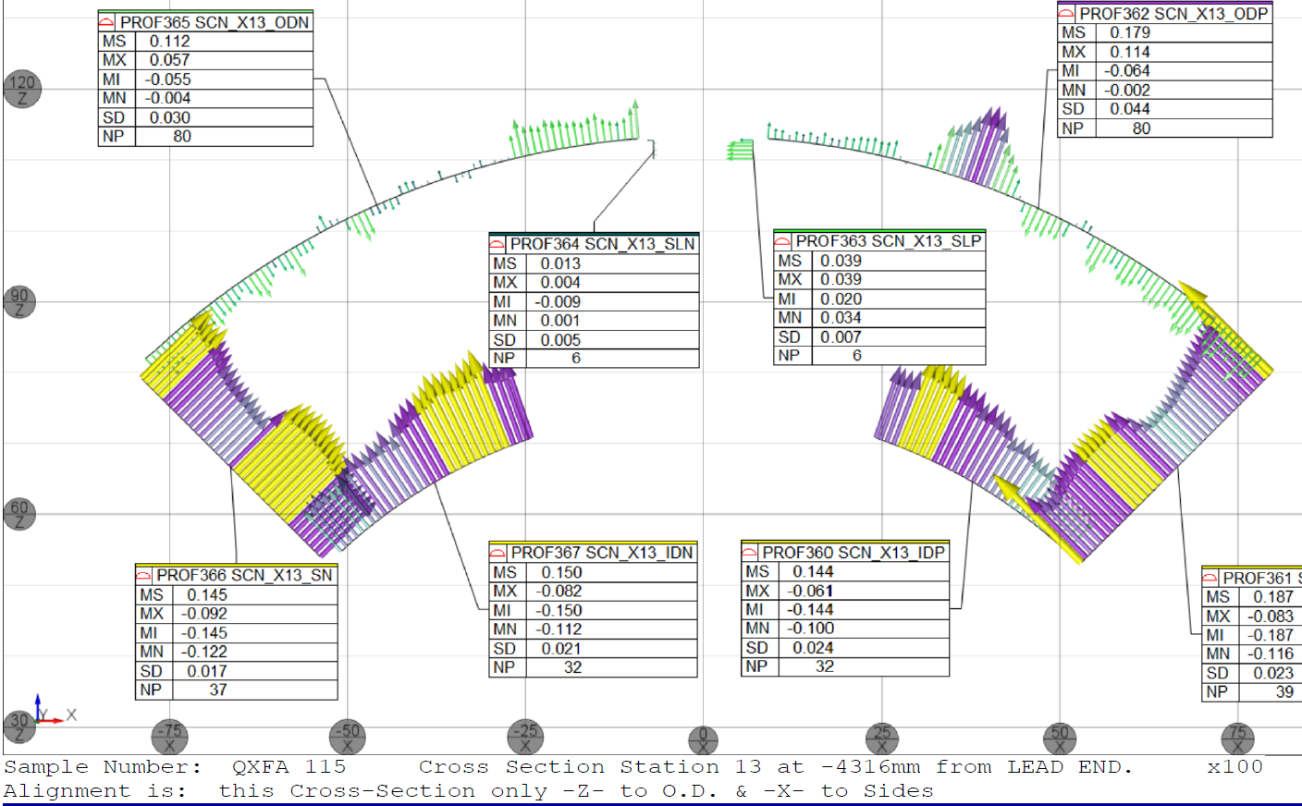
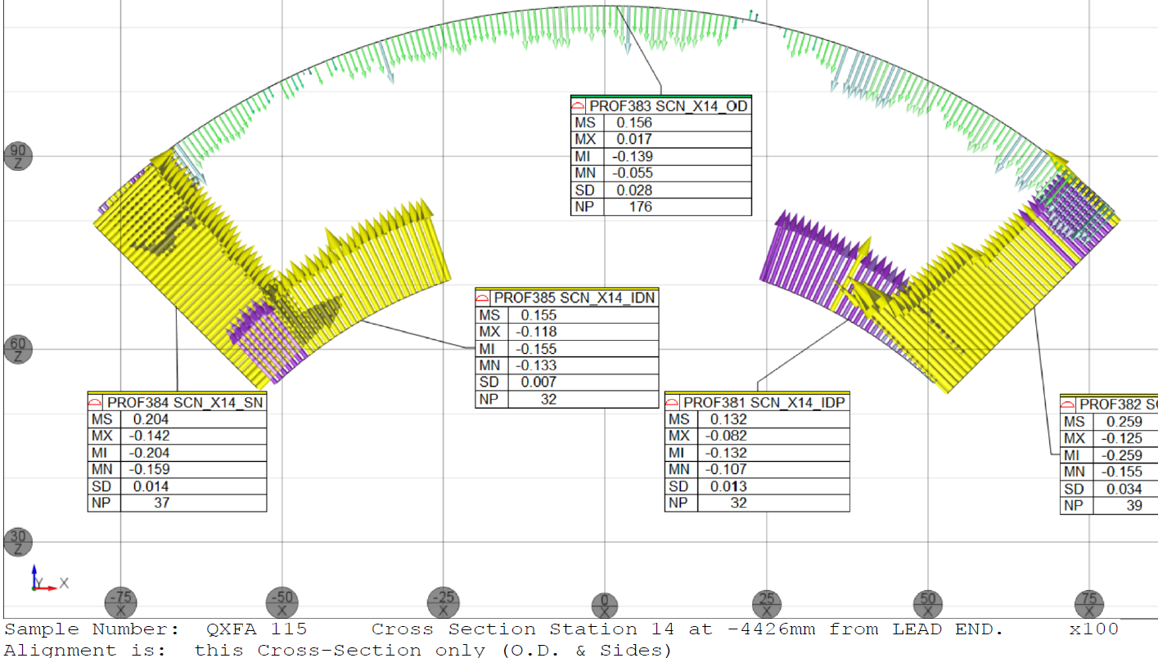
QXFA115 Coil Size, CMM (b6 shift)
mm, from Coil LE
327
740
270
2340
1540
3140
4426
3940
4316

Slide 11
Final Hi-pot Tests

Slide 12
QXFA112 Impulse Test

Slide 13
QXFA113 Impulse Test

Slide 14
QXFA115 Impulse Test

Slide 15
Final Electrical Checks
Measurement | QXFA112 | QXFA113 | QXFA 115* |  | Avg | StDev | StDev/Avg | Min | Max
Coil R @1 A (mV) | 609.3 | 606.12 | 613.07 |  | 608.655 | 11.18489334 | 0.01837641 | 589 | 639.7
Ls @ 20 Hz (mH) | 4.56 | 4.914 | 6.29 |  | 4.89430769 | 1.372540507 | 0.28043609 | 4.56 | 6.29
Q | 0.73 | 0.801 | 1.28 |  | 0.99753846 | 0.686510971 | 0.68820501 | 0.73 | 3.146
Ls @ 100 Hz (mH) | 3.17 | 3.423 | 6.24 |  | 3.39614286 | 0.905308545 | 0.26656963 | 1.86 | 6.24
Q | 1.61 | 1.637 | 5.44 |  | 1.88942857 | 1.02169101 | 0.54074074 | 1.52 | 5.44
Ls @ 1 kHz (mH) | 1.91 | 1.92 | 5.75 |  | 2.15607143 | 1.031657402 | 0.47848944 | 1.812 | 5.75
Q | 2.15 | 2.007 | 8.41 |  | 2.48228571 | 1.70309985 | 0.68610146 | 1.86 | 8.41
VTA1 (mV) | 0.0233 | 0.04 | 0.1 |  | 0.09985833 | 0.094520768 | 0.94654863 | 0.008 | 0.3
VTA2 | 0.072 | 0.09 | 0.1 |  | 0.14691667 | 0.099653117 | 0.67829689 | 0.055 | 0.35
VTA3 | 195.622 | 196.12 | 205.62 |  | 196.280167 | 3.662416174 | 0.01865913 | 190.21 | 205.62
VTA4 | 254.833 | 255.91 | 266.43 |  | 255.52025 | 4.455349269 | 0.01743638 | 247.79 | 266.43
VTA5 | 255.098 | 255.7 | 266.64 |  | 255.720667 | 4.439629498 | 0.01736125 | 248.02 | 266.64
VTA6 | 260.827 | 261.44 | 272.5 |  | 261.350583 | 4.546806317 | 0.01739735 | 253.58 | 272.5
VTA7 | 260.97 | 261.45 | 272.7 |  | 261.536667 | 4.53983671 | 0.01735832 | 253.74 | 272.7
VTA8 | 266.271 | 266.89 | 278.1 |  | 266.85675 | 4.602241558 | 0.01724611 | 258.86 | 278.1
VTB8 | 266.81 | 267.3 | 278.5 |  | 267.348333 | 4.595306085 | 0.01718846 | 259.29 | 278.5
VTB7 | 266.919 | 267.64 | 278.7 |  | 267.576583 | 4.595637088 | 0.01717503 | 259.52 | 278.7
VTB6 | 272.248 | 273.13 | 284.3 |  | 272.9315 | 4.735065814 | 0.01734892 | 264.94 | 284.3
VTB5 | 272.81 | 273.46 | 284.7 |  | 273.2775 | 4.765522874 | 0.0174384 | 265.27 | 284.7
VTB4 | 278.378 | 279.72 | 290.3 |  | 279.113167 | 4.696444092 | 0.01682631 | 270.67 | 290.3
VTB3 | 421.24 | 422.17 | 436.8 |  | 421.775 | 6.647560666 | 0.01576092 | 409.36 | 436.8
VTB2 | 606.05 | 593.7 | 629.8 |  | 605.8425 | 10.41682039 | 0.01719394 | 589.08 | 629.8
VTB1 | 606.1 | 607.82 | 629.8 |  | 606.700909 | 9.776191352 | 0.01611369 | 589.13 | 629.8
QHB1 | 1.96 | 1.855 | 2.07 |  | 1.89664286 | 0.141004973 | 0.0743445 | 1.61 | 2.08
QHB2 | 1.94 | 1.869 | 2.1 |  | 1.91785714 | 0.132417977 | 0.06904476 | 1.65 | 2.1
QHB3 | 1.96 | 1.878 | 2.07 |  | 1.92414286 | 0.128815909 | 0.06694716 | 1.62 | 2.08
QHB4 | 1.94 | 1.865 | 2.03 |  | 1.89935714 | 0.126214198 | 0.06645101 | 1.61 | 2.05
* b6 shift

Slide 16
QXFA112 Discrepancy Reports
DR Number | Document | DR Status
11605 | QXFA Coil Winding and Curing Traveler, cable insulation damage from vendor repaired. | Closed
11662 | QXFA Splice / Epoxy Impregnation Traveler, wedge insulation flaked off after reaction and repaired. | Closed
11680 | QXFA Splice / Epoxy Impregnation Traveler, peristaltic pump error, reset with power cycle. | Closed
11689 | QXFA Splice / Epoxy Impregnation Traveler, epoxy flash removal at midplane repaired. | Closed

Slide 17
QXFA113 Discrepancy Reports
DR Number | Document | DR Status
11649 | Preparation for Coil Winding and Curing Traveler, black marks and popped strands, repaired. | Closed
11660 | QXFA Coil Winding and Curing Traveler, cable insulation damage from vendor, repaired. | Closed
11681 | QXFA Reaction Traveler, Kapton found between turns before reaction and removed. | Closed
11682 | QXFA Reaction Traveler, technician concern regarding fit of the shell. Assembly inspected and no issues found. | Closed
11695 | QXFA Splice / Epoxy Impregnation Traveler, wedge insulation separation after reaction, repaired. | Closed
11696 | QXFA Splice / Epoxy Impregnation Traveler, chipped plasma coating after reaction, repaired. | Closed
11711 | QXFA Splice / Epoxy Impregnation Traveler, epoxy hose damaged from clamp overtightening, repaired. | Closed
11718 | QXFA Splice / Epoxy Impregnation Traveler, a portion of a modified L1 QH trace included a sliver of copper. No action taken. | Closed

Slide 18
QXFA113, DR11718

Slide 19
QXFA115 Discrepancy Reports
DR Number | Document | DR Status
11730 | QXFA Coil Winding and Curing Traveler, one layer of the multilayer pole tape frayed during installation due to tech error, repaired. | Closed
11753 | QXFA Reaction Traveler, after L2 coil curing, L1 pole insulation moved out of position, repaired. | Closed
11770 | QXFA Splice / Epoxy Impregnation Traveler, wedge bare spot after reaction, repaired. | Closed
11791 | QXFA Splice / Epoxy Impregnation Traveler, 1 mil SS strip used as a lead for QH trace electrical measurements tore. Torn piece removed at later step. | Closed
11793 | Electrical Testing Traveler, electrical measurements skipped due to late trace. Measurements taken at a later step. | Closed
11858 | Splice / Epoxy Impregnation Traveler, small nonmetallic foreign object potted above S2 glass. | Closed
11869 | QXFA Splice / Epoxy Impregnation Traveler, CMM bumps on coil, S2 glass delamination. | Closed

Slide 20
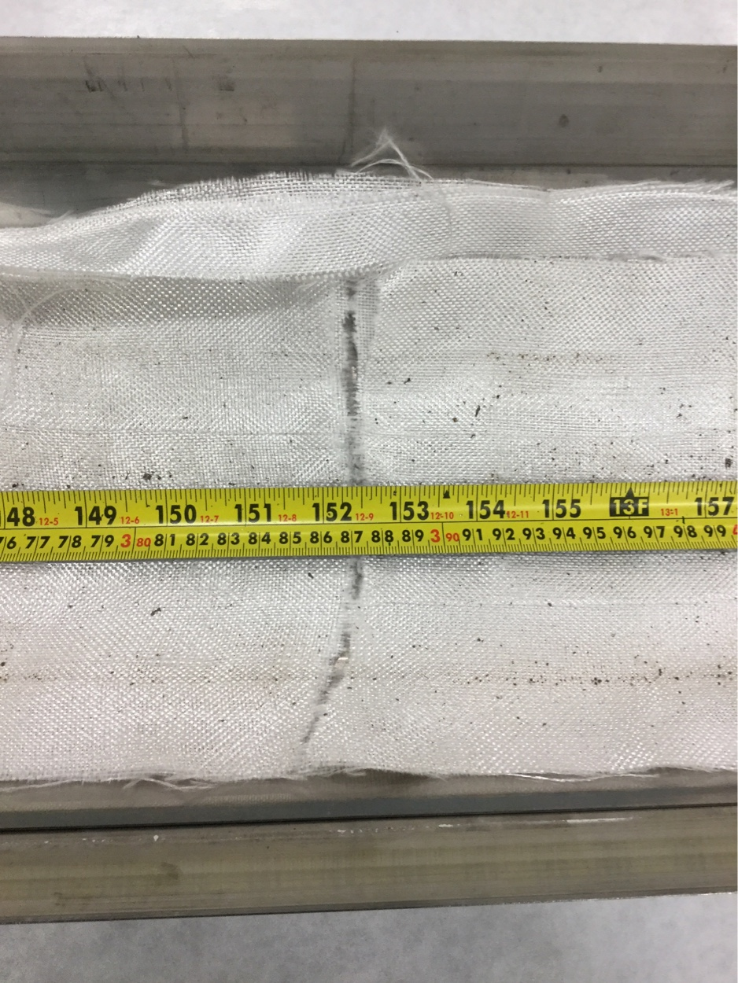
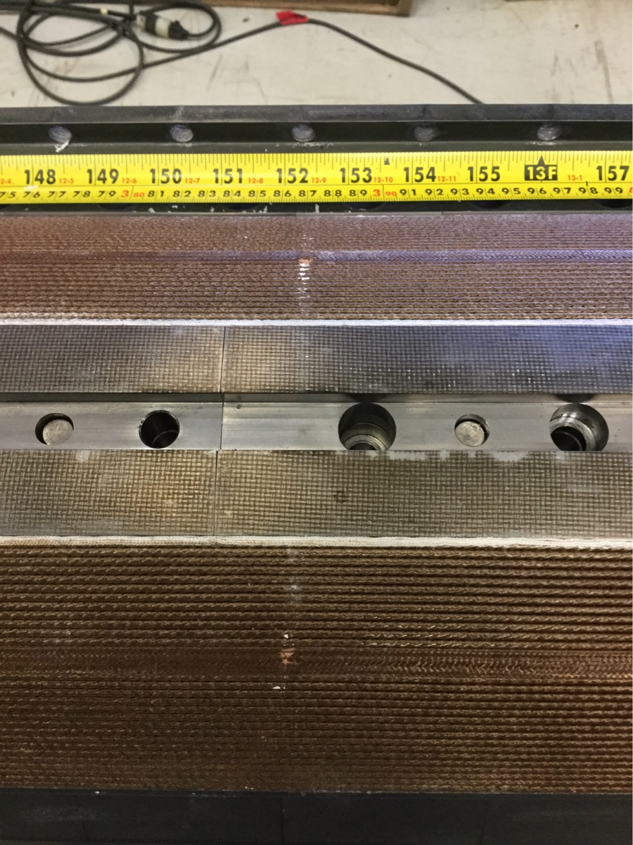
QXFA115, DR11770
Near return end of coil, 3.87 m from LE.

Slide 21
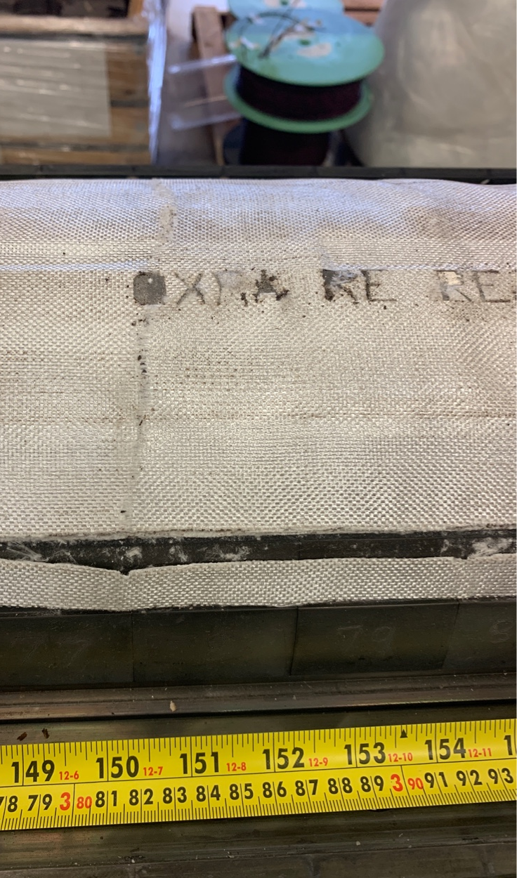
QXFA115, DR11770
Cause of Nonconformance:
Clear cause is unknown. Possible cause is a high-pressure seam between 2 form blocks #78 & #79. The contact between these 2 form blocks coincides with the tear in glass and the missing insulation on the L2 wedges on both sides.
Disposition:
Repair the wedge insulation using GE varnish diluted with acetone.
Swap reaction form blocks #78 & #79 with form blocks #1 & #2 for the next reaction cycle.
Etch affected form blocks with revised position numbers.
Add a reminder in the next traveler (QXFA116) to inspect position at for blocks #78/79 (152.5" from LE)to see if swapping blocks made an improvement.
QXFA116

Slide 22
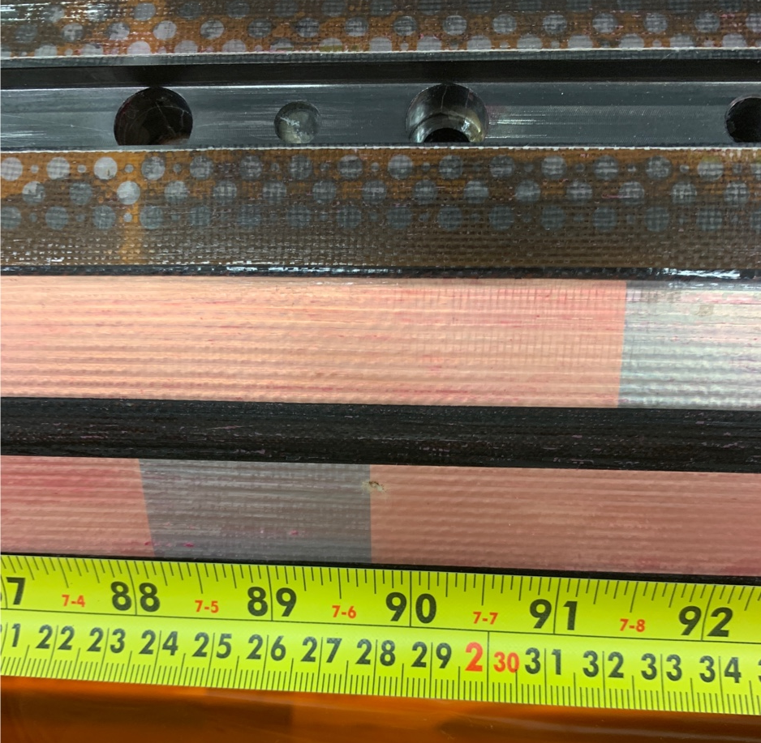
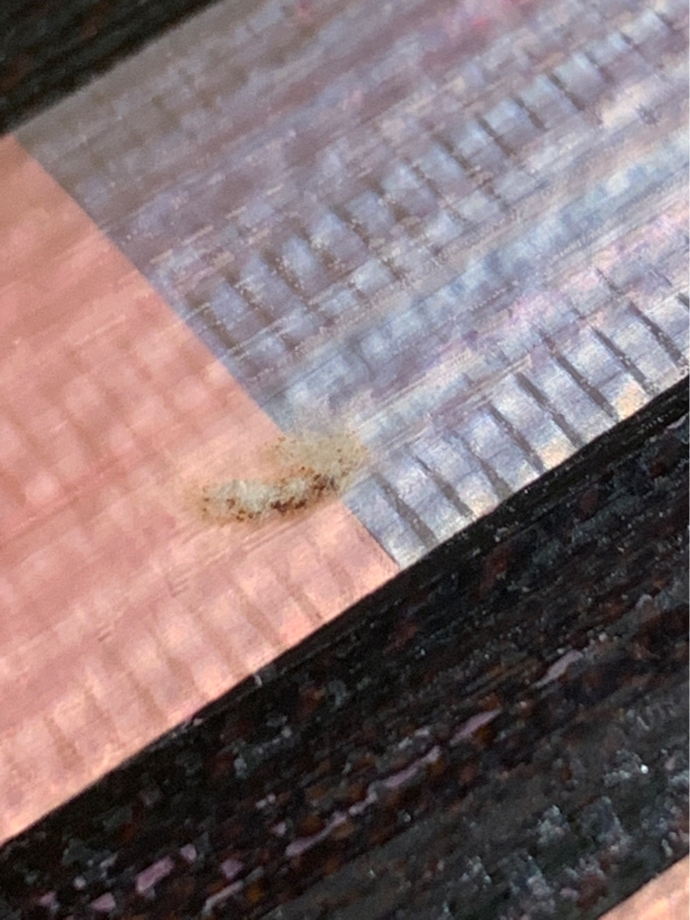
QXFA115, DR11858
Cause of Nonconformance:
Unidentified foreign object, nonmetallic in appearance, surrounded by epoxy above the S2 glass. Not known how it got there, but timing wise it occurred after the installation of the S2 glass and before or during the installation of the mold released Mylar.

Slide 23
Addition Information

Slide 24
MQXFA Coil CMM Profile Measurement Locations

Slide 25
Zone and Thermocouple explanation
Each thermocouple controls the zone that they are labeled. For example, TC 1 controls zone 1, TC 2 controls zone 2, etc.
The one over-temperature thermocouple is not assigned a number nor a zone because it monitors the entire furnace for overheating.
TC 7 controls zone 7, which is located at the top back and top door of the furnace
TC 8 controls zone 8, which is located at the bottom back and bottom door of the furnace.
Since the top back and top door sections of the furnace are very similar, such that they do very little to heat up the furnace, zone 7 covers two areas of the furnace while only being controlled by TC 7. The same applies for the bottom back and bottom door, being controlled by TC 8.
= K Thermocouple (Controlling)
= Over-temperature Thermocouple
Purple numbers= Thermocouple label
Green text= Zone label
TC= Abbreviation for thermocouple
Zones 1 & 2 use 18,913.3 Watts
Zones 3 & 4 use 28,640 Watts
Zones 5 & 6 use 9,546.7 Watts
Zones 7 & 8 use 5,220 Watts
Zone 2
Zone 1
1
Zone 7
7
2
Zone 7
Zone 4
Zone 3
Zone 8
8
4
3
Zone 8
6
Zone 6
Zone 5
5

Slide 26
