Slide 1
Coil Acceptance Measurements Coils 112, 113, 203, 206, 115 Electrical and CMM
MQXFA04 Coil Selection Review
Dan Cheng, Jordan Taylor, Dave Yeagly, et al.
10/30/2019
LBNL

Slide 2
Electrical Testing Notes
Fluke Multimeter (Continuity Tests, Sequential-R Voltage Measurements, Hand-Held Resistance Measurements)
Chroma 10973 (Hipot)
Expected to replace this with the Hypotultra 7850
LCR Meter
GW Instek LCR-819
Keysight Technologies E4980AL-032 (used to verify results of 112 and 113)
ECG-Kokusai Winding Test DWX-05 (Impulse Testing)

Slide 3
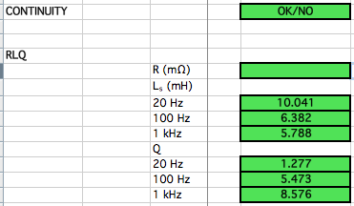
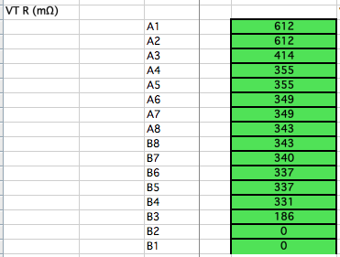
Coil 112 EQC (Post-ship, Pre-Coil Pack)

Slide 4
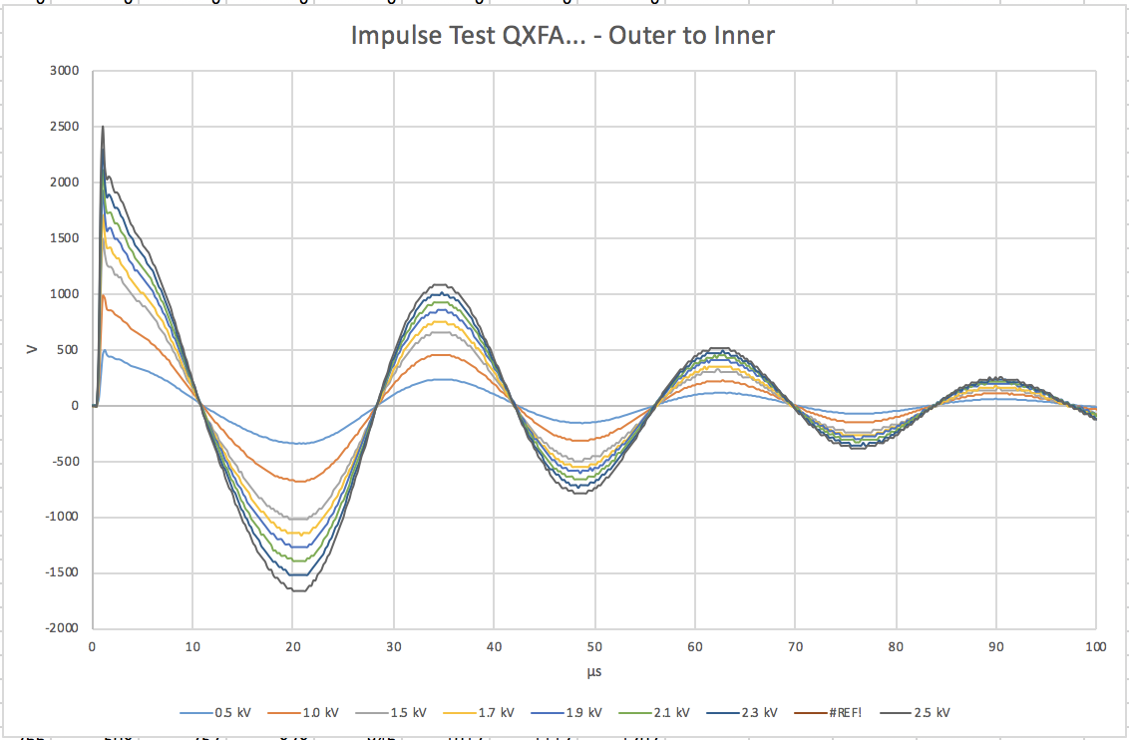
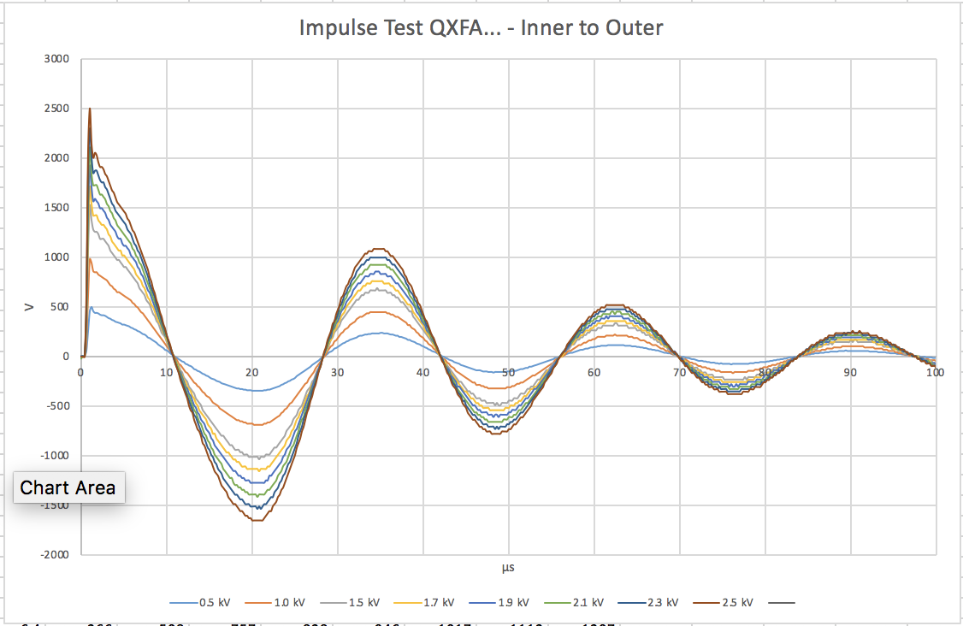
Coil 112 EQC (Post-Ship Impulse)
Direct
Reverse

Slide 5
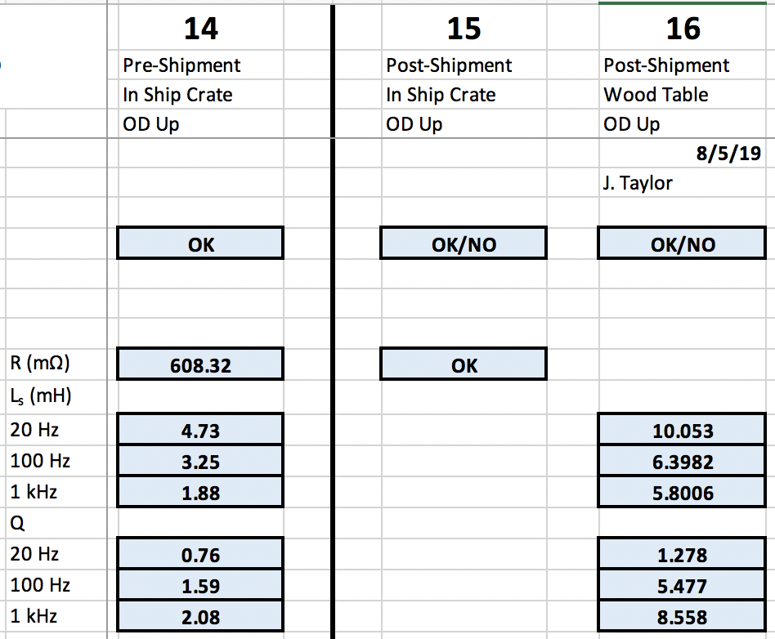
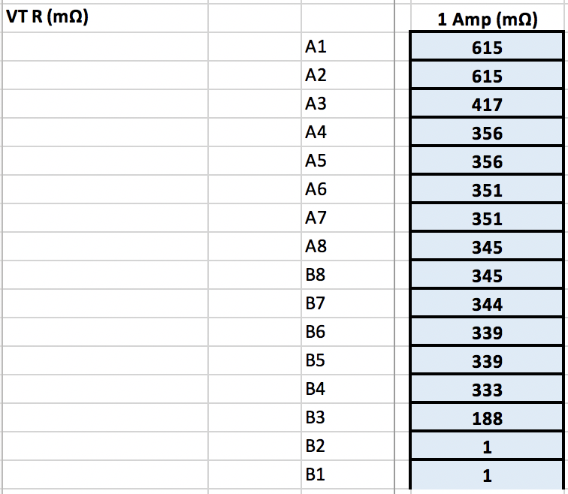
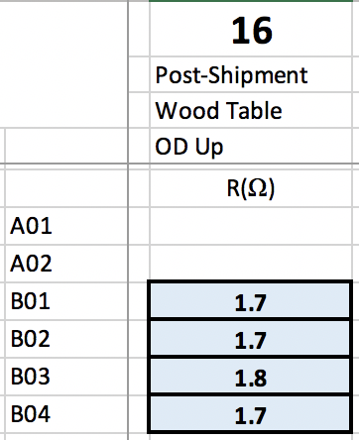
Coil 113 EQC (Post-ship)
Same variances observed as before

Slide 6
Coil 113 Updated Qualifications
Coil 113 Pole segment 3 shows weakness to the coil, on the order of ~20 MΩ
When hipot tested to 500 V, test was stopped when leakage current passed 10 µA
Updated electrical criteria requires only 100 V hipot from pole segments to Coil
Under these test conditions the coil passed with a leakage current of 8.6 µA

Slide 7
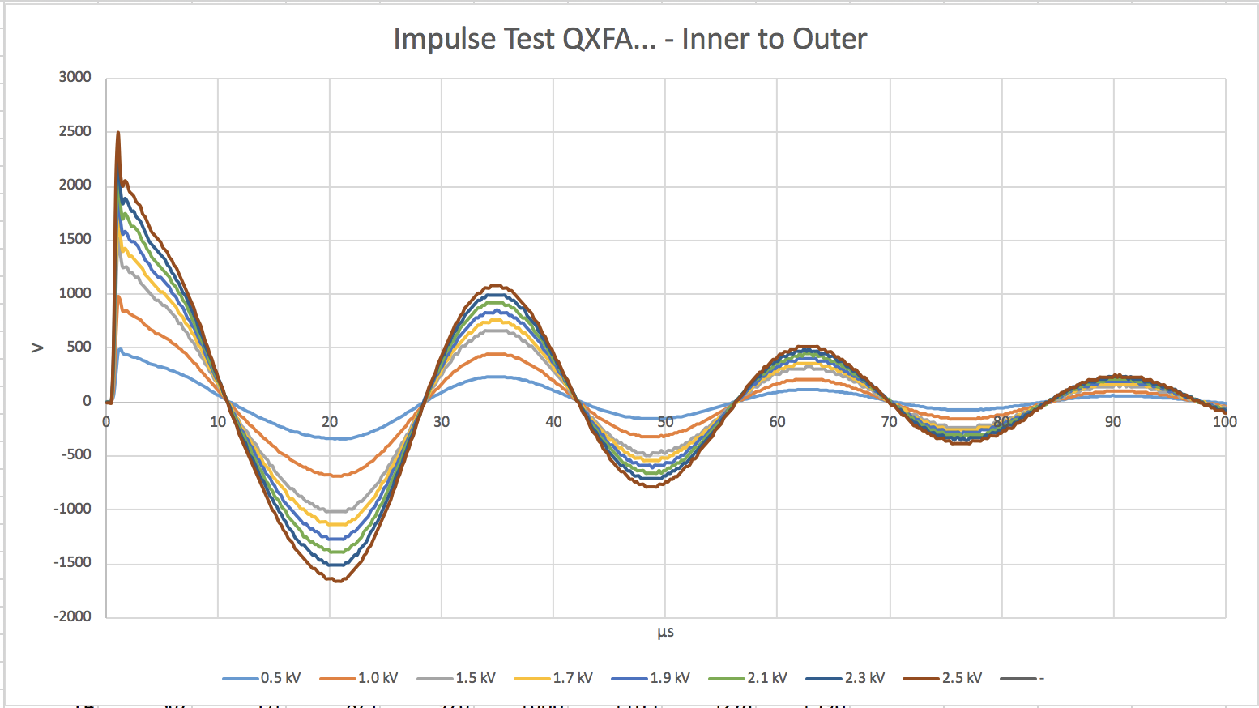
Coil 113 EQC (Post-Ship Impulse)

Slide 8
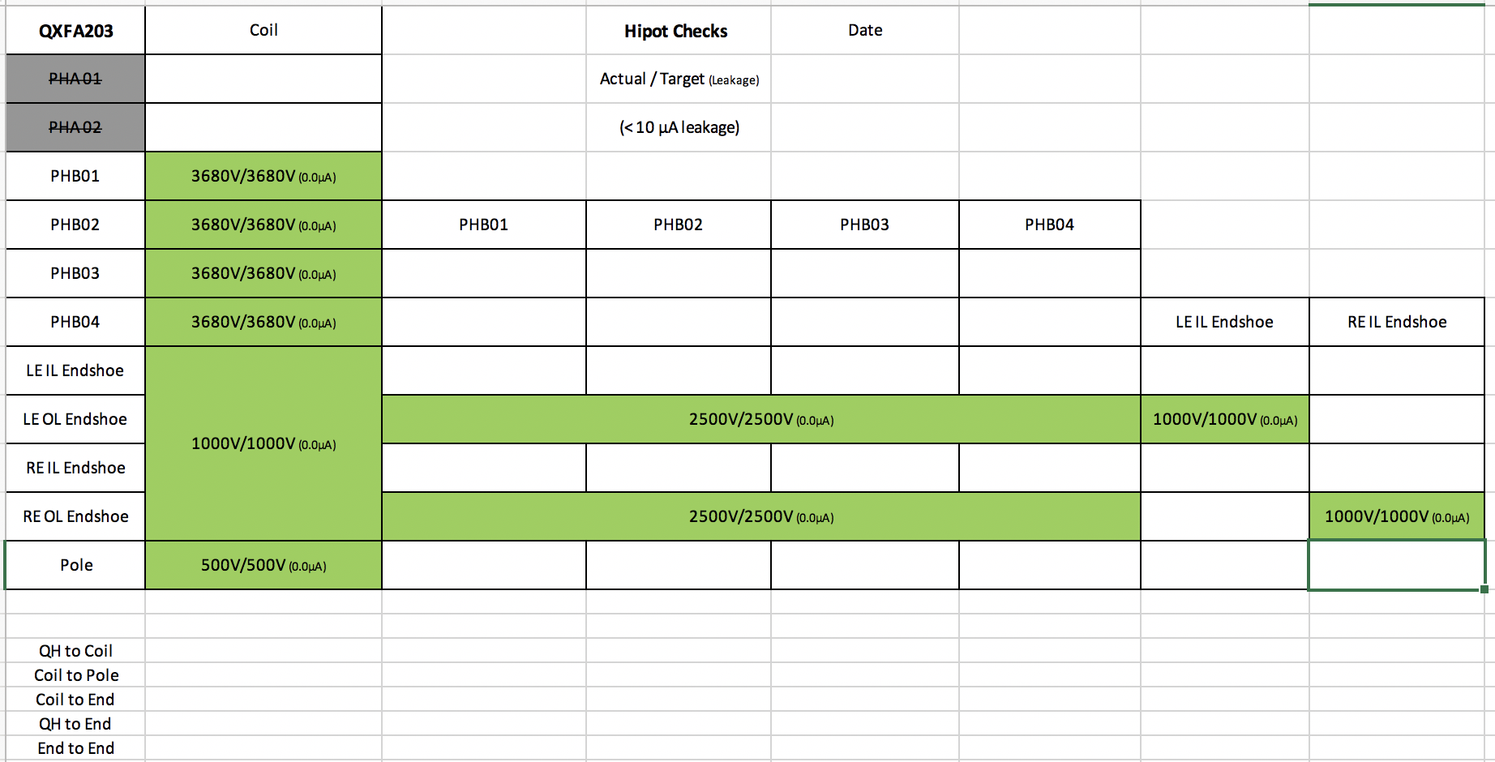
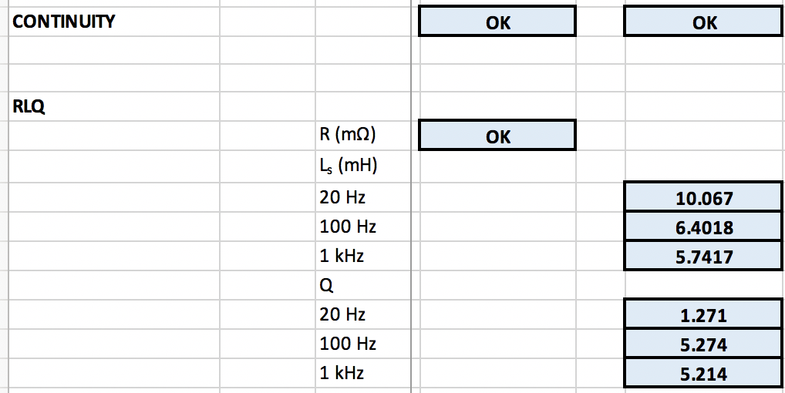
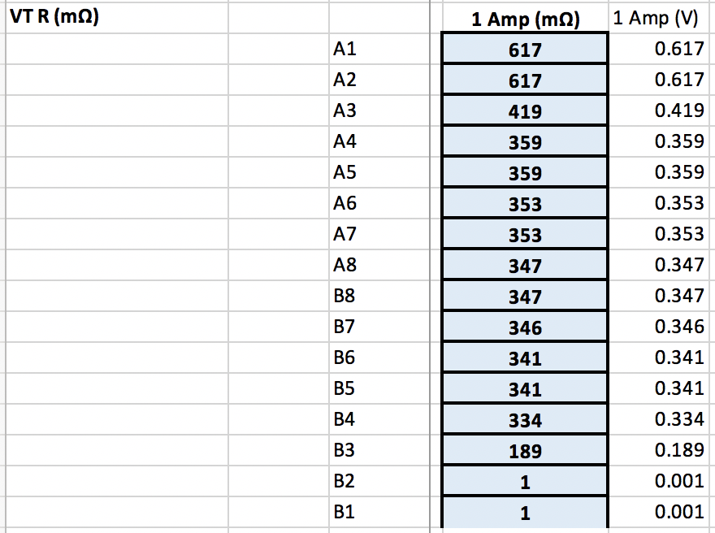
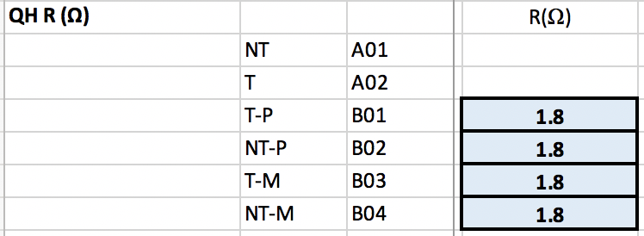
Coil 203 EQC

Slide 9
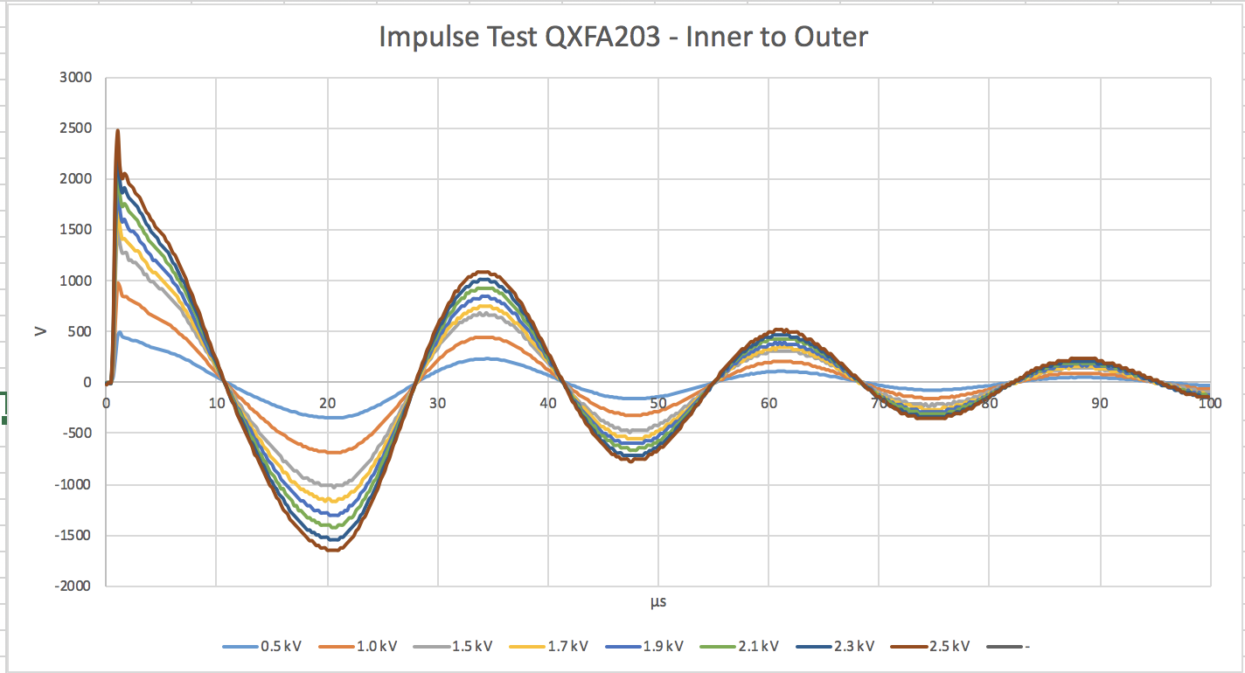
Coil 203 EQC (Post-ship Impulse)

Slide 10
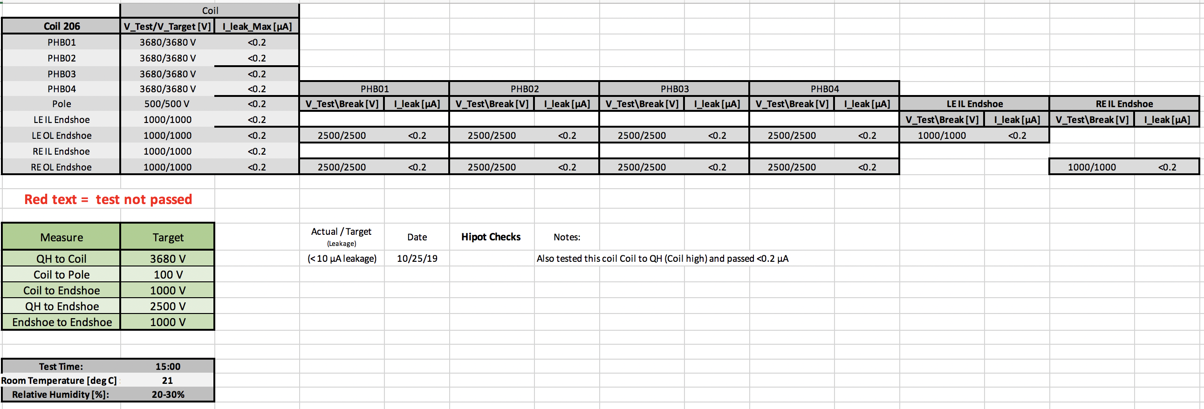
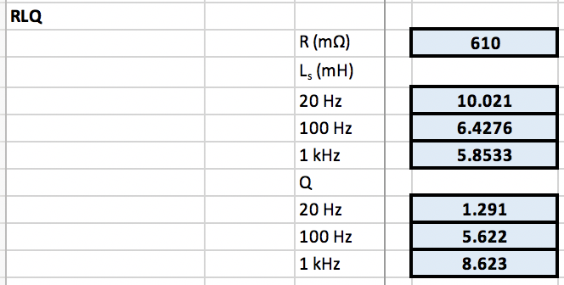
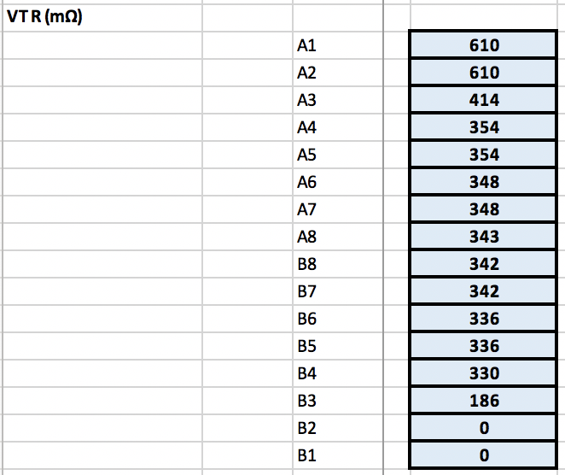
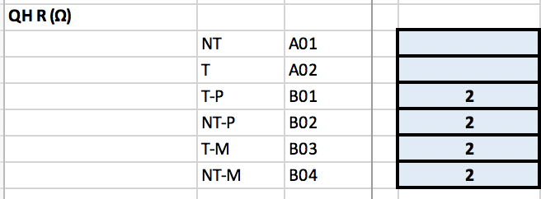
Coil 206 EQC

Slide 11
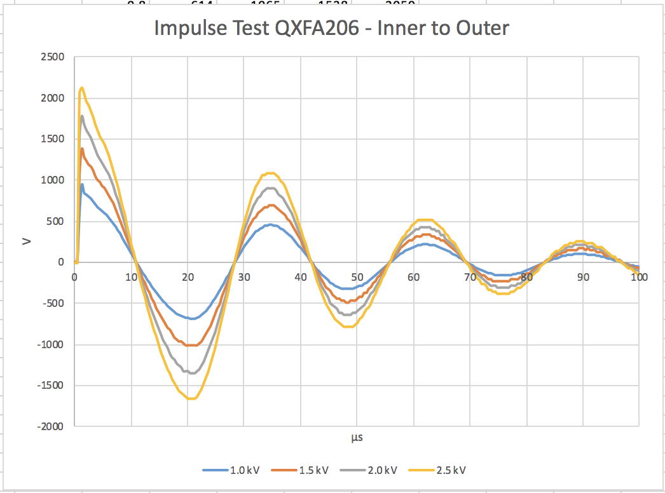
Coil 206 EQC (Post-ship Impulse)

Slide 12
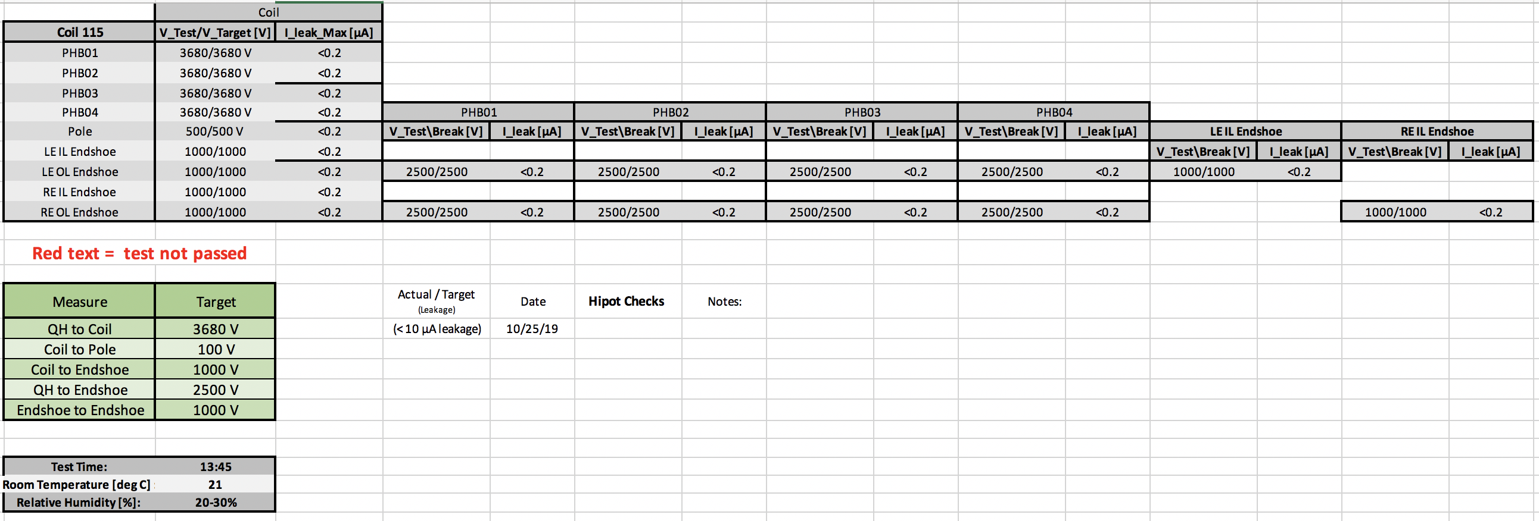
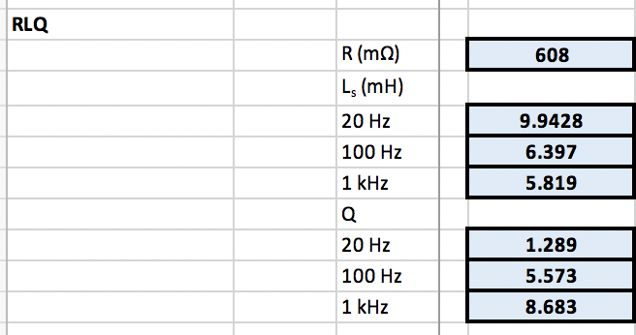
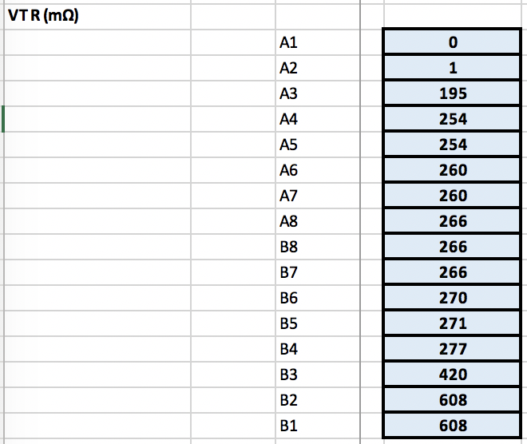
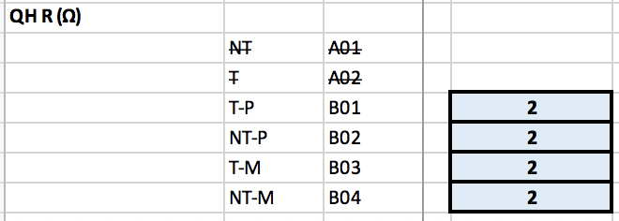
Coil 115 EQC

Slide 13
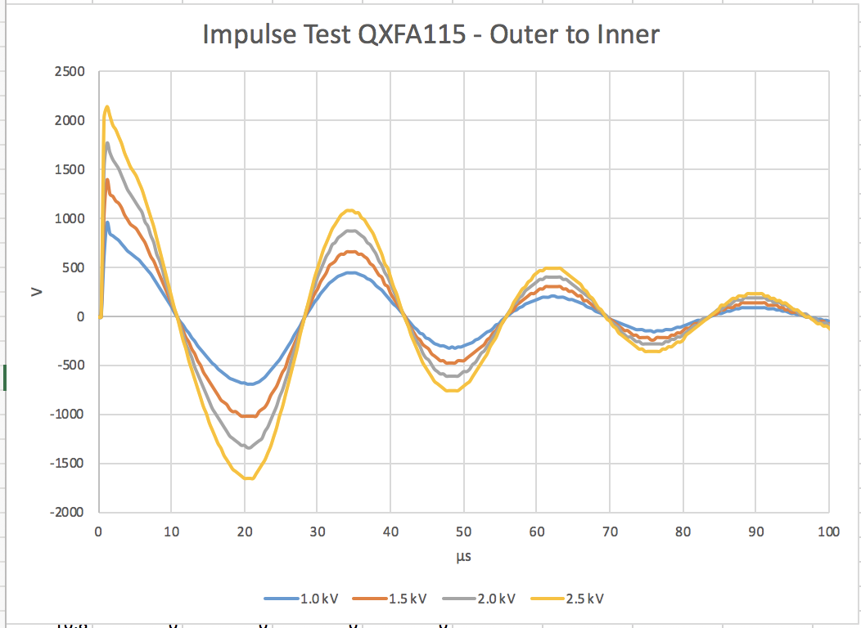
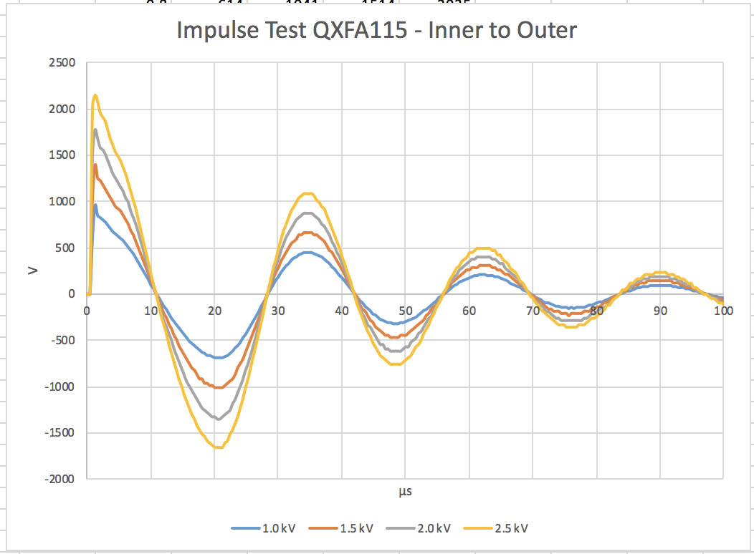
Coil 115 EQC (Post-ship Impulse)

Slide 14
Coils Electrical QC Acceptance Summary
Electrical QC measurements of 5 coils were presented
Coils 112, 115, 203 and 206 passed with no electrical issues highlighted
Coil 113 has a weakness from the pole segment #3 to the coil, on the order of ~20 MΩ
It passes revised hipot requirements to coil-pole at 100 V
Impedence and LQ values consistently differ from pre-ship values
Observed the same behavior as with magnet MQXFA03 coils and earlier, but verified a some coils with a second LCR unit

Slide 15
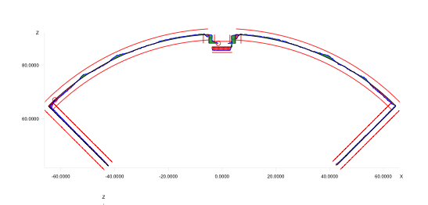
CMM Measurements
All LBNL data was taken using a Zeiss Accura for CMM
Calypso software post-processed data
All surfaces were “best-fit” to reference geometry with equal weighting
The alignment key was not included in coil 109 measurements
ID was not measured (will be with new LBNL CMM system)
New Leica tracker system will be utilized for later coils, along with Spatial Analyzer (weighted fit will be possible)

Slide 16
CMM Measurements
Coils are measured after receipt
Cross Section Data was collected in three sections
LE Section (2 points)
10 straight section locations (10 points)
RE Section (1 point)
For Pre-series magnets SG is only at ~3940 mm location
Prior three locations no longer used
Coil 112 did not have this measurement location (measured before changes implemented)
2 LE Points
RE Point
3140 mm
3940 mm
740 mm
1940 mm
CMM Model Standard:
Inner Radius: 74.75 mm
Outer Radius: 113.376 mm
Midplane offset: 0.125 mm

Slide 17
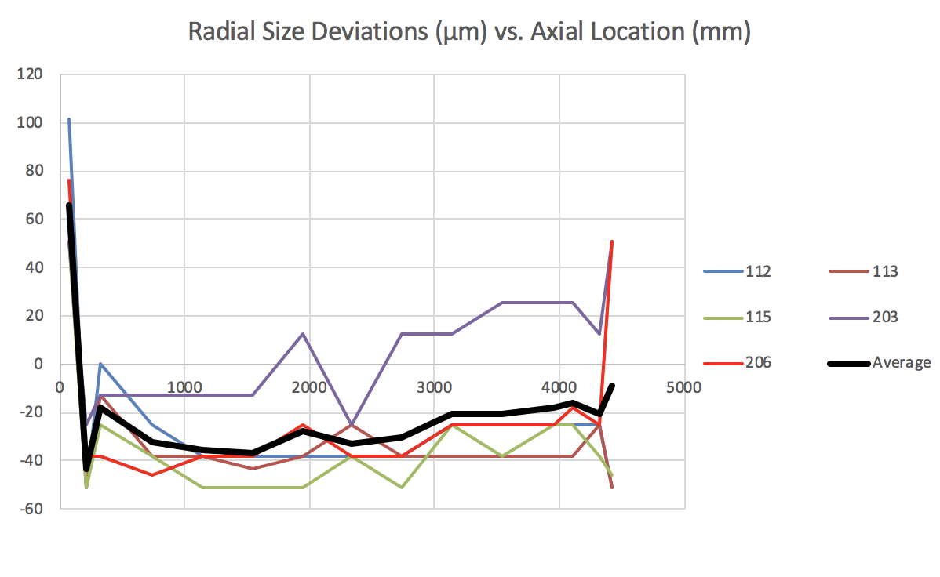
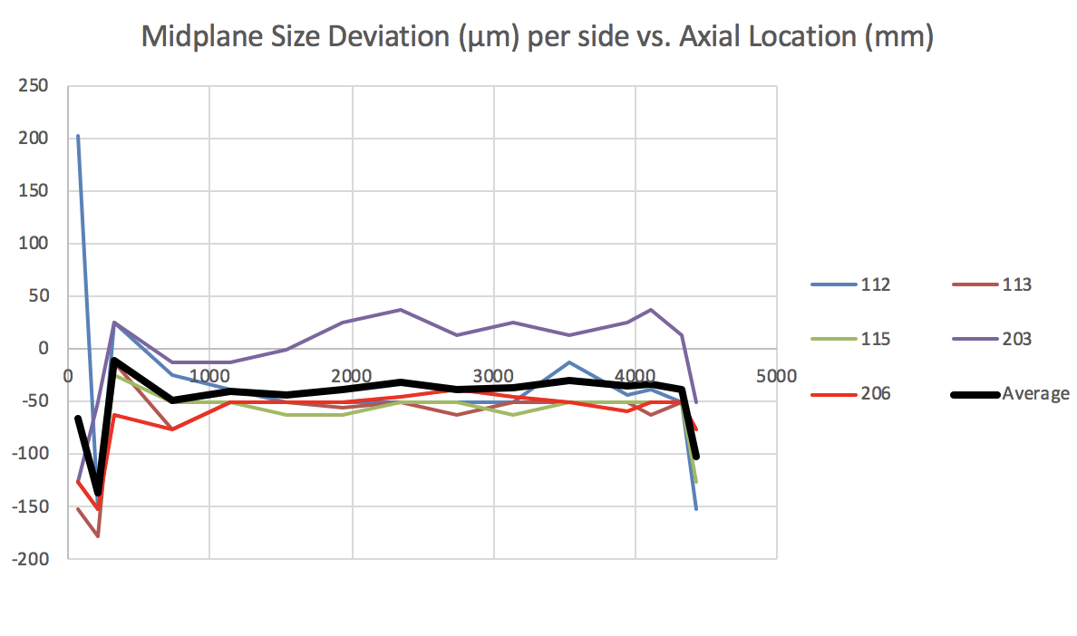
MQXFA04 Coils CMM Summary plots
*see next slide for ends discussion

Slide 18
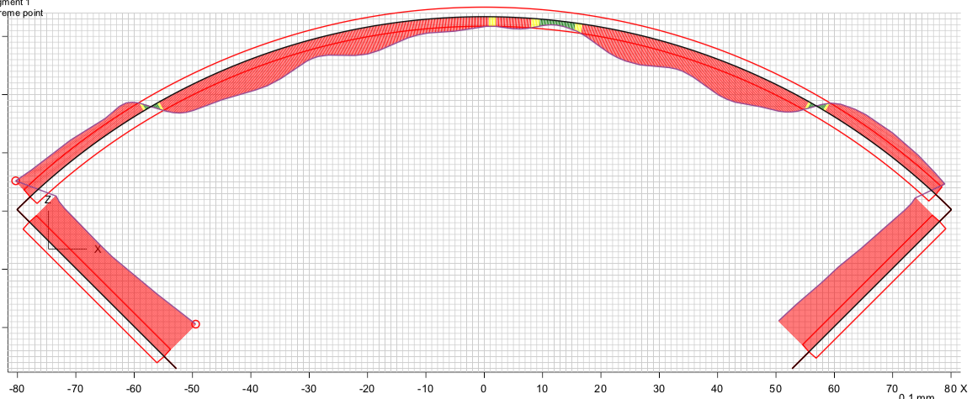
Note on CMM Measurements on end
Profile at 70
There is a pocket in the end shoe for the solder connections to be made
“Global Fit” of the profile may overstate profile deviations of the OD
Net radial and midplane deviations are much smaller than what is depicted
New Leica system and Spatial Analyzer software may be utilized to minimize this “global fit” error
Past Fuji paper results showed good exposure even on the ends
End-specific shimming likely is not required

Slide 19
MQXFA04 Coil CMM Meas. Summary
Based on “global fit” visual CMM data after testing:
“Straight section” (averaged profiles between 320 mm and 4323 mm)
Radial deviations averaged ~-0.001” (~25 µm) undersized
Midplane deviations averaged ~-0.0015” (~35 µm) undersized
Ends (averaged 2 points on LE, 1 point on RE)
Radial: ~-0.0005” / Midplane: ~-0.004”
Coils are mostly undersized by ~0.001” from nominal, except in the ends
Coil 203 appears to be closer to nominal size (but oversized compared with the other four)—may require additional shimming if chosen for use

Slide 20
Additional Slides

Slide 21
Coil Pack Assembly Process
Ground plane insulation layout
Coil CMM measurements
Nominal Radial shims
Actual coil radial / azimuthal deviations from nominal
Nominal pole key
Shim (radial / azimuthal)
Assembly with Fuji paper
No pole key shims
Possible repeat
Assembly with radial shims and pole key shims
Measurement of pole gap dimensions along the length using measurement pins
Verify pole gap
Pole SG measurements
Pole SG measurements
Fuji Paper exposure check

Slide 22
Coil Pack Build Process
1st (Fuji) coil pack goal
Assess the proper effective radial shimming to ensure preload to all coils; measure key gaps
2nd Coil-pack (final, though Fuji may be repeated):
Include pole key shimming, based on 1st (Fuji) coil pack measurements, no Fuji paper

