Slide 1
Coil ordering in MQXFA04 based on conductor properties
Maria Baldini, Vittorio Marinozzi

Slide 2
MQXFA04 cables: RRR estimations
Maximum expected coil to ground voltage at quench: 670 V (EDMS 1963398, Us-HiLumi Docdb 879)
COIL | CABLE
113 | P43OL1094
203 | P43OL1096
112 | P43OL1100
115 | P43OL1102
206 | P43OL1103
Rolled samples used to estimate RRR of the coil
Each cable: 40 strands in parallels coming from several spools
Spools come from different billets.
For each cable:
If the Cu/NCu value of the spool used for the cable is not present, the Cu/NCu of a particular spool is estimated averaging data from spools belonging to the same billet.
A weighted mean (weight= # of strands) is used to estimate cable RRR and Cu/Ncu values.
conductor OST 108-127
Extracted strands major and minor edges + 2 straight sections RRR’s started from cable P43OL1095

Slide 3
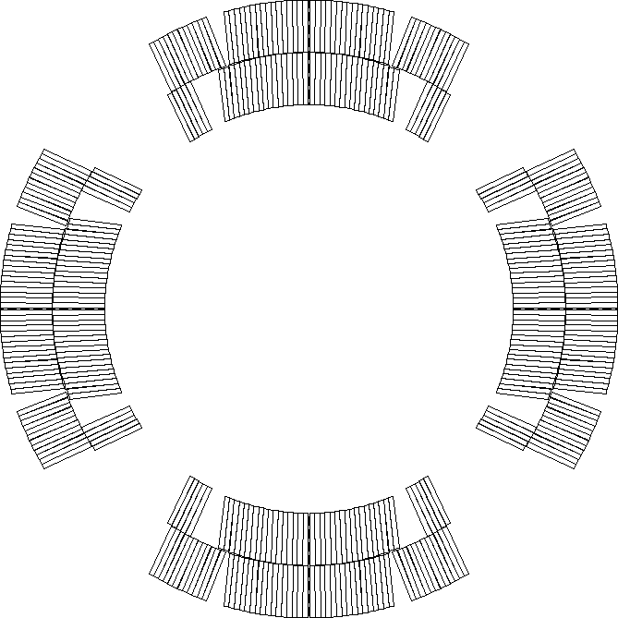
MQXFA04 coils
COIL | RRR (rolled) | Cu/NCu
112 | 202.09 | 1.17
113 | 224.735 | 1.16
115 | 153.875 | 1.23
203 | 235.75 | 1.174
206 | 147.05 | 1.211
Assumptions
113
112
Nominal current
Nominal protection (CLIQ 600 V - 40 mF, OL QH 300 V – 7.05 mF)
No failures
P2
P1
P3
P4
115
203

Slide 4
MQXFA4 peak voltages
Coil ordering | Peak voltage [V]
112-113-115-203 | 323
112-113-203-115 | 321
112-203-113-115 | 321
112-203-115-113 | 323
112-115-203-113 | 321
112-115-113-203 | 321
113-112-115-203 | 324
113-112-203-115 | 321
113-203-112-115 | 321
113-203-115-112 | 324
113-115-203-112 | 321
113-115-112-203 | 321
Coil ordering | Peak voltage [V]
115-113-112-203 | 321
115-113-203-112 | 322
115-203-113-112 | 321
115-203-112-113 | 321
115-112-203-113 | 321
115-112-113-203 | 321
203-112-113-115 | 321
203-112-115-113 | 325
203-115-112-113 | 321
203-115-113-112 | 321
203-113-115-112 | 325
203-113-112-115 | 321
Voltages are equivalent and well below 670 V: No specific ordering is necessary

Slide 5
Worst case with energy extraction during vertical test
203-113-115-112 (electrical order 203->112->113->115)
Nominal current (16470 A)
37.5 mΩ dump (10 ms delay)
2 QH fail
Peak voltage to ground: 431 V
Below 670 V

