Slide 1
Iceberg Updates
Kathrine Cipriano
October 16th, 2019

Slide 2
Additions to Iceberg System
New LN2 flow control valve
Smaller flow coefficient
Reduced pressure fluctuations to ~0.1 psig (was previously +1 psig)
PID loop tuning could still improve, reducing pressure fluctuations even further
New backpressure regulator at LN2 condenser outlet
Increased LN2 condenser pressure from atmospheric to 25 psig
This increases the temperature of the LN2 and prevents argon ice build-up inside the condenser
Maintained ~54in LAr in the cryostat with condenser LN2 level at ~3.5in
Internal filter installed
Uses same set up as Luke internal filter (actuated vapor outlet valve and liquid inlet valve)
Cycles are based on liquid level, not time

Slide 3
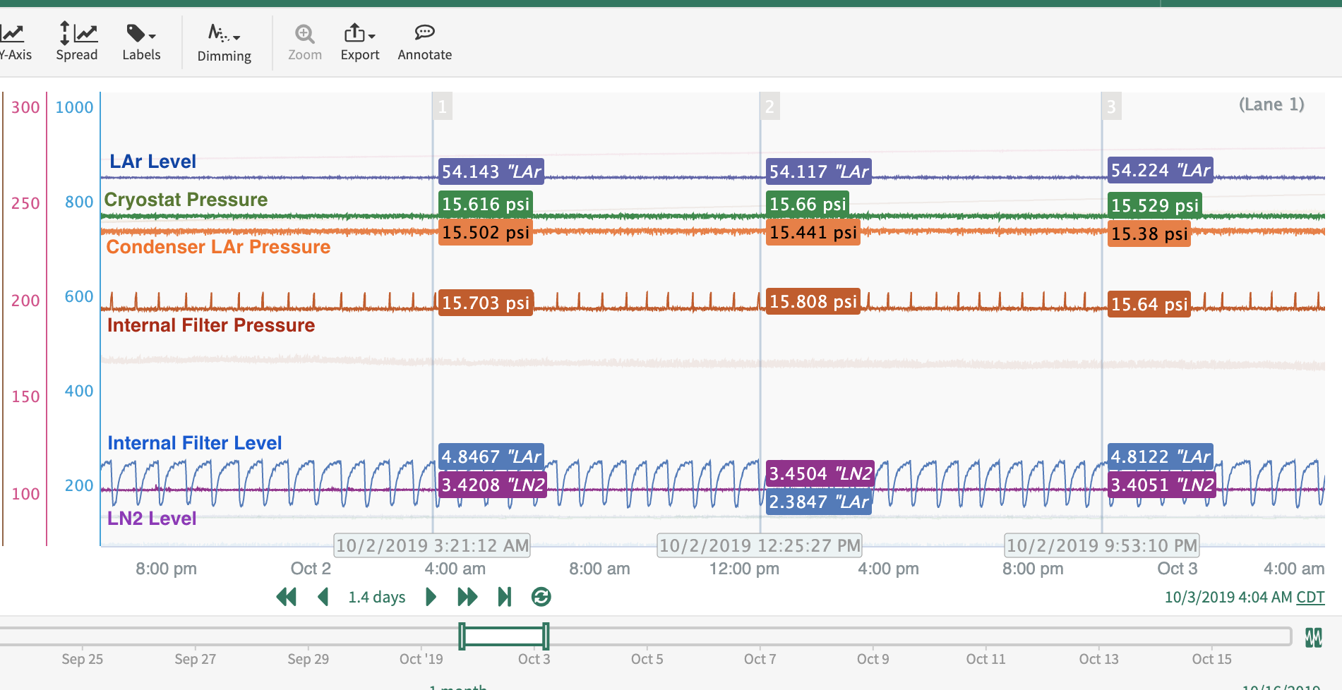
Plot of Cryostat Steady State from 10/01 – 10/03
K. Cipriano | Iceberg Updates

Slide 4
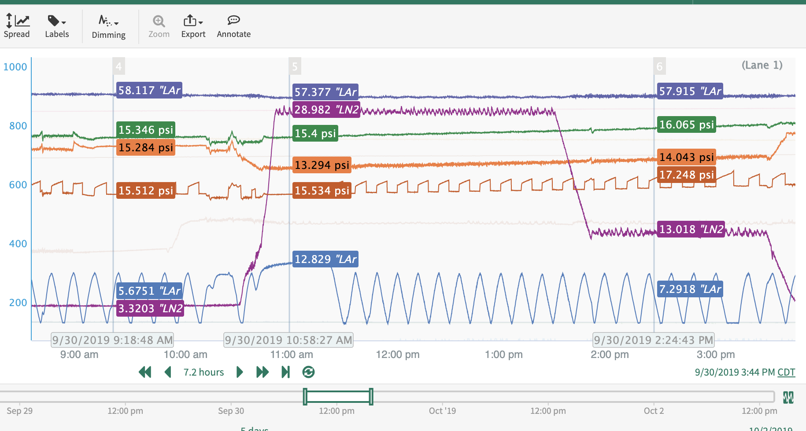
Test of Condenser LN2 Level and Cryostat Pressure
LAr Level
Cryostat Pressure
Cond GAr Pressure
I.F. Pressure
I.F. Level
LN2 Level
K. Cipriano | Iceberg Updates

Slide 5
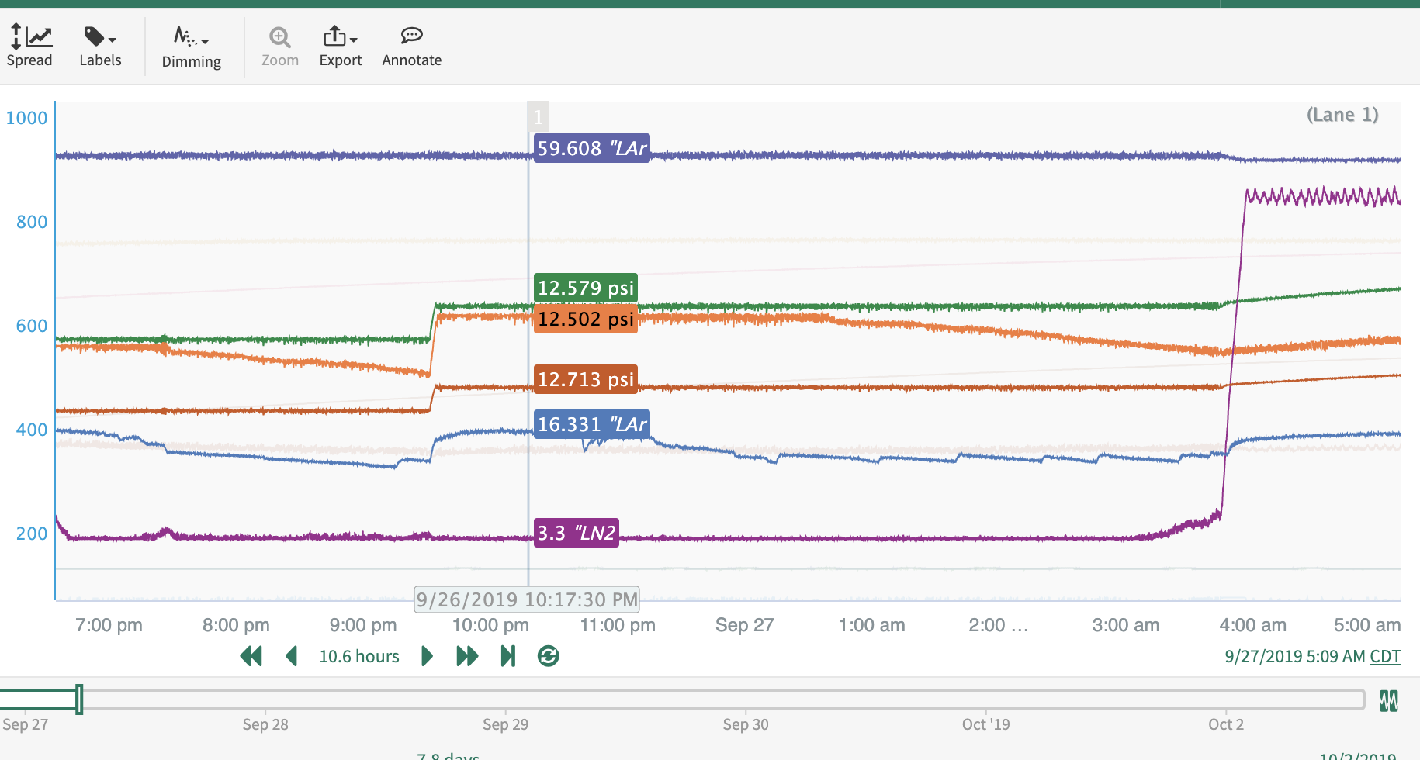
Condenser Trend
Condenser starts working, then condenser argon gas pressure starts to decrease, then condenser stops working
K. Cipriano | Iceberg Updates

Slide 6
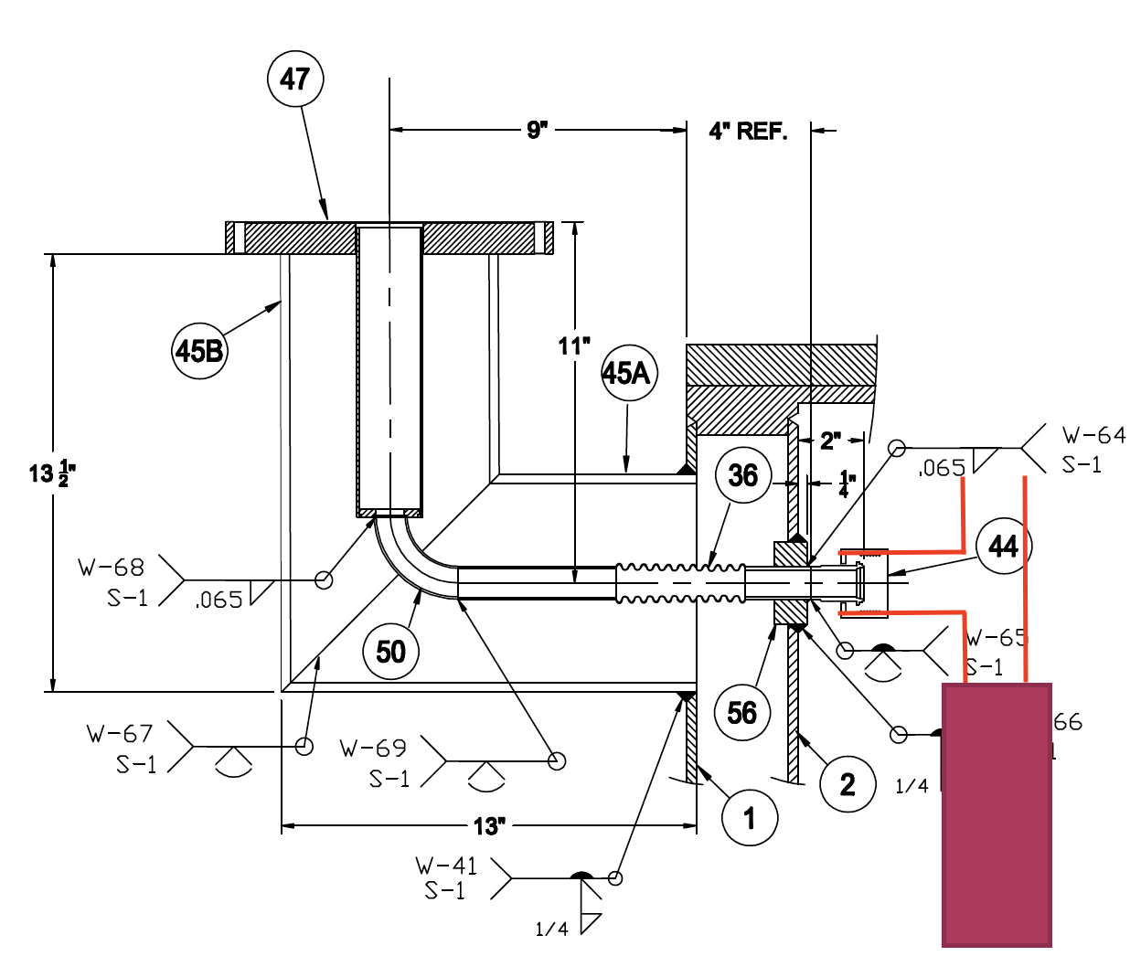
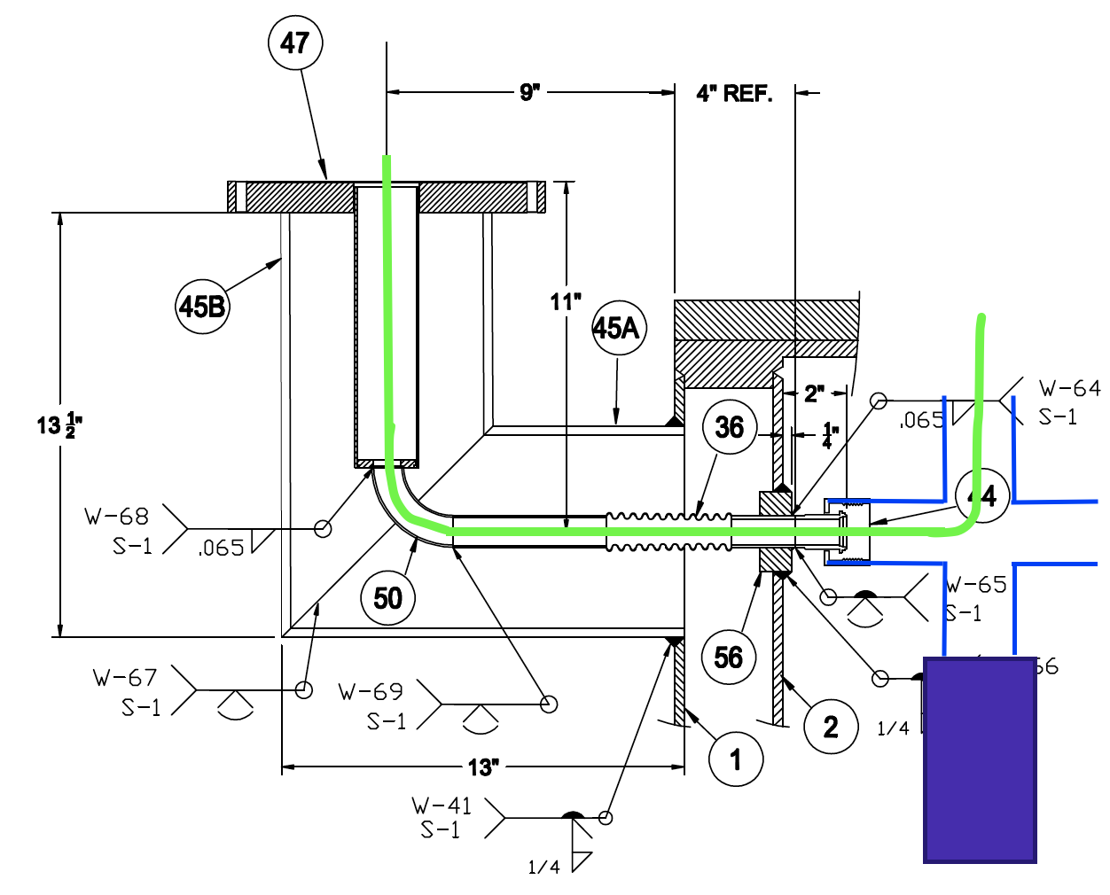
Condenser Return Tee
Current set up
Proposed set up
Sintered metal filter: Media grade 5, 2ft long, 0.062 wall thickness, 1.5in OD
K. Cipriano | Iceberg Updates

Slide 7
Calculations
Cryostat heat load and resulting boil off rate
1000 W – 50.51 lb/hr
Volumetric flow rate of LAr from condenser back to cryostat
0.074 gpm
Required cross-sectional area for LAr to flow from condenser to cryostat
0.0119 in²
Cross-sectional area of narrowest part of condenser tube
0.196 in²
Argon gas pressure drop from cryostat to condenser
5.5 x 10⁻⁸ psi
Liquid pressure drop across sintered metal filter (at condenser outlet)
0.0021 psid
Height of liquid head required to push LAr through sintered metal tube
1.083 mm
This indicates that the filter is being blocked by water ice
We plan to add molecular sieve media inside the sintered metal to absorb more water
K. Cipriano | Iceberg Updates

Slide 8
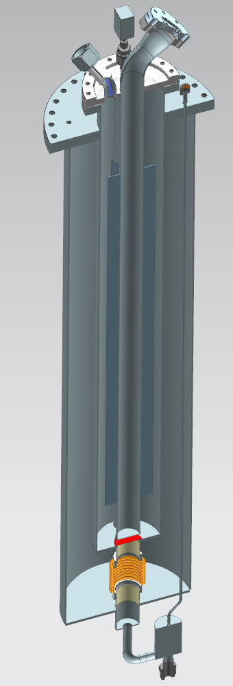
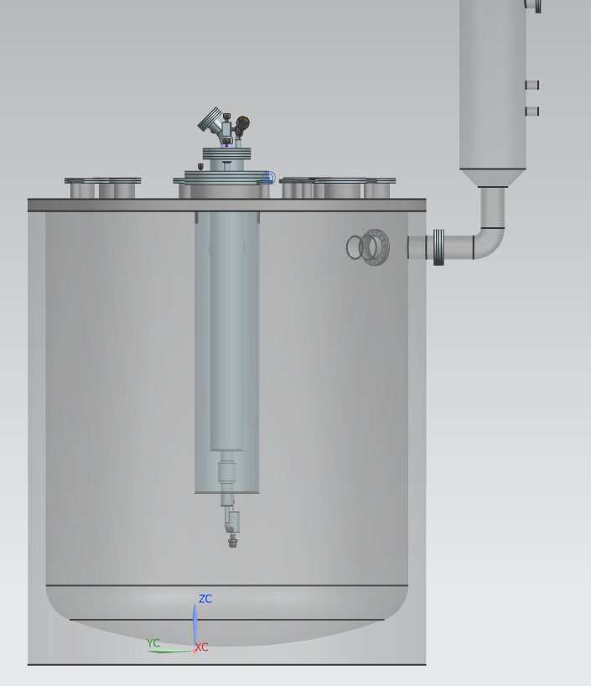
Internal Filter
K. Cipriano | Iceberg Updates

