Slide 1

Advancing Open Science through distributed High Throughput Computing
Frank Würthwein
OSG Executive Director
Professor of Physics
UCSD/SDSC

Slide 2
Open Science
All of open science irrespective of discipline
Advance the maximum possible dynamic range of science, groups, and institutions
  From individual undergraduates to international collaborations with thousands of members.
  From small colleges, museums, zoos, to national scale centers of open science.
Advancing this entire spectrum requires us to have a diversified portfolio of services

Slide 3
OSG Services for Campuses
OSG-operated and campus-operated submission points.
The OSG Compute and Data Federations
Research Facilitation, training and workforce development.
Software distribution and runtime environment.

Slide 4
Submit points overall today
Campuses
  AMNH
  BNL
  Duke
  Fermilab
  Illinois Institute of Tech.
  ISI (USC)
  Jefferson Lab
  MIT
  UC Irvine
  UCSD
  UNL
  UW-Madison
“Organizations”
  Cyverse
  IceCube
  LIGO (Caltech)
  SBGrid
  Snowmass
  Veritas
  Virgo (NIKHEF)
  Xenon
Several of these have multiple submit points.

Slide 5
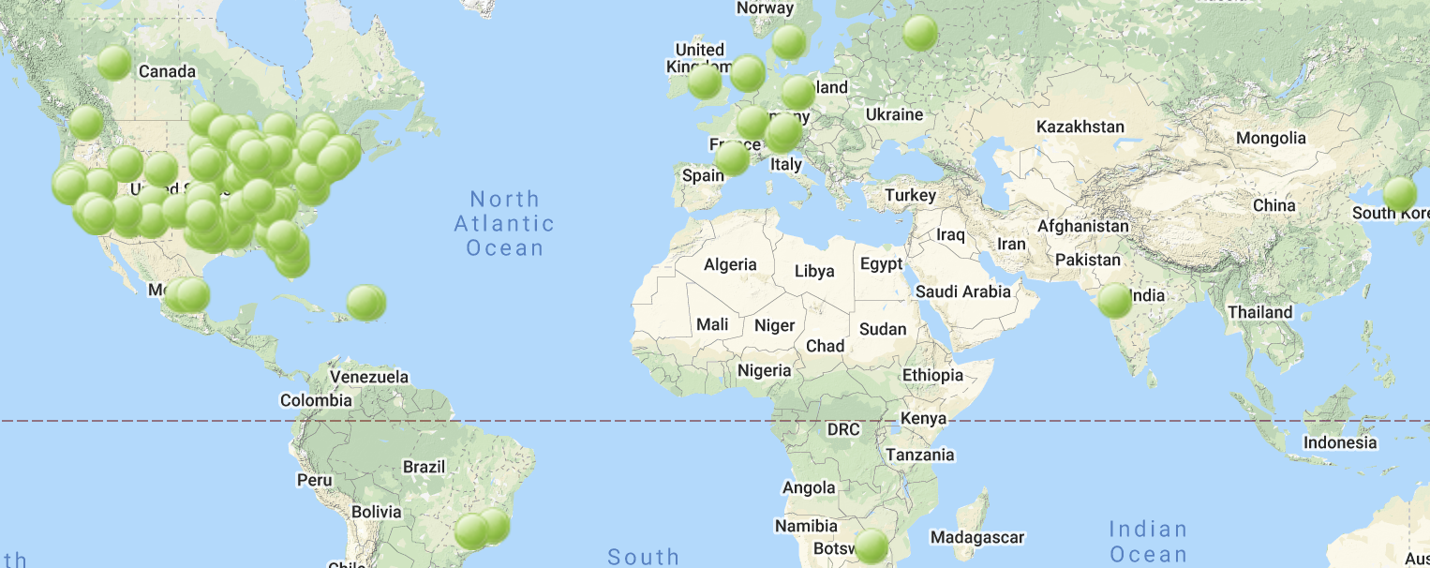
OSG Compute Federation
126 “green dots” listed on this map
Accounting for ~ 160M hours/month … 160M/(24x30) = 222 thousand cores
… but the real story is so much more complicated ….

Slide 6
Many ways to BYOR … and more
A Compute Federation
BYOR
BYOR
BYOR
BYOR

Slide 7
Federation = distributed control
OSG works on three simple principles:
  Resource Owners determine policy of use
    This means that all policy of use is set locally by the clusters that join the federation.
  Resource Consumers specify the types of resources they are willing to use.
    How much RAM? How many cores per node? …
  OSG submits it’s own batch system as ‘jobs’ into local batch systems.
    User jobs are submitted locally, queued centrally, and execute anywhere that matches requirements after resource becomes available.
OSG operates overlay system(s) as services for all of science

Slide 8
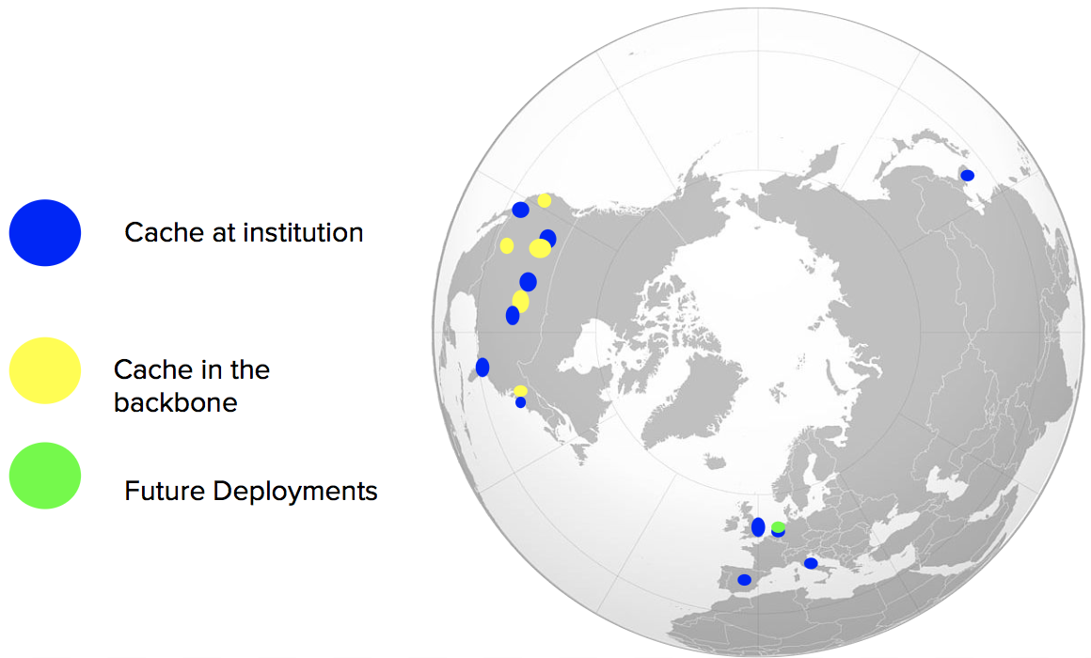
OSG Data Federation
“Netflix for Open Science”
Collaboration | Working Set | Data Read | Reread Multiplier
DUNE | 25GB | 131TB | 5.4k
LIGO (private) | 41.4TB | 3.8PB | 95
LIGO (public) | 4.3TB | 1.5PB | 318
MINERVA | 351GB | 116TB | 340
DES | 268GB | 17TB | 66
NOVA | 268GB | 308TB | 1.2k
RPI_Brown | 67GB | 541TB | 8.3k
More than a dozen caches
deployed across 3 continents
Data pulled from federation
in 6 month period 3-8/2020
Including several at POPs of Internet2 and GPN.
Recent use includes “collaborations”, “public data” accessed by single PIs, and “personal data” accessed by single PIs
(9 single PIs with >1TB of personal data read)

Slide 9
Data Federation Goals
People come with their data on their local storage systems.
OSG offers to operate a Data Origin Service to export your data into the OSG Data Federation.
  We give you a globally unique prefix for your filesystem namespace, and then export your namespace behind it.
  We allow you to decide who can access what.
OSG then strives to guarantee ”uniform” performance across the nation by operating caches to:
  Hide access latencies
  Reduce unnecessary network traffic from data reuse (by many jobs)
  Protect the data origins from overloads
OSG operates overlay system(s) as services to all of science

Slide 10
Sharing does not imply “quid pro quo”
We are delighted to work with your campus to facilitate open science, in any form. Your researchers can utilize the OSG at any scale, regardless of how much computing you share with the community.

Slide 11
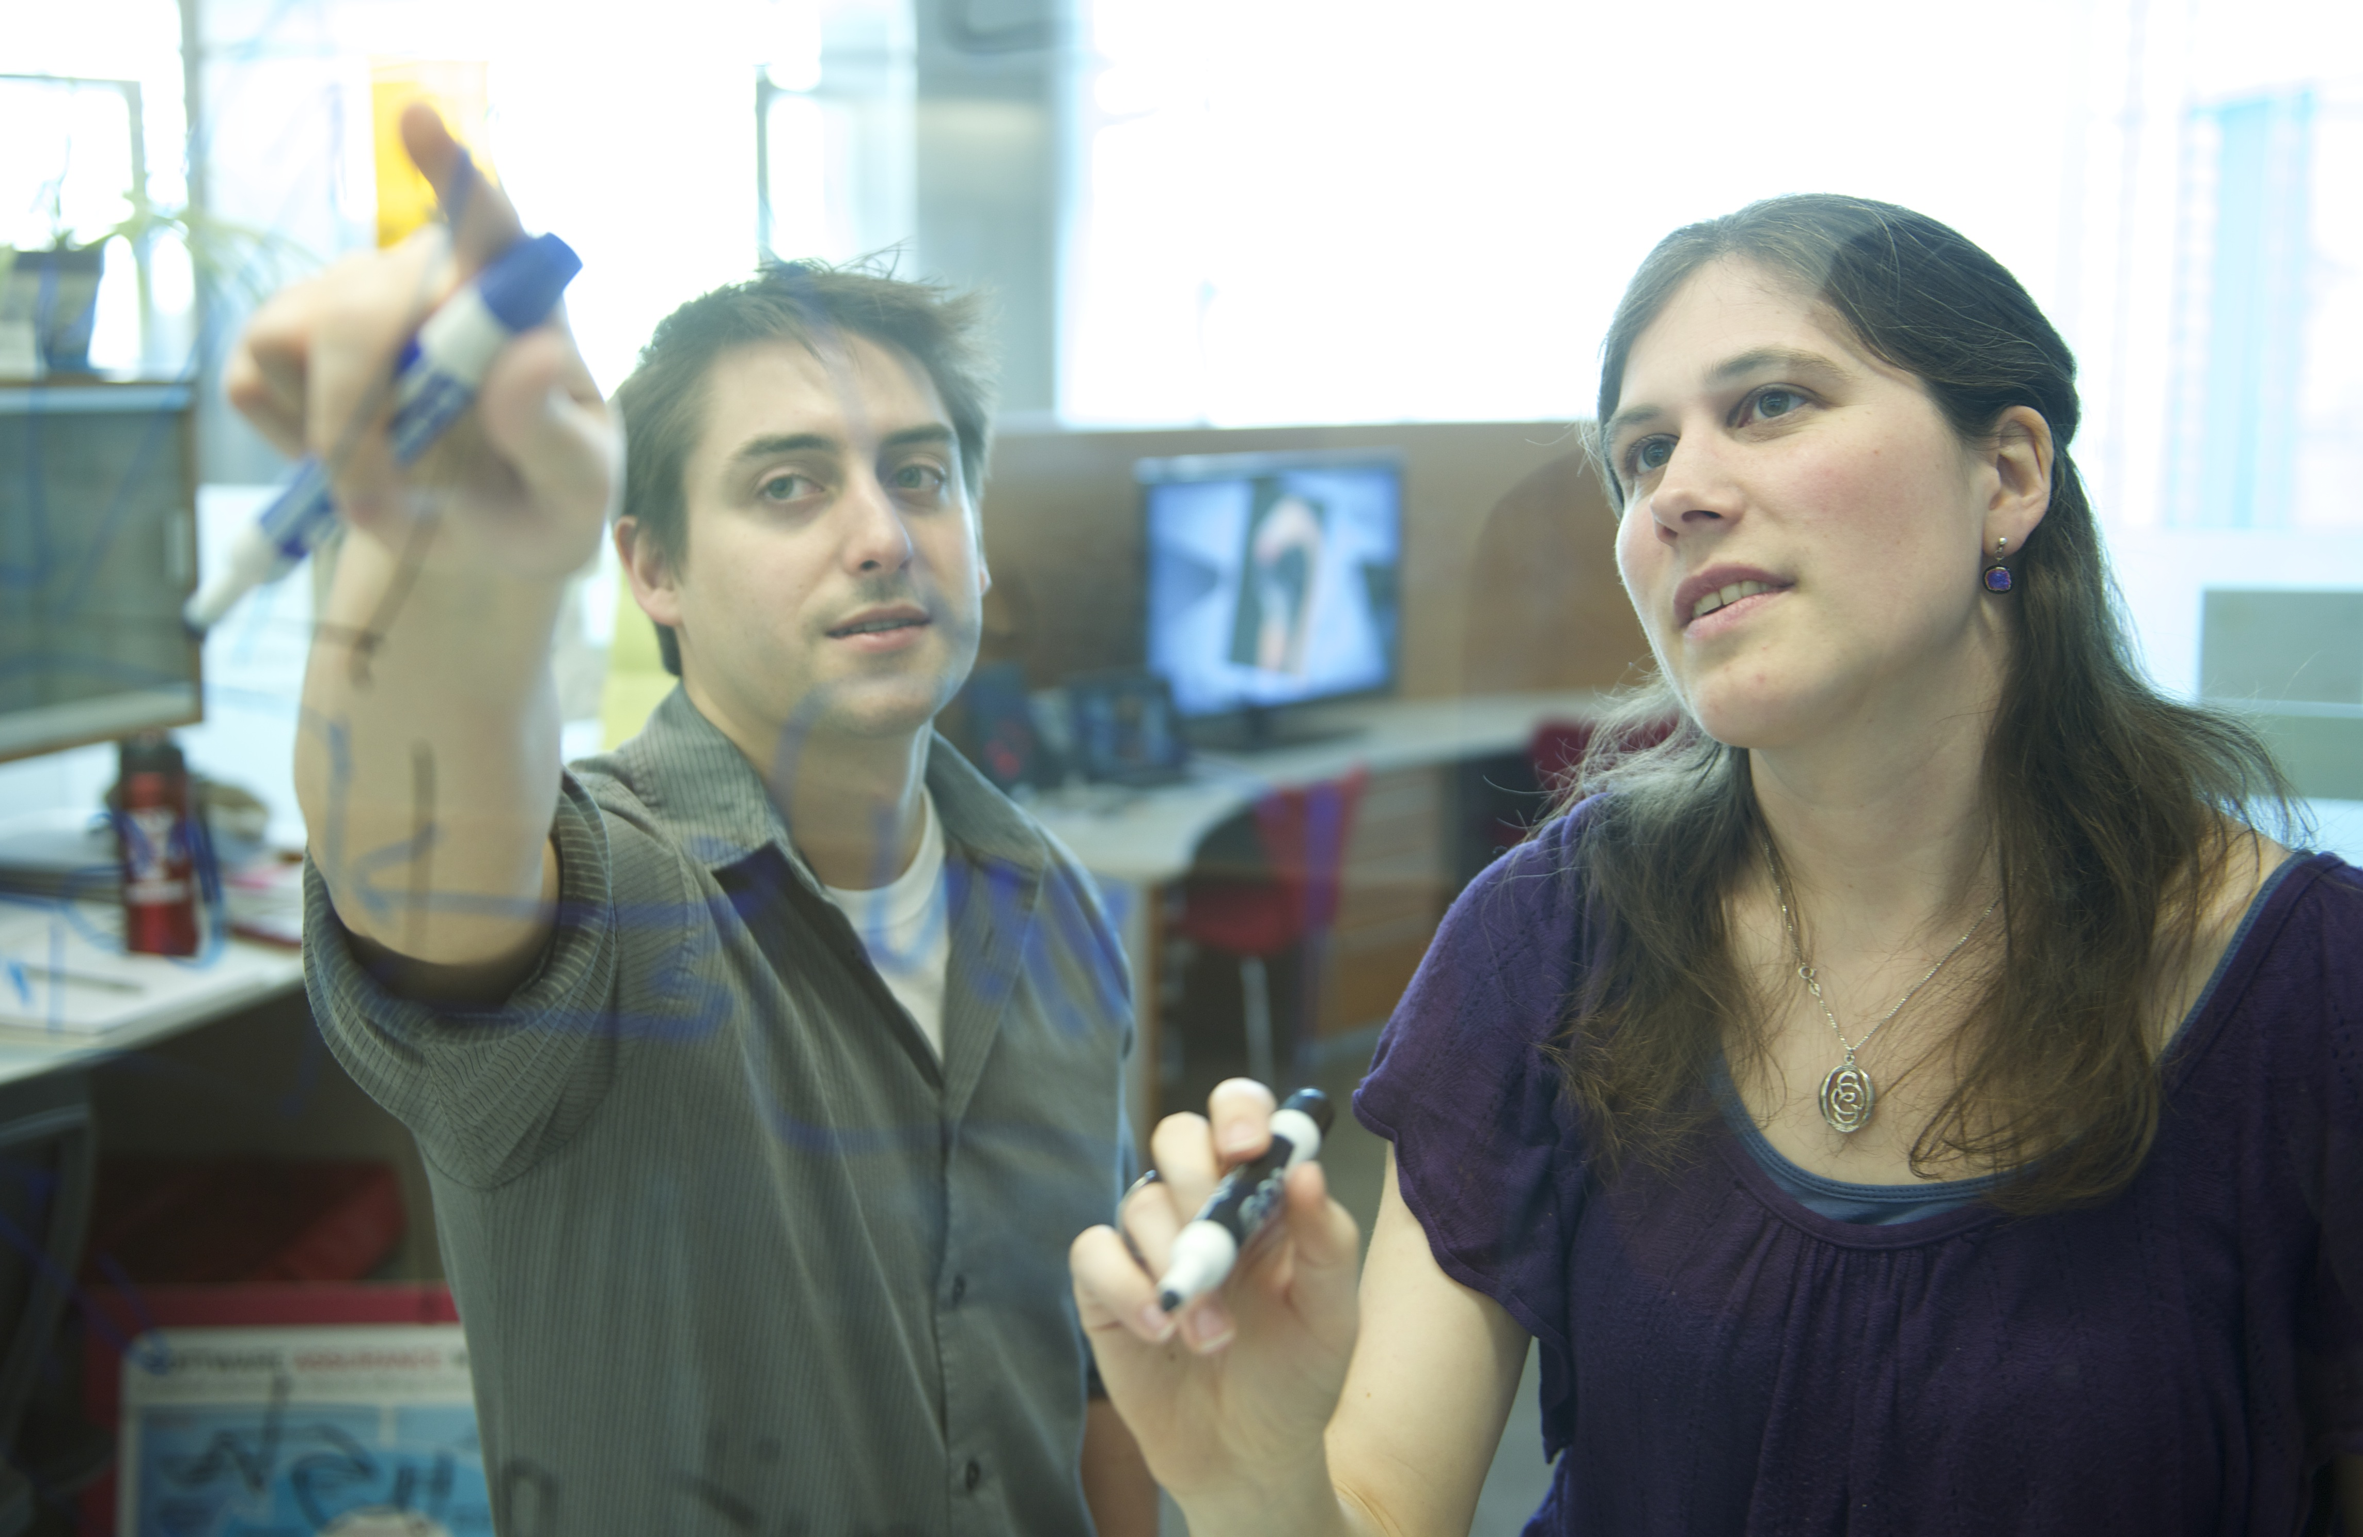


Facilitation Services
Proactive, personalized guidance and support for:
Institution-specific submit points
Sharing institutional resources via OSG
Data federation across OSG sites
Individual researchers using OSG Connect
Local workshops
OSG-hosted education and training
Learning from the
OSG Facilitation Community
We are especially interested in
“Training the Trainers”

Slide 12
Software Distribution & Runtime environment
We help users with software portability solutions.
We offer a standard “module environment” and are prepared to add new modules as needed by the community.
  At present 377 software modules are supported.
We make extensive use of singularity containers, including 488 curated containers to support a variety of application environments.
We offer services that allow you to offer our environment for use by your local users on your local cluster.

Slide 13
Summary & Conclusion
OSG’s objective is to “Advance Open Science through distributed High Throughput Computing”
OSG thinks of its science stakeholders in terms of 4 categories:
  Individual Researchers
  Campus Research Computing Organizations
  Multi-campus Science Teams
  “Big Science” Collaborations
OSG offers a diversified portfolio of services to support these different science stakeholders.
Contact us at: help@opensciencegrid.org

