Slide 1
DINOS AND DATA 2
THE EVOLUTION OF RESEARCH COMPUTING AT THE AMERICAN MUSEUM OF NATURAL HISTORY

Slide 2


AMNH Team
Michael Benedetto
CISO and Deputy CIO
mbenedetto@amnh.org
Sajesh Singh
Manager of Scientific Computing
ssingh@amnh.org

Slide 3
About the Museum
OUR MISSION
To discover, interpret, and disseminate—through scientific research and education—knowledge about human cultures, the natural world, and the universe.

Slide 4
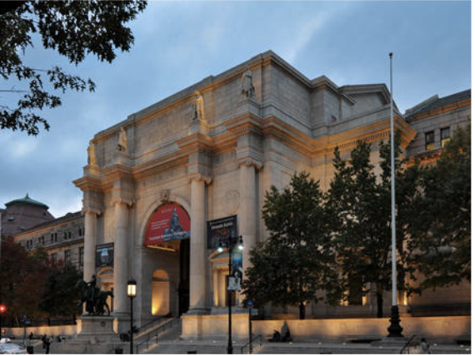
About the Museum
Founded in 1869.
28 interconnected buildings housing permanent and temporary exhibition halls, a library, and the Hayden Planetarium
Collections containing 33 million specimens
Occupies 2 million square feet
5 million annual visitors.
Richard Gilder Center for Science, Education, and Innovation under construction.

Slide 5
About the Museum- Exhibitions
45 Permanent Exhibition Halls
3 Galleries for Special Exhibits
Live Butterfly Vivarium
Hayden Planetarium
Immersive “Space Shows”
Giant Screen Films
Margaret Mead Film Festival
Asimov Debates
Travelling Exhibits
Notes:
Original development of the space show was done with rendering support at San Diego Super Computing Center.
- SEGP from SDSC enabled original sponsored connection to Internet2 in 2000.

Slide 6
About the Museum - Education
Richard Gilder Graduate School (Ph.D.)
Master of Arts in Teaching (M.A)
Research Experience for Undergraduates (REU)
BridgeUP: STEM
Helen Fellowship
Adventures in Science
Middle School Institutes
Urban Advantage
Seminars on Science
Notes:
Those that wish to delve deeper into the science presented in our exhibitions have access to a myriad of educational opportunities provided by the Museum
RGGS
First Ph.D. degree granting program for any museum in the western hemisphere. Comparative biology
MAT
First Urban Residency Program offered by a Museum. Housed at the RGGS. Supported by NSF Grant Number DUE-1340006
For Women and girls with a love of science.
BridgeUP: STEM is focused on the intersection of computer science and science. This portfolio of programs includes:
tuition-free intensive 2+ year Brown Scholars program for high school girls
the Helen Fellowship, a one-year post-baccalaureate fellowship for women
introductory middle school institutes covering a range of computational topics, like climate change
an annual overnight hackathon for professional developers and students addressing computational challenges in a given scientific discipline

Slide 7
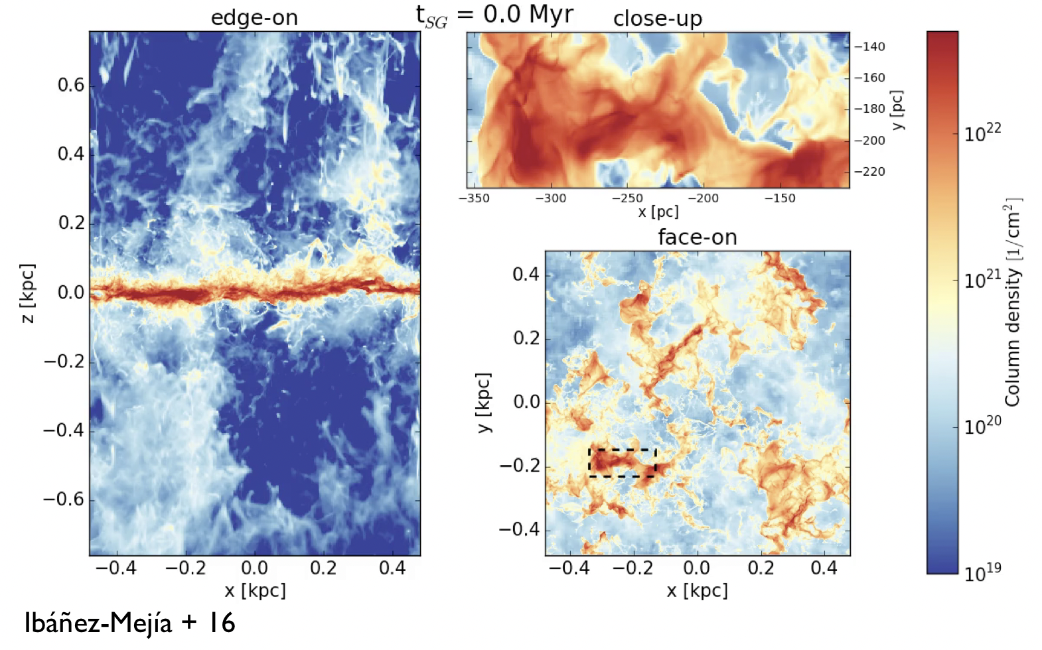
About the Museum – Research
Home to over 200 scientific staffers.
Vertebrate Zoology
Invertebrate Zoology
Paleontology
Physical Sciences
Anthropology
Notes:
Vertebrate Zoology
Mammalogy
Icthyology
Herpetology
Invertebrate Zoology
Entomology
Intertebrates
Paleontology
Physical Sciences
Astrophysics
Earth and Planetary Sciences
Anthropology
In addition to their research, the curators and scientific staff actively collaborate with our education and exhibitions departments to deliver high quality exhibits and programs rooted firmly in science. They also serve as faculty for many of our education programs, most notably our graduate and post graduate offerings.

Slide 8
About the Museum – Research
Sackler Institute for Comparative Genomics
Ambrose Monell Cryo Collection
Center for Biodiversity & Conservation
Southwest Research Station
Natural Science Collections Conservation
Notes:
Outside of primary scientific divisions, AMNH has established several other research initiatives including:
The Sackler Institute for Comparative Genomics
The Ambrose Monell Cryogenic Collection
Center for Biodiversity & Conservation
Southwest Research Station
Labs focused on Natural Science Collections Conservation, both at AMNH and beyond.
AMNH IT works closely with members of the Sackler Institute of problems requiring HPC resources. Established in 2001, the Sackler Institute’s approach is to consider the 3.8 billion year history of life as a grand biological experiment, one whose observation requires the integration of molecular, anatomical, and paleontological data. That effort has now become the focus of more than 70 research staff and students using facilities that include modern molecular labs, a frozen tissue lab, and substantial bioinformatics capability supported by our HPC efforts. Members of the Sackler team have been instrumental in both the development and adoption of those efforts.

Slide 9
Evolving Research Computing at AMNH
Notes:
● “COSMO”- 280 Compute CPU
● “ARES”- 64 Compute CPU (hyperthreaded to 128 cores)
- OSG Connected.
● “HEL”- 672 Compute CPU
- OSG Connected.
- Primary for COVID tagged jobs.
● “HUXLEY-” 512 Compute CPU (hyperthreaded to 1024 cores)
● “MENDEL”- NSF Funded in 2019.
- 1344 Compute CPU (hyperthreaded to 2688 cores),
- 2x GPU nodes, NVIDIA
- 2x High Memory Nodes (768GB mem each)

Slide 10
Evolving Research Computing at AMNH
Governance
Open
Science Grid
National Platforms
Cloud Computing
Education
Engagement
Research
Data Archive
Centralized
HPC/HTC
DB/ DAM
Support
Science DMZ
Open Space
Project
Grants Development
Dept.
Cluster
Support
Engaging
Science
R&E
Networking
Collaborations
“Traditional” IT
Notes:
R&E collaborations:
Utah/ Linköping University/ AMNH: OpenSpace
XSEDE/ TACC (Fluid Dynamics in gas clouds)
SDSC/ NASA: Digital Galaxy Project.
MPO/ AMNH: Project 1644 (Oppenheimer)
AMNH/ NYSERNet/ ERN/NRP (potential)

Slide 11

AMNH CC* Grants
Award 1827153 (2018)
Built a Science DMZ at AMNH to provide high-speed low latency connections to AMNH researchers and collaborators.
Connected to NYSERNet/ Internet2 for research computing.
Deployment of multiple FIONA Data Transfer Nodes (DTN) for high-speed data transfer orchestrated using Globus.
Federation with InCommon.
Native IPv6 support.
Collaborated with TrustedCI for security design and review.
Provides the foundation for other research computing initiatives.
Award 1925590 (2019)
Building a new central HPC resource for AMNH researchers, students, and collaborators.
Cluster includes standard compute nodes, GPU nodes, and high-memory nodes.
Dedicated DTN for cluster.
Will be OSG connected.
“Cloud bursting” to AWS in fall 2020/ spring 2021.
Standardization of open source tools.

Slide 12
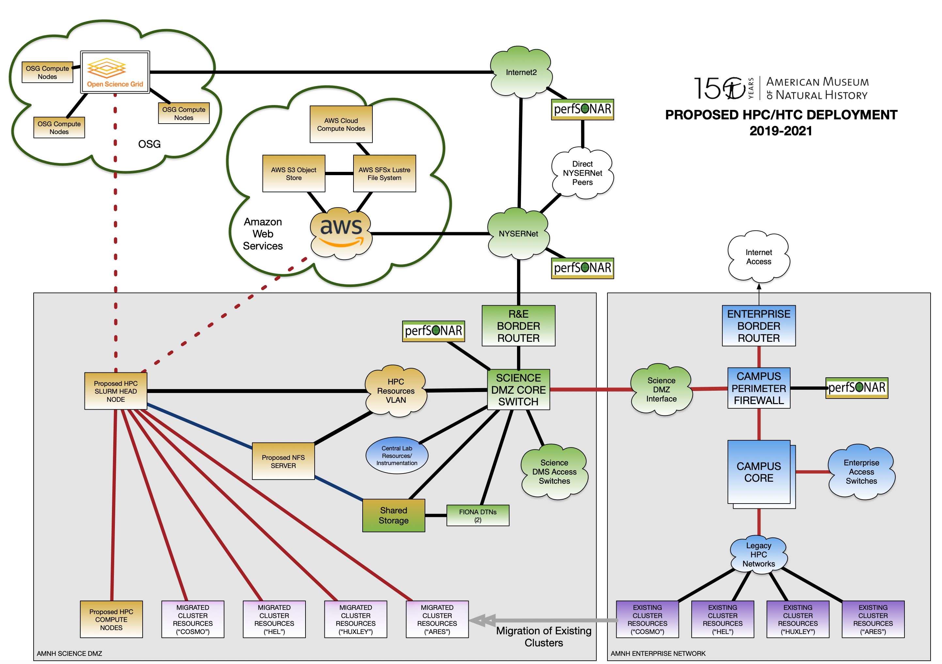
Research Computing Strategic Plan
Continued expansion of Science DMZ.
Redeployment of current clusters using a redesigned open source framework.
Migrate existing clusters to the Science DMZ.
Deployment of IPv6.
Cluster Federation with InCommon.
Acquire additional compute capacity (traditional and GPU).
Cloud Bursting.
Open Science Grid.
Regional and National Platforms
Engagement with researchers.
Notes:
Different Open Source tools to allow greater flexibility
SLURM Resource Manager
XD MoD
Ganglia
Grafana
Xcat

Slide 13
AMNH and OSG- Local Submission Node
Built onsite submission node.
  Researchers can login to an OSG submit point using local credentials​
  Jobs can access input data locally without need to transfer to intermediary first​.
  Allows for output to be available at job completion without ​need to manually transfer data back

Slide 14
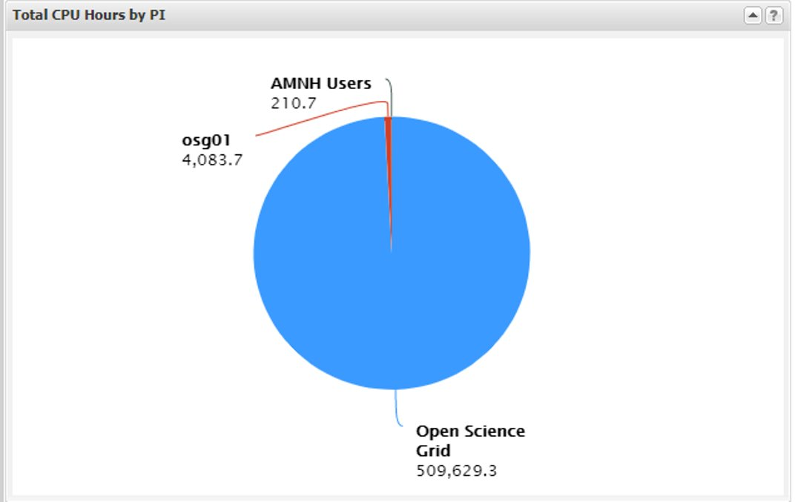
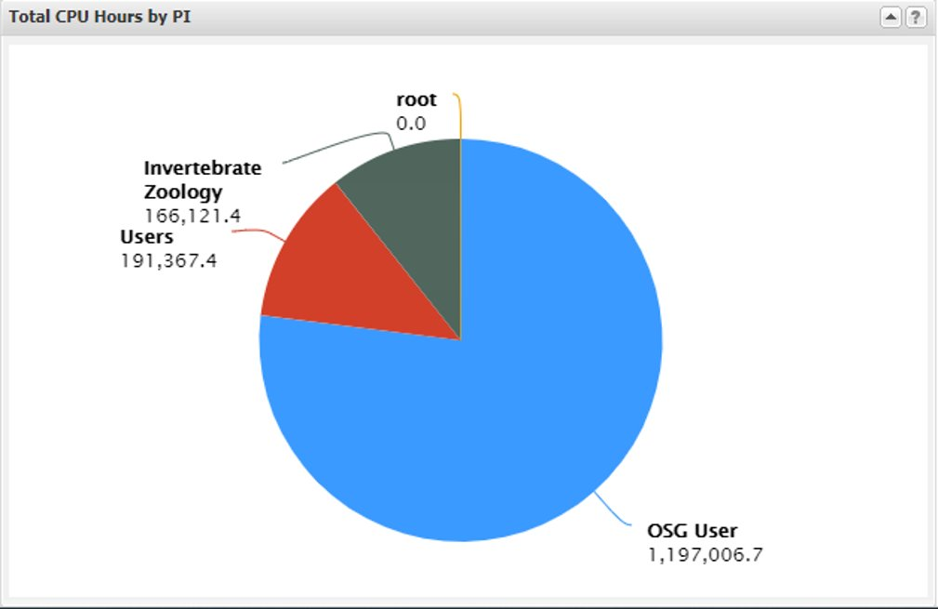
AMNH and OSG- Additional Resources Added
Prior to March 2020, only a single cluster (ARES) was being shared with OSG.
Added a second cluster (HEL) for jobs tagged for COVID priority in March.
ARES Utilization
HEL Utilization
Additional clusters being added to OSG, including MENDEL, our new HPC funded by NSF CC* Grant 1925590.
Notes:
Goal is for all AMNH clusters to be on OSG by spring 2021 w/ local submit nodes.

Slide 15
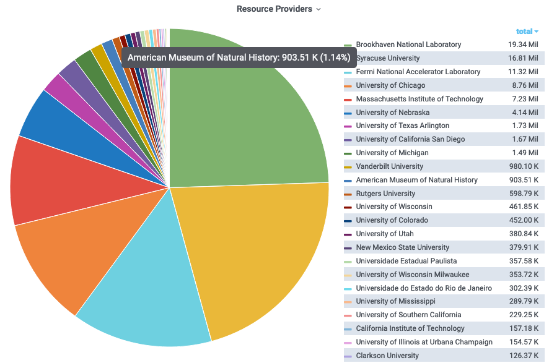
AMNH and OSG- COVID-19 Research
Although relatively small in terms of overall contributions, AMNH has been proud to be part of the OSG COVID-19 research efforts.
AMNH dedicated cluster resources for use on this project.

Slide 16
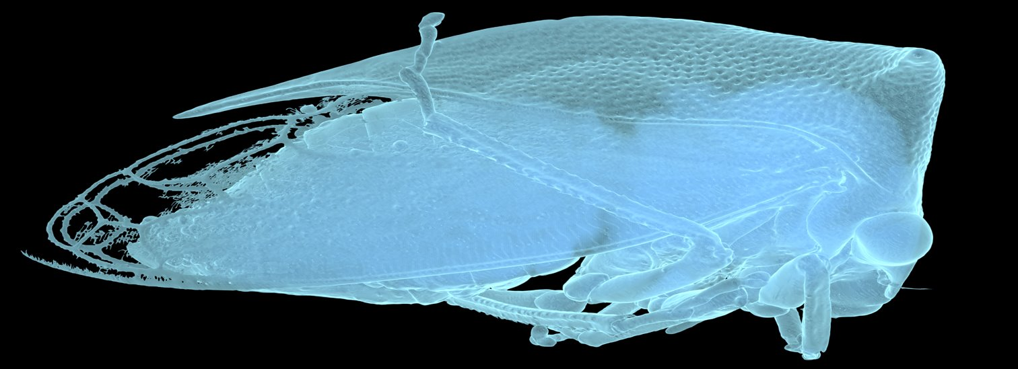
Hollister Herhold, PhD. Student, RGGS
This is an image of a Tree Hopper (Order Hemiptera, Family Membracidae).
Micro-CT scanned at the Microscopy and Imaging ​Facility (MIF) at AMNH, at a voxel size (resolution) of 8 microns.
Entire specimen is less than 1cm in length, demonstrating the ​ ability to recover extremely fine morphological details.
Post-processed using 3D Slicer, an open-source project for volume ​image data and analysis. Lighting and texturing was done in Blender 2.80, a popular open-source animation and rendering package.
Image was rendered using Blender on the Open Science Grid. ​
Image copyright (c) 2019, H. Herhold/AMNH.
Notes:
Additional rendering by Herhold completed (not available for public yet).
Technique is being adapted to work in earth sciences (rendering of sample analysis data

Slide 17
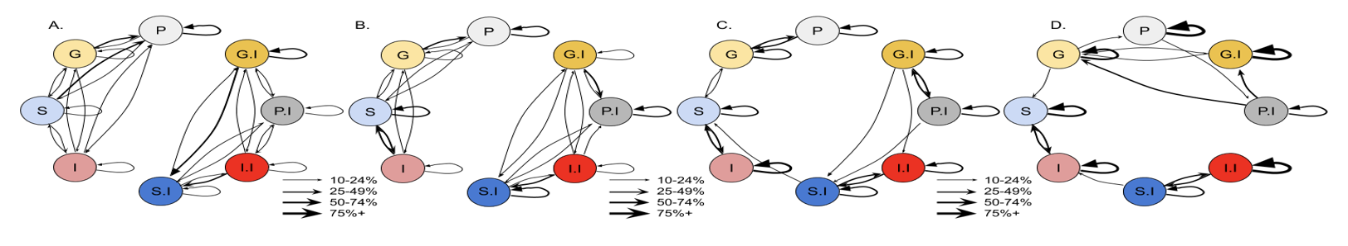
Kaiya Provost, Research Associate & PhD. Candidate
Using OSG to run simulations to evaluate how species have evolved in southwestern deserts​.
Generated 24,000+ and counting simulations using population simulation software SLiM 3.​
Using OSG instead of on-site resources only this project went from a 6-year simulation project to a 6-week simulation project.
Paper in pre-print: https://www.biorxiv.org/content/10.1101/2020.06.17.157842v1.article-metrics
Image copyright (c) 2020, K. Provost/AMNH.
Figure 6: Overall model classifications are easily confused at young ages but improve with older ages. Arrows begin at the true model and end​ at the assigned model. Line thickness of arrows indicates the percentage of time those assignments are made. Assignments under 10% are ​ omitted for clarity. Demographics include single panmictic populations (“P”, grey), isolation-with-migration or gene flow (“G”, yellow), secondary ​ contact (“S”, blue), and isolation (“I”, red). Suffix of “.I” after demography indicates that IBD is present. A) 6,000 generations. B) 21,000 ​generations. C) 120,000 generations. D) 1,000,000 generations. Models with IBD are on the right, models without IBD are on the left.
Notes:
From KAIYA (re: diagram): Those are the results of a Neural Network which is trained on our simulated data. We taught our neural network how to tell the difference between different kinds of simulations. Those kinds of simulations describe the kind of evolutionary history our simulated organisms lived under. For instance, one simulation is that the organisms lived their entire evolutionary history in two populations that never met. Another simulation is where the organisms came back in contact after a long time period of being apart. And so on. Regardless, each of those colored circles in the diagram represents one unique kind of simulation. We asked the neural network, which had learned how to tell apart these simulations, to tell apart some new ones. Then we counted how many times the neural network was right, vs when it was wrong. The arrows that go between the colored circles show the results. Arrows start at the simulation/colored circle that is correct, and then they point at the simulation/circle that the neural network guessed. When the arrows stay on the same circle, that means the neural network guessed right. When the arrows moved between circles, that means the network guessed wrong. How thick the arrow is shows how many times this happened, so a thicker arrow means that the neural network made that choice more often. Finally, there are four panels in the figure. This is four different lengths of time that we simulated the evolutionary histories of our organisms for. From left to right, we simulated for 6,000 years, 21,000, 120,000, and 1 million years.

Slide 18
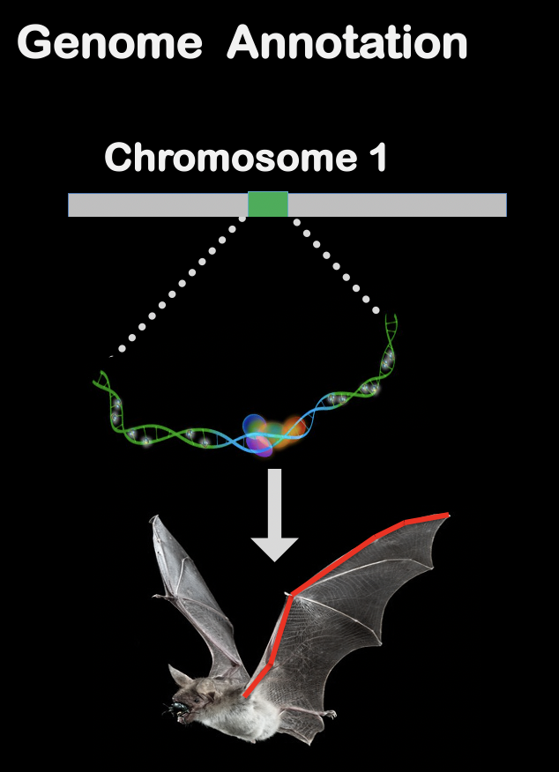
Ariadna Morales - Gerstner Postdoctorial Scholar
Analysis of the genome data of of the genus Myotis
Research at the AMNH is setting the genomic basis of a new model system in mammals (bats) to study the ​ mechanisms of repeated evolution of traits.
Used OSG to run 80K jobs that took 4 weeks to complete.
  Using only onsite resources would have taken 4 months or more.
Results generated by this research are relevant to understand immune system of bats and resistance to diseases that may impact humans.
  Especially important considering COVID-19.
Notes:
Used OSG to analyze whole genome data of 20 bats of the genus Myotis. Most of the analyses involved ​ genome assembly, mapping to a reference genome, and reference-based genome annotations and gene predictions using software such as bwa, samtools, bcftools, minimap2, lastz, and other genome utilities and custom scripts.
Ran ~80K jobs on OSG which took approximately 4 weeks to complete. Using only on-site resources this ​ would have taken about 4 months to run.
Research at the AMNH is setting the genomic basis of a new model system in mammals (bats) to study the ​ mechanisms of repeated evolution of traits
Generated 20 new bat genomes using bioinformatic tools to ​explore genomic regions of high and low divergence linked to purifying selection, gene inactivating regions, mutations ​ leading to gain or change in function, molecular differences associated with diet and feeding behaviors, variation in ​genes related to lipid and fatty acid metabolism. All the analyses mentioned above require computationally intensive analyses that would be impossible to perform –or would take several weeks or even months– in powerful desktop ​computers or in a cluster with a limited number of nodes.
Using OSG resources has significantly reduced the number ​ of computational hours to generate results that will be published in peer-reviewed journals and presented at scientific ​meetings.
Moreover, results generated by this research are relevant to understand the immune system of bats and ​resistance to diseases that may affect humans.
Given the current health crisis that the world is facing due to COVID-19, ​genomic research on bats is crucial to understand, address, and prevent future pandemics.​

Slide 19
Thank You
Questions?

