Slide 1


HL-LHC Accelerator Upgrade Project
Giorgio Apollinari/Ruben Carcagno
Project & Deputy Project Manager
Lorri Stapleton, PCS
Fermilab – October 22nd, 2019

Slide 2

Plans for Today
Project Status
  Financial Situation
  Project Cost and Schedule Performance
  FY20 Funding and CR
  Preparation for IPR
  Issues
Technical Status of 302.3

Slide 3
Financials (Sep Report)
FY19 is over !
FY Obligations by Lab (updated Sep 2019):
Contingency available at Labs at the end of FY19: ~16.7 M$
 | FY16-FY19 Disbursements | FY16-FY19 OBG | Available Contingency
FNAL | 50,348 k$ | 39,136 k$ | 11,212 k$
BNL | 10,475 k$ | 8,737 k$ | 1,738 k$
LBNL | 16,797 k$ | 12,993 k$ | 3,804 k$
Total | 77,620 k$ | 60,866 k$ | 16,754 k$
To be Updated

Slide 4
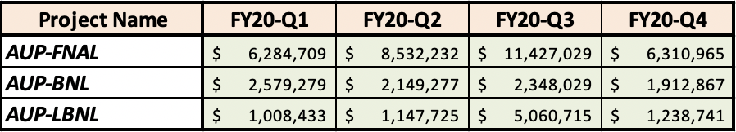
Funding for FY20
Provided funding needs for FY20 to M. Procario on Sep. 6th
Based on FY20 Obligations of HL-LHC AUP in Jul.’19 P6
FNAL has received communication from DOE that FY20 IFP is for 32,554 k$
  BNL received IFP of 8,989 k$
  LBNL should have received IFP of 8,455 k$
These IFPs include sizable Contingency at BNL and LBNL (see next slide):
  BNL Contingency: ~3,000 k$ by end of FY20
  LBNL Contingency: ~3,700 k$ by end of FY20
AFP FNAL funded for 6,300 k$ (CR to Nov. 21st )
  BNL AFP: ??
  LBNL AFP: ??

Slide 5
Financials (cont)
FY20-IFPs have been communicated to Labs:
 | Requested FY20 Funds | FY20 OBG | Available FY20 for Contingency | FY16-FY19 Contingency (slide #3) | Total Contingency by end FY20
FNAL | 32,554 k$ | 22,914 k$ | 9,640 k$ | 11,212 k$ | 20,852 k$
BNL | 8,989 k$ | 7,764 k$ | 1,225 k$ | 1,738 k$ | 2,963 k$
LBNL | 8,455 k$ | 8,567 k$ | -112 k$ | 3,804 k$ | 3,692 k$
 | FY16 | FY17 | FY18 | FY19 | FY20 | FY21 | FY22 | FY23 | FY24 | Total
M$ | 0.12 | 0.5 | 27.0 | 50.0 | 50.0 | 48.7 | 33.9 | 21.0 | 11.5 | 242.72
By end of FY20, 53% of AUP funds
will have been disbursed

Slide 6
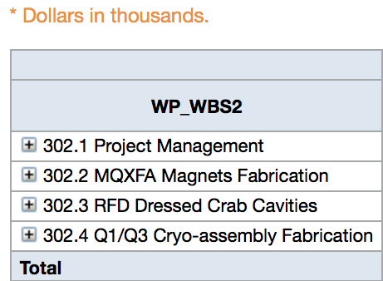
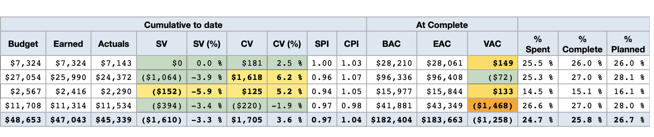
Cost Performance Report
(End of FY19 Report)
Compared to last month, SPI stable at 0.97, CPI stable at 1.04
September 2019 Status:
  SPI = 0.97 (stable), CPI = 1.04 (stable)
Total Project Cost (TPC): $242.7M
Budget At Completion (BAC): 182.3M
Estimate at Completion (EAC): $183.6M
ETC (EAC-ACWP): $138.3M
Contingency (TPC – EAC): $59.1M
% Complete (Planned): 26.7%
Contingency as % work-to-go: 42.7% (on EAC)
44.1% (on BAC)
New EAC Estimate
(includes coil yield)

Slide 7
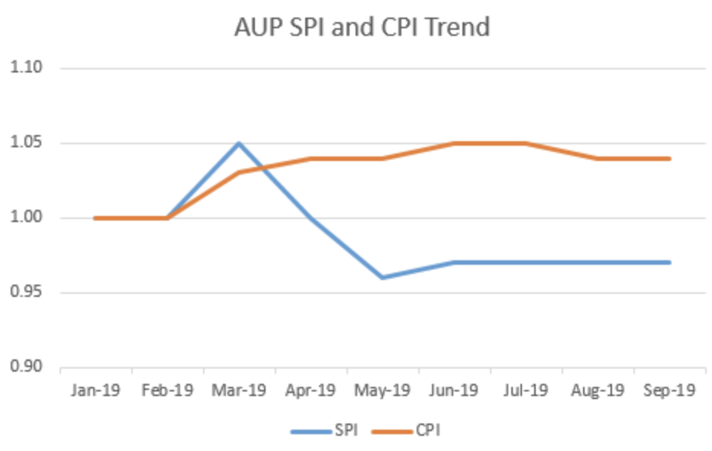
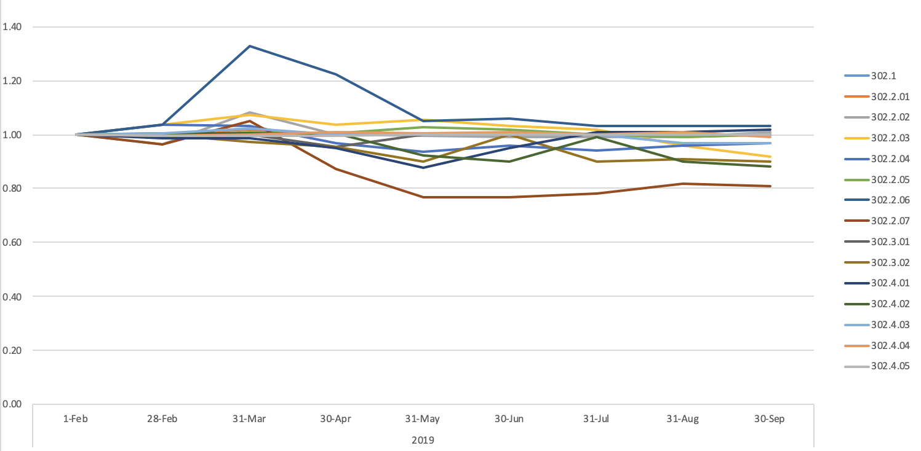
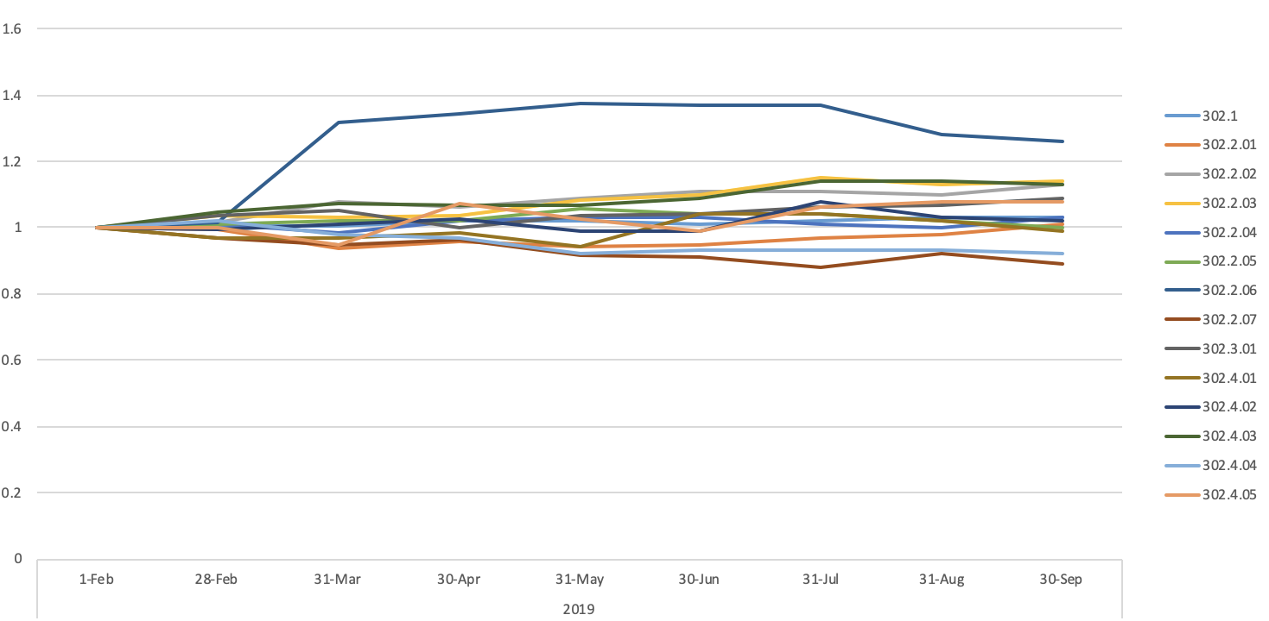
Cost Performance Trends
SPI by CA
CPI by CA
BNL Faster on Ship.
Tooling
BNL Ship. Tooling under budget
LBNL Slower on Magnets

Slide 8
Baseline Change Requests
Sep. ‘19 CCB#15 – 3 BCRs postponed/rejected
MR:~1.006M$
BCR # | Description | Cost | Schedule | Comment
HL-LHC AUP 0105 302.4.04 | Zero Magnet Test Date Change | 0$ | 0 days | Approved
HL-LHC AUP 0095 302.4.05 | Q2 Bus Bar Production Parts | 115k$ | 0 days | Approved
HL-LHC AUP 0100 302.4 | New Quench Antenna Design for AUP Magnet Testing | 199k$ | 0 days | Approved Correct the magnet number to MQXFA-04 in the description text.
HL-LHC AUP 0093 302.4.2 | Practice Cold Mass Fabrication – Addition of Labor | 143K$ | 0 days | Approved
HL-LHC AUP 0108 302.2.1 | Testing of Mirror Magnet | 73.4K$ | 0 days | Approved
HL-LHC AUP 0107 302.2.7 | ARMCO Iron Delivery, Invoicing and Storage Adjustments | 59k$ | 0 days | Approved
HL-LHC AUP 0078 302.2 | Remapping of Coils due to number of Rejections | (597 k$) | 0 days | Approved

Slide 9
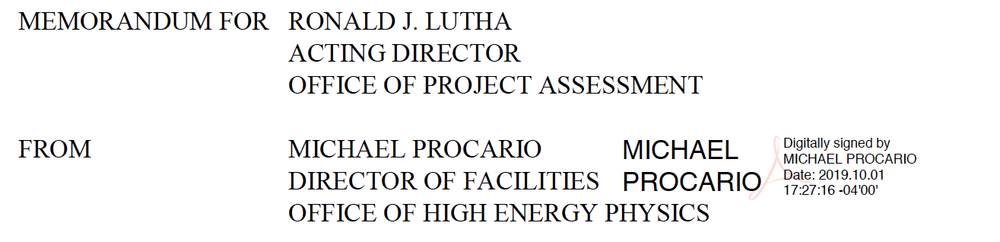
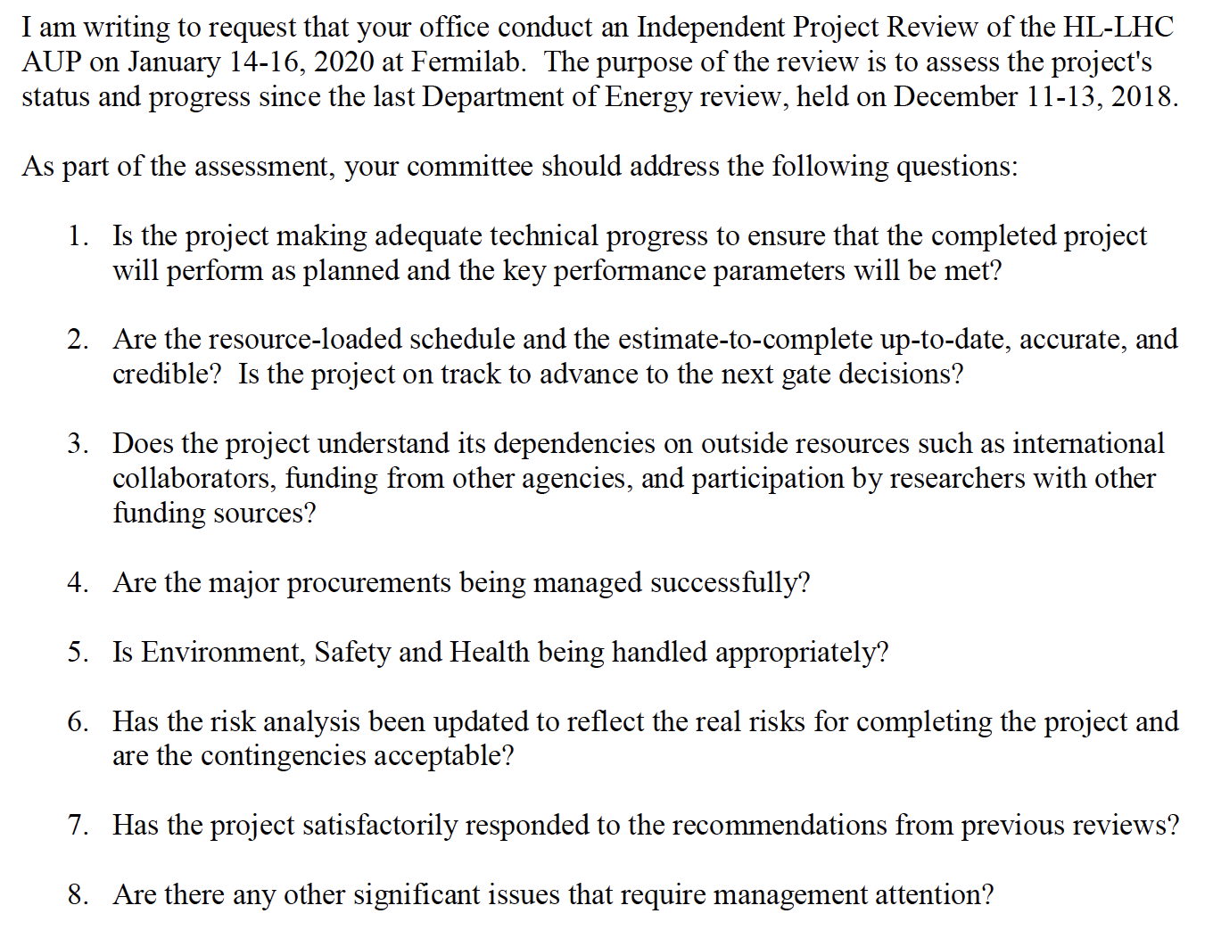
IPR Preparation
AUP IPR scheduled for Jan 14th – 16th, 2020
Received Charges

Slide 10
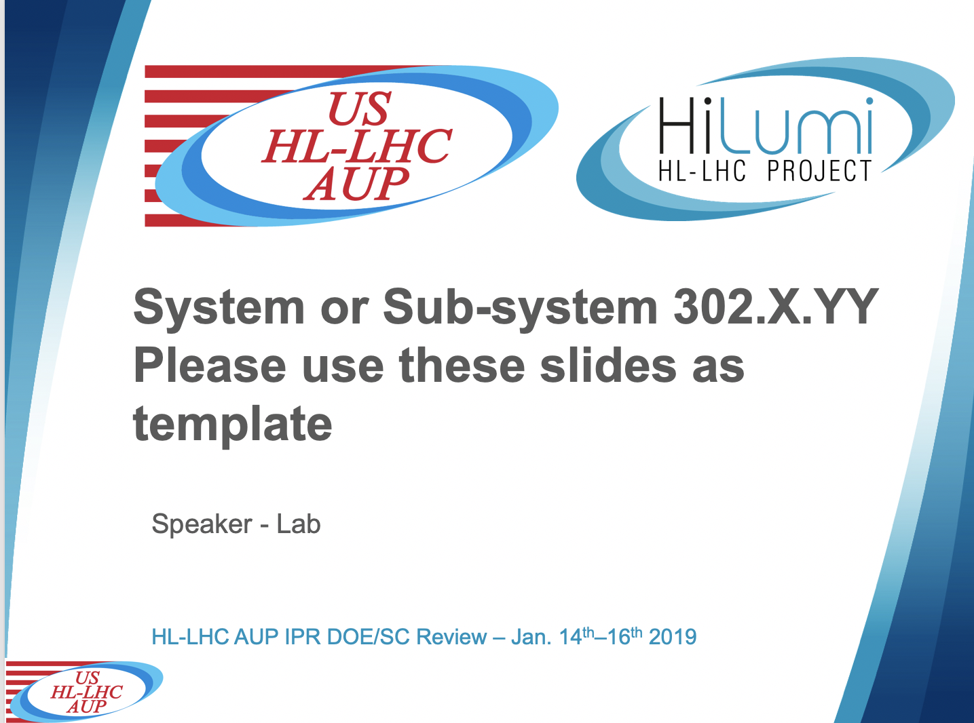
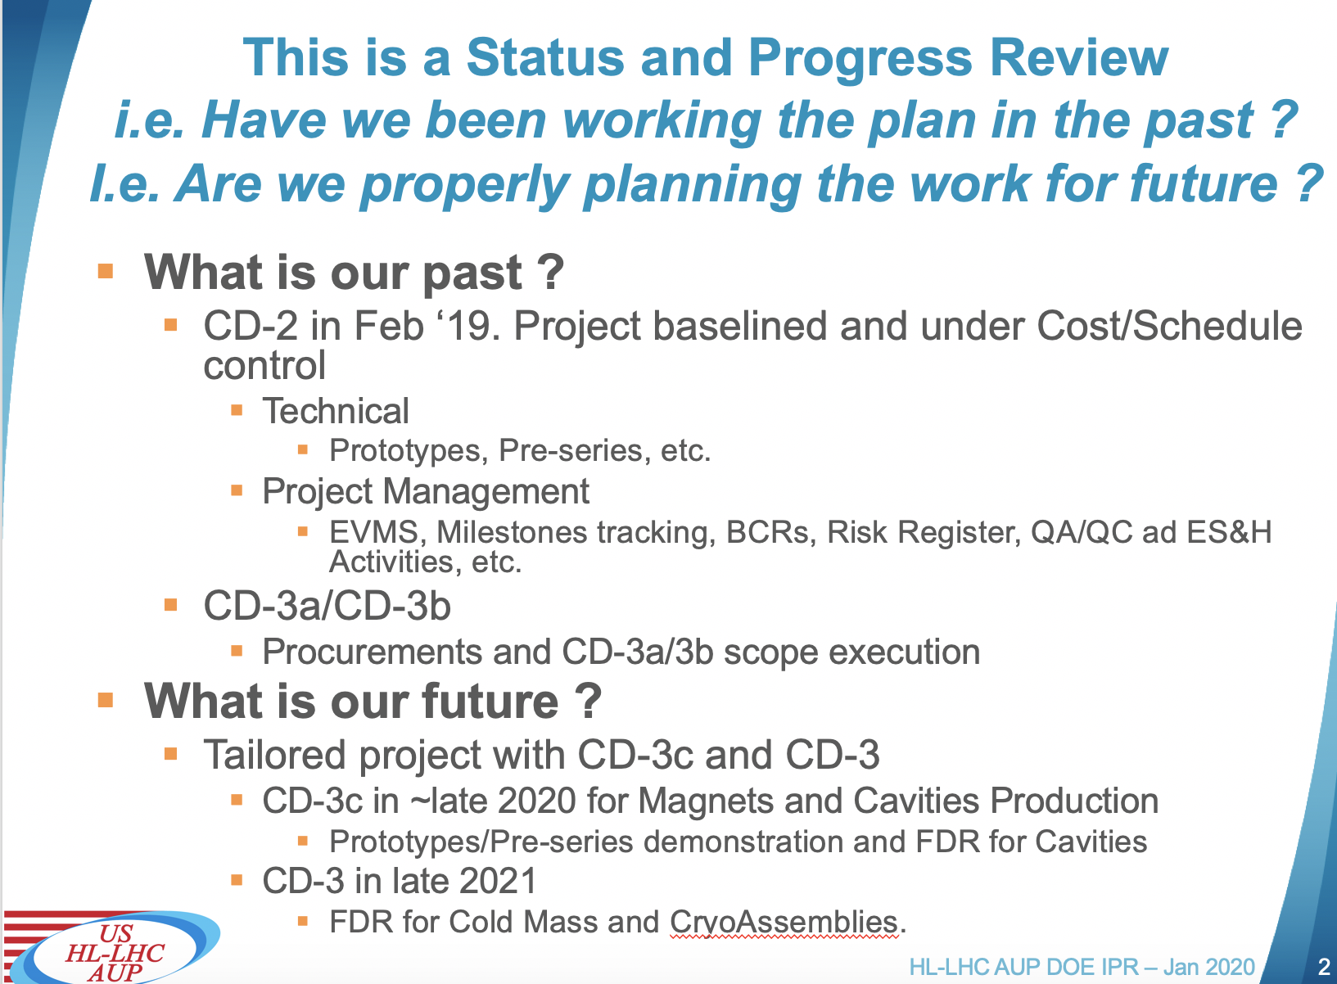
IPR Preparation (cont.)
Agreed with IPT on showing Oct ‘19 closing data
  Dec. ‘19 would not be available, Nov. ‘19 would make posting during year-end period challenging
Rehearsals during first 3 weeks of Dec. ’19, posting by Dec 20th
Distributed Instructions and Template for IPR Review to all presenters at CD-2/3b review
Agenda to be finalized by mid-November with CPO, FPD and FPM

Slide 11
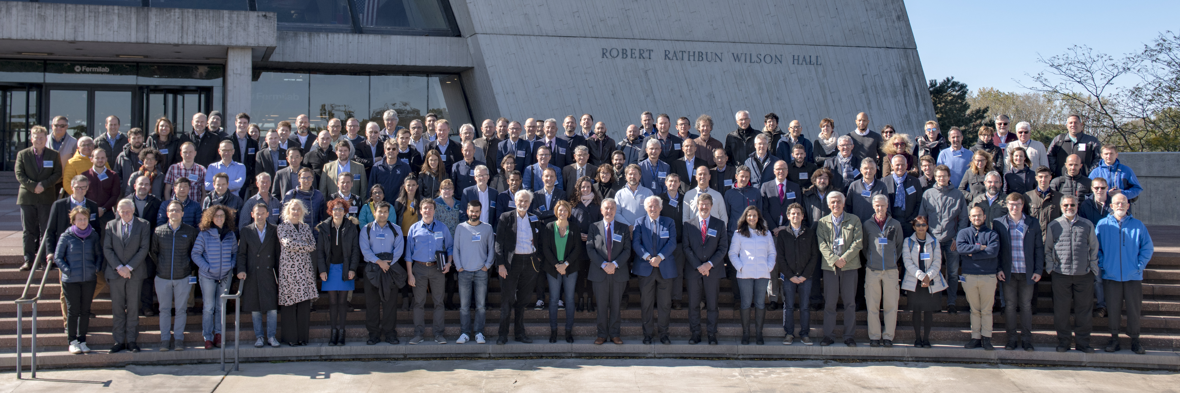
9th HiLumi Collaboration Meeting @ FNAL
Main take-aways:
  CERN is not getting any faster than AUP in making magnets
  QH swap appears to be favored solution
    Decision is advertised by end of CY20
  Acceptance at Nominal (rather than Ultimate) is still frowned upon, notwithstanding the acknowledged difficulties in ever reaching 7.5 TeV at the LHC.

Slide 12
Issues
No change from September PMG !
  Technical Performance
    Huge expectation on MQXFA03
    Plan to declare success on Nominal (16,470 A) + ~150 A, punt pushing for Ultimate after test of CERN Prototype#1
  QH Decision
    Swapped QH appears to be favored.
    OK with AUP. Mitigation in place with short mirror coil to be tested in Jan. ‘20.
  QA/QC is still a sour point in AUP activities
    Lead Insulation in MQXFA03 !
    Missing “Boots on the Ground” checks/auditing
    Off-Normal Procedures at FNAL & BNL & LBNL
  Tooling for humidity-controlled Hipot testing

Slide 13
AUP QA/QC Issues
From QM-J. Blowers
QA Issues raised/encountered at BNL:
QA Issues at FNAL:
QA Issues at LBNL:
Issue | Status
Coil 208 L1/L2 lead conductor damaged during curing | Final DR completed. CERN NCR uploaded to EDMS and is under review.
Upon receiving inspection of MQXFA03 at BNL, it was discovered that the leads were missing their full insulation | Repair work was thoroughly planned between the three labs (off-normal WPC), and repairs were successfully completed week of 14-Oct. LBNL is performing RCA/HPI and updating their procedures.
Issue | Status
During assembly of MQXFA03 at LBNL, coil 109 developed a short to ground | Coil was replaced with #205. Coil is en route to FNAL, where the cause will be investigated.
During winding of coil 118 the cable roped and moved unexpectedly on a spool and was damaged beyond repair. | Height of the winding is now verified prior to the start of each coil winding. Rigorous maintenance/operations handoff has been implemented.
Issue | Status
MQXFA03 splice box CLIQ lead design was modified, but the impact of the change on work performed at BNL was not actively verified. | Magnet is currently being installed at BNL, and so far no issues have been encountered Formal process to manage design changes has been written, reviewed, and feedback incorporated. Plan to release in November.
MQXFA03 leads missing full insulation (issue from above) | LBNL is performing RCA/HPI and updating their procedures

Slide 14
302.2 Update
Cable fabrication & Insulation
From L2-G. Ambrosio
Fabricated & Insulated cables:
  27 Accepted
  1 Rejected
    Crossover caused by Cu build-up on spool at vendor
Bare cable fabrication at LBNL: 36 completed
Insulation braiding at NEWT: 35 completed
RRR measurements at LBNL: 27 measured

Slide 15
302.2 Update
Coil Fabrication Status
From L2-G. Ambrosio
At FNAL, Coils to date = 14
  8 accepted – 2 underway
  2 quarantined
    109 electrical issue: last coil before saddle change
    114 impregnation anomaly: impregnation was faster than usual
  2 rejected
    108 electrical issue: last but one coil before saddle change
    118 winding issue: winder was returned in operation with boom at different elevation after maintenance
At BNL, Coils to date = 9
  3 accepted - 3 underway
  1 quarantined
    206 shipping anomaly: higher shocks than usual, very likely to be accepted
  2 rejected
    205 winding issue: winder was returned in operation with temporary clamp still installed
    208 curing issue: layer jump moved out of place before curing

Slide 16
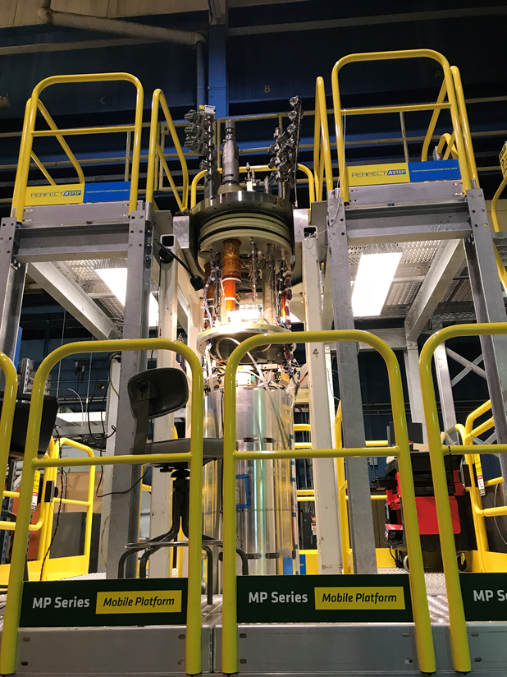
302.2-302.4 Handshaking
Magnet Assembly at LBNL & Test at BNL
From L2-G. Ambrosio
MQXFA03 Magnet (first Pre-Series) arrived at BNL
  Coil lead insulation refurbishment done at BNL (1 week delay)
Started MQXFAP2 disassembly in order to recover parts (~$400k)
MQXFA04 magnet expected to be ready to ship by end of January 2020
Parts for structures A04-A08 are arriving
ARMCO steel: half procurement (whole production) has arrived or is in shipment
MQXFA03 ”verticalized” at BNL

Slide 17
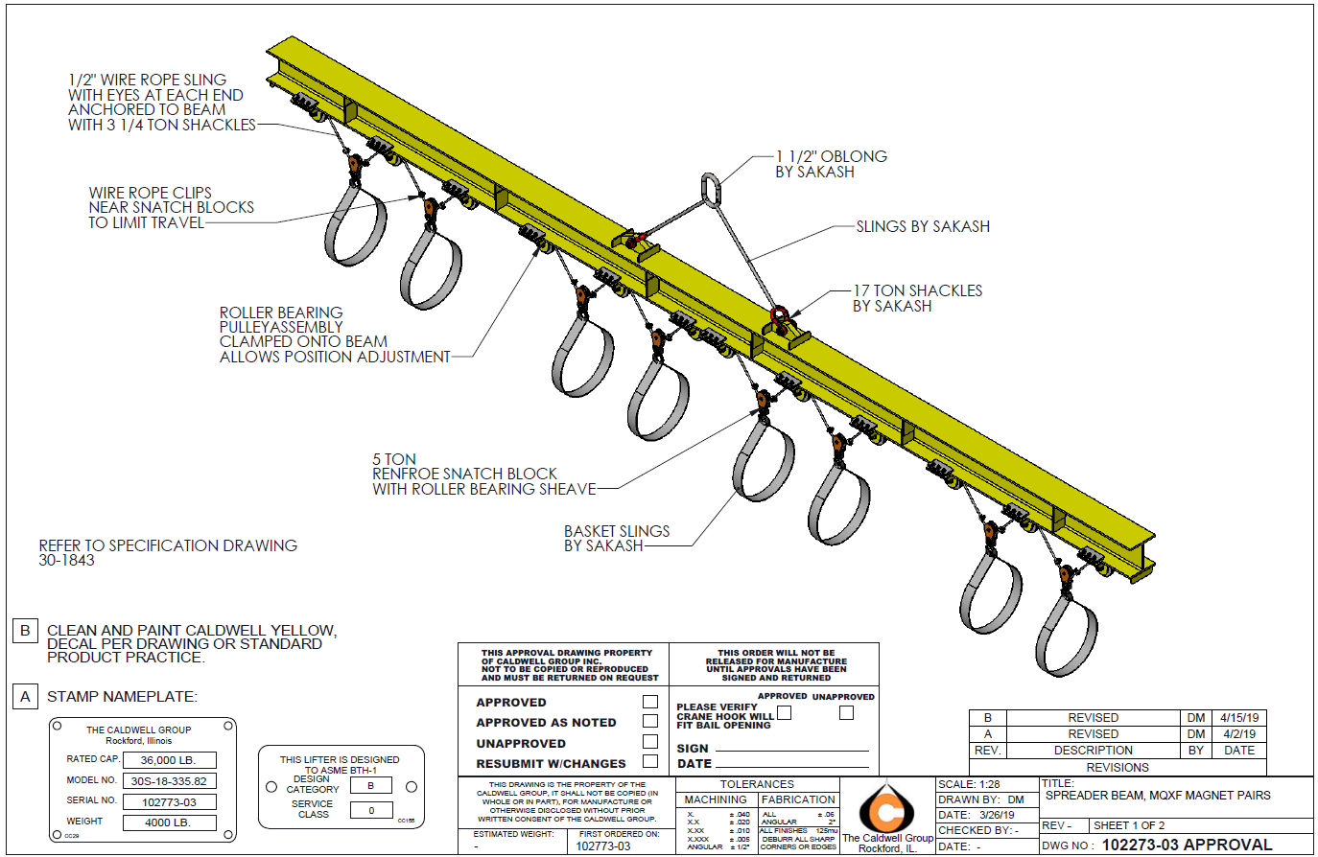
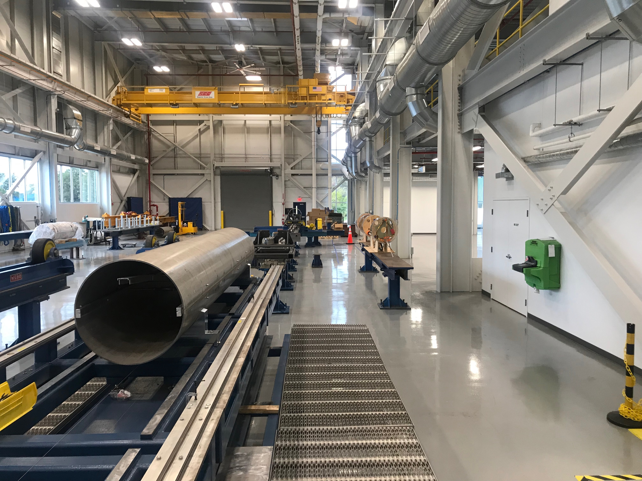
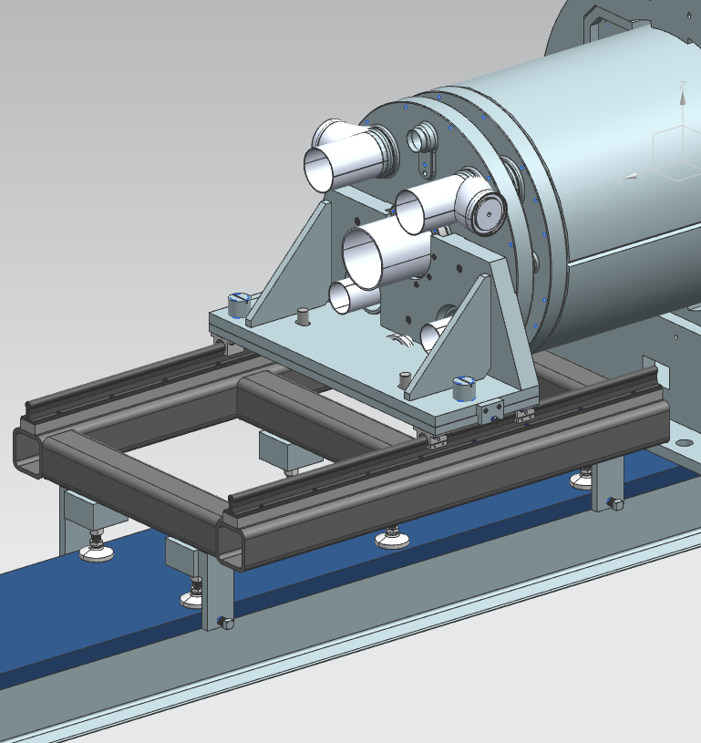
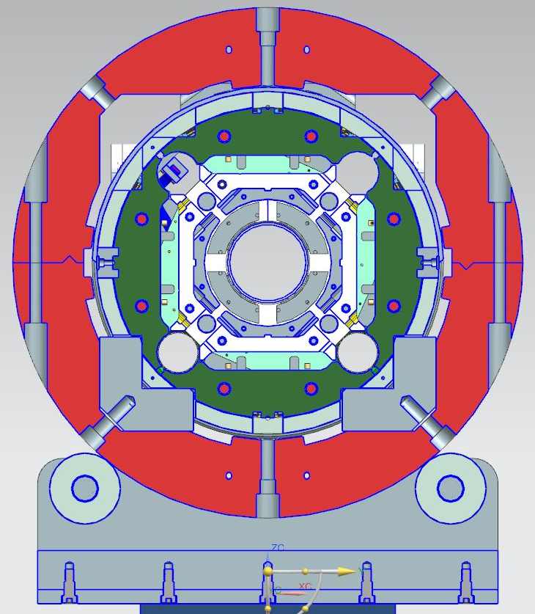
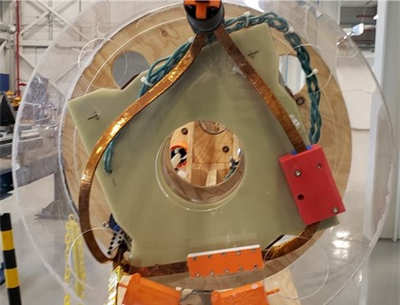
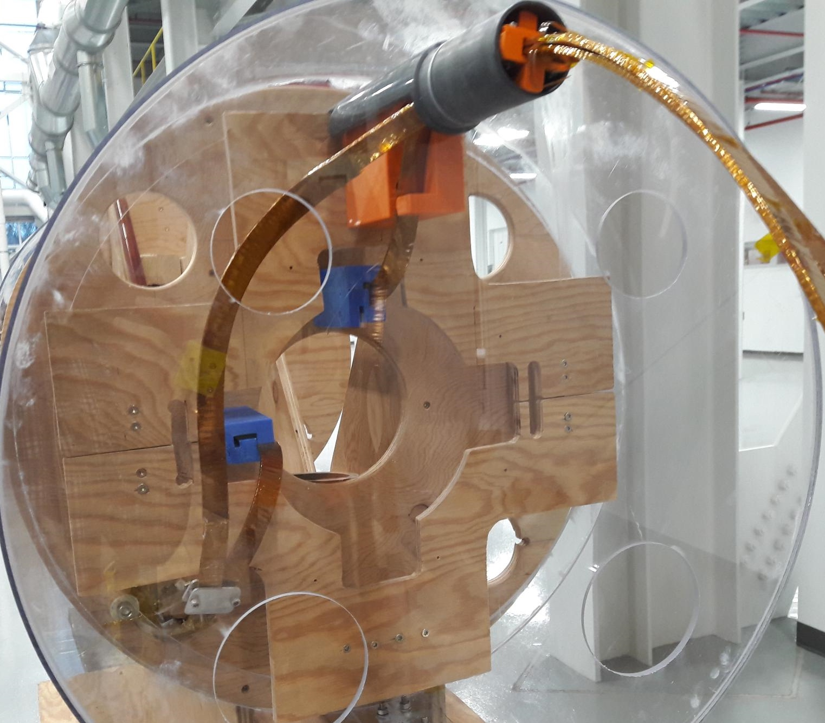
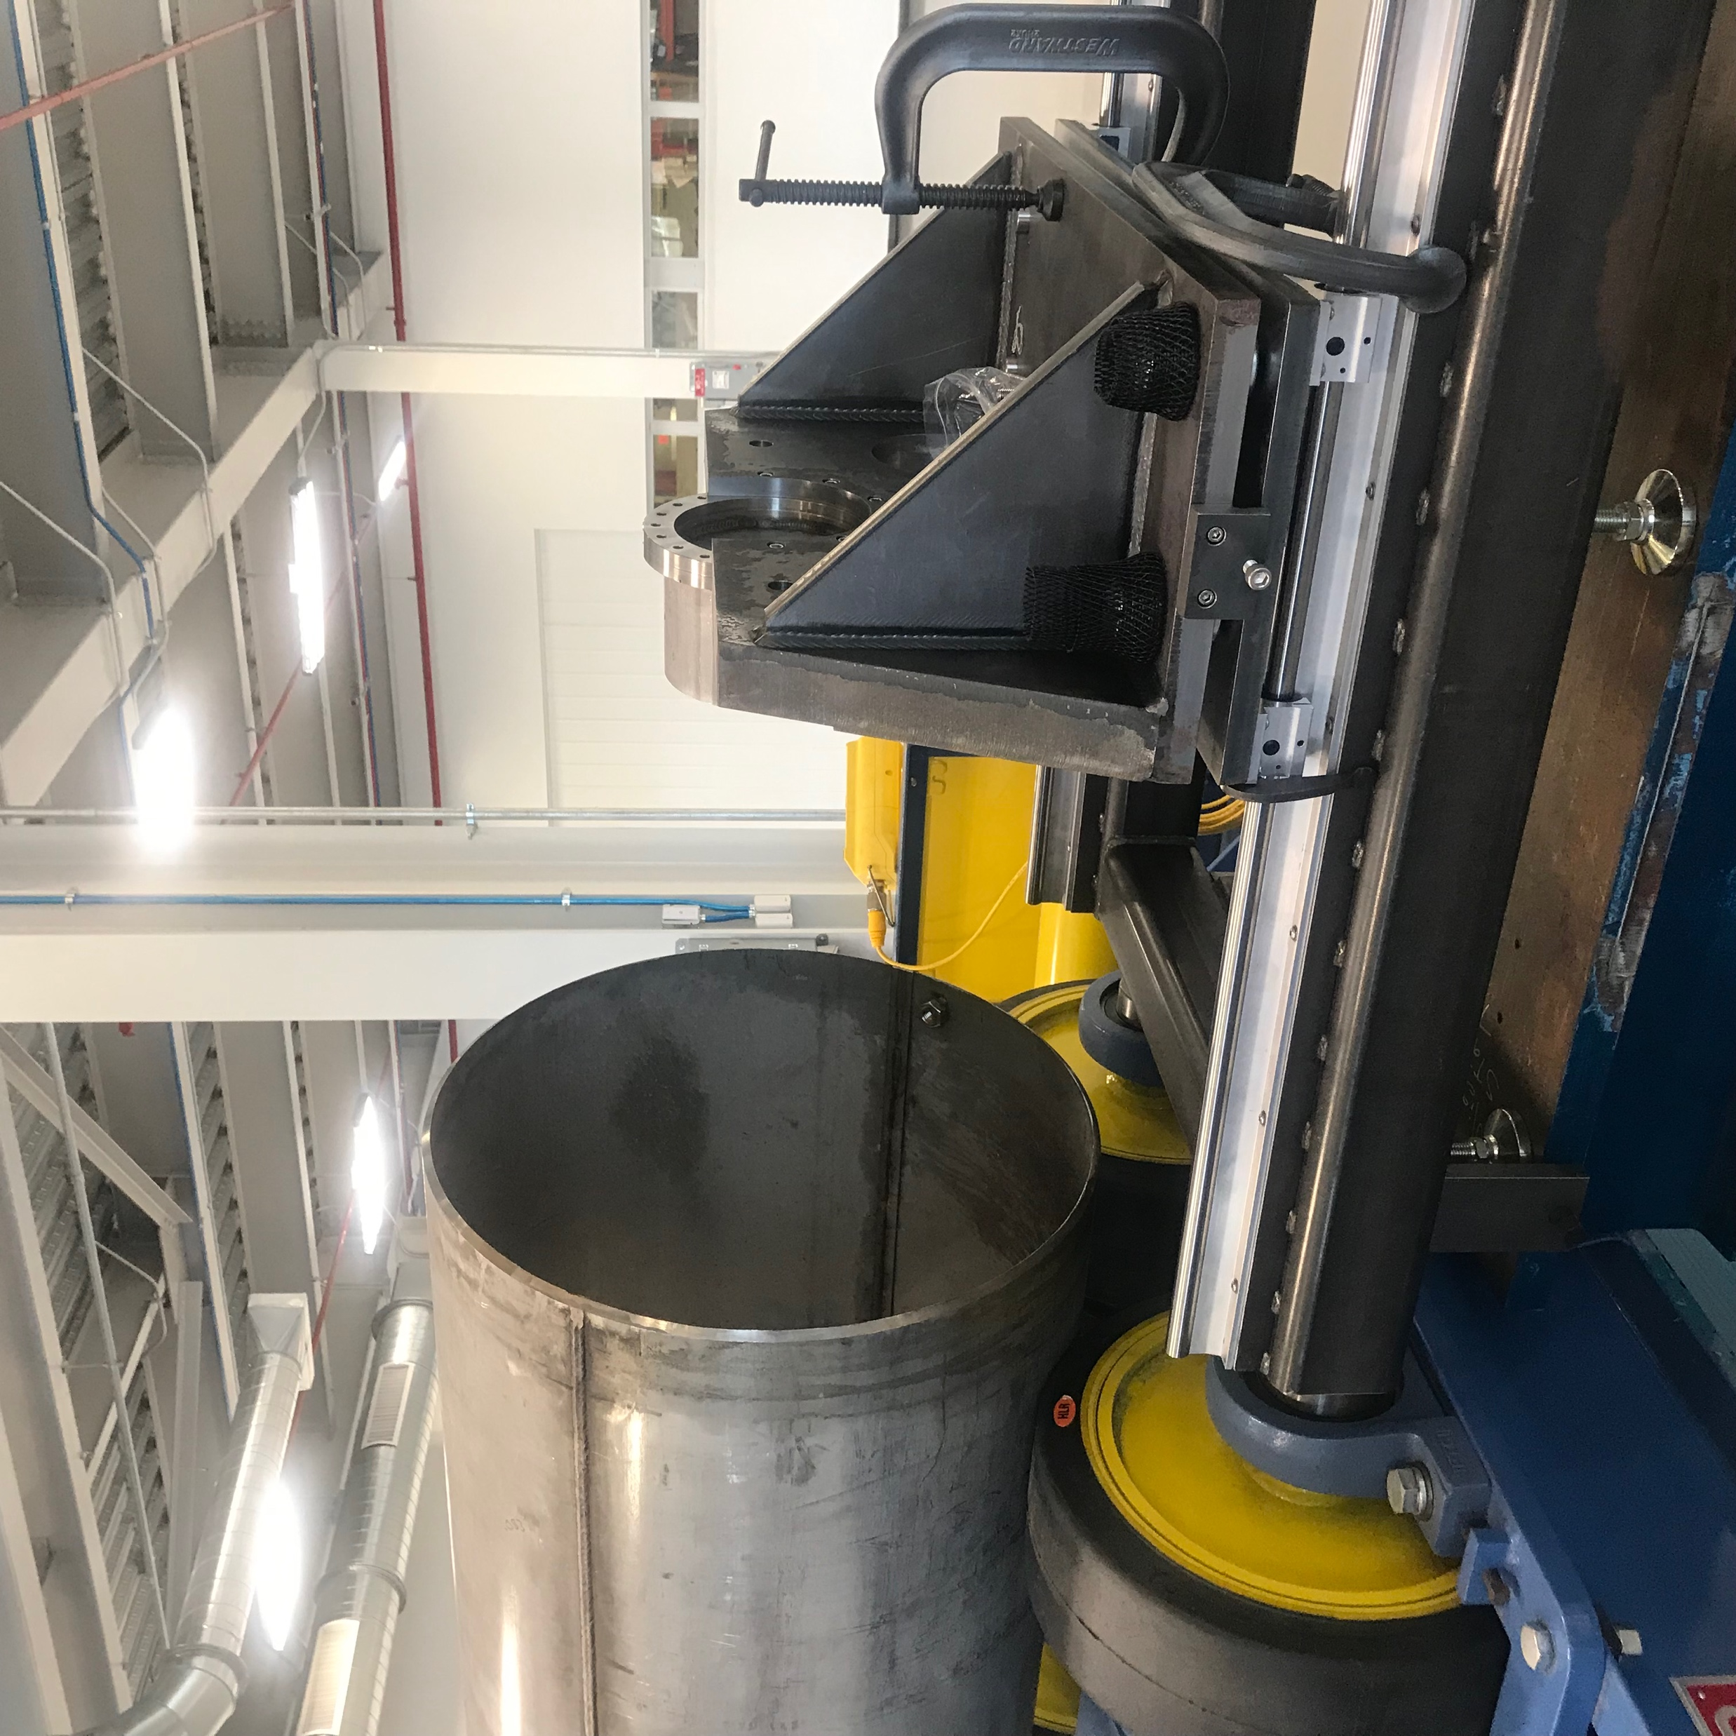
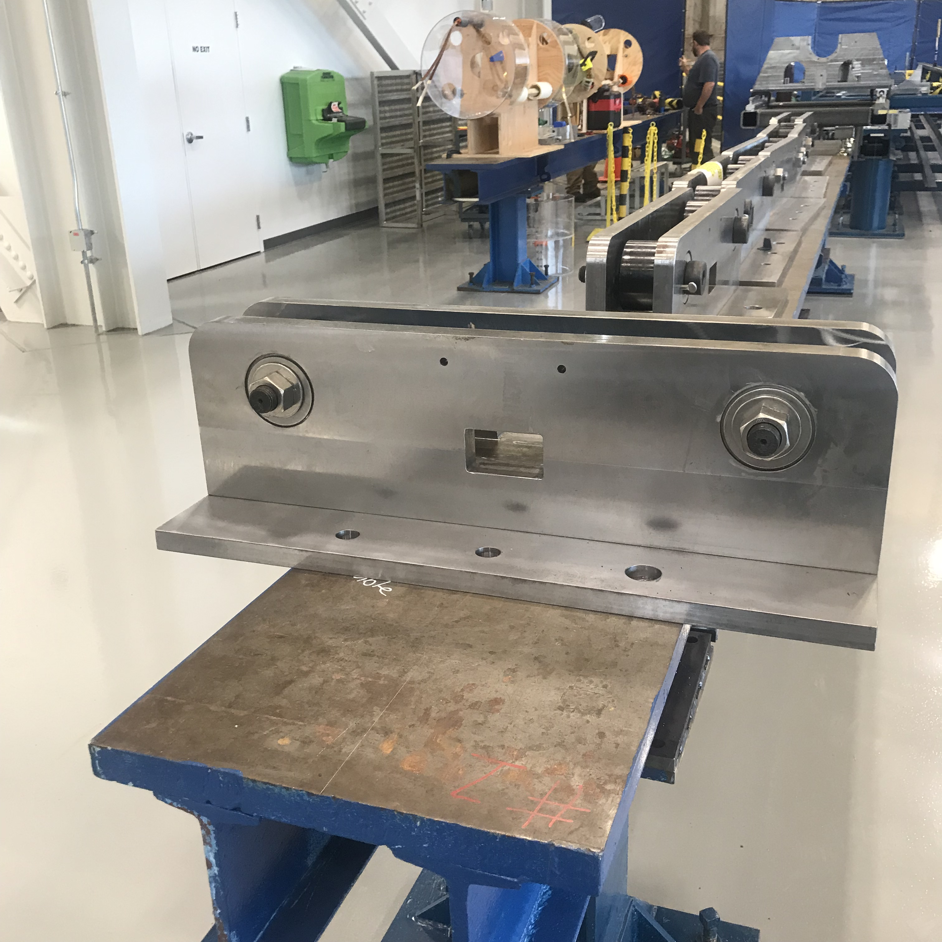
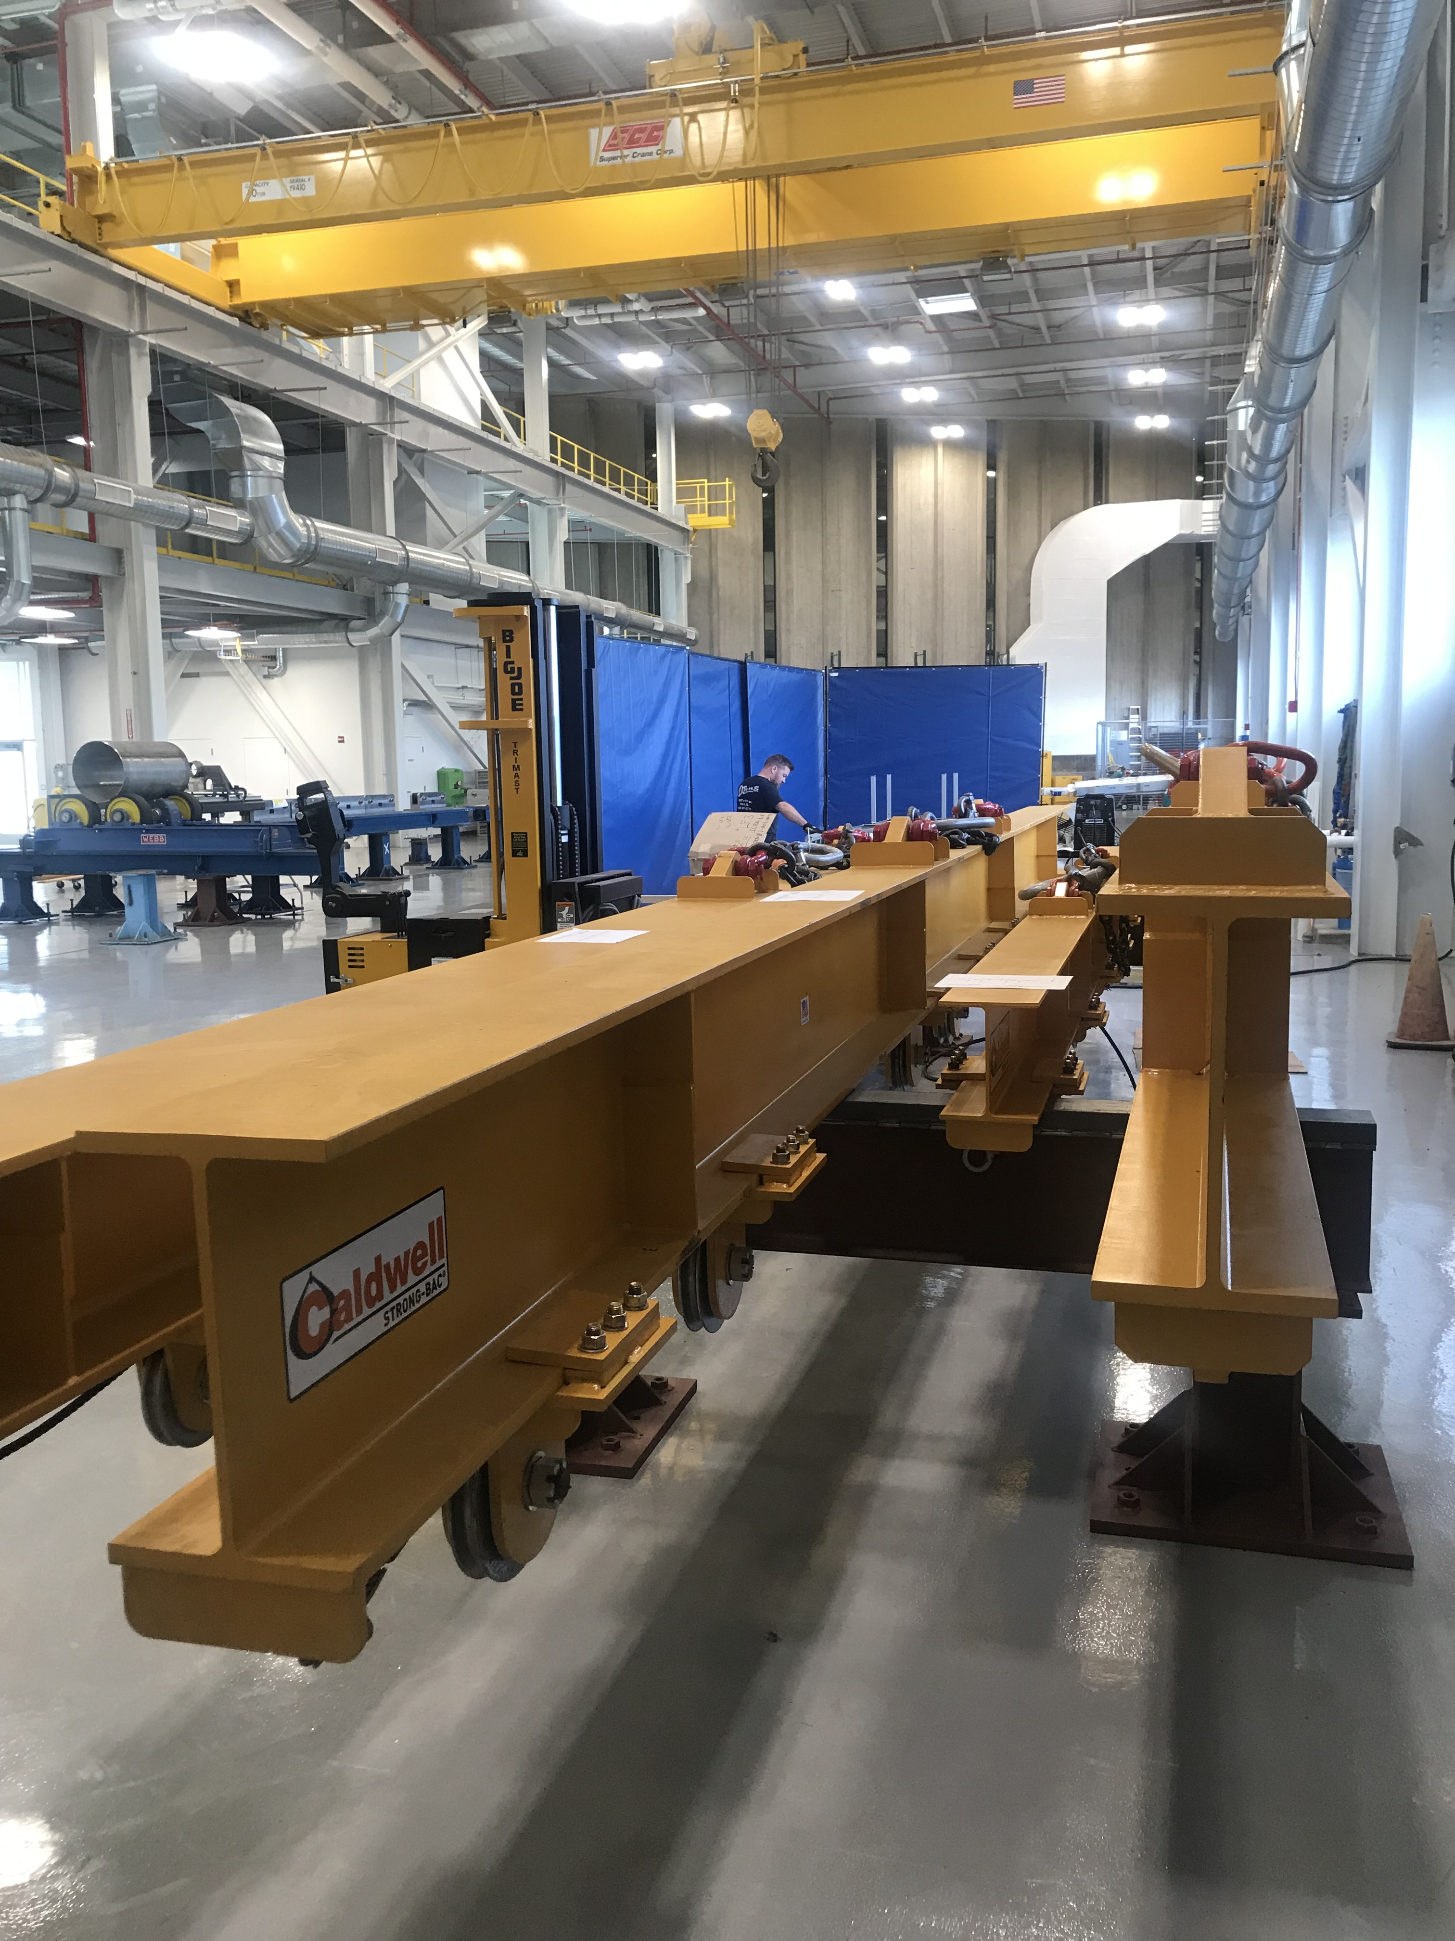
302.4 Update
Infrastructure, tooling, Bus bar
From L2-S. Feher
CM Tooling designed
procurement in progress
Cryostat tooling CDR review at vendor site this week; proposal to build the platform by the same vendor
Q1/Q3 design complete
Q2 design close to completion
Cold Mass Welding Table under Alignment
Q1/Q3
Q2
Expansion loop mockup
PMG Meeting 10/22/19

Slide 18
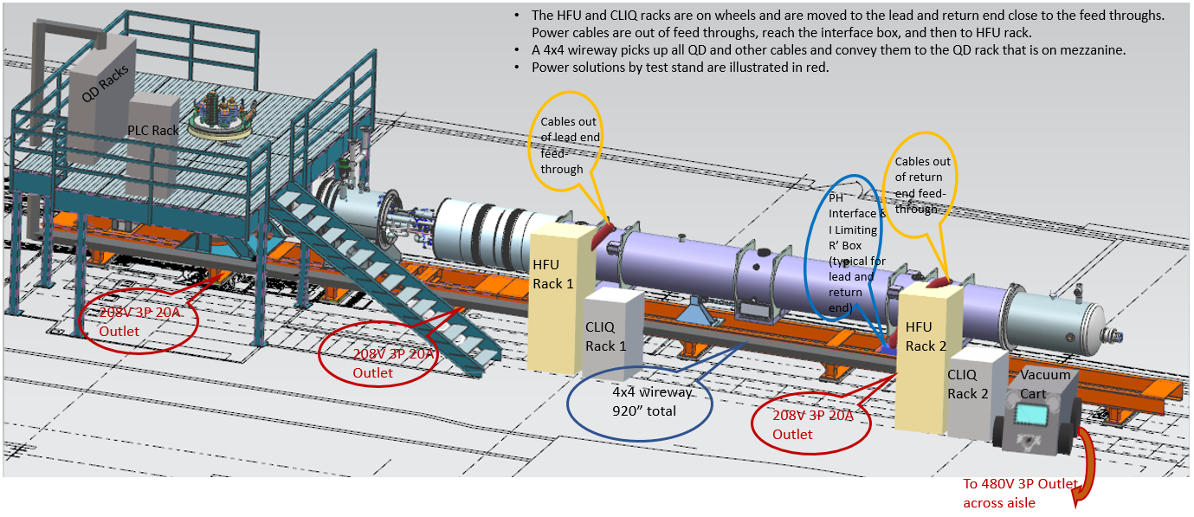
BNL CRYOGENICS UPGRADES
302.4 Update
Testing Facilities
From L2-S. Feher
Horizontal Test Stand at Fermilab
Linde 1430 Refrigerator/Liquefier 50 L/hr, 114 W
Linde 1610 Liquefier 80-100 L/hr
Linde 1430 is in house, not yet plumbed in.
Linde 1610 at BNL still under refurbishment.
Together with CTI4000 Refrigerator/Liquefier,
total capacity will be about 400 L/hr.
Lot of progress in every front
Lambda plug has been fabricated and being tested
Adapter box fabrication
Cryogenic infrastructure upgrade
QP modules completed waiting for system tests
MM probe driving module successfully tested
Zero magnet test milestone is in March 2020
Has been demonstrated to make 3 quenches a day (excellent heat exchanger and pumping capabilities)

Slide 19
Future PMG/RMB/CCB
 | Oct (mod.) | Nov
PMG (3rd Tues.) | 22nd (today) | 19th
TB/RMB (2nd Wed.) | 9th | 13th
CCB (3rd Wed.) | 23rd | 20th
Next PMG on Nov. 19th 2019
  Is this OK with everyone ?
  Proposed Location IB3-A due to parking limitation at WH

