Slide 1
ICEBERG Power (As Found)
Shekhar, Linda, Carlos, Rory et al.
10/17/2019

Slide 2
Why As found
We have 4/12 fuses blown in WIB in CE.
We have several FEMBs that are not initializing.
We see unusual behavior in CE Power when PD SSP power is turned on/off

Slide 3
ICEBERG CE Electrical
DUNE ICEBERG CE Rack Documentation
https://docs.dunescience.org/cgi-bin/private/ShowDocument?docid=10515
https://fermipoint.fnal.gov/service/tsworc/Lists/tsworc/DispForm.aspx?ID=2659
https://fermipoint.fnal.gov/service/tsworc/Lists/tsworc/Attachments/2659/iceberg-controls.pdf
https://fermipoint.fnal.gov/service/tsworc/Lists/tsworc/Attachments/2659/ORC_CE_Rack_ICEBERG.pdf
DAQ DUNE TPC Cold Electronics Test
https://docs.dunescience.org/cgi-bin/private/ShowDocument?docid=9877

Slide 4
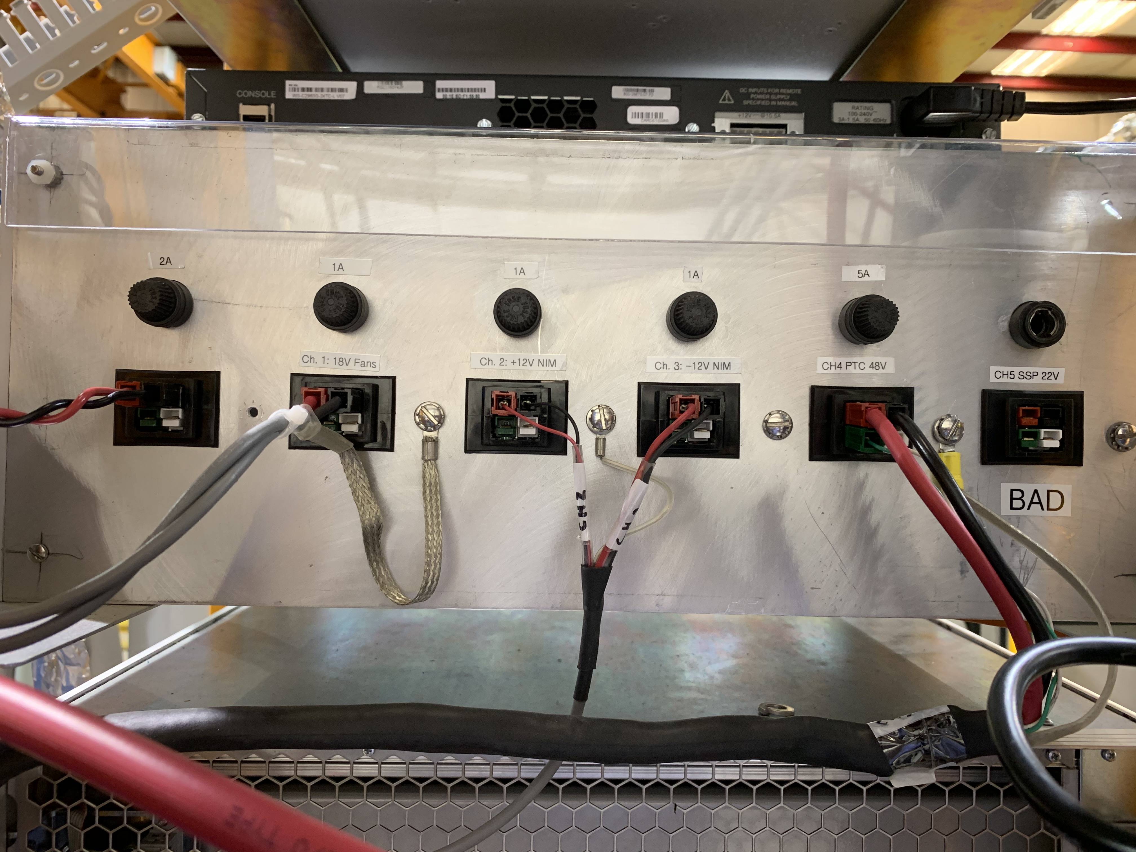
Wiener PL506
Ch 0 (SSP) 22V/1.7A
s
Ch 1 18V/1A
s
Ch 2 12V/1A
s
Ch 3 12V/1A
Ch 4 48V/3A
CE as in drawing
s
Ch 5 Empty

Slide 5
PL506 Explanations
Need to understand PD SSP Power Cable Shield is not connected.
Does not have a shield connected by design of PD ?? (ORC document)
Need to understand how the Purity Monitor Ground is used at the end of NIM (It is open at other end)
We verified 100 Ω resistor to ground exists in Purity Monitor electronics module
https://docs.dunescience.org/cgi-bin/private/RetrieveFile?docid=10515&filename=PL506_to_NIM_powercable.pdf&version=5
This is as per drawing.

Slide 6
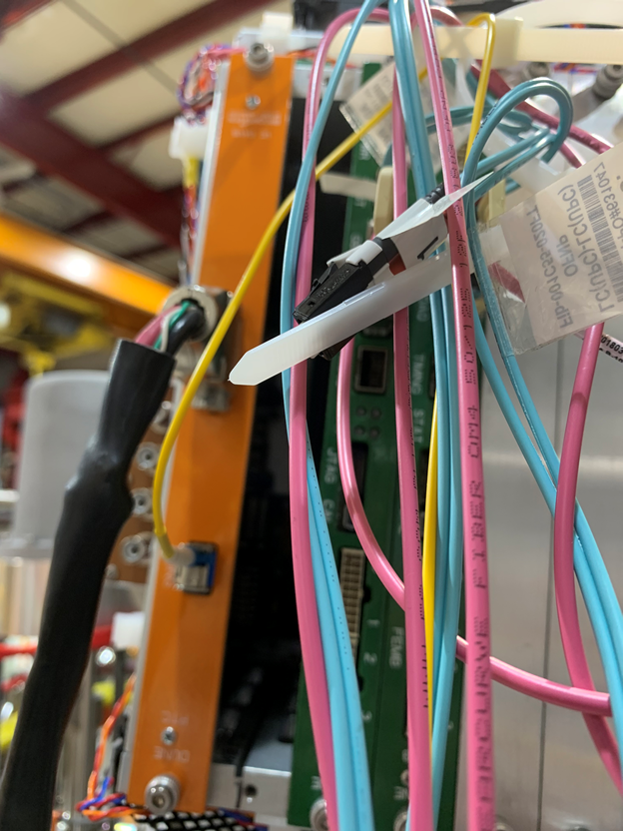
PL560→ PTC and Fan in WEIC

Slide 7
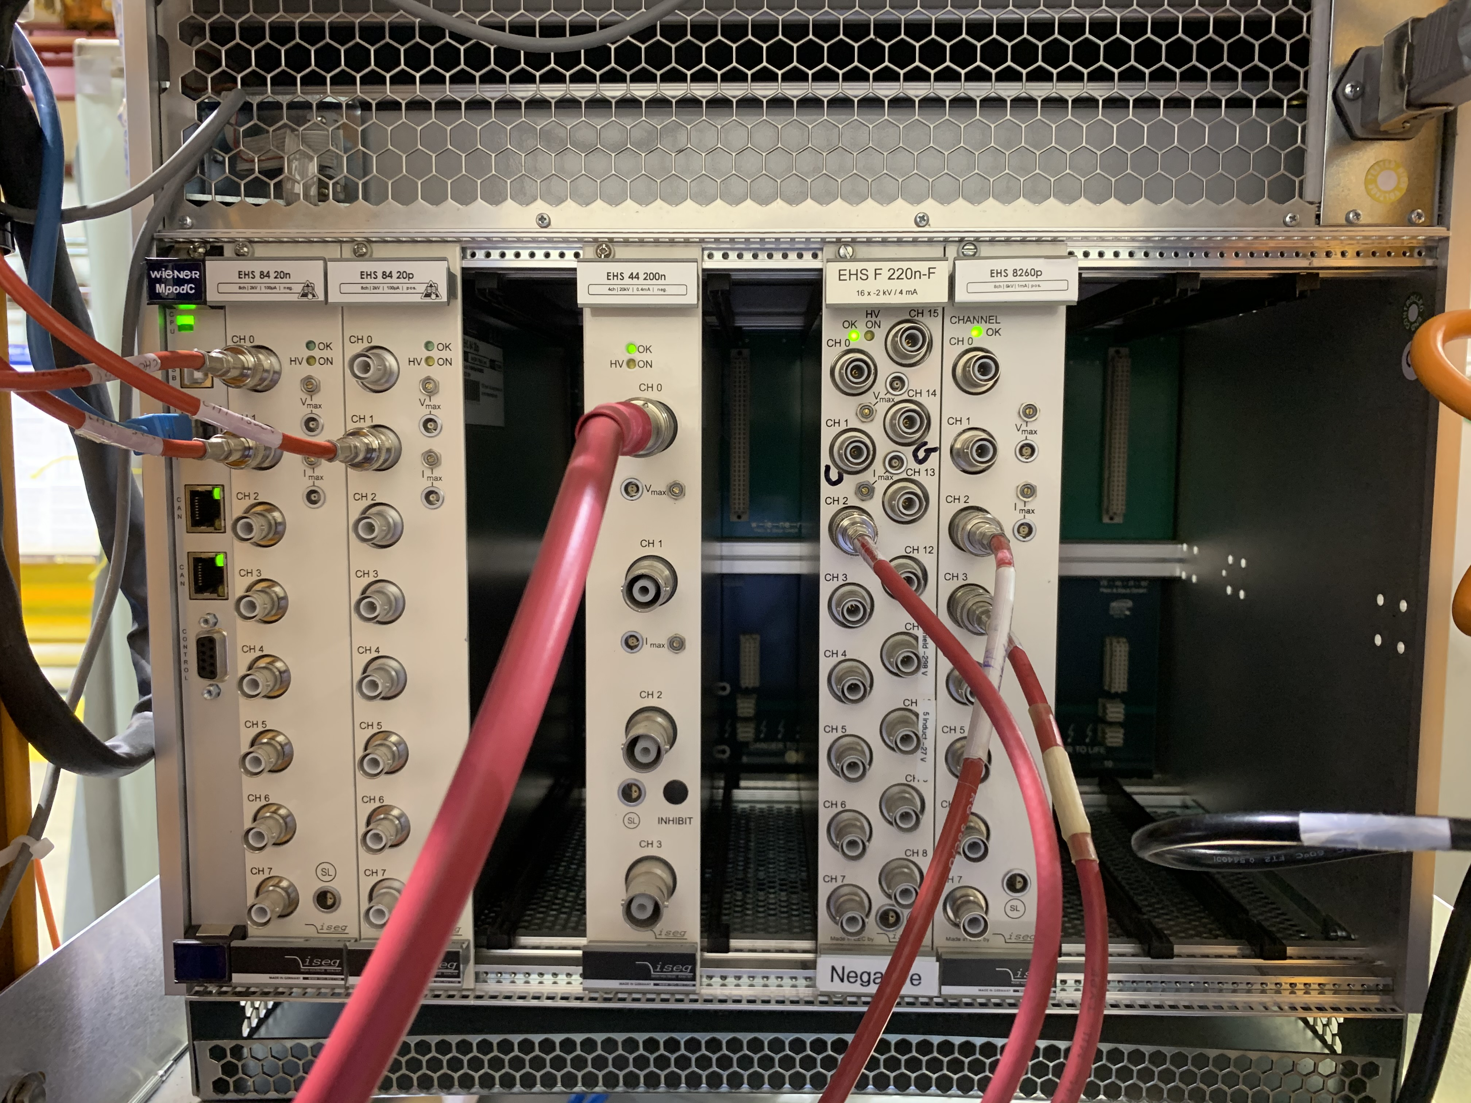
MPOD Crate
MPOD Crate is as per document except:
Two new high precision units have been added in slot 0 and 1
Purity Monitor SHV RG58 have been moved to Slot 5 and 6

Slide 8
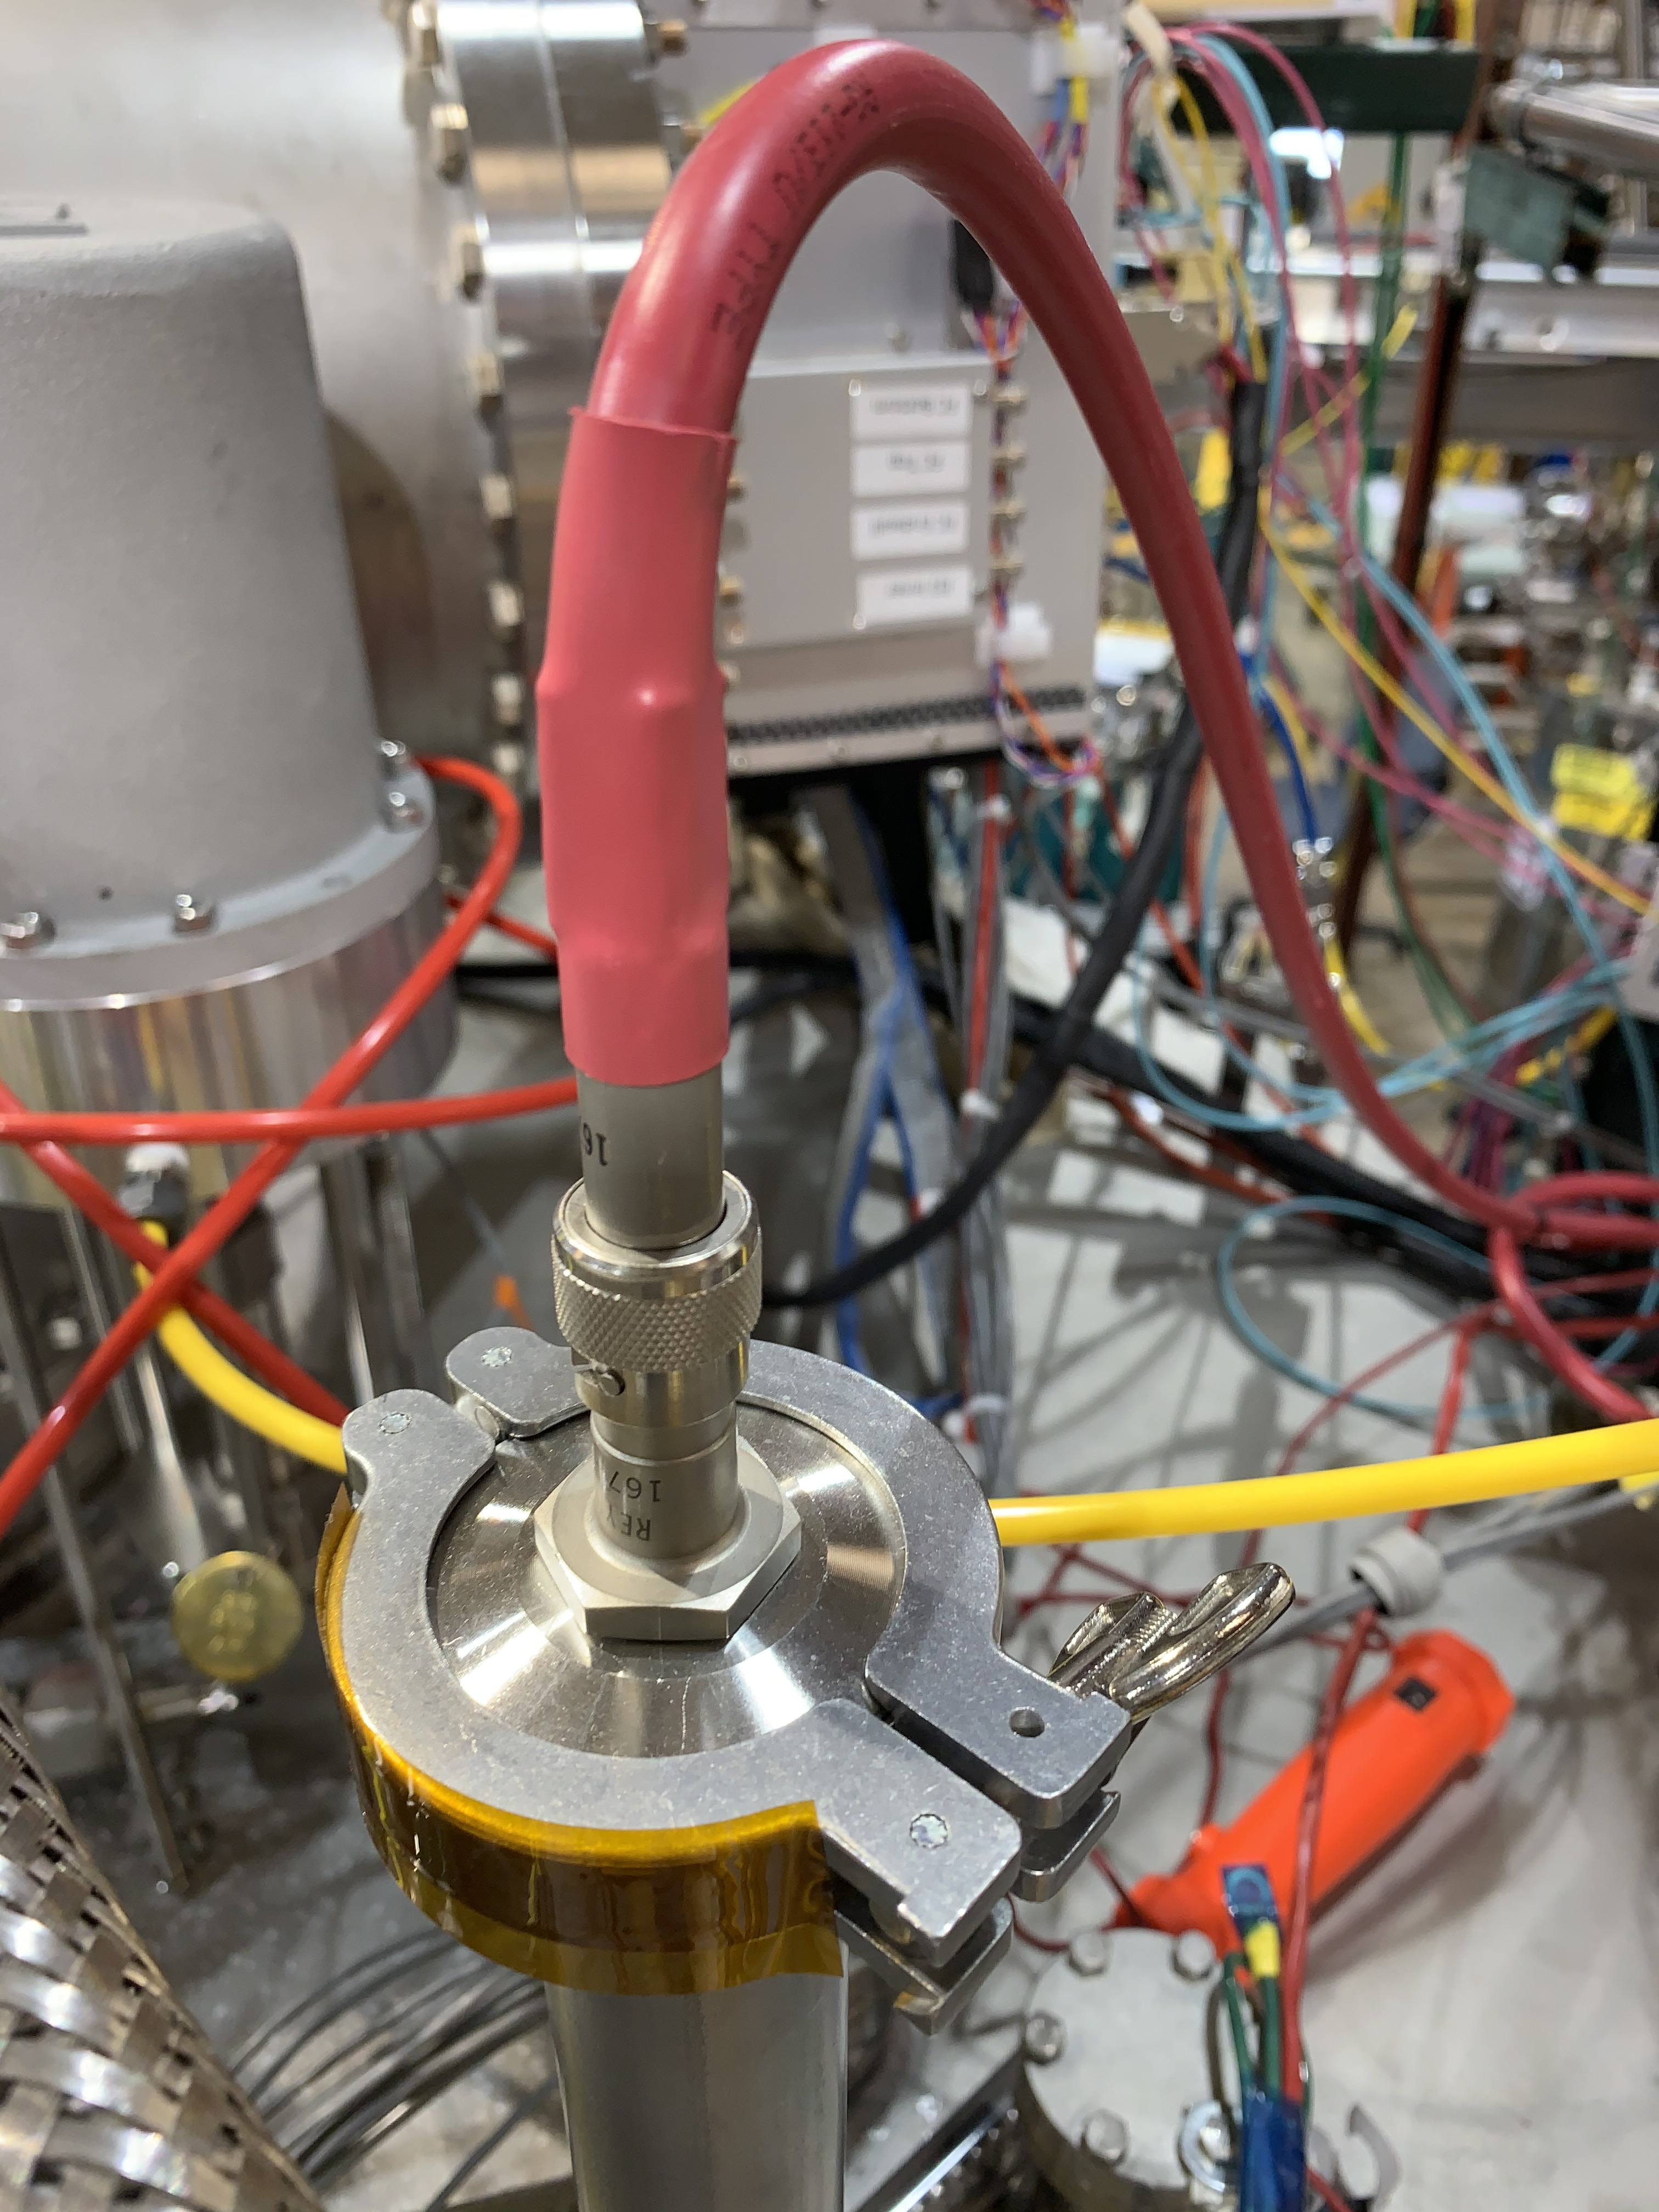
MPOD → Wire Bias and Cathode

Slide 9
CE: Electrical

Slide 10
ICEBERG PD Electrical
DUNE ICEBERG PD Documentation
https://docs.dunescience.org/cgi-bin/private/ShowDocument?docid=11257
https://docs.dunescience.org/cgi-bin/private/RetrieveFile?docid=11257&filename=SSP_Grounding_Cabling.pdf&version=5

Slide 11
PD: DAPHNE Configuration

Slide 12
PD: SSP Configuration

Slide 13
Cryogenic Controls: As Build

Slide 14
Summary
ICEBERG DAQ is connected to cryostat only through optical fiber.
CE Detector Electrical: We have not found any inconsistency in the DUNE grounding rules, documents submitted and as found at ICEBERG.
PD Electrical: Three differences have been found
DAPHNE and SSP: There exists a 11kOhm resistance between the Detector Ground and +/- 2.5 V power supply return
SSP: When switching to SSP readout the Ground Jumper cable between the 48 V and +/- 2.5 V power supplies was not removed.
SSP: The SSP document submitted and as found, differ in ground connection.
SSP Circuit common (Power Ground, Analog Ground, PCB Ground) is directly connected to Detector Ground.
Purity Monitor: No inconsistency found.
Cryogenic Control: No inconsistency found but drawing needs updating (as attached earlier).

