Slide 1
Iceberg Updates
Kathrine Cipriano
October 24th, 2019

Slide 2
Proposed Condenser Plans
Replace 5 micron sintered metal filter with 20 micron filter
Sent to purchasing dept. on 10/23, 5-6 week lead time
Add molecular sieve material to condenser return
Mole sieve material onsite
Add heater to condenser return
Bakes out any moisture when pulling vacuum before filling cryostat
Insert a tube in the condenser to separate the gas and liquid volume (snorkel design)
Currently calculating snorkel tube size to ensure gas and liquid have enough cross sectional area to flow to/from the condenser
Once a size has been determined, I will order the tube
K. Cipriano | Iceberg Updates

Slide 3
Proposed Internal Filter Plans
Determine the gas pressure drop through the internal filter vapor outlet
There is a sintered metal filter at the vapor outlet of the filter to prevent media (and any media particulate) from getting into the cryostat. This could be causing the slow cycle time.
Determine pressure drop through internal filter liquid inlet
There is a sintered metal filter at the vapor outlet of the filter to prevent media (and any media particulate) from getting into the cryostat.
Replace current heater with a smaller heater (located near bottom of heater tube) with improved thermal coupling
Watlow Firerod heater sent to purchasing dept. 10/24
Test level probe for calibration or scaling issues
Change internal filter to cycle based on time interval, not liquid level
K. Cipriano | Iceberg Updates

Slide 4
Other Proposed Plans
Decrease the amount of time needed to pull vacuum before filling
Install LN2 Cold Trap
Calibrate RTDs in cryostat
Replace RTDs in internal filter
New RTDs sent to purchasing 10/24, 1 week lead time
Take measurement of RTDs under condenser inlet and vent
Measure with respect to cryostat and TPC
K. Cipriano | Iceberg Updates

Slide 5
Schedule
Cryostat top plate removed (estimating early next week) – 10/30
20-micron sintered metal condenser filter arrives – 12/02
Calculations completed – 10/30
Start preparing internal filter for modifications
Sintered metal for internal filter ordered - 10/30
Sintered metal for internal filter arrives – 12/06
Install sintered metal in internal filter – 12/09
Pressure test internal filter, update documentation
Regenerate internal filter – 12/23
K. Cipriano | Iceberg Updates

Slide 6
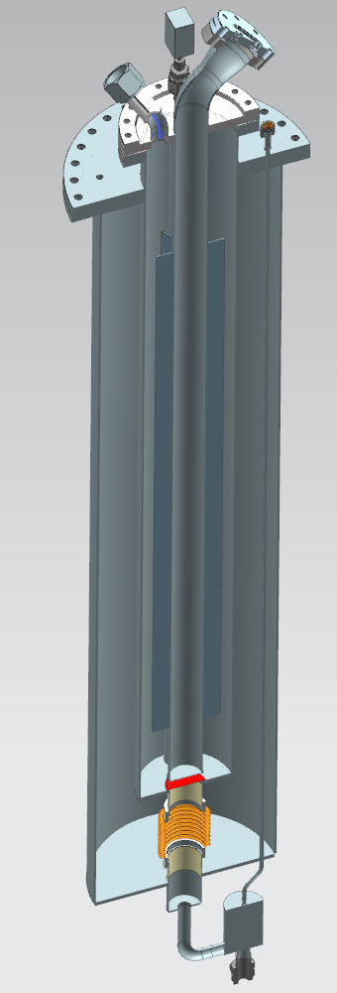
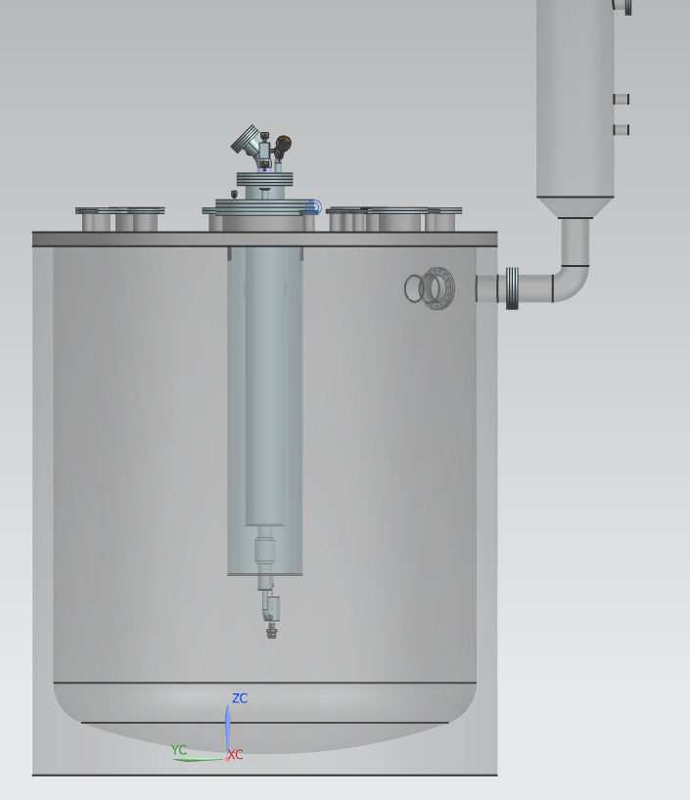
Internal Filter
K. Cipriano | Iceberg Updates

