Slide 1
CCD+OCIO All-Hands
Jon Bakken
October 28, 2019

Slide 2
What does Nigel’s Top 5 have to do with CCD & OCIO?
We are either directly working on these projects, or are providing support allowing our colleagues to accomplish these tasks
Liz, Jim & I, as well as rest of lab, appreciate your efforts – Thanks!
Re-emphasize safety across the site. *** and Cyber Security
LBNF: goal is to baseline in spring 2020.
PIP-II: baseline review will be January 28.
Mu2e: funding complete, must close out successfully.
Continuing to improve business systems & operations is necessary. ***
Cyber Security, Safety
Business systems, FermiDash
SURF networking, printing
TeamCenter
Office Environment
Service Management
File Storage
Virtual Systems
Networking
Databases
Central Web, SharePoint
Project Management

Slide 3
Climate Survey
We held individual CCD & OCIO All-Hands meetings to discuss the Climate Survey.
I wrote reports of what I heard & circulated them with CCD & OCIO to make sure I correctly captured the discussion we had in our meetings.
These reports are available on my newsletter site, with permissions set depending on your CCD or OCIO org.
These reports were also delivered to Liz.
One Monday Lab Senior Staff meeting was dedicated to the discussion of the climate survey topics. Nigel was at this meeting.
Computing & the Lab are serious about fixing concerns raised by employees.

Slide 4
Climate Survey Summary – CCD
Management needs to address the workload.
Not enough time to do the “right thing”.
SWF effort contingencies need to be part of the plan
No time to adequately plan for what we should be doing
Legacy systems need to be retired, not carried along forever
Management needs to create better career paths
In industry, IT promotions happen every ~2 years, not so at FNAL
IT job descriptions are up for review in December with WDRS & we will be discussing creating multiple (~10?) sub levels between each major IT grade level.
Specifications for promotions need to be clearly defined.
What are the chances of being promoted even if all criteria for promotion are met? Many senior people are doing a good job
Professional Training is deficient
Travel is often restricted
Many training sessions are only held in large conference cities (Las Vegas, San Diego, Orlando)

Slide 5
Staffing – relief coming
New 003756 Applic Dev & Sys Analyst I
Natalia R – transferred from SCD to join ESO’s DBA team
Still Pending:
SOS – Authentication
IR – Inspire/Indico/DocDB
BIN – ServiceNow
CST – Security

Slide 6
Climate Survey Summary – OCIO
Many in OCIO feel disconnected from SCD/CCD
Suggested restarting quarterly Cookie Caucus, with CIO & Division Heads always attending
Have a Computing All-Hands where our team members give a 3-minute presentation highlighting their work
Employees need “freedom to discuss” without management involvement.
Formed Focus Group without management (DH & above)
Representation from CCD+OCIO+SCD
Present computing concerns to Liz + Jim + Jon, general to EAG reps
Need anonymous email to CIO, CCD & SCD DH that will encourage more employees to air their grievances. (Done)
Career paths – same comments as in CCD
Sexual Harassment (and other types of harassment)
Much goes unreported, with fear of job reprisals & comments like ”he’s always like that” being some of the [unacceptable] reasons
You can report incidents that others have told you about even if you didn’t witness it yourself, support from management + WDRS

Slide 7
Worth mentioning:
Current Computing representatives currently on the EAG are
Pengfei Ding – Bonnie King
Keenan Newton – Nicholas Peregonow.
You can submit an idea or question to the EAG at https://eag.fnal.gov/
Anonymous email to Liz: https://computing.fnal.gov/cio-anonymous-contact-form/
Anonymous email to Jon: https://computing.fnal.gov/ccd-head-anonymous-comments-form/
Anonymous email to Jim: https://computing.fnal.gov/scd-head-anonymous-comments-form/

Slide 8
Incident Backlog Reduction
I’ve been pushing very hard since May to reduce our incident backlog.
Incidents older than 30 days have been reduced substantially – Great work everyone! Let’s drive that number to 0!
Request backlog reduction is next.

Slide 9
ITIL Processes
Requests
Workload is roughly the same for the past 5 years
(not completed)
Changes
(not completed)

Slide 10
ITIL is working well for us
ISO20k Surveillance Audit: Nov 13-14
Incidents count going steadily down implies quality is steadily going up.
(not completed)

Slide 11
Wonders of the Lab
I often hear from CCD & OCIO folks that they are excited to be working at the lab & helping advance science, but at the same time, they don’t understand the big picture of what our scientists & engineers are working on.
I plan on including 1-2 slides in each of these ongoing all-hands to give a non-technical overview of a major activity at Fermilab.
All of the material comes from OoC or lab web pages.

Slide 12
Wonders of the Lab – PIP-II
https://pip2.fnal.gov PIP-II: baseline review will be January 28

Slide 13
Wonders of the Lab – PIP-II
PIP-II will be the heart of our accelerator complex & will produce a high intensity proton beam
PIP-II = Proton Improvement Plan – II
Groundbreaking was in March 2019, Experimental Beams in 2026.
PIP-II will vastly improve what is already the most powerful high-energy particle beam for neutrino experiments.
Needed for LBNF/DUNE & other research at our lab
With PIP-II at the center of the laboratory’s accelerator complex, Fermilab will remain at the forefront of particle physics research & accelerator science.
Side note: PIP-II is the first DOE U.S. accelerator project with substantial contributions from international partners.

Slide 14
PEMP Notable (Objective 8.2) – Sexton-Kennedy
Ensure the appropriate completion of Plans of Actions & Associated Milestones (POAMs) for
Email Multi-Factor Authentication
Web Security Implementation
Web security – essentially eliminate HTTP:// & make all access HTTPS:// - project is underway for more than a year by Pete’s team & expecting a successful completion by next May
Email MFA – Mandate to the Lab to prevent stolen passwords from being used to access email & send SPAM
Technical Leader is Joe Klemencic Project Manager is Matt Crawford
Heavy involvement by Authentication, Email & Desktop Engineering teams.
CCDM Meeting scheduled for 11/21 to discuss plan forward

Slide 15
Passwords
Most browsers allow you to store passwords for websites internally in their browser password store.
This make logging in very simple next time.
HOWEVER – it is not allowed at FNAL unless you also have a have a master password set in your browser’s password store.
Doing this also throws up another obstacle in case your machine is compromised or stolen.
CyberSecurity often gets asked about Password Wallets. They reviewed the options and are recommending KeePass as a Password Wallet – Risk Analysis is still under way.
Recommended only, no support yet for the KeePass app
Clients for all platforms
Open source
Most popular
Not web based

Slide 16
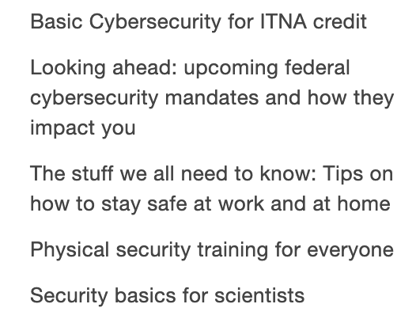
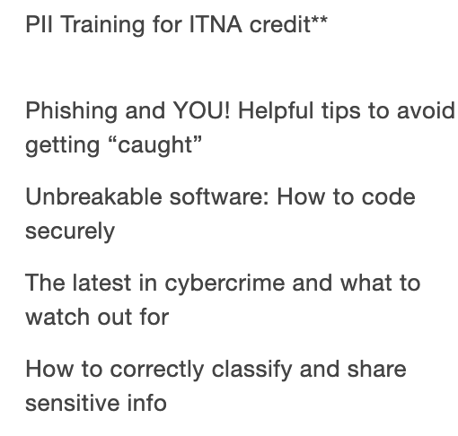
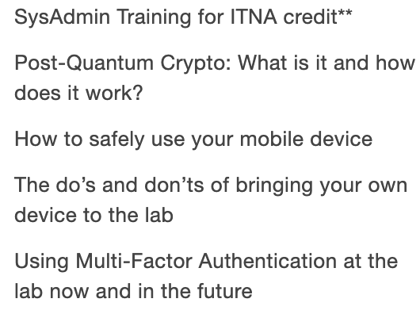
CyberSecurity Awareness Days – WH 1WEST
Tuesday Nov. 5 to Thursday Nov. 7, starting at 10AM each day.
https://computing.fnal.gov/cybersecurity-atwork/cybersecurity-awareness-week/
You do not need to be a cybersecurity expert to learn something at this event.
Many required security classes are offered in these sessions
Everyone should be up to date with all their cyber training after the CyberSecurity Awareness Days

Slide 17
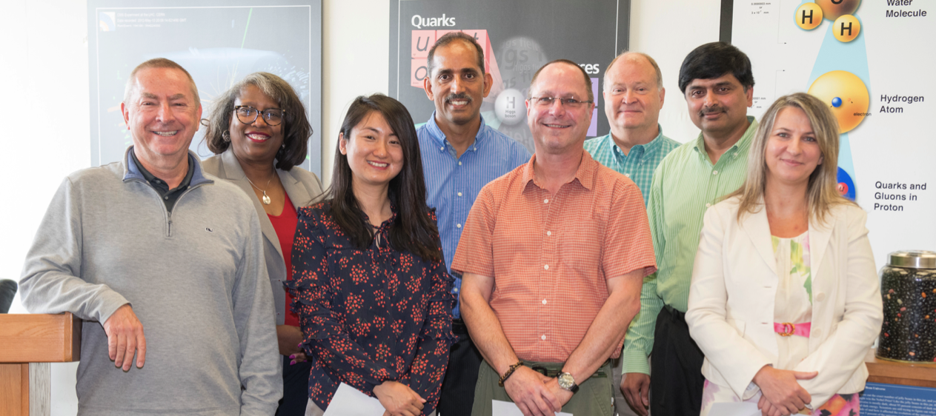
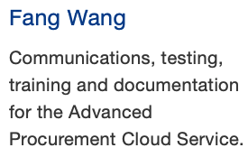
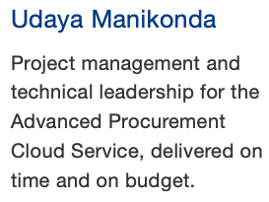
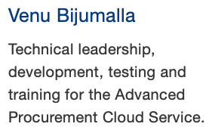
Congratulations to the CCD/OCIO EPRA Awardees
Uday
Venu
Fang

Slide 18
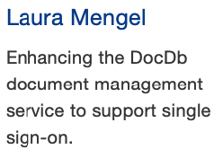
Congratulations to the CCD/OCIO EPRA Awardees

Slide 19
Congratulations to our Finance Team
This was the first year Computing Department heads used BPS for their budget planning exercises.
Special thanks to Christina Kelly & Gabi Garcia who provided a lot of support & guidance throughout the process.
Thanks to Rob Carrara who worked closely with SCD & Panagiotis’s quantum team to prepare the Field Work Proposals financials for the Quantum Funding.
And of course, thanks to Valena S for keeping us all on track.

Slide 20
Congratulations to the Email team, especially Andy Huguenard
For understanding why many emails were incorrectly ending up in people’s junk folder instead of their inbox.
Four main reasons:
The email belonged in junk because the sender spoofed their return address
Some windows outlook clients incorrectly identified mail as junk
Microsoft scan returned “SPAM” after mail returned from Proofpoint. Fixed by mail transport rule.
Some 3rd party apps (especially on phones/tablets) incorrectly identified mail as junk.

Slide 21
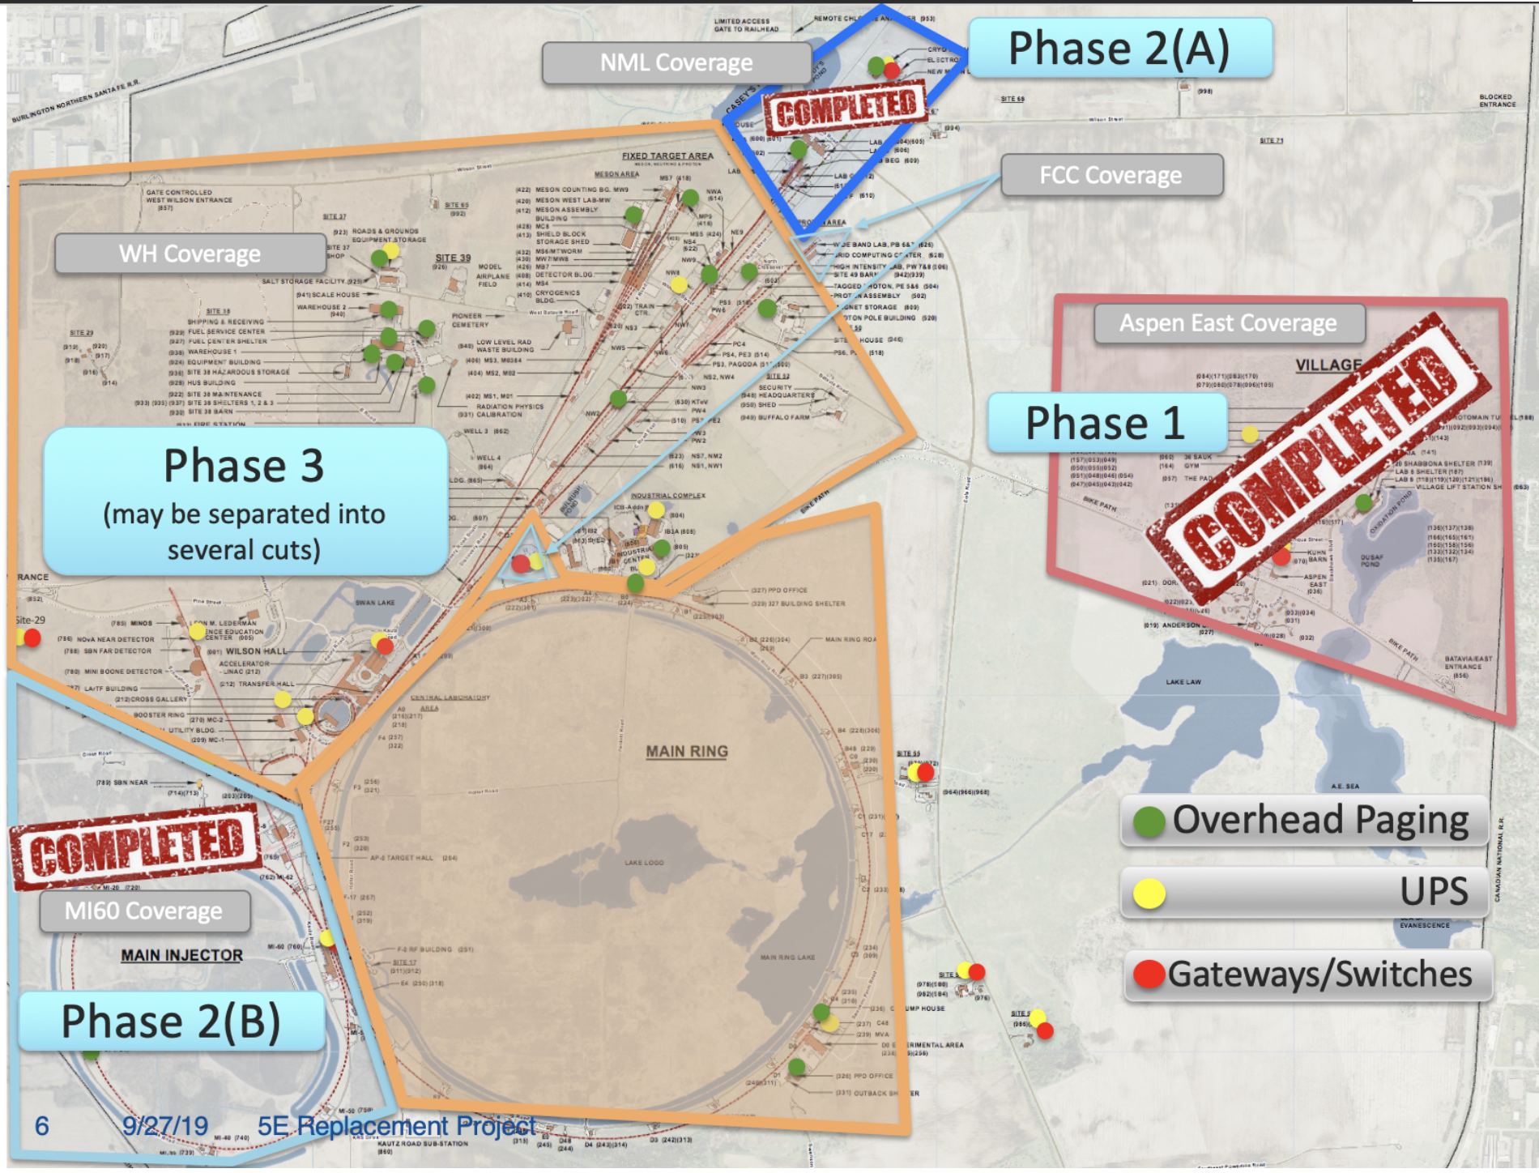
Congratulations to Telecom + Networking
Fantastic progress on replacing the 1980’s AT&T 5ESS switch

Slide 22
Phase 1 = Village, completed 7/24/19
Phase 2 = New Muon Lab & MI60, completed 9/26
Phase 3 = Wilson Hall ~3000 phones – Scheduled for 12/11
Team has worked after 5 PM, sometimes to midnight, to convert phones to VoIP so our staff will not be affected during their workday
Goals of 5ESS project:
Replace 5ESS switch
Deploy soft phones (Cisco Jabber) to employees
Deploy new Intralab Instant Messaging

Slide 23
Thanks to Service Owners & Rick K & Hannah W who helped create the Managed Services Runbook
Each major area that NTT provides service for the lab has a chapter in our Runbook. 13 chapters in total. Over 400 pages.
Each chapter is based on the Statement of Work we created during the RFP process to select a vendor.
The chapters clearly list expectations & any deliverables, that are required. For example ‘label all cables on both ends’
Very detailed items or processes that change are in Knowledge Articles.
Both ANL & University of Chicago have asked for our Statement of work.
This is a public document & Procurement delivered the package to them.

Slide 24
Thanks to Computing Joint Task Force Members
Last January Nigel asked Liz to set up a joint task force with ANL & University of Chicago to see where we could share more. There has been excellent progress since then.
SCD’s Jim A & Adam L – Monthly Seminar Series starting
11/13 11AM at UC. Speaker is PPD’s Nahn Tran
Security – Irwin G & Joe K – sharing data on cyber threats
Joint Purchases – Rick K, Mark K, Hannah W
Discussions about “global” procurement vehicle for UC/ANL/FNAL has many issues to work out
Task Force is concentrating on one common hardware & one common software procurement vehicle
Progress is slow, but promising.
UC doing all the heavy procurement lifting.

Slide 25
ISPMT has restarted Information System Portfolio Management Team
Goal: Advise the CIO/CFO/COO on computing needs & priorities in a manner that supports & guides the strategic direction of business computing at Fermilab.
Forum for facilitating meaningful discussions regarding computing needs.
Provide processes to assist with the establishment of relative priorities of computing projects & initiatives
Provide input into the development of technology roadmaps that will be used to guide decision-making.
Decision making body – Chiefs & Business D/S Heads
Ongoing ISPMT Projects:
Site Access & Badging
Work Planning & Controls
5ESS Replacement
EBS Approval Management Engine
Reliability Fix for Everbridge

Slide 26
Nine FY20 ISPMT Projects under consideration:
Applicant Tracking
Data Service for Site Access & Badging
eBS 1-year Upgrade
Enterprise Governance & Compliance Tools
Facilities Computerized Maintenance Management System
Learning Management System
Modernize Quality Tools
Strategic Workforce Planning System
Time & Attendance Modernization

Slide 27
FY19 Promises & Achievements
We create tactical plans for all our services. These are great for computing folks but are often hard for the rest of the lab to grasp.
To remedy that problem, I also ask department heads to create a list, referred to as Promises, that list the major items we do that the rest of lab can easily recognize.
For example, “Deploy a new online stock catalog” is a Promise, but ”Add memory to improve stock catalog performance” is not.
Promises fit into CCD’s three major goals:
Improve users’ experience both at the lab & when they use our services remotely
Modernize & automate the lab’s business processes
Enable mobility – provide access to information & services any time, any place, on any device

Slide 28
FY19 Promises
Improve users’ experience both at the lab & when they use our services remotely
10 promises – 5 completed, 5 multi-year on track
Modernize & automate the lab’s business processes
22 promises – 9 completed, 7 multi-year on track, 2 in-progress, 4 postposed due to lack of funding/resource/vendor issues
Enable mobility – provide access to information & services any time, any place, on any device
2 promises – 1 multi-year on track, 1 postponed due to vendor issues
Outstanding work – Thanks Everyone!

Slide 29
Backup slides

Slide 30
FY19 Promises Status: Improve users’ experience both at the lab & when they use our services remotely, p 1/2
Modernize Computing Sector conference rooms. Continue to roll out Zoom rooms & Solstice rooms, standardizing controls & simplifying the user experience. 38 zoom & 40 Solstice rooms deployed
Begin multi-year project to upgrade legacy network core to the new 100Gb site interconnect. 75% complete
Begin multi-year project to upgrade campus infrastructure to 100Gb. 25% complete.
Deploy Multi-Factor Authentication for the site VPN to improve the lab’s security posture. Completed
Improve Multi-Factor security by rolling out YubiKeys & removing RSA tokens, where appropriate. Completed
Establish Fermilab network at SURF. Completed, Improvements coming.

Slide 31
FY19 Promises Status: Improve users’ experience both at the lab & when they use our services remotely, p 2/2
Continue segmentation of the network & transitioning these areas into new security zones behind the site-firewall. 143 subnets behind site-firewall
Modernize Node Registration process for lab owned equipment to simplify end user experience, as well as to provide full support for IPV6. Phase I (Data Cleanup) complete.
Deploy a new WordPress/SharePoint Library book catalog replacing the 16-year-old, unsupported, legacy SPIRES system. Completed
Expand Enterprise Search by providing greater integration to authenticated DocDB content & adding the Enterprise Search experience to WordPress. In progress, expect 12/31/19 (WordPress) & 3/31/20 (DocDB)

Slide 32
FY19 Promises Status: Modernize & automate the lab’s business processes, p 1/4
Support the Site Access & Badging process by developing forms & processes in ServiceNow. Phase 1 Complete, Phase 2 in progress, scheduled for 3/3/20
Deploy electronic payments to employees eliminating paper checks. Completed
Deploy a Work Planning & Controls System to eliminate many existing paper forms & automate their processes Completed, ESH piloting currently project
Deploy iSupplier & Sourcing Modules to automated processes in Procurement, Accounting & Receiving. Completed
Upgrade Sunflower MobilTrak & ExcessTrak software Completed
Redesign & enhance Workday to PeopleSoft Payroll interface Completed

Slide 33
FY19 Promises Status: Modernize & automate the lab’s business processes, p 2/4
Upgrade Clover ETL to latest vendor supported version Completed
Deploy the next phase of the Self-Service Property Portal, with FESS Phase 2 & 3 Completed
Implement OBIEE reporting for Sunflower & PeopleSoft Delayed until Nov 19. After review, a decision was made to build required reports for PeopleSoft users using PeopleSoft queries instead of OBIEE
BPS/PBCS Release3 Project was on hold due to unavailability of funds
Upgrade FermiWorks (Workday) to new Releases Upgraded to Workday feature Releases 31, 32 & 33 on 9/10/18, 3/11/19 & 9/9/19

Slide 34
FY19 Promises Status: Modernize & automate the lab’s business processes, p 3/4
Upgrade Fermidash infrastructure, SSIS, SSAS & related components Postponed due to lack of resources
Convert FileMaker Pro databases (ESH&Q) to Oracle Apex solutions. Postponed due to lack of resources
Upgrade FTL (Kronos) from Flash based interface to HTML5 interface Waiting for vendor release, will start this project in February 2020 & plan to go live in May 2020
Develop & support the customer facing interface to support the FERRY project. This will allow SCD to increase operational efficiencies across their Division. Completed
Develop Cell Phone Billing Approval system to replace current paper-based form process. Stalled due to vendor induced issues & competing priorities.

Slide 35
FY19 Promises Status: Modernize & automate the lab’s business processes, p 4/4
Develop Telephone Repair process in ServiceNow to replace current paper-based form process. Completed
Large-scale destruction of expired records stored offsite (possibly 25% of holdings). In progress, expect mid-FY20 completion
Upgrade to SharePoint 2019 to will provide the lab even greater flexibility & features for managing content as well as integration with Office365. In progress, expect 1/31/20 completion
Reduce our printer fleet through rightsizing to minimize the cost in terms of resources & future Managed Print contracts. Phase 1 completed, Phase 2 in FY20
Upgrade Teamcenter to V11, & all of its associated CAD products. Completed
Migrate Windows 7 systems to Windows 10 before Windows 7 EOL in Jan 2020. In progress. Evaluation, planning & testing has been completed. Migration phase in progress.

Slide 36
FY19 Promises Status: Enable mobility – provide access to information & services any time, any place, on any device, p 1/1
Begin 2-year project to replace AT&T 5ESS switch, delivering phone services via desk phone, computer, tablet, or cell phone. On target, expected completion Summer 2020
Deploy WorkDay mobile app for Benefits Selection in November. Postponed until November 2020 (issues with vendor app)

