Slide 1
Experimental Landscape
Snowmass Community Summer Study
Seattle Snowmass Summer Meeting 2022
Andrew J. Lankford
University of California, Irvine
July 17, 2022
I thank all my colleagues who kindly provided material for my presentation, especially the program managers at DOE and at NSF.

Slide 2

Outline
P5 will be charged to develop a strategic plan for U.S. particle physics for future. The starting point for the plan will be the present program.
Outline of my presentation:
  General comments about the program
  Overview of experimental program, organized by P5 science driver
  Closing remarks
In this presentation, I would like to convey the diversity, richness, and balance of the current experimental program.
  Broad science scope, covering great range of different, but inter-related topics.
  Experiments with a diversity of scale, from small- to mega-
  Part of a global program of collaborative international efforts & shared facilities
  While P5 prioritizes projects, it does so in the context of the science drivers and of the program as a whole.
Recall that P5 = Particle Physics Project Prioritization Panel.

Slide 3

Strategic vision of 2014 P5: Particle physics is global
The current U.S. HEP program is guided by the 10-year strategic plan of 2014 P5 report:
“Pursue the most important opportunities wherever they are, and host unique, world-class facilities that engage the global scientific community.”
“The United States and major players in other regions can together address the full breadth of the field's most urgent scientific questions if each hosts a unique world-class facility at home and partners in high-priority facilities hosted elsewhere.”
The U.S. experimental program depends upon reliable partnerships.
P5 = Particle Physics Project Prioritization Process

Slide 4
2014 P5’s Science Drivers
2014 P5 distilled the compelling scientific questions developed by the 2012-2013 Snowmass community process into five topics that should drive the U.S. HEP program for the subsequent 10 years (within a 20-year vision):
  Use the Higgs boson as a new tool for discovery.
  Pursue the physics associated with neutrino mass.
  Identify the new physics of dark matter.
  Understand cosmic acceleration: dark energy and inflation.
  Explore the unknown: new particles, interactions, and physical principles.
P5 emphasized that the 5 science drivers are intertwined,
e.g. synergy between precision physics and direct production,
or the insights that cosmic surveys shed on neutrino properties.
P5 then identified the highest priority projects for a balanced program that addresses these science drivers in constrained budget scenarios.

Slide 5
Foundations of the experimental program
The experimental program is built upon the foundation of other critical research activities.
  Theory
  Technology R&D:
    Accelerator R&D
      See the 2015 HEPAP Accelerator R&D Subpanel report.
    Detector R&D
      See recent basic research needs (BRN) report.
      including microelectronics
  Software & Computing
    including AI/ML
  DOE & NSF support theoretical + experimental Quantum Information Science.
The experimental program, and its foundation, cannot exist without its expert science & technology workforce.

Slide 6
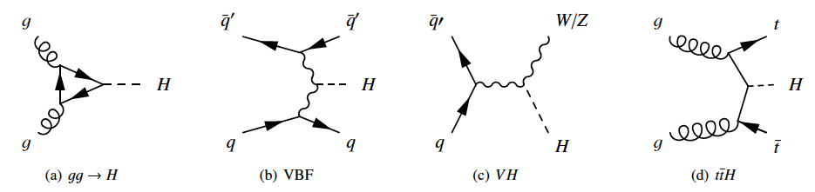
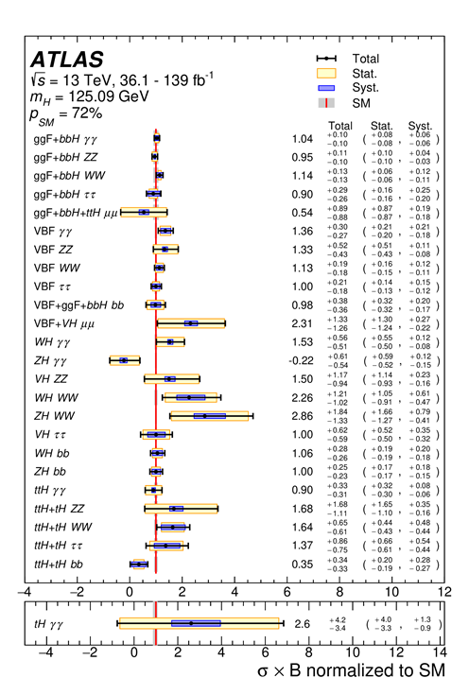
Use the Higgs boson as a new tool for discovery.
LHC and HL-LHC are the only means to produce and characterize the Higgs for the next decade or longer.
  Precision measurements of Higgs properties leading to any deviations at the few %-level.
  Access to rare processes, H decay to µµ.
ILC, FCC-ee, or other Higgs factory would eventually allow measurements of higher precision.
A very high energy proton-proton collider (e.g. FCC-hh) would later allow other improved measurements, particularly Higgs self-coupling.

Slide 7
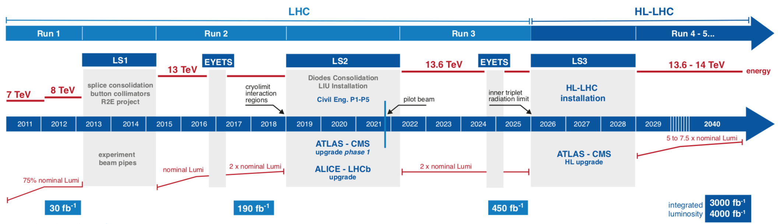
The U.S., the LHC, and the HL-LHC
  LHC has been one of the largest investments of U.S. in HEP, ever.
    LHC accelerator (DOE)
    ATLAS (DOE+NSF), CMS (DOE+NSF), LHCb (NSF, DOE NP), ALICE (DOE NP)
  U.S. is single largest collaborating nation on both ATLAS & CMS.
    US-ATLAS: ~19% of ATLAS; US-CMS: ~27% of CMS
U.S. plays leading roles on LHCb (6 U.S. institutions)
U.S. LHC Detectors Operations Program – DOE + NSF
Supports Maintenance & Operations and Software & Computing
Spearheads HL-LHC Software & Computing planning + R&D

Slide 8
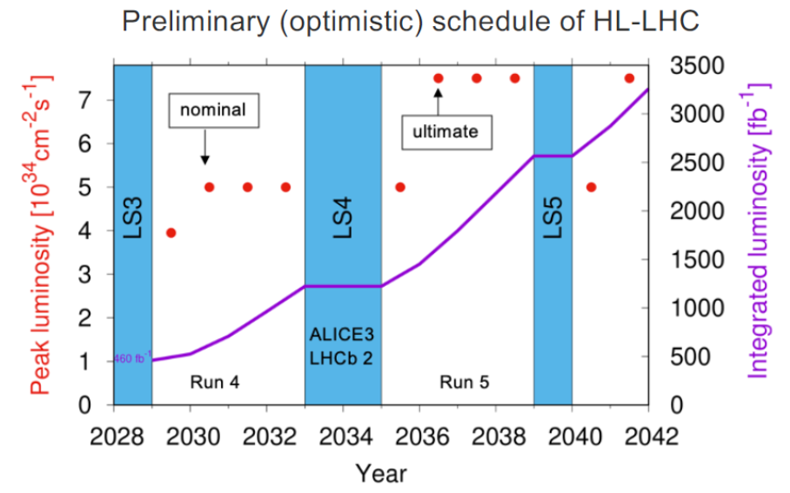
LHC and HL-LHC upgrades
“The LHC upgrades constitute our highest-priority near-term project.”
  Phase-I upgrades were installed during LS2 for Run 3 started July 5th.
  U.S. investment continues for HL-LHC upgrades for Run 4.
DOE: HL-LHC AUP
  Accelerator Upgrade Project
    CD-3 – December 2020; (re-baseline in 2022: COVID & LS3 sched)
DOE & NSF: HL-LHC [Phase-II] ATLAS & CMS upgrades
    NSF MRFEC: Feb 2020
    CD-2’s ATLAS + CMS in Fall 2022
    Early start: CD-3’s:
    ATLAS – CD3a 9/21
    CMS – CD-3a 6/21, CD-3b 6/22
LHCb Upgrade I – installed in LS2
LHCb Upgrade II – for LS4
x 2.5, then x 5 instantaneous luminosity
x 7 integrated luminosity (wrt end Run 3)
ESPPU highlighted flavor physics at LHC & HL-HLC.

Slide 9




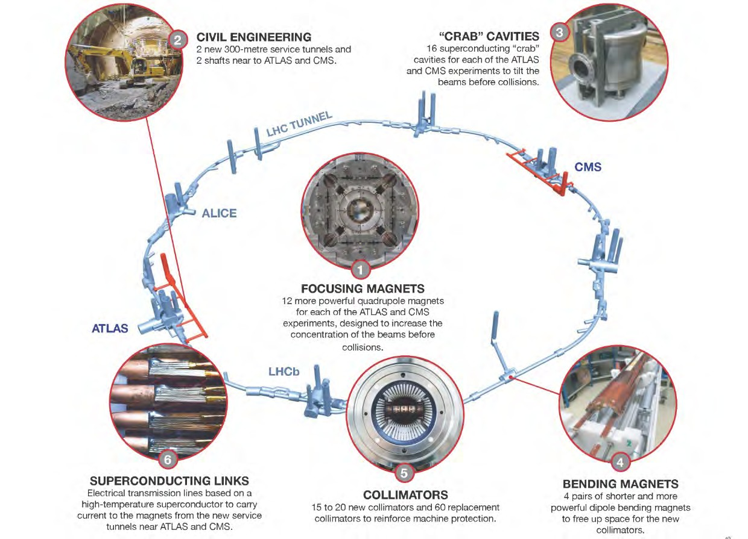


HL-LHC Accelerator Upgrade Project:
Enabling U.S. Science Participation at CERN’s LHC
DOE contribution:
RFD Crab Cavities
2 proto
2 pre-series
10 cavities
DOE contribution:
10 cold mass
(Nb Sn) assemblies
3
4 each for
ATLAS & CMS
interaction regions
2 spares
DOE potential future contributions:
Hollow e-Lens Components and/or other areas of common interest

Slide 10











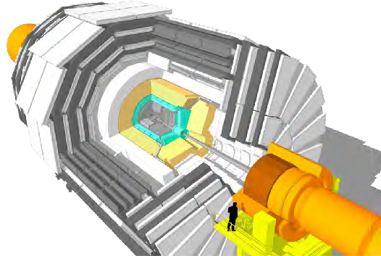
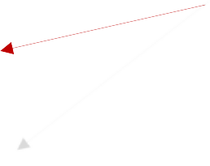





















CMS HL-LHC Upgrade
Upgrade for performance at high rate & high efficiency for LHC Run 4.
NSF & DOE support large U.S. roles. NSF MREFC – Feb. 2020; DOE CD-2 in Fall 2022
L1-Trigger/HLT/DAQ https://cds.cern.ch/record/2283192 https://cds.cern.ch/record/2283193
DOE
Barrel Calorimeters
NSF
https://cds.cern.ch/record/2283187
NSF
New FE/BE electronics for full granularity readout at 40 MHZ
MHz with precise timing for e/γ at 30 GeV
Tracks in L1-Trigger at 40 MHz
PFlow-like selection 750 kHz output
•
ECAL and HCAL
new Back-End boards
Muon systems
NSF
HLT output 7.5 kHz
https://cds.cern.ch/record/2283189
DT & CSC new FE/BE readout
DOE
RPC back-end electronics
New GEM/RPC 1.6 < η < 2.4
New Calorimeter Endcap
https://cds.cern.ch/record/2293646
Extended coverage to η ≃ 3
Referred to as HGCAL, EC, CE
3D showers and precise timing
Si, Scint+SiPM in Pb/W-SS
Beam Radiation Instr. and Luminosity, and Common Systems and Infrastructure https://cds.cern.ch/record/202
Tracker
0886
All Funding Agencies
https://cds.cern.ch/record/2272264
MIP Timing Detector https://cds.cern.ch/record/2296612 Precision timing with:
Si-Strip and Pixels increased granularity
Design for tracking in L1-Trigger
DOE
Extended coverage to η ≃ 3.8
NSF
DOE
Barrel layer: Crystals + SiPMs
Endcap layer: Low Gain Avalanche Diodes
= U.S. contributions to CMS HL-LHC Upgrade Scope

Slide 11



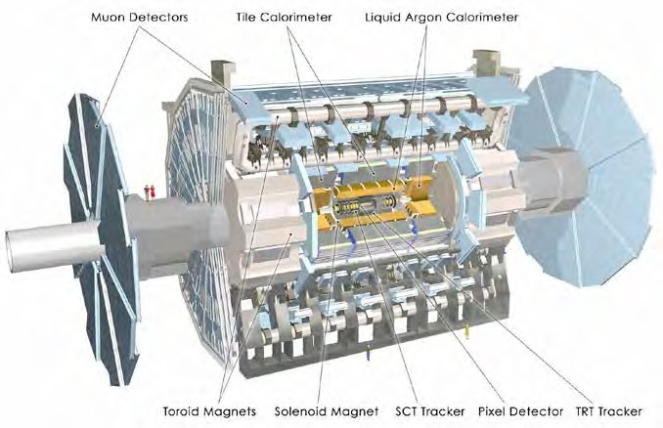
ATLAS HL-LHC Upgrade
Upgrade for performance at high rate & high efficiency for LHC Run 4.
NSF & DOE support large U.S. roles. NSF MREFC – Feb. 2020; DOE CD-2 in Fall 2022
DOE Scope:
Electronics Upgrade for LAr and
Upgraded Trigger & DAQ:
Infrastructure and
Tile Calorimeters; muon system
L0: 1 MHz; improved HLT
Common Projects
Barrel Inner Tracker (pixel & strip detector)
LAr Calorimeter front- end analog chip development
DAQ hardware
(data flow elements)
Common systems and infrastructure projects
NSF Scope:
‘Triggering’ at high luminosities
Readout electronics for LAr, Tile, Muons
Common systems and
High granularity timing detector (forward region)
High-11 muon tagger
New muon chambers in the inner barrel region
New inner tracking detector (all silicon tracker, up to |11|=4)
infrastructure projects
11

Slide 12
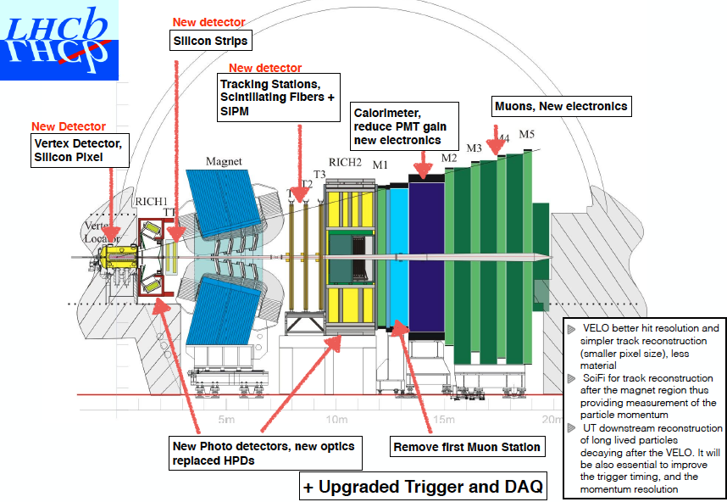
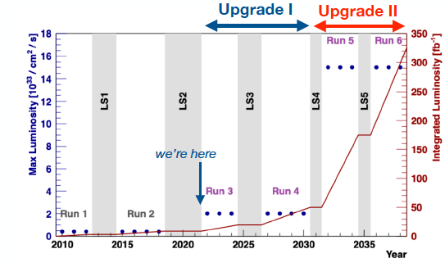
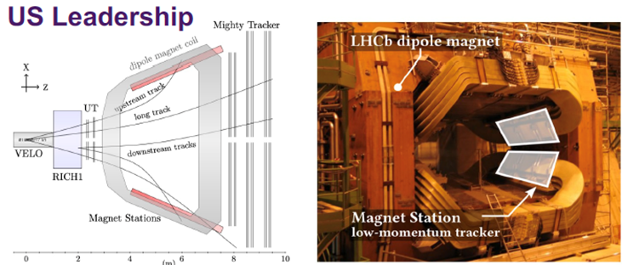
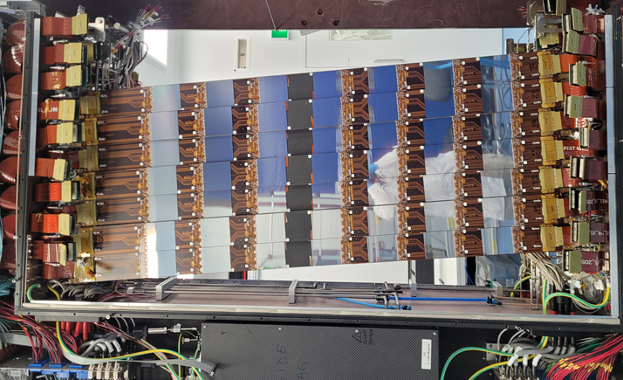
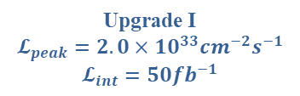
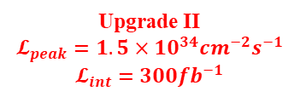
LHCb Upgrades I & II
Upgrade I
$$𝓛_{peak}=2.0×{10}^{33}{cm}^{−2}s^{−1}$$
$$𝓛_{int}=50{fb}^{−1}$$
Upgrade II
$$𝓛_{peak}=1.5×{10}^{34}{cm}^{−2}s^{−1}$$
$$𝓛_{int}=300{fb}^{−1}$$
U.S. contributions:
GPU trigger application
Triggers for inclusive heavy flavor & dark sector
Upgrade Ib:
U.S. leadership in
low-momentum tracker stations in magnet
Upgrade II – Key features
4D vertex detector
5D calorimeter - U.S. R&D
U.S. leadership in upstream tracker detector

Slide 13
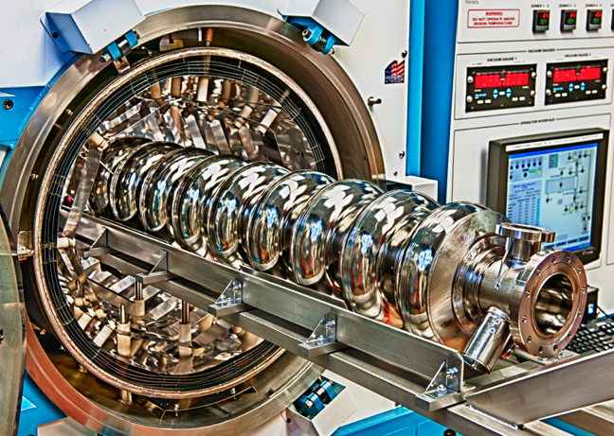
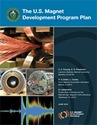
Seeding the future: Energy Frontier planning
Future collider strategy in the 2014 P5 plan:
  Support development & realization of ILC
    Focus on SRF R&D, high gradient & high Q
  R&D towards a very high-energy pp collider
    Focus on next-generation high-field dipoles through U.S. Magnet Development Program.
Advancing colliders of the proposed size, scale & complexity requires
intergovernmental discussion & global coordination.
Concerted U.S. Govt. interagency effort during the last ~5-6 years to support moving forwards with a proposed ILC in Japan and to collaborate with CERN on a proposed FCC.
DOE coordinates with ILC International Development Team to prepare ILC for its “Pre-Lab” phase.
DOE plans to participate in any future intergovernmental discussion with Japan & global partners.
2020: DOE & CERN signed a FCC agreement to continue R&D & participate in the FCC Feasibility Study
Current efforts for ILC and/or FCC focus primarily on accelerator R&D, but DOE grants for the LHC experiments may apply up to 25% funds for development and physics studies for experiments for future colliders.
Other collider concepts are being considered during Snowmass/P5 process, which will guide future U.S. R&D and investments
Notes:
Add graphics

Slide 14
Pursue the physics associated with neutrino mass.
“In collaboration with international partners, develop a coherent short- and long-baseline neutrino program hosted at Fermilab.”
U.S. working abroad:
  Long-baseline:
  T2K
  Atmospheric/solar:
  SuperK
  Reactor:
  Daya Bay
  JUNO
  Short-baseline:
  IsoDar
  Currently at FNAL:
  Short-baseline:
  MINERvA
  MicroBooNE*
  ICARUS
  Long-baseline:
  NOvA
Future Outlook at FNAL:
  Short-baseline:
  SBN
    SBND
    ICARUS
  Long-baseline:
  LBNF/DUNE
  Others in U.S.:
  Short-baseline: Atmospheric:
  COHERENT (ORNL) IceCube
  ANNIE (R&D; FNAL) 0ν2β:
  CCM (LANL) EXO-200
  Reactor: (0ν2β is now DOE NP)
  PROSPECT* (ORNL) Neutrino mass:
  Project-8
Cosmic surveys also shed light on neutrino properties.

Slide 15
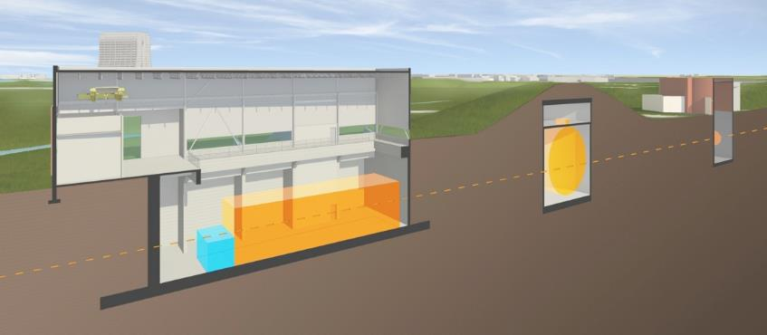
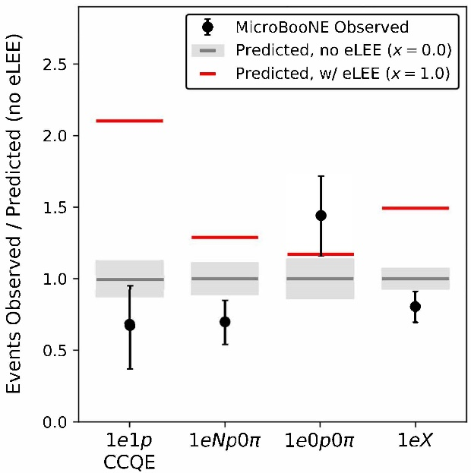

Short-Baseline Neutrino Program
Two principal goals:
  Resolve experimental anomalies in measured ν-spectrum, including search for sterile neutrinos.
  Demonstrate the liquid argon TPC detector technology for DUNE.
Three detectors:
  MicroBooNE - physics running complete; first results published on ½ data set;
  47 papers, ½ physics + ½ R&D
  ICARUS – brought from Gran Sasso, Italy via refurbishment at CERN – operating
  SBND – Short-Baseline Near Detector – under construction
MicroBooNE $υ_{e}$ appearance
MicroBooNE (existing)
170-ton LAr
MiniBooNE
ν
Far Detector – ICARUS (760-ton LAr)
Now preparing for detector installation

Slide 16
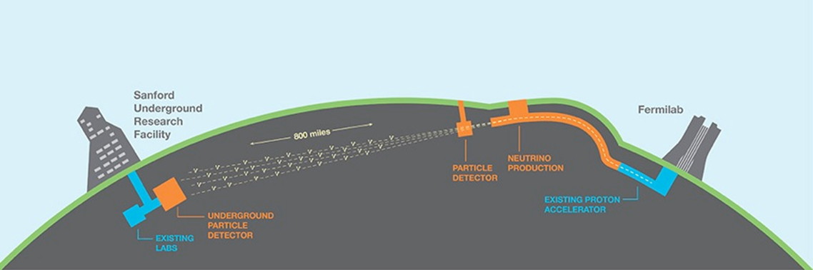
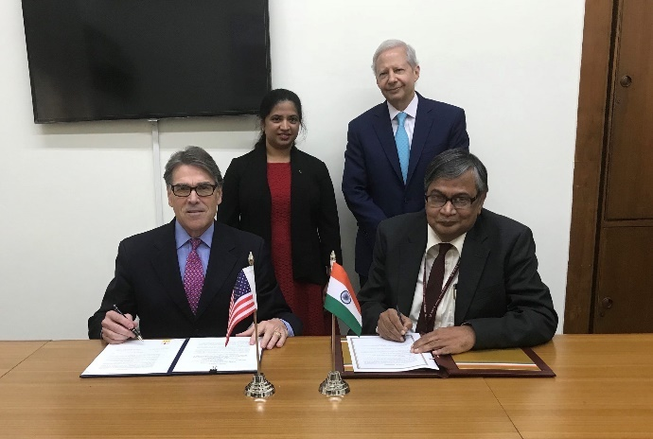
Long-Baseline Neutrino Program – LBNF/DUNE
Long-Baseline Neutrino Facility / Deep Underground Neutrino Expt.
LBNF/DUNE
  Identified by P5 as the highest priority large project in its time frame.
  Centerpiece of a U.S.-hosted, international neutrino program.
  The 1st international science facility hosted in the U.S.
>1100 collab.
198 inst.
32 nations
UK-U.S. S&T Agreement
20 Sept 2017
Strong support for international collaboration within U.S. Govt.
US DOE – India DAE S&T Agreement for neutrino physics - 16 April 2018

Slide 17
Proton Improvement Plan II (PIP-II)
1.2 MW proton beam on target; beam ready when LBNF ready (2031); upgradeable
  Will also support other research goals by providing increased beam power and high reliability to future Fermilab experiments.
Replace existing 50-year-old linac with a high-power, 800-MeV SRF linac.
  Based on LCLS-II experience (and ILC R&D)
Being built with international partners: India, Italy, UK, France, Poland.
CD-3 - April 2022 (CD-3a – March 2021)
Ultimate goal for upgrade of proton complex is >2 MW to LBNF w/ Booster upgrade.

Slide 18
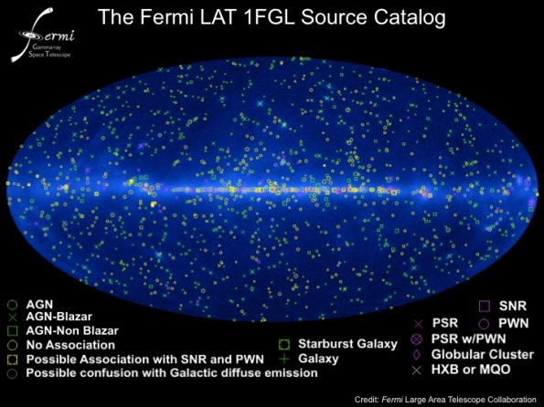
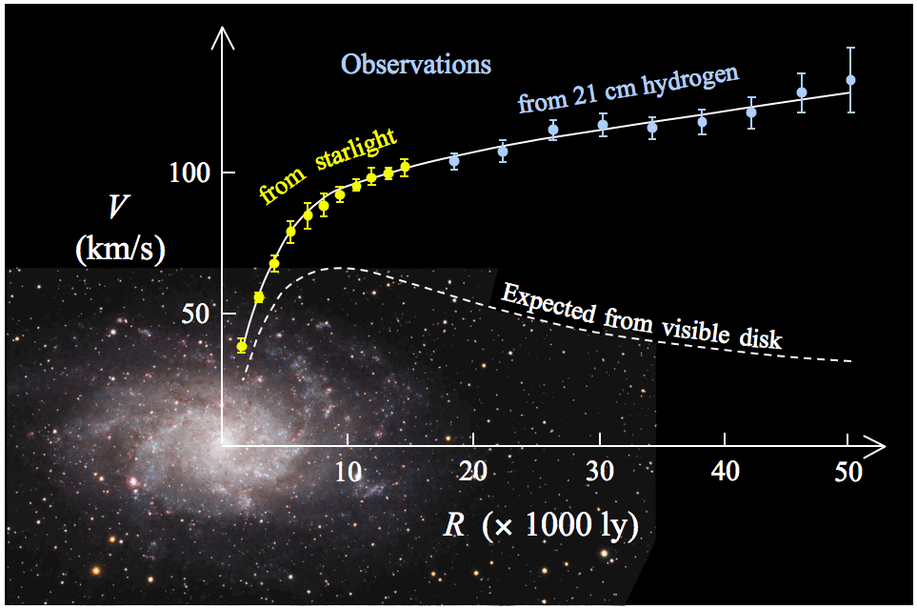
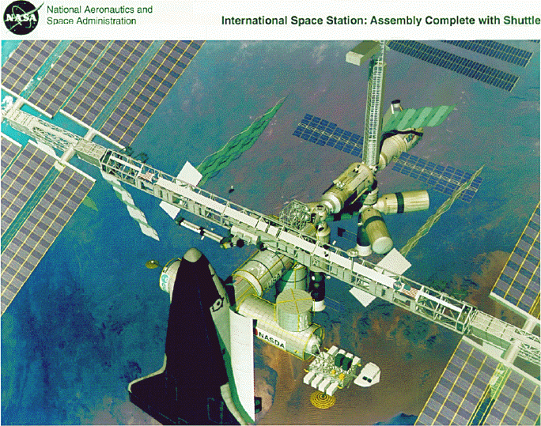
Identify the new physics of dark matter.
P5: “It is imperative to search for dark matter along every feasible avenue.”
4 complementary experimental approaches, each providing essential clues:
  direct detection,
  indirect detection,
  observation of large-scale astrophysical effects,
  dark matter production at accelerators.
Indirect detection:
Research continuing with Fermi-LAT & AMS-02.
HAWC sensitive to very heavy DM particles.
DOE has no new initiatives planned.
Large-scale astrophysical effects:
Evidence for Dark Matter M33 (galaxy rotation curve Wikipedia)

Slide 19



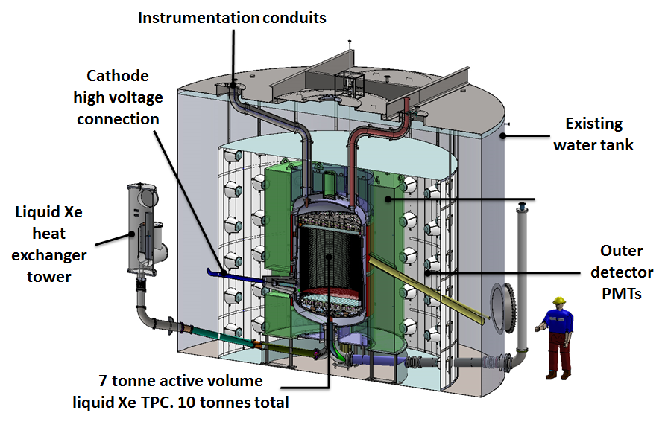
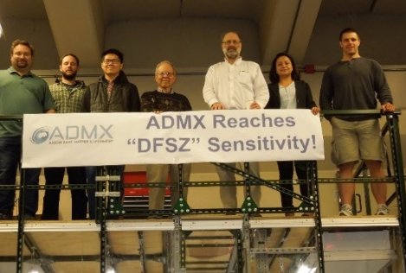
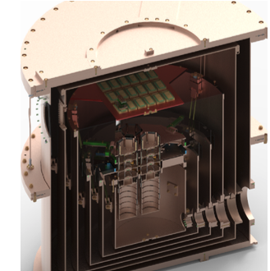
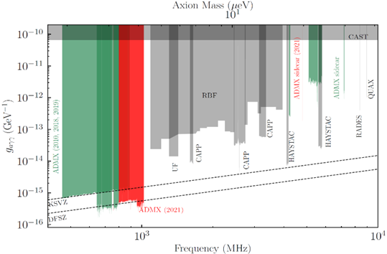
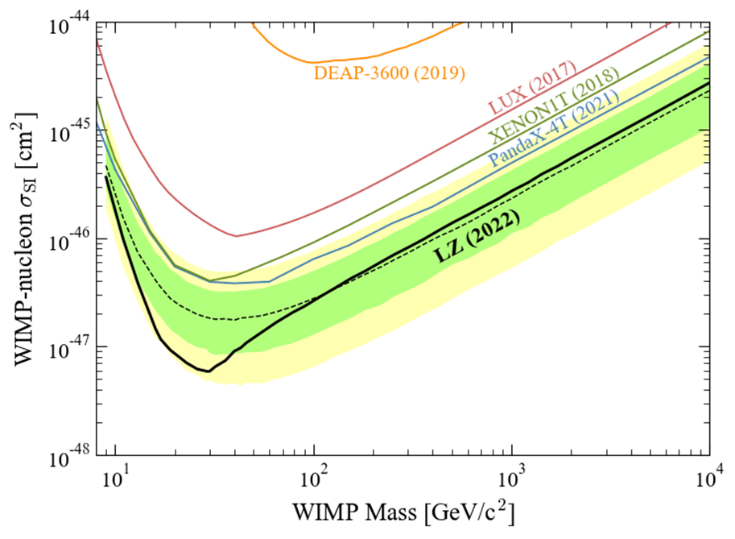
Direct detection searches for dark matter
DM-G2 program: 3 complementary experiments
DOE + NSF-PHY partnership
WIMP search
Si/Ge at SNOLab
Fabrication complete - 2022
Operations – 2024
at Univ. of Washington
Axion search
Operating since 2017
at SURF (South Dakota)
WIMP search
LXe
First results this year
NSF supports numerous searches:
ABRACADABRA, ALPS-II, ARIADNE, COSINE, DAMIC-M, DarkSide, HAYSTAC, SABRE, SENSEI, XENONnT, R&D
Looking further forward, 2014 P5 also recommended one or more DM-G3 experiments.

Slide 20

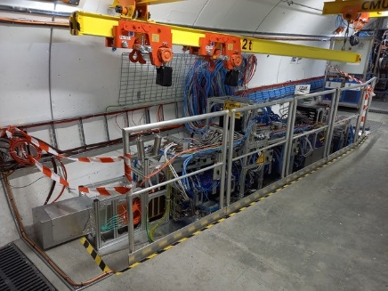
Dark matter production at accelerators
Dark matter production with particle colliders
  Many DM searches at the LHC in ATLAS + CMS + LHCb & FASER
  “invisible signatures” (mono-X; h->invisible, etc.)
  “visible signatures” (e.g. mediator to dijets)
  searches in the SUSY context
This active program will continue at HL-LHC.
Results also from BABAR, BELLE & BELLE-II.
Dark matter production in intense particle beams
  JLab: Heavy Photon Search (HPS); APEX in electron/positron beam
  LANL: Coherent CAPTAIN-Mills (CCM10) in neutron beam
  New concepts under study in context of DMNI: e.g. CCM200, LDMX
Dark matter future planning via:
  All experimental techniques were explored at workshop on Dark Matter in 2017.
  U.S. Cosmic Visions: New Ideas in Dark Matter 2017: Community Report
  Dark Matter New Initiatives funds development of 6 small project concepts
    4 in Cosmic Frontier, 2 in Intensity Frontier

Slide 21
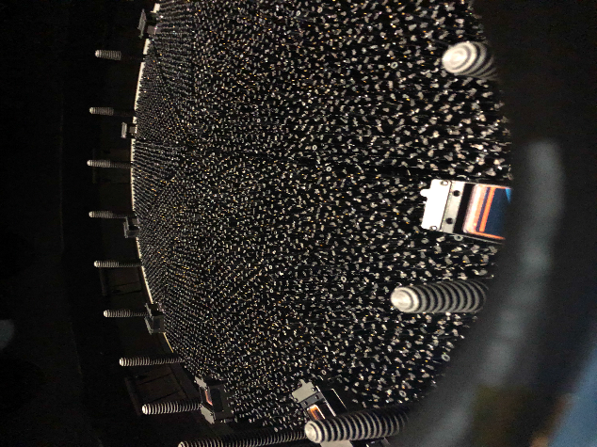
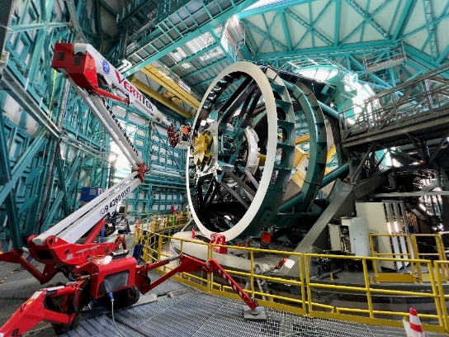
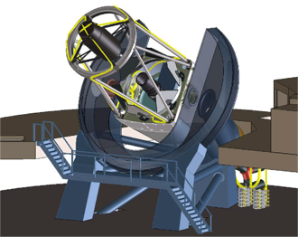
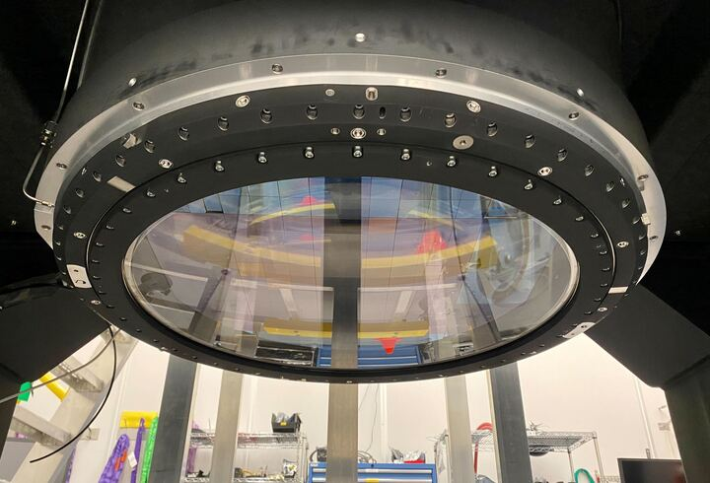
Understand cosmic acceleration: dark energy & inflation
Dark energy: complementary imaging & spectroscopic surveys
Transitioning from Stage III:
eBOSS – Extended Baryon Oscillation Spectroscopic Survey – final results 2020
DES – Dark Energy Survey – survey complete; data processing nearing completion
to Stage IV:
Vera C Rubin Observatory
Legacy Survey of Space and Time (LSST)
aka Large Synoptic Survey Telescope
DESI
Dark Energy Spectroscopic Instrument
LSSTcam completed in 2021; to Chile in 2023
DOE + NSF MREFC
Dark Energy Science Collaboration (DESC) planning
Data taking to start late 2024.
Data taking started 2021
Fire has interrupted
LSSTCam focal plane - DOE
DESI focal plane
DESI on Mayall
Rubin telescope – NSF-AST

Slide 22
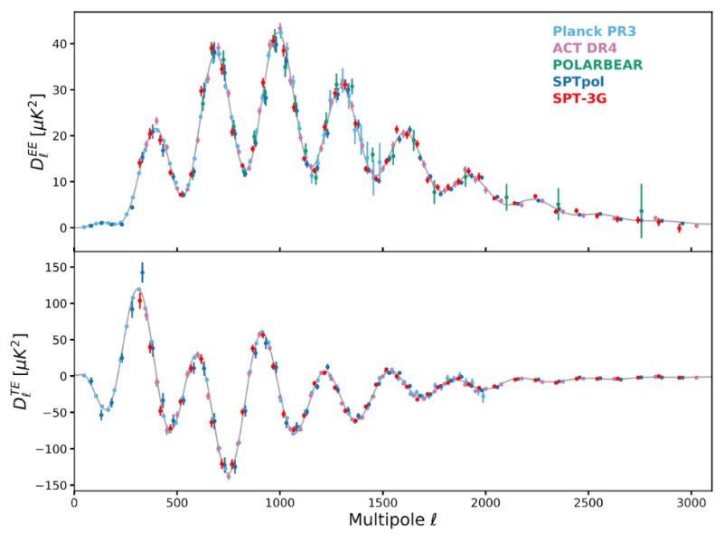
Understand cosmic acceleration: dark energy & inflation
Inflation: Cosmic Microwave Background (CMB)
SPT-3G
Operating Stage 3:
South Pole Telescope
  Survey started in 2018
  DOE-NSF partnership
  1st science results - 2021
Planning for next generation:
CMB Stage 4 (CMB-S4)
  Recommended by 2014 P5 + ASTRO2020; DOE-NSF partnership
  CMB-S4 Concept Definition Taskforce Report approved in 2017; CD-0 - 2019
  science goals, technical requirements, strawman concept
  Learned in 2022 that must reduce footprint to fit South Pole infrastructure.
  A note: P5 suggested international collaboration and coordination on Stage 4.
Dark Ages initiative (w/NASA): LuSEE-Night – Pathfinder mission to search for Dark Ages signal on lunar farside; MIE started FY22; launch 2025.
Measure low-frequency radio sky; sensitive to 21-cm emission from hydrogen at high redshift (z>30)

Slide 23
Explore the unknown.
Explore the unknown: new particles, interactions, and physical principles.
Some approaches to exploring the unknown as outlined by P5:
  High energy colliders – ATLAS + CMS
  Precision physics & rare processes
    Heavy quarks & tau leptons – LHCb, Belle-II
    Rare kaon decays – KOTO, NA62
    Rare muon decays and processes – Mu2e, MuonE,
    Muon magnetic moment – Muon g-2
    Baryon number violation – LHCb
    Electric dipole moments - ACME
    CPT* - CeNTREX
    Monopoles* - MoEDAL
  Cosmic particles – AMS-02, HAWC, Pierre Auger, VERITAS, BEACON, pSCT, ARA, IceCube, Radar Echo Telescope, RNO-G, SNEWS (synergy w/ multi-messenger astro)
  New low-mass particles (e.g. hadron spectroscopy) – LHCb

Slide 24
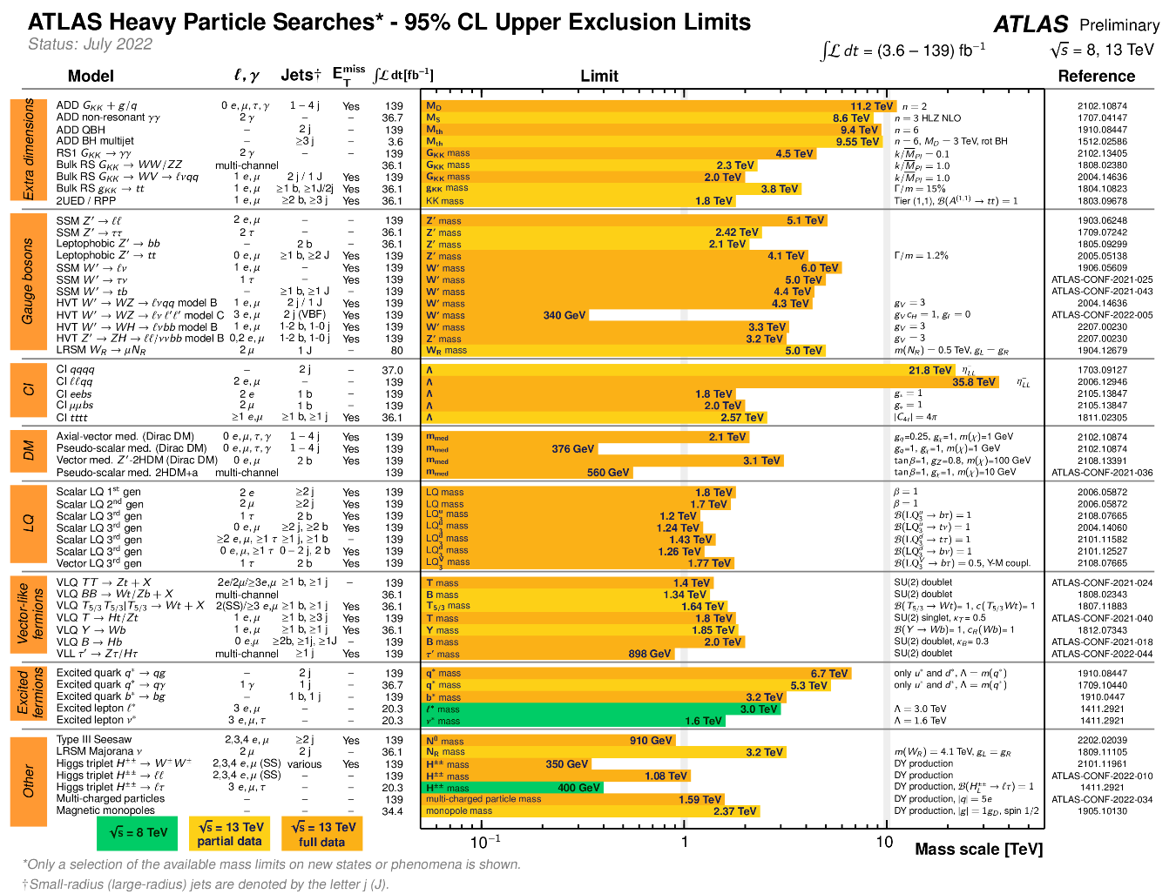
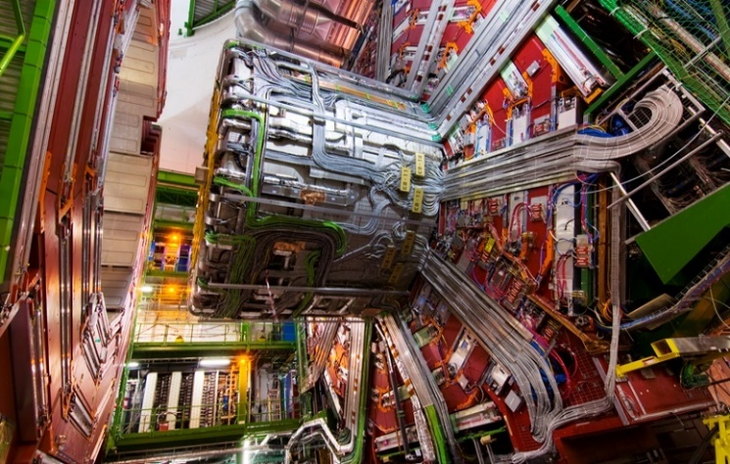
Explore the unknown at high-energy colliders
Searches at high-energy colliders are one approach to exploring the unknown.
HL-LHC => Up to 40% larger discovery potential for new physics than prior to upgrades

Slide 25
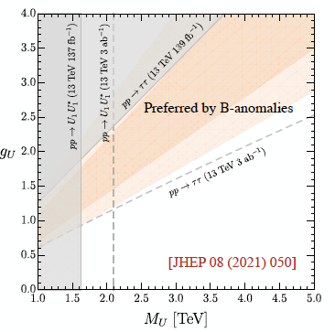
Explore the “unknown” thru precision measurements
Ongoing precision experiments:
  Collaboration with Japan on K meson studies with K0T0 and on heavy quark and τ lepton precision studies with Belle II.
  LHCb at LHC
    Highlights in semi-leptonic B decays, hadronic B decays, CKM matix, charm mixing & CPV
The FNAL Muon Program
  Muon g-2
    Results from 1st year running published
    Now has 19x data of BNL predecessor from 5 years under analysis
  Mu2e
    Under construction (CD-3 – 2016)
    Re-baseline planned in 2022
    1st run in 2026
LHC leptoquark limits & B anomalies
Muon g-2
Mu2e

Slide 26
DOE HEP MIE Project Status
COVID seriously impacted numerous projects.
Subprogram | TPC ($M) | CD Status | CD Date
INTENSITY FRONTIER
LBNF/DUNE | ~3000 | CD-3a | Sept 1, 2016 (CD-1RR in July 2022)
Proton Improvement Project (PIP-II) | 978 | CD-3 | April 18, 2022
Muon-to-Electron Conversion Experiment (Mu2e) | 273.7 | CD-3 | July 14, 2016 (Rebaseline expected in 2022)
ENERGY FRONTIER
LHC ATLAS Detector Upgrade | 33.25 | CD-4 | Aug 19, 2019
LHC CMS Detector Upgrade | 32.22 | CD-4 | June 10, 2019
High-Luminosity LHC (HL-LHC) Accelerator Upgrade | 242.72 | CD-3 | Dec 21, 2020 (Rebaseline expected in 2022)
High-Luminosity LHC (HL-LHC) ATLAS Detector Upgrade + NSF MREFC | 149-181 | CD-3a | October 16, 2019 (CD-2 in Fall 2022)
High-Luminosity LHC (HL-LHC) CMS Detector Upgrade + NSF MREFC | 144-183 | CD-3b | June 24, 2022 (CD-2 in Fall 2022)
COSMIC FRONTIER
Cosmic Microwave Background, Stage 4 – CMB-S4 | 320-395 | CD-0 | July 25, 2019
LUX-ZEPLIN (LZ) | 55.5 | CD-4 | September 21, 2020
Super Cryogenic Dark Matter Search - SNOLAB (SuperCDMS-SNOLAB) | 40.3 | CD-3 | November 18, 2021
Dark Energy Spectroscopic Instrument (DESI) | 56.33 | CD-4 | May 11, 2020
Large Synoptic Survey Telescope Camera (LSSTcam) + NSF MREFC | 168 | CD-4 | September 28, 2021
ADVANCED TECHNOLOGY R&D
Facility for Advanced Accelerator Experimental Tests II (FACET-II) | 26 | CD-4 | September 13, 2021

Slide 27
Closing remarks
The U.S. experimental particle physics program has been guided for the last several years by the strategic plan presented in the 2014 P5 report. It is time for an update.
The 2014 P5 plan is motivated by intertwined 5 science drivers:
  Use the Higgs boson as a new tool for discovery.
  Pursue the physics associated with neutrino mass.
  Identify the new physics of dark matter.
  Understand cosmic acceleration: dark energy and inflation.
  Explore the unknown: new particles, interactions, and physical principles.
The 2014 P5 strategic plan is:
science driven.
broad, covering a great range of different, but inter-related questions.
a balanced program (not a strict prioritization).
part of a global program of international collaborations & shared facilities.
The 2023 P5 strategic plan will build upon today’s experimental program and upon the projects that will soon complete. This Snowmass Community Summer Study will provide the new information upon which the 2023 P5 strategic plan will be built.
=> Let’s assemble a plan that shares the strong characteristics of the 2014 plan.

Slide 28
Thank you.

