Slide 1
SURF Outreach and Community Relations
Mike Headley
SDSTA Executive Director
SURF Lab Director
Snowmass CSS
July 24, 2022

Slide 2
SURF Outreach and Culture Scope
  Inclusion, Diversity, Equity and Access (IDEA) Office
    Supporting a welcoming work environment in collaboration with HR office.
    Coordinating communication and relationship with Tribal Nations.
  K-12 Education and Outreach
    Providing STEM education experiences for K-12 students and teachers.
    Supporting the transition to post-secondary.
  Public Outreach / Communications
    Public outreach, media relations and marketing.
    Local community outreach (includes significant senior leadership involvement).
  Sanford Lab Homestake Visitor Center (SLHVC)
    SURF’s face in the local community.
    Connecting to broader community with opportunities for inter-generational learning.
  SURF Artist in Residence Program
    Summer residency program. Sharing the wonder of SURF’s science and ops through art.

Slide 3
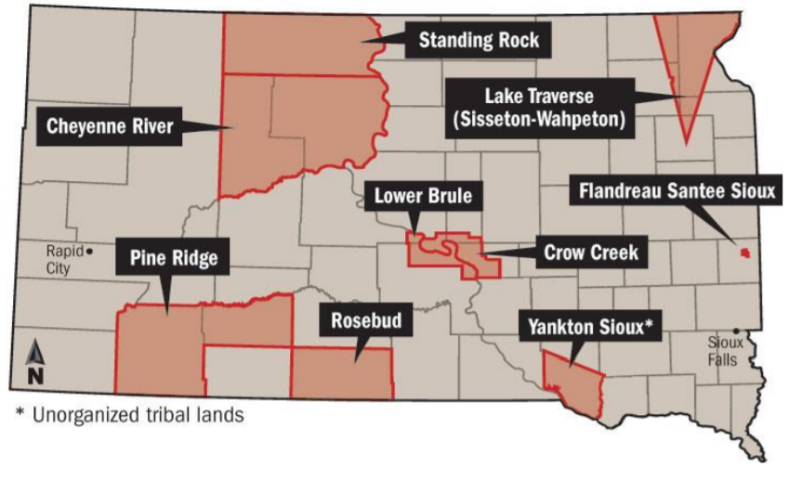
Tribal Nations within South Dakota
Notes:
Nine sovereign tribal nations share the same geography as South Dakota.

Slide 4
SURF Working Alongside Region’s Tribes
The Black Hills are sacred to the Tribes of the region (“Paha Sapa” or “hills that are black”).
U.S. Federal requirements
  National Historic Preservation Act
  Impacts of U.S. Gov’t investments must be assessed. Tribes consulted.
Beyond legal requirements, SURF has placed high priority on Tribal relations and building strong partnerships from the start.
SURF’s efforts include:
  Commitment to treat sacred lands with respect.
  Regular interactions with Tribes—with staff dedicated to this purpose.
  Public outreach efforts focusing on Native culture and history.
  K-12 STEM education outreach efforts with Tribal schools in region.

Slide 5
SURF Commitments to Tribes
Impacts on the land are minimized. No new areas will be disturbed.
Rock extracted (800,000 tons) for LBNF Project will remain in the Black Hills.
Any artifacts found will be properly managed and preserved.
SURF Wastewater Treatment Plant instrumental in improving water quality of local streams.
SURF adheres to strict recycling procedures.

Slide 6
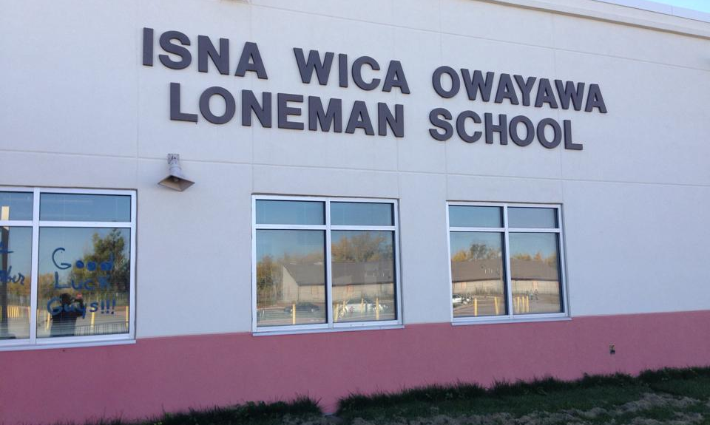
Isna Wica Owayawa (Loneman School)
Notes:
Isna Wica Owayawa (EES-nah, WEE-chah, Oh-WHY-ya-wah)
Located within the Pine Ridge Indian Reservation
Serves about 250 students in Kindergarten through 8th grade
Staff met with school officials at the South Dakota Indian Education Summit in September 2019 during a presentation on Student Engagement
Provided info about summer professional development
Three teachers signed up and attended virtual professional development training (Summer 2020)
A teacher (Maridel Hallare) who had attended the professional development training asked for supplemental material for their Saturday “After School” program (August 2020)
Both students and teachers attended the Saturday programming
Students were divided into two groups: Kindergarten through 4th Grade; and 5th grade through 8th Grade
SURF provided curriculum for one Saturday per month curriculum (free of charge)
In 2020, the program was completely virtual

Slide 7
Isna Wica Owayawa (Loneman School)
Several teachers from Loneman participated in 2021 professional development.
Three teachers were accepted into Cohort 5 SD Math SD Sci program.
  Previously, only one Native teacher applied.
SURF E&O staff have visited Loneman for E&O programming.
  Scheduling was a challenge. Patience was key.
Holiday backpacks distributed at Loneman.
  School supplies, snacks, personal hygiene, and one STEM item.
We aim to replicate this work at other tribal schools in the region.
Notes:
SD Math, SD Sci: (October launch – goal of program is to build math and science teacher leaders across the state; build network of SM teachers)

Slide 8
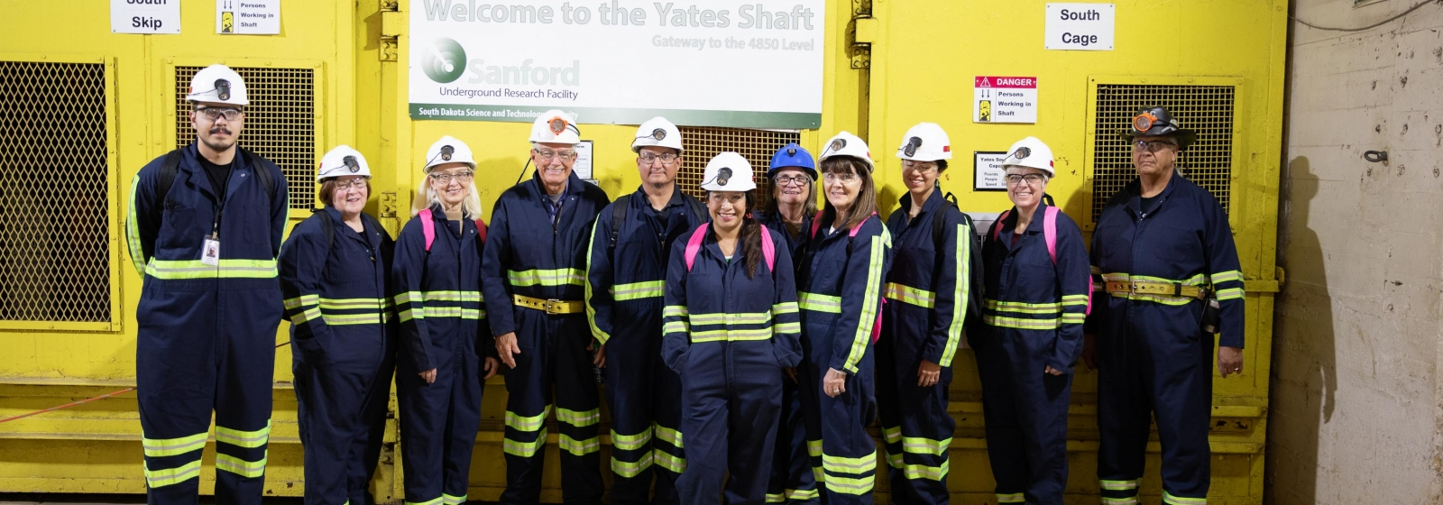
Cultural Advisory Committee
Established in 2010, meets at least three times annually.
CAC receives laboratory updates and advises on cultural efforts.
SURF staff and community members maintain a cultural strategic plan.

Slide 9
Sacred Circle Garden (Cangleska Wakan)
The SURF Foundation is raising funds to create an ethnobotanical garden on Yates Complex at SURF.
Focus is a Native American medicine wheel with native plants.
Vision is to increase understanding and respect for indigenous cultures of the Black Hills.
It will be a place that protects our environment, our rich history, and the values that connect us.
An array of activities planned and integration with Visitor Center tours.
www.sanfordlab.org/garden

Slide 10
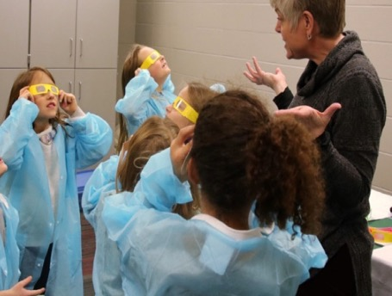
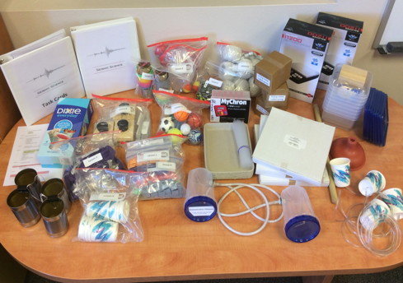
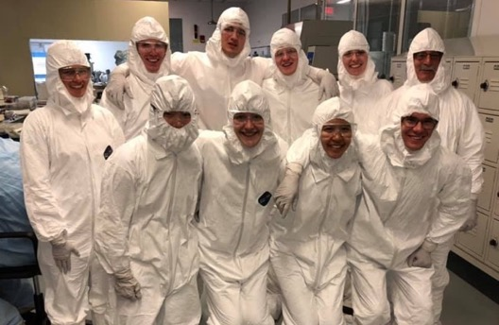
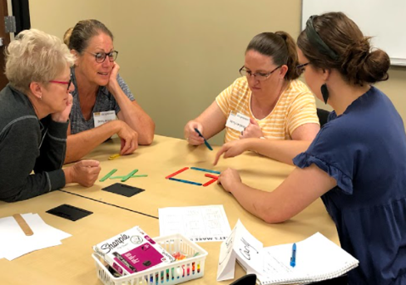
K-12 Education and Outreach Scope
Presentations & Field Trips | Curriculum Units and Resources | Career Exploration and Development | Supporting Teachers
K12 presentations Face to face Virtual options Field trips in spring and fall | 5-15 hours of fully designed and resourced science curriculum 17 unique curriculum units available for checkout | Davis-Bahcall Scholars Program Summer internship opportunities Pre-service educator program support | Professional development offerings Curriculum resources Science content support Just-in-time support

Slide 11
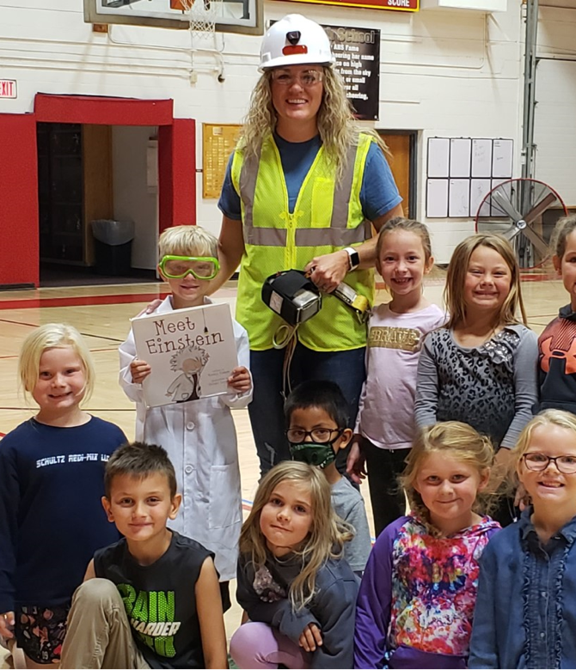
Education and Outreach: Updates and Plans
WHY: Every student deserves high-quality, engaging, relevant, equitable and rigorous science learning opportunities.
Direct work with students far exceeded goals for 2021-22.
Summer teacher professional development in process.
Updating and expanding content: New Underground Ventilation Challenge
and Safety Presentation.
Post-Secondary
Davis-Bahcall Scholars Program
Summer Internships (Incl. slots for underrepresented groups)
Work with University Teacher Education Programs Across the State
Black Hills State University University of South Dakota
Northern State University Augustana University
Dakota State University South Dakota State University

Slide 12
Education and Outreach: By the Numbers
# Teachers

Slide 13
Education and Outreach: By the Numbers
School Year | 2018-2019 (pre-COVID) | 2019 – 2020 (COVID begins) | 2020-2021 (during COVID) | 2021-2022*
Field Trips | 1,117 | 254 | 58 | 419
Classroom Presentations | 6,704 | 3,704 | 2,005 | 14,037
Curriculum Units | 3,598 | 3,236 | 3,384 | 3,683
Other | 1,055 | 918 | 298 | 1,468
Total Student Contacts | 12,474 | 8,112 | 5,745 | 19,607
* As of May 31, 2022
Notes:
Update for as of May 30

Slide 14
Local Community Coordination
SDSTA has built a strong relationship with local community over 15 years.
Monthly coordination meetings held with SDSTA, Lead City officials, local Fermilab management, and major LBNF subcontractors.
As a non-profit, investment in community activities has been challenging.
  Recently, leaning in more in this area. Generating a positive response.
Generally, public meetings have been held as needed (rock dust issues).

Slide 15
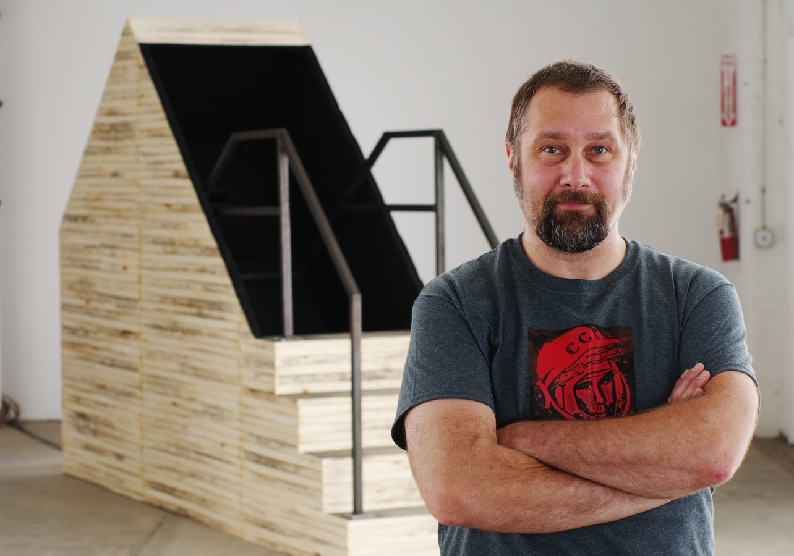
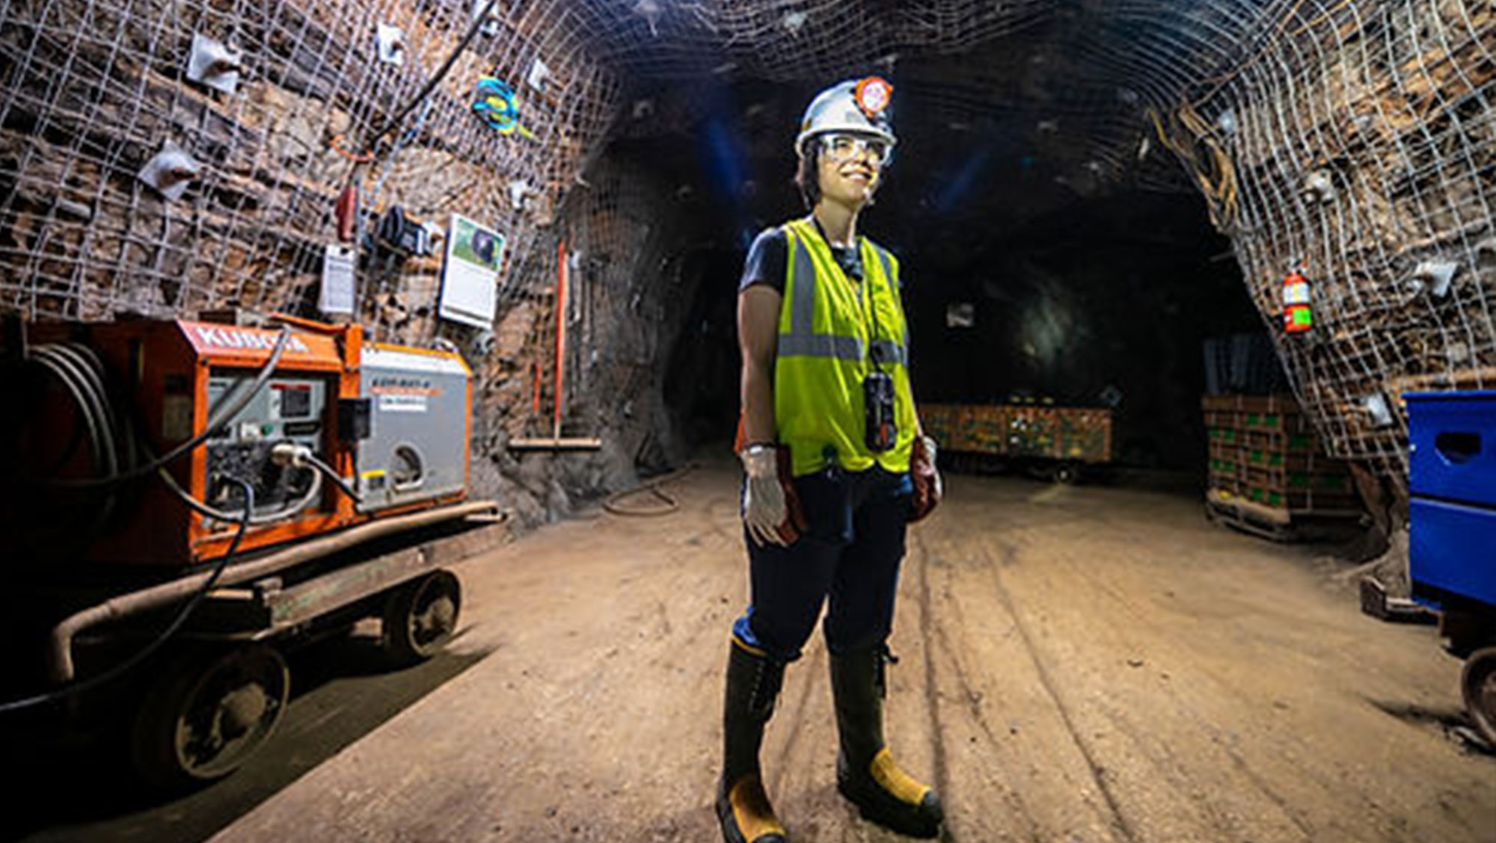

Artist in Residence Program (AiR)
Funded by the SDSTA. Inspired by the science at SURF.
Program is in the third year of existence.
Each artist contributes one piece to the SURF permanent collection.
Year one AiR, Gina Gibson, held recent virtual show at Fermilab. Show planned for U. of Michigan.
Year three AiR features artist Gary Sczerbaniewicz.

Slide 16
Lessons Learned Along the Way
Cultural outreach
  Persistence is key. Interactions can’t be seen as transactional. Work at the “speed of trust.”
  When mistakes are made, be humble, willing to learn, and willing to change.
Community engagement
  Our community has little patience for bureaucracy and slowly delivered solutions.
  Transparency is essential when communicating with the public to build trust.
  Bring the right people to the conversation to address questions immediately.
  Participation in community activities and initiatives is well received.
  Demonstrate a commitment to the health and safety of our neighbors.

Slide 17
Thank You

Slide 18
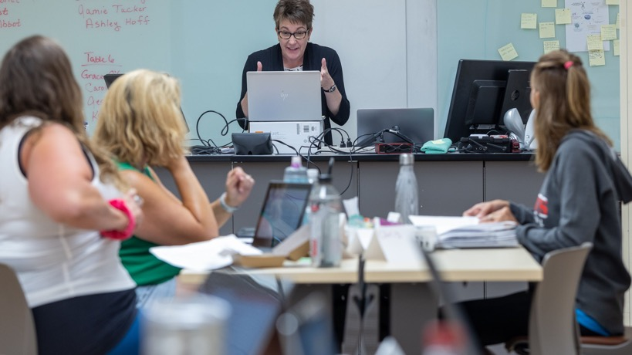
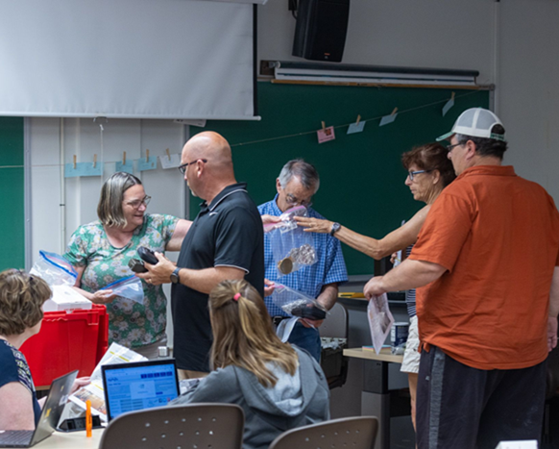
Education and Outreach: Professional Development
SURF E&O Offerings
Powerful and Productive Mathematical Discourse (hybrid)
Supporting and Sustain 3D Science Instruction (hybrid)
The Power of Place-Based Learning (F2F)
Implementing 3D Instruction (Virtual)
Enhancing Mathematics with Application (F2F)
In Partnership with SD EPSCoR
Fundamentals of 3D Instruction & Biofilms (Virtual)
Making Thinking Visible (F2F and Virtual)
Supporting Implementation of Biofilm Curriculum Modules (Virtual)
In Partnership with Black Hills State University
Computational Thinking in STEM (F2F with 4th Grade Teachers)
Computational Thinking in STEM (F2F with 5th Grade Teachers)
In Partnership with the SD Department of Education
SDMath/SDSci Teacher Leadership Program
Notes:
External entities look to the SURF E&O team to provide science education expertise. SURF E&O is the preeminent science teacher education support in the state.

