Slide 1
Community Outreach at SURF
Constance Walter, Communications Director
Sanford Underground Research Facility
‘America’s Underground Science Laboratory’
Snowmass, July 2022

Slide 2
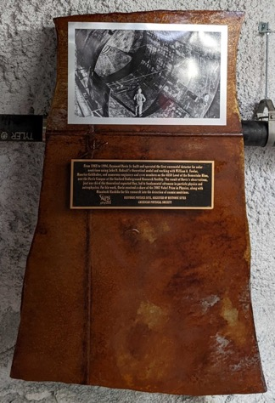
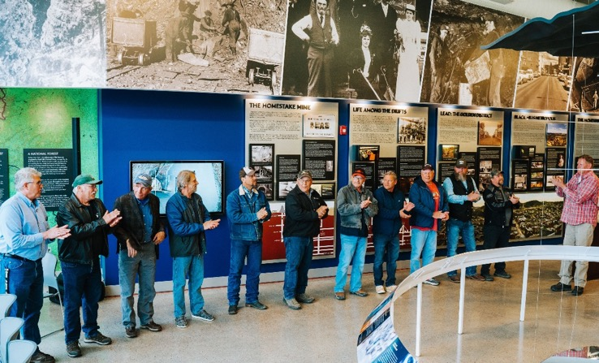
Community Outreach
Historic Site Dedication, May 13, 2022
In 2020, SURF was designated a historical site in physics by the American Physical Society, recognizing the significant neutrino research done by Ray Davis. Members of Davis’ family attended the celebration
Davis Campus 10-year Anniversary: May 20, 2022
SURF celebrated the people who built the Davis Campus and the scientists who built the experiments.

Slide 3
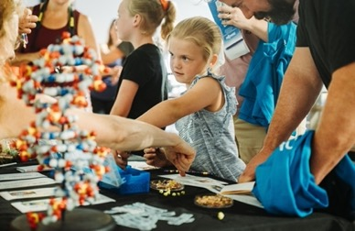
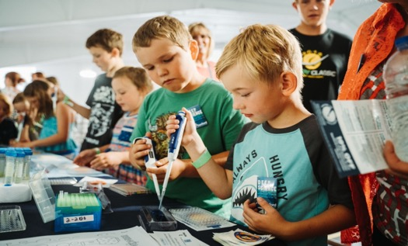
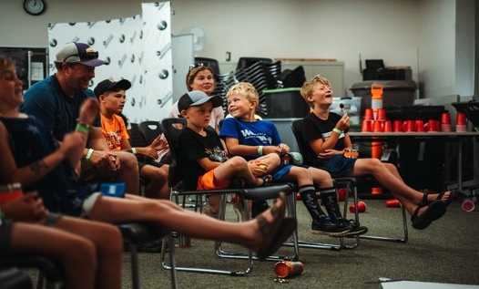
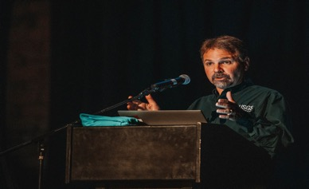
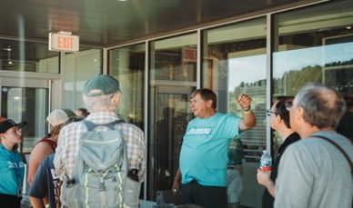
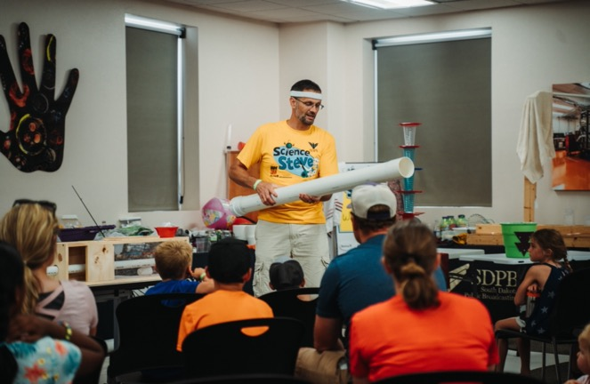
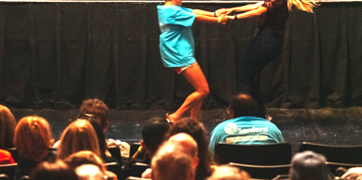
Scenes from Neutrino Day 2022

Slide 4
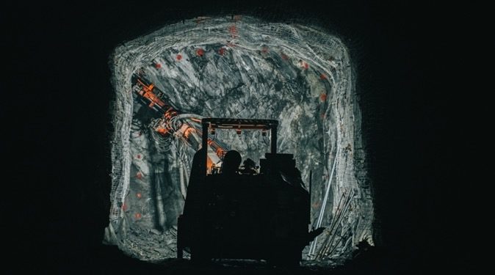
Deep Talks

Slide 5
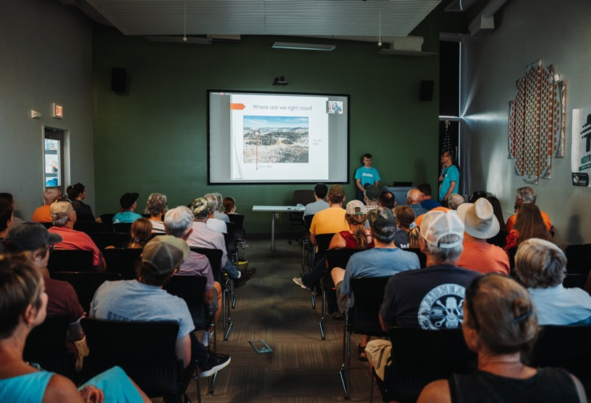
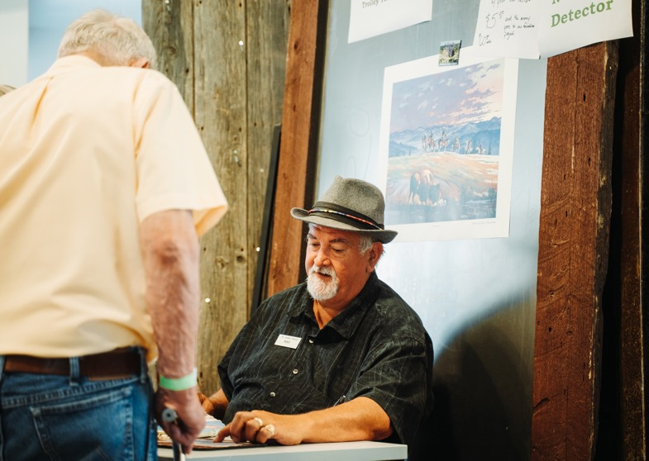
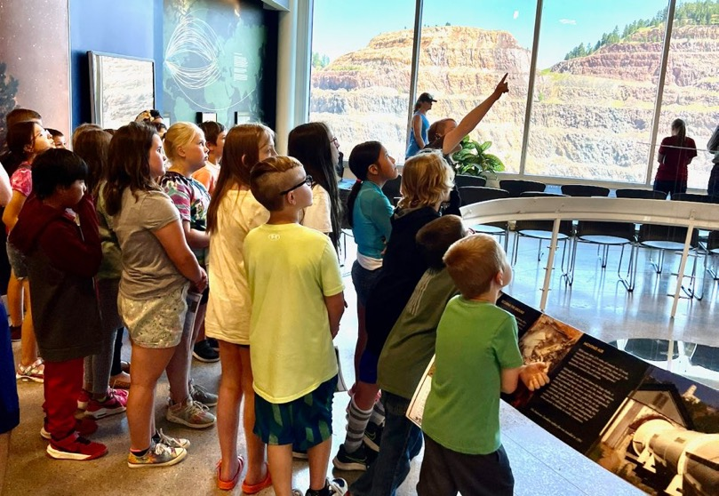
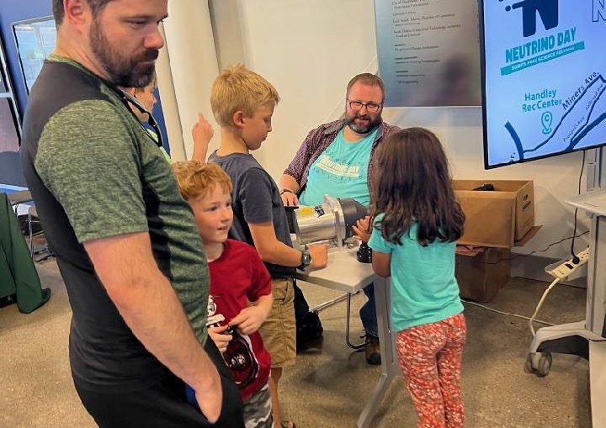
Sanford Lab Homestake Visitor Center Acquired Jan. 7
Honor the Past
Showcase the Present
Inspire the Future
Community and Chamber networking
Inter-generational learning
Exhibit hall
Events
Winterfest
Deep Talks
Field Trips
Road Scholars
Trolley Tours
Fireworks Over the Open Cut

