Slide 1
e⁺e– Collider Forum Report
Precision Electroweak to Discoveries at Energy Frontier
From $\sqrt{s}=M_{Z}→M_{WW}→M_{Z+H}→M_{tt}→500 GeV→550 GeV→15 \text{TeV}$
Download Report from: https://snowmass21.org/energy/start#final_reports Feedback: https://docs.google.com/document/d/12z7sF3Qhg0Xk54yp_s71IPPJCzKknkq9kxYQhQFLaXQ/edit

Slide 2
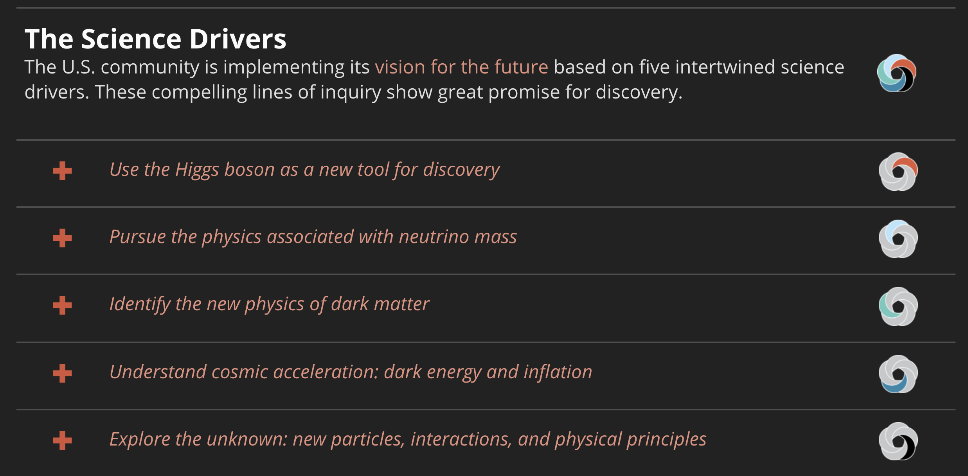
e⁺e– Collider Forum Report
From $\sqrt{s}=M_{Z}→M_{WW}→M_{Z+H}→M_{tt}→500 GeV→550 GeV→15 \text{TeV}$
Higgs Factory
Shovel Ready
O(10) TeV
Advanced Concepts

Slide 3
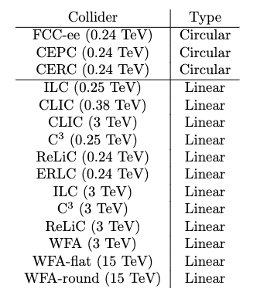
ITF Evaluated Collider Types
Circular Colliders
From $\sqrt{s}=M_{Z}→M_{WW}→M_{Z+H}→M_{tt}$
Tera-Z, millions of H – very high luminosity
”Upgrade” to pp-machine for high energy
Linear Colliders
Polarization, Energy Reach
From $\sqrt{s}=M_{Z}→M_{WW}→M_{Z+H}→550 \text{GeV}$
Upgraded / Expanded facilities: $\sqrt{s}→3 \text{T}\text{eV}$
Advanced technologies: $\sqrt{s}→15 \text{TeV}$
Beam Delivery Advances for high luminosity

Slide 4
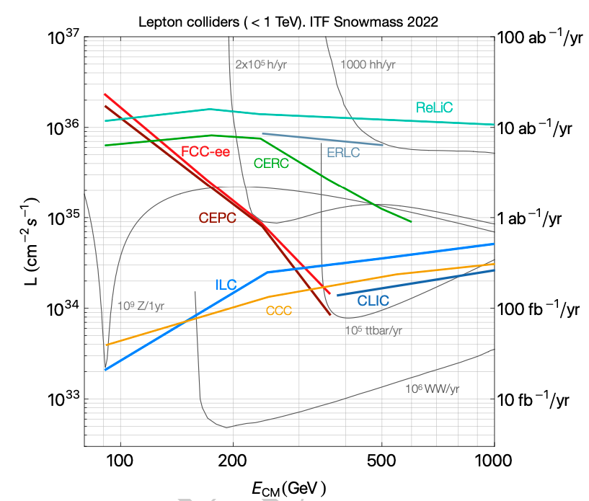
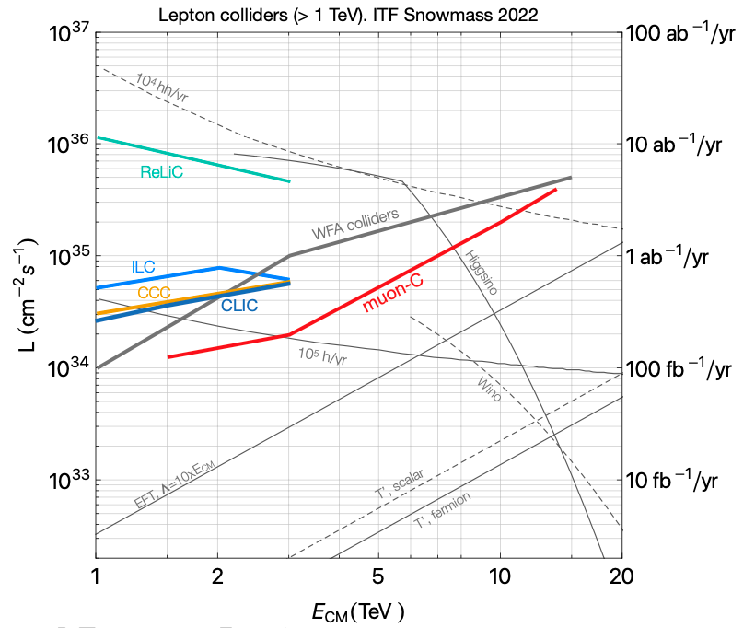
ITF: Luminosity vs $√s$ Landscape

Slide 5
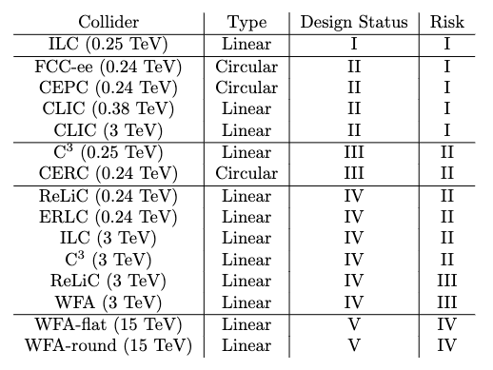
ITF: Machine Design Status and Risk
Design Status
TDR Complete
CDR Complete
Substantial Docs
Limited Docs
Risk
Low Risk
Medium Low Risk
Medium High Risk
High Risk

Slide 6
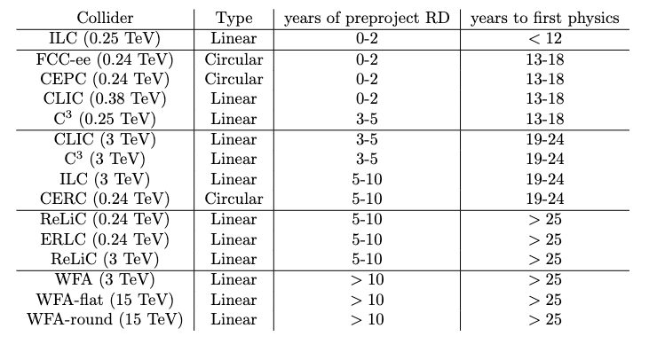
ITF: Machine R&D & Physics Timelines
Shovel Ready
Higgs Factory ASAP
O(10) TeV e⁺e– R&D Need

Slide 7
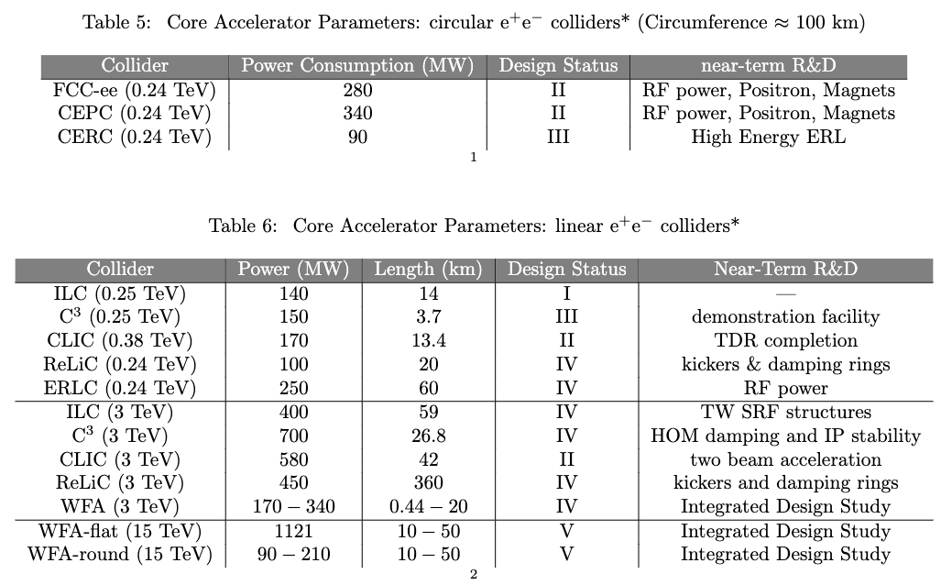
ITF: Core Accelerator Parameters (Cost Drivers)
Active LINAC Length
Beam Delivery System ~ 3km
Active LINAC Length
BDS Larger

Slide 8
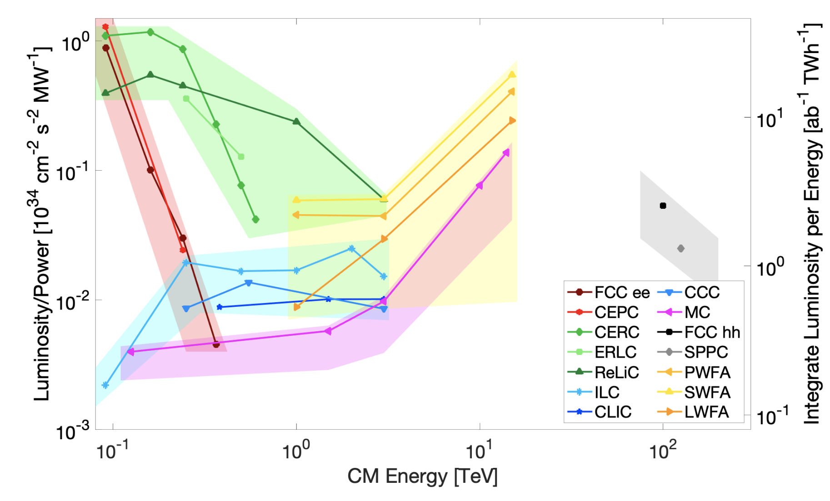
Luminosity / Power vs Energy from ITF
Points computed from proponent submitted parameters table
Uncertainty band is ITF judgement based on many considerations: technical design status, risk assessment, …

Slide 9
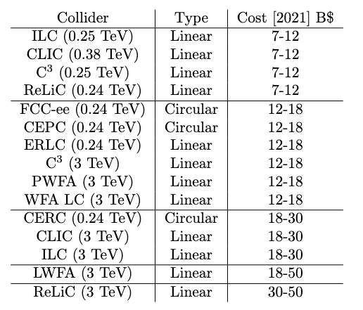
FWIW – ITF Estimated Costs
Difficult to estimate accurately
Depends on methods used
Individual proponents have their own estimates
ITF did the best to treat all machines on equal footing with ~uniform method

Slide 10
Physics Timeline vis-à-vis Integrated Luminosity
Caveat – run plans are adjustable; start of physics times are different
Technically feasible times: ILC < 12y, FCC-ee, CLIC, CEPC, C3 : 13-18y
ILC “shovel ready” – awaiting funding decision, potential for earliest start
FCC-ee, CLIC – post HL-LHC
Circular colliders have shorter runs, higher luminosity
Linear collider runs have access to polarization and higher energy
Possibly earlier project start (Shovel ready ILC)
Both provide good precision on Higgs Couplings & EWK

Slide 11
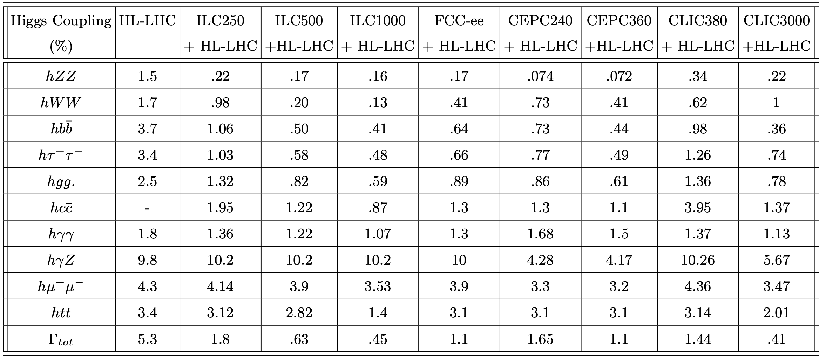
Higgs Couplings

Slide 12
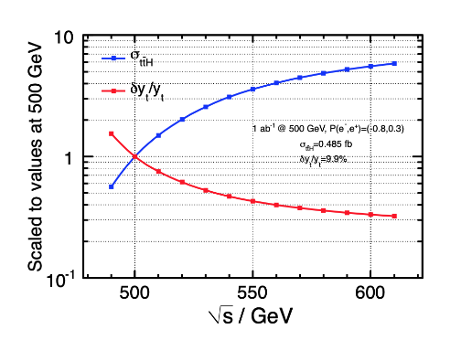
Top-Yukawa and Higgs Self-Coupling
Advantages of Energy Reach
Double Higgs production
E_{CM} (TeV) | Precision of λ_{HHH}
HL-LHC | 50%
ILC 0.5 | 20%
CLIC 1.5 | 36%
CLIC 3 | 9%
μCol 10 | 4%

Slide 13
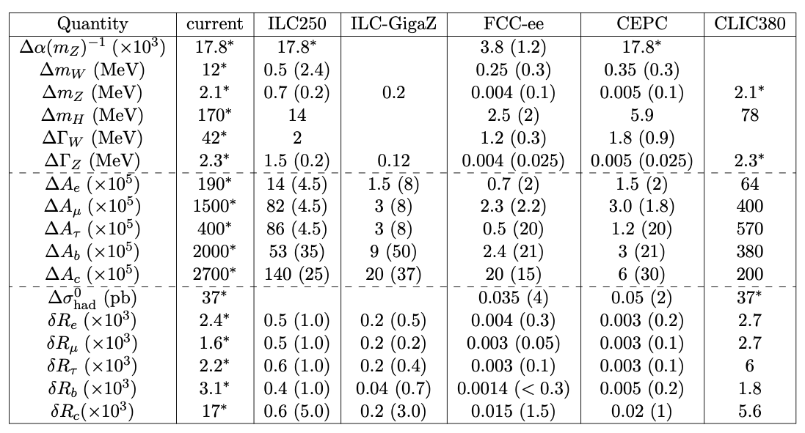
Electroweak Observables
ILC GigaZ is a big improvement over current status
FCC-ee TeraZ suggests even bigger leap forward in precision

Slide 14
Detectors for e⁺e– Colliders
Main features
Pixel tracker with lowest possible mass and possible radius
Low-mass outer tracker for excellent momentum resolution to high energies
A highly segmented calorimeter for particle flow
A large superconducting solenoid enclosing above
Muon chambers
Triggerless readout
Additional features
Timing detectors
Particle ID K/π/p separation
Highly segmented detectors with good resolution were simulated to make physics studies
We do need those fancy detectors to meet those physics goals!

Slide 15
Detector R&D Partial Itemized List
Several R&D paths need to be supported, e.g.,
Reduction of the material in the trackers to minimize multiple scattering
Monolithic Active Pixel Sensors (MAPS) – increased granularity
Low-Gain Avalanche Diodes (LGAD) – potential for time measurement
3D integration may reduce the material in pixelated sensors-readout assemblies and improve their performance and reliability
Thin film detectors to drastically reduce the amount of material
Submicron pixels with a quantum well to improve the position resolution of vertex detectors
Precision of the timing of signals in the tracker and the calorimeter into the 10 ps range → 4D / 5D Reconstruction, Particle ID
Modern versions of Ring Imaging Cherenkov and Transition Radiation Detectors
R&D to develop technologies to efficiently distribute power and cooling
R&D to make the technologies scalable to enable the construction of a large detectors

Slide 16
Detector R&D Needs
Preparation of a Technical Design for a Detector needs an R&D program
That goes beyond generic R&D is needed
Address the specific detector challenges for e⁺e– colliders.
Such a program needs to start now
for the technology to build a full-scale e⁺e– collider detector
For the Higgs Factory research program to begin ASAP !
Synergies continue to help, even in case of non-generic R&D
Past example: CALICE to CMS HGCal
Short-term: LHC Phase-2 Upgrades, EIC, Mu2e
Long-term: Proton-collider & muon-collider detectors

Slide 17
Synergies
The vast majority of ~30,000 currently operating accelerators globally are electron accelerators.
Electron accelerator R&D ranges from industrial applications to the cutting-edge development of ultimate storage rings and linear accelerator based XFELs.
This fortunate situation allows e⁺e– colliders to leverage these global efforts to provide a viable path to a collider reducing the R&D costs to the HEP budget.

Slide 18
Conclusion from Executive Summary
Given the strong motivation and existence of proven technology to build an e⁺e– Higgs Factory in the next decade, the US should participate in the construction of any facility that has firm commitment to go forward.
Awaiting such commitment, the US should also pursue research and development of multiple options in this decade.
This ensures that the global community will be able to begin constructing at least one such machine in the following decade
Potential siting of a facility (ILC? C3? …) in the USA should also be pursued.
US investments in further advancing technology
will ensure the technical readiness of proposed facilities,
improves the eventual physics reach of a collider and
maintains the community engagement needed for the US to contribute to the construction of a collider.

Slide 19
The e⁺e– Community Asks from EF & AF Reports
We hope Snowmass Community Leaders & Eventually P5 support:
Higgs Factories (from EF draft report)
Starting 2025: Establish a targeted e⁺e– Higgs Factory detector R&D progress for US participation in a global collider
Starting 2030: Support construction of an e⁺e– Higgs Factory
After 2035: Begin and support the physics program of the Higgs Factories
Ramp up funding support for detector R&D for EF multi-TeV Colliders
Wake Field Accelerators (Presently, GARD funded) (from AF draft report)
Advanced wake field accelerator concepts should strive toward feasibility studies and integrated design reports for an O(10 TeV c.m.e.) collider and experimentally demonstrate collider-quality emittances, efficiencies and energy spreads, staging, final focusing schemes and positron acceleration. Targeting 10 ab^{–1} or above for 10-TeV e⁺e–
Reduction of power consumption is one of the main challenges of future colliders. ERLs

