Slide 1
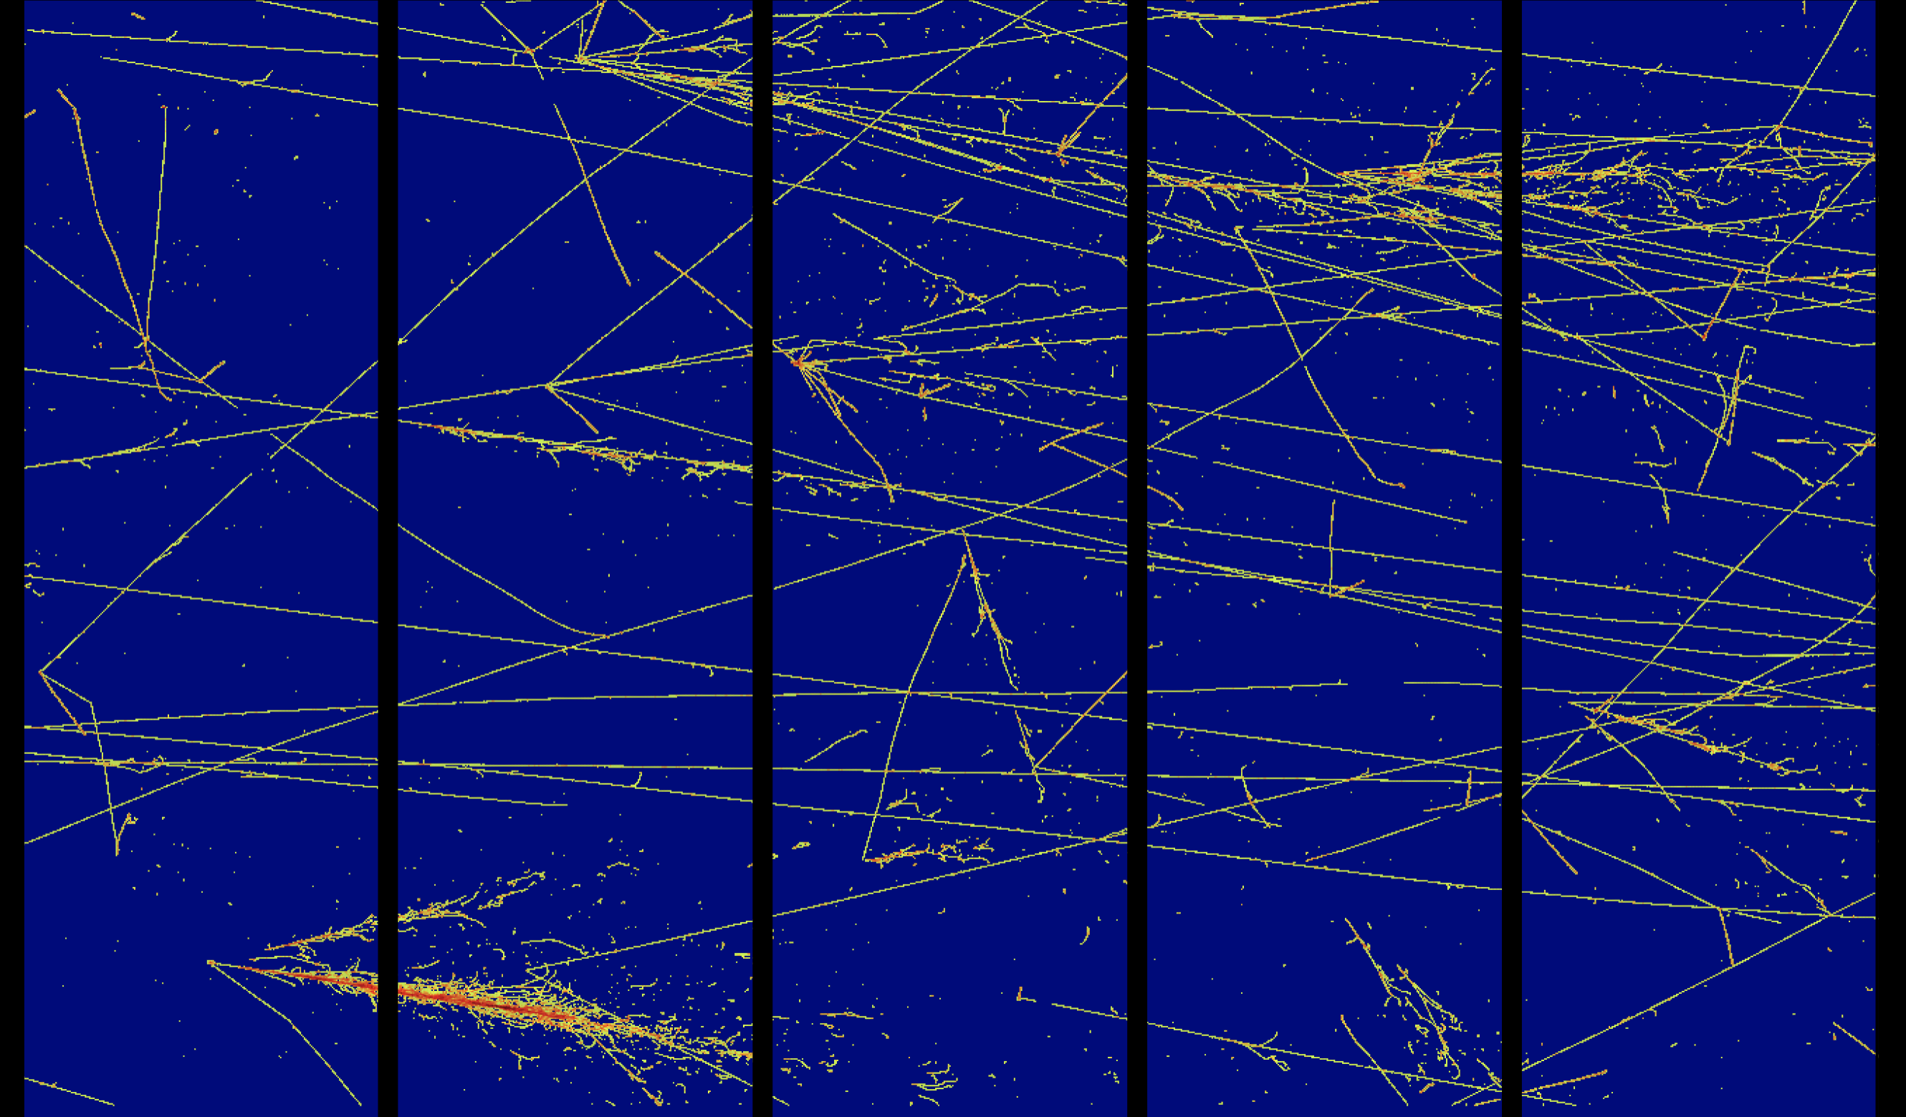

The Modular LArTPC
Design and Prototype for the
DUNE ND
Zoya Vallari
On behalf of the DUNE Collaboration
July 23, 2022
Snowmass Neutrino Frontier
Notes:
Required, exciting and status

Slide 2
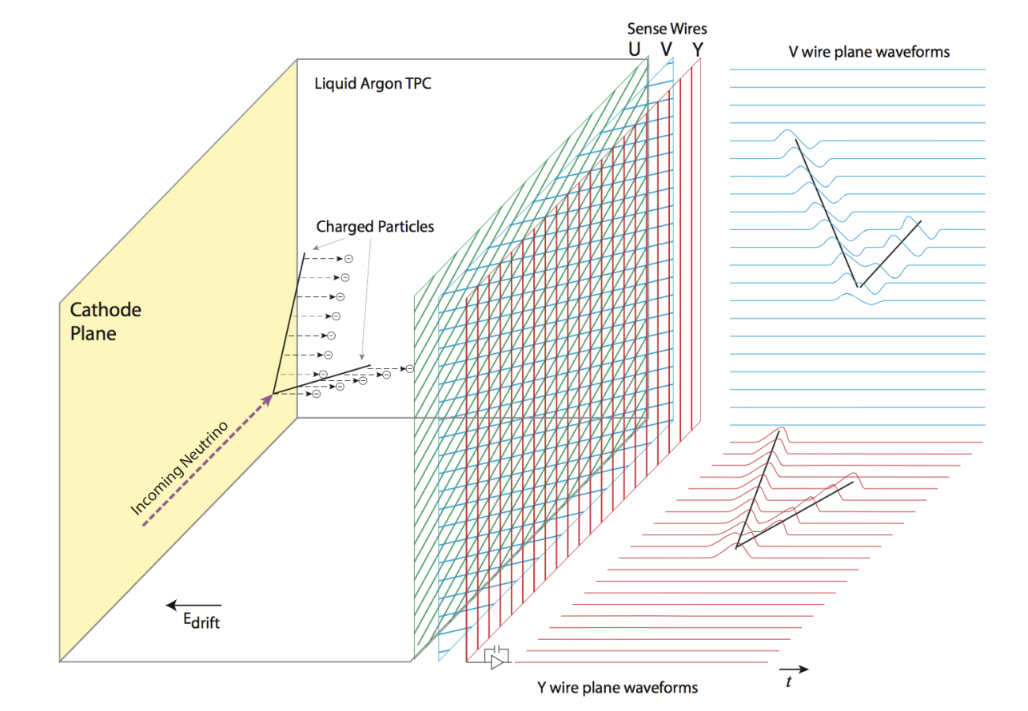
The LArTPC
classical
The Liquid Argon TPCs are fully-active tracking calorimeters.
Neutrino interaction in LAr produces ionization and scintillation light
The ionization charge drifts in a uniform electric field to finely segmented wire planes.
The scintillation light is collected using PMTs.
Notes:
Noble liquids, in general, make great neutrino targets: → dense! → easily ionizable → highly scintillating (provides another detection method!) → If pure => high electron mobility => long drift lengths! → Great dielectric medium => can hold very high voltages

Slide 3
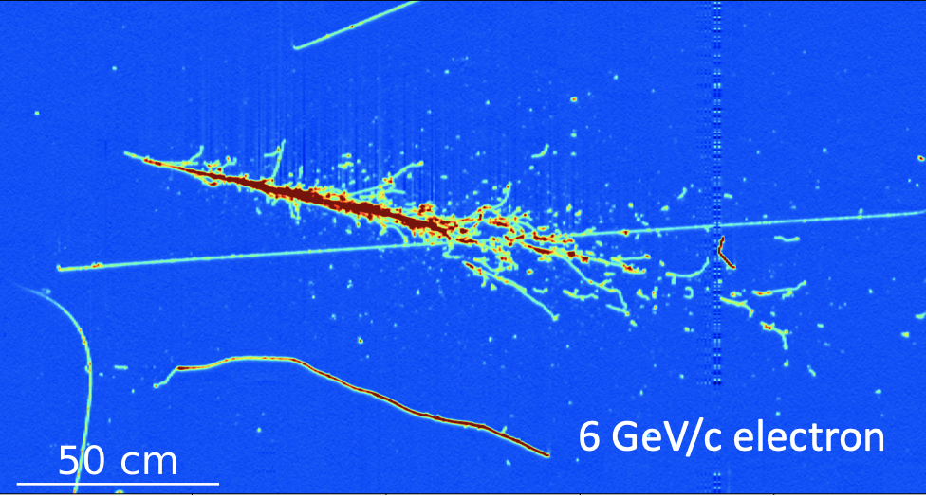
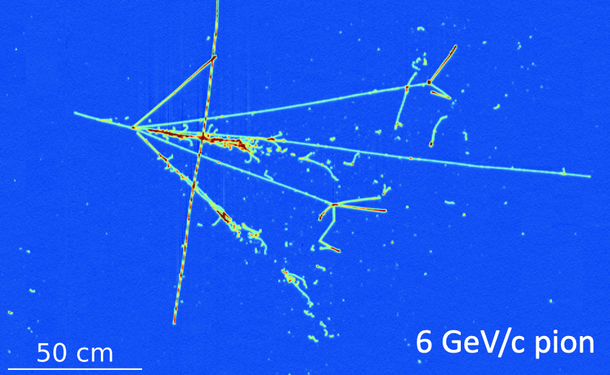
Why LArTPC ?
Excellent spatial and calorimetric resolution provides exceptional capabilities for precision study of neutrinos.
Multiple wire orientations give independent views of the same event.
Scintillation light provides valuable timing information.
LArTPCs provide 3D reconstruction!
ProtoDUNE SP LArTPC Events

Slide 4
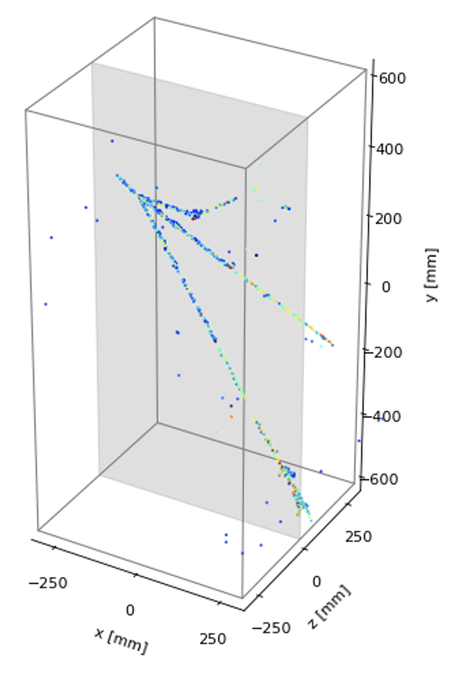
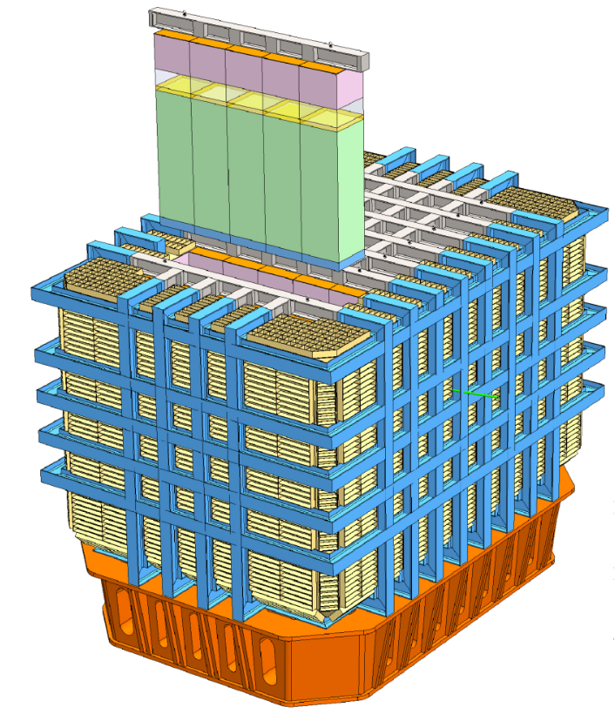
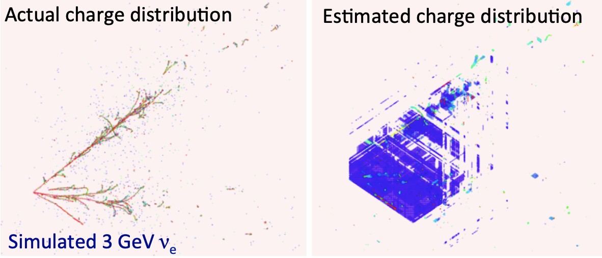
Modular LArTPC
Pixelated
Modular Pixelated LArTPC provides *True 3D imaging*
However, classical TPCs infer 3D reconstruction by combining 2D views.
Ambiguities in projective wire readout aggravate in high multiplicity environment.

Slide 5
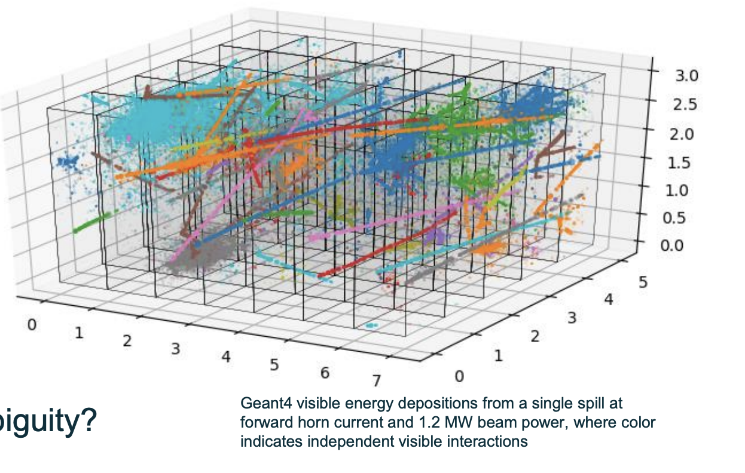
Why Modular LArTPC for DUNE?
Simulation of 1.2 MW LBNF beam spill at DUNE ND
neutrino
beam
Image by B. Russell (LBNL)
G
Geant4 visible energy deposits - color indicates independent visible interactions.

Slide 6



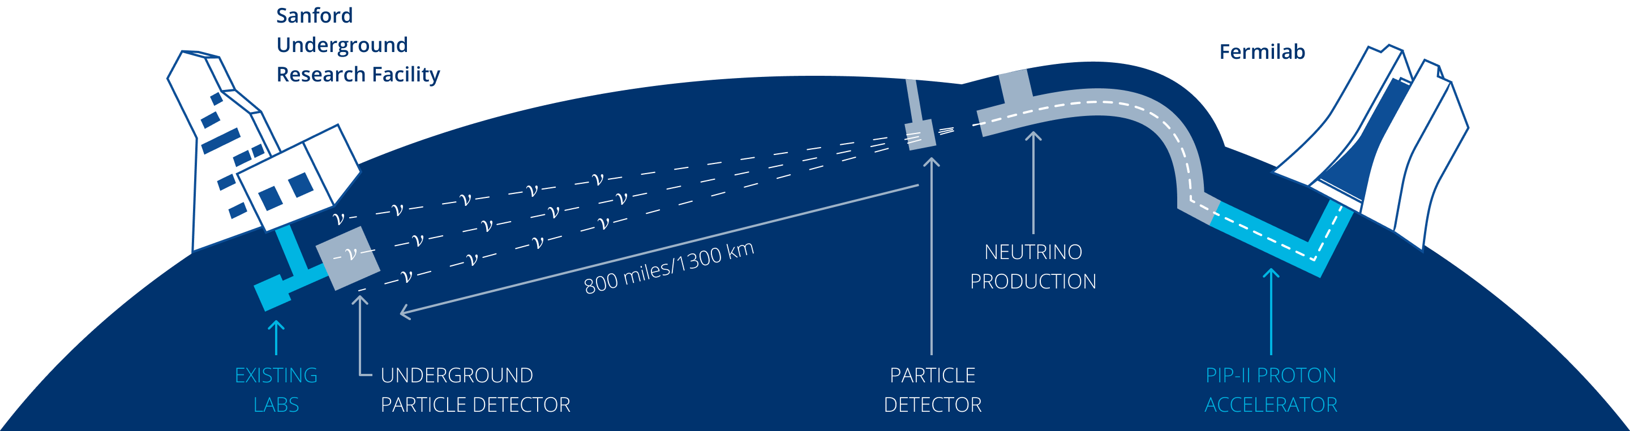
The DUNE Experiment
DUNE Overview @ Snowmass: C. Marshall July18th
DUNE will use the most intense accelerator neutrinos from the LBNF beam and detect them at SURF 1300 kms away. Near Detector (ND) at Fermilab will provide crucial in-situ constraints for measurements at the FD.
NEAR DETECTOR
Event rate
cross-section
oscillation probability
neutrino flux
detector response
Far Detector
FAR DETECTOR
Near Detector
ν? / ν?
ν_{μ} / ν_{μ}
Long baseline O(~100 km)
neutrino beam

Slide 7
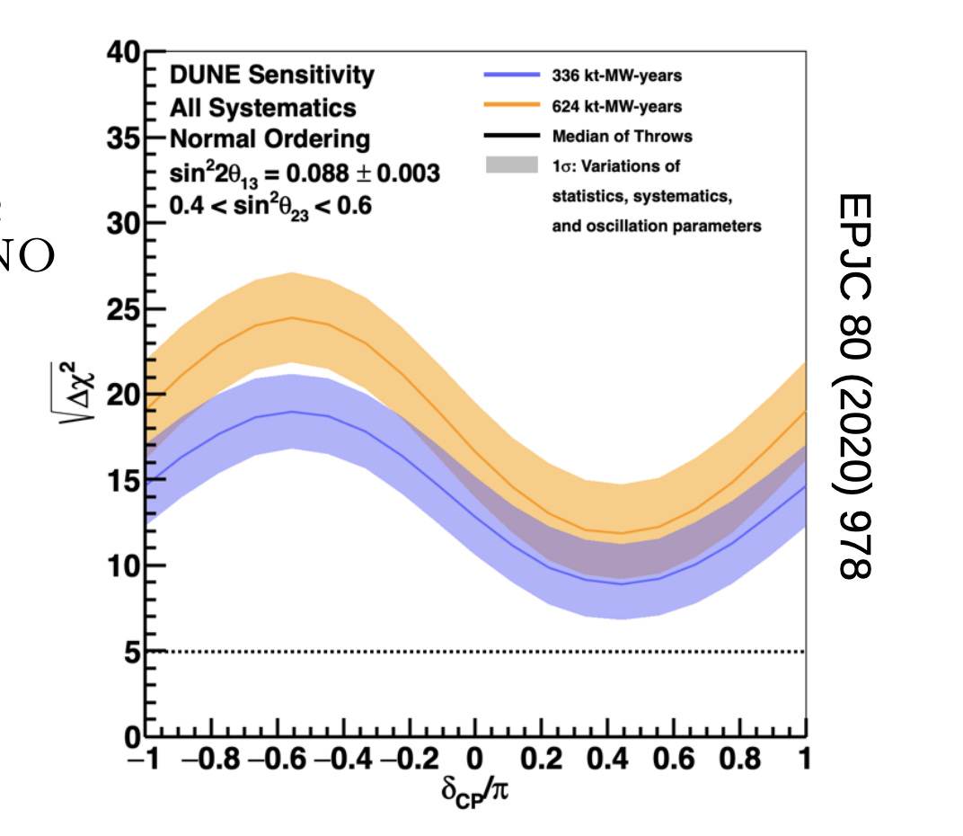
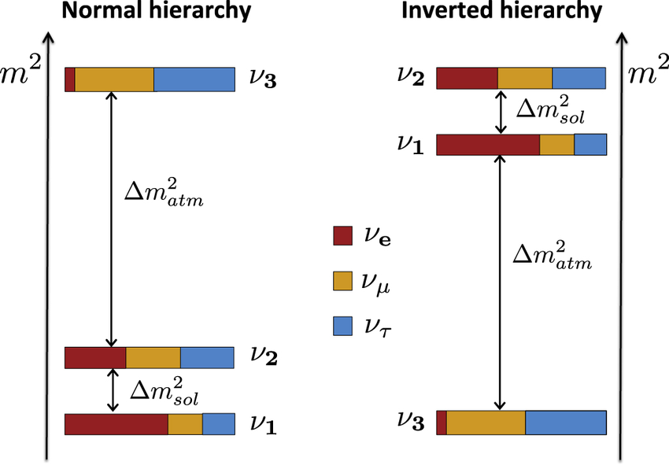
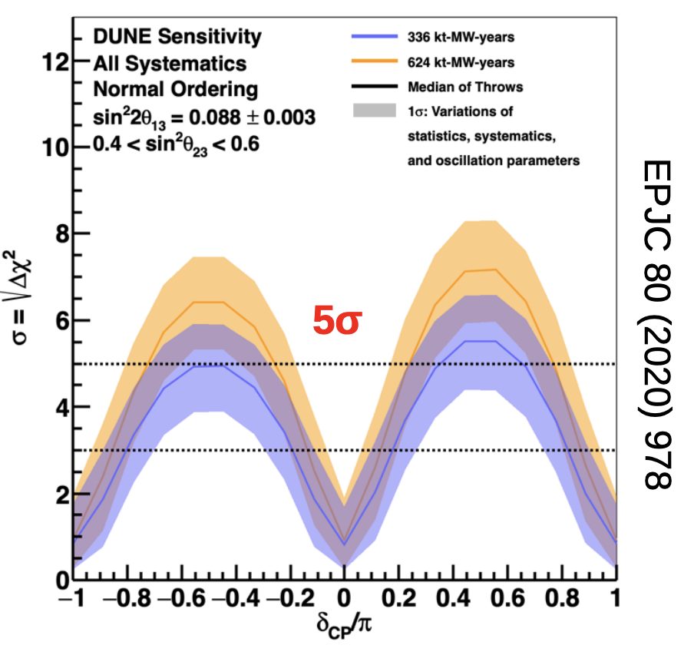

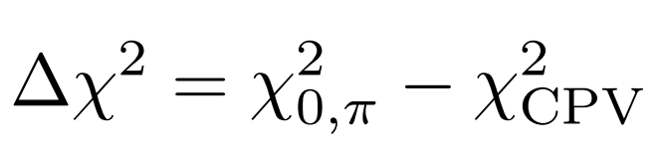
DUNE Physics goals* : Discovery
DUNE Oscillation Overview @ Snowmass: C. Wilkinson July19th
oscillation
?
Normal Ordering
Inverted Ordering
Mass Ordering: Normal or Inverted?
?
δ_{CP}: Do neutrinos violate CP?
*other cool searches for supernova, DSNB, BSM physics and sterile searches not included here!
Notes:
I’ll share the status of where we are currently but I can quite definitively say that we are very well poised to answer these questions in the next decade or so and that makes LBL physics very exciting to me.

Slide 8
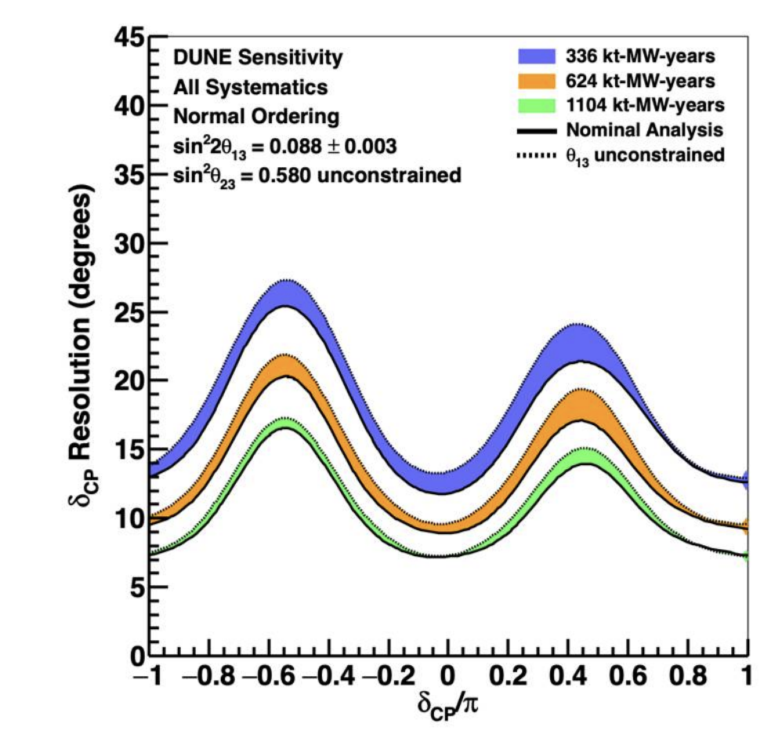
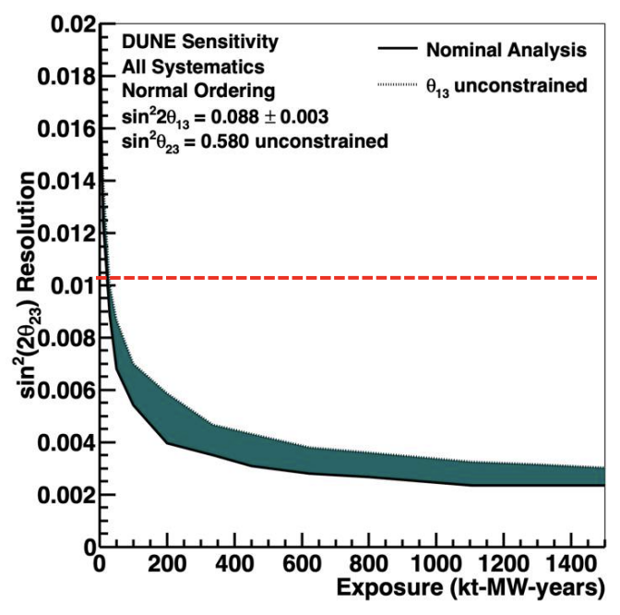

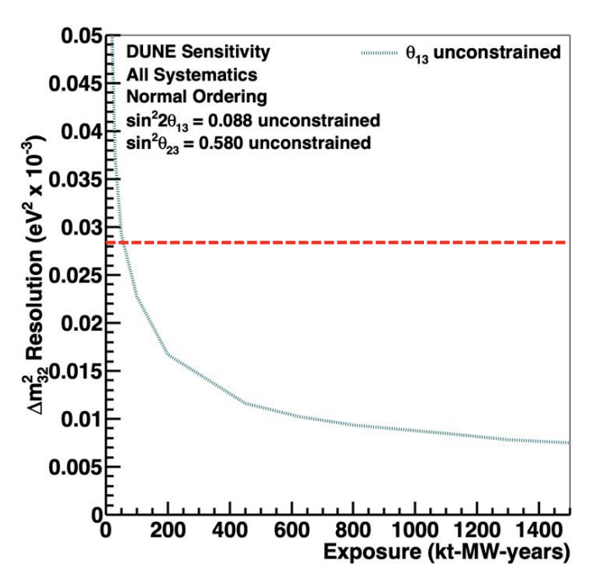
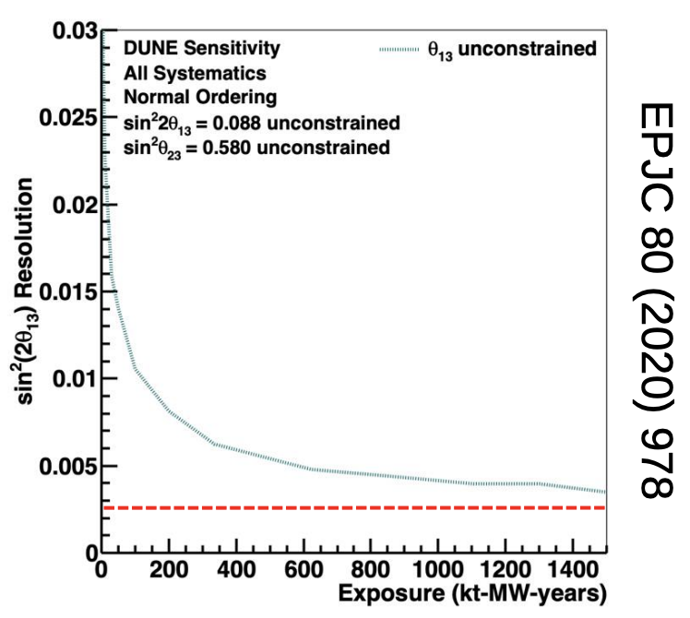
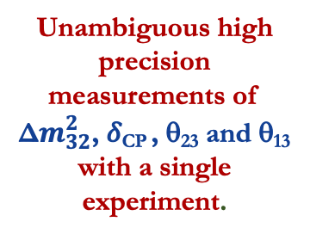
DUNE Physics goals* : Precision
DUNE Oscillation Overview @ Snowmass: C. Wilkinson July19th
oscillation
Unambiguous high precision measurements of Δ$m_{32}^{2}$, 𝛿_{CP} , θ₂₃ and θ₁₃ with a single experiment.
*other cool searches for supernova, DSNB, BSM physics and sterile searches not included here!
Notes:
I’ll share the status of where we are currently but I can quite definitively say that we are very well poised to answer these questions in the next decade or so and that makes LBL physics very exciting to me.

Slide 9
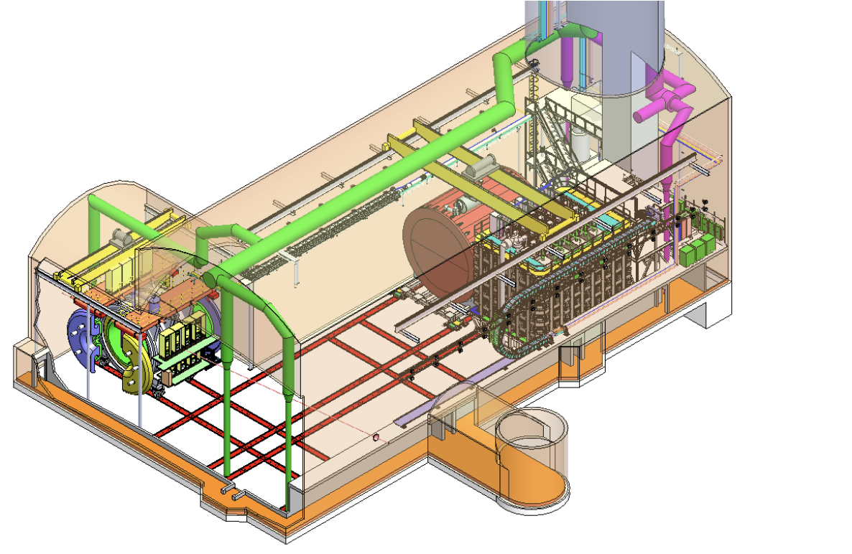
The DUNE ND Overview
Magnetized Temporary Muon Spectrometer (Phase-I) → High Pressure Gas Argon TPC (Phase-II)
DUNE Oscillation Overview @ Snowmass: D. Cherdack July19th
Previous talk by T. Mohayai
ND-LAr
7 x 5 array of modular 1x1x3 m³ LArTPCs with pixel readout and high photodetector coverage.
SAND
System for On-Axis Neutrino Detection
Fixed On-axis magnetized beam spectrum monitor
Beam
axis
✨ This talk ✨
Next talk by Z. Ghorbanimoghaddam
PRISM
System for moving the LArTPC + muon tracker up to 30m transverse to the beam direction to enable scans of beam at multiple off-axis positions

Slide 10

The Near Detector
Objective: Predict the observed neutrino spectrum at the FD
Requirements
Measurements transferable to the FD
Constrain the cross-section model
Measure the neutrino flux
Obtain measurement with different fluxes
Monitor time variations of the neutrino beam
Operate in high-rate environment
Never go on a long baseline adventure without a near detector – Anonymous.
arXiv 2103:13910 DUNE ND CDR

Slide 11


ND-LAr Report Card
Objective: Predict the observed neutrino spectrum at the FD
Requirements
Measurements transferable to the FD
Constrain the cross-section model
Measure the neutrino flux
Obtain measurement with different fluxes
Monitor time variations of the neutrino beam
Operate in high-rate environment
ND-GAr
PRISM
SAND
arXiv 2103:13910 DUNE ND CDR

Slide 12
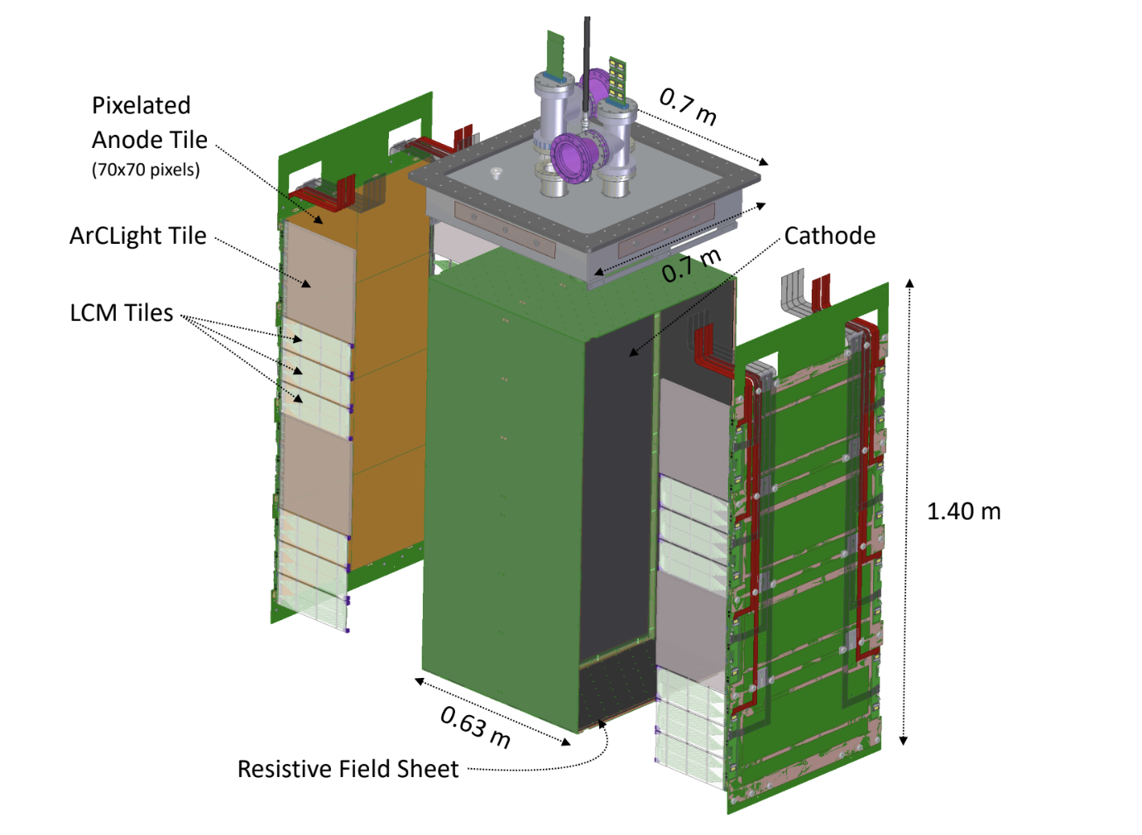
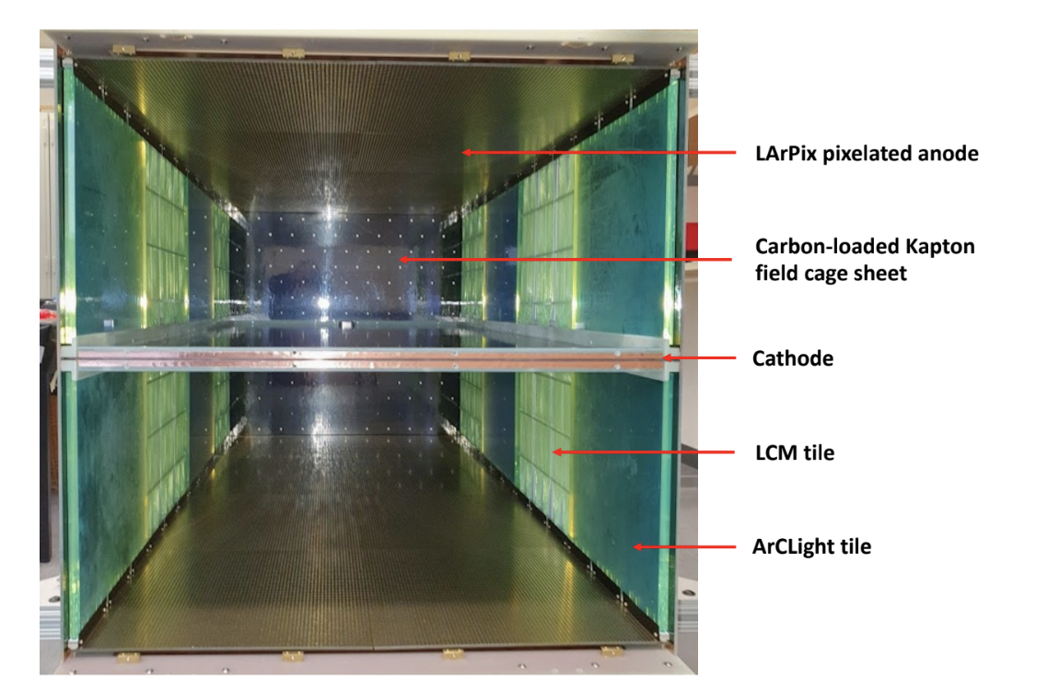
ND-LAr Design
Key Features:
Pixelated charge readout
High photodetector coverage with a large are dielectric photon detection system
Highly resistive foil for electric field shaping
Modular design provides optical segmentation
Top-down view of the module prototype
60%-scale module prototype
ND-LAr Design :
Active size: 5m deep, 7m wide and 3m tall
5 x 7 hermetic TPC modules – 1m x 1m x 3m
Short drift (50 cm)
Minimal inactive material with density similar to LAr

Slide 13
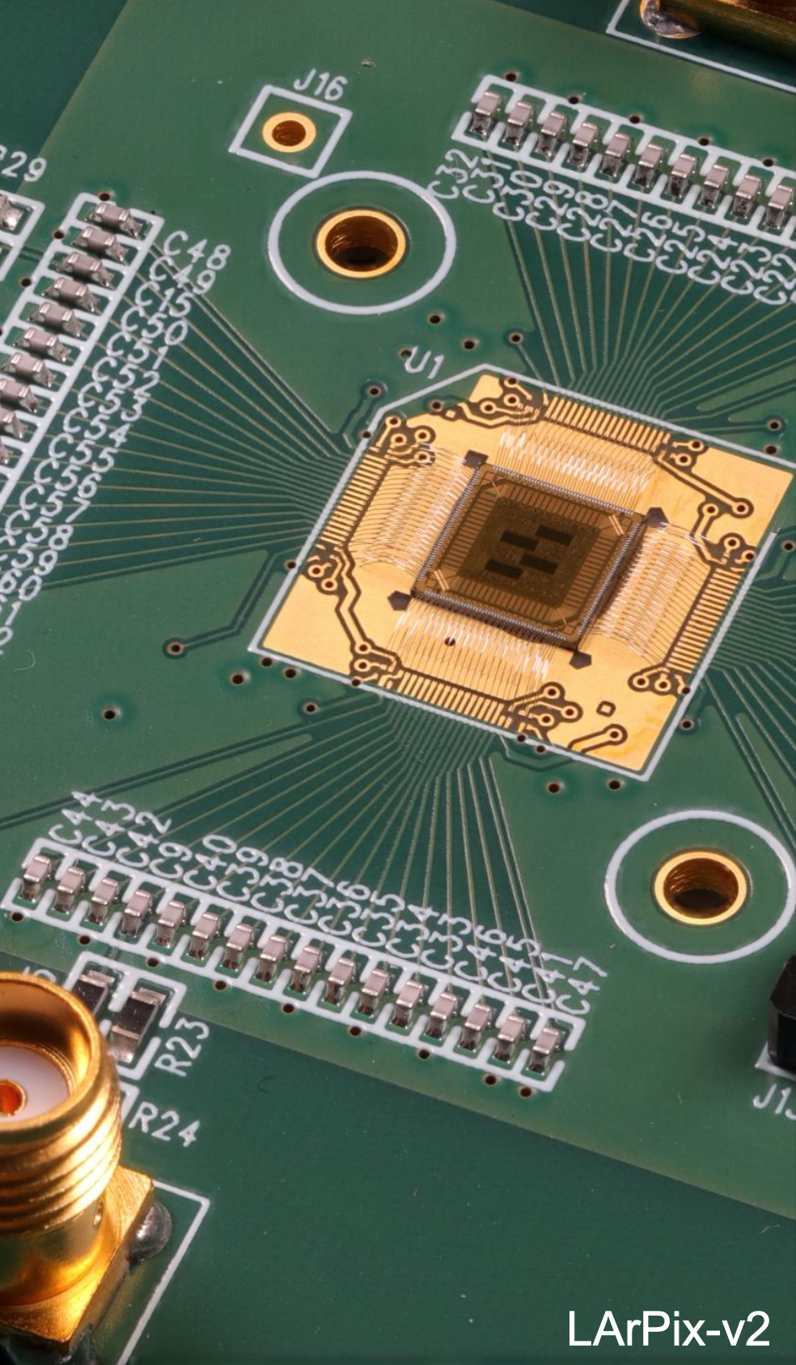
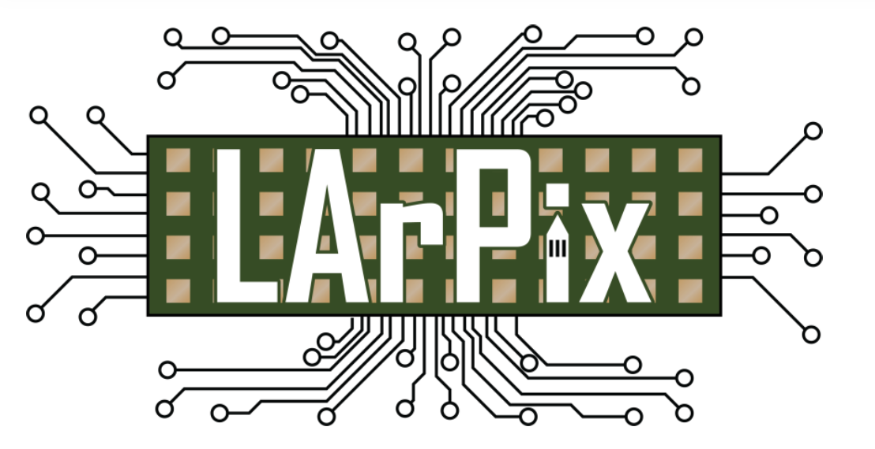
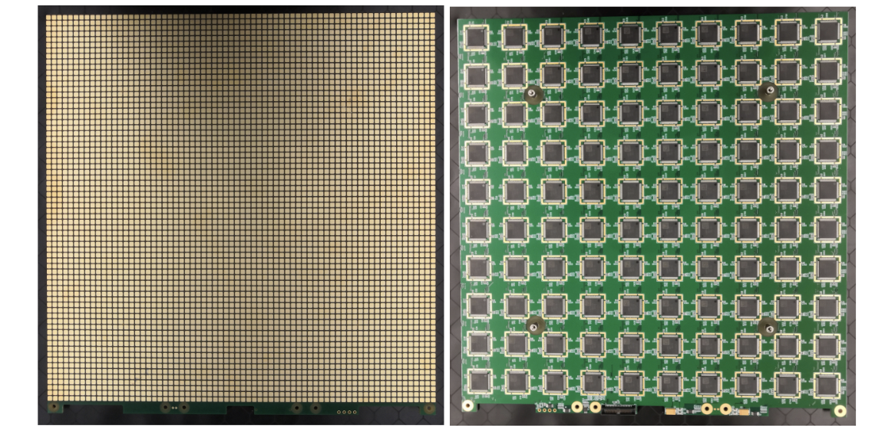

Pixelated Charge Readout
Provides unambiguous 3D tracking of charged particles crossing a LArTPC.
Low-power, low-noise integrating amplifier with self-triggered digitization and readout
Charge stays on pixel until digitization and/or reset
Always active – continuous self-triggering
LArPix-v2a ASIC
LArTPC Pixelated Readout @ Snowmass: B. Russell July 20th
Dan Dwyer et al. JINST 13 (2018) P10007
LArPix Pixel tile
• 32 cm x 32 cm large-format mixed signal PCB
• 100 LArPix-v2a ASICs/tile
• 4900 pixel pads with 4.4 mm pixel pitch
LArPix Pixel tile with pixel pads(front) and ASICS(back)

Slide 14
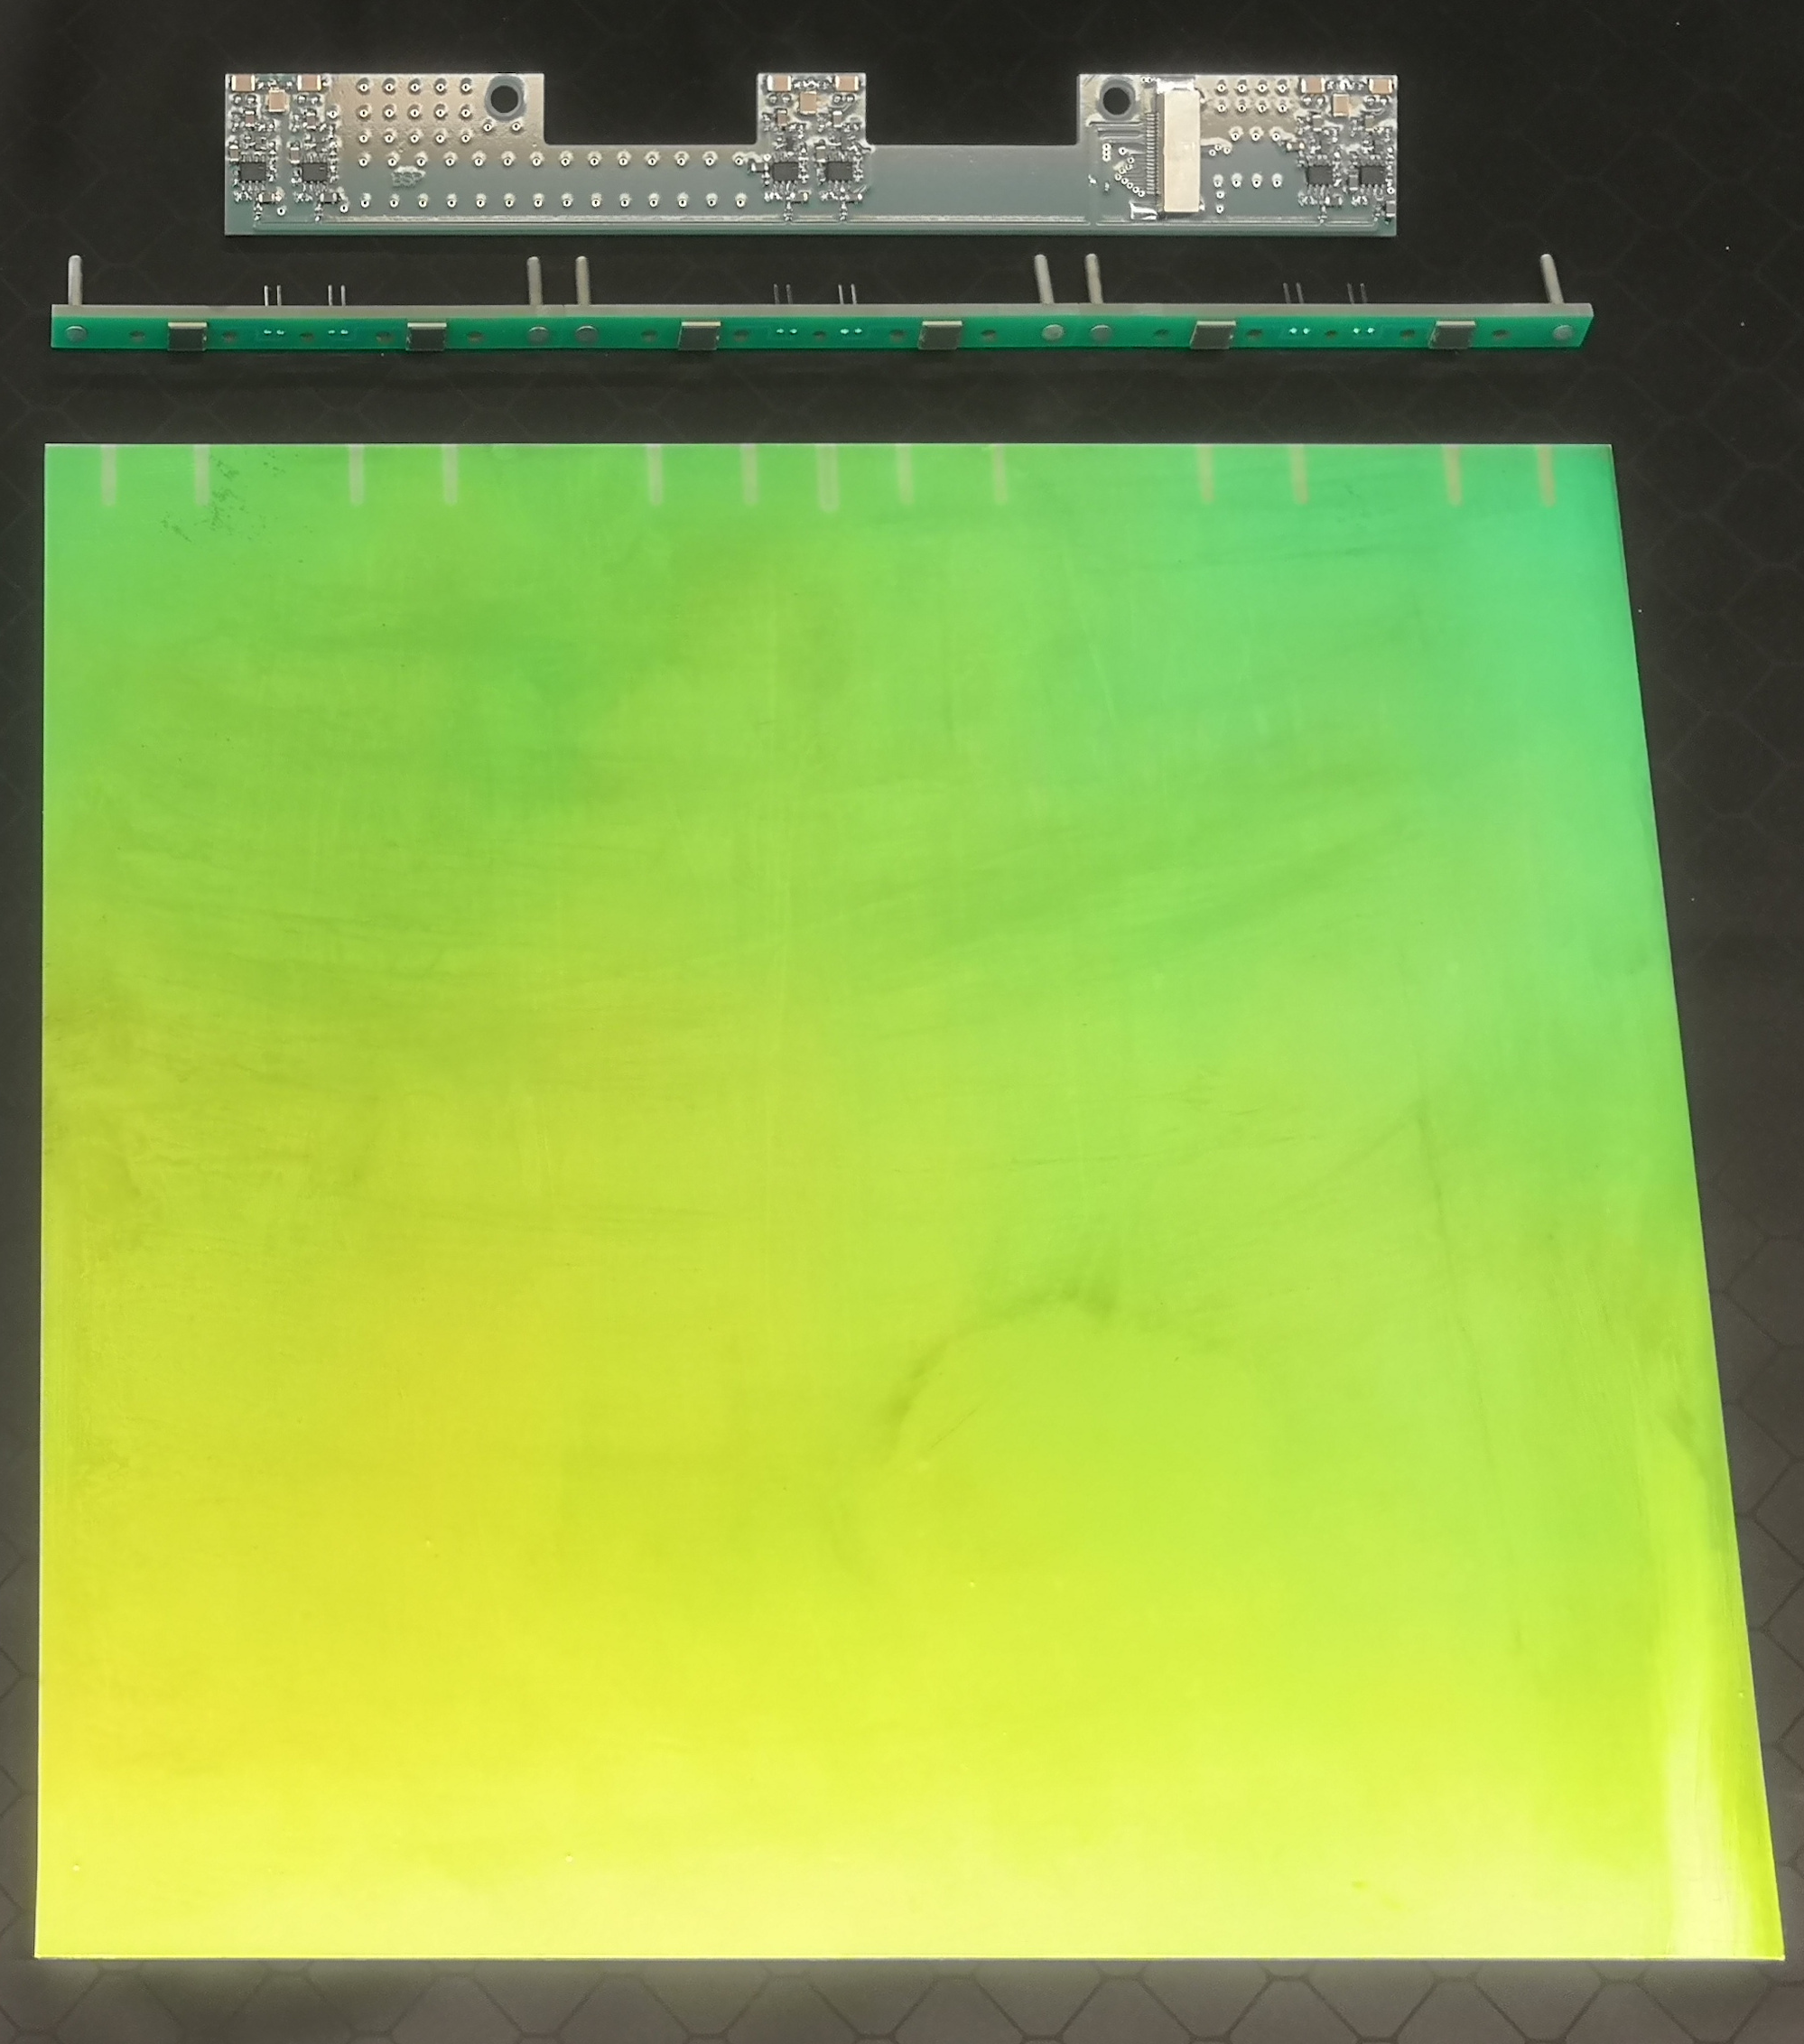
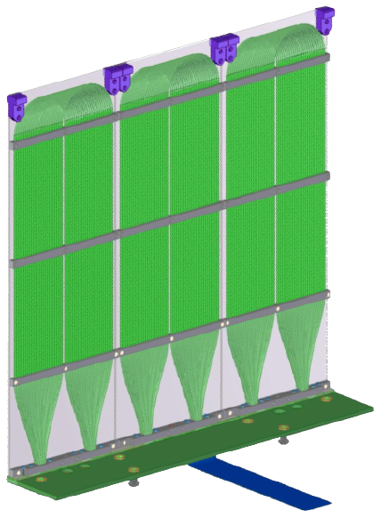
Light Readout System
ArCLight Tiles
LAr produces scintillation light of wavelength ~128 nm.
The TPC needs a high-performance light detection system with:
  High coverage with a dynamic range
  Fast readout to provide precise spatial resolution
  Capability to operate in high-rate environment
LCM Tiles
Notes:
Argon is highly transparent to its own scintillation light. Both ArCLight (Argon Cube Light) detection modules and LCM (Light Collection Modules) are dielectric light traps with optically coupled SiPMs (Silicon Photomultipliers) for the light detection.
Both are coated with a thin layer of TPB (Tetraphenyl butadiene) that acts as a wavelength shifter, shifting the UV scintillation light to blue light

Slide 15
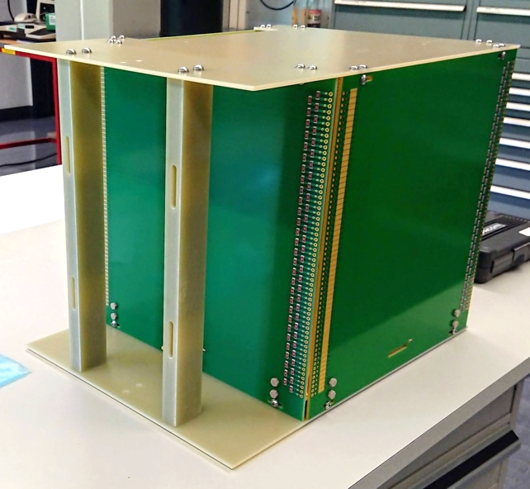
Timeline of Technical Demonstrations
Resistive Shell
Charge readout
2018-2020
Demonstration of individual novel technologies
2020
Single cube prototypes: first combined test of charge readout and light readout systems
2021-2022
Single modules : Ton-scale, fully-integrated prototype of ND-LAr module (Next Slides)
2022-2023
2x2 demonstrator from four single modules in the neutrino beam at Fermilab: ProtoDUNE ND (discussed ahead!)
Light readout
Single Cube

Slide 16
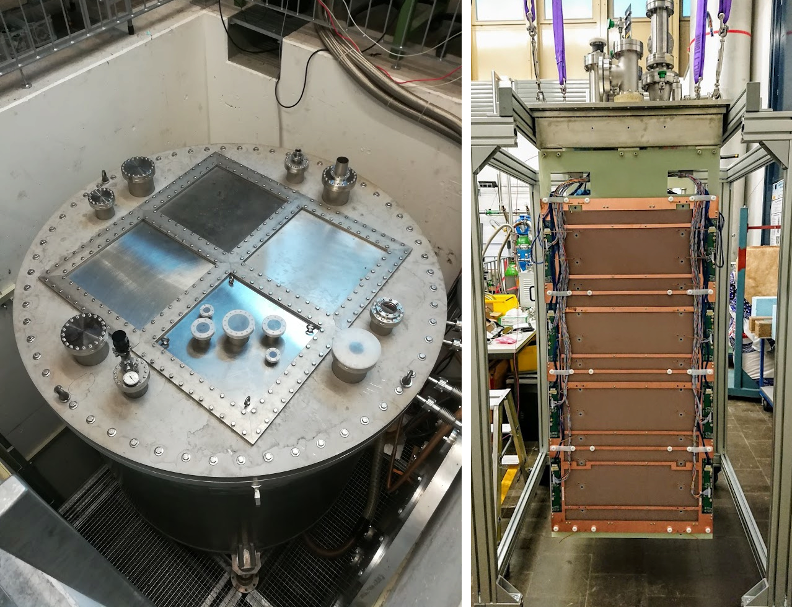
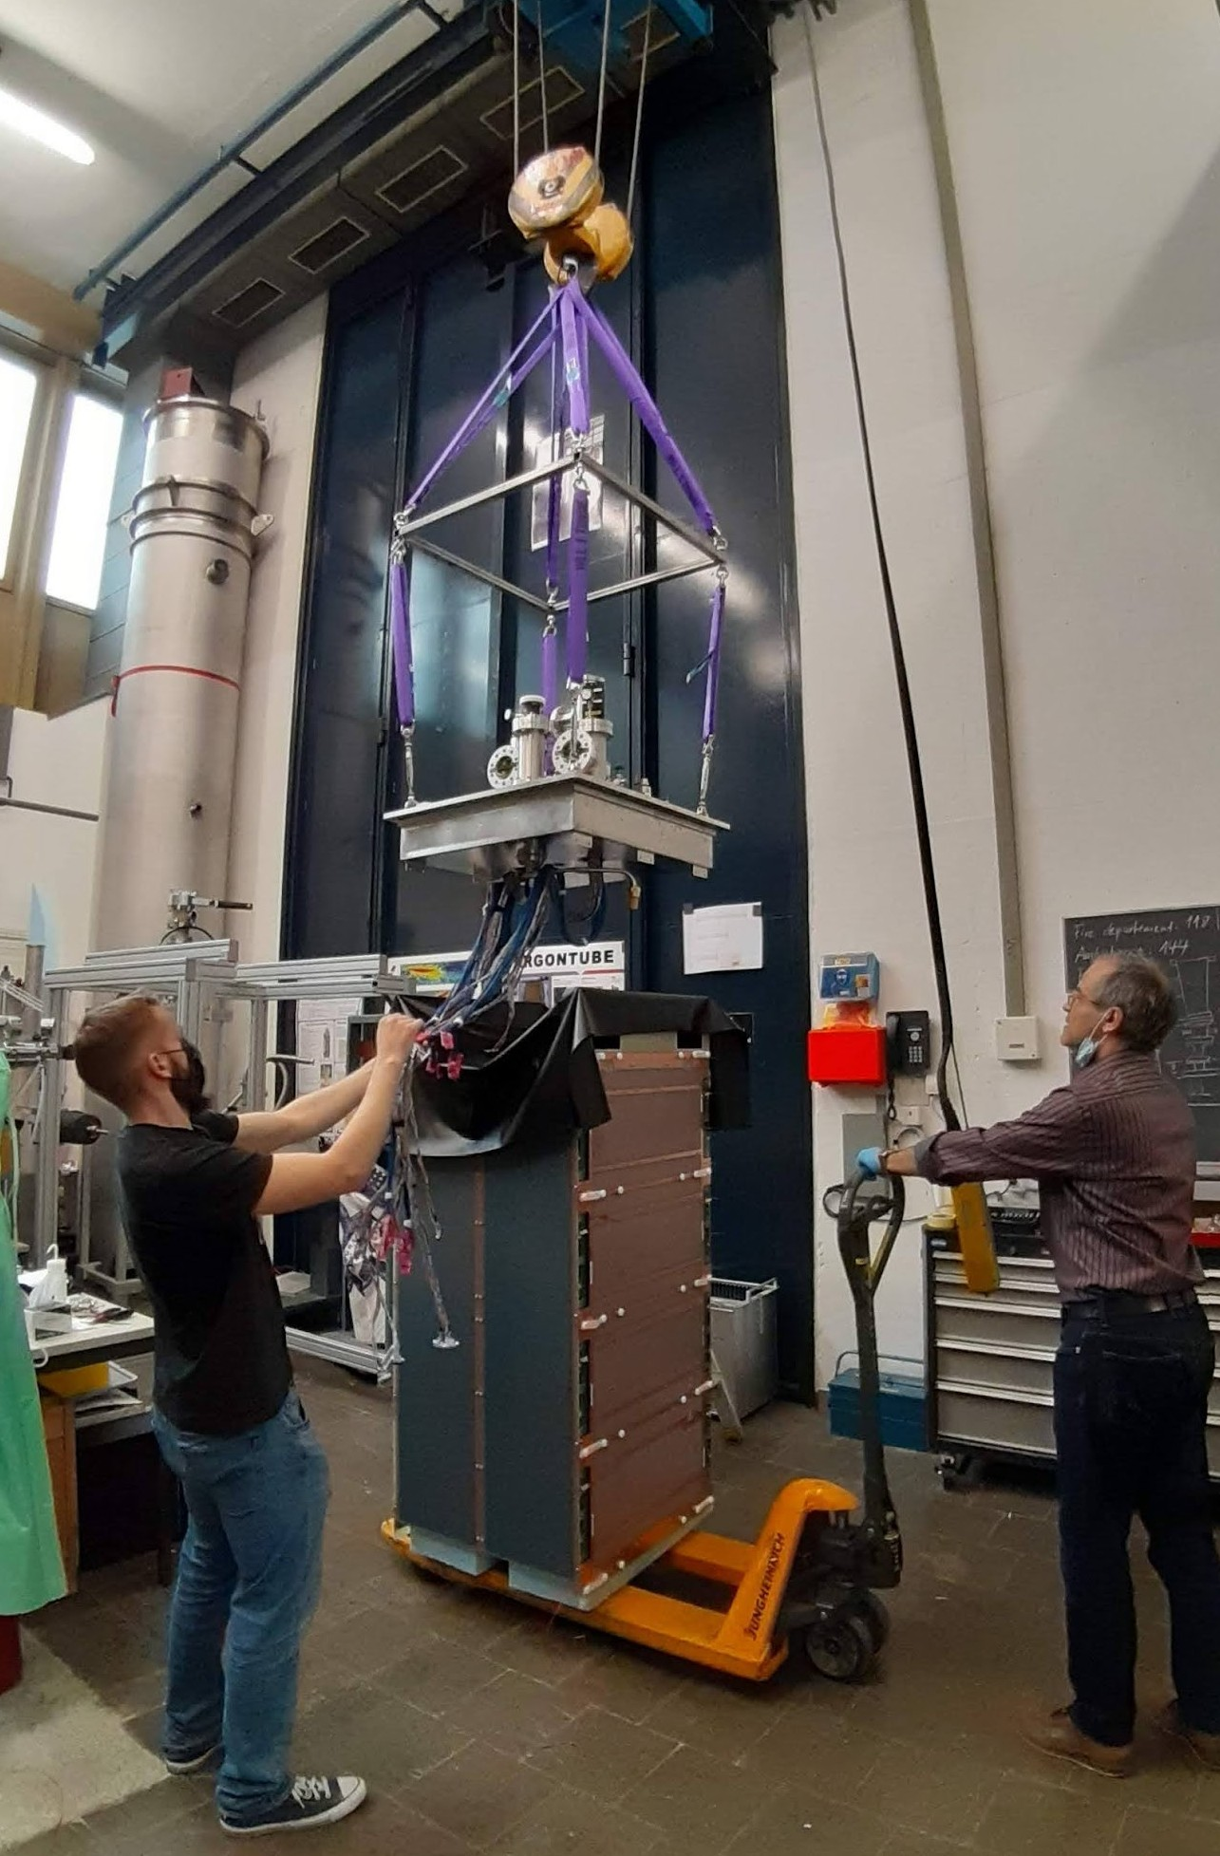
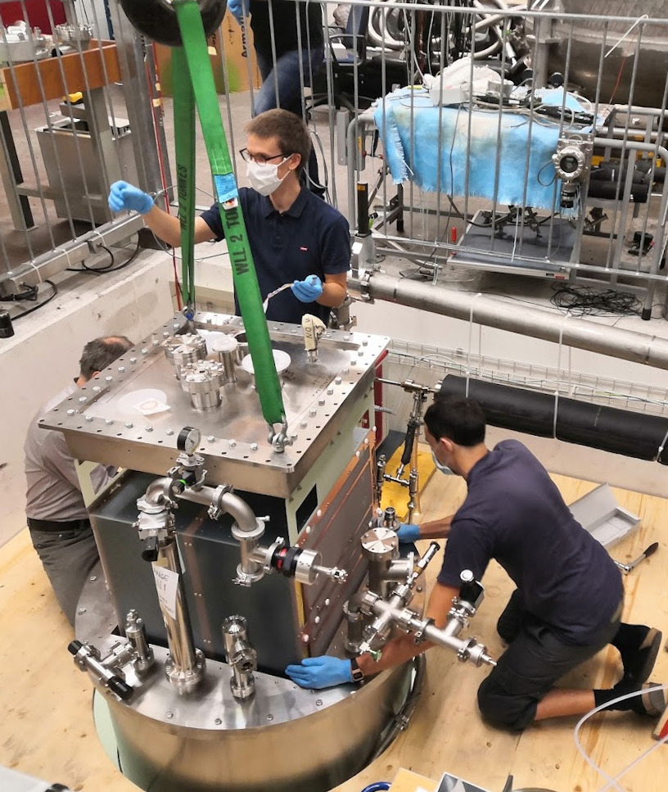
Single Module Demos @ BERN
4 individual fully integrated, ton-scale LAr Modules are being tested at Bern at cryogenic temperatures.
Collected data from O(~100M) cosmic ray induced events during Module-0 and Module-1 runs.

Slide 17
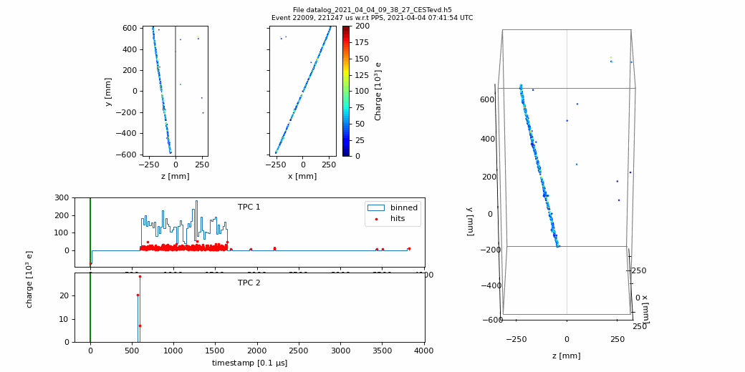
Single Module Demos @ BERN
Through-going muon track

Slide 18
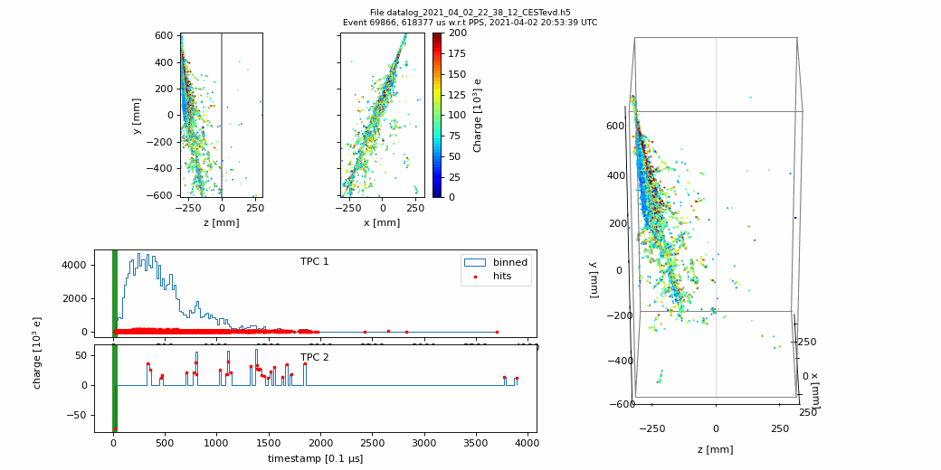
Single Module Demos @ BERN
Shower event caused by very high-energy mons

Slide 19
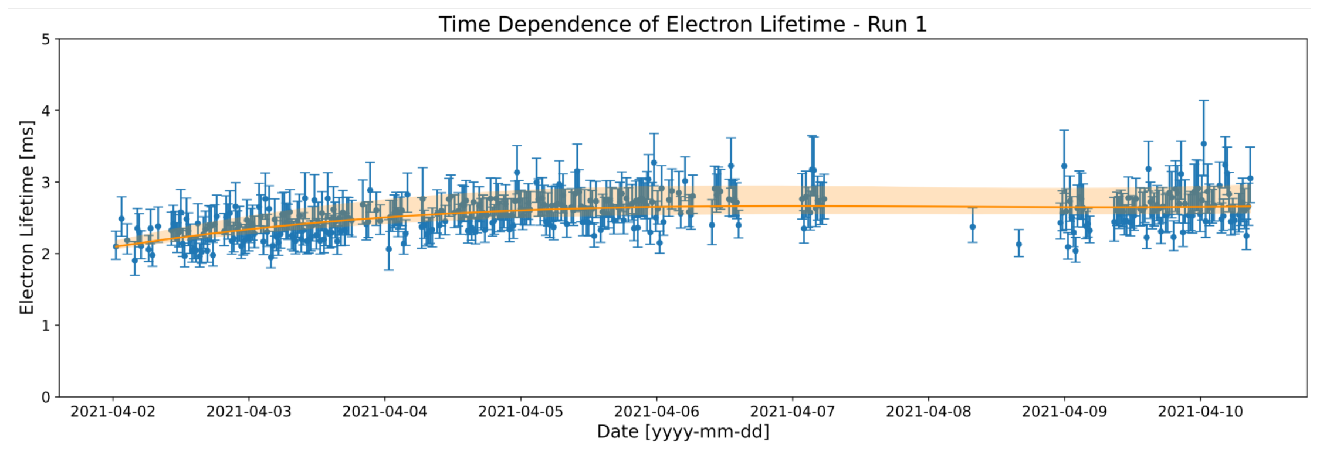
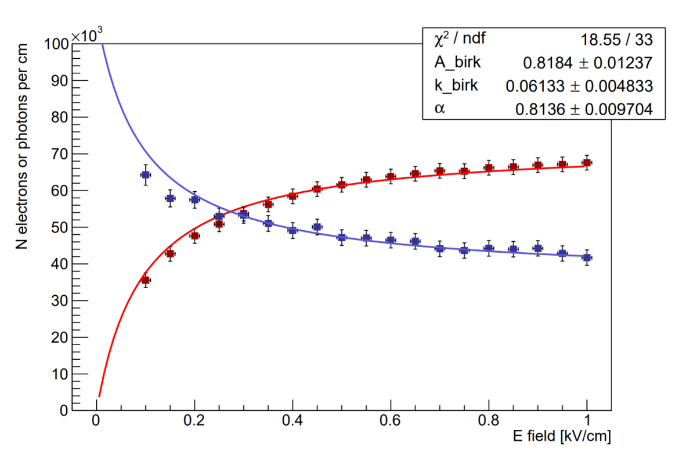
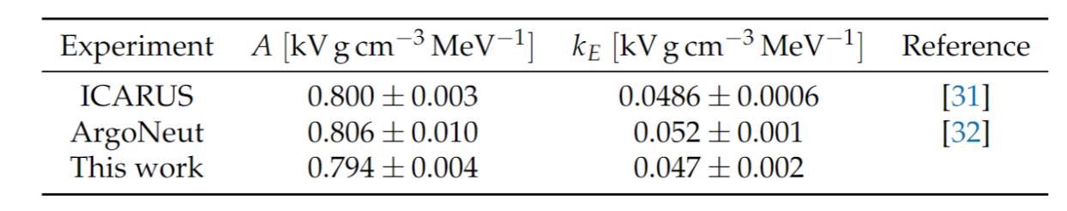
Single Module Demos @ BERN
PRELIMINARY
With high statistics data, Module-0 is already producing competitive measurements.
  Simultaneous fit of charge and light yield gives measurements that are consistent with ICARUS and ArgoNeut.
Publication on Module-0 data analysis is in preparation: ”Performance of a modular ton-scale pixel-readout liquid argon Time Projection Chamber”.
PRELIMINARY
✨ Coming Soon ✨
Notes:
Measurement of electron-lifetime at a drift electric field of 500 V/cm of >2ms surpasses the 0.5ms threshold requirement for ND-LAr and shows stable purity.
Simultaneous fit of charge yield and light yields from vertical through-going cosmic muon tracks measured at varying electric field gives a measurement of parameters of Birk’s recombination model.

Slide 20
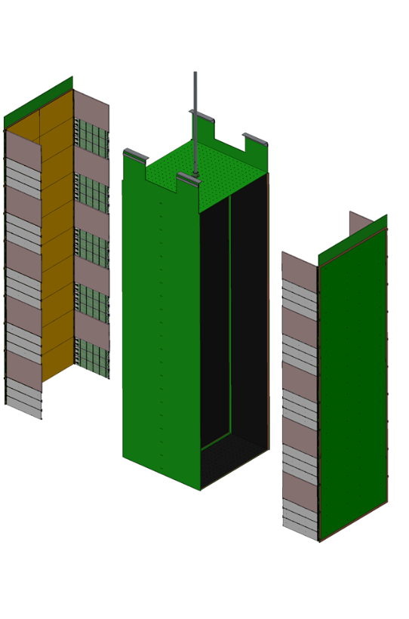
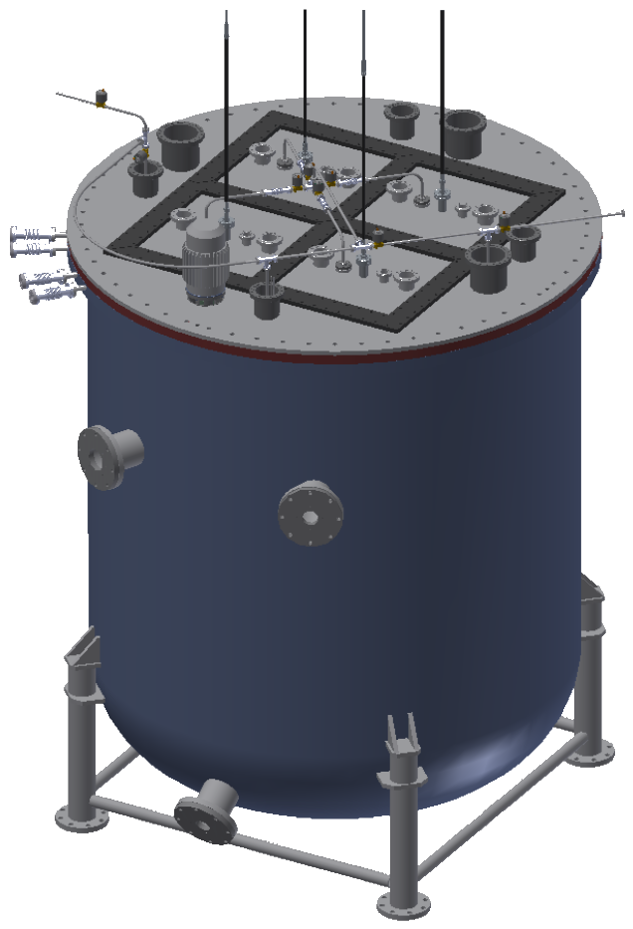
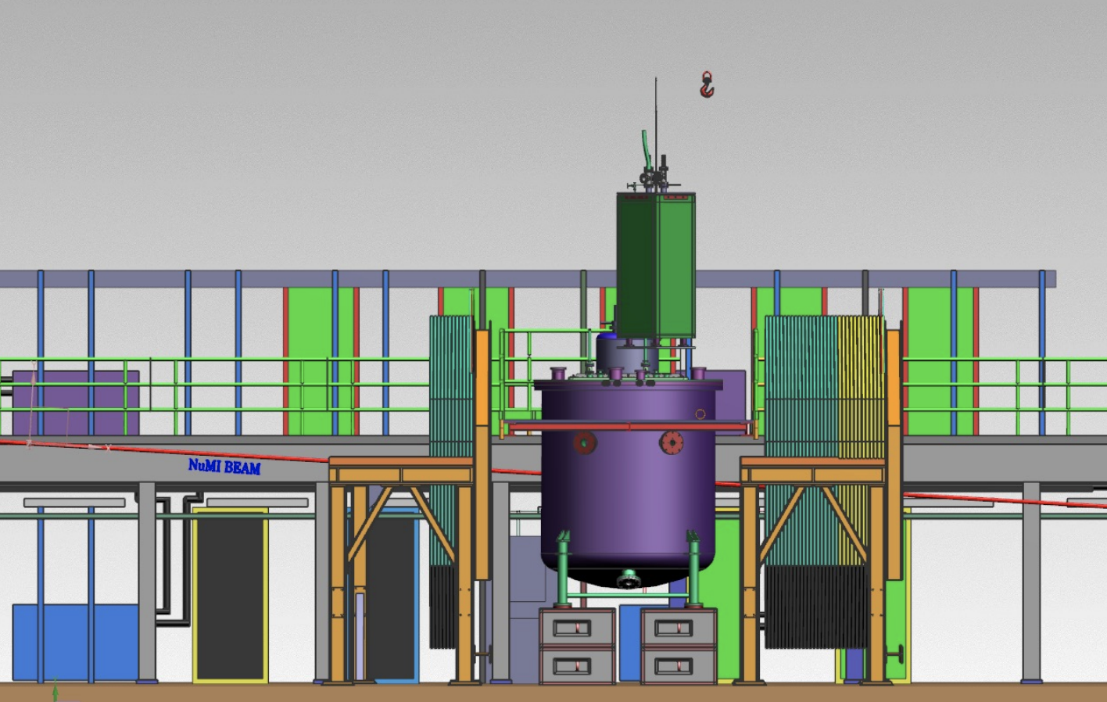
2x2 Demonstrator : Fermilab
All 4 LArTPC modules will be assembled as a prototype modular detector with repurposed scintillator planes from Minerva providing additional tracking.
A run in the NuMI beam would provide the first neutrino beam run with comparable intensity to the LBNF beam.
x 4
MINOS Underground Cavern
Scintillator planes
2x2 Cryostat
ND-LAr Module
2x2 Cryostat
NuMI Beam

Slide 21
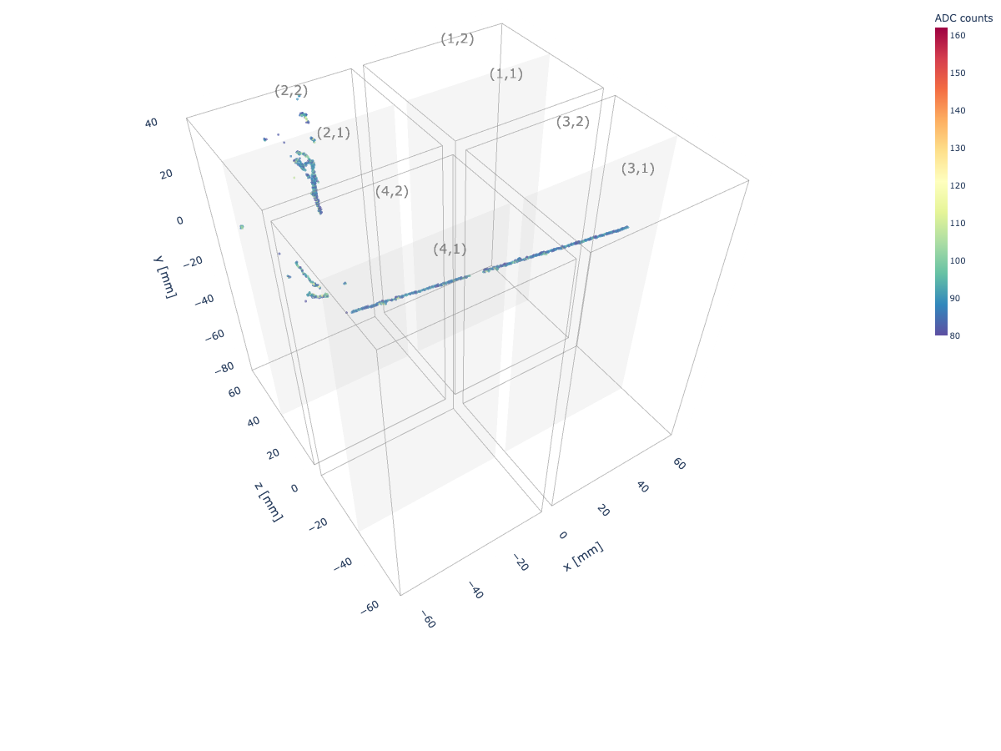
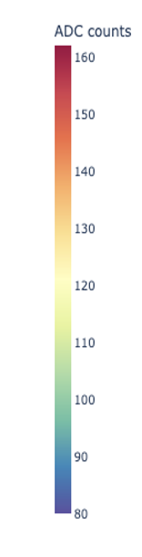
2x2 Demonstrator : Fermilab
Goals:
  Integration and installation of modules in a cohesive detector.
  Operations protocol for underground operations.
  Neutrino signal identifications and reconstruction.
  Understanding detector performance with pile-up in a neutrino beam.
Status:
  Module-0 and Module-1 are undergoing rigorous acceptance and checkout tests at Fermilab.
  Module-2 and Module-3 will be assembled and shipped from Bern over the next couple of months.
  On-schedule for a run in 2022 - 2023.
Simulation of a neutrino event producing muon and EM shower in 2x2 demonstrator

Slide 22
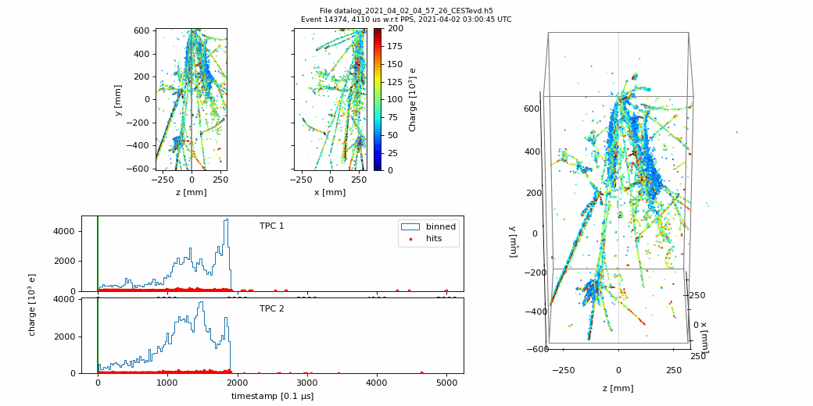
Summary
DUNE is the next generation precision neutrino experiment with discovery potential for CP violation in leptons and neutrino mass ordering.
ND will provide critical constraints to neutrino flux and cross-sections at the FD.
A Modular-LArTPC is needed to tolerate the extremely high event rate at the DUNE ND.
Novel technologies designed for DUNE ND-LAr have been demonstrated to work successfully in a single module.
ProtoDUNE-ND (2x2 demonstrator) is currently being assembled and a run in NuMI neutrino beam is coming up soon!
Provides exciting new physics opportunities to the community both short and long-term!

Slide 23
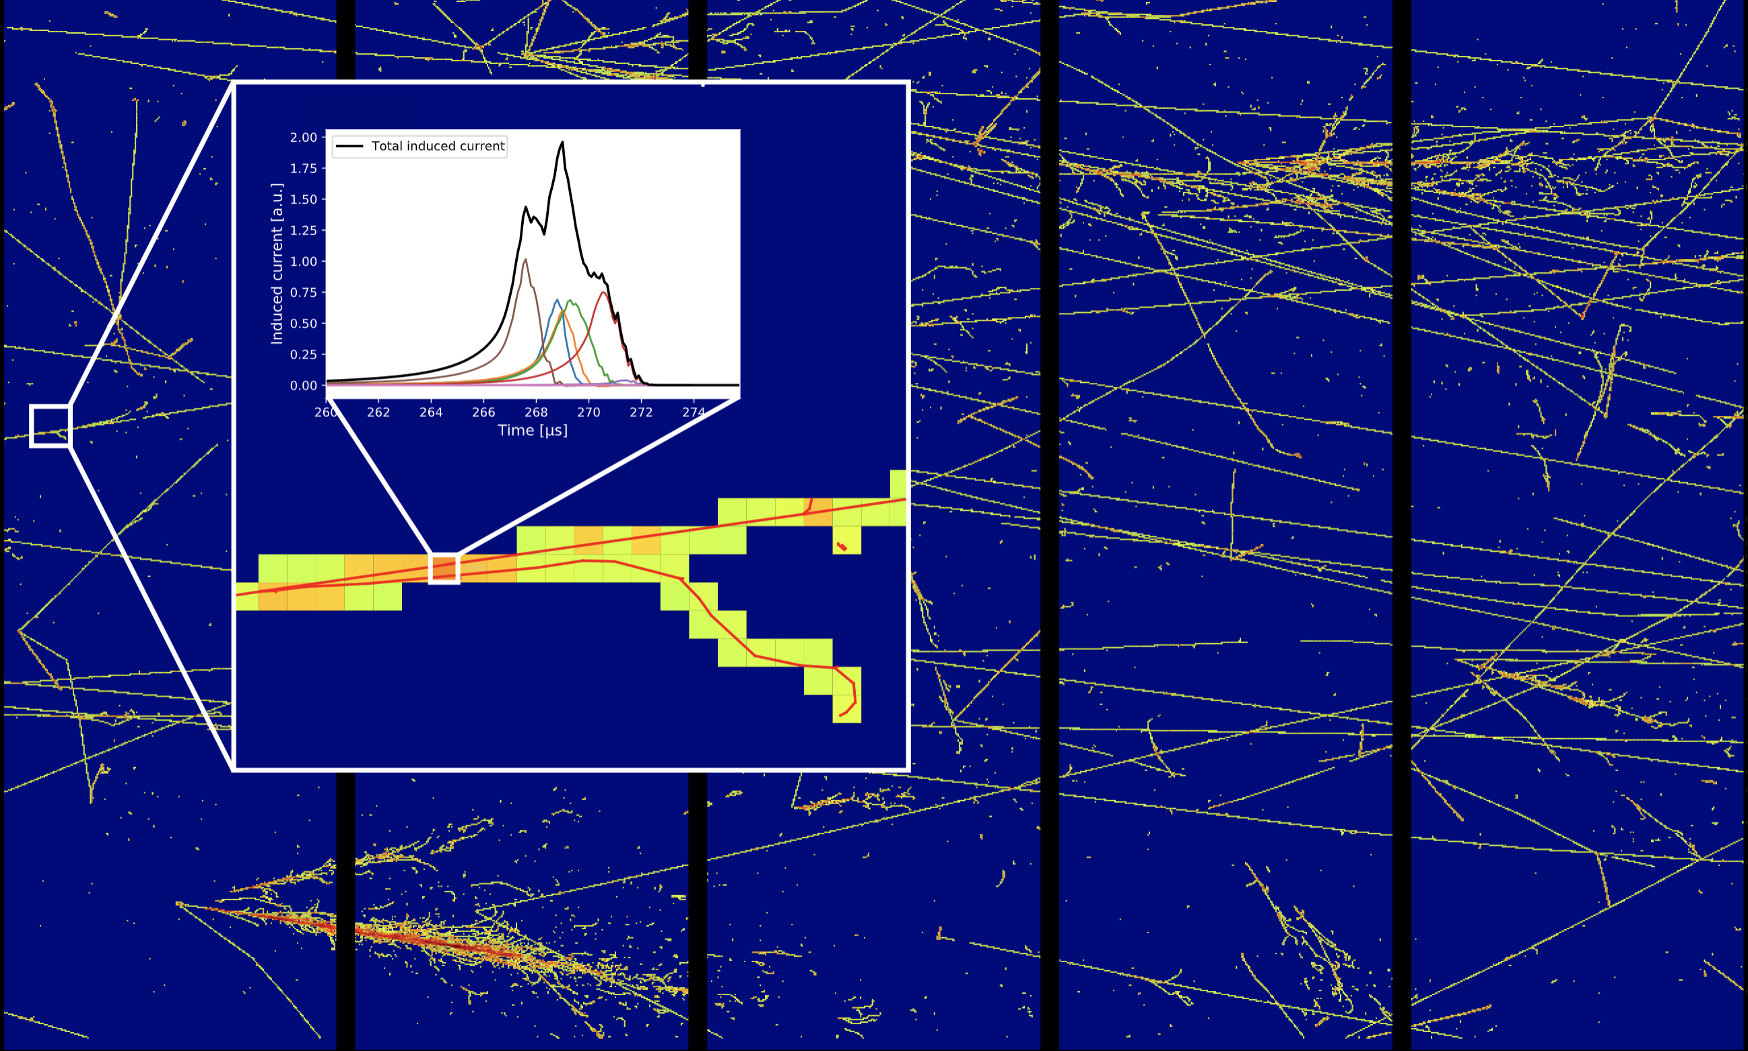
Thank You!
Image by R. Soleti (LBNL)
Measuring neutrino interactions pixel-by-pixel!

