Slide 1
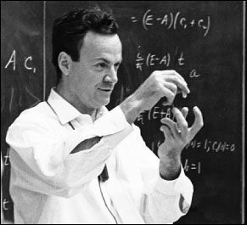
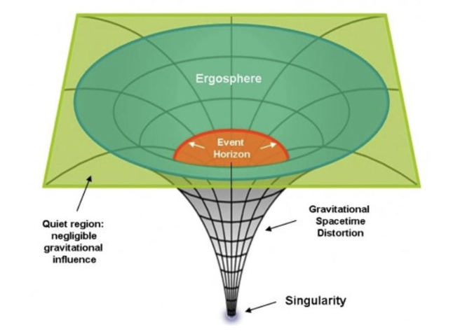
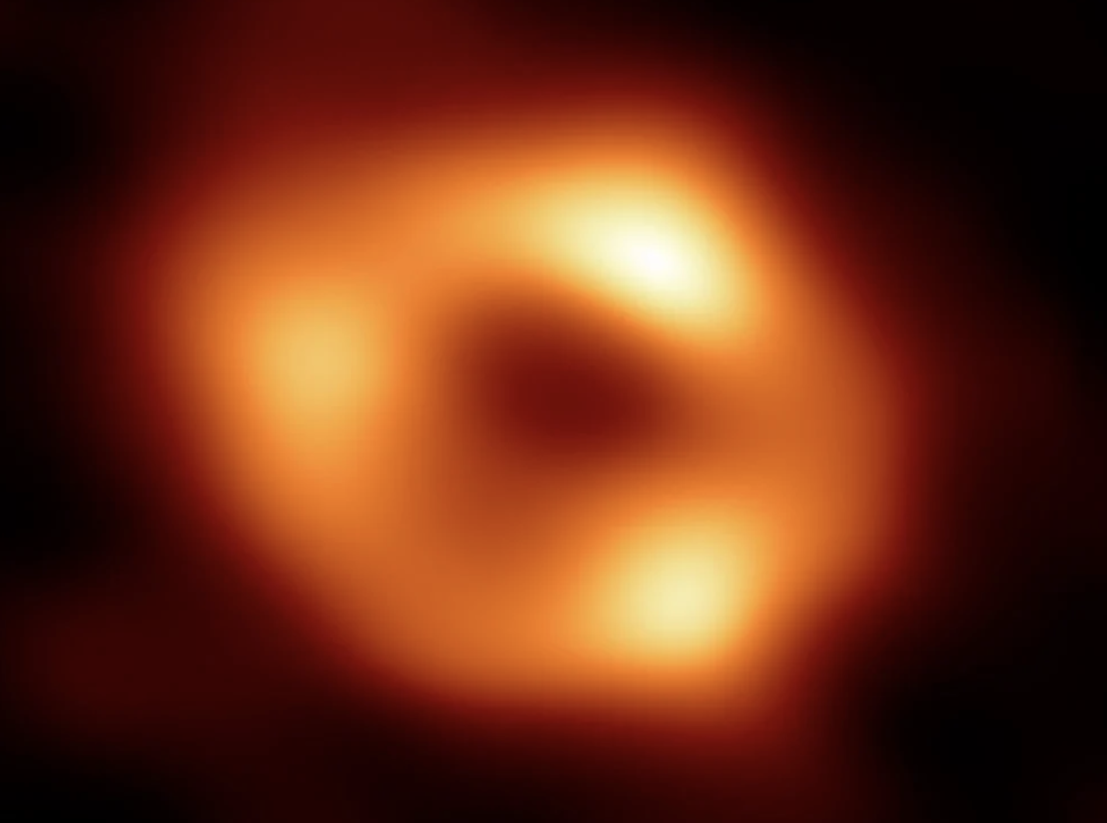
HEP/QST Landscape: Foundations
The origins of quantum science & technology arose from scientists confronting challenges in particle physics/gravity:
quantum computing/simulation (Feynman 1981)
quantum sensors/metrology (Heisenberg 1927, Caves 1981)
quantum communications/entanglement (Einstein-Podolsky-Rosen, 1935, Hawking 1976)
The HEP community continues to have large footprint on the intellectual high ground of QST, because it underlies the foundational questions of our science (see talk by Geoff Penington)
J. Lykken (Fermilab)

Slide 2
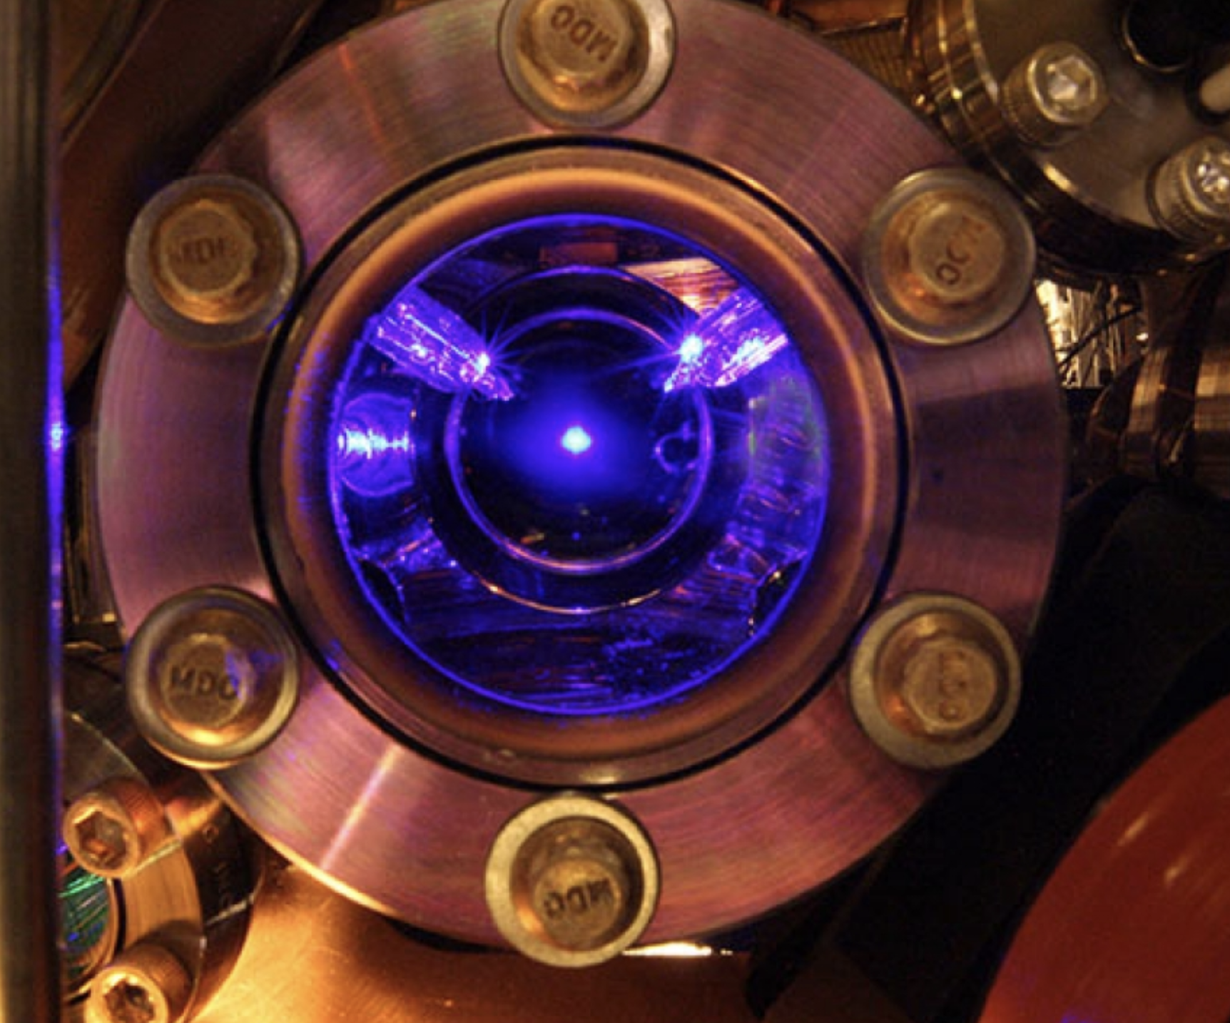
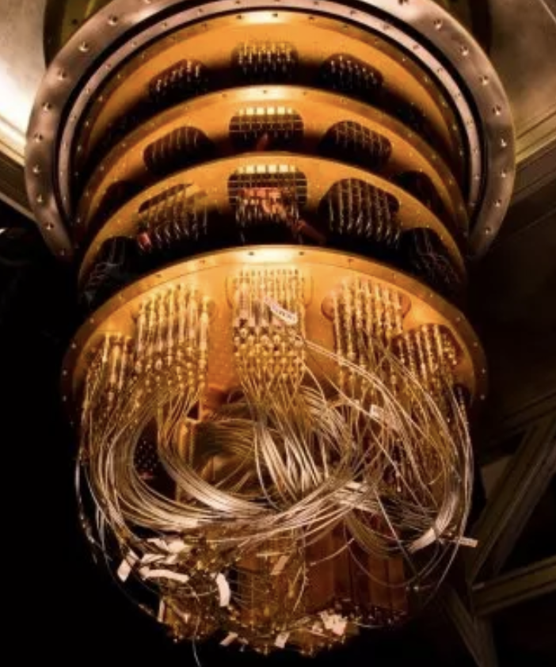
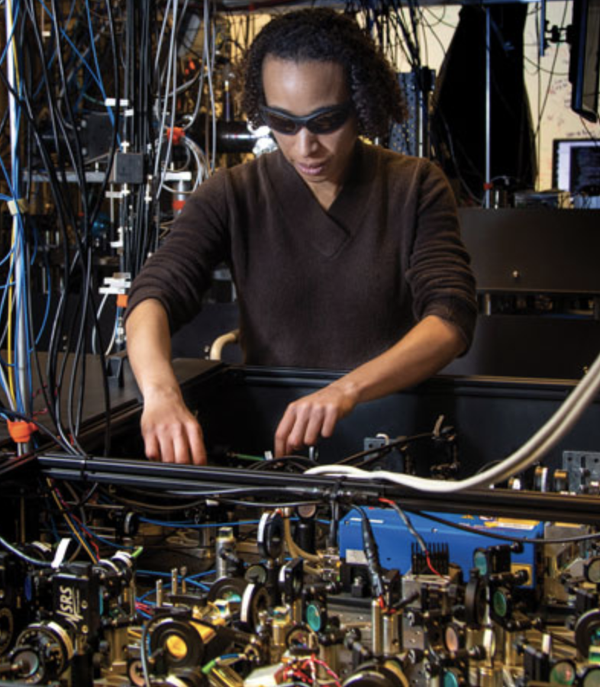
HEP/QST Landscape: QST for HEP
Other communities have growing scientific interests in QST and are making important advances:
Condensed matter, materials and AMO: superconducting qubits, ion traps, cold atoms, topological materials, spin-based sensors, …
High performance computing: quantum hardware/software for quantum problems
Quantum Information Science: quantum physics in the language of information theory
Quantum metrology: pushing the limits of sensing and precision measurements
HEP has a lot to gain from collaborating with these communities!
J. Lykken (Fermilab)

Slide 3
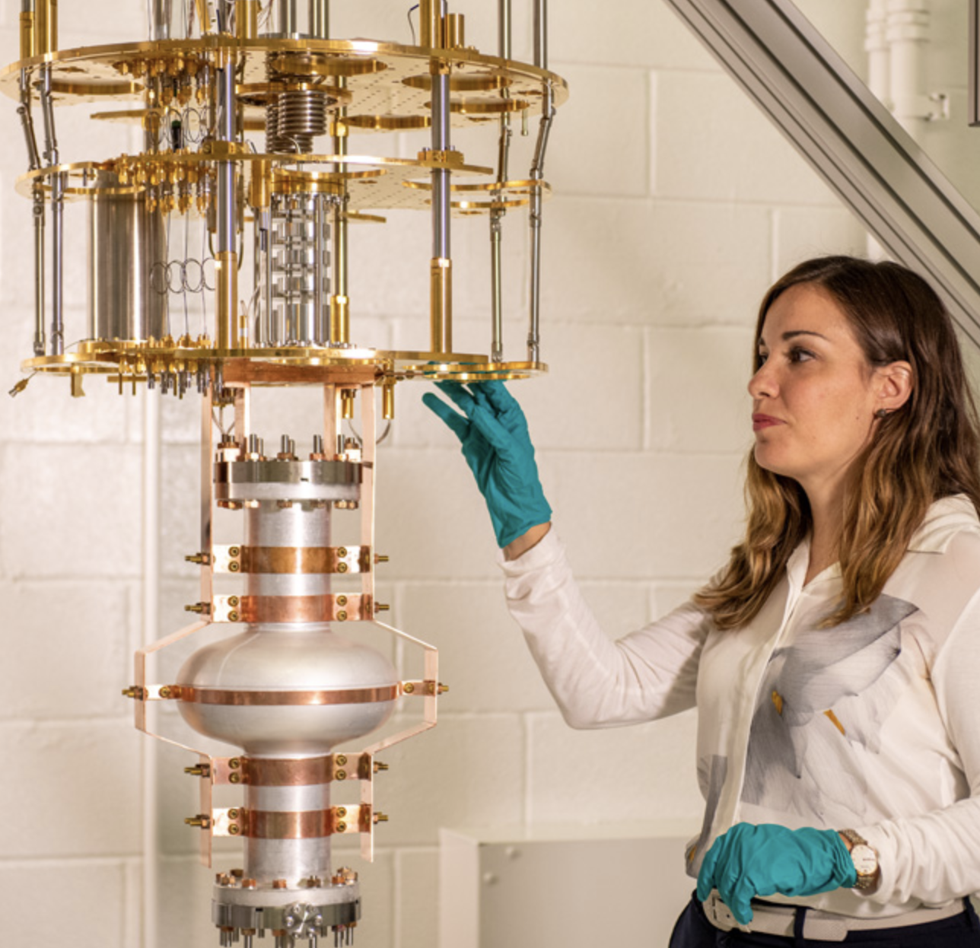
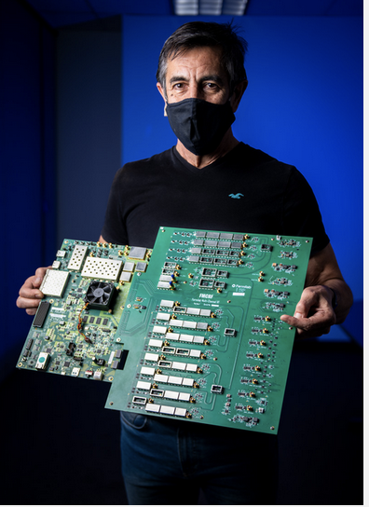
HEP/QST Landscape: HEP for QST
Other communities recognize that HEP brings value to the quantum ecosystem:
We have lots of hard quantum problems!
Because of the demands of our science, we are world leaders in many technologies relevant to the larger quantum ecosystem, including superconducting RF, advanced control systems, fast timing, cryogenics, design, scale up and deployment of sensor systems
Because of the demands of our science, we are early adopters of new technologies and approaches, not afraid to get our hands dirty with NISQ quantum computers/simulators, hybrid computing systems, sensor and sensor network prototypes, quantum machine learning, …
Because of the nature of our experiments, we take the long view: LHC and DUNE will still be operating 20 years from now, lattice gauge theory took 30 years to mature, etc
J. Lykken (Fermilab)

Slide 4
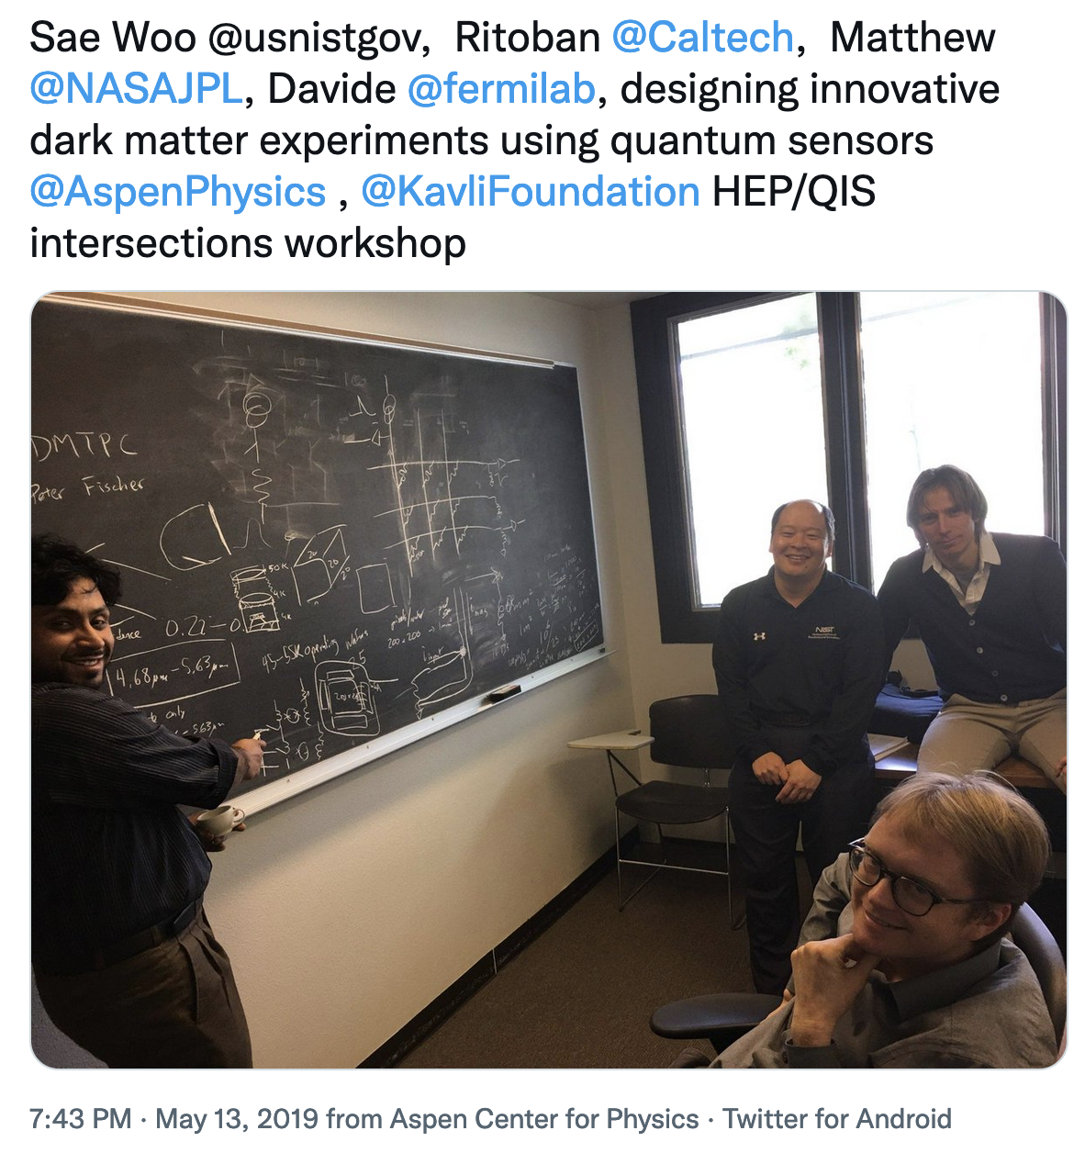
HEP/QST Landscape: DOE HEP
QST did not exist as a topic in the 2013/14 Snowmass/P5 process.
A first order phase transition occurred in 2018 with the DOE National Quantum Initiative (see talk by Paul Dabbar)
The DOE HEP QuantISED program started in FY18 with 14 funding awards for university-led projects and 27 to lab-led consortia (ANL, BNL, FNAL, ORNL, LANL, LBNL, SLAC)
From the start, HEP QuantISED highly leveraged by encouraging collaborations with other scientific communities and programs/agencies. (ASCR, BES, DOD, NASA, NIST, NP, NSF,…)
The first HEP QuantISED experiment, Dark SRF, began in 2018. QuantISED FY19 awards included two more quantum experiments, both based on atom interferometry expertise developed outside HEP.
J. Lykken (Fermilab)

Slide 5
HEP/QST Landscape: DOE HEP
FY21: ramp up of the $115M HEP-led NQI center SQMS at Fermilab
Three other NQI centers have HEP PIs in the org chart: QSC, Q-NEXT, and QSA
J. Lykken (Fermilab)

Slide 6
HEP/QST Landscape: Snowmass 2022
For Snowmass 2022, QST was not organized as a separate “frontier”, but instead integrated into the Computational, Instrumentation, and Theory Frontiers, which are themselves cross-cutting frontiers:
CompF6: Quantum Computing (Travis Humble, Gabe Perdue, Martin Savage)
IF1: Quantum Sensors (Thomas Cecil, Kent Irwin, Reina Maruyama, Matt Pyle)
TF10: Quantum Information Science (Simon Catterall, Roni Harnik, Veronika Hubeny)
These topical groups have a total of 22 whitepapers from ~400 distinct authors, not counting pre-existing collaborations
It is evident from the whitepapers that there is cross-cutting overlap with all the other frontiers: Energy, Neutrino Physics, Rare Processes and Precision, Cosmic, Accelerator, Underground Facilities, and Community Engagement!
J. Lykken (Fermilab)

Slide 7
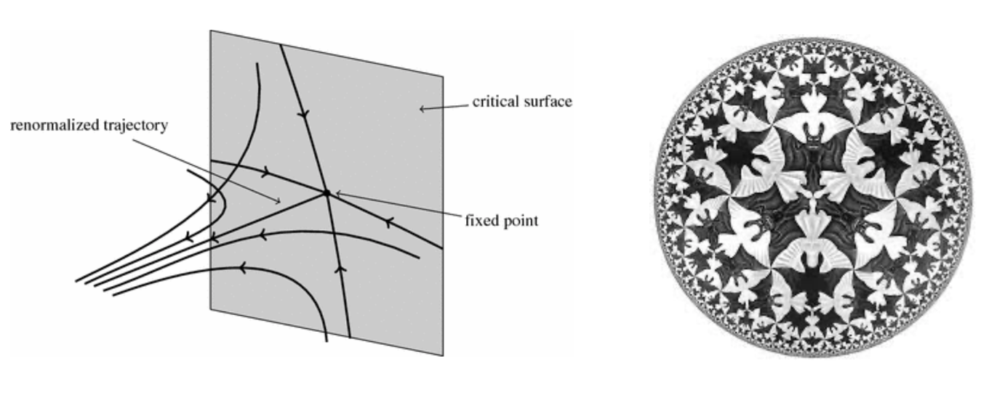
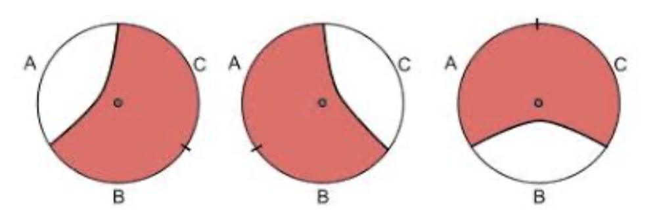
Snowmass whitepapers: foundations
“Quantum information in quantum field theory and quantum gravity” arXiv:2203.07117
What is QFT? cast quantum field theory in the language of quantum information and entanglement
The quantum origins of spacetime: holographic duality predicts surprising phenomena such as teleportation via traversable wormholes, that might teach us more about how spacetime emerges from quantum microphysics
Quantum simulation: understanding how in principle to formulate strongly coupled field theories or quantum gravity as tractable quantum simulations, similar to Wilson’s deep insights from asking how to simulate QFT on a classical computer.
QFT and quantum error correction: holographic duality suggests that study of strongly coupled gauge theories might bring additional insights and models for quantum error correction.
similar points made in Shamit Kachru’s theory summary
J. Lykken (Fermilab)

Slide 8
Snowmass whitepapers: quantum computing
“Quantum Simulation for High Energy Physics” arXiv:2204.03381
”Quantum Computing for Data Analysis in High Energy Physics” arXiv:2203.08805
“Quantum Computing Systems and Software for High Energy Physics Research” arXiv:2203.07091
HEP is full of hard problems not tractable with classical computing:
Real-time strong interaction processes like LHC collisions and neutrino-nucleus collisions at DUNE
Non-equilibrium dynamics like cosmic inflation and baryogenesis
As with lattice gauge theory circa 1980, don’t sit on your hands until adequate quantum computing hardware is available – get started now!
HEP is also full of problems where incremental improvements in speed/accuracy have large value:
LHC triggers, modeling of hadronization/showers, pattern/anomaly recognition, tagging
Look for near term HEP quantum advantage taking into account limitations of NISQ era devices
J. Lykken (Fermilab)

Slide 9
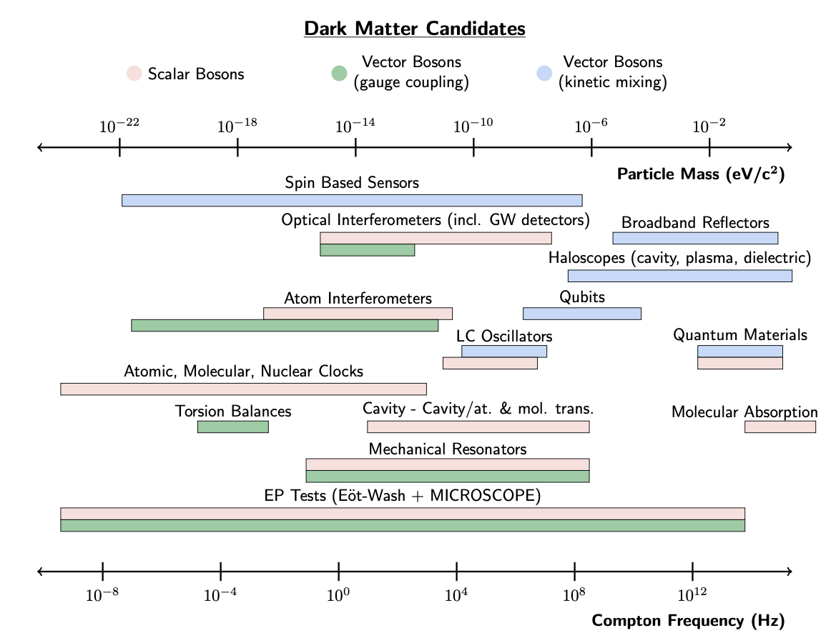
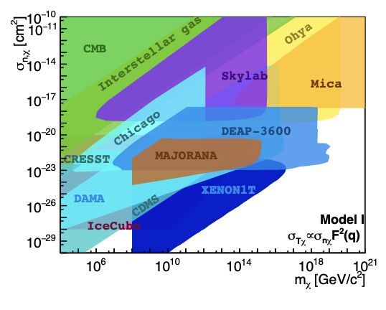
Snowmass whitepapers: quantum sensors for DM
“New Horizons: Scalar and Vector Ultralight Dark Matter” arXiv:2203.14915
“Ultraheavy Particle Dark Matter” arXiv:2203.06508
Special challenges e.g., of detecting dark matter that is either ultralight or ultraheavy
Direct detection of DM is one of the primary goals of HEP, so cannot ignore the hard cases
Roadmap to discovery:
Theory study of candidates and signatures
Collaboration between HEP and atomic, molecular, optical, nuclear, and solid-state physics, metrology, and QIS
Robust R&D, deploy pathfinders
J. Lykken (Fermilab)

Slide 10
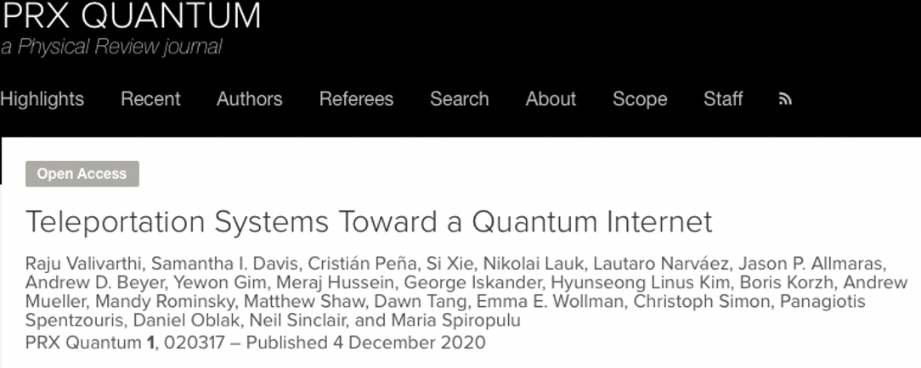
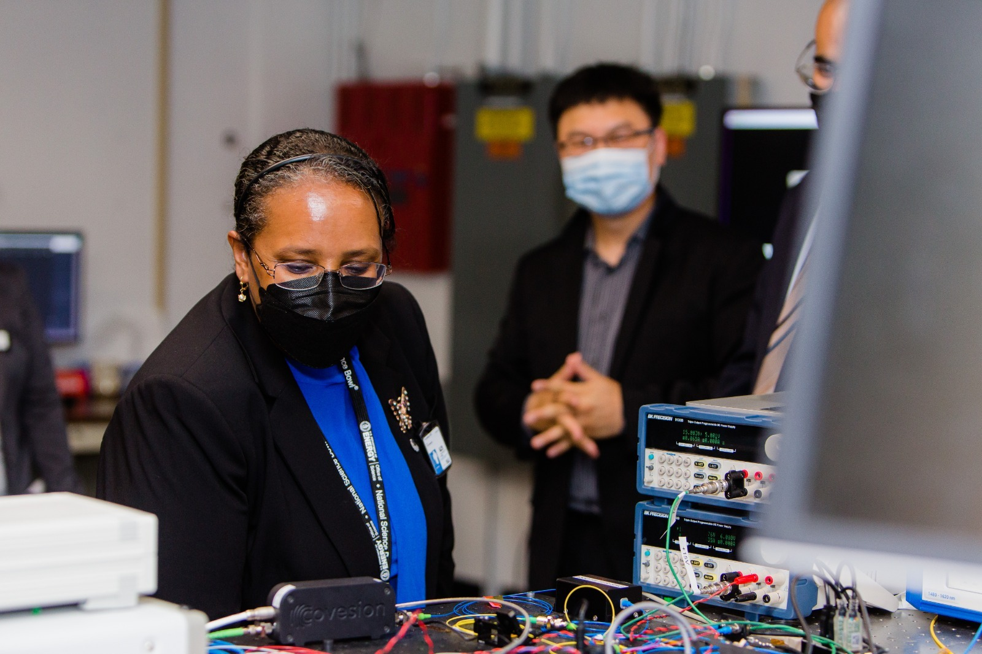
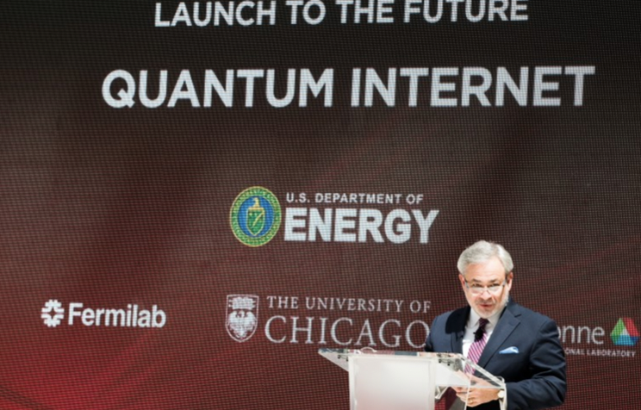
Snowmass whitepapers: quantum networks
“Quantum Networks for High Energy Physics” arXiv:2203.16979
Quantum Networks for HEP: Quantum networks of quantum sensors or clocks, quantum telescopes
HEP for Quantum Networks: HEP knows how to do real time picosecond time synchronization, etc
J. Lykken (Fermilab)

Slide 11
HEP/QST Landscape: CERN QTI
CERN Quantum Technology Initiative includes
Quantum computing and algorithms
Quantum theory and simulation
Quantum sensing, metrology and materials
Quantum communication and networks
Relatively new but ramping up, engaging with the European quantum ecosystem
“CERN’s traditional collaborative culture and the specific position of CERN as an international multidisciplinary scientific research centre put the Organization in an ideal position to act as a hub, an honest broker, for knowledge advancement and sharing across communities and to promote broader discussions about the development and use of quantum technologies for science and society.”
J. Lykken (Fermilab)

Slide 12
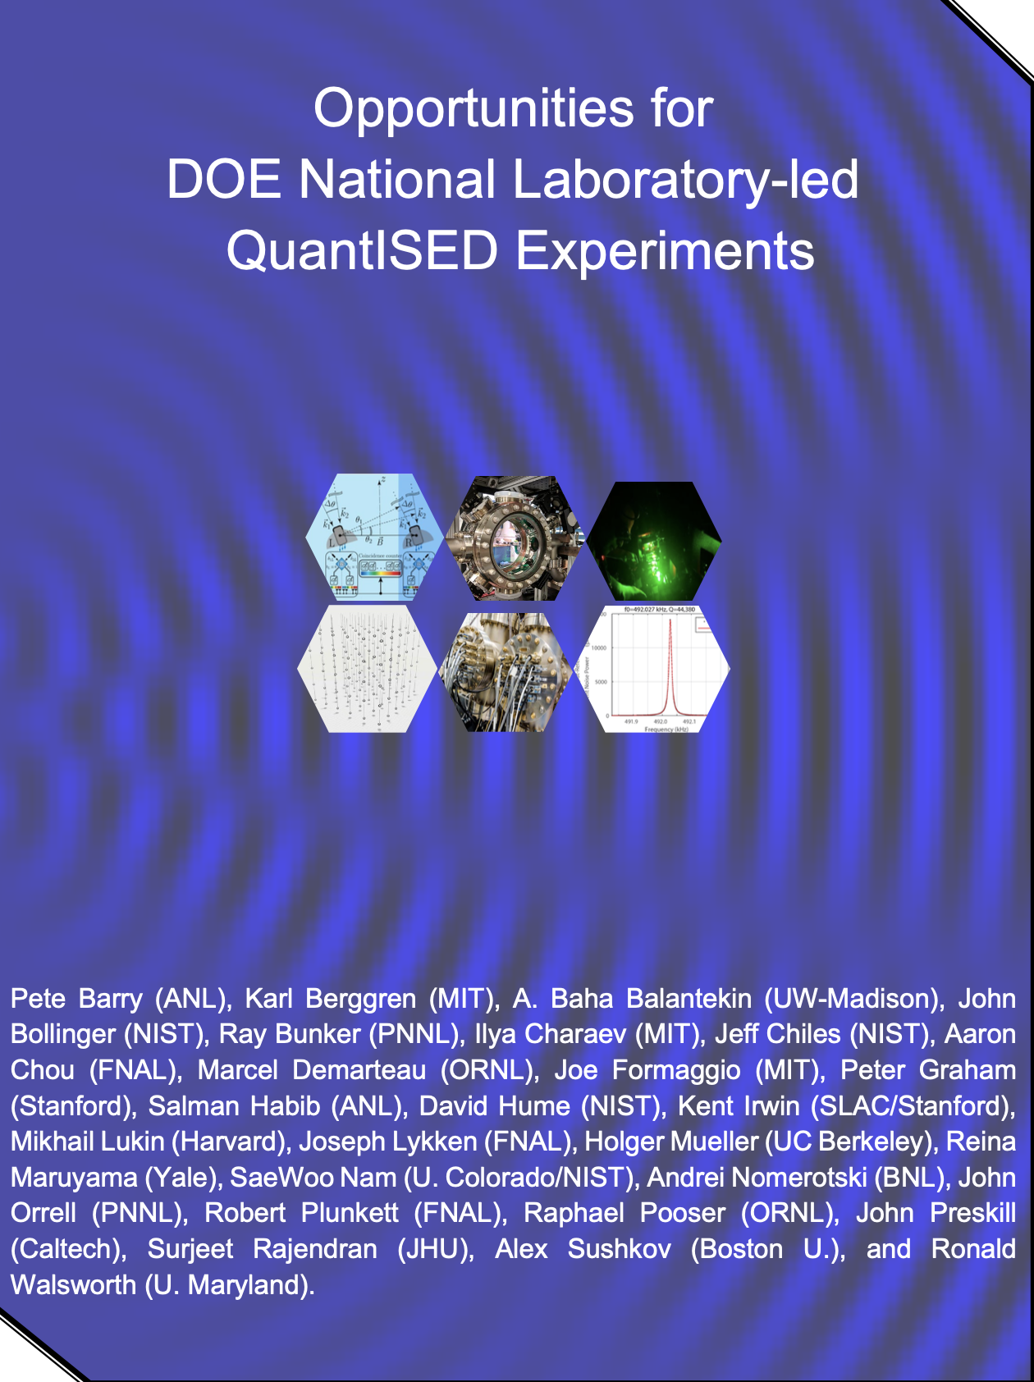
HEP/QST Landscape: quantum pathfinders
See arXiv.2102.10996
DOE QuantISED has already supported a few experiments
Could grow this into a continuing portfolio of low-cost high return pathfinder experiments
Emphasis on pathfinders for future HEP science targets that exploit quantum sensor technologies
Small experiments are great for the health of HEP:
Provide more opportunities for junior scientists
Attract and train a more diverse scientific workforce
Convince our stakeholders to invest in larger mature versions
J. Lykken (Fermilab)

