Slide 1
Snowmass EF wiki: https://snowmass21.org/energy/start
Energy Frontier - Introduction
Snowmass Community Summer Study (CSS)
Seattle, July 17-26, 2022
Laura Reina (FSU), Meenakshi Narain (Brown U.), Alessandro Tricoli (BNL)

Slide 2
Energy Frontier: explore the TeV energy scale and beyond
Aims at advancing the investigation of still open fundamental questions
and exploring the unknown

Slide 3
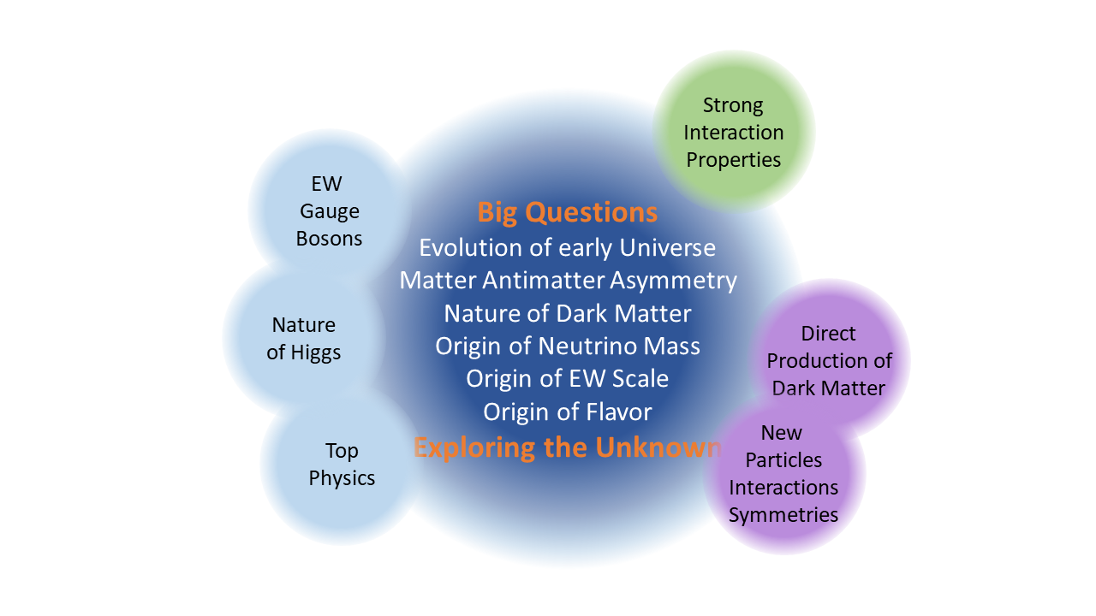
Energy Frontier: explore the TeV energy scale and beyond
Each question manifests as a variety of processes, that can be used as probes to discover and characterize the nature of the new physics

Slide 4
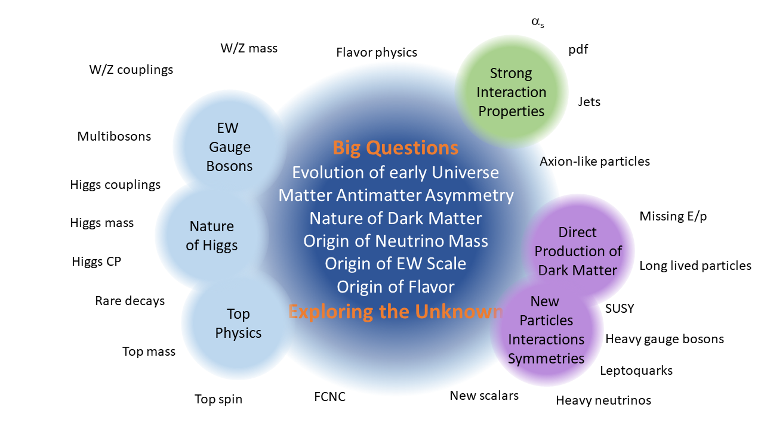
Energy Frontier: explore the TeV energy scale and beyond
Through the breadth and multitude of collider physics signatures

Slide 5
Energy Frontier: explore the TeV energy scale and beyond
Addressing the “Big Questions” need EF explorations to proceed along two main complementary directions:
Study known phenomena at high energies for indirect evidence of BSM physics
Search for direct evidence of BSM physics at the energy frontier
The Energy Frontier is at a turning point, in which experimental guidance is needed to shed light on new physics beyond the SM.
The HL-LHC is the approved short-term project with a potential to shed light on BSM physics directly through searches and indirectly via precision measurements of the Higgs boson and all SM parameters.
During this Snowmass, the focus of the discussion is to identify projects and machines which extend the reach of the HL-LHC in terms of precision measurements and direct searches.
Preparations for the next collider experiments beyond the HL-LHC have to start now to maintain and to strengthen the vitality and motivation of the community.

Slide 6
Energy Frontier Machines
Discoveries at the Energy Frontier are intricately linked to new accelerators, detector instrumentation, advances in theory (including calculation tools), and innovative analysis technologies and frameworks.
Goals of the next Energy Frontier Machines:
Look for indirect evidence of BSM physics
Need factories of Higgs bosons (and other SM particles)
Need high precision to probe the TeV scale and beyond
→ Need both luminosity and energy
Search for direct evidence of BSM physics at the energy frontier
Need to explore the multi-TeV scale → Need energy
Need to explore what LHC/HL-LHC may have difficulty exploring → Need luminosity
A clear path towards the identification of the next collider project has to be well supported by the US and international community as a whole.

Slide 7
Energy Frontier Machines: Energy and Precision
New physics can be at low and at high mass scales: Naturalness would prefer mass scale close to the EW scale, but direct searches of specific models have placed stronger bounds around 1-2 TeV.
We need to use both energy and precision
Investigation at the energy frontier allows one to combine direct BSM searches with precision measurements of observables sensitive to scales above the available center-of-mass energy.
Depending on the mass scale of new physics and the type of collider, the primary method for discovery new physics can vary.
The type of collider employed directly influences what signatures are possible to probe within the foreseeable accelerator parameters, detector technology and physics backgrounds.

Slide 8
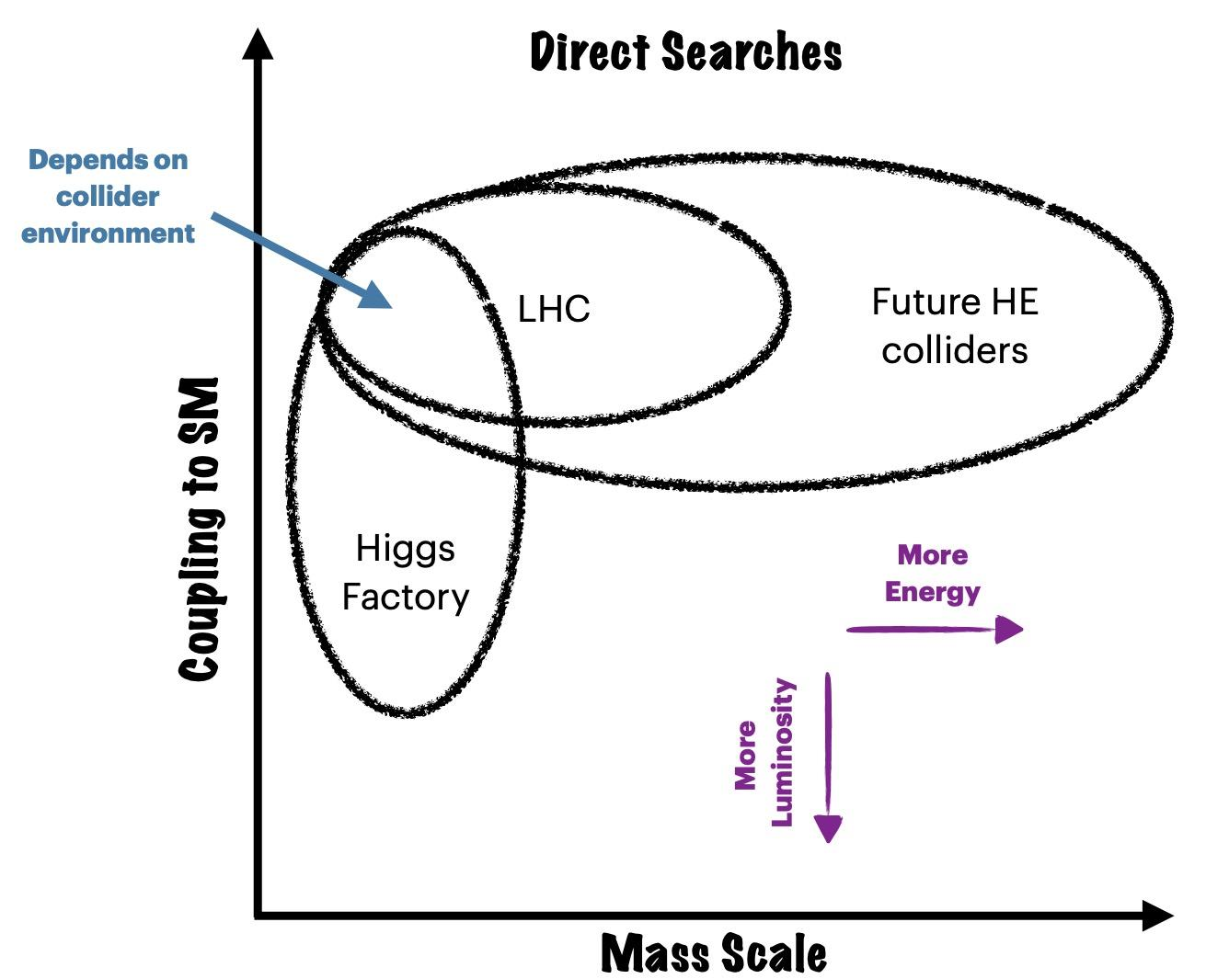
Energy Frontier Machines: Direct Searches
Lessons learned from the LHC:
a Higgs-like particle exists at 125 GeV
no other signal of BSM physics.
either there is a gap to the scale of new physics, or it must be more weakly coupled to the SM or hidden in backgrounds at the LHC.
HL-LHC will either strengthen these conclusions or point us in a particular direction for discovery.
Future colliders must have complementary potential to answer these fundamental questions beyond what the LHC physics program can probe.
Use a simplified picture where generic new physics spans a 2D parameter space of coupling of these new states to the SM and its mass scale.
Pursue multiple approaches for BSM searches depending on the type of collider considered.

Slide 9
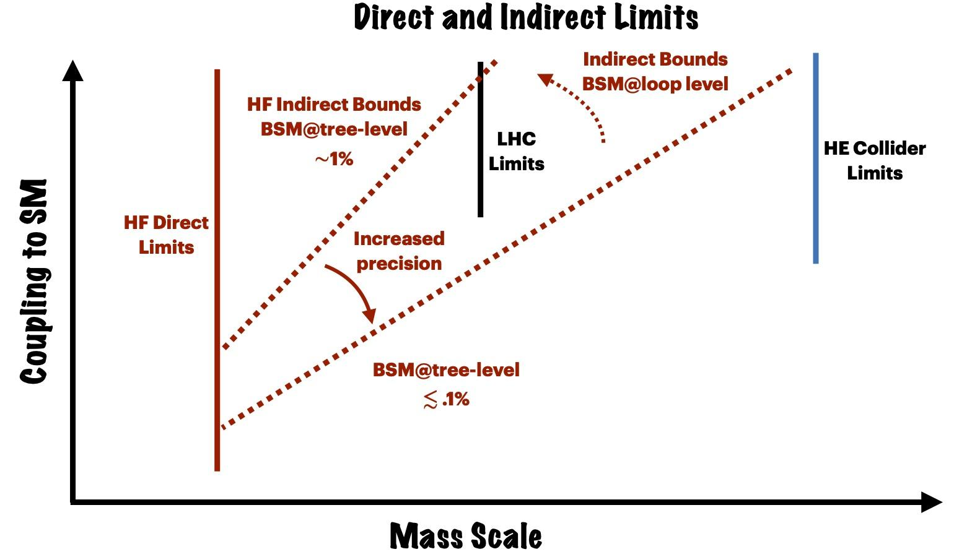
Energy Frontier Machines: Precision Measurements
Precision measurements allow probing scales above the kinematic limit for direct searches at colliders.
Effective Field Theory techniques are deployed when there is a gap between the energy scale probed and the scale of new physics.
In a simplified picture:
Energy versus precision trade-off crucially depends on the attainable precision.
New physics at tree level:
δη_{SM}~ g²_{BSM} E²/M²
New physics at loop level:
δη_{SM}~ 1/16π² × g²_{BSM} E²/M²
HF: Higgs factory
HE: high-energy or multi-TeV collider

Slide 10
Energy Frontier Machines: Precision Measurements
For example, Higgs Factory has increased reach in the coupling vs mass plane through indirect searches benefiting from increased precision.
the level of precision reached is ultimately a function of technology and control of systematic uncertainties.
A 1% precision measurement suggests a scale probed of up to a few TeV, if BSM physics couples at tree-level to the observables of interest.
Potentially within reach of the LHC, and the type of UV physics determines whether or not this results in additional reach beyond LHC or complementary probes.
If new physics couples at loop-level then the scale probed indirectly is lower.
The ultimate precision, and what scale the High Energy (HE), i.e. multi-TeV, colliders can probe is ultimately a collider specific question.
HF: Higgs factory
HE: high-energy or multi-TeV collider

Slide 11
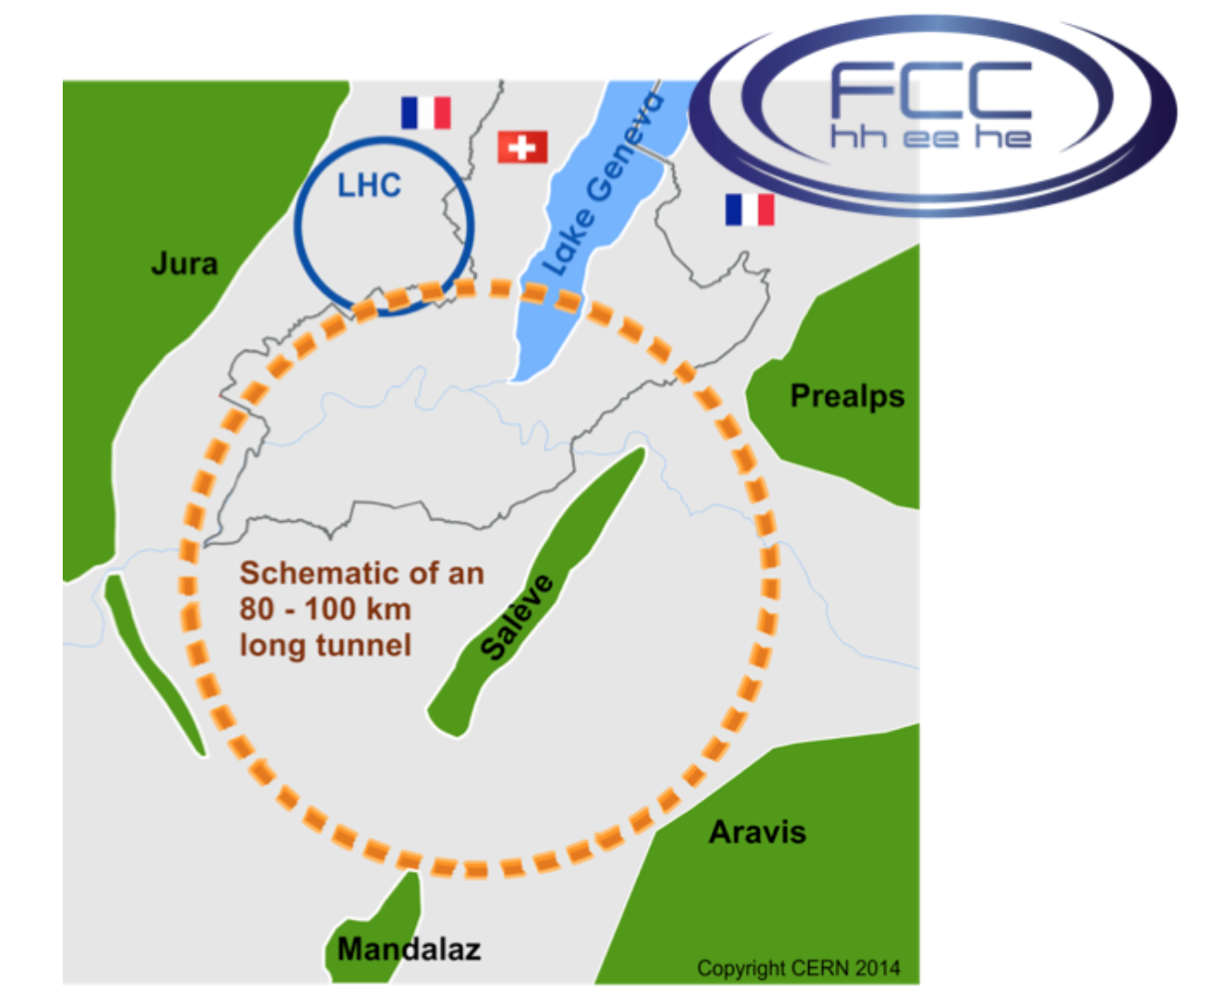
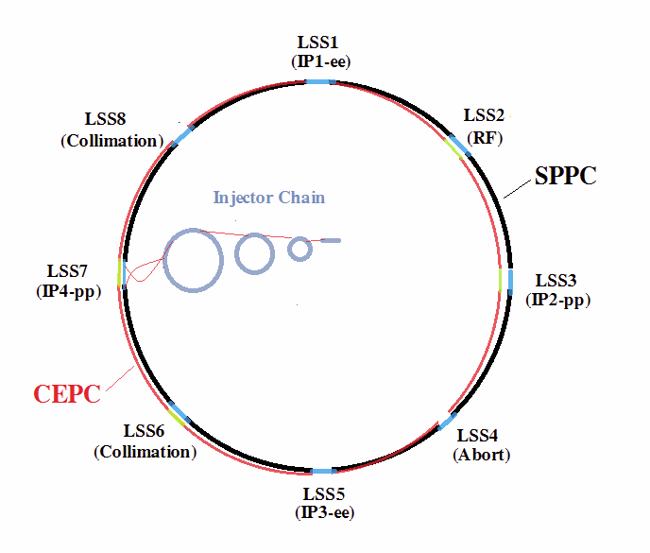
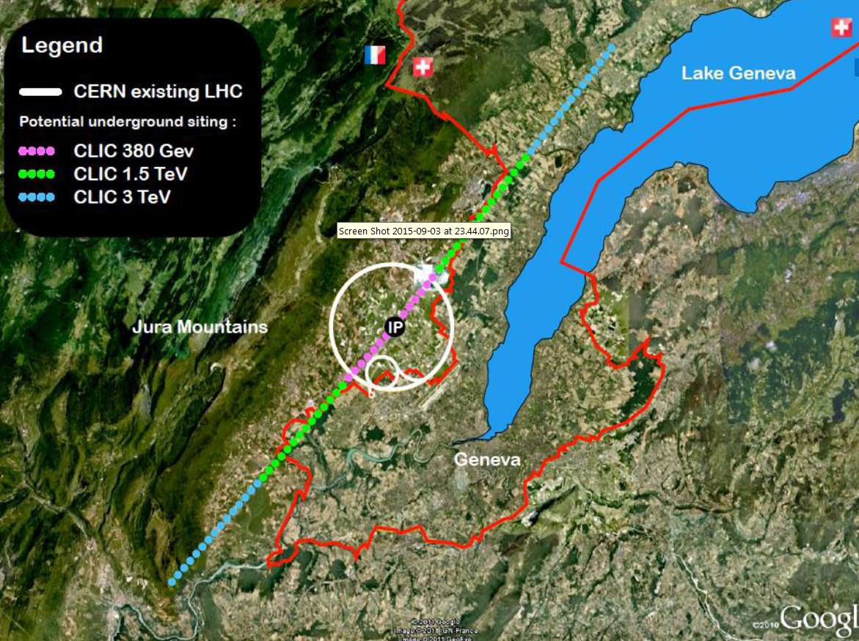
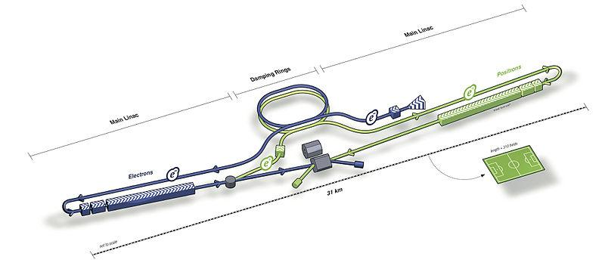
Which machines?
Muon Collider
- e⁺e⁻
- hadron-hadron
- hadron-electron
FCC
CEPC SppC
ILC
CLIC
LHeC
+C³ ?

Slide 12
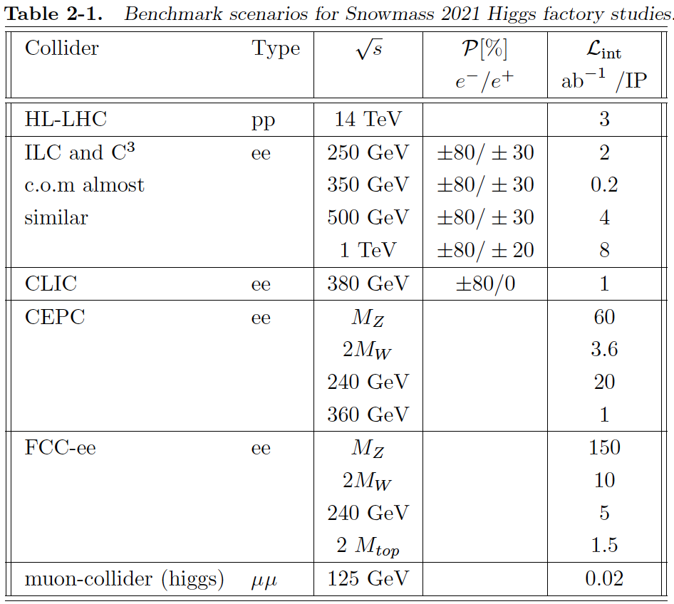
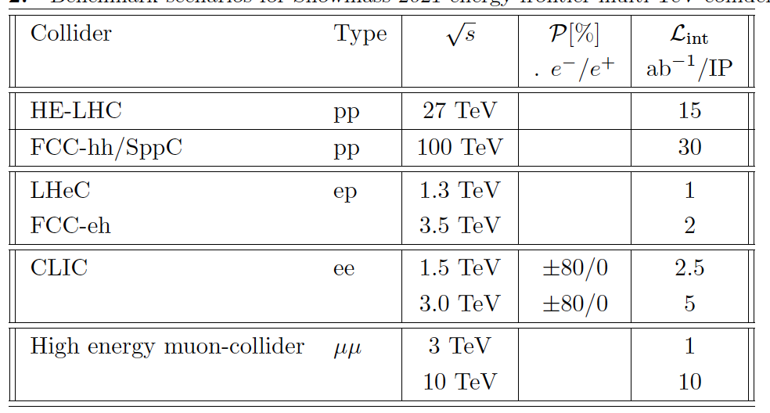
Snowmass 2021:
EF Benchmark Scenarios
Higgs-boson factories
(up to 1 TeV c.o.m. energy)
Multi-TeV colliders
(> 1 TeV c.o.m. energy)

Slide 13
Summary:
Energy-frontier colliders are the ultimate tool we possess to clarify the fundamental nature of deviations observed either at EF colliders or in low-energy experiments.
Some current examples of deviations in precision measurements of SM parameters that provide targets for direct BSM searches and call for direct exploration to clarify their nature.
anomalies in (semi)leptonic B-hadrons decay, including hints of lepton flavor universality violations,
the muon anomalous magnetic moment (g_{μ} − 2)
the recent W mass measurement
We need both increased energy and increased precision for the full exploration of the Energy Frontier Program.
The Energy Frontier program should be broad and have the ability to directly and unambiguously probe energy scales of the order of several TeV.

Slide 14
Backup

Slide 15
Big Picture Questions
set at the beginning of Snowmass
Snowmass Day, Sept 24, 2021
Why is physics at the energy frontier important?
How should the US be involved in near future and far future energy-frontier machines after HL-LHC?
What could be the energy-frontier machines that follow the HL-LHC?
How can the US continue to play a leadership role in energy-frontier experiments?
How can the Snowmass process help develop a plan for the energy-frontier research and convince the community about our priorities?
Should we start entertaining the idea of a future collider in the US again? If so, what are our goals, the benefits for the US and the international community, and how can we get there?
etc...

