Slide 1
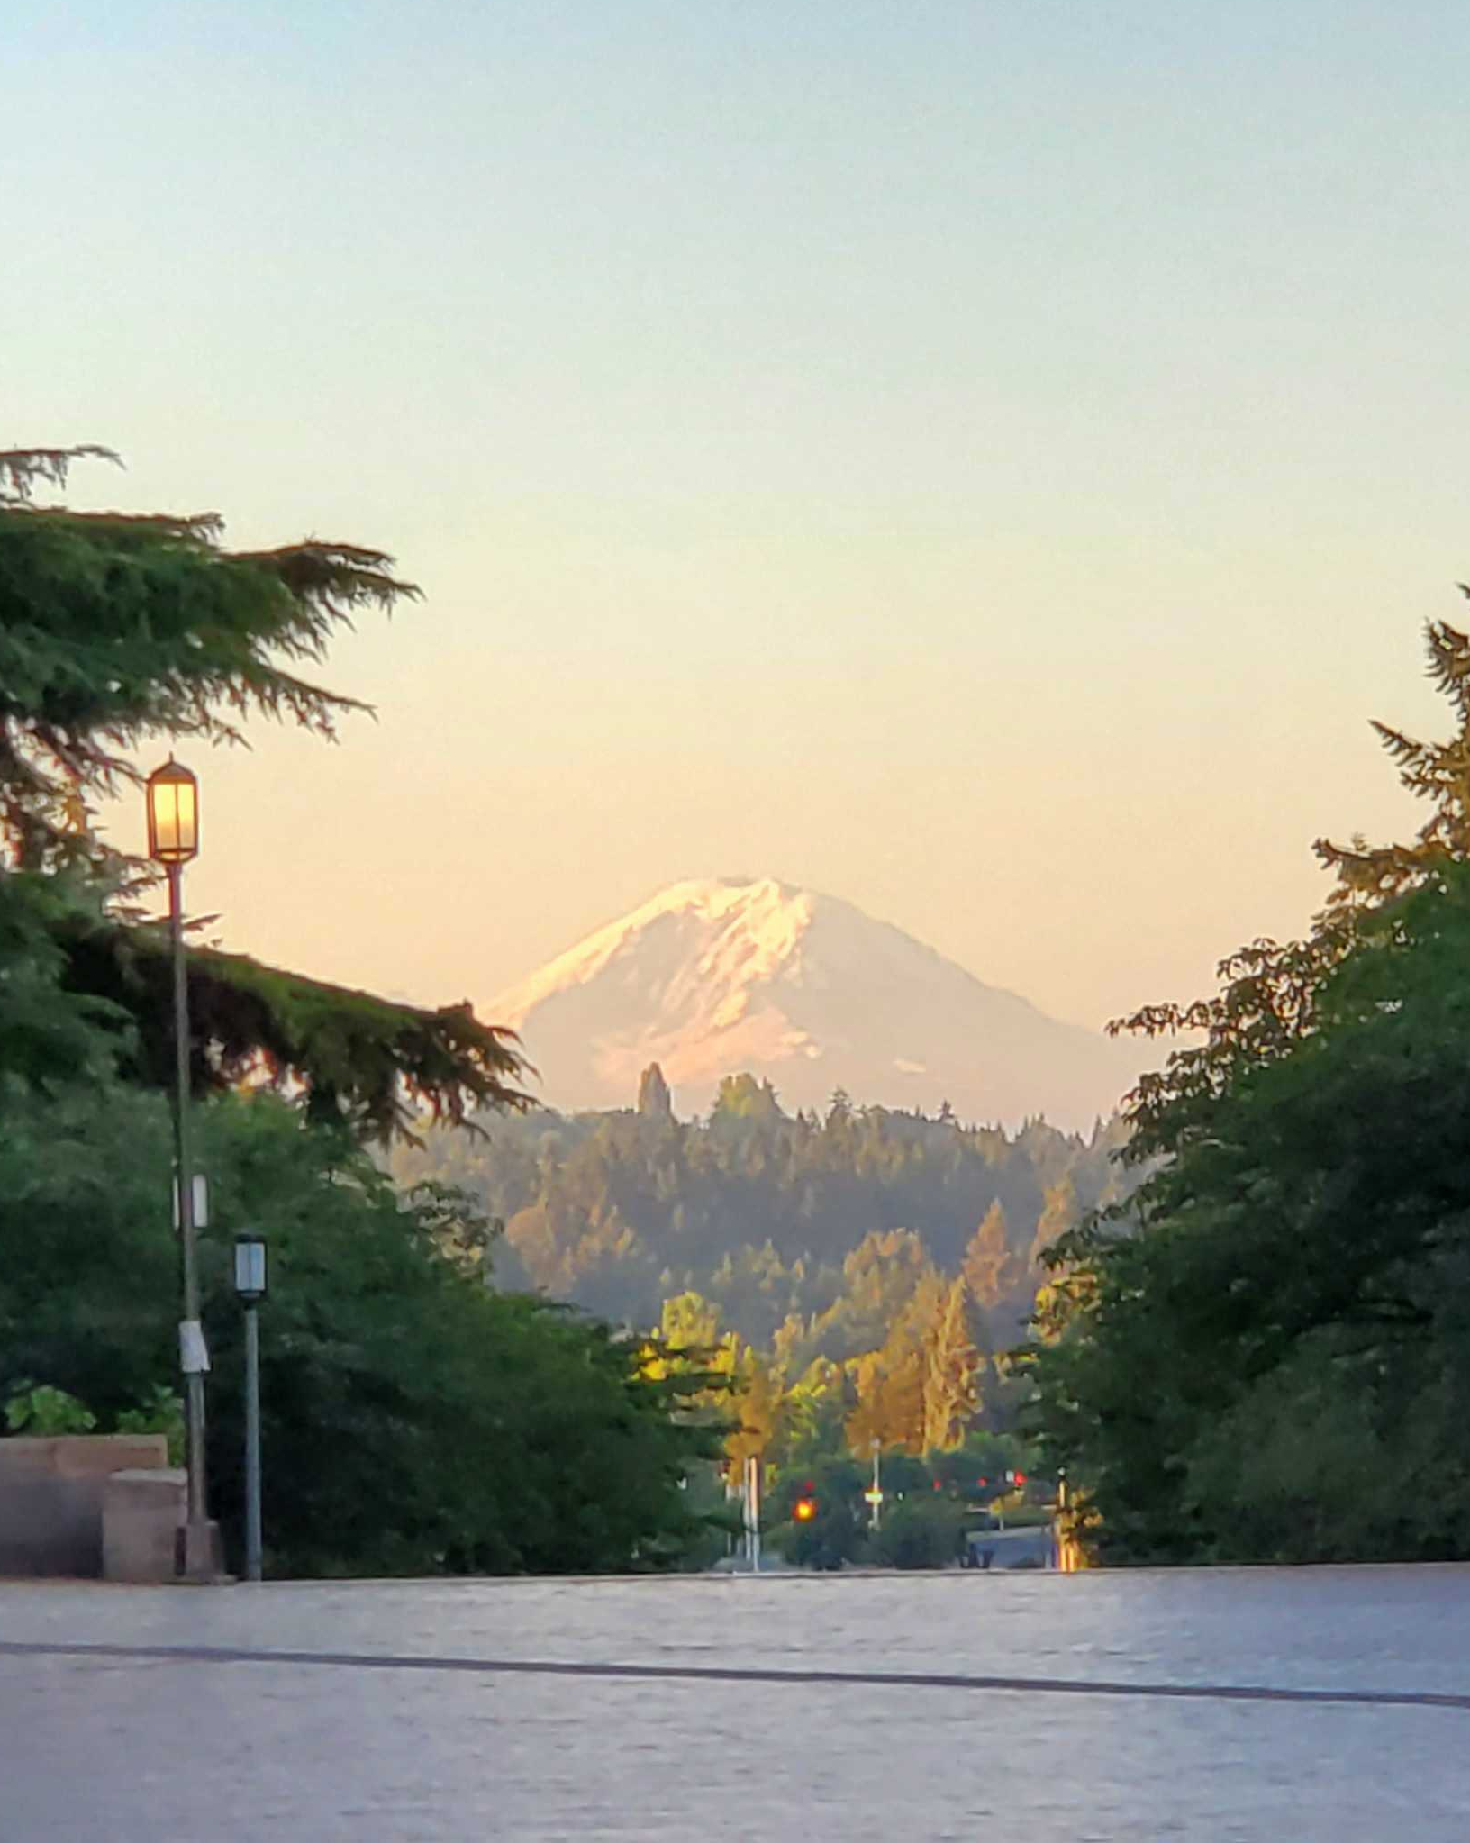
Pictures from the QCD Frontier
M. Begel, S. Höche, Y.J. Lee, H.-W. Lin,
S. Mukherjee, Pavel Nadolsky,
C. Royon, and M. Schmitt (conveners)
On behalf of QCD and Strong Interactions Topical Groups:
EF05: Precision QCD
EF06: Hadronic structure and forward QCD
EF07: Heavy Ions

Slide 2
Joint EF05-06-07 report on QCD to be released soon!
EF QCD Session, Monday
Detailed discussions of
Current and future hadron collider facilities
Perturbative calculations and QCD tests ($α_{s}$, $m_{b}^{\overline{MS}}$ ,…)
Parton distribution functions (PDFs) and fragmentation functions (FFs)
Predicting hadron structure in lattice QCD
Forward scattering and saturation
Jet substructure
Photon-photon scattering
Ultraperipheral collisions
QCD with heavy ions
Cross cutting aspects

Slide 3
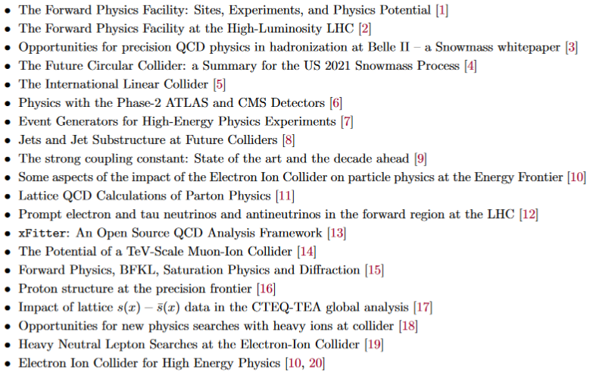
Based on 19 Snowmass’2021 White Papers

Slide 4
QCD draws strong interest in numerous discussions at the Snowmass CSS…
… as the only QFT that can be experimentally studied in perturbative and nonperturbative phases
… as the key theory in HEP phenomenology now and in the future
… it is rich both in data and in ideas!

Slide 5
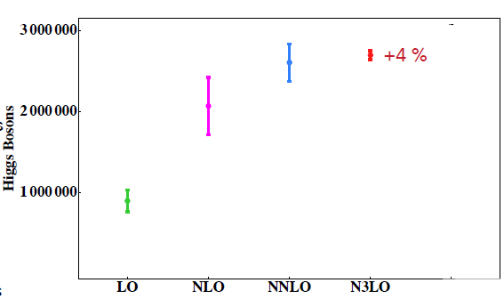
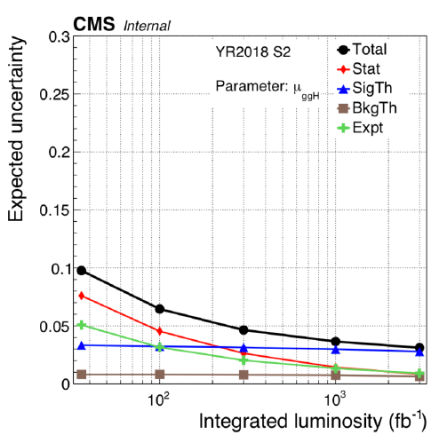
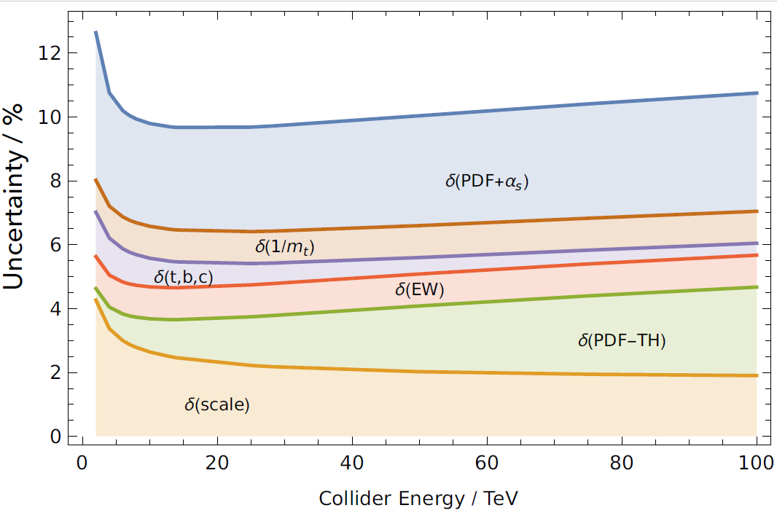
Higgs physics relies on QCD
B. Mistlberger, CTEQ SS22
Theory cross section @13 TeV, 2018
Sources of theor. uncertainty
Experimental
Uncertainty on $σ(pp→H)$
Experimental,
perturbative, and nonpert.
sources
[Dulat et al., 2018]

Slide 6
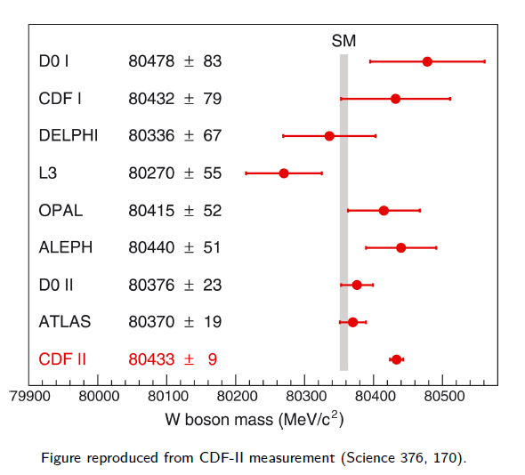
Electroweak precision physics relies on QCD
For instance, $W$boson mass measurements at the Tevatron and LHC
LHCb: $80,354±32$
See J. Isaacson, TF06+07, for discussion of QCD+EW theory issues

Slide 7
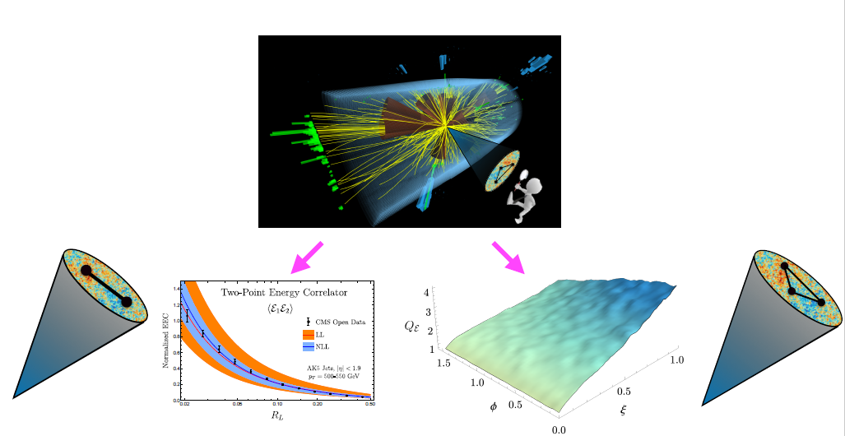
Toward jet substructure as a precision science
I. Moult, CompF03, TF07
QCD dynamics at various energy scales is imprinted in angular distributions of particle energy flows.
Developments in formal QCD and AI/ML open avenues to learn about this dynamics directly from recorded collider events

Slide 8
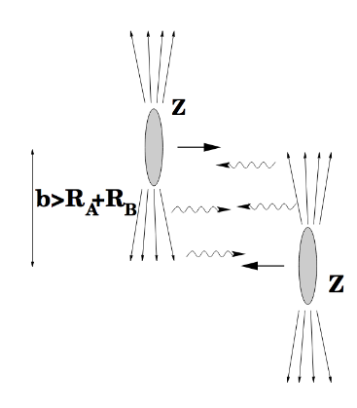
Forward QCD
New forward QCD experiments: LHCb, Forward Physics Facility, forward diffractive scattering, central exclusive production, LHC as a photon-photon collider
(TMD) factorization formalisms and evolution at small x
Best observables to look for small-x factorization (BFKL) and parton saturation
Incisive measurements and predictive models for diffractive scattering
Saturation in the nuclear medium (ALICE, EIC, …)
QCD dynamics at very large x (intrinsic charm)
Precision of Monte-Carlo programs for forward particle production
Prospects to probe small$−x$ dynamics at intermediate virtualities in ultraperipheral $pp,$ $pA, AA$ collisions
M. Strikman, EF QCD

Slide 9
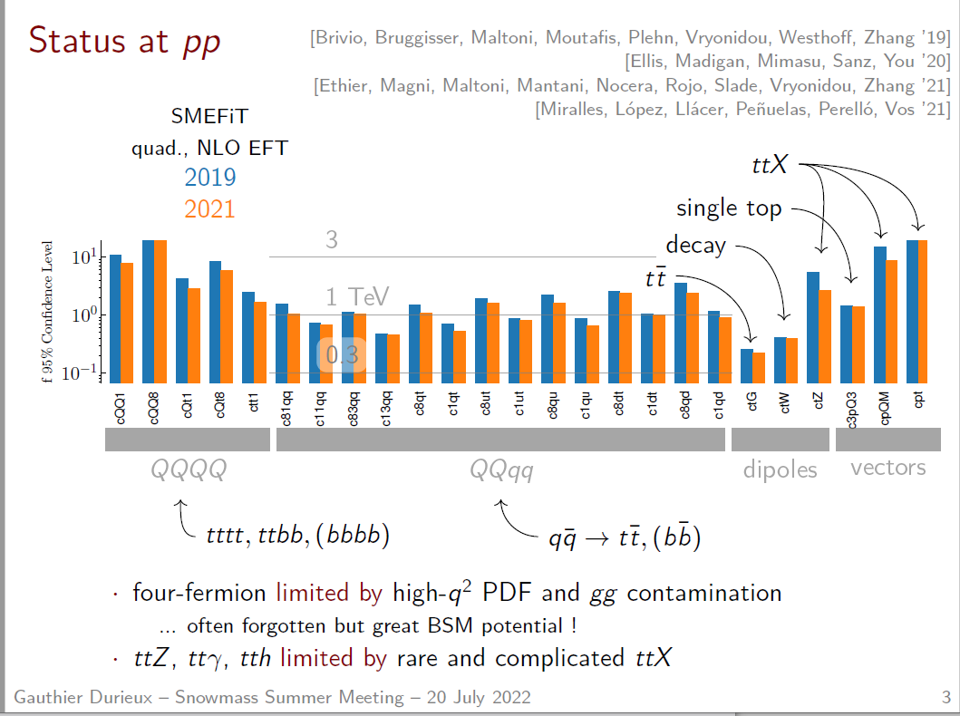
G. Durieux, EF03
QCD controls accuracy of SMEFT analyses

Slide 10
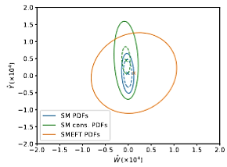
Higher-dim operators and QCD effects
modify SMEFT exclusion limits
F. Petriello, TF07
Fitting SMEFT coefficients and PDFs together can modify the constraints, too
A. Greljo et al., arXiv:2104.02723

Slide 11
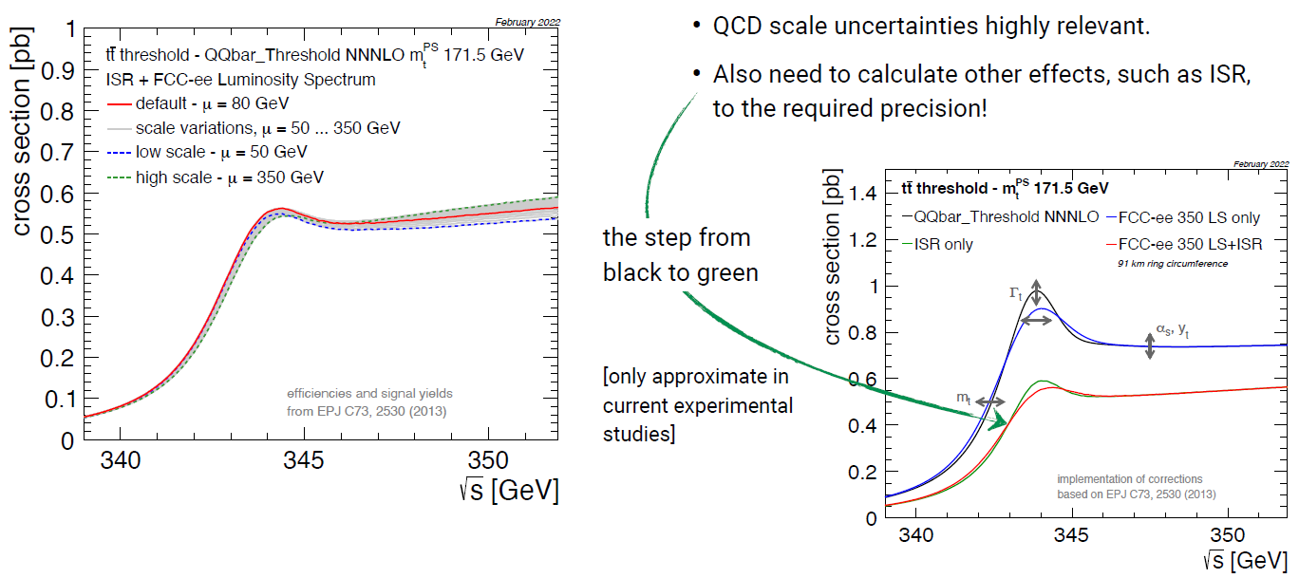
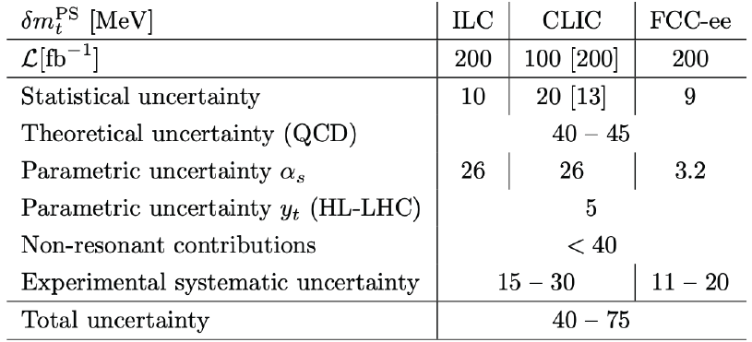
F. Simon, EF03
QCD theory = the key factor in $t\overline{t}$ threshold scans at FCC-ee

Slide 12
Multi-loop revolution in perturbative QCD drives critical advancements in many areas
NNLO QCD + NLO EW predictions are now a standard for many LHC processes
N3LO is becoming available and will be in [high] demand in the HL-LHC era

Slide 13
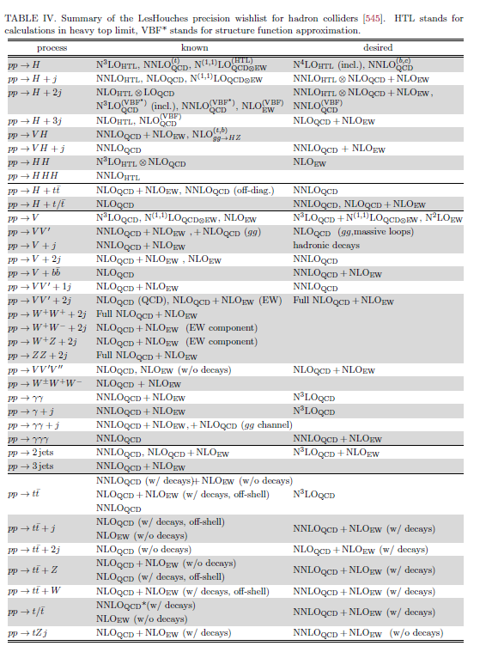
2022 Les Houches wish list for PQCD calculations for hadron colliders
[545] A. Huss, J. Huston, S. Jones, and M. Pellen, “Report on the standard model precision wishlist,”. To appear in Les Houches 2021: Physics at TeV Colliders.

Slide 14
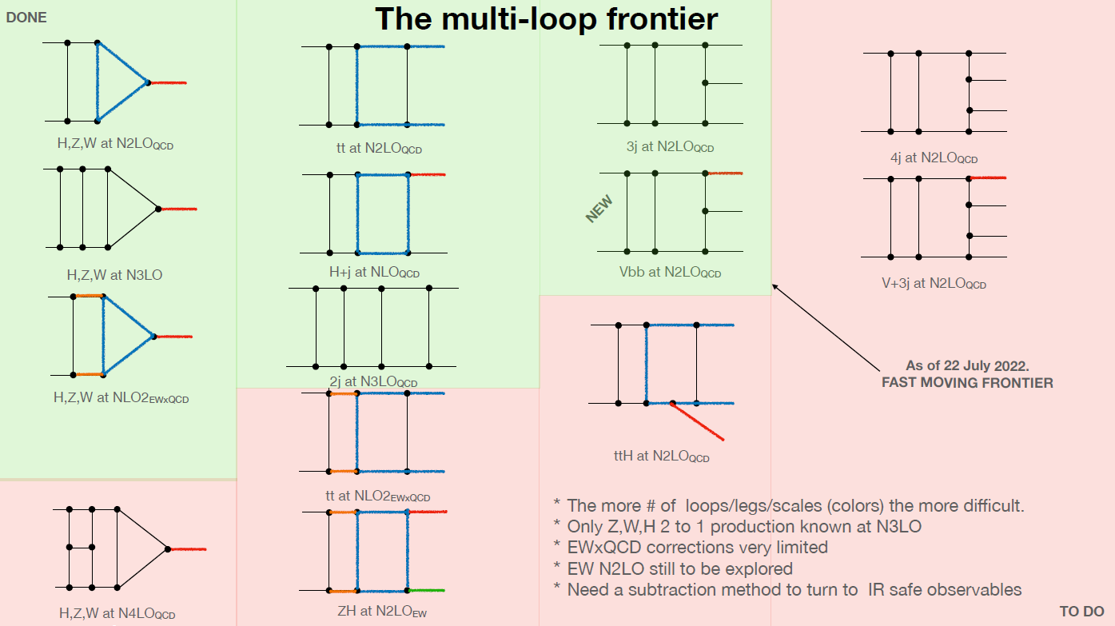
F. Maltoni, TF06+07

Slide 15
QCD coupling strength $α_{s}(M_{Z})$ is the least known coupling of the Standard Model. Even gravity is known better. Yet, $α_{s}$ controls accuracy of many collider measurements.

Slide 16
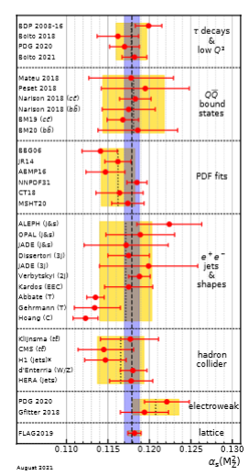
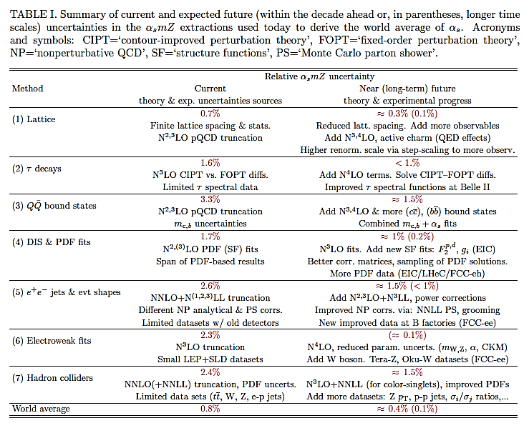
Future measurements of the QCD coupling
individual $α_{s}$ measurements can reach precision of $∼0.1\%$
D. d’Enterria et al., EF QCD, arXiv:2203.08271

Slide 17
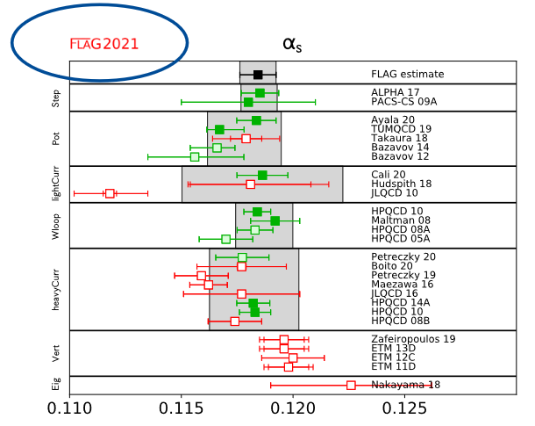
Lattice QCD & world-average $α_{s}$combination
A. Kronfeld
Lattice determinations of $α_{s}$ in multiple channels are projected to be [far] more precise than many experiments. Several challenges with combining the eclectic $α_{s}$ inputs with the current procedure.
Time to rethink how the world-average $α_{s}$ combination is performed?

Slide 18
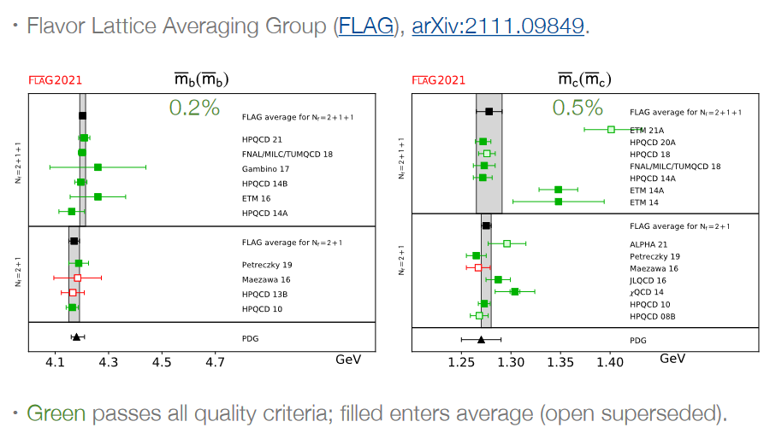
Heavy-quark masses
A. Kronfeld
In $m_{c}$, $m_{b}$ calculations, lattice QCD already surpasses the PDG average in accuracy

Slide 19
Precision parton distribution functions for (N)NNLO calculations are obtained in versatile global analyses, with lattice QCD providing increasingly valuable inputs

Slide 20
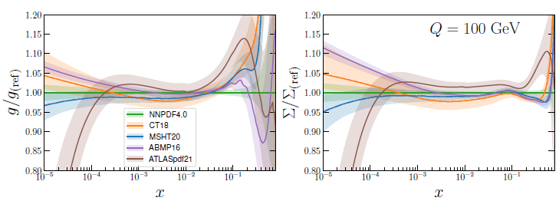
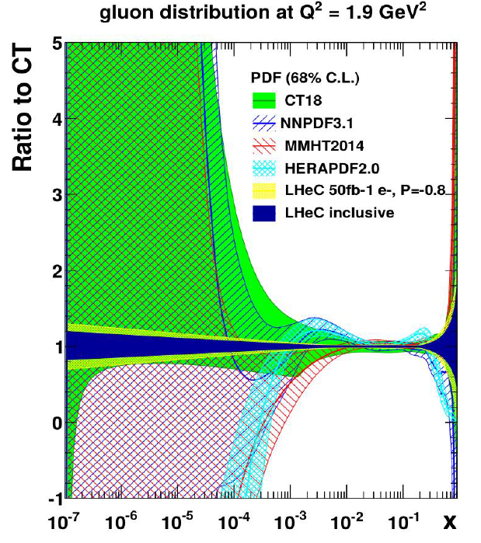
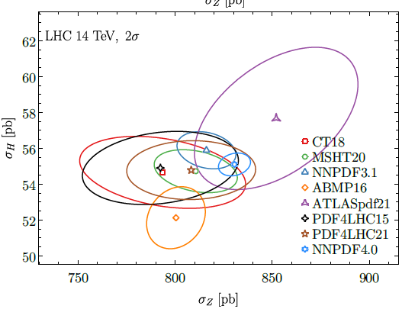
Progress in PDF analysis
K. Xie, EF QCD
The current status
2022
…and future prospects
an optimistic post-LHeC uncertainty,
requiring all advancements in the
PDF fitting methodology
Late 2030’s

Slide 21
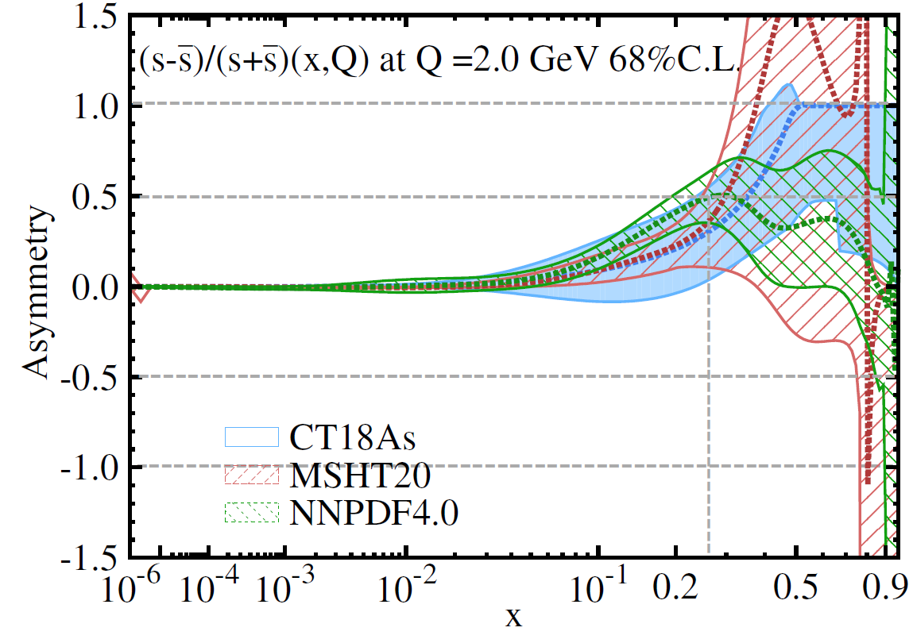
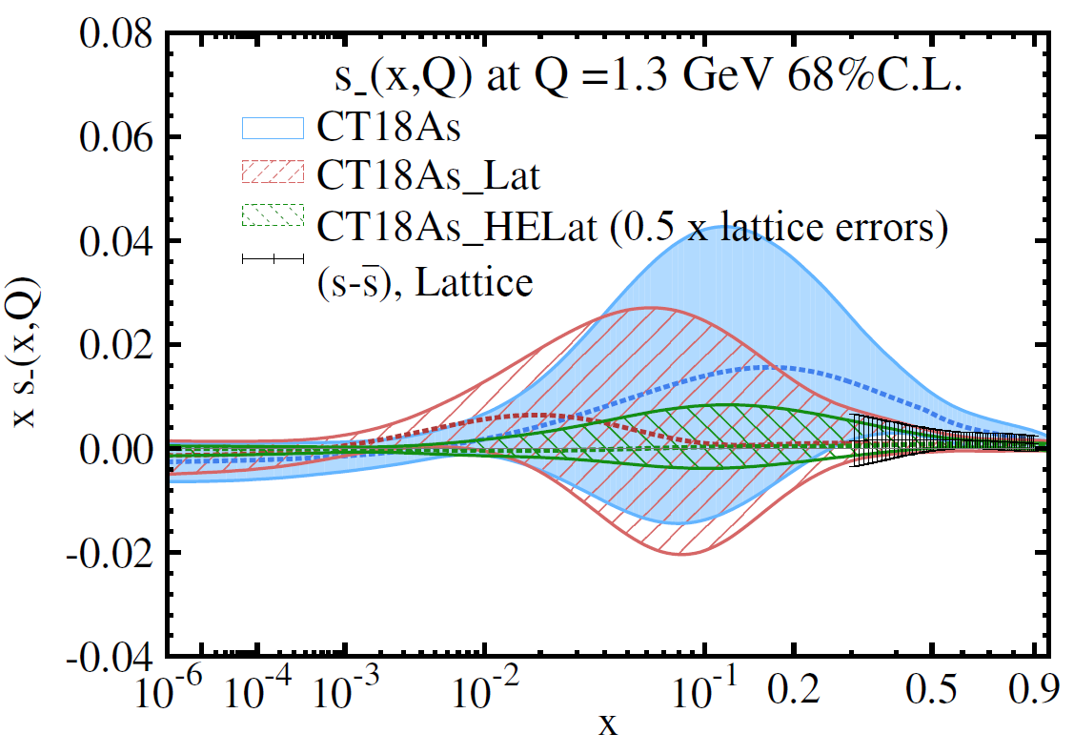
Lattice QCD for unpolarized PDFs
H.-W. Lin, TF05
Precise pheno PDFs are used to calibrate lattice PDF calculations
In turn, lattice QCD can constrain PDFs (subleading, polarized, meson, TMDs, GPDs,…) that are difficult to access in experiments
Example: the strangeness asymmetry $s\left(x,Q\right)−\overline{s}(x,Q)$ at $x>0.2$ is difficult to measure (left), but can be predicted in lattice QCD (right)
differences reflect the pulls of LHC and other experiments
T.-J. Hou et al., arXiv: 2204.07944

Slide 22
New DIS and forward physics experiments that run concurrently with, or after the HL-LHC, create a strong synergistic effect in both SM and BSM studies

Slide 23
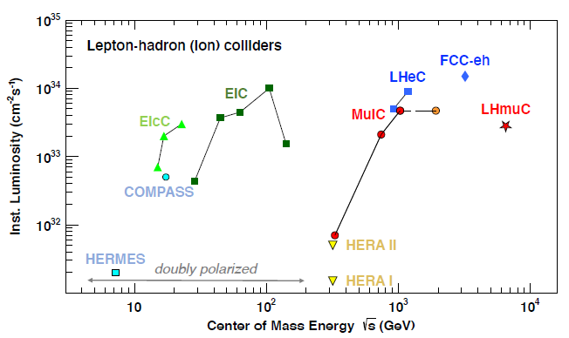
Electron-Ion Collider
the only new large-scale accelerator facility planned for construction in US in the next few decades
polarized electrons with polarized beams of proton and light ions
many opportunities for QCD and beyond:
Precision 3-dimensional tomography of hadrons and nuclei
Physics of QCD jets
Physics of heavy flavors
Partonic saturation
Electroweak and beyond standard model physics
arXiv:2203.06258
The EIC will strengthen the physics reach of the HL-LHC

Slide 24
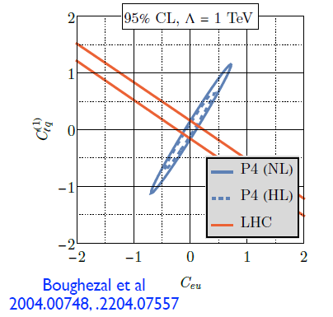
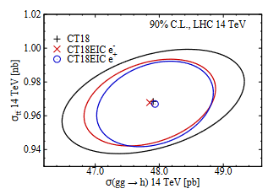
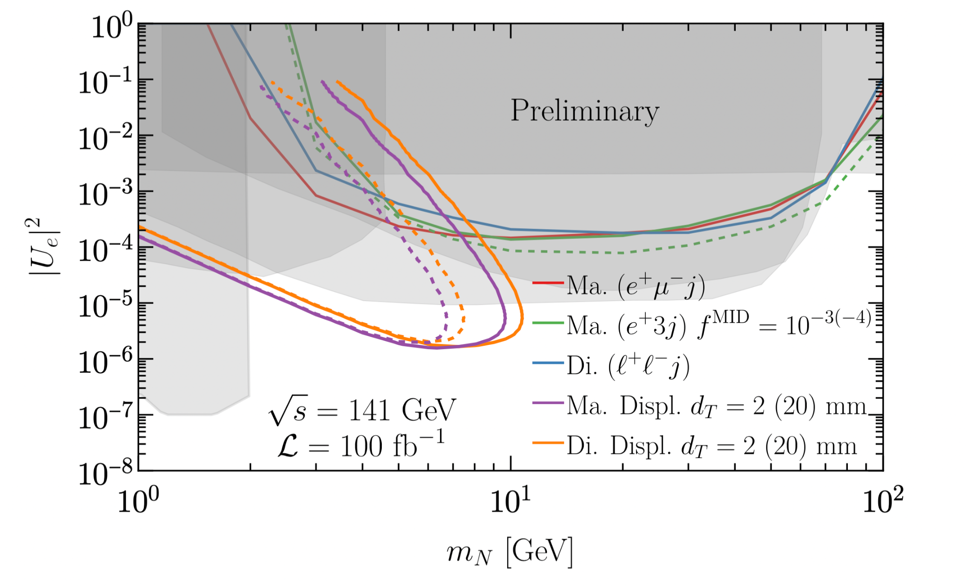
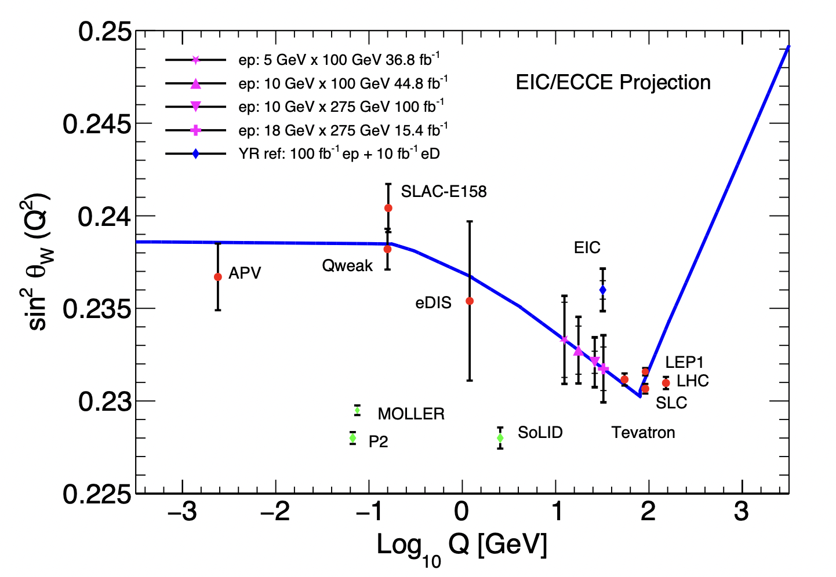
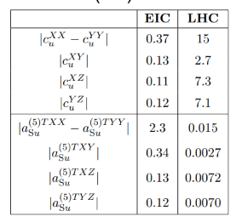
Electron-Ion Collider: a wealth of HEP-focused studies
heavy neutral lepton searches arXiv: 2203.06705
SMEFT Wilson coefficients
PDFs: arXiv:2103.05419
weak mixing angle arXiv: 2203.13199
Lorentz/CPT violations
A. R. Vieira et al., 1911.04002

Slide 25
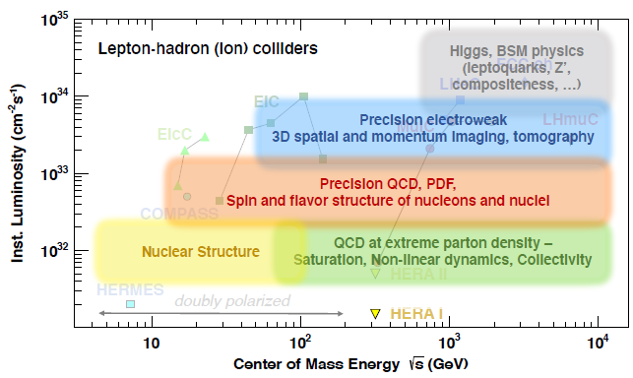
The Muon-Ion Collider, Large Hadron Electron Collider, FCC-eh
D. Acosta et al., “The Potential of a TeV-Scale Muon-Ion Collider,” arXiv:2203.06258 [hep-ph]
LHeC, FCC-he Study Group, arXiv:1206.2913, 2007.14491
Exceptional machines for BSM discoveries, Higgs physics such as measurement of $κ_{H→c\overline{c}}$,
and SM tests at (sub)percent precision

Slide 26
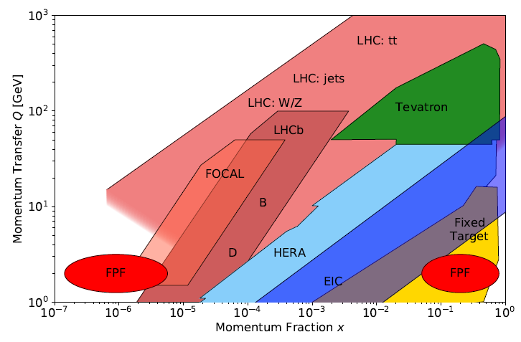
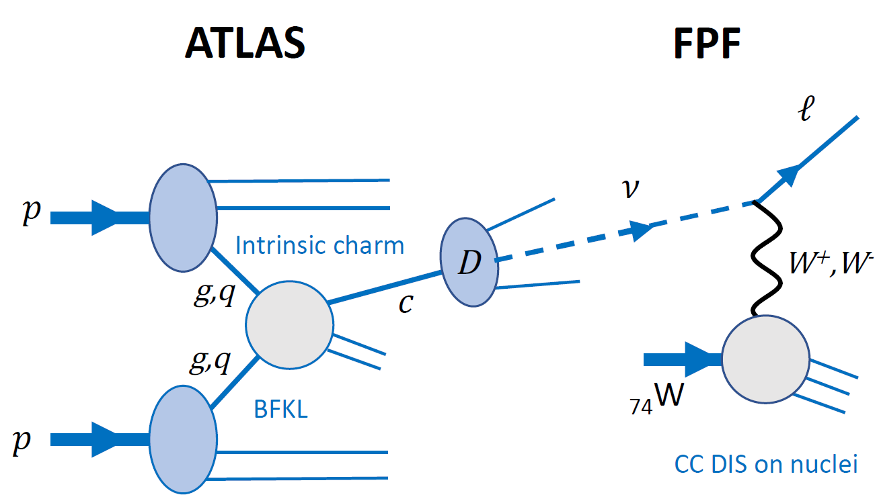
The Forward Physics Facility at CERN
M. H. Reno, EF QCD
The FPF can clarify multiple aspects of QCD in the new forward region in coordination with the HL-LHC and EIC

Slide 27
Progress in QCD increasingly depends on cross-cutting research

Slide 28
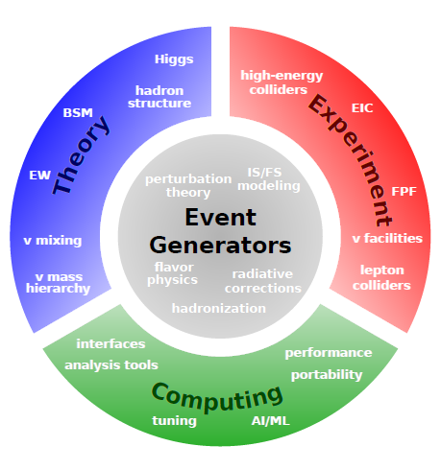
Cross-cutting QCD
Many future successes depend on developments at the intersections of high-energy QCD and other domains
For example, multi-functional QCD event generators play the central role in collider studies
Low-energy QCD facilities will elucidate nonpert. QCD aspects of resummations, jet substructure
Consistent estimates of systematic uncertainties are indispensable for precision analyses and require experimental-theoretical collaborations
J. Isaacson, EF-TF

Slide 29
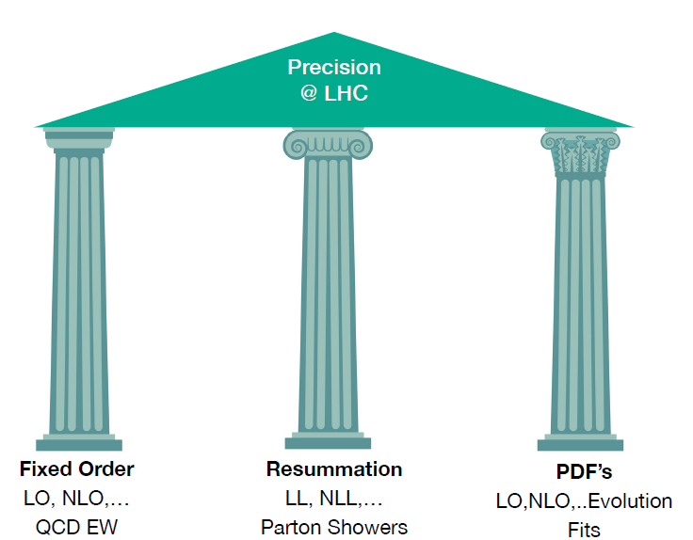
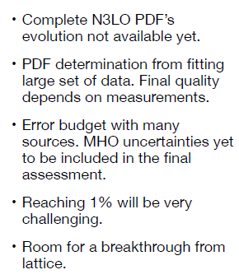
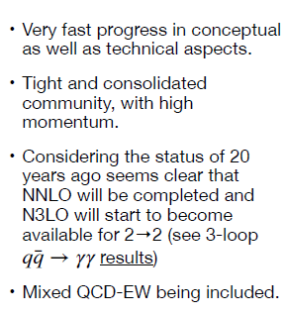
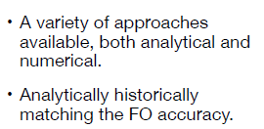
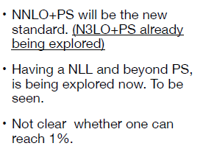
Cross-cutting goals for reaching 1% precision at the HL-LHC
F. Maltoni, TF06+07

Slide 30
QCD at 1% accuracy
N2LO and N3LO calculations
QCD infrastructure
for these calculations
representative uncertainty estimates
systemwide processes and standards for
accuracy control
Lots of promise in this area
Parton showers, fast NxLO interfaces, PDFs, ... must be comparably accurate
or The Importance of Being Earnest with Systematic Errors (experiment+theory;
traditional or AI/ML)
This must be a part of the precision-focused community culture

Slide 31
Why QCD?
Many precision measurements - in Higgs, top, and EWK - are limited by our understanding of QCD
Completing the HL-LHC & EIC programs - together with a Higgs factory - will provide unprecedented levels of precision in QCD impacting most areas in the Energy Frontier
Many thanks to the participants of the Seattle meeting and EF TGs for their strong interest in the topic.

