Slide 1
RF7: Hadron Spectroscopy Welcome and Summary of RF7 activities
Conveners:
Richard Lebed, Arizona State University, Richard.Lebed@asu.edu
Tomasz Skwarnicki, Syracuse University, tskwarni@syr.edu

Slide 2
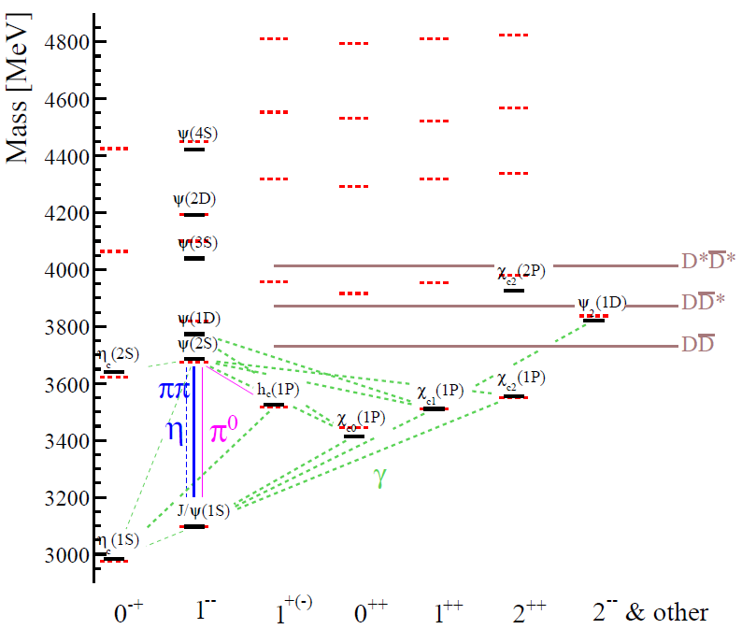
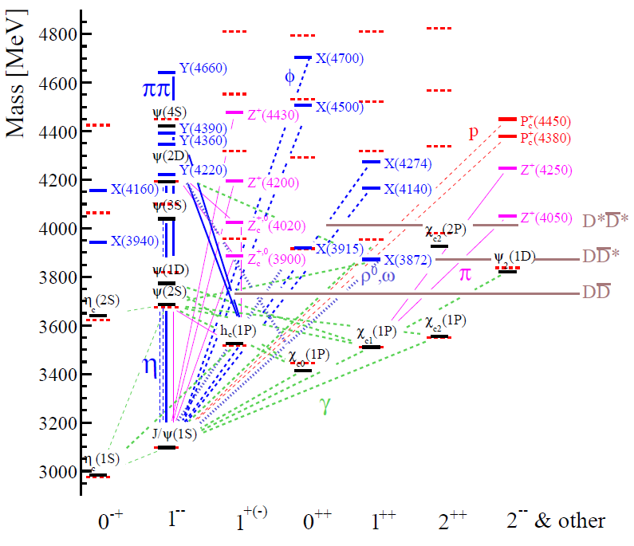
Hadron Spectroscopy is in crisis
Charmonium in textbooks $\left(c\overline{c}\right)$
$T_{cc}$(6900)
Real charmonium system
…
$$J/ψ$$
predicted
$P_{cs}^{0}$(4459)
$$Λ$$
New particle Zoo
open flavor thresholds
$Z_{cs}^{+}$(4216)
$Z_{cs}^{+}$(4000)
$$D_{s}\overline{D^{∗}}$$
measured
$$K^{+}$$
Internal structure of the new particle Zoo is poorly understood

Slide 3
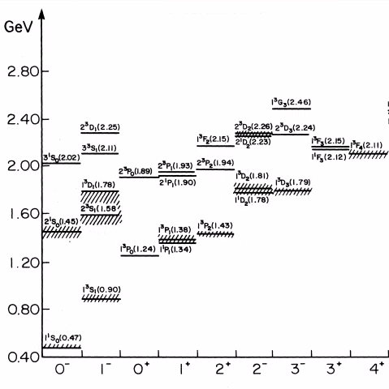
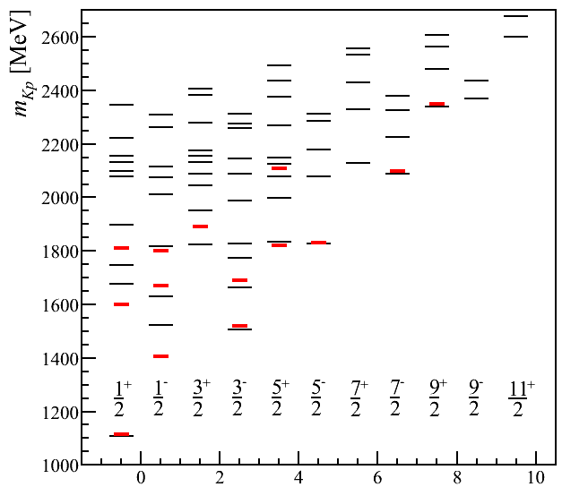
It is time to stop pretending that we understand hadrons
Excited kaons $q\overline{s}$
Excited $Λ$’s $uds$
S. Godfrey, N. Isgur
PR,D32,189 (1985)
Mesons in a relativized quark model with chromodynamics
New Zoo is likely also here!
$$K^{∗}ω,K^{∗}ρ$$
Λ* mass predictions by Loring-Metsch-Petry EPJ, A10, 447 (2001)
vs
Well-established Λ*s
$$Kω,Kρ$$
$$K^{∗}π$$
$$K^{∗}(892)$$
$$KN$$
$$Kπ$$
πΣ
Λ(1405)
$$K$$
Λ
Didn’t Gell-Mann tell us so?

Slide 4
Summary of RF7 activities – topical group structure
June 24, 2020 session on “Hadron Spectroscopy” within EF06
Hadron Spectroscopy added as its own Topical Group [first time ever for Snowmass] within Rare and Precision Frontier in July, 2020 (RF7) with Rich Lebed (Arizona State U.) and T.S. (Syracuse U.) as conveners, who invited many subconveners for a good representation of the broad experimental and theoretical communities studying topics we concentrated on:
Heavy-Quark Conventional Hadrons
Bryan Fulsom (PNNL), Alexis Pompili (U. of Bari), Elena Santopinto (INFN Geona)
Heavy-Quark Exotic Hadrons:
Liupan An (CERN), Ryan Mitchell (Indiana U.), Sasa Prelovsek (U. of Ljubjana)
Light-Quark Exotic Hadrons:
Sean Dobbs (Florida State U.), Justin Stevens (College of William&Mary), Adam Szczepaniak (Indiana U.)

Slide 5
Summary of RF7 activities - meetings
Three early workshops to review each subtopics (7-8 presentations each, good attendance virtual attendance):
Sep.16, 2020 Heavy-Quark Exotic Hadrons
Sep.23, 2020 Heavy-Quark Conventional Hadrons
Sep.30, 2020 Light-Quark Exotic Hadrons
Oct.2, 2020 Review 14 LoIs at RPF Townhall meeting
Two additional workshops to review remaining topics:
Nov.18, 2020 Opportunities in Hadron Spectroscopy
Dec.16, 2020 Joint Session with Energy Frontier (EF06,EF07) on hadron production (there is also a joint discussion session at this meeting on Friday, July 21, 2022 at 10:30am)
Workshop to restart activities after a COVID pause:
Oct.25, 2021 Update on Hadron Spectroscopy
This year activities:
Consolidation of LoIs into ~10 White Papers relevant to our subgroup
May 17, 2022 Presentations of white papers in parallel session of RPF Cincinnati Meeting

Slide 6
RF7 White Papers
Future Physics Potential of LHCb, LHCb collaboration, LHCb-PUB-2022-012, CERN-LHCb-PUB-2022-012, in 2022 Snowmass Summer Study, 2022, https://cds.cern.ch/record/2806113
Physics with the Phase-2, ATLAS and CMS Detectors, ATLAS and CMS collaborations, CMS PAS FTR-22-001, ATL-PHYS-PUB-2022-018 http://cds.cern.ch/record/2806962
Review of CMS Contribution to Hadron Spectroscopy (Snowmass 2021 White Paper), R. Chistov, V. Papadimitriou, S. Polikarpov, A. Pompili and A. Sanchez-Hernandez, arXiv:2204.06667
Belle II Physics Reach and Plans for the Next Decade and Beyond, Belle II collaboration, arXiv:2207.06307
Physics in the Tau-Charm Region at BESIII, BESIII collaboration, arXiv:2204.08943
Hadron Spectroscopy at STCF, F.-K. Guo, H. Peng, J.-J. Xie and X. Zhou, arXiv:2203.07141
Hadron Spectroscopy in Photoproduction, M. Albaladejo, L. Bibrzycki, S. Dobbs, C. Fernandez-Ramırez, A. Hiller Blin, V. Mathieu et al., arXiv:2203.08290
Substructure of Multiquark Hadrons, M. Karliner, E. Santopinto et al., arXiv:2203.16583
Need for Amplitude Analysis in the Discovery of New Hadrons, JPAC collaboration, arXiv:2203.08208
Hadron Spectroscopy with Lattice QCD, J. Bulava et al., arXiv:2203.03230

Slide 7
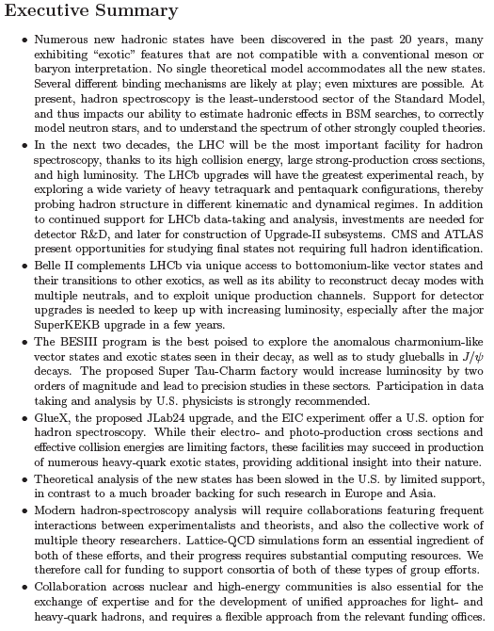
RF7 Summary Report
Drafted by R.L. and T.S. with input from the submitted white papers and their editors
Feedback from the RF7 community at the RPF Cincinnati meeting (May 18, 2022)
The improved draft circulated to the RF7 mailing list on July 11.
We are accepting comments until the end of the Seattle meeting (July 26, 2022)
We expect to submit it to arXiv by early August

Slide 8
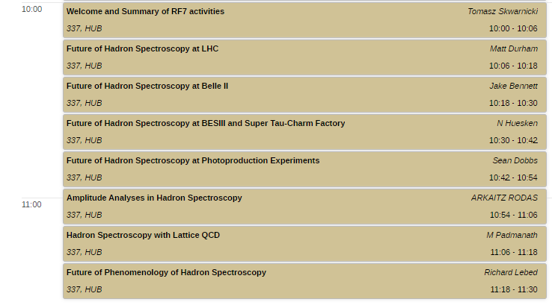
Today session
Short review presentations (10 + 2 min) by the representatives of the major stakeholders
Please stick to your allocated time!
More of discussion opportunities at the Friday joint session with EF 10am-12pm, MGH, Rm 248 (no talks scheduled!)

