Slide 1
Energy Frontier
Large Experiments
Snowmass Community Summer Study (CSS)
Seattle, July 17-26, 2022
Laura Reina (FSU), Meenakshi Narain (Brown U.), Alessandro Tricoli (BNL)
Snowmass EF wiki: https://snowmass21.org/energy/start

Slide 2
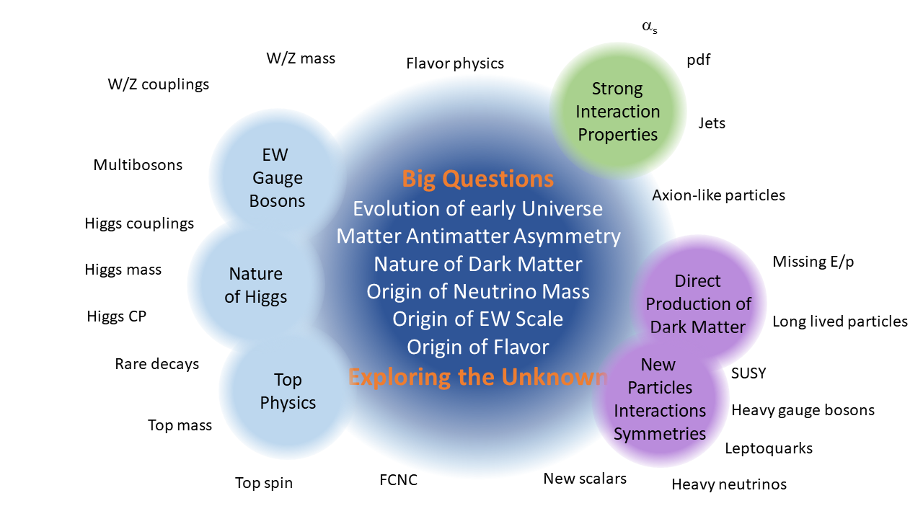
Energy Frontier: explore the TeV energy scale and beyond
Aims at investigating open fundamental questions and exploring the unknown, using various probes to discover and characterize the nature of new physics, through the breadth and multitude of collider physics signatures

Slide 3
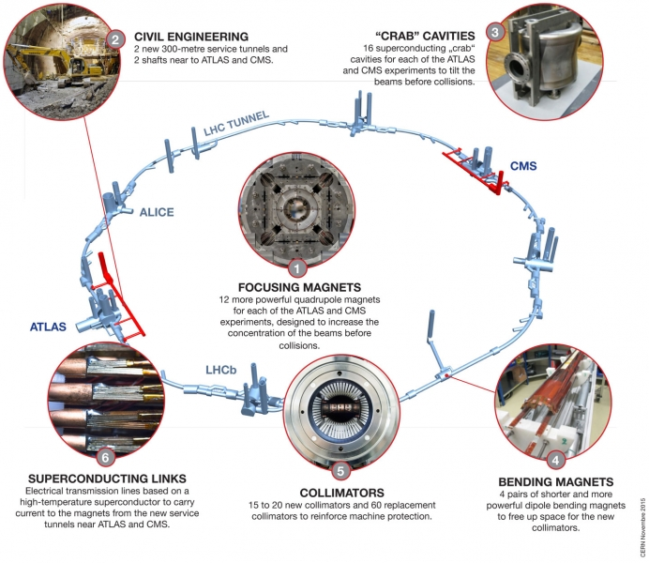
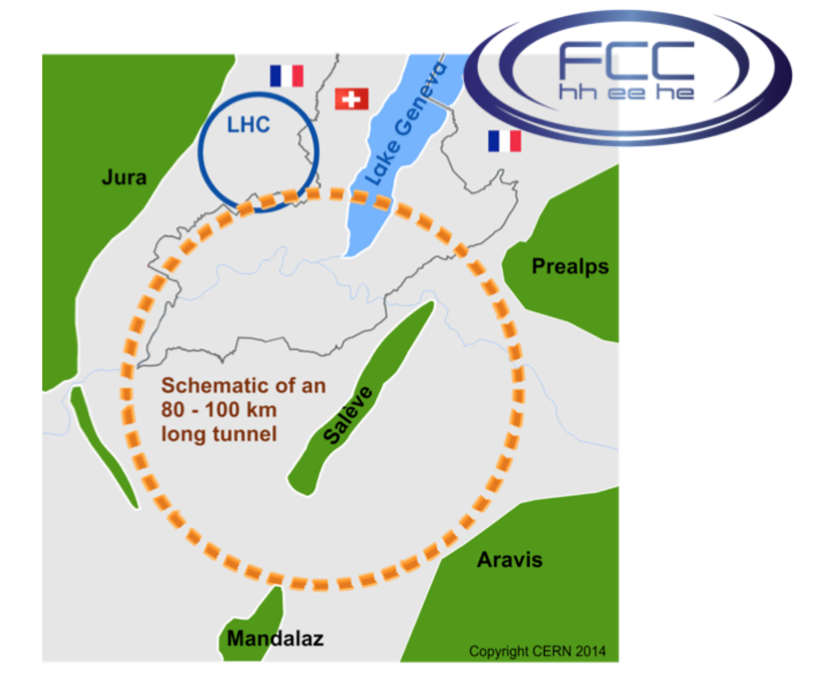
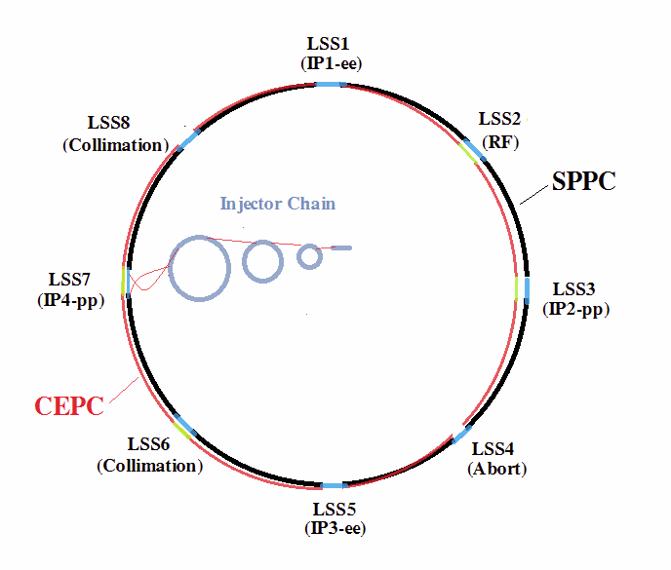
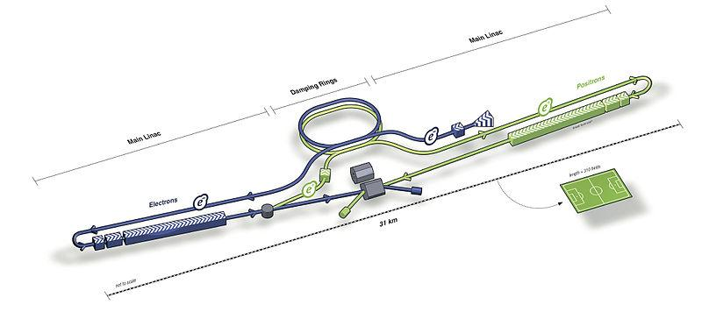
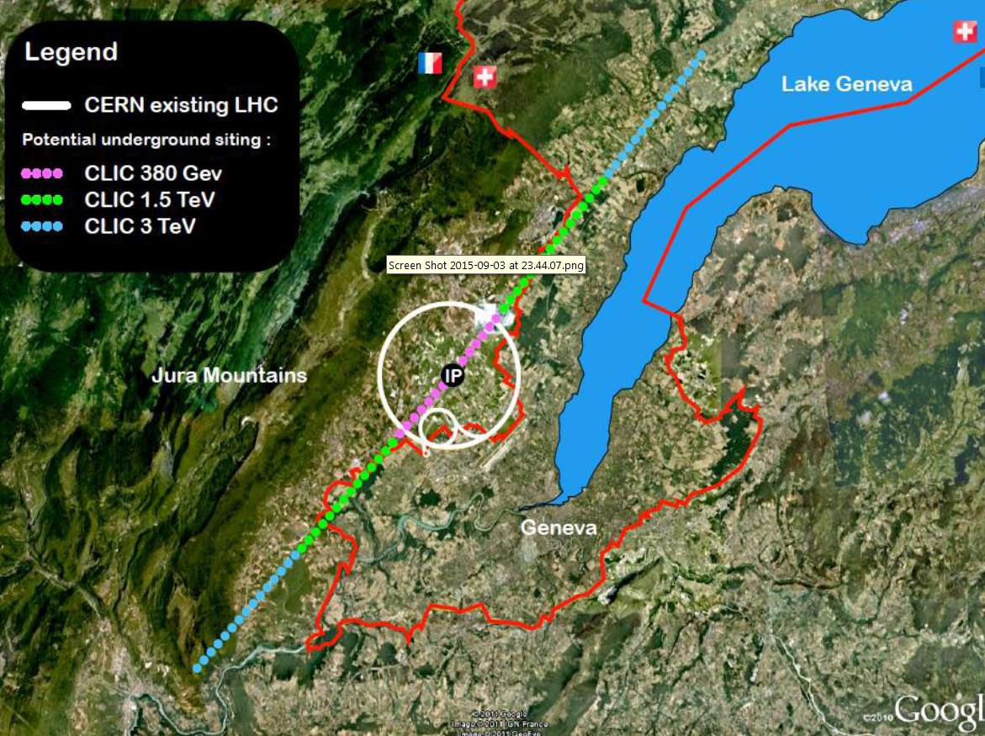
Which machines?
HL-LHC
Muon Collider
Looking for indirect evidence of BSM physics
Need factories of Higgs bosons (and other SM particles) to probe the TeV scale via precision measurements
Search for direct evidence of BSM physics at the energy frontier
Need to directly reach the multi-TeV scale
- e⁺e⁻
- hadron-hadron
- hadron-electron
ILC
CEPC SppC
FCC
LHeC
+CCC /HELEN
CLIC

Slide 4
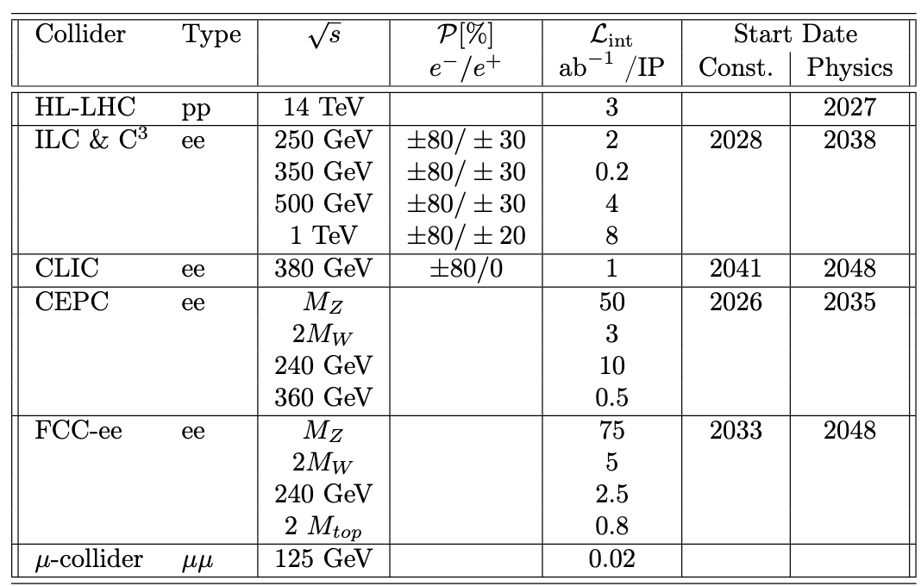
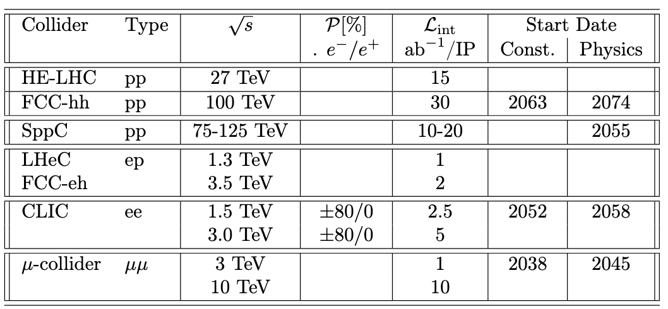
Energy Frontier Benchmark Scenarios
Higgs-boson factories
(up to 1 TeV c.o.m. energy)
Multi-TeV colliders
(> 1 TeV c.o.m. energy)

Slide 5
Timelines

Slide 6
Indicative scenarios of future colliders [considered by ESG]
Proton collider
Construction/Transformation
Electron collider
Preparation / R&D
Muon collider
2038 start physics
Japan
5 years
ILC: 250 GeV
2 ab⁻¹
500 GeV
4 ab⁻¹
1 TeV
≈ 4-5.4 ab⁻¹
20km tunnel
31km tunnel
40 km tunnel
2035 start physics
China
CepC: 90/160/240 GeV 100/6/20 ab⁻¹
100km tunnel
SppC: 75-125 TeV, 10-20 ab⁻¹
LHC HL-LHC (14TeV, 3 ab⁻¹)
(13.6TeV, 450 fb⁻¹ )
2048 start physics
100km tunnel, installation
FCC-ee: 90/160/250 GeV -150/10/5 ab⁻¹
350-365 GeV 1.7 ab⁻¹
installation
CERN
FCC hh: 100 TeV ≈ 30 ab⁻¹
29 km tunnel
50 km tunnel
2020
2030
2040
2050
2060
2070
2080
2090

Slide 7
Possible scenarios of future colliders
Proton collider
Construction/Transformation
Electron collider
Preparation / R&D
Muon collider
Original from ESG by UB
Updated July 25, 2022 by MN
Proposals emerging from this Snowmass for a US based collider
CCC
Muon Collider
Timelines technologically limited
Uncertainties to be sorted out
Find a contact lab(s)
Successful R&D and feasibility demonstration for CCC and Muon Collider
Evaluate CCC progress in the international context, and consider proposing an ILC/CCC [ie CCC used as an upgrade of ILC] or a CCC only option in the US.
International Cost Sharing
Consider proposing hosting ILC in the US.
2040 start physics
CCC: 250 GeV
2 ab⁻¹
550 GeV
4 ab⁻¹
2 TeV
≈ 4 ab⁻¹
5 years
8 km tunnel
RF upgrade
USA
2045 start physics
13 years
muC:Stage1
3 TeV
Stage2
10 TeV;
≈ 10 ab⁻¹
4km & reuse Tevatron ring
Note: Possibility of
125 GeV or 1 TeV at Stage 1
OR 4km+6km km ring
10km & 16.5 km tunnels
2020
2030
2040
2050
2060
2070
2080
2090

Slide 8
Costs

Slide 9
Large Projects
Project | Construction Start date (yr) | Construction End date (yr) | Construction Cost B$
Higgs Factories
CepC | 2026 | 2035 | 12-18
CCC (higgs Fac) | 2030 | 2040 | 7-12
ILC (higgs Fac) | 2028 | 2038 | 7-12
CLIC | 2041 | 2048 | 7-12
FCC-ee | 2033 | 2048 | 12-18
Multi-TeV Colliders
Muon Collider (3 TeV) | 2038 | 2045 | 7-12
Muon Collider (10 TeV) | 2042 | 2052 | 12-18
SppC | 2043 | 2055 | 30-80
HE CCC | 2055 | 2065 | 12-18
HE CLIC (3 TeV) | 2062 | 2068 | 18-30
FCC-hh | 2063 | 2074 | 30-50
Cost estimates from the ITF report by AF.
Please refer to the document for
explanations now they were
estimated and associated caveats
Link to the report on AF wiki

Slide 10
Medium Project Scale R&D requests
Project | R&D Start date (yr) | R&D End Date (yr) | R&D cost M$
Higgs Factory detector R&D | now | 2035 | ~100-150
CCC higgs factory | 2024 | 2028 | ~100
CCC High Energy | 2045 | 2050 | ~200
Muon Collider (1-3 TeV) | now | 2040 | ~300
Muon Collider (10 TeV) | 2040 | 2047 | ~200
Estimated US Contributions
In the spirit of Snowmass numbers are very preliminary. They give an approximate scale.
Need to be vetted further.

Slide 11
Accelerator & Detector
R&D Needs

Slide 12
Higgs Factories Multi-TeV Machines
Support a fast-start for construction of an e+e- Higgs Factory
Viability of Facilities and Challenges (from AF)
ILC:
Ready to go, polarization
Long, e+ source,
consider CCC technology for upgrades
FCCee & CEPC :
Ongoing feasibility study
Longest, $$, power consumption
CLIC:
Lowest power needs, shortest
2-beams (or klystrons?), tolerances
Cool Copper Collider or HELEN:
new proposals from Snowmass
lower cost option to ILC/CLIC
large gradients at least 70MV/m (HELEN) CCC capability up to 120-155 MV/m
Support for R&D for EF multi-TeV colliders
Viability of Facilities and Challenges (from AF)
CLIC-3 TeV :
Established CDR, demo facilities
Long, $$$, huge power consumption
FCChh-100 TeV:
Re-use FCCee tunnel, high-L, LHC exp.
20(?) yrs for 16 T magnets, $$$, power
SPPC-125 TeV:
Re-use CepC tunnel, ep 0.12+62.5 TeV
(N) yrs for 20 T magnets, $$$, power
Muon Collider-10(14) TeV:
Potentially lowest cost, best Lumi/TWh
6D cooling R , D on many subsystems

Slide 13
Detector R&D Needs
Preparation of a Technical Design for a Detector needs an R&D program
Highly segmented detectors with good resolution were simulated to make the case for physics studies for Higgs Factories & Multi-TeV Colliders.
We do need complex/cutting-edge detectors to meet the ambitious physics goals! The needs extend beyond generic R&D.
Address the specific detector challenges for e⁺e– colliders.
Such a program needs to start now
to explore the technology to build a full-scale e⁺e– collider detector
It takes about 10 years from CD0 to end of construction of a collider detector.
Thus investment in targeted detector R&D for a Higgs Factory has to start soon!

Slide 14
Detector R&D Needs for Higgs Factory
Main features identified together with Instrumentation Frontier:
Pixel tracker with lowest possible mass and possible radius
Low-mass outer tracker for excellent momentum resolution to high energies
A highly segmented calorimeter for particle flow
A large superconducting solenoid enclosing calorimeter and tracker
Muon chambers
Triggerless readout
Timing detectors
Particle ID K/π/p separation
sophisticated electronics to handle large data volume
Understanding the Machine Detector Interface
Need engineering to go from prototypes to detector

Slide 15
Summary
An opportunity for US to take leadership in colliders
US EF community strongly supports
A fast start of construction of an e+e- Higgs Factory (FCC-ee, ILC, C³, CLIC) [Large Project]
Request for targeted detector R&D for Higgs Factory [in the range of small project costs]
Request for investment in R&D towards lowering of costs for Higgs Factory [lower end of medium project costs]
interest in new technologies from early career scientists
Request for investment in R&D towards multi-TeV colliders
significant interest for adding muon collider R&D. [lower end of medium project costs]

Slide 16
backup

Slide 17
The definitions of small, medium and large experiments are:
Large: >$500M
Medium: $75M - $500M
Small; <$75M

