Slide 1
mpgds: recent advances, current r&d, and the European strategy
Klaus Dehmelt on behalf of all WP1 contributors
Seattle Snowmass Summer Meeting 2022
July 22, 2022

Slide 2
recent advances - mpgd
Micro Pattern Gas Detectors → MPGD
Motivation and goal for MPGD development → cost-effective, large-scale detectors with excellent position and timing resolution in high-rate applications
Significant development time invested
understanding optimal manufacturing techniques for MPGDs
understanding their operation
mitigation of undesirable effects, for instance discharges and ion backflow
Culmination in formation of CERN-RD51 collaboration → 2008
CERN PCB workshop → source of essential expertise in production, mitigation and correction of production issues, critical input for R&D

Slide 3
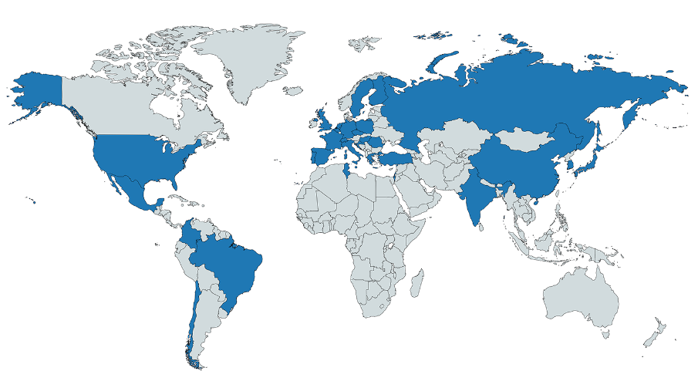
current r&d: the source
CERN-RD51 collaboration → technical collaboration, established in 2008
Comprises ~450 collaborators from 89 institutes from 31countries
Well organized and managed
Driver for the coordinated efforts within the MPGD community
more techniques becoming available or affordable
new detection concepts are still being introduced
existing ones are being substantially improved
Seven Working Groups WG
Transversal to RD51 activities, covering all aspects of R&D

Slide 4
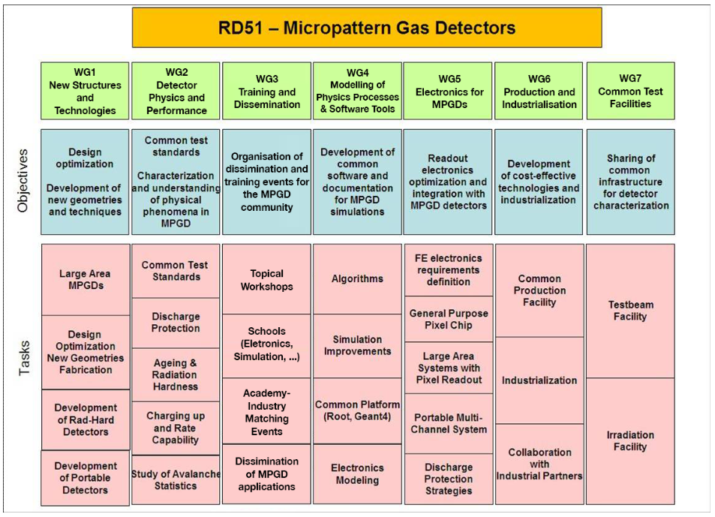
current r&d: the source
Seven Working Groups WG, transversal to RD51 activities, covering all aspects of R&D

Slide 5
current r&d
Gas Electron Multiplier (GEM) + Micro-Mesh Gaseous Structure (Micromegas) → well established MPGD devices
More to come → THGEM, μRWell, …
Finding applications in many fields
HEP, NP, Astrophysics, Medical applications, Homeland Security, Commercial applications, …
Tracking, particle identification, timing, photo-detectors
Triggered electronics development
Number of LOIs received → illustration of ongoing developments and expansion of MPGD use

Slide 6
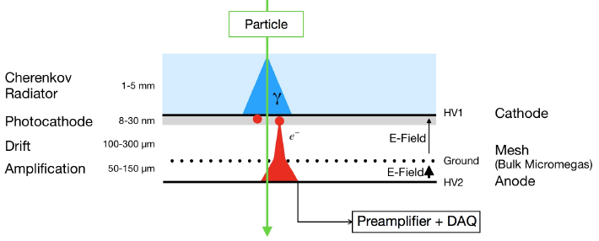
current r&d
High-precision timing → the Micromegas PICOSEC concept
Prototypes show excellent timing resolution σ_{t}=O(20ps) for MIPs, σ_{t}=O(70ps) for photons
Few pads’ prototypes → many pads' prototypes

Slide 7
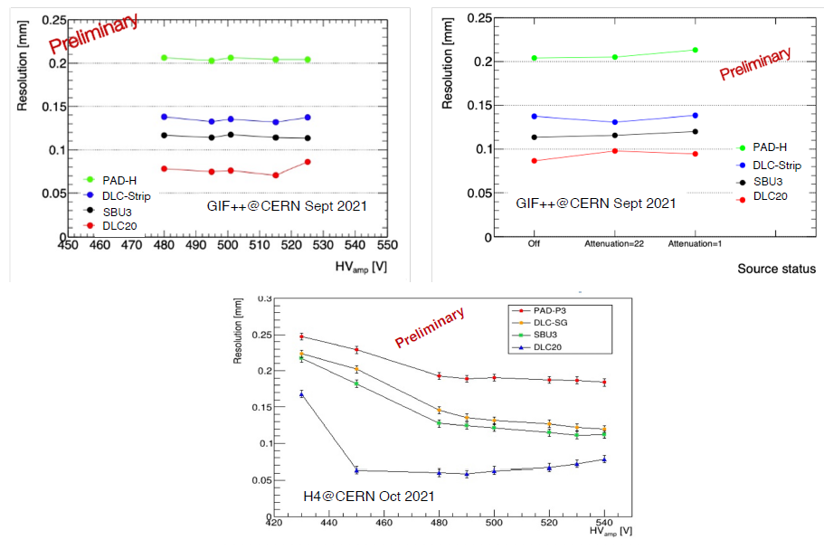
current r&d
Pixelated resistive Micromegas for high-rate environments
Rate capability goal 10s MHz/cm² with stable and efficient operation
Development toward large areas
Diamond-like Carbon DLC resistive layer techniques

Slide 8
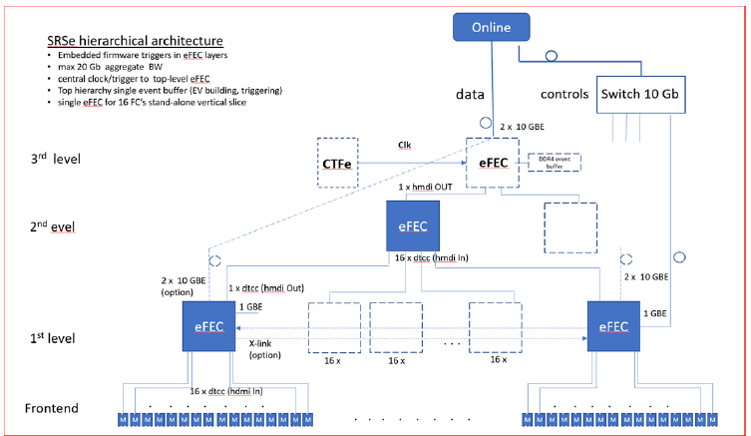
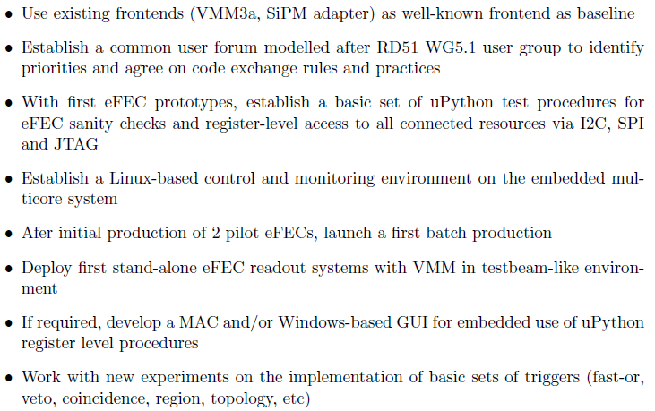
current r&d
Scalable Readout System SRS established readout system
designed for scalability from desktop stems to rack-sized readout systems running under the same Online DAQ and Control system
Extended SRS-e paradigm adds real-time trigger functionality, deep trigger pipelines and generalized frontend link
Workplan developed

Slide 9
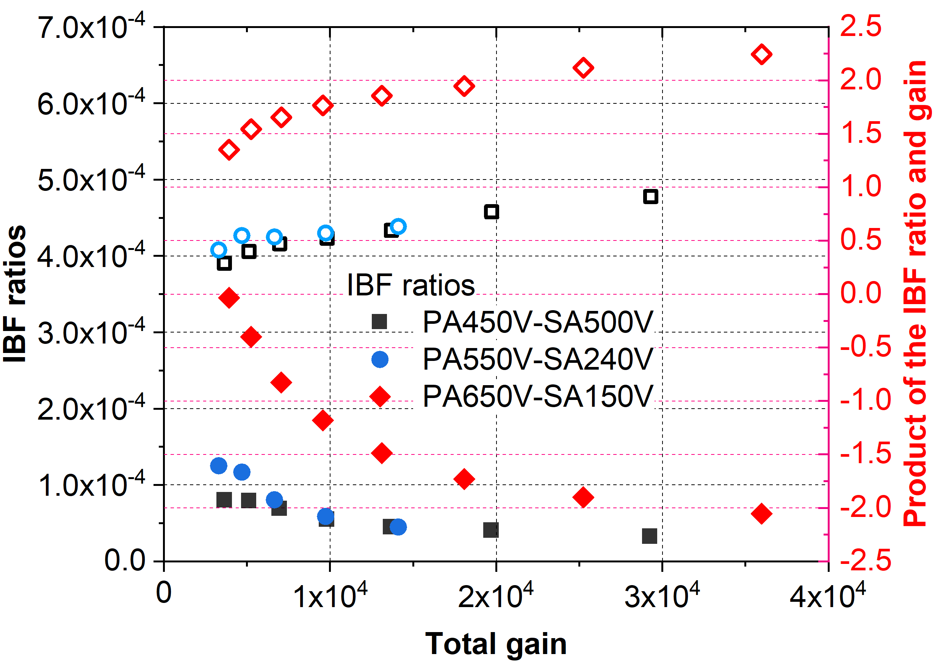
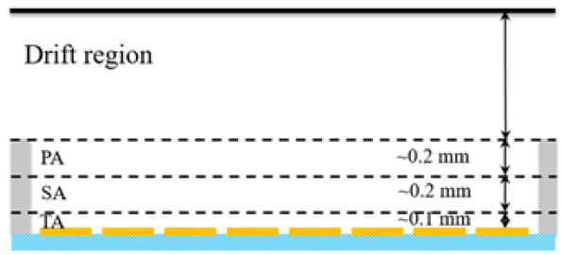
current r&d
High gain, low IBF multilayer Micromegas
Motivated by painful IBF issue for every Time Projection Chamber → need to gateless for high readout speed application
MPGD intrinsically IBF blocker → Micromegas superior

Slide 10
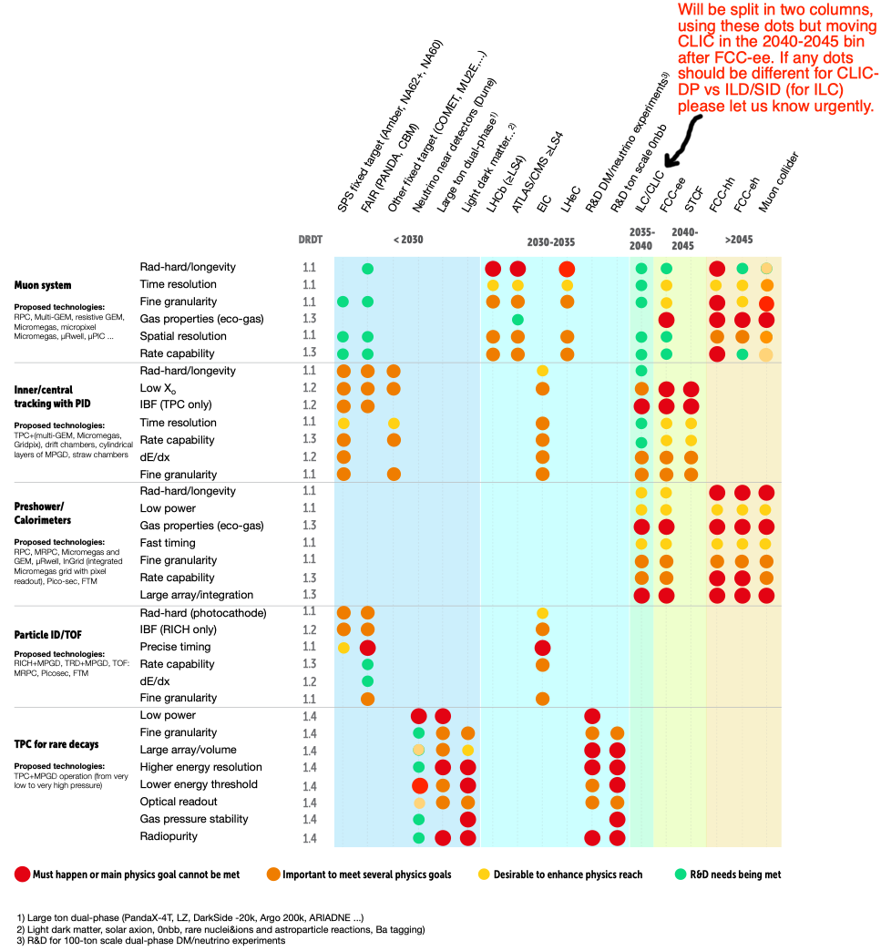
the European strategy
European Committee for Future Accelerators - ECFA
mandated to develop a roadmap to balance
R&D efforts in Europe
After extensive expert and community
consultation phase → final roadmap
approved end of 2021
Gaseous detectors as one of the many
work-packages → TF1

Slide 11
the European strategy
Detector R&D Roadmap → Detector R&D Themes DRDT

Slide 12
the European strategy
Plan is to restructure RD51
Formation of DRDC1 in 2023(?)
RD51 will cease to exist after 15 successful years of operation
Restructuring and implementation within the ECFA Detector R&D roadmap
Basic Research Needs BRN study analogous to ECFA Detector R&D roadmap
BRN roadmap did not have gaseous detectors as topic
SNOWMASS 2021 study introduced gaseous detectors as topic
U.S. community planning should be synergistic: BRN → ECFA Detector R&D roadmap
U.S. community should stay engaged with DRDC
U.S. community should establish MPGD facility/center within the country

