Slide 1
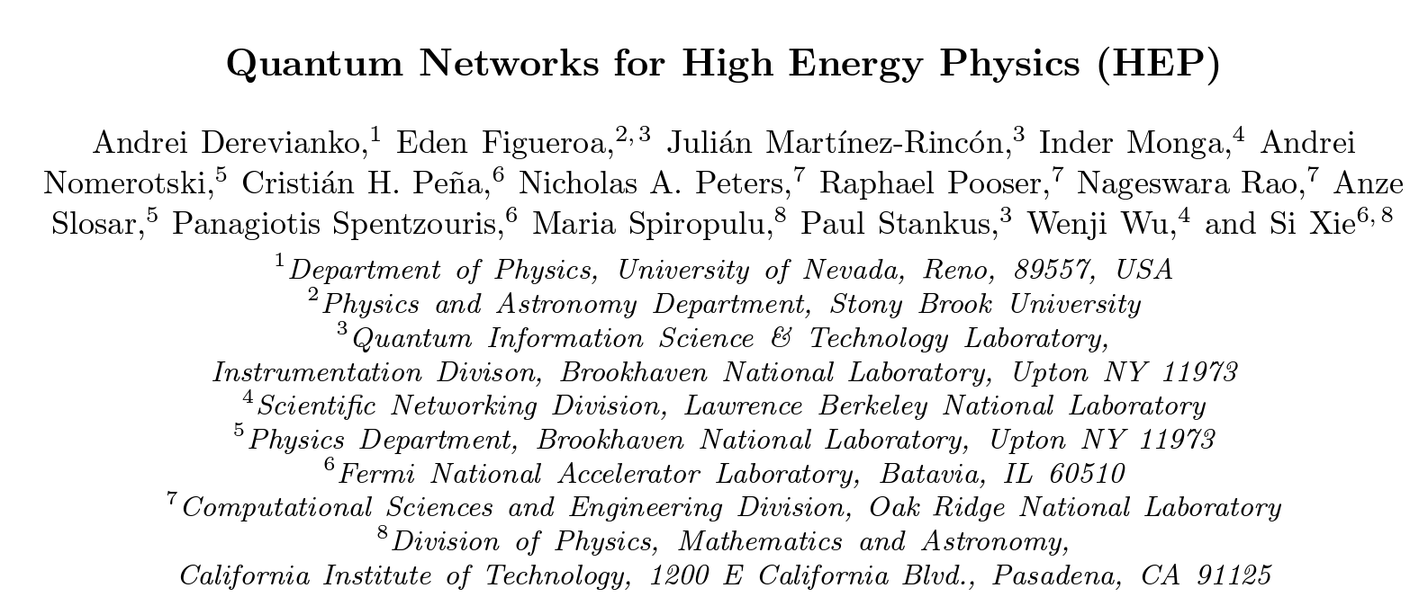
quant-ph/2203.16979

Slide 2
Outline
Motivation
Metcalf’s Law
Squeezed states
Entanglement
Applications
Quantum security (biggest application outside HEP, OE and CESER funded since 2011)
Quantum computing (covered elsewhere)
Quantum sensor networks
Challenges
Rate/loss tradeoffs in quantum communications
Quantum repeaters

Slide 3
Motivation
Quantum/Classical Breakeven
Metcalf's Law: network value scales as square of connected elements
Quantum network: potentially exponential

Slide 4
Squeezing and Entanglement
Phase
Phase
Amplitude
Amplitude
Can be used to reduce readout noise
Amplitude
squeezing
Coherent
State
Bell State Analysis
Classical
Communication
$$\left.\left|ψ\right.\right\rangle$$
Entangled correlations enable quantum teleportation
state transfer
helps in building long-distance entanglement
Unitary
$$\left.\left|ψ\right.\right\rangle$$
Entangled
Source

Slide 5
Quantum networks of sensors
Goal: use quantum effects - squeezing and entanglement - to improve on classical capabilities by networking quantum sensors
Potential Networked Quantum Sensors:
Quantum-assisted Long-Baseline telescopes
Atomic Clocks
Magnetometers
Matter wave interferometers
Accelerometers

Slide 6
Fundamental Rate/Loss Tradeoff Bound
M. Takeoka, M., Guha, S. & Wilde, M. M. Fundamental rate-loss tradeoff for optical quantum key distribution. Nat. Comms. 5, 5235 (2014).
Fiber Distance (km, proxy for loss)
S. Pirandola, R. Laurenza, O. Carlo & L. Banchi, “Fundamental limits of repeaterless quantum communications,” Nat. Comms, 8, 15043 (2017).
Need non-Gaussian operations (like Bell State Analysis) to exceed these bounds → quantum repeaters

Slide 7
Where do we go from here?
Given there is a large parameter space, where does HEP benefit most from quantum sensor networks?
What parameter regime tests are not tractable via conventional techniques?
Where can we afford to operate on the rate/loss tradeoff?
Terrestrial quantum networks on metro area scales (and smaller)
Satellite networks (potentially low SNR)
Beyond (long-term): quantum repeater networks

Slide 8
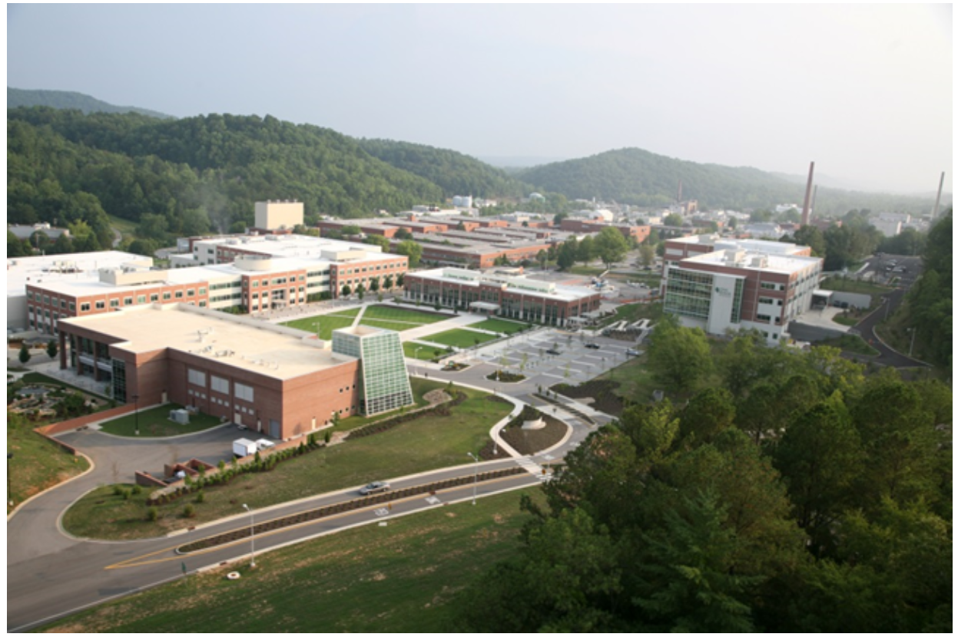
Thank you for your attention.
Summary
Entanglement and squeezing can improve quantum networks of quantum sensors
Small scale quantum networks are possible now
More work needs to be done to gain full benefits of quantum sensor networks potential for exponential scaling advantage
Recent DOE Workshop Report References
“Quantum Sensing for High Energy Physics,” arxiv.org/1803.11306 (2018)
“Quantum Networks for Open Science,” arxiv.org/1910.11658 (2019)
”Quantum Internet Blueprint Workshop Report,” https://www.osti.gov/biblio/1638794/ (2020)

Slide 10
Entanglement Swapping
Distribute entangled pairs along links, entangle with Bell State Analysis (BSA)
Distribute
Swap
BSA
BSA
BSA
Fewer pairs
Longer distance
Swap
again
BSA
BSA
Long-distance
shared entanglement
Transmission of entangled photons is non-deterministic
Store entanglement in a quantum memory
Before BSA to increase probability of chained BSA
Hold long-distance entanglement for teleportation
Storage causes errors
Need to “fix” shared entanglement or teleportation can fail
Purification, Concentration, Distillation, Quantum Error Correction

Slide 11
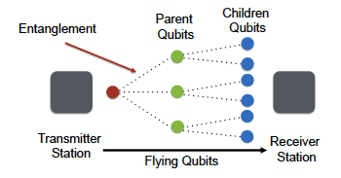
All-photonic quantum repeater based on tree cluster states
(physical qubits)
“logical”
Encode “logical” quantum information into a quantum error correcting code of multiple physical qubits (single photons)
Transmit
Perform quantum error correction to encode on “new” photons

