Slide 1
C3 from the AF1 Point of View
AF1: Beam Physics and Accelerator Education
Mei Bai (SLAC)

Slide 2
AF1: Beam Physics and Accelerator Education
04: Physics Limits of Ultimate Beams
Dedicated workshop (joint with AF4, AF6, and Aries) to discuss ultimate beam parameters such as energy, intensity, brilliance, beam power on-target allowed by the fundamental laws of physics. Discuss practical limits from engineering and technology.
Venue: online
Co-Org with: AF4, AF6, & Aries
01: Education, Diversity and Outreach
Dedicated meeting (workshop)
Invite all LoI contributors
Discuss issues and propose steps
Date: Target October
Venue: online
04
01
03
02: Research Center/Facility
Discussion forum to clarify needs of test/R&D facilities to support concept R&D, training, and educational needs.
Venue: online
Co-Org with AF4, AF6, etc
03: Computational Tools & Machine Learning
Propose joint with Computational Frontier to cover tools extending modeling capabilities, potential ML impacts, education, and more efficient use of resources.
Co-Org with: Comp Frontier
02

Slide 3
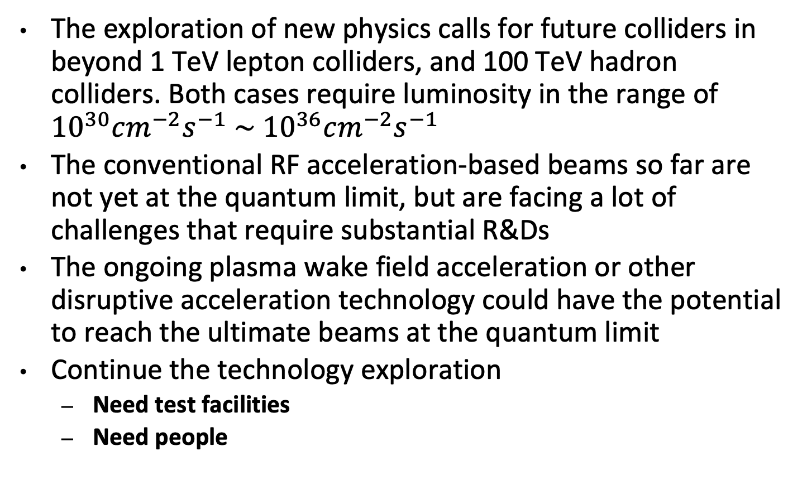
Summary
The exploration of new physics calls for future colliders in beyond 1 TeV lepton colliders, and 100 TeV hadron colliders. Both cases require luminosity in the range of ${10}^{30}cm^{−2}s^{−1} \sim$ ${10}^{36}cm^{−2}s^{−1}$
The conventional RF acceleration-based beams so far are not yet at the quantum limit, but are facing a lot of challenges that require substantial R&Ds
The ongoing plasma wake field acceleration or other disruptive acceleration technology could have the potential to reach the ultimate beams at the quantum limit
Continue the technology exploration
  Need test facilities
  Need people

Slide 4
AF1 Recommendations
Establish a decadal road map of accelerator and beam physics research in the DOE OHEP General Accelerator R&D (GARD) to address the four ABP ”grand challenges” in beam intensity, beam quality, beam control and beam modeling
Re-establish a program of beam physics research on general collider related topics, in particular, towards future e +e − colliders and muon colliders
Strengthen and expand capabilities of the US accelerator beam test facilities to maintain their competitiveness w.r.t. worldwide capabilities.
Comprehensive recommendations for addressing work force
    -- Education: support for USPAS, universities and DOE traineeship programs
    -- Outreach:
-- Yearly national undergrad-oriented recruiting class to draw in talent and Lab programs and
expectations to deliver colloquia at universities
    -- Diversity Equity and Inclusion

Slide 5
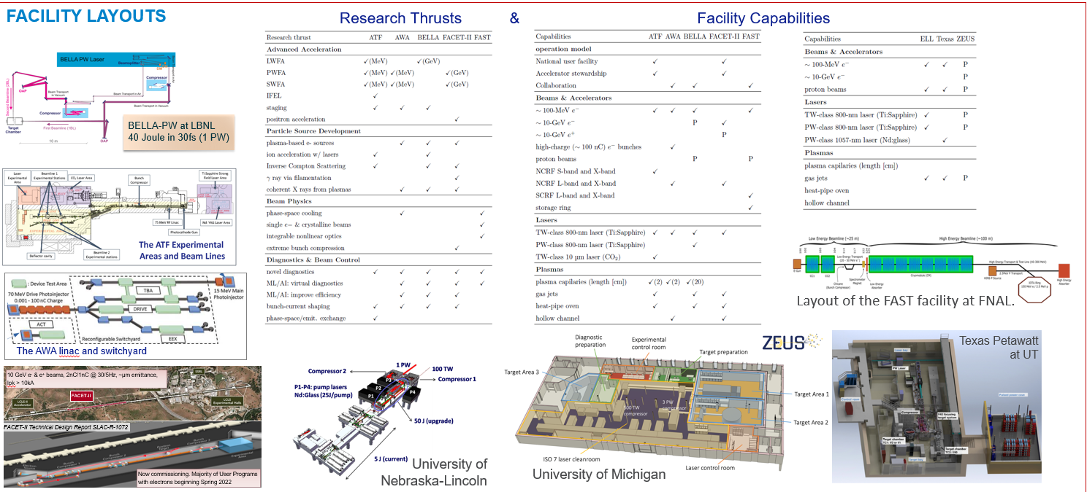
Beam Test Facilities: Research Thrust & Capabilities
(O(100) MeV energy drive beams, O(10) Petawatt drive lasers, O(1) Gigawatt RF power sources
From J. Power, ANL, AF1 Report, July 21, 2021

Slide 6
Look from AF1 point of view
Beam Physics Grand Challenges:
High brightness beams
  -- low emittance photo injector, advanced beam
  dynamics for linac and beam delivery system
  -- strong synergy with X-FEL
Beam control and modeling
Acc. S&T Challenges:
Novel HG RF structure and technologies
Large scale LN cryogenic for accelerator system
  -- design, modeling, monitoring and controling
Tunable permanent magnets
C3Demo facility will be complementary to the existing beam test facilities.
The staged approach has strong synergies with other accelerator based scientific fields needs and can have strong near-term impact.
The full realization will not only help to reduce the technical risks for the realization of C³, but also be the facility for accelerator and beam science R&D as well as training next generation workforce.

Slide 7
