Slide 1
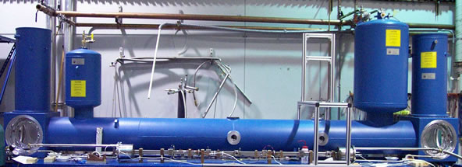
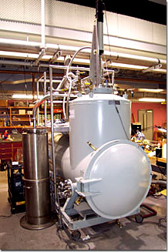
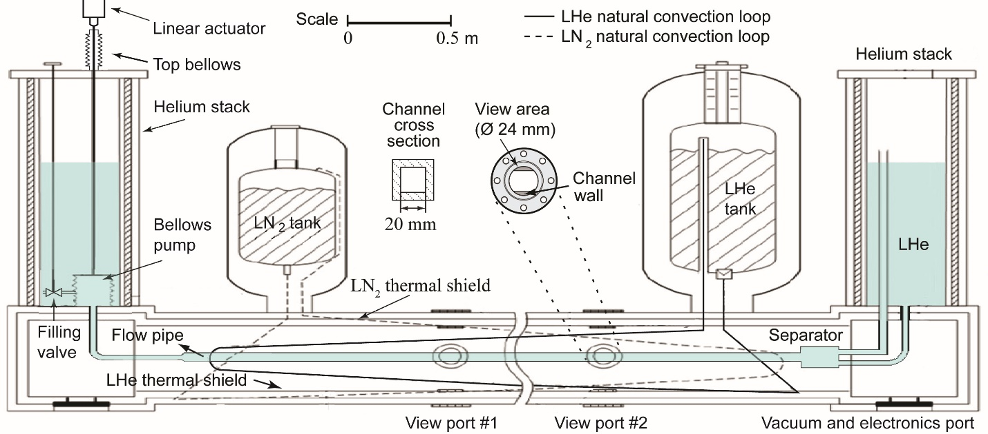
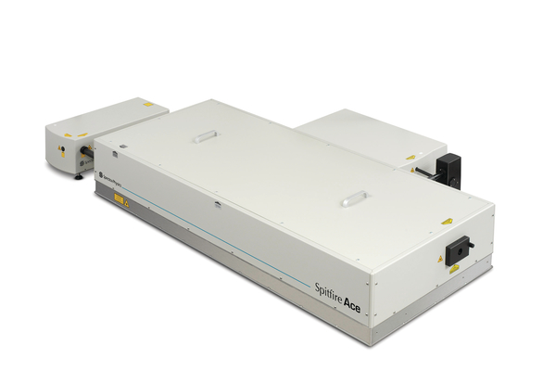
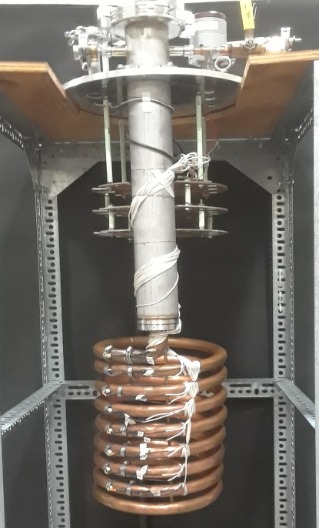
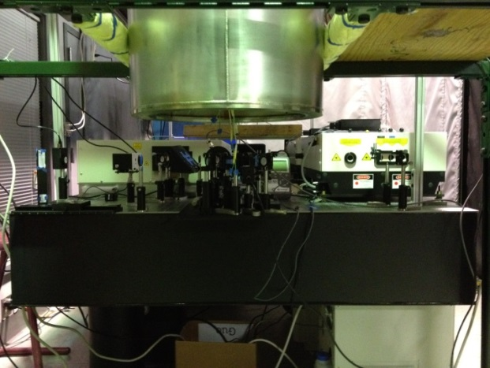
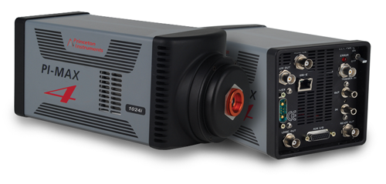
Our facilities:
Liquid Helium Flow Visualization Facility (LHFVF)
Cryogenic Helium Experimental Facility (CHEF)
Regen-amplifier fs-laser system
Fluorescence Flow Visualization Facility
Gen-III ICCD camera
Vacuum break testing facility
Page 1

Slide 2
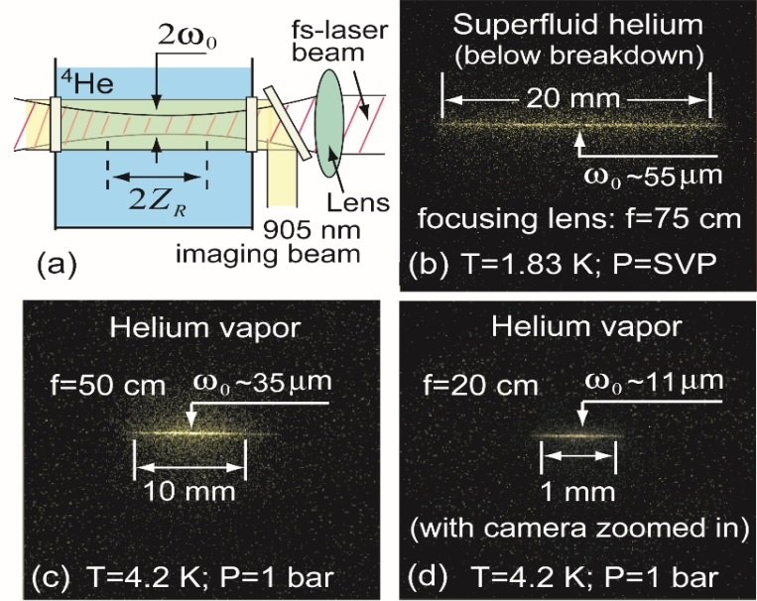
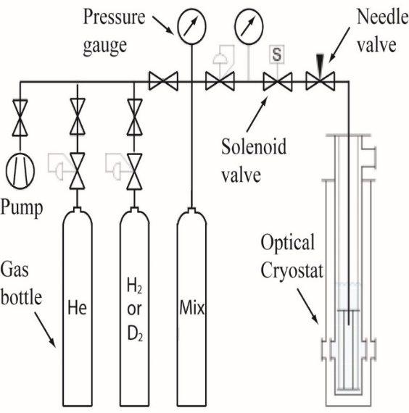
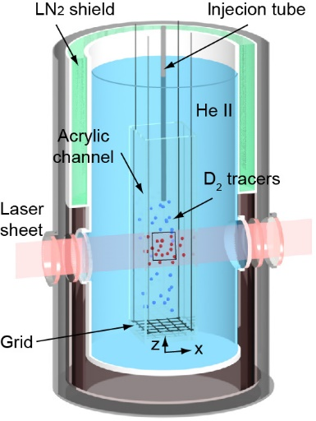
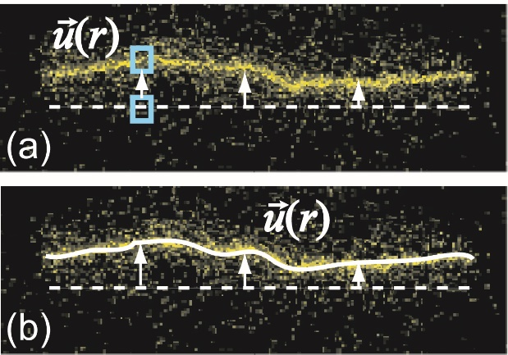
Our unique strength:
Powerful quantitative flow visualization measurement capability in cryogenic fluids:
Molecular tagging velocimetry:
Particle tracking velocimetry:
W. Guo, et al., PNAS, 111, 4653 (2014)
A. Marakov, et al., PRB 91, 094503 (2015)
J. Gao, et al, PRB, 97, 184518 (2018)
T. Kanai, PRL, 127, 095301 (2021)
S. Yui, et al., PRL., 124, 155301 (2020).
Y. Tang, et al., PNAS, 118, e2021957118, (2021)
S. Yui, et al., PRL., 129, 025301 (2022)
Page 2

Slide 3
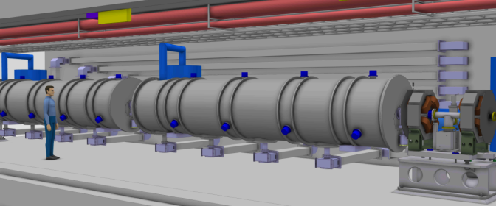
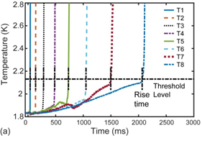
Existing R&D work pertinent to particle accerlerator cryogenics
(1) Heat/mass transfer during loss-of-vacuum accident for cryogenic systems.
PI: Guo
03/2022 -06/2023
(renewal)
Amount: $675,000
Cryomodule
Interconnect
04/2019 - 03/2022;
Amount: $600,000
04/2016 - 03/2019;
Amount: $765,000
ESS TDR
N. Garceau, S. Bao, W. Guo, Int. J. Heat Mass Tran., 181, 121885 (2021)
S. Bao, N. Garceau, and W. Guo, Int. J. Heat Mass Tran., 146, 118883 (2020)
N. Garceau, S. Bao, W. Guo, S.W. Van Sciver, Cryogenics, 100, 92 (2019)
N. Garceau, S. Bao, and W. Guo, Int. J. Heat Mass Tran., 129, 1144 (2019)
Knowledge gained could guide the design and safe operation accelerator cryogenic systems
Page 12

Slide 4
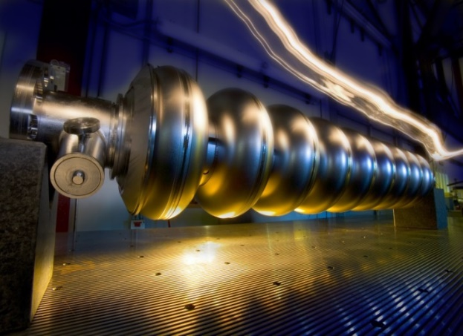
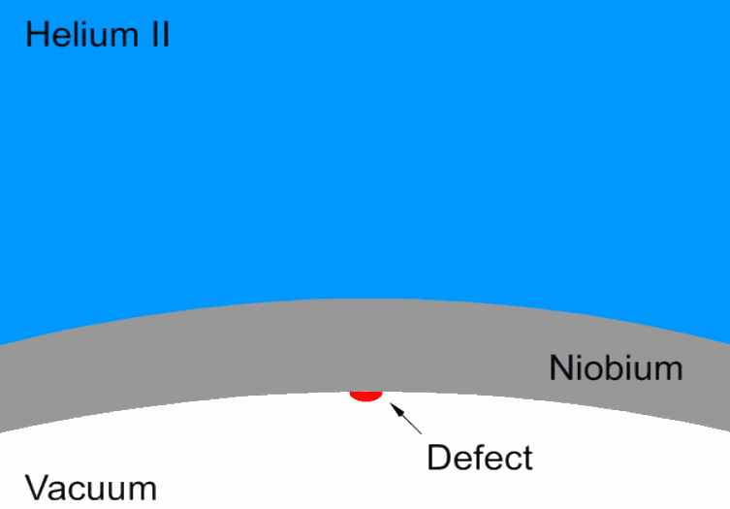
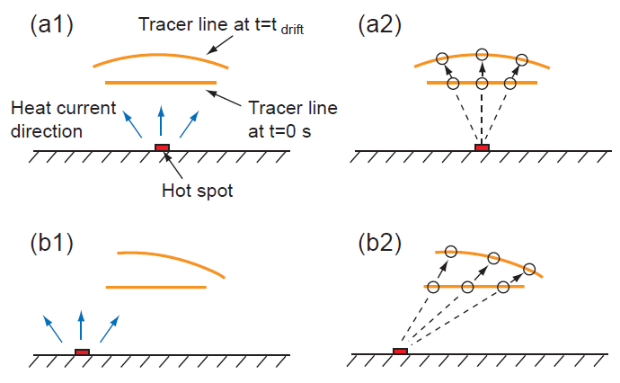
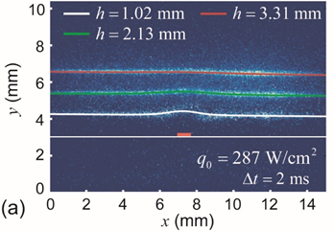
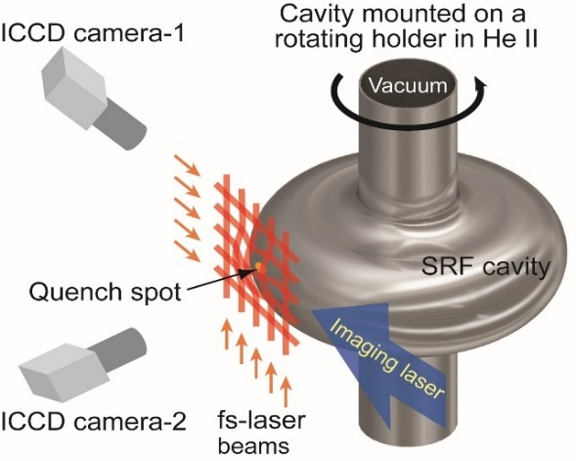
(2) SRF cavity quench spot detection:
SRF cavities, cooled by He II, are critical components of modern particle accelerators.
The maximum accelerating field is limited by cavity quenching caused by heating from tiny defects on the inner surface.
S. Bao and W. Guo, Phys. Rev. Applied, 11, 044003 (2019)
S. Bao et al., Int. J. Heat Mass Trans., 161, 120259 (2020)
Our flow visualization-based quench spot detection technique has demonstrated superior spatial resolution, i.e., ~ 10^2 microns.
Page 13

