Slide 1
The Cool Copper Collider: An Advanced Concept for a Future Higgs Factory
Emilio Nanni for C³ Enthusiasts
AF 3/4 Discussion
7/17/22

Slide 2
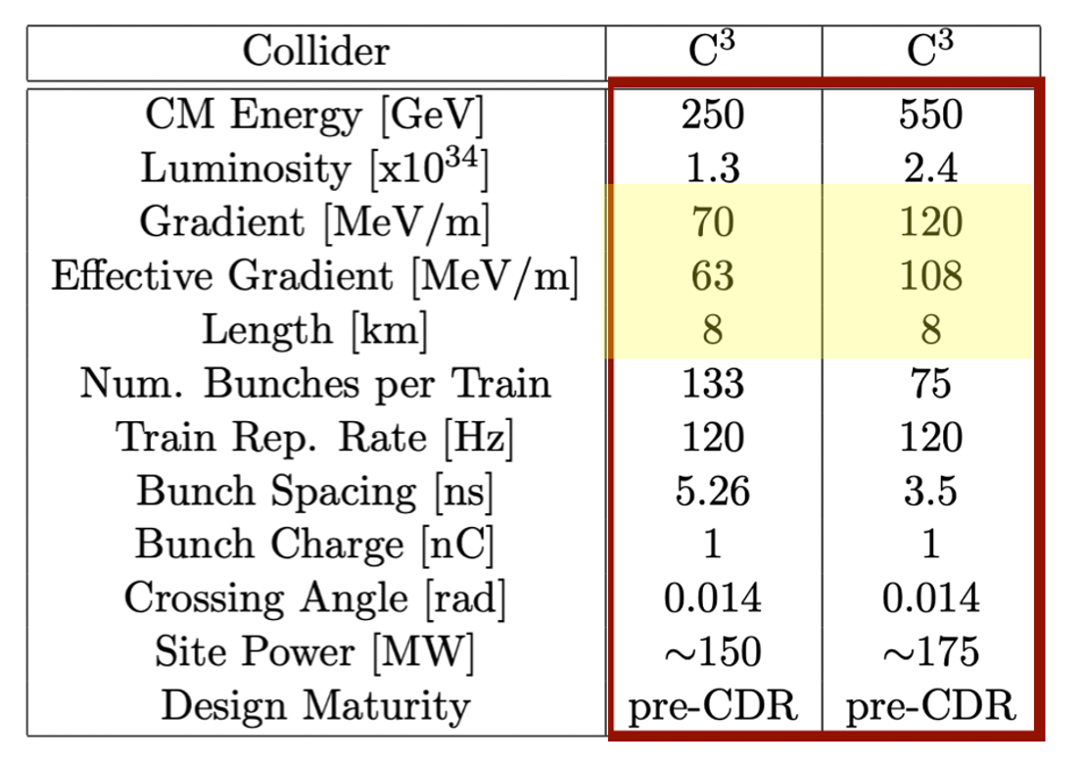
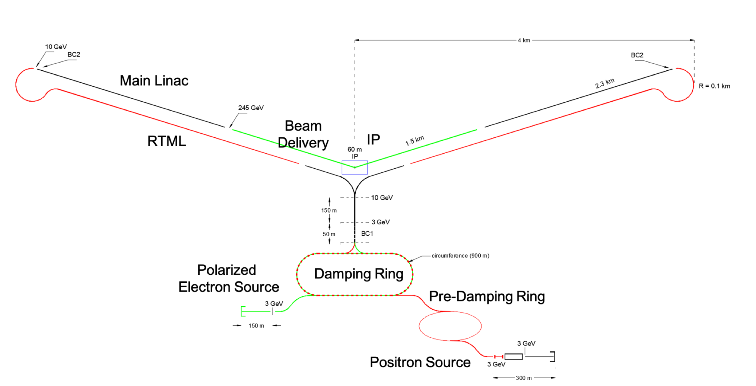
Baseline Design/Layout and Parameters
C³ – Cool Copper Collider – A cryogenic (80 K) high-gradient distributed coupling accelerator concept
8 km footprint for 250/550 GeV CoM ⟹ 70/120 MeV/m
7 km footprint at 155 MeV/m for 550 GeV CoM – present Fermilab site
Large portions of accelerator complex are compatible between LC technologies
Beam delivery and IP modified from ILC (1.5 km for 550 GeV CoM)
Damping rings and injectors to be optimized with CLIC as baseline
C³ - 8 km Footprint for 250/550 GeV

Slide 3
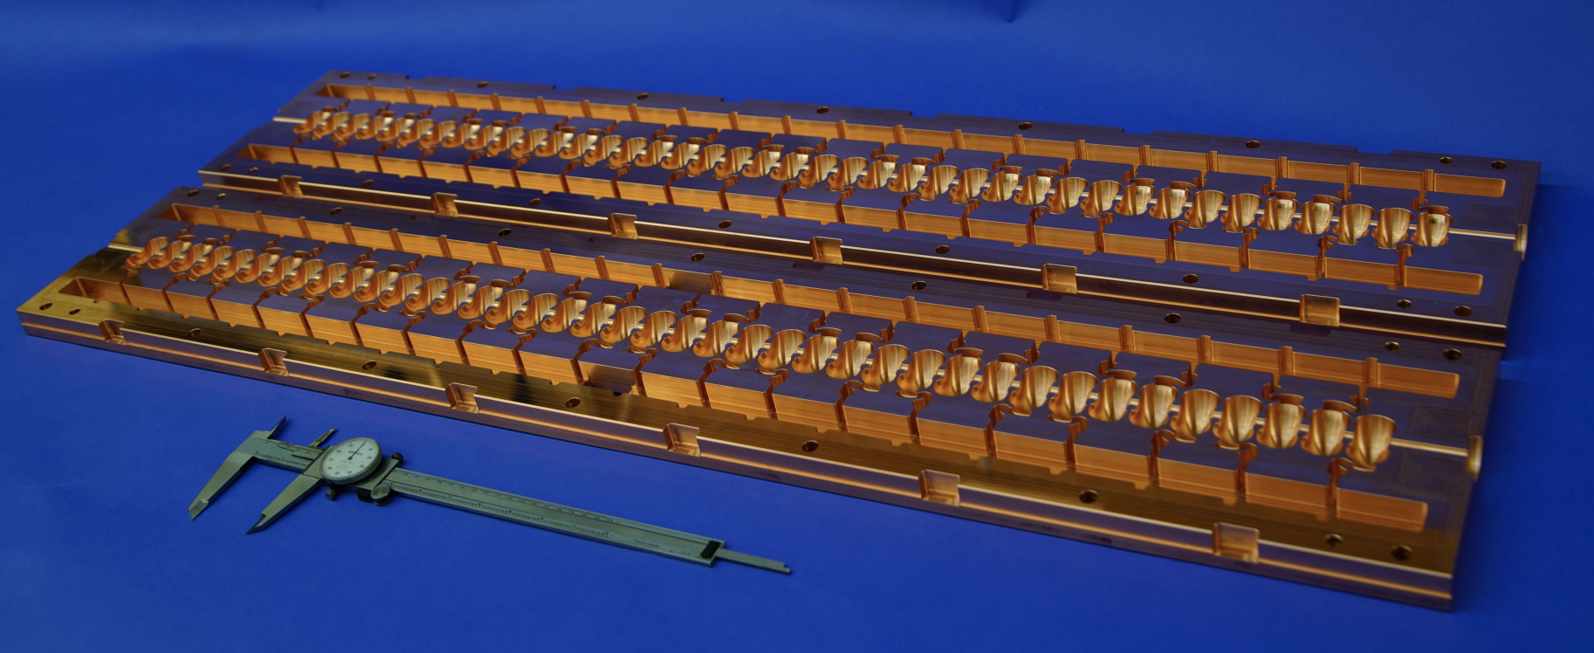
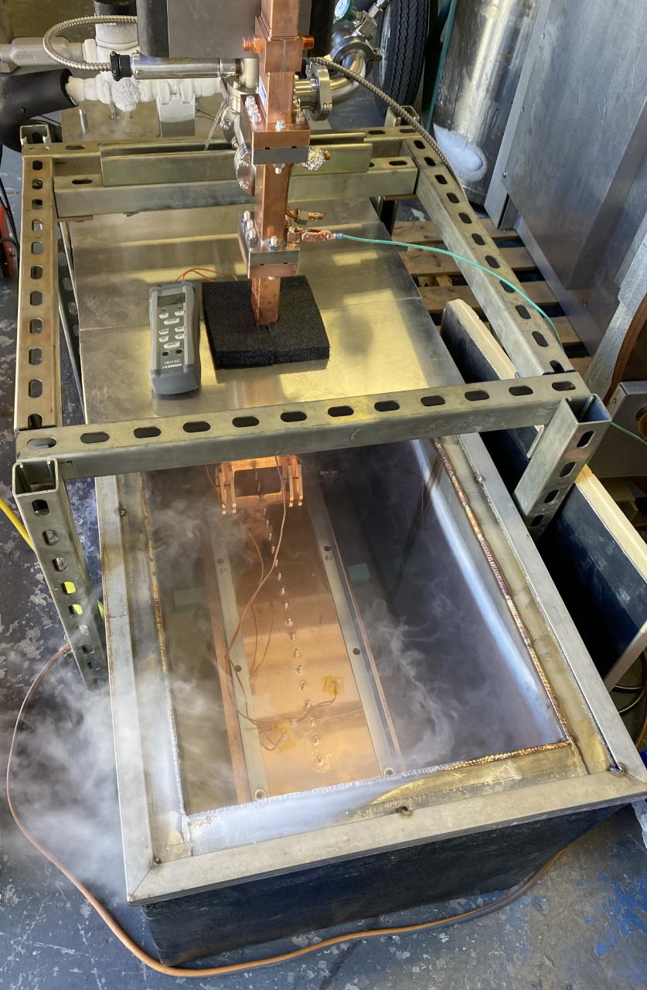
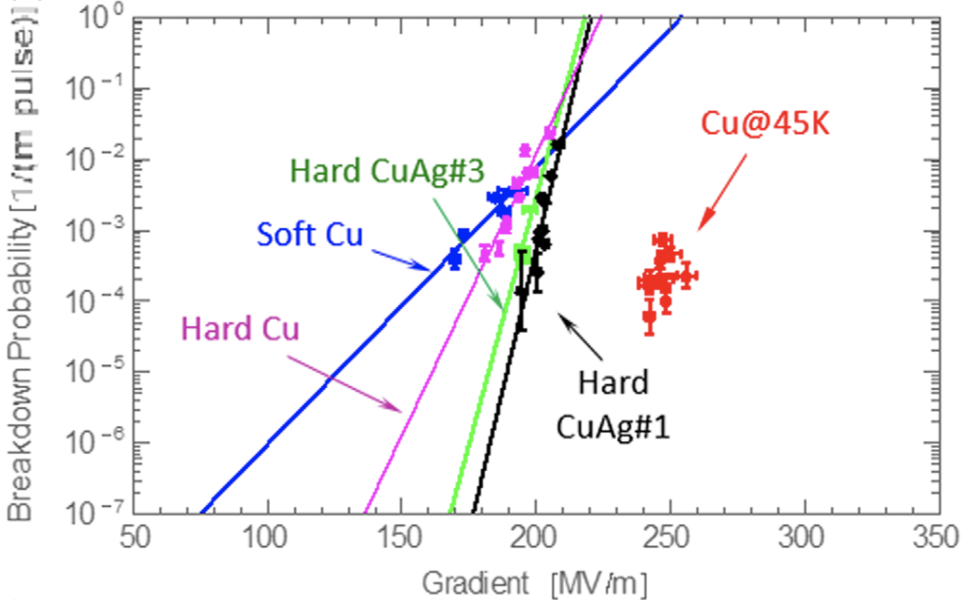
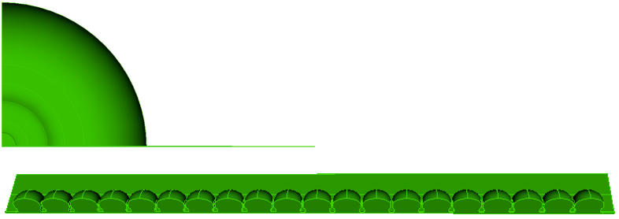
Key Technologies
Present Focus is the Main Linac
In Future Expand to Rest of Complex
Maximize Structure Efficiency and Performance
Distributed Coupling
Modern Manufacturing
Prototype One Meter Structure
C³ Cryo Test
High Accelerating Gradients
Cryogenic Operation
Integrated Damping
Slot Damping with NiChrome Coating

Slide 4
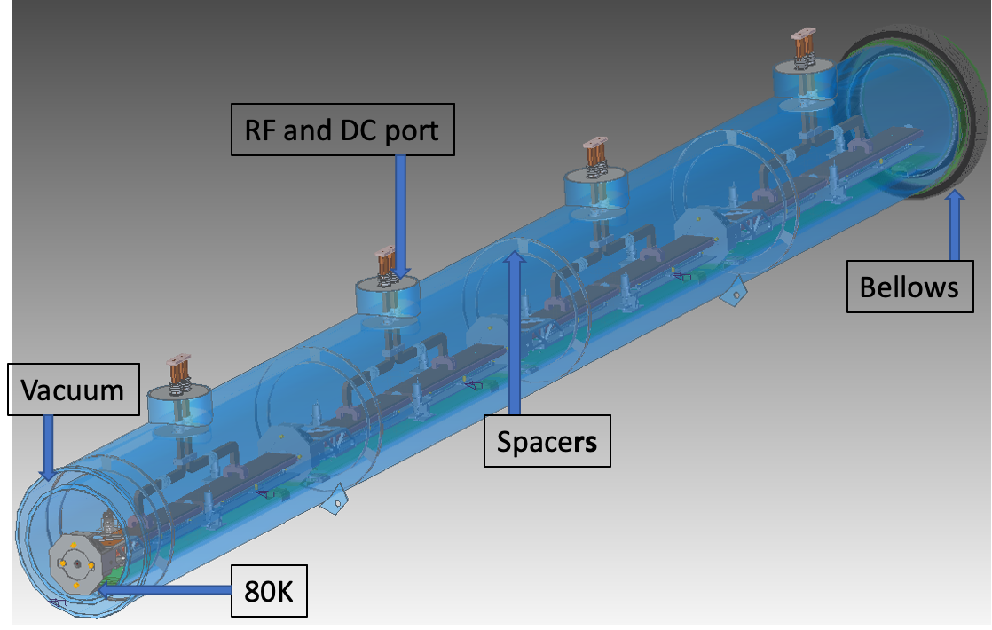
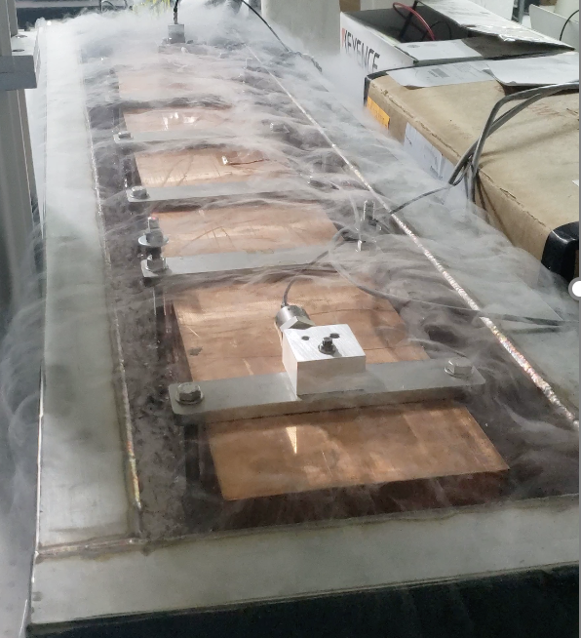
Accelerator Design and Challenges
Cryomodule Concept
Accelerator Design
Engineering and design of prototype cryomodule underway
Focused on challenges identified with community through snowmass (all underway)
Gradient – Scaling up to meter scale cryogenic tests
Vibrations – Measurements with full thermal load
Alignment – Working towards raft prototype
Cryogenics – Two-phase flow simulations to full flow tests
Damping – Materials, design and simulation
Beam Loading and Stability - Thermionic beam test
Scalability – Cryomodules and integration
Laying the foundation for a demonstration program to address technical risks beyond RDR (CDR) level
Vibration
Studies
C³ Session at Snowmass Friday 22nd 340, HUB
https://indico.fnal.gov/event/22303/sessions/20646/#20220722

Slide 5
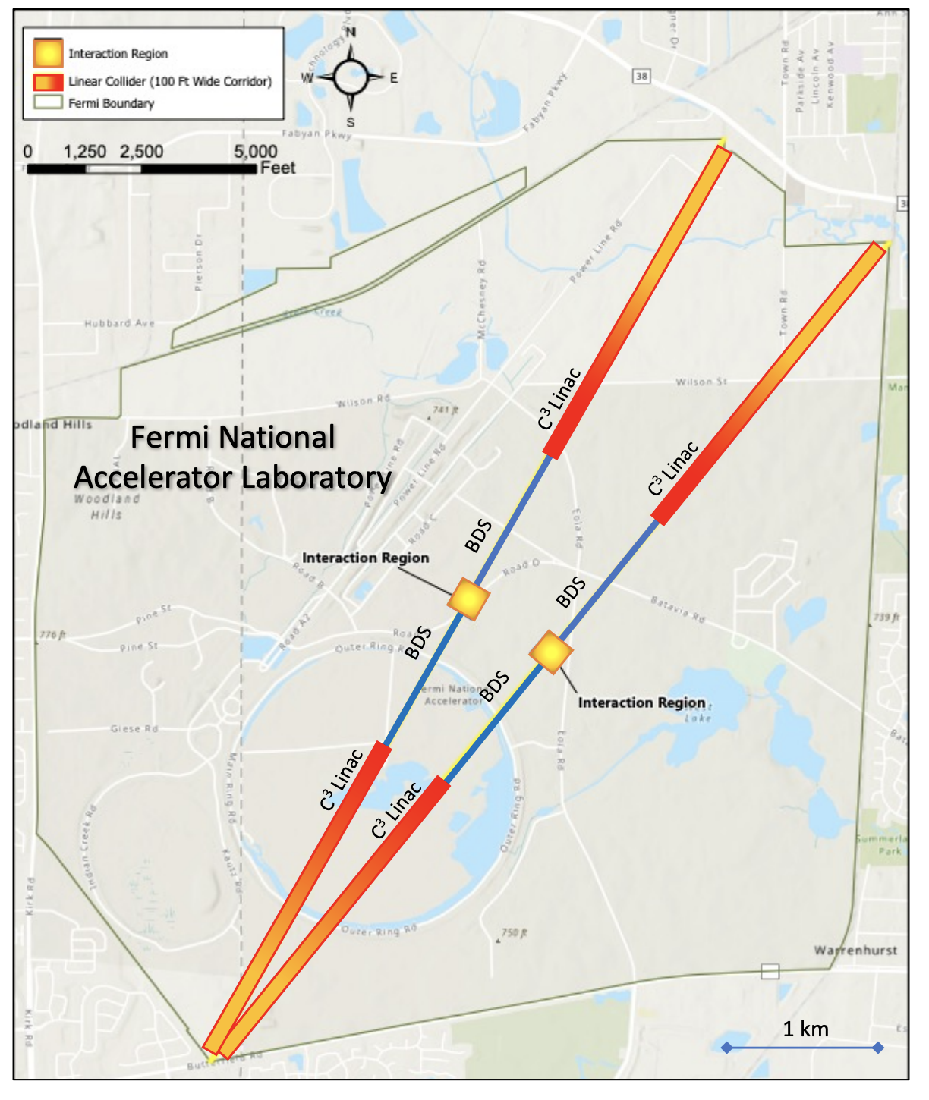
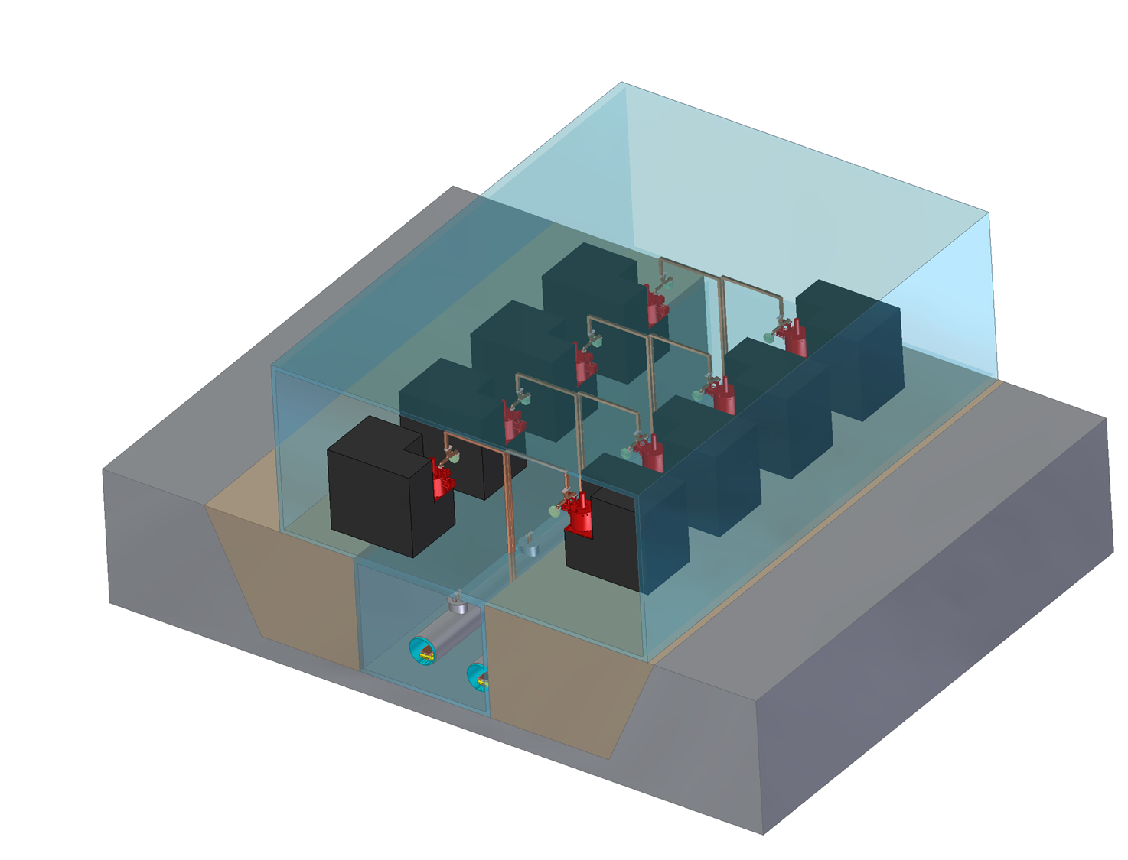
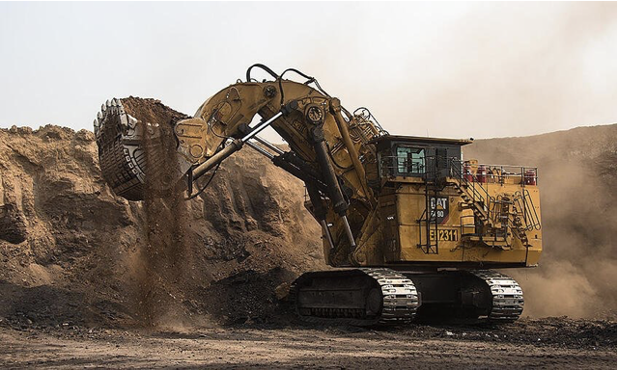
Civil Engineering and Site
Fermilab Site Filler
Compact footprint <8 km for 550 GeV allows for many siting options
Evaluating both underground and surface sites
Underground – less constraints on energy upgrade
Surface – lower cost and faster to first physics
National Lab and Green Field are Possibilities
Surface-Site Mockup (Tunnel in White Paper)
Hanford Site
Rapid Excavation / Parallel Installation
No Vertical Shafts

Slide 6
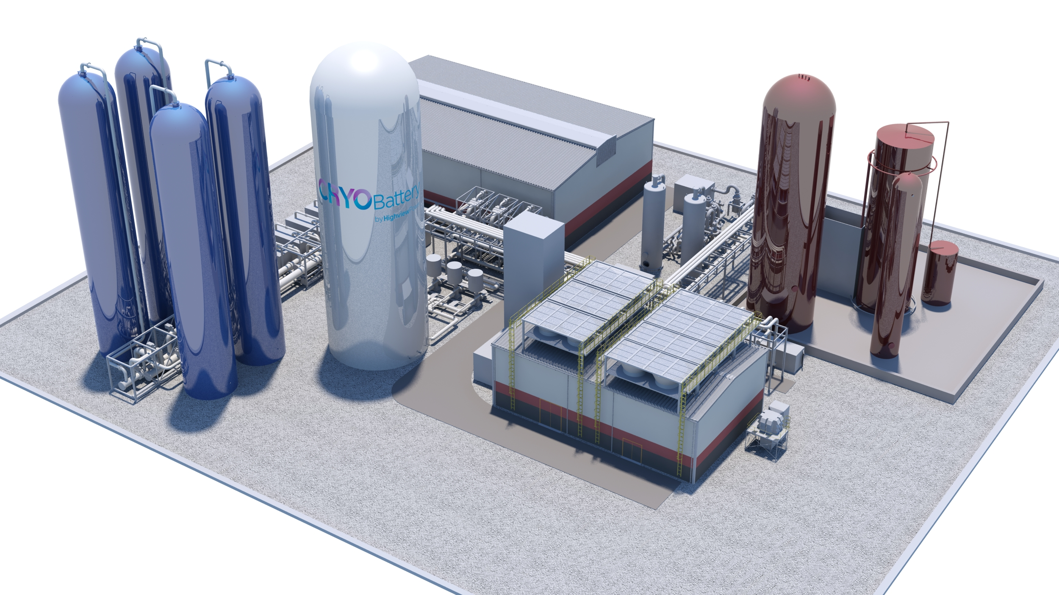
Sustainability
Temperature (K) | 77
Beam Loading (%) | 45
Gradient (MeV/m) | 70
Flat Top Pulse Length (𝜇s) | 0.7
Cryogenic Load (MW) | 9
Main Linac Electrical Load (MW) | 100
Site Power (MW) | ~150
250 GeV CoM - Luminosity - 1.3x10³⁴
Parameter | Units | Value
Reliquification Plant Cost | M$/MW | 18
Single Beam Power (125 GeV linac) | MW | 2
Total Beam Power | MW | 4
Total RF Power | MW | 18
Heat Load at Cryogenic Temperature | MW | 9
Electrical Power for RF | MW | 40
Electrical Power For Cryo-Cooler | MW | 60
Accelerator Complex Power | MW | ~50
Site Power | MW | ~150
Compatibility with Renewables
Cryogenic Fluid Energy Storage
Intermittent and variable power production from renewables mediated with commercial scale energy storage and power production
Highview Power

Slide 7
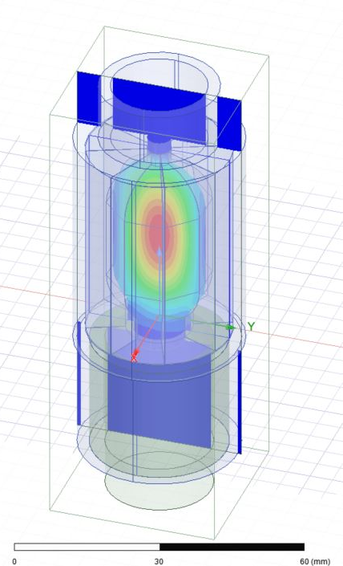
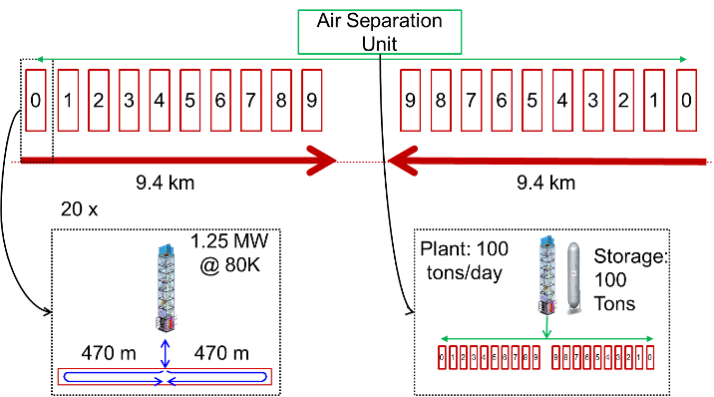
Proposals for Upgrades and Extensions
Luminosity
Energy
HTS Pulse Compressor
REBCO Coatings
Beam power can be increased for additional luminosity
C³ has a relatively low current for 250 GeV CoM (0.19 A) - Could we push to match CLIC at 1.66 A? (8.5X increase?)
Pulse length and rep. rate are also options
Scalability studied to 3 TeV
Requires rf pulse compression for reasonable site power
Higher gradient option (155 MeV/m) in consideration
Cryogenics Scale to multi-TeV
Parameter | Units | Baseline | High-Lumi
Energy CoM | GeV | 250 | 250
Gradient | MeV/m | 70 | 70
Beam Current | A | 0.2 | 1.6
Beam Power | MW | 2 | 16
Luminosity | x10³⁴ | 1.3 | 10.4
Beam Loading |  | 45% | 87%
RF Power | MW/m | 30 | 125
Site Power | MW | ~150 | ~180
Qo ~ 400k
Le Sage, CERN Collaborators
Caution: Requires serious investigation of beam dynamics - great topic for C³ Demonstration R&D
arXiv:1807.10195 (2018)

Slide 8
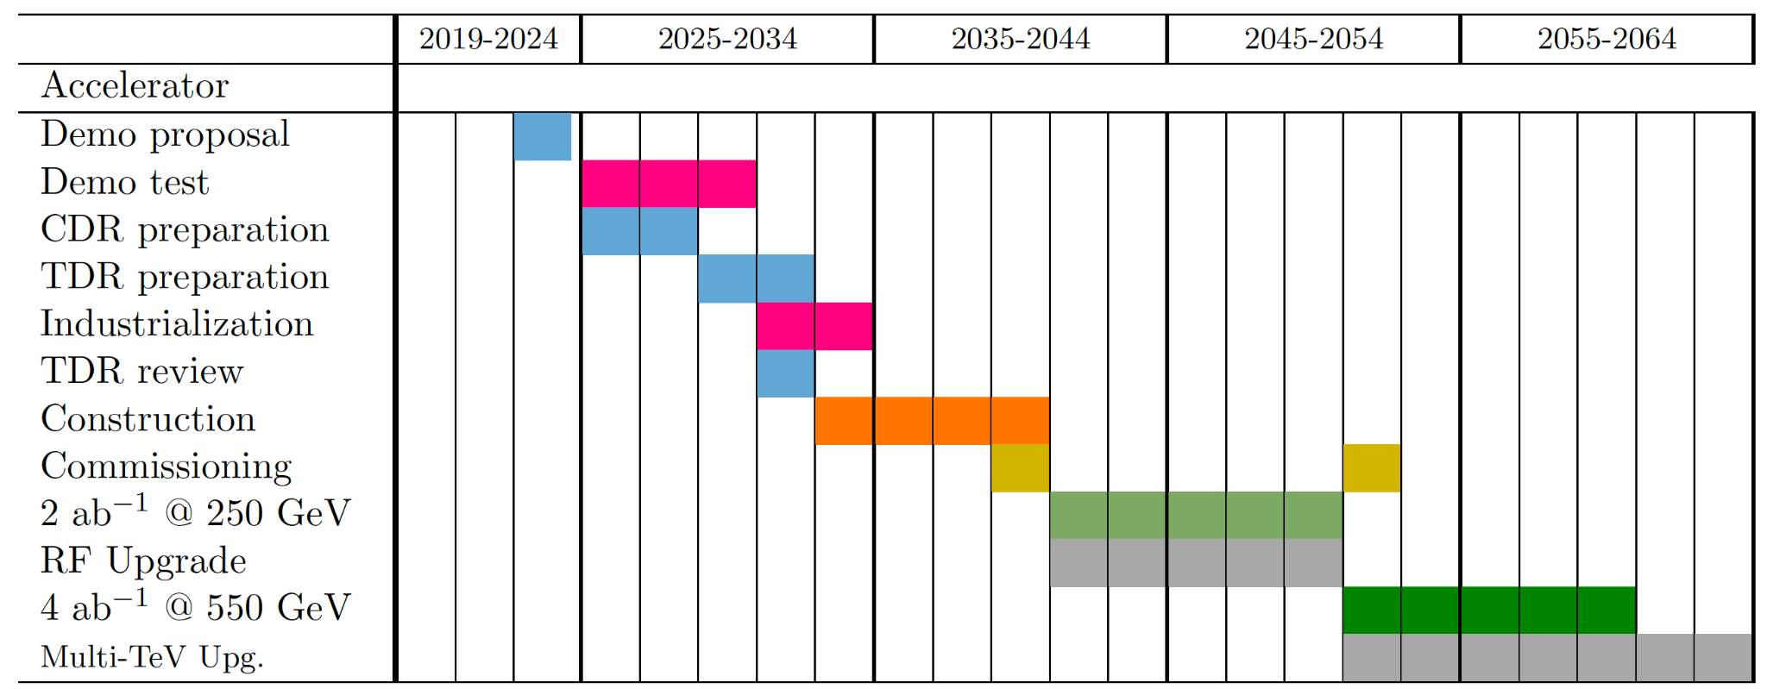
Stageability to Future Experiments
Technically limited timeline
Community engagement through Snowmass to define the parameters of the C³ proposal

Slide 9
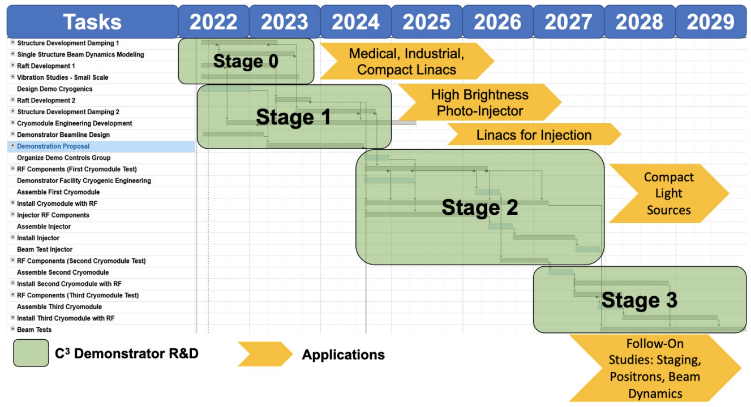
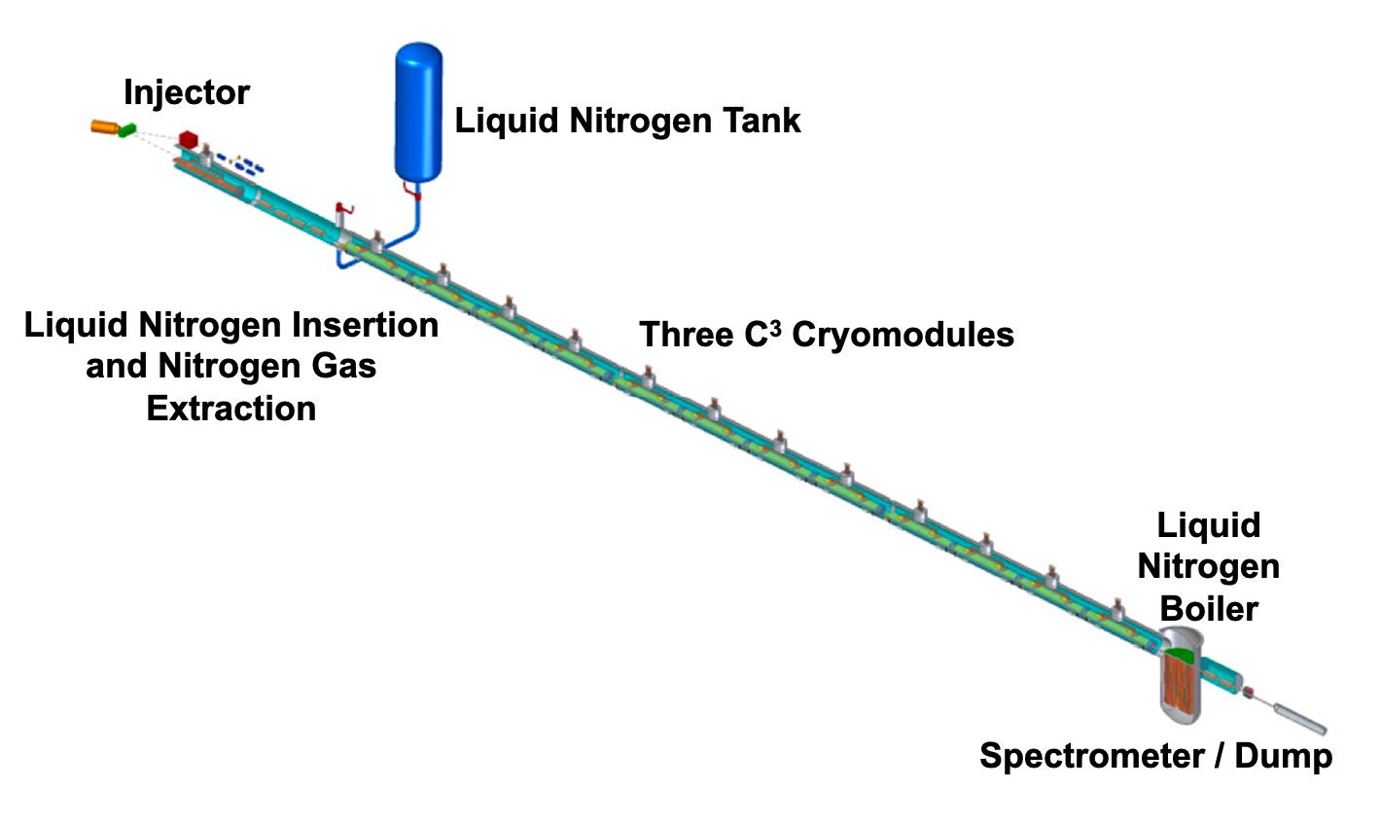
State of Proposal and R&D needs (5 years)
Next Steps:
C³ Demonstration R&D Plan
Demonstrate fully engineered cryomodule
~50 m scale facility
3 GeV energy reach
Answer technical questions needed for CDR
https://arxiv.org/abs/2203.09076

Slide 10
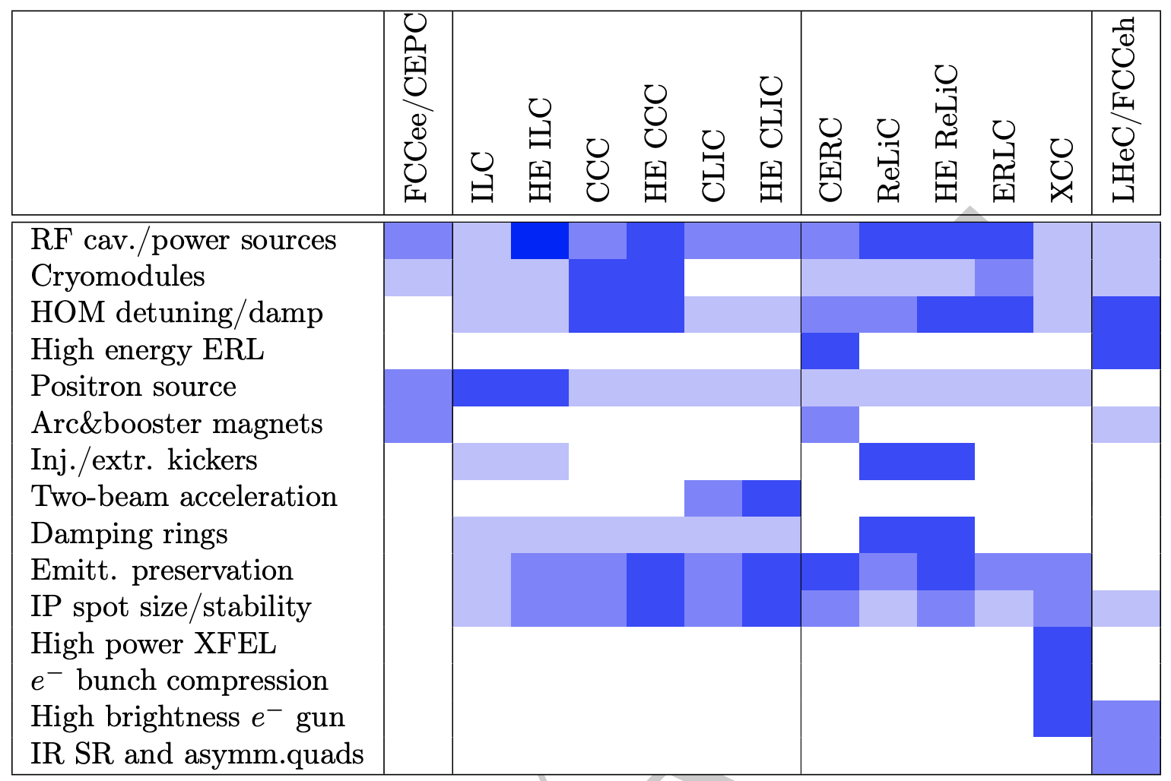
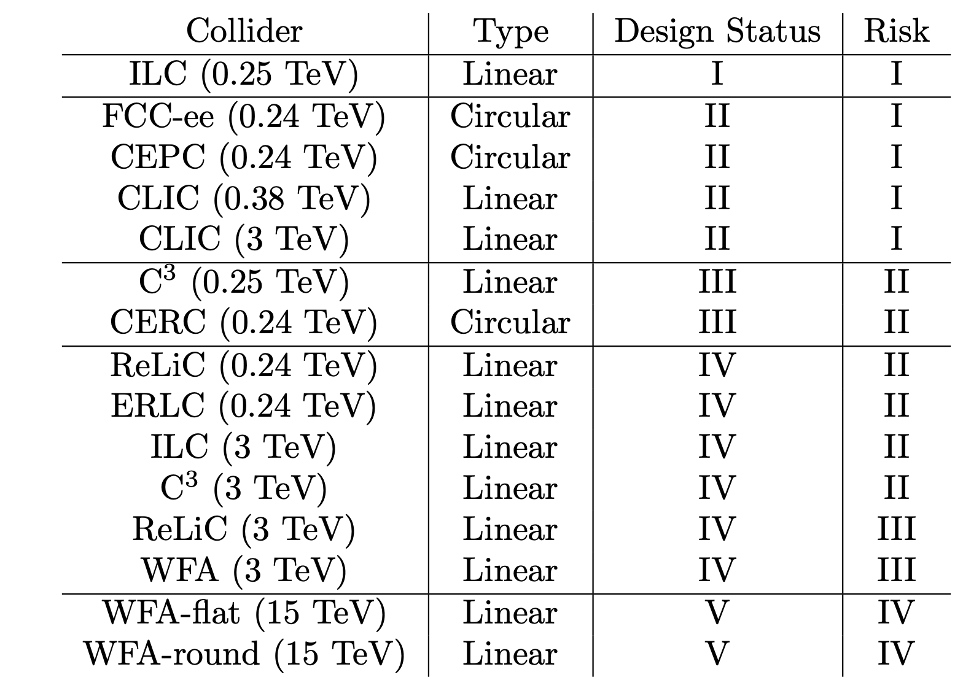
ITF Maturity Assessment

Slide 11
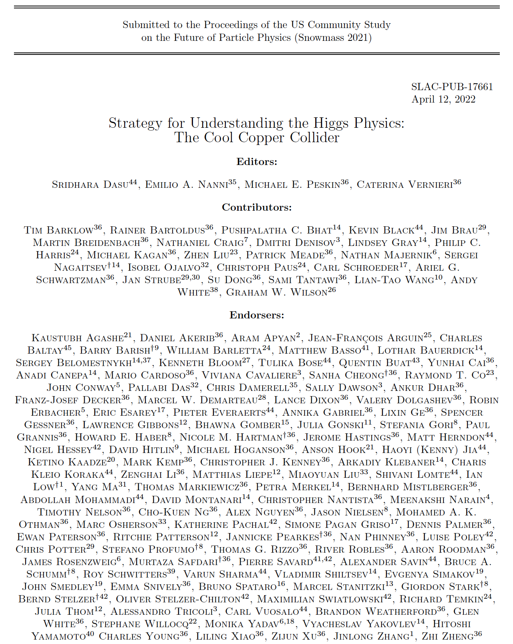
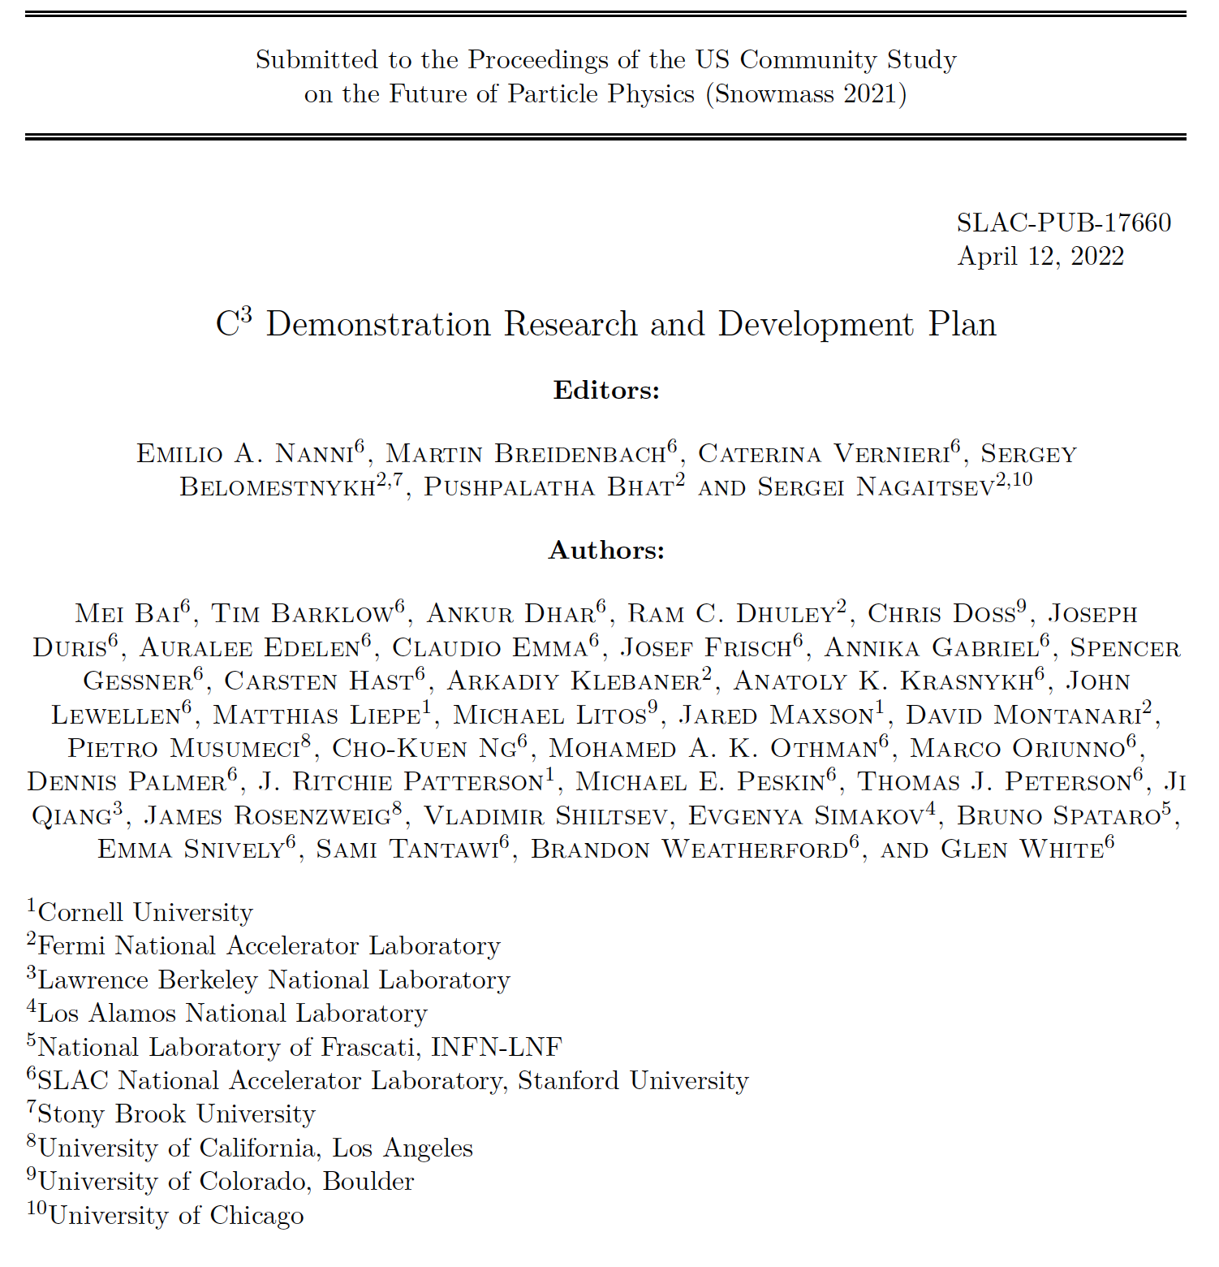
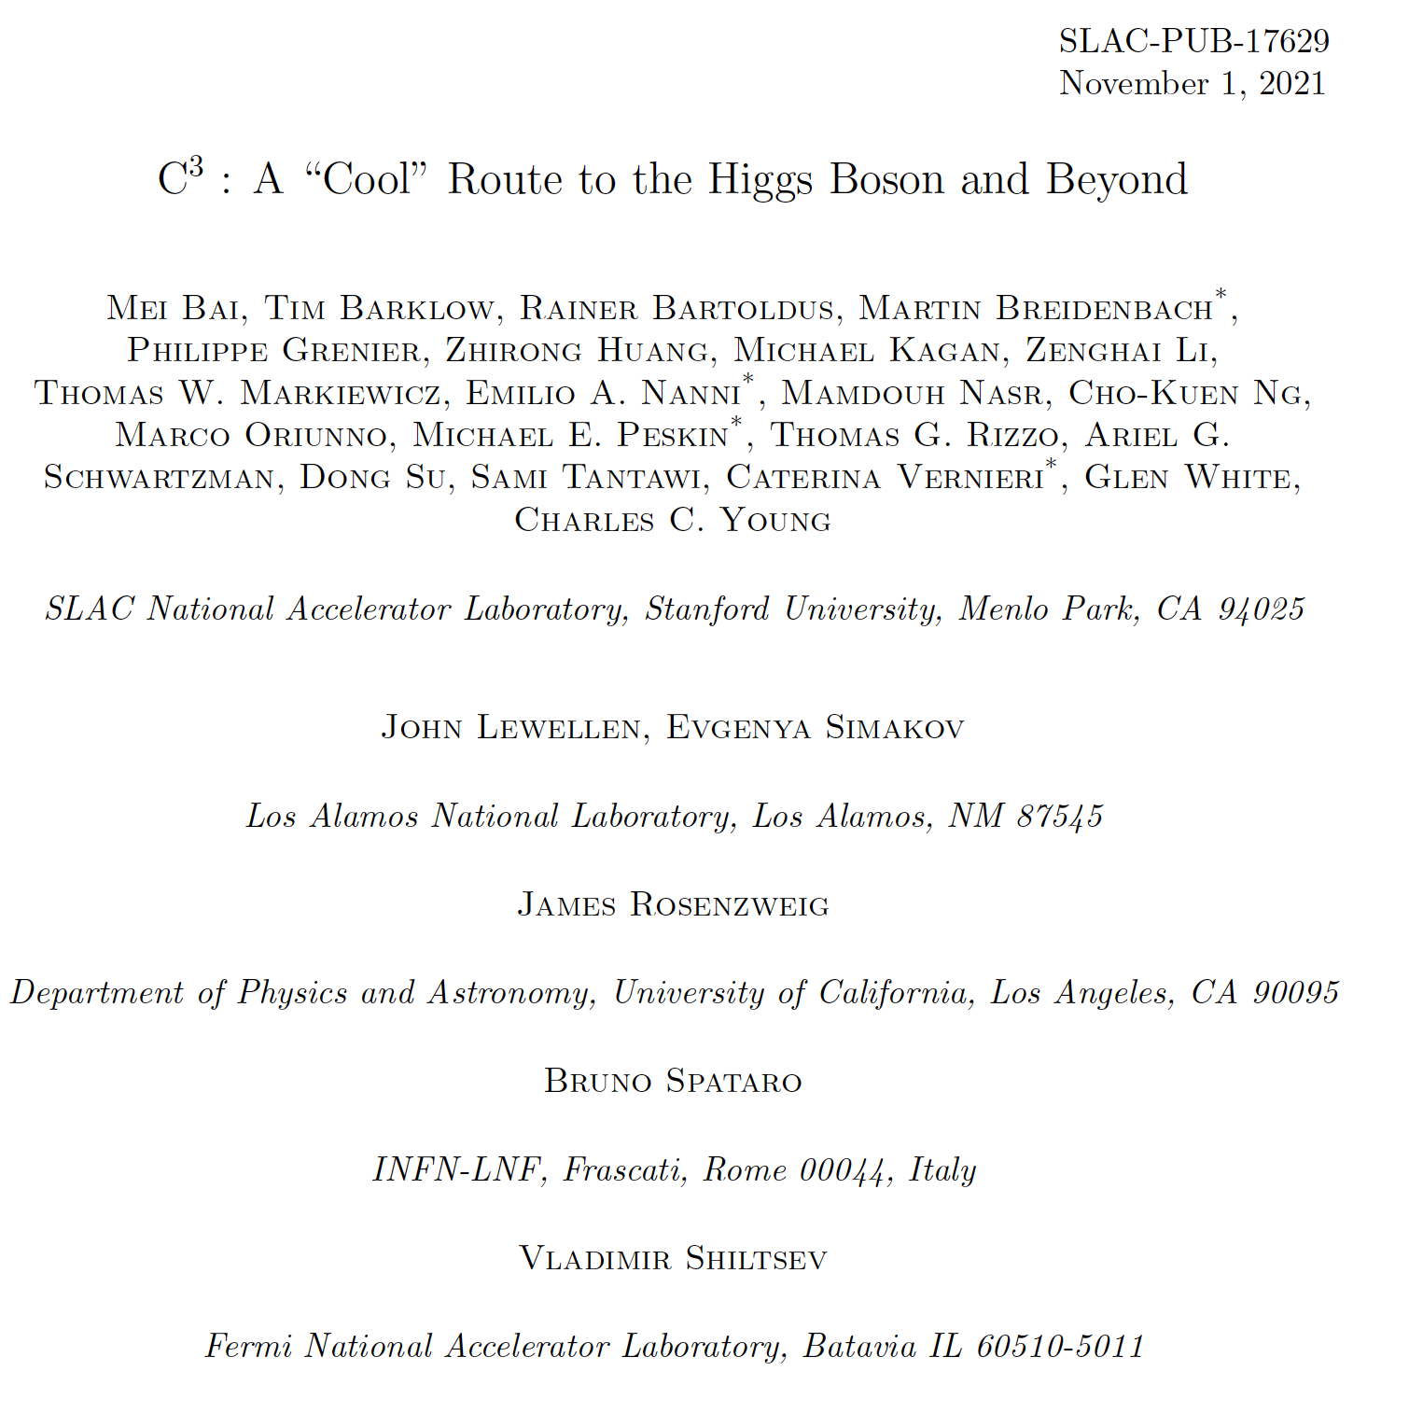
Acknowledgements
Additional Contributors
Mitchell Schneider
Charlotte Whener
Gordon Bowden
Andy Haase
Julian Merrick
Bob Conley
Radiabeam
Cici Hanna
Zariq George
Valery Borzenets
More Details Here (Follow, Endorse, Collaborate):
https://indico.slac.stanford.edu/event/7155/

