Slide 1

Snowmass Community Summer Study Workshop
The US Magnet Development Program
Status and Plans
Soren Prestemon
US Magnet Development Program
Lawrence Berkeley National Laboratory

Slide 2
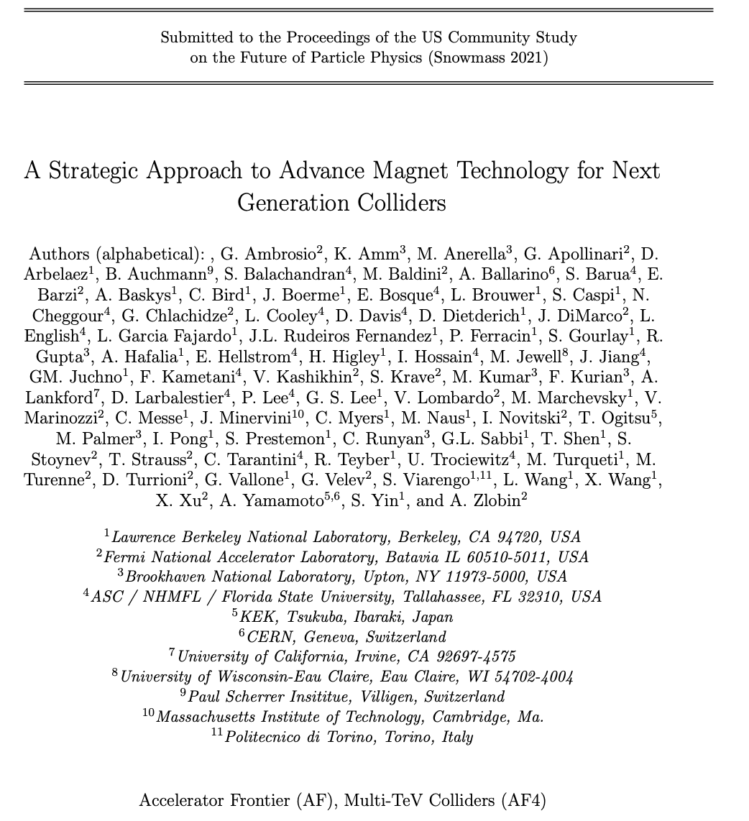
The HEP community needs advances in superconducting magnet technology to explore new physics realms via colliders
A strategic whitepaper detailing progress in magnet R&D was submitted
  14 “Statements” are highlighted in the document that summarize key points and future goals for our field
  Complementary strategic whitepapers were submitted describing the European efforts in the field, as well as complementary US initiatives for directed-R&D – see following presentations!
https://arxiv.org/abs/2203.13985

Slide 3
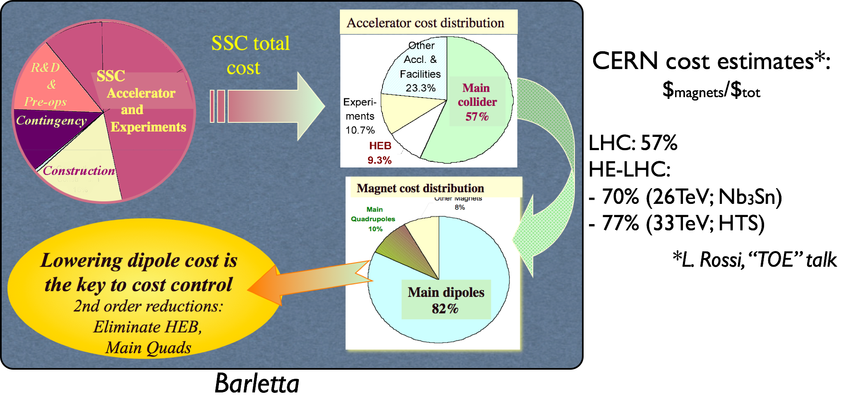
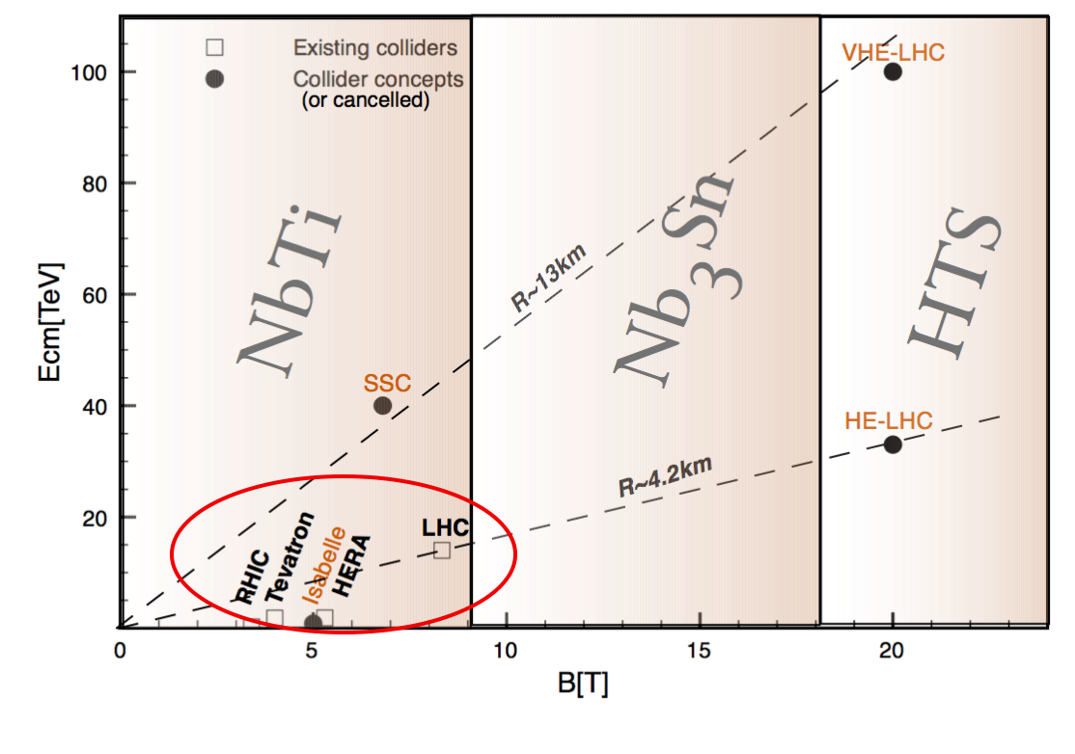
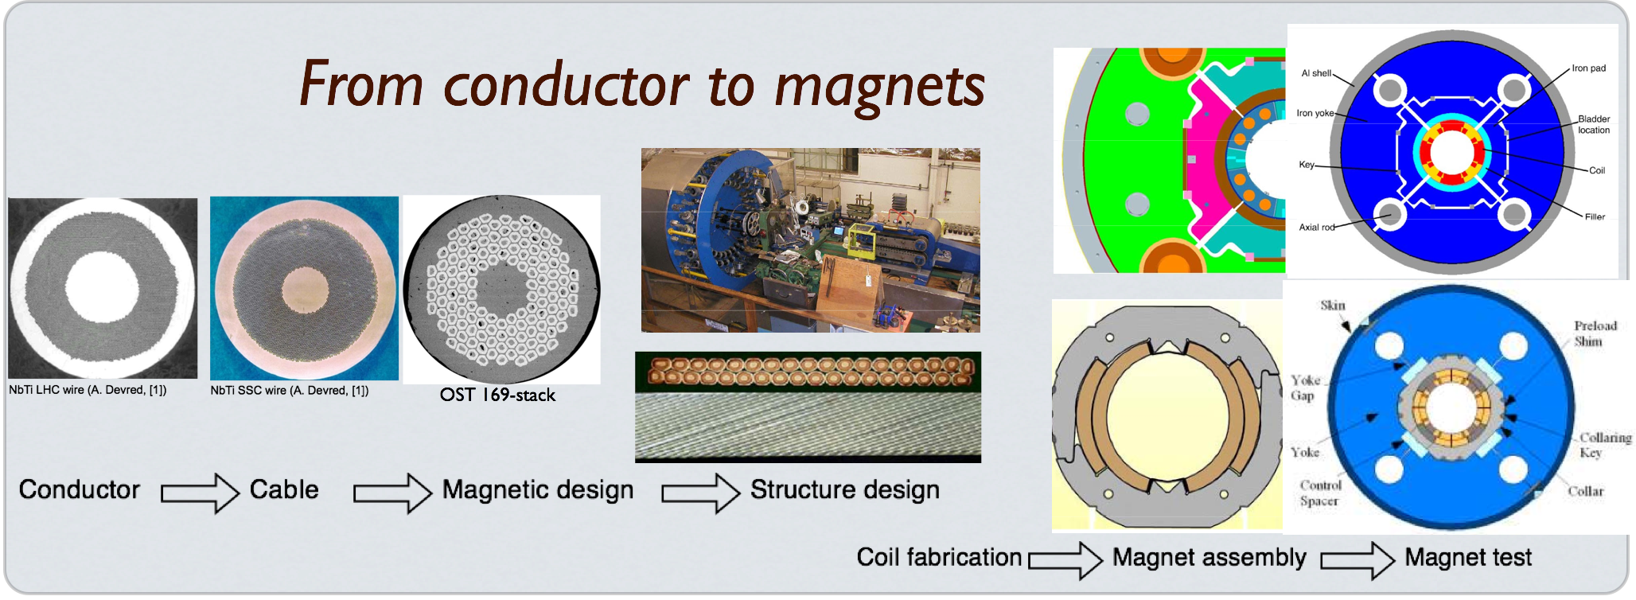
Magnet technology drives the cost and reach of a future collider
FCC
SppC
Cost/field-strength is the critical metric
Dominant cost drivers for a pp collider: Magnets and tunnel

Slide 4
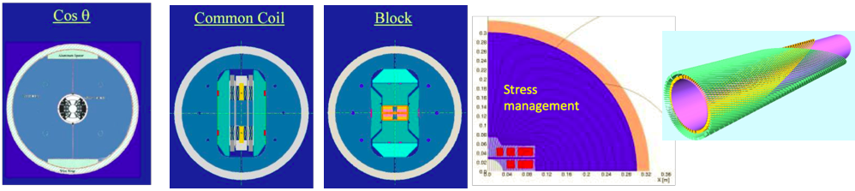


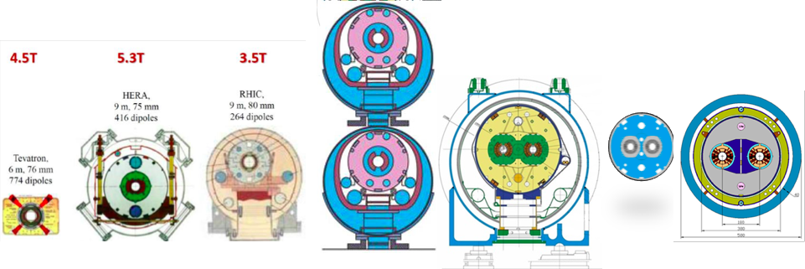


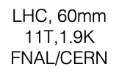



The “magnet zoo” of design alternatives
R&D magnet designs explore layouts that attempt to address issues associated with conductor strain (to avoid degradation) and reduction of conductor/coil motion (to minimize training)
Colliders (to-date) all based on Cos(t) designs – efficient
At high field “managing” stress through judicious force interception will be required
S. Prestemon, Workshop on Advanced Superconducting Materials and Magnets, KEK January 22 2019
S. Prestemon, Workshop on Advanced Superconducting Materials and Magnets, KEK January 22 2019

Slide 5
R&D efforts for accelerator magnet technology are becoming more structured
DOE created the US Magnet Development Program (MDP) in ~2016
Europe recently formed the High Field Magnet program (HFM)
The programs strive to coordinate efforts to more rapidly advance technology development
https://arxiv.org/abs/2011.09539
http://arxiv.org/abs/2201.07895
General R&D - programmatic
(example: US MDP)
Directed R&D
(Technology readiness)
(ex: LARP)
Directed R&D
(Technology readiness)
Project
Project
(ex: HL-LHC AUP)
The US DOE approach balances long-range R&D and project preparation

Slide 6
Program vision and goals
Initiated by DOE-OHEP in response to 2013 Snowmass/P5
Vision
  Maintain and strengthen US Leadership in high-field accelerator magnet technology for future colliders;
  Further develop and integrate magnet research teams across the partner laboratories and US Universities for maximum value and effectiveness to MDP;
  Identify and nurture cross-cutting / synergistic activities with other programs (e.g. Fusion), to more rapidly advance progress towards our goals.
  Motivate and grow a new generation of magnet experts for future facilities
Overarching goals:
  Explore the performance limits of Nb3Sn accelerator magnets, with a sharpened focus on minimizing the required operating margin and significantly reducing or eliminating training
  Develop and demonstrate an HTS accelerator magnet with a self-field of 5T or greater, compatible with operation in a hybrid HTS/LTS magnet for fields beyond 16T
  Investigate fundamental aspects of magnet design and technology that can lead to substantial performance improvements and magnet cost reduction
  Pursue Nb₃Sn and HTS conductor R&D with clear targets to increase performance, understand present performance limits, and reduce the cost of accelerator magnets

Slide 7
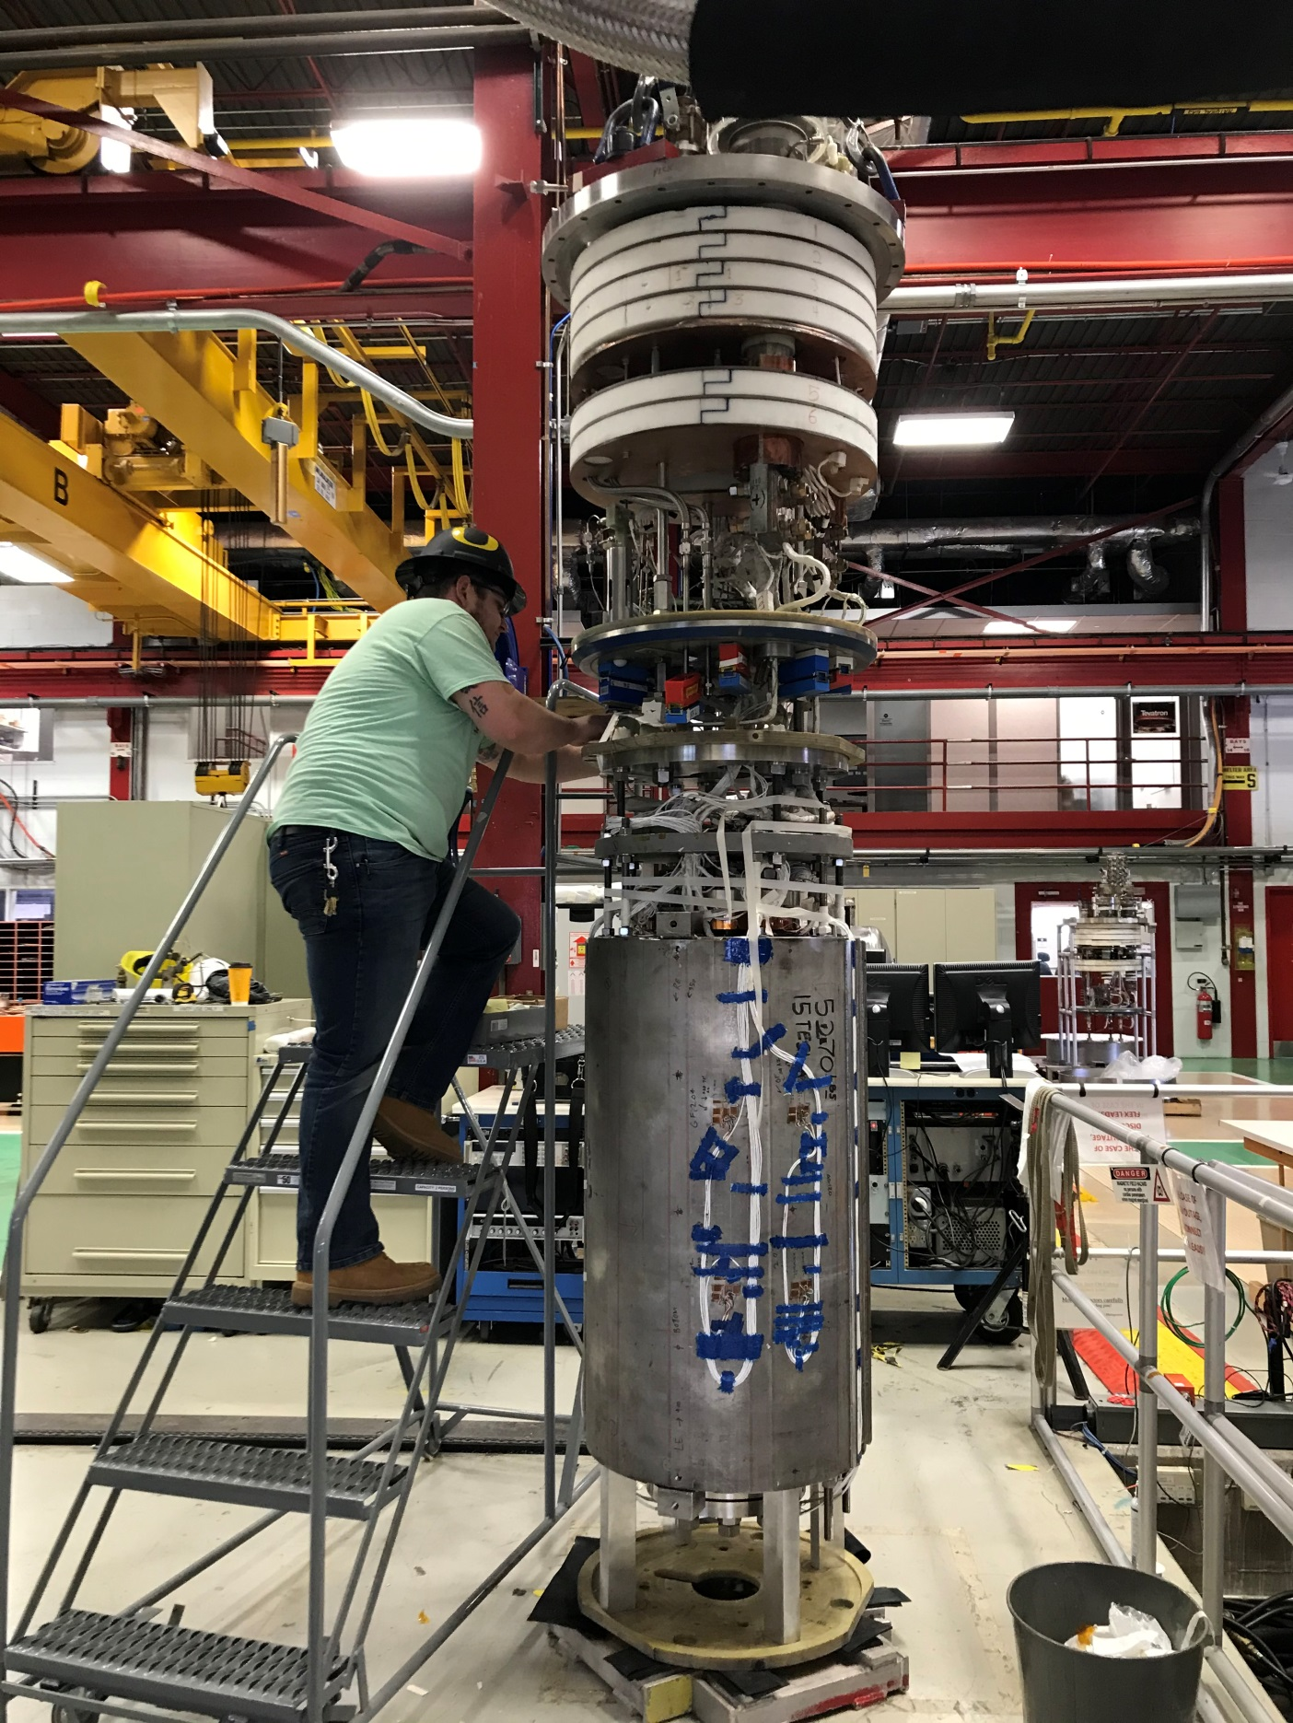
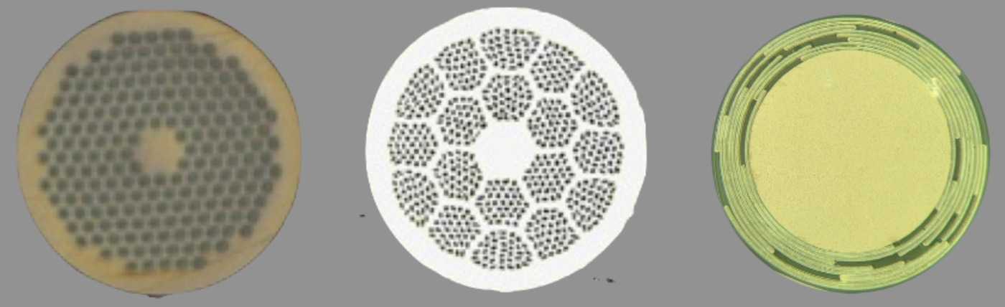
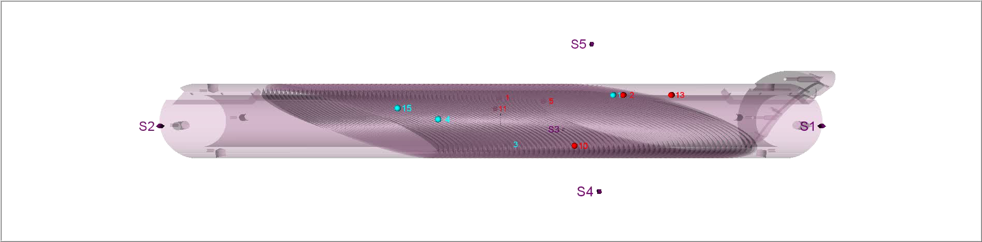
Major results from MDP on multiple fronts
Progress on multiple fronts
  Cos-theta magnet MDPCT1 (FNAL) achieved 14.5T (60mm aperture)!
  First two 2-layer Nb₃Sn Canted-Cos-theta (CCT) magnets (90mm bore) tested
    Reached 86-88% short-sample; different epoxy => improved training;
  Steady progress on REBCO CORC™-based magnet technology
  Significant progress on Bi2212 magnet technology
    4.7T common coil => no training!
  Variety of developments and improvements in diagnostics
  Important developments in conductor R&D (with industry)
    Record Nb₃Sn via Zr doping; strong promise from Hf alloying
    “High-Cp” as a means to improve Nb₃Sn quench performance
    Record Bi2212 wire performance
      Significantly exceeds “FCC spec” at 16T
      New Bi2212 powder producers – seeded by SBIR
  And many others…

Slide 8




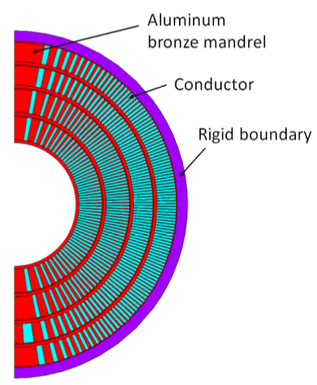
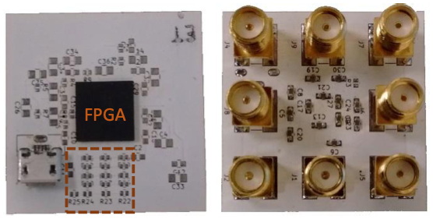
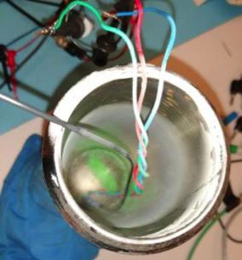
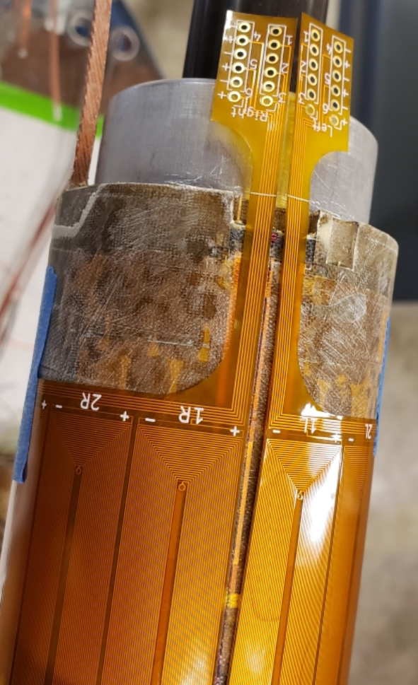
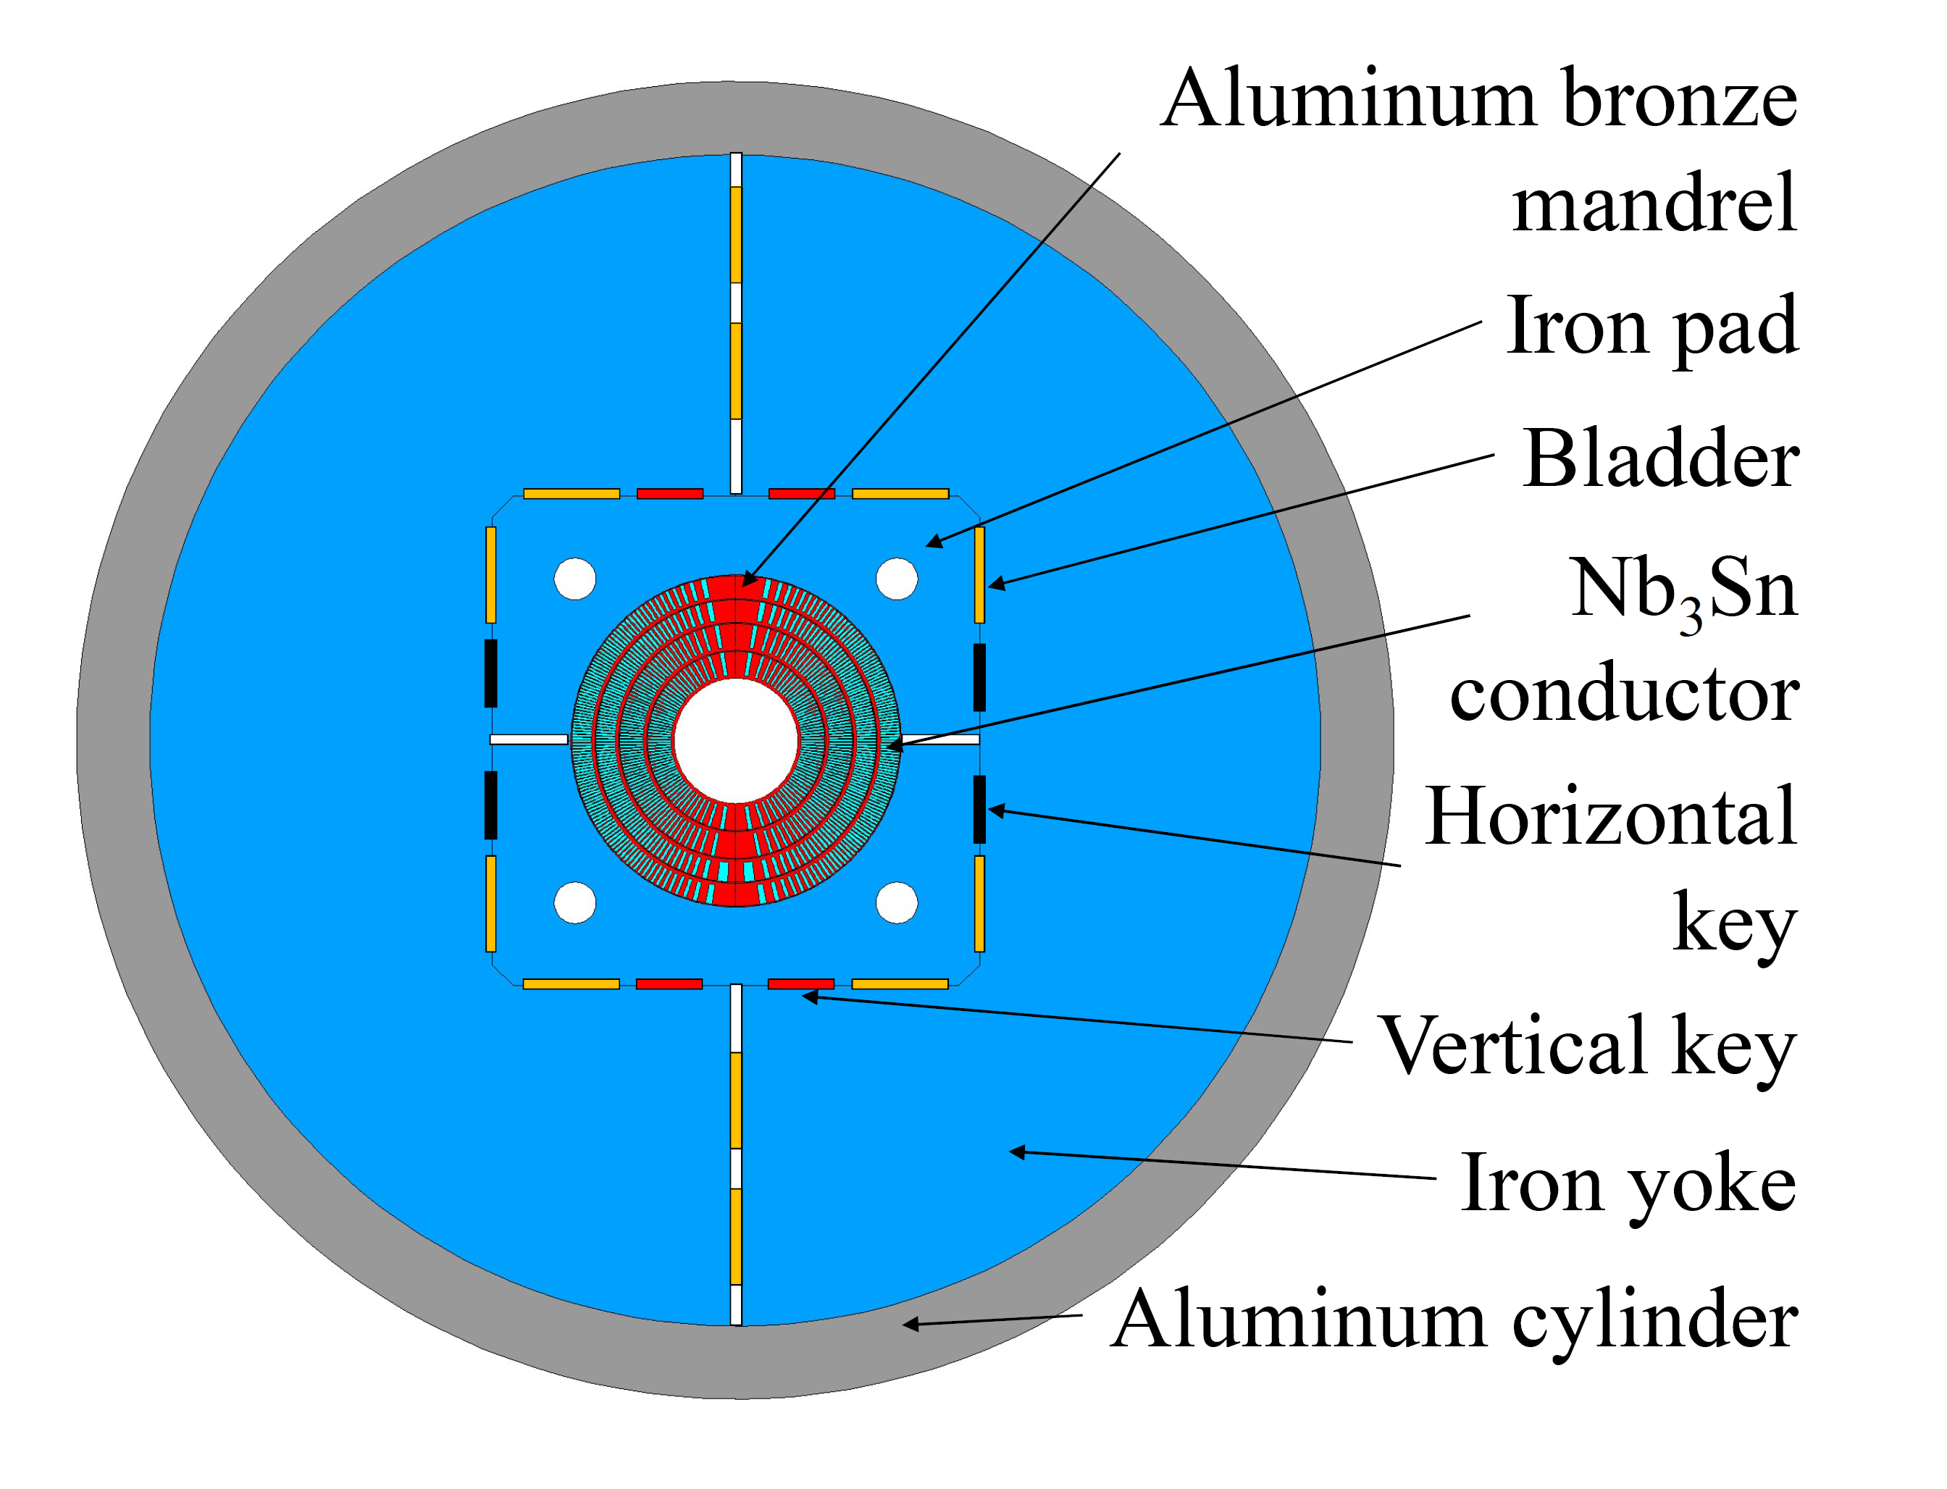
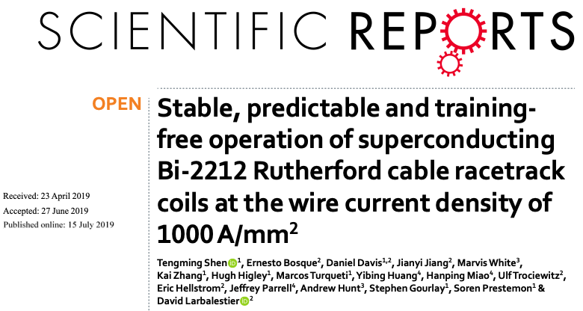
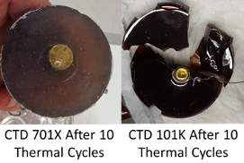
MDP results and developments prepare for high-field prototypes – stress-managed and hybrid magnets
MDP Magnet R&D results pave path to stress-managed high-field hybrid HTS/LTS magnets
Conductor/cable samples
Diagnostics & materials dev.
=> Fast turn-around, specific experiments
Subscale / HTS insert magnets
=> Critical to develop magnet technology
Full size R&D magnets
=> Final demonstration of MDP deliverables
Cryo-Field-programmable gate array
Plastic optical fiber
Development of advanced epoxies with US industry
Subscale CCT with new flexible quench antenna

Slide 9
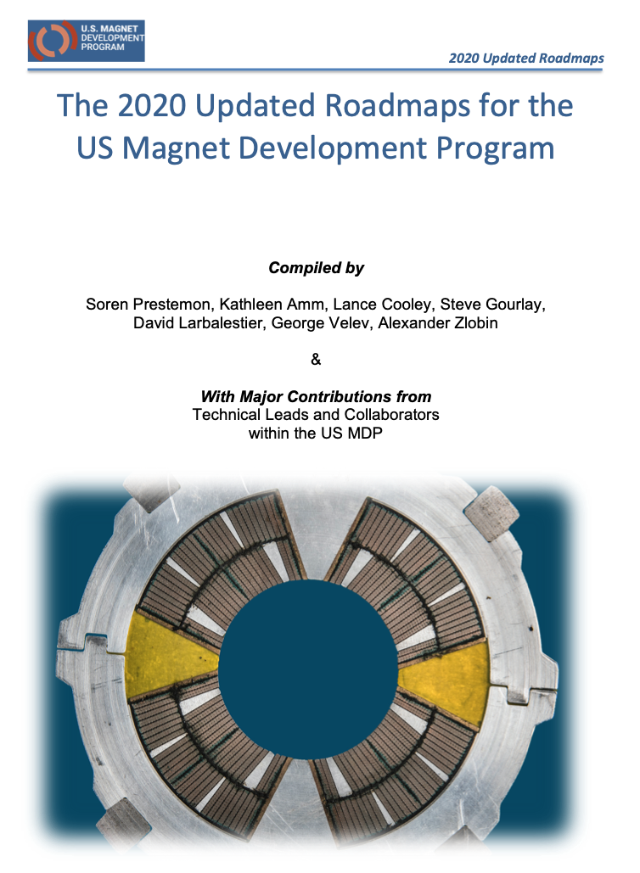
Program roadmap for the 2020-2024 period
Strategic directions for the (2020) updated plan:
  Probing stress management structures
  Hybrid HTS/LTS designs
  Understanding and impacting the disturbance-spectrum
  Advancing both LTS and HTS conductors, optimized for HEP applications
  We also introduced a new technology element
  20T Hybrid Magnet Design & Comparative Analysis,
  => designed to prepare for future milestones and directions

Slide 10
Ten-year roadmap
A 10-year high-level roadmap recognizes this Snowmass process and possible program adjustments
Significant synergies with other programs
  NHMFL development of high field solenoid technologies
  Fusion development of high-field HTS-based Tokamaks
  The DOE HEP and FES offices are investing now in a High Field Cable Test Facility
  We are working with DOE’s ARDAP to identify means to strengthen US industrial/laboratory ecosystem in superconductors and magnets
MDP can provide critical developments for many of the HEP science applications advocated at Snowmass – but will require enhanced funding

Slide 11
Progress in magnet technology is critical to enable future colliders, and is currently resource-limited
MDP is a mature, effective multi-lab program – Limited by funding resources!
  Strong oversight by independent experts
    Technical Advisory Committee (2-3 times / year):
      A.J. Lankford (Chair); G. Apollinari, A. Ballarino, J. Minervini, M. Palmer, A. Yamamoto/T. Ogitsu
    Steering Council (~1 / year):
      H. Wheerts (Chair); T. Raubenheimer, + Lab Directors (or delegates)
Reviewed by DOE-OHEP in December 2019
  A.J. Lankford (UCI), Chair; Ruben Fair (Jefferson Lab); Pierre Vedrine (CEA-Saclay)
Comments: Effectiveness in implementing a prioritized and optimized program: MDP management has been effective in establishing a successful R&D program. It has also been effective in implementing its strategic plan, as demonstrated by the important accomplishments in each of its thrust areas.

Slide 12
Summary: A strong magnet R&D program is essential to deliver on HEP science facility needs
MDP focuses on ”generic” magnet R&D that builds the foundations for Particle Physics applications
  Strong modeling and analysis developments – leverage HPC, AI/ML
  Strong diagnostics developments – insight into magnet performance, protection, control
  Development of core magnet technologies – materials, processes, testing
  Development of superconductors – performance, scalability and cost
  And most critically => development of the next generation of magnet experts for the community!
MDP can be effectively complemented by directed R&D when the time is right - i.e. a potential project is on the horizon
A long-range magnet R&D program, designed to advance magnet technology while fully leveraging the broader community’s strengths, is vital to HEP and the future of particle physics.

