Slide 1


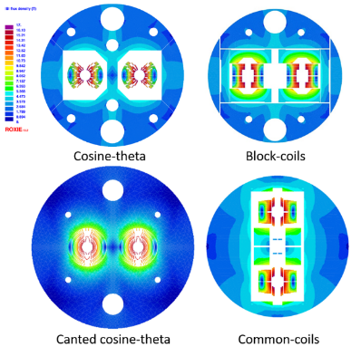

European
Magnet R&D Roadmap
for Particle Physics
Pierre Vedrine
on behalf of HFM Expert Panel,
Luis García-Tabarés , Bernhard Auchmann, Amalia Ballarino, Bertrand Baudouy, Luca Bottura, Philippe Fazilleau, Matthias Noe, Soren Prestemon, Etienne Rochepault, Lucio Rossi, Carmine Senatore, Ben Shepherd
Seattle Snowmass Summer Meeting 2022, 21 July 2022

Slide 2
Outline
Motivation
Panel activities
HFM Program and R&D plans
Costing
Conclusions

Slide 3

2020 Update of the European Strategy for Particle Physics
  “Europe, together with its international partners, should investigate the technical and financial feasibility of a future hadron collider at CERN with a centre-of-mass energy of at least 100 TeV and with an electron-positron Higgs and electroweak factory as a possible first stage. “
  “The technologies under consideration include high-field magnets, high-temperature superconductors, plasma wakefield acceleration and other high-gradient accelerating structures, bright muon beams, energy recovery linacs.
  The European particle physics community must intensify accelerator R&D and sustain it with adequate resources. A roadmap should prioritise the technology, taking into account synergies with international partners and other communities such as photon and neutron sources, fusion energy and industry. Deliverables for this decade should be defined in a timely fashion and coordinated among CERN and national laboratories and institutes.“
http://cds.cern.ch/record/2721370

Slide 4
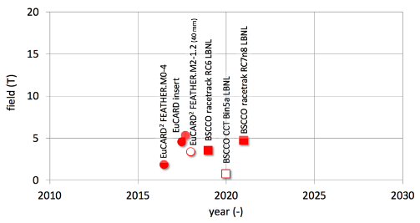
Motivation (1/2)
High Field Magnets (HFM) are among the key technologies that will enable the search for new physics at the energy frontier.
Approved projects (HL-LHC) and studies for future circular machines (FCC, SppC) call for the development of superconducting magnets that produce fields beyond those attained in the LHC .
Progress in highest field attained in European and international programs (EU-FP6 CARE , EU-FP7 EuCARD, EuCARD2, HL-LHC , ARIES, on-going I-FAST, HFM & US-DOE programs)

Slide 5
Motivation (2/2)
Lead times for the development of high-field magnets are long, with a typical duration in excess of a decade. It is hence important to pursue R&D in parallel with scoping studies of new accelerators.
The development of high field magnets naturally spans over many fields of science and requires a broad mix of competencies, implying a research team assembled as a collaboration ranging from academia to industry.
The development of novel SC magnet technology at the high field frontier requires specific infrastructure, often of large size.
An important matter underlying the above considerations is that of cost. In this respect we have to consider not only the construction cost of magnets, but also the cost of the R&D itself.
One such program will have to be of collaborative nature, with strong partnership among national laboratories, universities and industry in Europe and worldwide
These considerations point to the need of a sustained and inclusive R&D program for high-field superconducting accelerator magnets as a crucial element for the future of HEP, as underlined by the strong recommendation emitted by the European Strategy Group 2020

Slide 6

LDG Expert Panel on HFM Activities
Laboratory Directors Group supervision (directors of Large Particle Physics Laboratories, including the CERN directorate)
15 HFM Expert Panel meetings from January to November 2021.
  Indico Category 13420.
Two virtual international workshops.
  HFM State-of-the-Art, April 14-16, 2021
  https://indico.cern.ch/event/1012691/
  HFM Roadmap Preparation, June 1&3, 2021
  https://indico.cern.ch/event/1032199/
One closed panel session on to consolidate the
30-page final report.
  HFM Roadmap Implementation, Sept. 15-16, 2021
  https://indico.cern.ch/event/1063355/
Accelerator R&D Roadmap published in Jan 2022.
  https://arxiv.org/abs/2201.07895

Slide 7
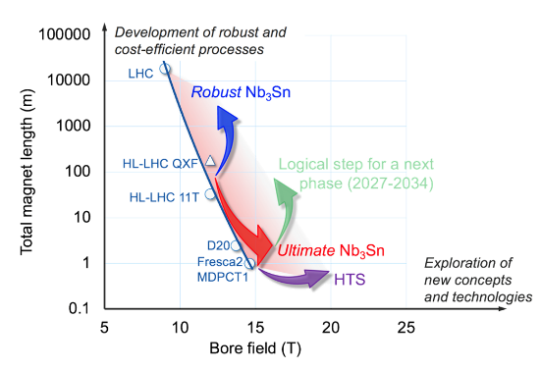
THE GOAL OF THE PROGRAM
The Program is aimed at finding the intersection between Performance, Cost and Robustness
  Demonstrate Nb₃Sn full potential in terms of ultimate performance (towards 16 T)
  Develop Nb₃Sn magnet technology for collider-scale production, through robust design, industrial manufacturing processes and cost reduction (benchmark 12 T)
  Demonstrate suitability of HTS for accelerator magnet applications, providing a proof-of-principle of HTS magnet technology beyond the reach of Nb₃Sn (towards 20 T)
Performance
Robustness
Cost
Goal

Slide 8
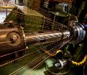
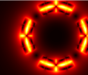

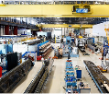
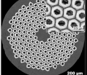
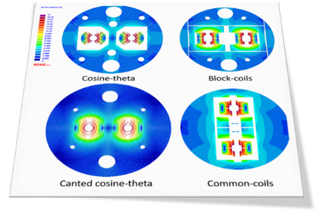
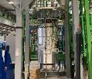
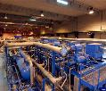
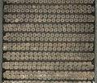
THE ELEMENTS OF THE PROGRAM AND THEIR INTEGRATION
A selection of different design aspects including magnets components, has to be integrated seamless with instrumentation, cryogenics, powering and protection to configure a full overall solution
Production infrastructure
Powering and Protection
Processes and Methods
Super Conductor
Magnet design
Test and Instruments
Cryogenics and Thermal Management
Materials

Slide 9
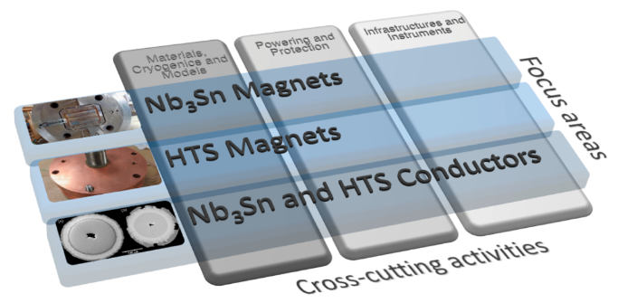
R&D Focus Areas and Cross-Cutting Activities
“The R&D programme must be holistic in nature: a compatible selection of electromagnetic, mechanical and thermal design approaches, conductors, materials, and manufacturing processes and methods needs to be integrated seamlessly with instrumentation and protection into a specific magnet solution responding to the required specification.“
Conversely, work across R&D areas must be closely coordinated.
Definition of 6 interleaved roadmaps
  Nb₃Sn and HTS Conductors
  Nb₃Sn magnets
  HTS magnets
  Materials, Cryogenics and Modelling
  Protection and Powering
  Infrastructure and Instrumentation

Slide 10
Fast-Turnaround R&D Programme as an Innovation Funnel
HFM R&D has suffered from slow turnaround and late feedback on selected technologies.
“We propose to structure the magnet R&D as a succession of meaningful fast-turnaround demonstrations, ranging from non-powered material […] samples […] towards ultimate specifications. In this way, new technologies can be tested under realistic conditions at the earliest possible stage, the smallest relevant scale and cost, and the fastest pace.“
Materials and Composite Samples (not powered)
HTS Samples and Technology
Powered Samples and Mechanical Models
HTS Design Studies
(LTS/HTS hybrid , all-HTS)
Sub-scale Magnets
Short Magnets at Intermediate Field
(11…12T)
Sub-scale HTS Magnets
Hybrid LTS/HTS R&D Magnets
(4.2 K)
All-HTS
R&D Magnets
(4.2…20 K)
Short Ultimate Magnets (14…16T)
Long Robust Magnets (11…12T)
HTS Demonstrator Magnets
(16…20 T)
Long Robust
Ultimate Magnets
(14…16 T)
Examples of multi-scale demonstrators for LTS and
HTS magnet R&D, adapted from Figs. 2.11 and 2.12.

Slide 11
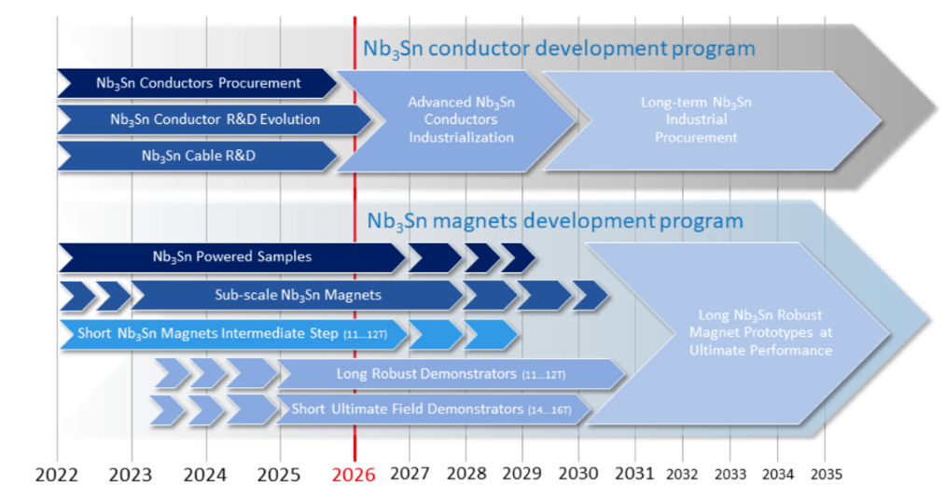
HFM R&D Timeline –
Nb3Sn Conductor and Magnet R&D

Slide 12
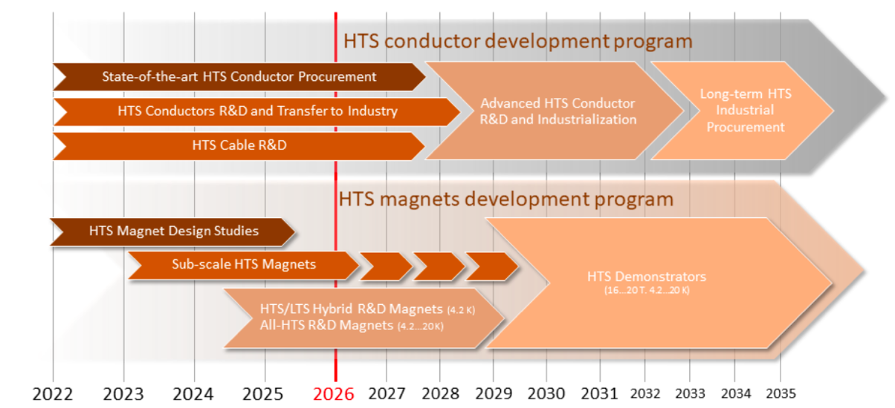
HFM R&D Timeline –
HTS Conductor and Magnet R&D

Slide 13
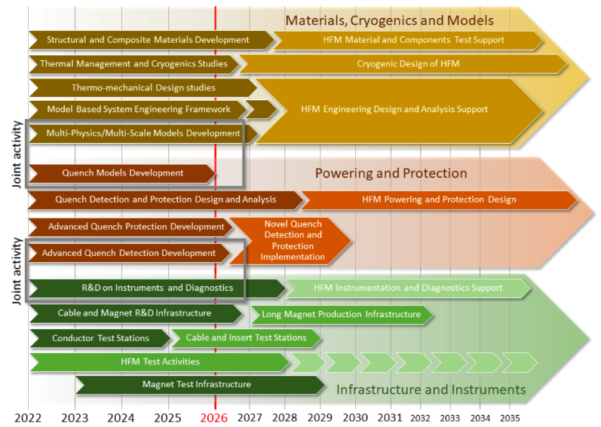
HFM R&D Timeline –
Cross-Cutting R&D Activities

Slide 14
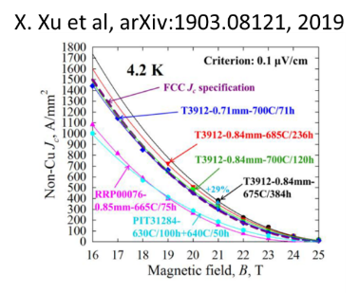
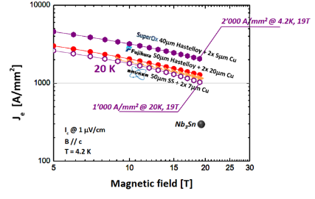

HFM R&D plans related to superconductors
Nb₃Sn Conductor
  Advance performance of Nb3Sn wires beyond present state-of-the-art, with a target 1500 A/mm2 at 16 T (mechanical properties, magnetization & stability, cost…).
  Develop cables with high engineering current density, J_{E} ≈ 600 A/mm², appropriate to yield a compact and efficient coil design.
  Increase the number of qualified manufacturers of HEP-class Nb3Sn conductor and make the material less expensive in view of a demonstration of production scale-up.
HTS Conductor
  Focus is on REBCO (exploit complementarity with US-MDP for Bi-2212)
  Achieve controlled, homogeneous and reproducible geometrical and electro-mechanical properties along the full length,
  Industrialize production to assure feasibility of long - 1 km target – unit lengths and reduce the cost to make future large-scale applications affordable.
  Develop, qualify and identify the type of cable suitable for accelerator quality magnets (stack, CORC, Roebel, novel concepts);
  Study electrical insulation and suitable impregnation processes;

Slide 15
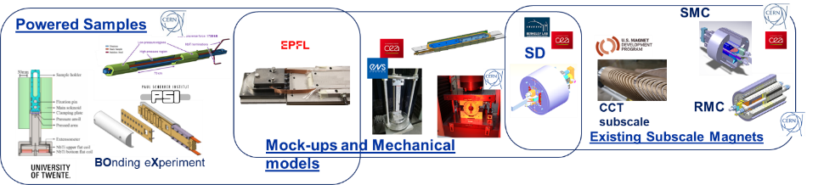
HFM R&D plans related to Nb3Sn magnets
Develop robust (12 T target) and ultimate (towards 16 T) field designs in parallel to samples and subscales in an agile mode that incorporates insights from previous steps.
Develop Nb3Sn magnet technology for robust and scalable manufacturing for long magnets and promotion of automation and innovations leading to simplified manufacturing processes,
Test new technologies at smallest possible scale using short model or other small-scale test facilities in this context at the earliest possible moment
Complete the knowledge of material parameters and proper implementation of coil and other materials as well as interfaces in 3D models

Slide 16
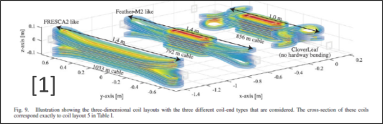
HFM R&D plans related to HTS magnets
  Manufacture and test sub-scale and insert coils as a “R&D vehicle” and demonstration of operation beyond the reach of Nb₃Sn.
  Explore the ‘controlled-insulation’ scheme for HTS coil by testing coils with reasonable current and test it with requirements for accelerators.
  Optimize the shape design to reduce wrong field components (//c).
  Study the end design options (cloverleaf, CCT,…) to mitigate the complexity of tape ratio aspect and hard way bending
  Explore and model the screening currents effects (magnetization and temporal stability) and ways to decrease/remove these effects (overshoot/vortex shaking/temperature increase)
  Explore the possibility of intermediate temperature range (10-20 K) and dry magnet (conduction cooled).

Slide 17
HFM R&D plans related to Cross-cutting Technology
Materials, Cryogenics and Modelling
  Develop and characterize materials and composites relevant to HFM
  Develop new engineering solutions for thermal management of high field magnets
  Consolidate the modelling tools to complement short model magnets.
HFM Magnet Protection
  Explore alternative detection methods (more difficult for HTS than for LTS) including new quench diagnostics
  Explore alternative protection methods (LTS and HTS have high energy density) to make them faster and more efficient.
HFM Production infrastructure
  Develop at the partners’ laboratories, dedicated infrastructure suitable for HFM R&D, at the start.
  Construction of full-scale prototypes, also engaging industry, is needed in early phases of the activity.
HFM Test Infrastructure and Instrumentation
  Review existing diagnostic, instrumentation and test infrastructure as required by HFM R&D, and establish future needs.
  Coordinate instrumentation and test infrastructure development and upgrades and facilitate sharing of test resources within the scope of HFM R&D.
HFM Applications to Science and Society
  Evaluate and foster the scientific and societal impact of the HFM R&D, maintaining a tight connection with the HFM stakeholders.

Slide 18
Program Costing: Nominal Scenario
The value of the program has been estimated using a bottom-up approach.
Note: Values are quoted as material value M (in MCHF) and personnel P (in FTEy). Personnel groups all classes, permanent (academic and technical staff) and temporary (academic and technical staff, students, post-docs and all other forms of external support labor acting on the laboratory premises, students, post-docs, associates, contractors).
Costing at 5 years : Material = 113 MCHF, Personnel = 478 FTEy
Costing at 7 years : Material = 154 MCHF, Personnel = 607 FTEy

Slide 19
Conclusions
The European HFM roadmap is published, taking into account the needs of the high energy physics community for future colliders.
The R&D plans are defined and have been translated into prioritized roadmaps, proposed demonstrators, milestones and deliverables, and engagement scenarios at the European level.
The implementation plans and coordination structures are being defined to be operational in the second half of 2022.
The impact of HFM magnet development on the industrial ecosystem, on the training and education of future generations of magnet builders, and on the sustainability of the technologies developed will also be explored.
Finally, we would like to emphasize the values of collaboration, and the connection to the on-going programs worldwide. Realizing the proposed HFM program will build a broad and resilient basis of competence and a strong magnet community

