Slide 1
Higgs-Energy LEptoN (HELEN) Collider
in 10 slides
Sergey Belomestnykh (Fermilab)
July 18, 2022

Slide 2
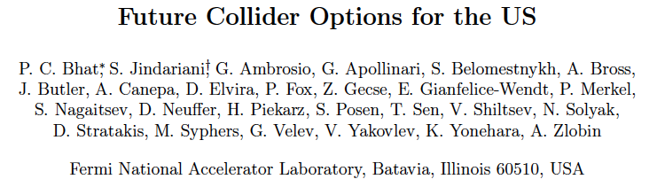
Motivation
ILC remains the most mature option (TDR level) for a Higgs factory. However, efforts to launch the project in Japan haven’t yet been successful.
This Snowmass is a great opportunity for the HEP community to consider options for major complementary facilities that can be hosted in the United States.
One of the several options proposed in the White Paper is a linear collider based on high gradient SRF (in the range of 55 MV/m to 90 MV/m; standing wave or travelling wave structures).

Slide 3
Introduction
There continues to be steady progress in developing the SRF technology with accelerating gradients demonstrated up to 50 MV/m while the ILC design requires 31.5 MV/m.
An aggressive R&D program on traveling wave SRF structures and innovations in cavity surface treatments and processing, an accelerating gradient of about 70 MV/m can possibly be reached within the next 2–3 years.
Further (longer term) research in developing new SRF materials, specifically Nb₃Sn, could enable ultimate gradients of 90 MV/m and higher.
Anticipating these advances in the near future, we propose a 250 GeV e⁺e– SRF linear collider (Higgs-Energy LEptoN collider, or HELEN collider) that can be sited at Fermilab. With the use of existing infrastructure and facilities at Fermilab, and the factor of >2 higher gradients, there could be significant cost reduction for the main linac relative to the ILC main linac cost.

Slide 4
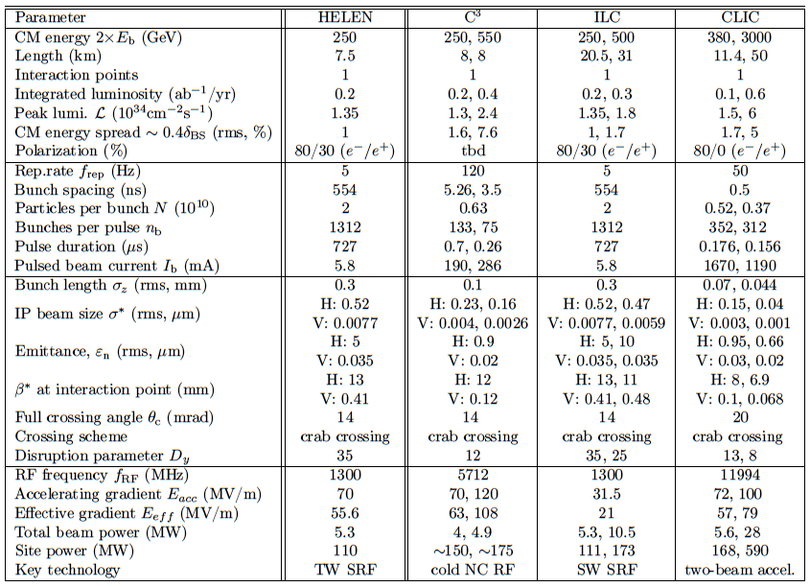
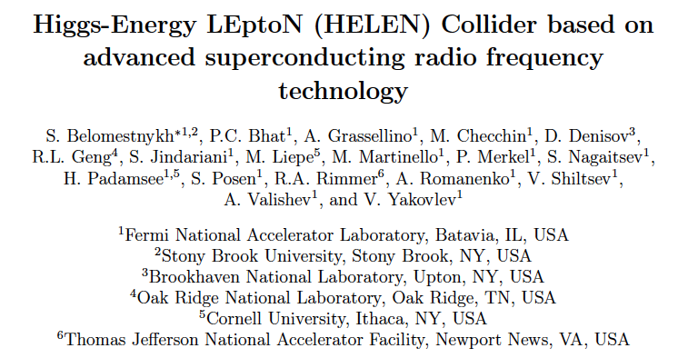
Baseline Design/Layout and Parameters
While we consider 3 different advanced SRF technologies, a traveling wave (TW) SRF operating at 70 MV/m is selected as the baseline option.
Most of the HELEN parameters (except for SRF) are identical to those of the ILC.

Slide 5
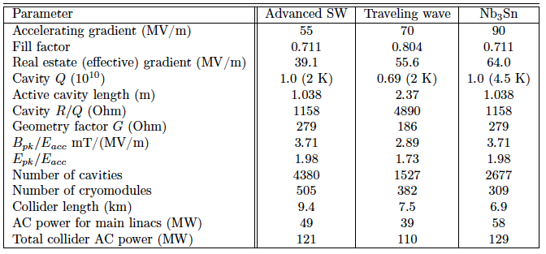

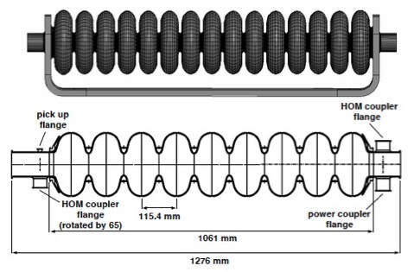
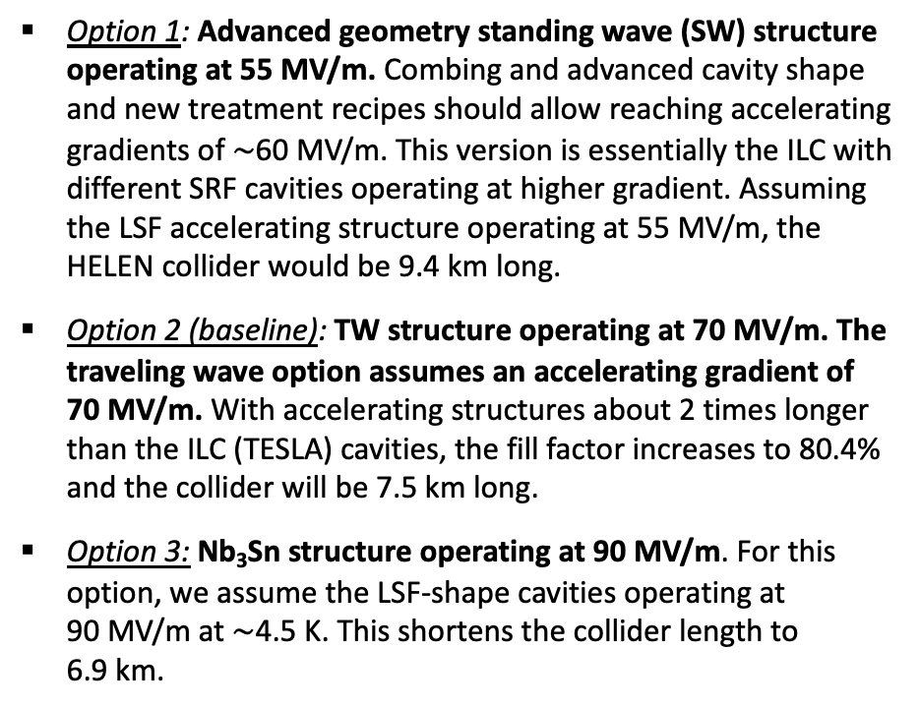

Key Technology: SRF
Option 1: Advanced geometry standing wave (SW) structure operating at 55 MV/m. Combing and advanced cavity shape and new treatment recipes should allow reaching accelerating gradients of $\sim$60 MV/m. This version is essentially the ILC with different SRF cavities operating at higher gradient. Assuming the LSF accelerating structure operating at 55 MV/m, the HELEN collider would be 9.4 km long.
Option 2 (baseline): TW structure operating at 70 MV/m. The traveling wave option assumes an accelerating gradient of 70 MV/m. With accelerating structures about 2 times longer than the ILC (TESLA) cavities, the fill factor increases to 80.4% and the collider will be 7.5 km long.
Option 3: Nb₃Sn structure operating at 90 MV/m. For this option, we assume the LSF-shape cavities operating at 90 MV/m at $\sim$4.5 K. This shortens the collider length to 6.9 km.
LL geometry
TESLA cell
Comparison of SW SRF cavity shapes
The TW structure with a 105$°$ phase advance per cell compared to the one-meter standing-wave TESLA structure

Slide 6
Accelerator design and challenges
The TW option was selected as the baseline for the following reasons:
It is the most efficient in terms of AC power consumption and is on par with the ILC site power demand.
It offers the best cost saving. Our preliminary estimate indicates that the cost savings (relative to the ILC main linac cost) are 13% for Option 1, 26% for Option 2, and 18% for Option 3.
The traveling wave technology can be demonstrated on a relatively short time scale. With an aggressive R&D program and innovations in cavity surface treatments and processing, the required accelerating gradient can possibly be reached within the next 2–3 years. After that, another 2–3 years would be needed to build and test a demonstration cryomodule, possibly with beam at the Fermilab’s FAST facility.

Slide 7
Potential siting at Fermilab
A 12-km footprint with N–S orientation, extending outside Fermilab boundary but with the Interaction Region (IR) remaining on site, was identified as a possibility.
Figure show HELEN collider on Fermilab site for the baseline option.

Slide 8
Proposals for upgrades and extensions
As HELEN is similar to ILC in many respects, all proposed ILC luminosity upgrade scenarios are applicable.
Considering the 12 km siting at Fermilab, the following energy upgrades are possible:
  350 GeV with Option 1
  500 GeV with Option 2
  500 GeV with Option 3 (10.8 km)
To make an energy upgrade to 1 TeV feasible, an alternative site shall be considered, see examples of options previously considered for ILC in the White Paper

Slide 9
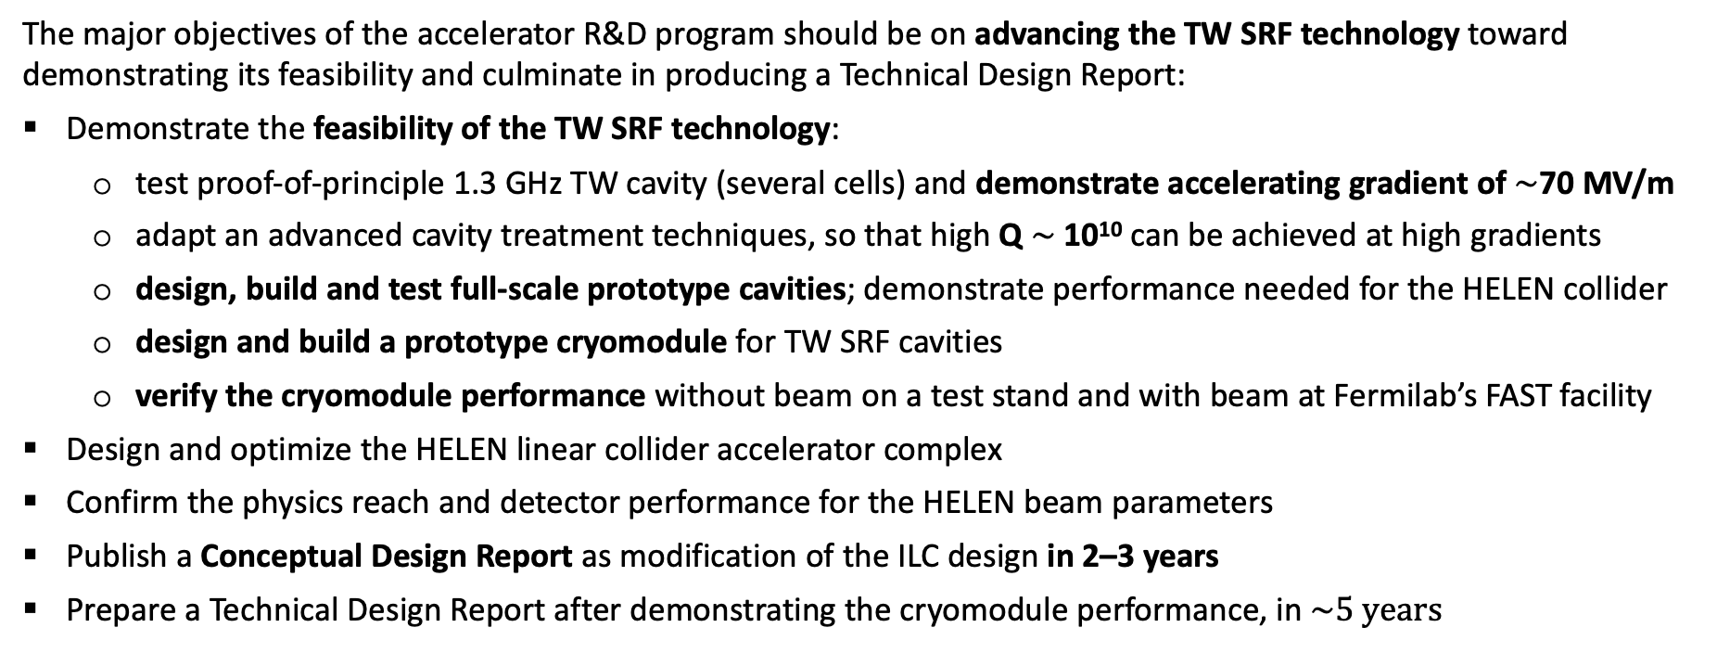
State of Proposal and R&D needs (5-10 years)
The major objectives of the accelerator R&D program should be on advancing the TW SRF technology toward demonstrating its feasibility and culminate in producing a Technical Design Report:
Demonstrate the feasibility of the TW SRF technology:
  test proof-of-principle 1.3 GHz TW cavity (several cells) and demonstrate accelerating gradient of $\sim$70 MV/m
  adapt an advanced cavity treatment techniques, so that high Q $\sim$10¹⁰ can be achieved at high gradients
  design, build and test full-scale prototype cavities; demonstrate performance needed for the HELEN collider
  design and build a prototype cryomodule for TW SRF cavities
  verify the cryomodule performance without beam on a test stand and with beam at Fermilab’s FAST facility
Design and optimize the HELEN linear collider accelerator complex
Confirm the physics reach and detector performance for the HELEN beam parameters
Publish a Conceptual Design Report as modification of the ILC design in 2–3 years
Prepare a Technical Design Report after demonstrating the cryomodule performance, in $\sim 5 years$

Slide 10
Evaluate your collider maturity
For most of the machine the Design and R&D maturity are the same as for ILC.
Three areas are different though:
  SRF R&D Maturity – 2
  ML Design Maturity – 3
  Site-specific Design issues – 2

Slide 11
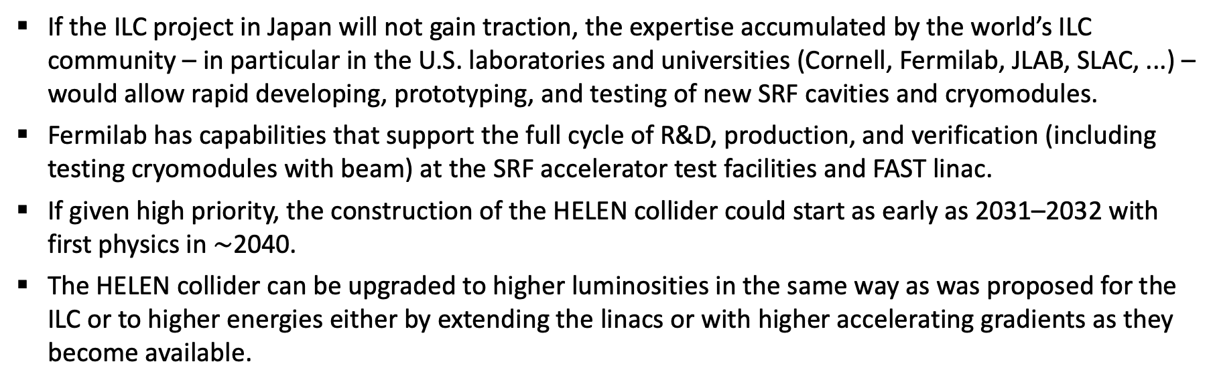
Summary
If the ILC project in Japan will not gain traction, the expertise accumulated by the world’s ILC community – in particular in the U.S. laboratories and universities (Cornell, Fermilab, JLAB, SLAC, ...) – would allow rapid developing, prototyping, and testing of new SRF cavities and cryomodules.
Fermilab has capabilities that support the full cycle of R&D, production, and verification (including testing cryomodules with beam) at the SRF accelerator test facilities and FAST linac.
If given high priority, the construction of the HELEN collider could start as early as 2031–2032 with first physics in $\sim$2040.
The HELEN collider can be upgraded to higher luminosities in the same way as was proposed for the ILC or to higher energies either by extending the linacs or with higher accelerating gradients as they become available.

Slide 12
Thank you!

