Slide 1
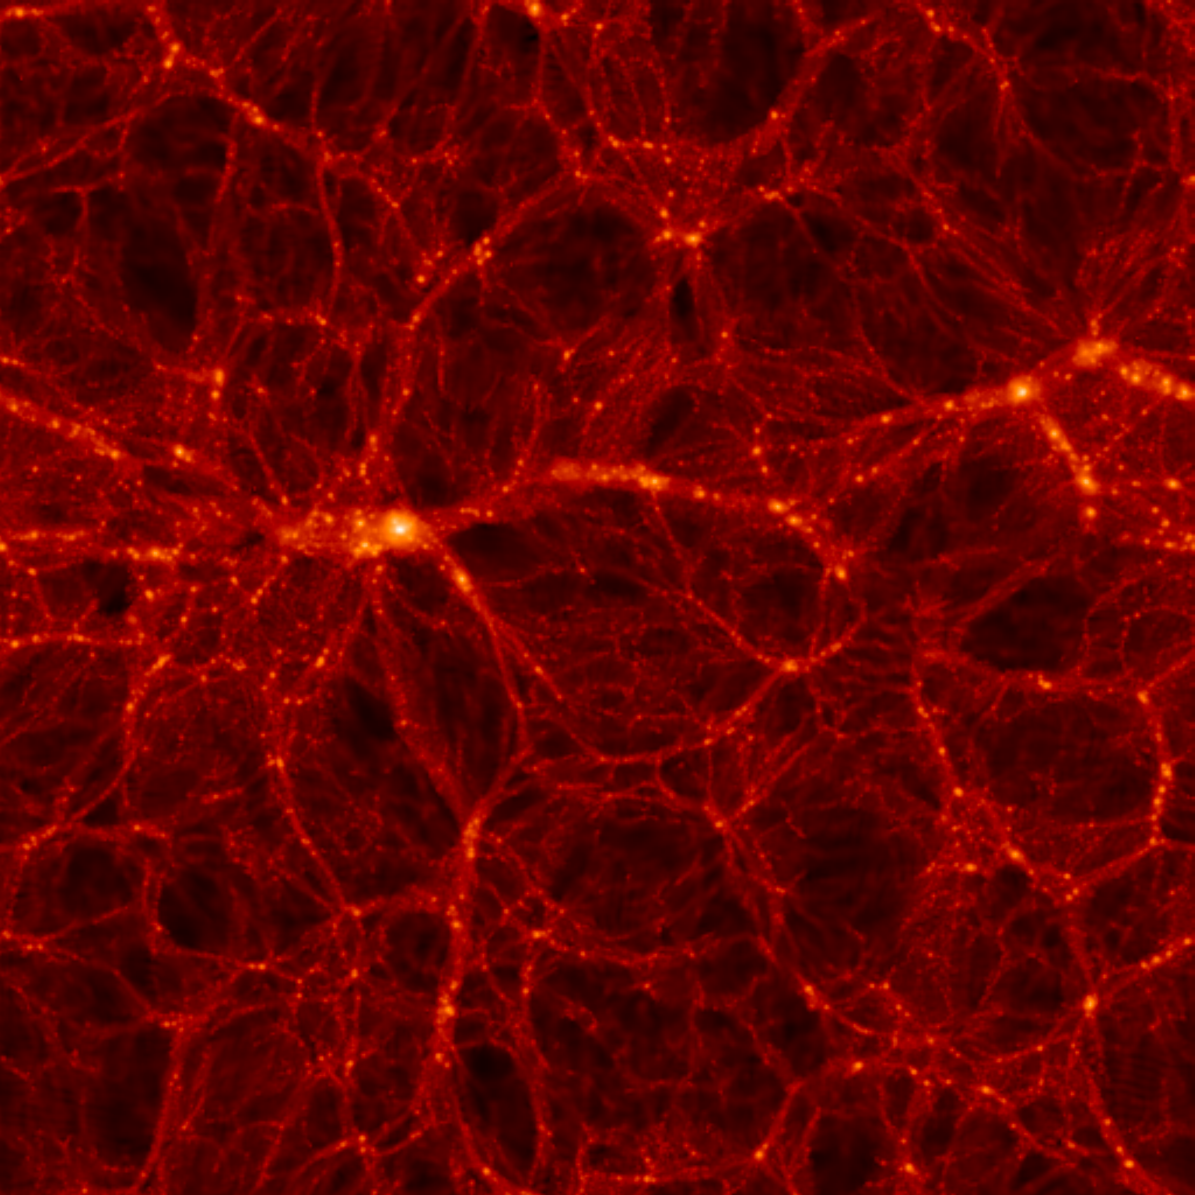
Neutrino mass in cosmology
Model dependence
$$ν_{e}$$
$$ν_{μ}$$
$$ν_{S}$$
$$ν_{τ}$$
Steen Hannestad, Aarhus University
Snowmass Summer Meeting 2022

Slide 2
NEUTRINO MASS AND ENERGY DENSITY
FROM COSMOLOGY
NEUTRINOS (AND OTHER LIGHT, WEAKLY INTERACTING
PARTICLES) AFFECT STRUCTURE FORMATION
BECAUSE THEY ARE A SOURCE OF DARK MATTER
(n ~ 100 cm⁻³)
FROM
HOWEVER, eV NEUTRINOS ARE DIFFERENT FROM CDM
BECAUSE THEY FREE STREAM
SCALES SMALLER THAN d_{FS} DAMPED AWAY, LEADS TO
SUPPRESSION OF POWER ON SMALL SCALES

Slide 3
N-BODY SIMULATIONS OF ΛCDM WITH AND WITHOUT
NEUTRINO MASS (768 Mpc³) – GADGET 2
256
Mpc
T Haugboelle, Aarhus University

Slide 4
AVAILABLE COSMOLOGICAL DATA

Slide 5
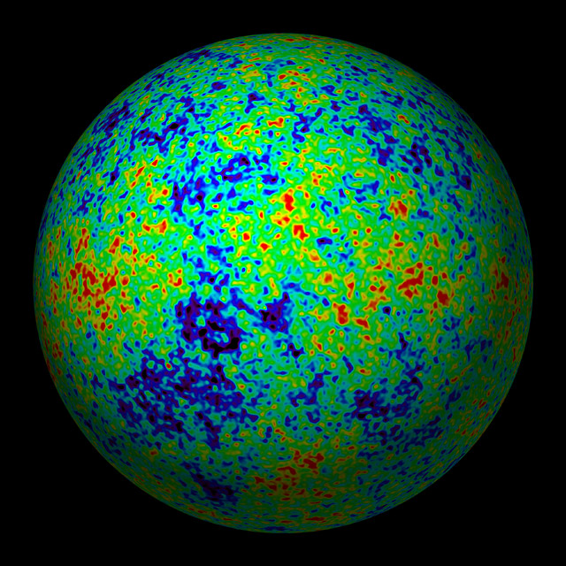
THE COSMIC MICROWAVE BACKGROUND
CMB TEMPERATURE AND POLARISATION

Slide 6
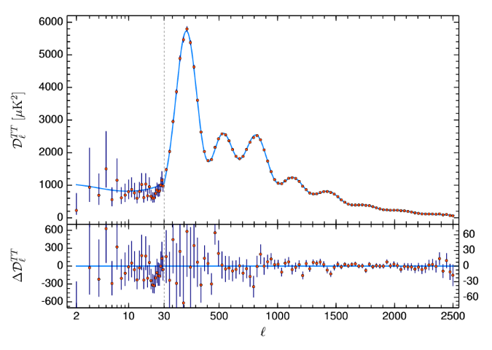
Aghanim et al. 2018 (Planck)

Slide 7
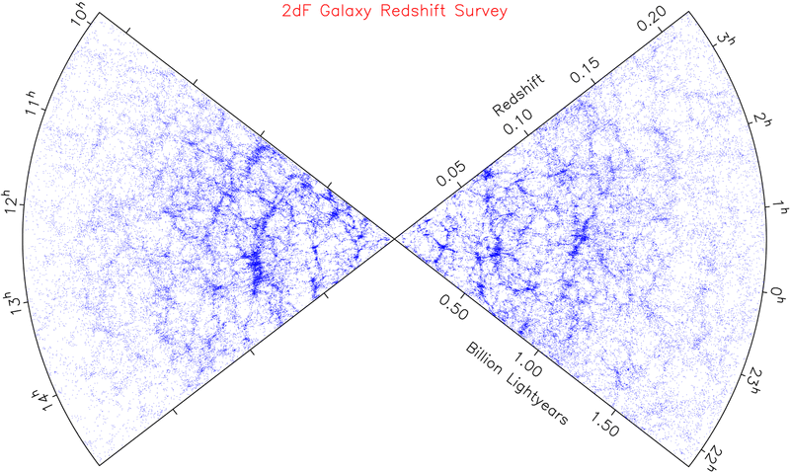
LARGE SCALE STRUCTURE SURVEYS

Slide 8
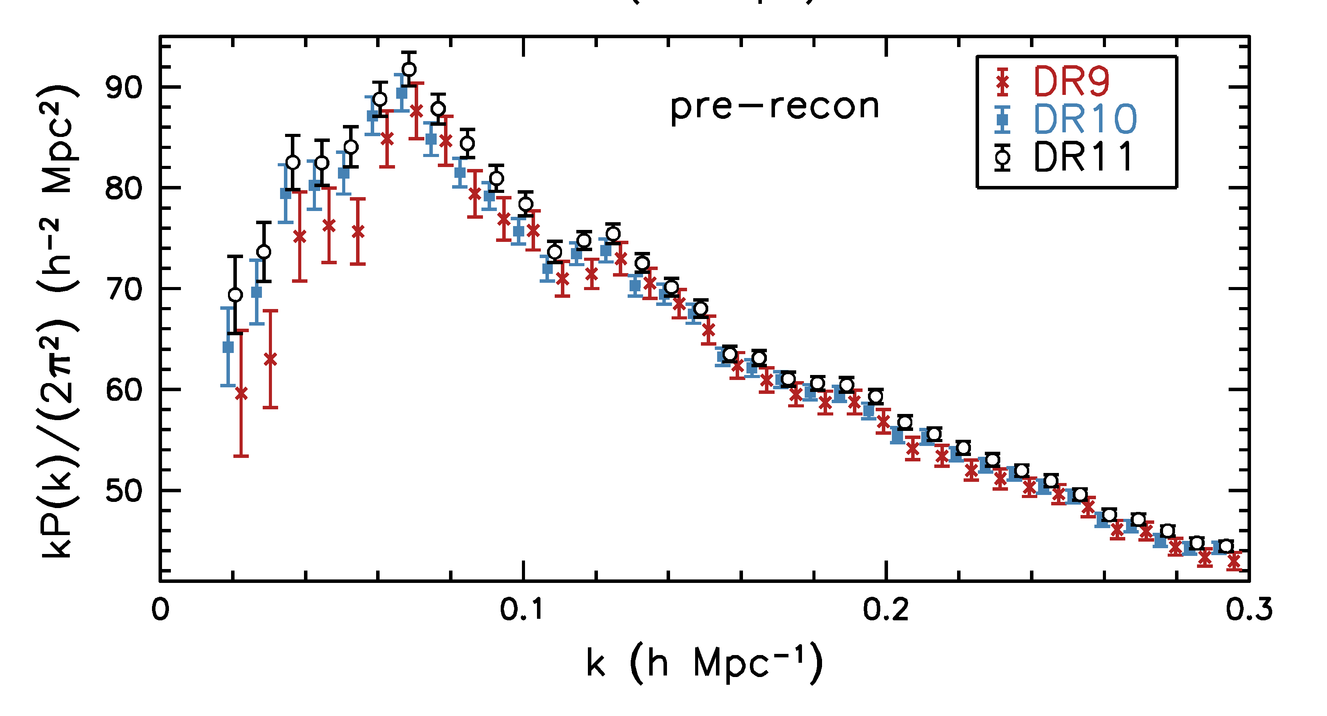
Anderson et al. 1312.4877 (SDSS)

Slide 9
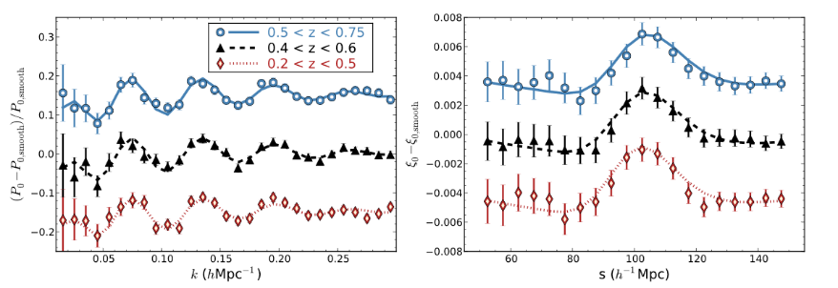
Alam et al. 1607.03155 (SDSS DR12)

Slide 10
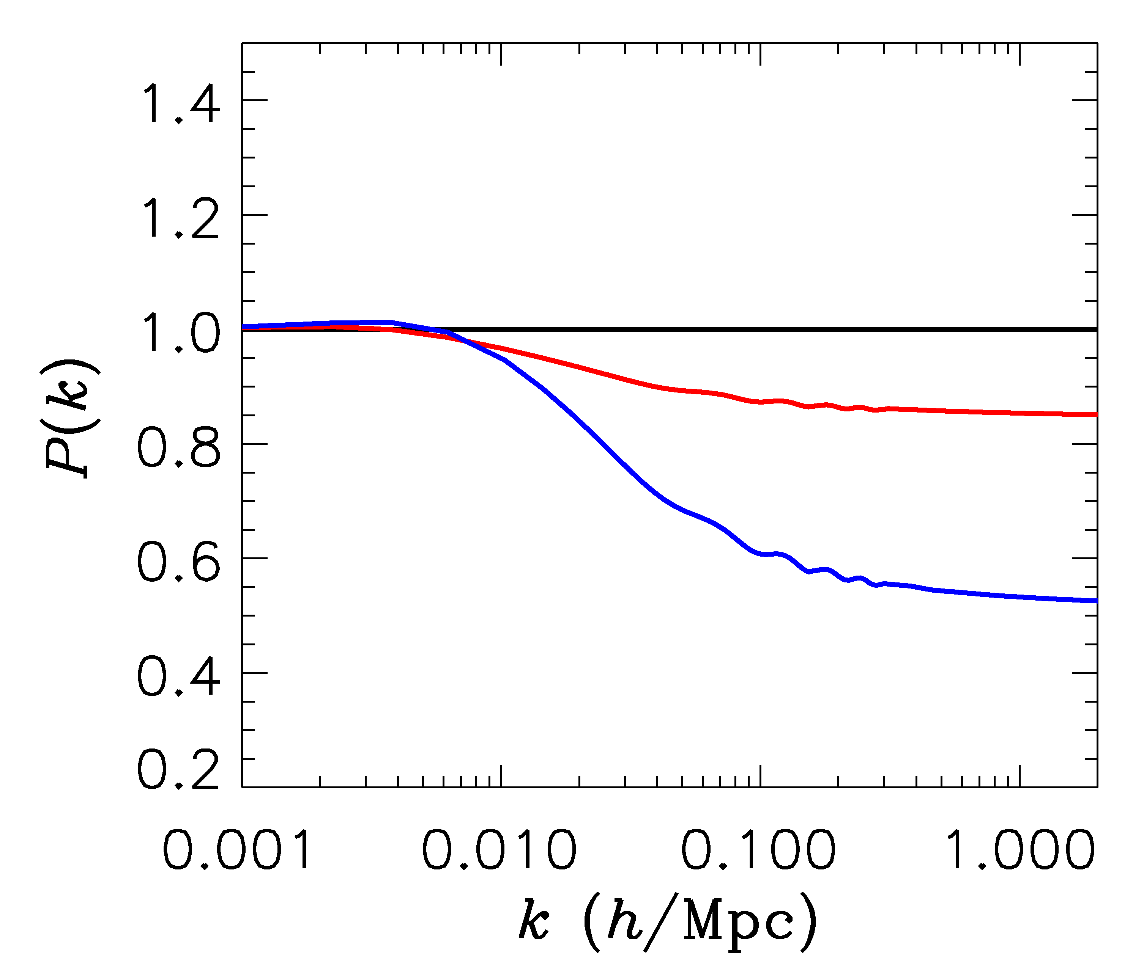
FINITE NEUTRINO MASSES SUPPRESS THE MATTER POWER
SPECTRUM ON SCALES SMALLER THAN THE FREE-STREAMING
LENGTH
$∑m_{ν}$ = 0 eV
P(k)/P(k,m_{ν}=0)
$∑m_{ν}$ = 0.3 eV
$∑m_{ν}$ = 1 eV

Slide 11
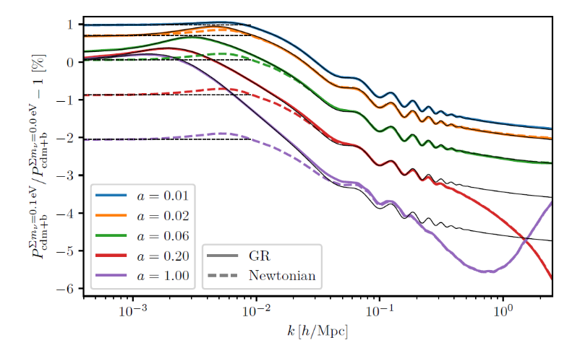
Tram et al. 1811.00904 (JCAP) (fully compatible with GR at the linear level)

Slide 12
NOW, WHAT ABOUT NEUTRINO
PHYSICS?

Slide 13
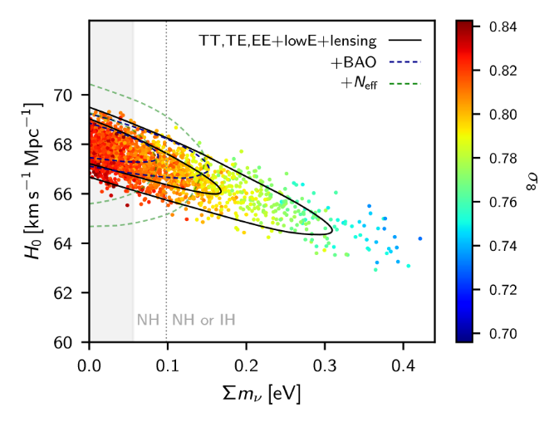
WHAT IS THE PRESENT BOUND ON THE NEUTRINO MASS?
DEPENDS ON DATA SETS USED AND ALLOWED PARAMETERS
THERE ARE MANY ANALYSES IN THE LITERATURE
AGHANIM ET AL.
(PLANCK 2018)

Slide 14
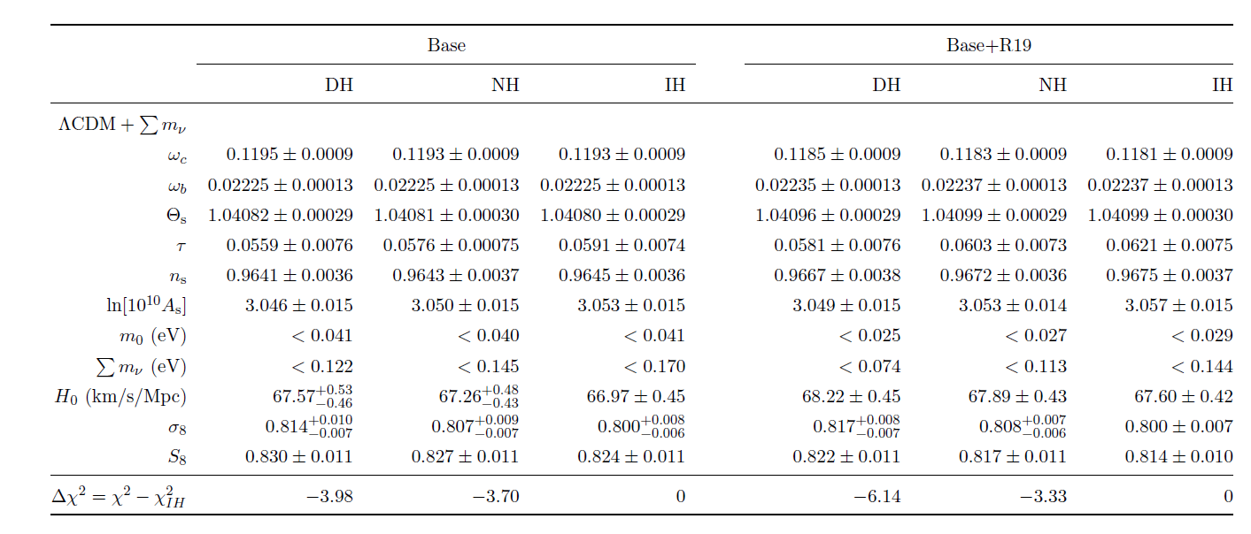
Choudhury & STH 1907.12598
See Eleonora’s talk for more detail

Slide 15
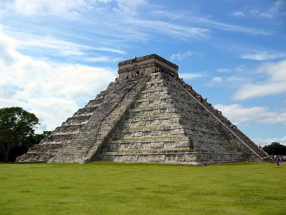
THE NEUTRINO MASS FROM COSMOLOGY PLOT
More data
+Ly-alpha
~ 0.1 eV
0.2-0.3 eV
0.2-0.3 eV
+ SNI-a
+WL
~ 0.15 eV
~0.5 eV
0.5-0.6 eV
+ SDSS
~0.15 eV
~ 0.5 eV
~0.5 eV
CMB only
0.7 eV
~ 1 eV
1.? eV
??? eV
Minimal
ΛCDM
+N_{ν}
+w+……
Larger model
space

Slide 16
How can the bound be avoided?

Slide 17
How does neutrino mass affect cosmology?
A non-zero neutrino mass leads to:
1) A modified matter-radiation transition, leading to a change in the Hubble rate and a slight increase in the early ISW effect
2) The lack of neutrino clustering below the free-streaming scale leads to a very substantial reduction in matter clustering.
This in turn leads to a substantial reduction in structure formation at all redshifts and e.g. a decrease in weak lensing

Slide 18
How can a large neutrino mass be allowed?
To be consistent with a large neutrino mass, a model can be built in two ways:
1) If the neutrino sector is left unmodified, the model has to counteract the effect of the neutrino mass, i.e. it needs more efficient clustering
2) Alternatively, neutrino physics must be modified so that a large neutrino mass does not affect structure formation substantially

Slide 19
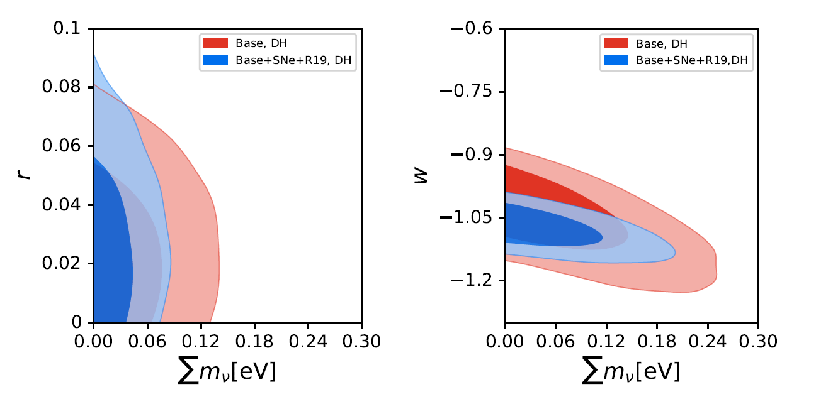
Simple examples belonging to category 1
Choudhury & STH 1907.12598

Slide 20
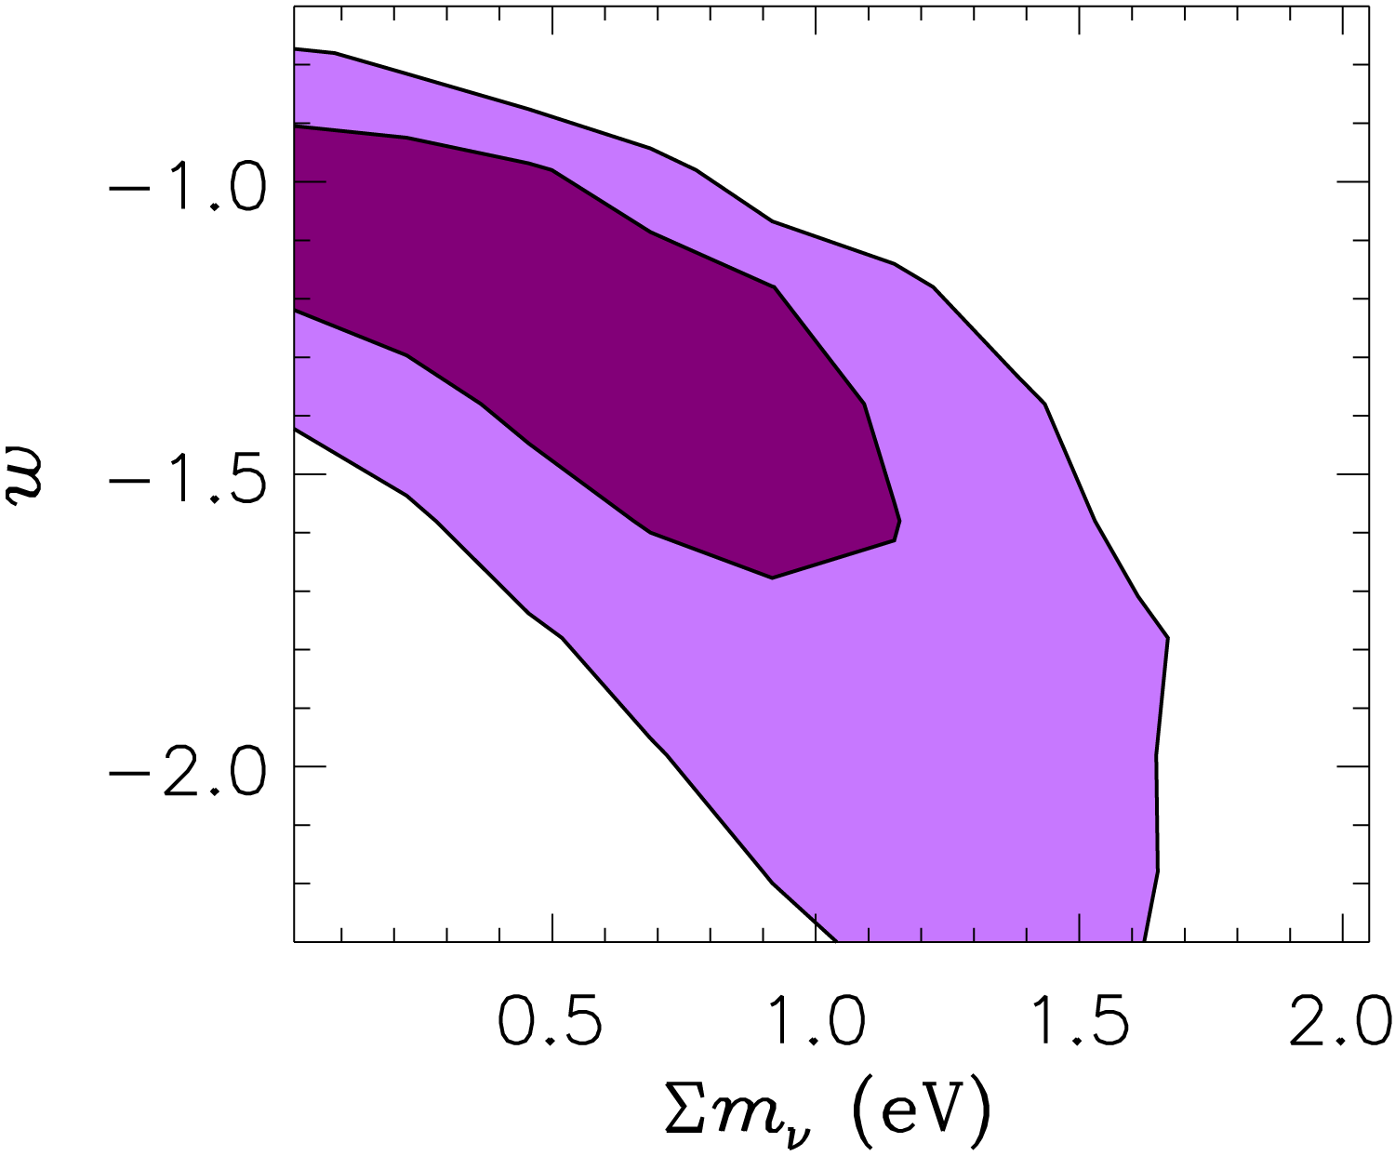
With better data it becomes increasingly hard for other cosmological
parameters to mimic the effect of a non-zero neutrino mass
For purely standard model neutrinos, the mass bound is fairly robust
2005: WMAP data
2019: Planck data

Slide 21
Examples belonging to category 2:
1) A time-varying neutrino mass
Making the neutrino mass dynamical can potentially evade cosmological bounds
Mass varying neutrinos (Fardon, Nelson, Weiner 2003)
Spontaneous neutrino mass generation (Dvali & Funcke 2016)
……

Slide 22
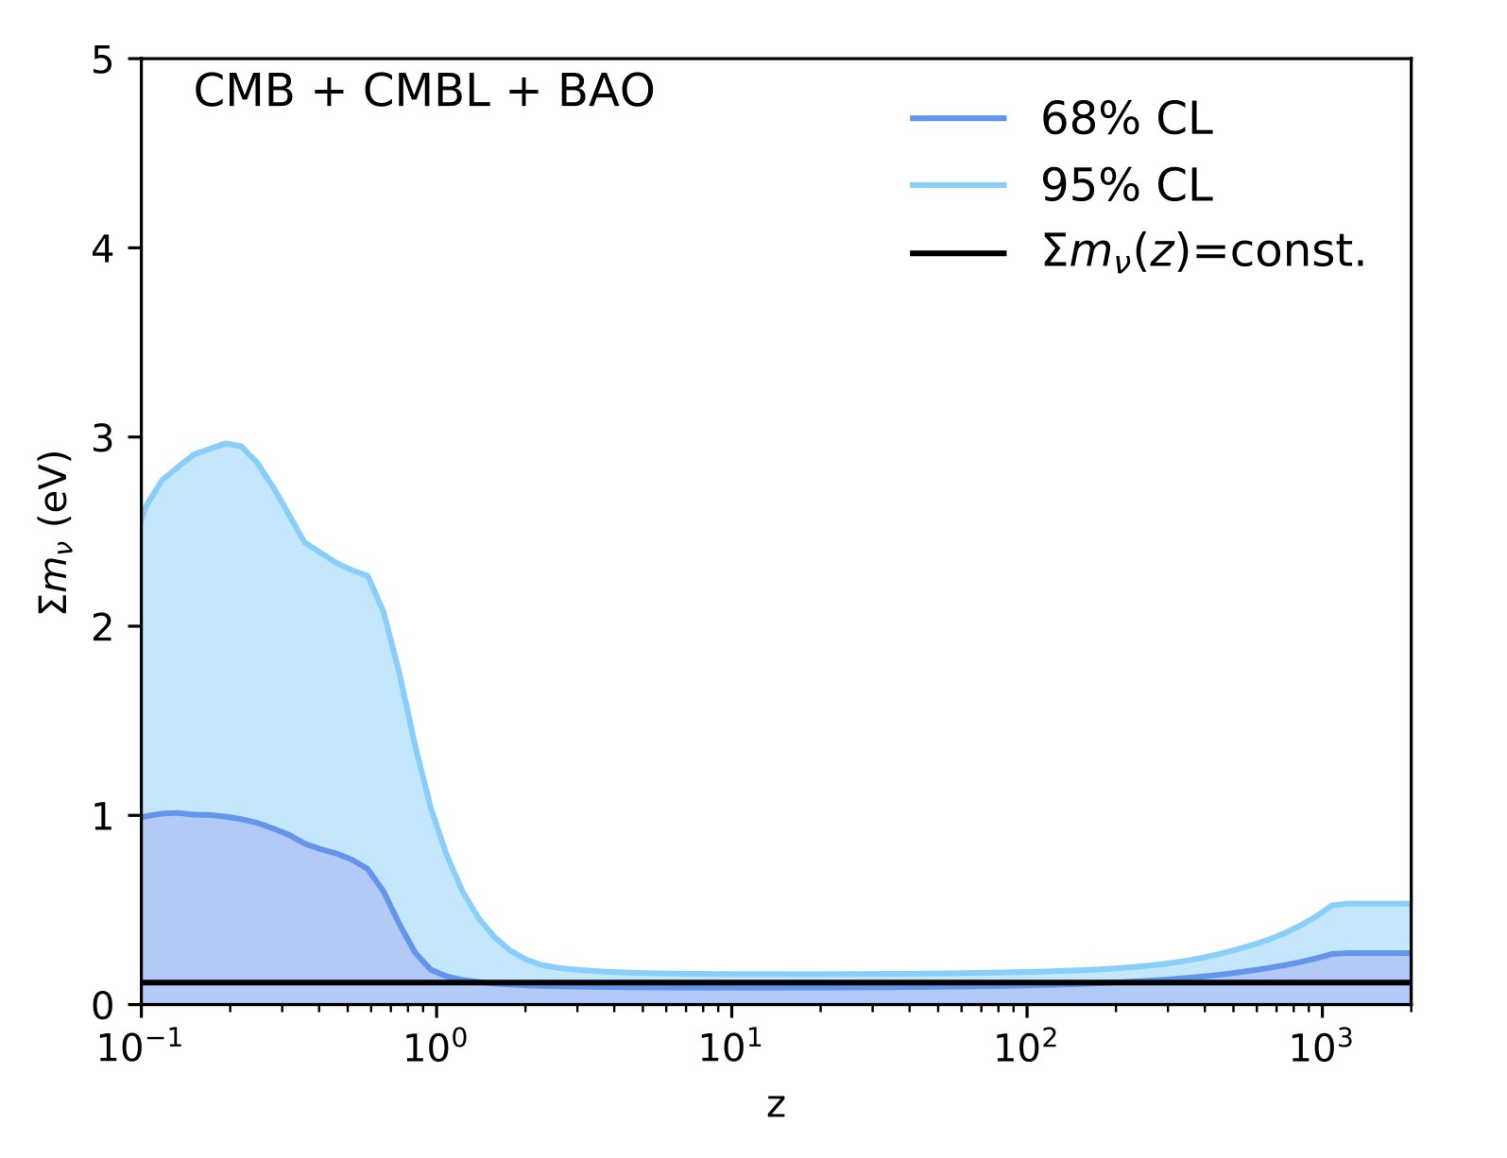
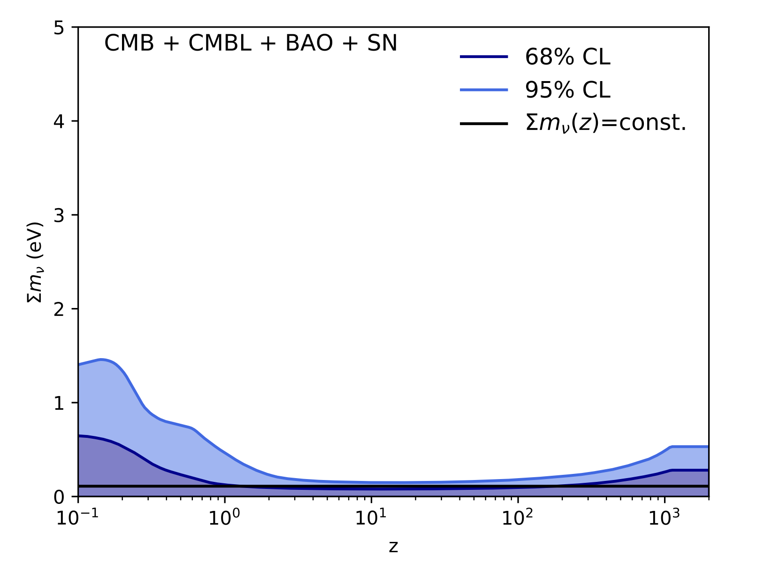
How can a large current neutrino mass be allowed?
Lorenz et al. arXiv:2102.13618

Slide 23
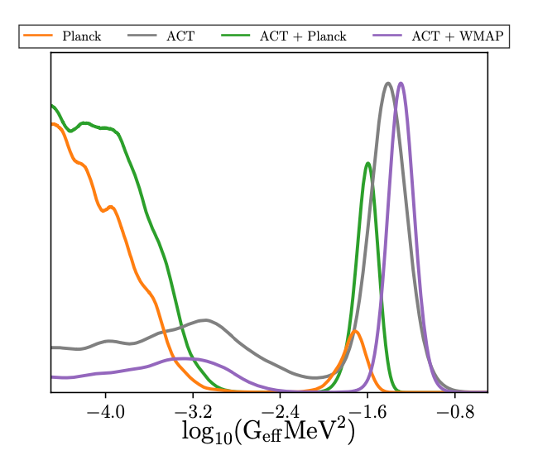
Examples belonging to category 2:
2) Non-standard neutrino interactions
The simplest example is a Fermi-like interaction (Cyr-Racine & Sigurdson 2013, Archidiacono & STH 2013, Forastieri, Lattanzi, Natoli 2015, recent works: Kreisch et al. 2207.03164, Choudhury, STH, Tram 2207.07142)
Can suppress free-streaming at early times, then decouples at late times
Surprisingly, fairly strong self-interactions
are not necessarily disfavoured
Kreis et al. 2207.03164

Slide 24
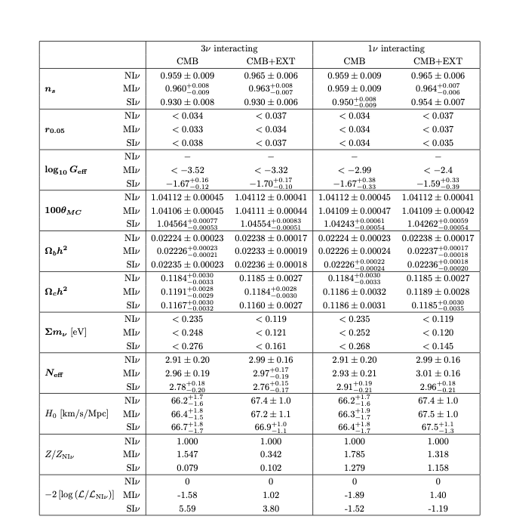
Examples belonging to category 2:
However, such interactions
have at most a moderate
effect on the mass bound
Choudhury, STH, Tram
2207.07164

Slide 25
Examples belonging to category 2:
2) Non-standard neutrino interactions
Another possibility is that neutrinos couple to a new, light (pseudo-)scalar.
This suppresses free-streaming at late time (neutrino recoupling, STH 2004)
Neutrinos can now pair-annihilate away through $\overline{ν}ν→φφ$ , effectively creating a neutrinoless universe (Beacom, Bell, Dodelson 2004)

Slide 26
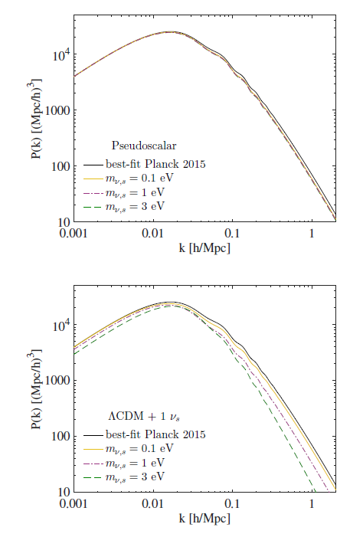
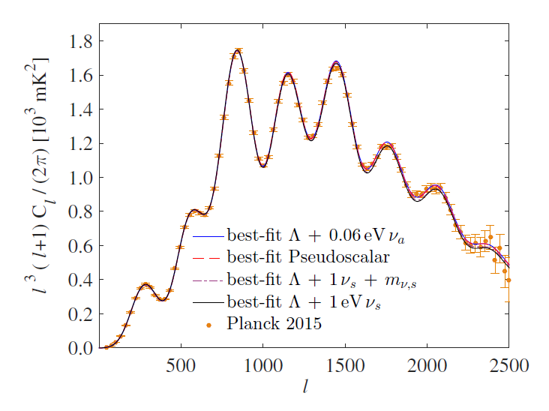
The usual suppression of matter
power does not occur because
the massive neutrinos disappear
as soon as they go non-relativistic
Archidiacono, STH, Hansen, Tram, arXiv:1508:02504 (sterile neutrinos)

Slide 27
Examples belonging to category 2:
For active neutrinos, annihilation of massive neutrinos typically requires
an interaction strong enough to completely suppress free-streaming until
after recombination – this is most likely not compatible with observations,
but some form of this scenario might work

Slide 28
And finally: Do we actually know that we have
measured a neutrino mass?
Cosmological observables (with the exception of BBN) have no flavour
Sensitivity
They measure: Current density contribution ($Ω_{ν}h^{2}$), early contribution to the radiation density ($N_{eff}$), to a very minor extent the epoch of relativistic to non-relativistic transition (but only if this lies around matter-radiation equality)
This means that:
Cosmology cannot tell if the hot dark matter is a neutrino mass or something else
Cosmology has no direct sensitivity to the mass hierarchy

Slide 29
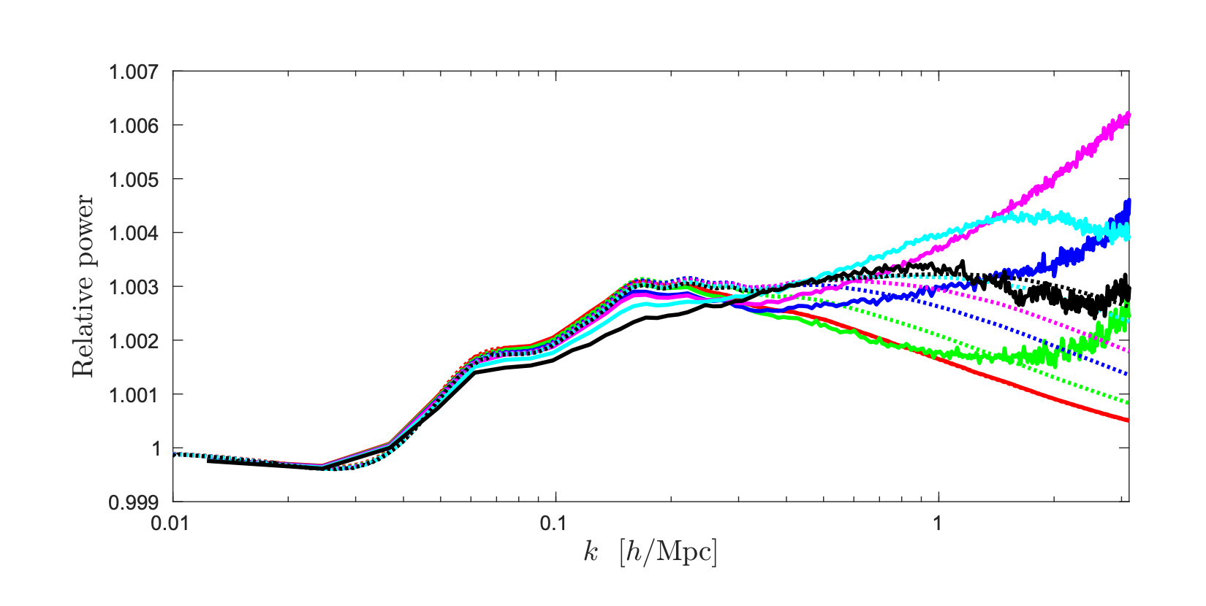
Example: What if hot dark matter was bosonic rather than fermionic
(with the same total density)?
Brandbyge & STH 1706.00025 (JCAP)

Slide 30
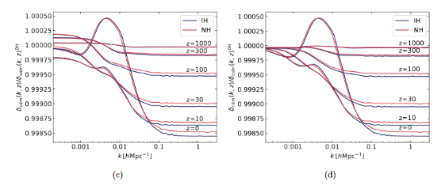
Can the specific hierarchy be measured using cosmology?
(as opposed to $∑m_{ν}$)
Archidiacono, STH, Lesgourgues, arXiv:2003.03354 (JCAP)
If $∑m_{ν}<0.07−0.08 eV$: Yes, indirectly because the inverted hierarchy can be excluded
If $∑m_{ν}>0.07−0.08 eV$: No, because even the best future data is only sensitive to $∑m_{ν}$, not to the individual masses

Slide 31
CONCLUSIONS
In $Λ$CDM type models, cosmology has extremely high sensitivity to neutrino mass
In extended models this sensitivity degrades somewhat, but with current data the bound is quite robust
Models with dynamical neutrino masses can evade current mass bounds and allow for masses measurable in lab experiments
The same might be true for models with non-standard interactions, but this is unclear
Finally: Even if a non-zero hot dark matter mass is measured in cosmology, we will not know if it is related to neutrinos

