Slide 1
NSF General PI Meeting
Jim Shank presenting for
NSF Participants @ Snowmass:
Denise Caldwell, Division Director, PHY
PHY Program Directors: Keith Dienes, Darren Grant, Jim Shank,
William Wester
National Science Foundation
Division of Physics
Snowmass Community Summer Study, Seattle, July 20, 2022
Notes:
Zoom link

Slide 2
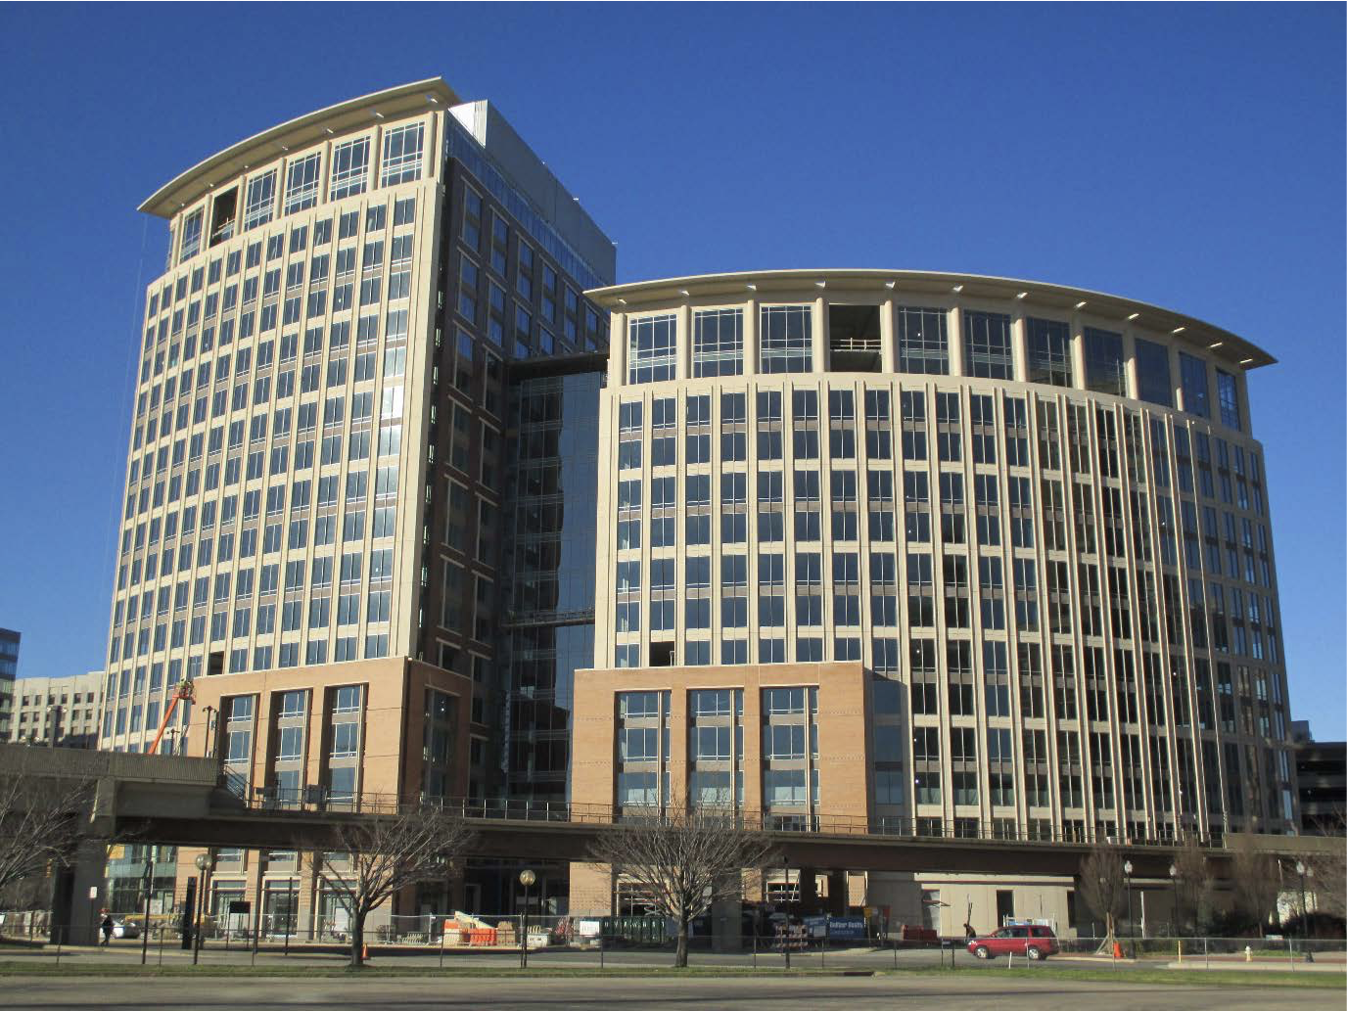
Overview
NSF Organization
Presidents Budget Requests 2023
Historical perspective of MPS funding
Updates on:
EPP Theory(w PA/Cosmology) and Exp.
PA Underground and Cosmic
Funding Opportunities

Slide 3
Division of Physics – Core Research Programs
Atomic, Molecular, & Optical Physics
Experiment: John Gillaspy; Kevin Jones,
Theory: Robert Forrey
Gravitational Physics + LIGO research
Pedro Marronetti
Newest faces:
Alfredo Galindo-Uribarri
Darren Grant
Jose Lopez
William Wester
Plasma Physics
Slava Lukin, Jose Lopez
Nuclear Physics
Experiment: Allena Opper;
Alfredo Galindo-Uribarri
Theory: Bogdan Mihaila
Elementary Particle Physics
Experiment: Jim Shank + 1
Theory: Keith Dienes
Physics of Living Systems
Krastan Blagoev
Particle Astrophysics
Experiment: Darren Grant, William Wester
Theory (+cosmology): Keith Dienes
Quantum Information Science
Alex Cronin;
Physics Frontiers Centers
Jim Shank Kathy McCloud
Large Facilities
Mark Coles
Physics at the Information Frontier
Bogdan Mihaila
Integrative Activities in Physics
(REU Sites, MRI, CAREER, BP)
Jose Lopez , Kathy McCloud

Slide 4
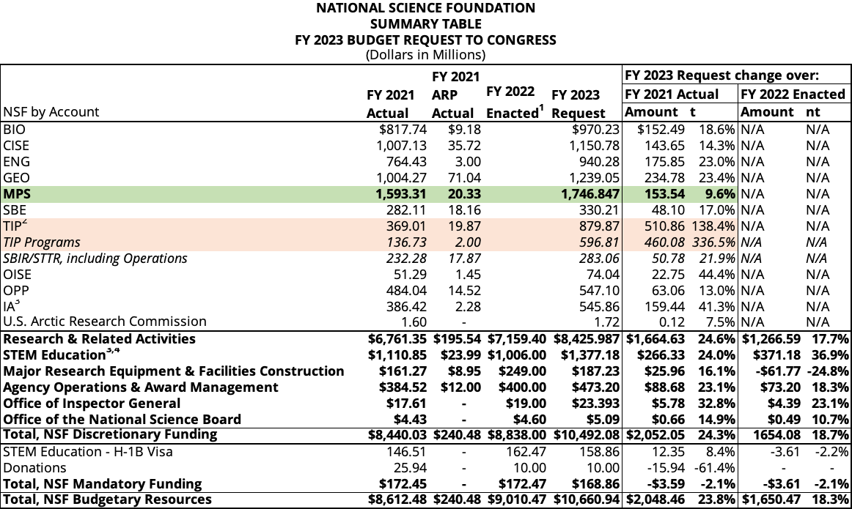
FY2023 President’s Request

Slide 5
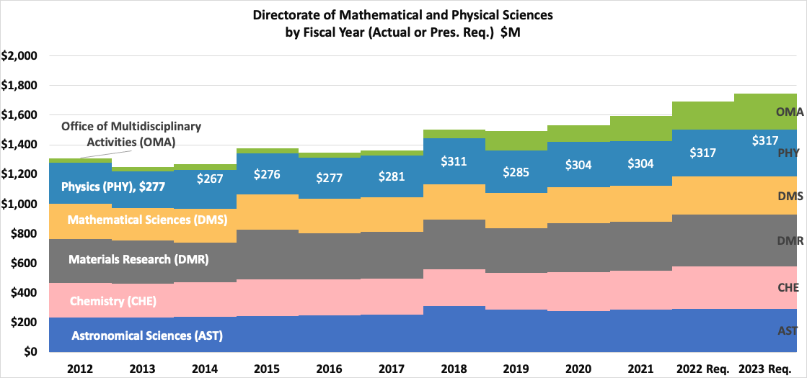

Slide 6
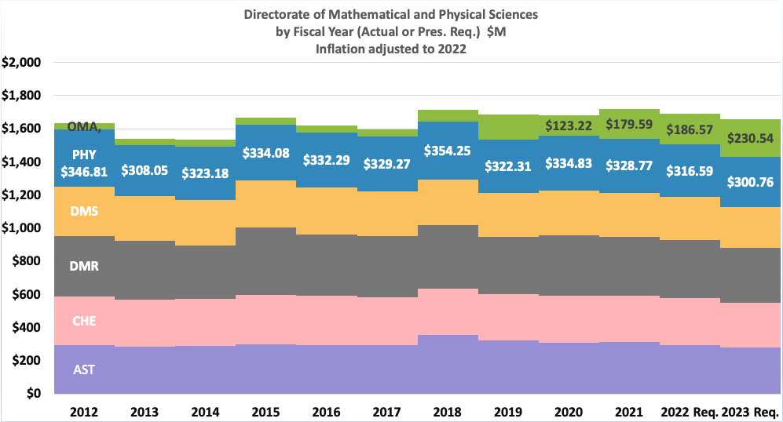
Notes:
CPI
https://www.bls.gov/data/inflation_calculator.htm

Slide 7
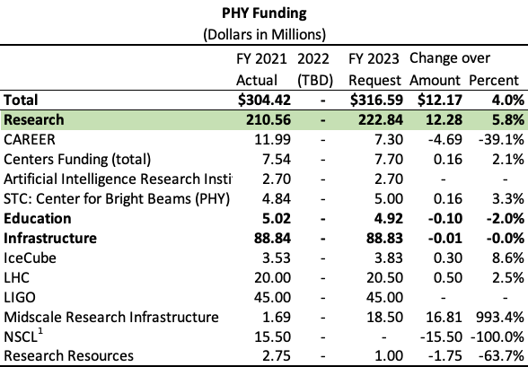
FY2023 President’s budget request

Slide 8
Major Research Equipment Account FY2023 President’s budget request
MREFC Account Funding, by Project
(Dollars in Millions)
 | FY 2020 Actual | FY 2021 Estimate¹ | FY 2022 Request | FY 2023 Request | FY 2024 Estimate | FY 2025 Estimate | FY 2026 Estimate | FY 2027 Estimate
Antarctic Infrastructure Recapitalization | $48.78 | $90.00 | $90.00 | $60.00 | $60.00 | TBD | TBD | TBD
DKIST | - | - | - | - | - | - | - | -
HL-LHC Upgrade | 33.00 | 33.00 | 36.00 | 33.00 | 18.00 | - | - | -
Mid-scale Research Infrastructure² | - | 76.25 | 76.25 | 76.25 | 76.25 | 76.25 | 76.25 | 76.25
RCRV | 25.00 | - | 5.00 | 1.98 | - | - | - | -
Vera C. Rubin Observatory | 46.35 | 40.75 | 40.75 | 15.00 | - | - | - | -
Dedicated Construction Oversight | 0.97 | 1.00 | 1.00 | 1.00 | 1.00 | 1.00 | 1.00 | 1.00
Total | $154.84 | $241.00 | $249.00 | $187.23 | $155.25 | $77.25 | $77.25 | $77.25

Slide 9
Experimental EPP Program
Elementary Particle Physics (EPP) Program, which primarily supports particle physics at accelerators and advances in detector development.
Range of program coverage:
High Energy Physics (ATLAS, CMS,…)
Precision Experiments (Neutrinos, LHCb, Rare-K, EDMs, …), LHCb M&O
Tools for Particle Physics (Artificial Intelligence, Instrumentation,…)
Program Director: J. Shank
EPP Program | FY 2015 | FY 2016 | FY 2017 | FY 2018 | FY 2019 | FY 2020 | FY2021
Awards issued | 19 | 12 | 7 | 18 | 15 | 15 | 20
CAREER awards | 1 | 2 | 1 | 1 | 0 | 3 | 0

Slide 10
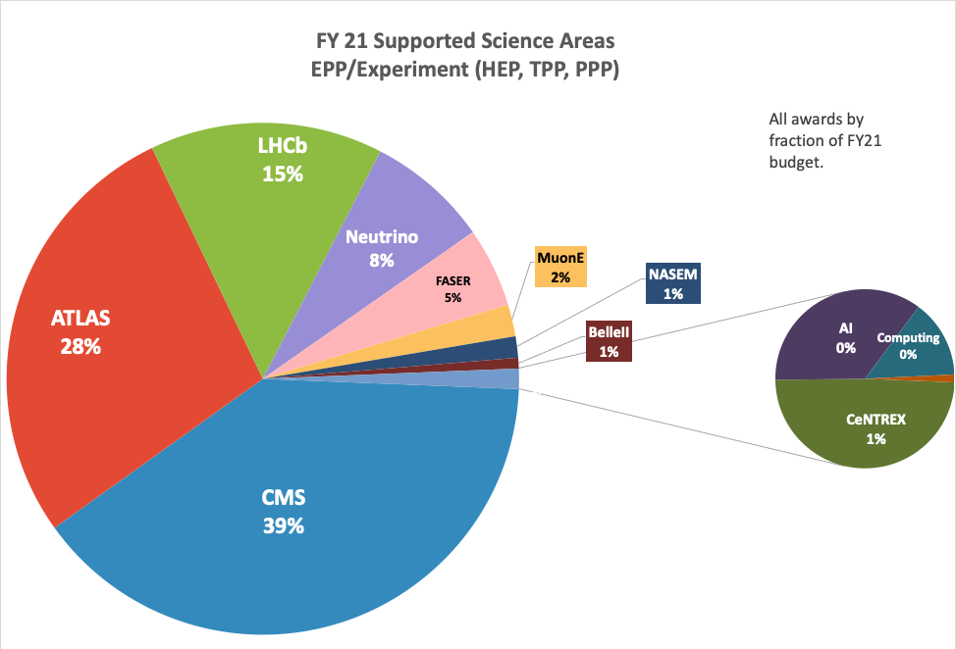
Full EPP-exp program at the end of 2021
Notes:
CENTEX: PM award to ColumbiaU. Collaborative Research: PM: CeNTREX, A Search for Nuclear Time-Reversal Symmetry Violation with Quantum-State-Controlled thallium fluoride (TlF) Molecules

Slide 11
Theoretical HEP and Particle Astro/Cosmology Programs
Particle Theory is essential to the success of the entire Particle Physics mission. We support cutting-edge investigator-driven research in two programs:
Theoretical High-Energy Physics
Theoretical Particle Astrophysics and Cosmology
Regular interactions with EPP, PA, Gravity Theory, Nuclear Theory, Astronomy, Materials Research, Mathematical Sciences, etc.
Supporting individuals, RUI's, and special facilities or initiatives (Aspen Center for Physics, TASI summer school, LHC Theory Initiative, etc.)
Trend: Dramatic increase in numbers of proposals, also huge numbers of new PIs applying
Program Director: K. Dienes
Theory Programs | FY 2015 | FY 2016 | FY 2017 | FY 2018 | FY 2019 | FY 2020 | FY 2021
Awards issued | 28 | 30 | 26 | 32 | 23 | 32 | 30
CAREER awards | 2 | 1 | 2 | 1 | 1 | 1 | 1

Slide 12
Experimental Particle Astrophysics Programs
Underground Physics (PA): This area supports university research that generally locates experiments in low background environments:
IceCube Science Program
Underground experiments, reactor neutrinos
Neutrino mass measurements
Searches for the direct detection of Dark Matter
Cosmic Phenomena (PA): This area supports university research that uses astrophysical sources and particle physics techniques to study fundamental physics:
Astrophysical sources of cosmic rays, gamma rays, neutrinos
Program Directors: D. Grant, W. Wester
Particle Astrophysics | FY 2015 | FY 2016 | FY 2017 | FY 2018 | FY 2019 | FY2020 | FY2021
Awards issued | 26 | 16 | 17 | 25 | 18 | 28 | 27
CAREER awards | 2 | 3 | 1 | 1 | 1 | 0 | 1

Slide 13
DEI
Making progress on Diversity, Equity, and Inclusion has been an NSF priority for a long time. Over the past few years we have taken additional steps in order to enhance our goals in these areas.
NSF now offers a large number of funding opportunities aimed at broadening participation in our field (new PIs, new institutions). Some of these have been in existence for a while, others are new.
New Investigator Workshops: learn about grant writing, meet Program Directors, etc.
MPS-ASCEND: postdoctoral fellowships, cohort-building across MPS subdisciplines
LEAPS-MPS: entry grants for faculty to initiate research, to provide alternate entry portal into the funding stream
MPS-HIGH: for current NSF PIs, bring targeted high-schoolers into your research
AGEP-GRS and PHY-GRS: for current NSF PIs, Supplements to bring extra grad students into your group
PREP: partnerships between MSIs and our Physics Frontier Centers
Physics Division also has special Broadening Participation (BP) funds
Many additional programs being formulated….
Also new MPS-wide and NSF-wide initiatives are coming!

Slide 14
Funding Opportunities

Slide 15
Primary NSF Physics Funding Opportunities
(relevant for high-energy physics, particle astrophysics, and cosmology)
https://www.nsf.gov/pubs/2021/nsf21593/nsf21593.htm: Our general, all-purpose Solicitation for our regular base grants. Use this as your default. Deadlines in Fall 2022, depending on specific program (see online).
https://www.nsf.gov/pubs/2014/nsf14579/nsf14579.htm. (“RUI”) Same as above, but for applicants from primarily undergraduate institutions. Check eligibility with your SRO
https://www.nsf.gov/pubs/2022/nsf22586/nsf22586.htm: (“CAREER”) An alternative funding track for those junior (untenured) faculty who, at this point in their careers, wish to undertake a significant education/outreach activity in addition to their research. Not simply a research-excellence prize, and not intended as a default for junior faculty unless you plan a major mix of research and education/outreach. Next deadline: July 27, 2022.
https://www.nsf.gov/publications/pub_summ.jsp?ods_key=nsf22604 (“LEAPS-MPS”) Grants designed to “launch the careers of pre-tenure faculty… at minority-serving institutions (MSIs), predominantly undergraduate institutions (PUIs), and Carnegie Research 2 (R2) universities … with the goal of achieving excellence through diversity.” Launch = you have no prior or current NSF grants (see special exceptions). Next deadline: January 26, 2023.
Supplements to existing NSF grants to fund a new graduate student. Emphasis placed on “increasing the involvement by members of underrepresented groups”. Apply anytime, fall preferred.
https://www.nsf.gov/pubs/2020/nsf20083/nsf20083.jsp: “MPS AGEP-GRS” (only for allowed institutions).
https://www.nsf.gov/pubs/2021/nsf21065/nsf21065.jsp: “PHY-GRS” (similar, but for remaining institutions).
https://www.nsf.gov/pubs/2022/nsf22501/nsf22501.htm: (“MPS-Ascend”) Fellowships to “support postdoctoral Fellows who will broaden the participation of under-represented groups”. Postdocs or graduating PhDs apply on their own after identifying a potential postdoctoral mentor. ). Next deadline: look online for new solicitation!
Other Divisions, such as Division of Astronomy, Math... Contact relevant Program Directors in both Divisions.
Proposal & Award Policies & Procedures Guide:
New PAPPG now in effect!
https://www.nsf.gov/pubs/policydocs/ pappg22_1/ index.jsp
Jim Shank (jshank@nsf.gov) -- HEP Experiment
Keith Dienes (kdienes@nsf.gov) -- HEP Theory & Particle Astro/Cosmo Theory
Darren Grant / William Wester (dgrant / wwester @nsf.gov) -- Particle Astro Experiment
Kathy McCloud (kmccloud@nsf.gov) -- for LEAPS-MPS and MPS-Ascend
PHY Contacts:

Slide 16
Once every three years (including this year!), the NSF Physics Division holds a competition for new Physics Frontier Centers (PFCs).
https://www.nsf.gov/publications/pub_summ.jsp?WT.z_pims_id=5305&ods_key=nsf22592
PFCs = University-based centers and institutes where the collective efforts of a larger group of individuals can enable transformational advances in the most promising research areas. The program is designed to foster major breakthroughs at the intellectual frontiers of physics by providing needed resources such as combinations of talents, skills, disciplines, and/or specialized infrastructure, not usually available to individual investigators or small groups, in an environment in which the collective efforts of the larger group can be shown to be seminal to promoting significant progress in the science and the education of students.
Pre-proposals required! Due August 1, 2022.

Slide 17
Precision Measurements
NSF 20-127
Dear Colleague Letter: Searching for New Physics Beyond the Standard Model of Particle Physics Using Precision Atomic, Molecular, and Optical Techniques
This DCL encourages interdisciplinary research across the domains of AMO and EPP physics aimed at developing new small-scale experiments and techniques that could complement large EPP facilities.
From 2021:
PM: Electron and Positron Magnetic Moments from a Quantum Cyclotron
PM: CeNTREX, A Search for Nuclear Time-Reversal Symmetry Violation with Quantum-State-Controlled TlF Molecules
PM: Precision Low-Energy Quantum Electrodynamic Theory and Fundamental Processes

Slide 18
New Limited Opportunity in EPP-exp Program
NSF 22-097 Dear Colleague Letter: Partnership in Experimental Elementary Particle Physics and STEM Education Research to Promote Broadening Research Participation
Partnership between PHY and Division of Undergraduate Education (DUE)
With this Dear Colleague Letter (DCL), PHY and DUE encourage proposals that involve collaboration between an experimental physicist(s) involved in research with the ATLAS or CMS detector and an educator(s) conducting research in STEM education. This partnership between the investigators should enable them to concurrently carry out research in experimental elementary particle physics (EPP) and advance educational practice and education research at the undergraduate (college/university) level within state-of-the-art research environments in physics. NSF is especially interested in receiving proposals from collaborations that have these goals and expected outcomes:
Exhibit strong intellectual merit for both the experimental particle physics research and the STEM education research at the undergraduate (college/university) level,
Strengthen diverse participation in physics research, and
Increase the diversity, quantity, and quality of the next generation of STEM professionals.
This is a pilot initiative. It is anticipated that no more than two projects will be funded in FY 2023.

Slide 19
Artificial Intelligence at NSF

Slide 20
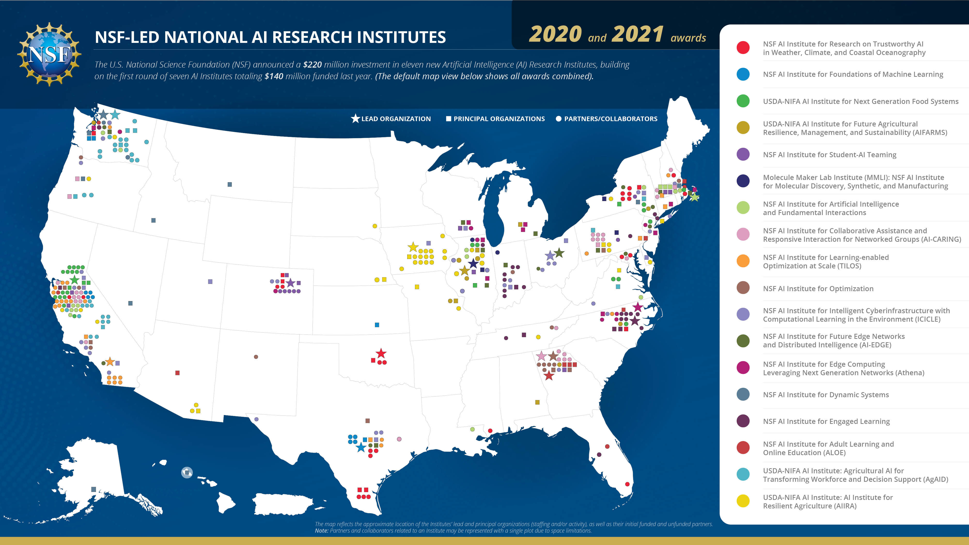
Artificial Intelligence at NSF
Download the interactive pdf version
Program Directors: S. Gonzalez, J. Shank, N. Sharp

Slide 22
AI Institutes
Solicitation NSF 20-503 for 2020
Solicitation NSF 20-604 for 2021 - less involvement with MPS
And now Solicitation NSF 22-502 for 2022. Again, less relevance to MPS
National Artificial Intelligence (AI) Research Institutes Accelerating: Research, Transforming Society, and Growing the American Workforce
Theme 1: Intelligent Agents for Next-Generation Cybersecurity
Theme 2: Neural and Cognitive Foundations of Artificial Intelligence
Theme 3: AI for Climate-Smart Agriculture and Forestry
Theme 4: AI for Decision making
Theme 5: Trustworthy AI
Theme 6: AI-Augmented Learning to Expand Education Opportunities and Improve Outcomes
MPS AI Dear Colleague Letter:
MPS ADAPT-DCL Started in 2021, resulting in 5 EAGER and 3 Supplement awards.
Continued in FY22 – funds just used up last week
CISE/OAC HDR Institutes:
Harnessing the Data Revolution : Institutes for Data-Intensive Research in Science and Engineering NSF 21-519
Award to U. Washington in Sept. 2021. ➔A3D3
No new HDR Institute, but TRIPODS solicitation is ongoing:
Harnessing the Data Revolution (HDR): Transdisciplinary Research in Principles of Data Science Phase II (TRIPODS)
NSF 21-604. Submission Window: January 04, 2022 - January 18, 2022

Slide 23
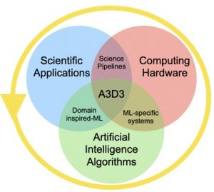
NSF Particle Physics Centers and Institutes
Institute for Research and Innovation in Software for High Energy Physics
Center for Bright Beams Science and Technology Center
Network for Neutrinos, Nuclear Astrophysics, and Symmetries (N3AS) (Physics Frontier Center)
Institute for Artificial Intelligence and Fundamental Interactions
Harnessing the Data Revolution Institute: Accelerated AI Algorithms for Data-Driven Discovery (A3D3) (https://a3d3.ai)
U. Washington
New

Slide 24
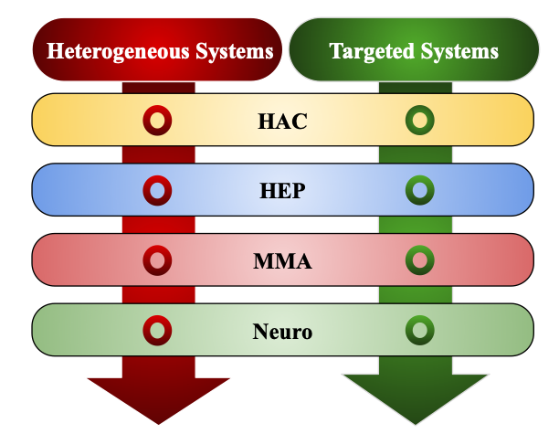
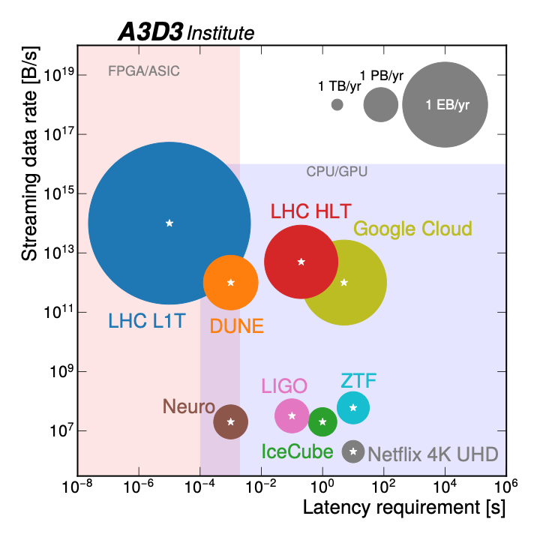
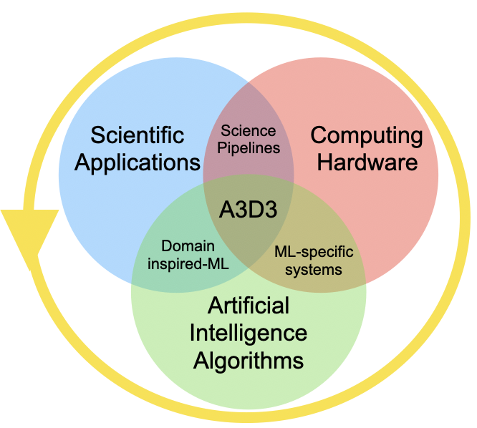
HDR Institute: Accelerated AI Algorithms for Data-Driven Discovery (A3D3)
Slide courtesy of S.-C. Hsu, U. Washington
The vision of A3D3 is to establish a tightly coupled organization of domain scientists, computer scientists, and engineers that unite three core components which are essential to achieve real-time AI to transform science: AI techniques, Computing Hardware, Scientific Applications
A3D3 pushes the boundaries of data processing beyond industry applications
Hardware and Algorithm Codevelopment (HAC) and three science drivers: high energy physics (HEP), multi-messenger astrophysics (MMA), and neuroscience (Neuro) are integrated through common Heterogeneous and Targeted Systems

Slide 25
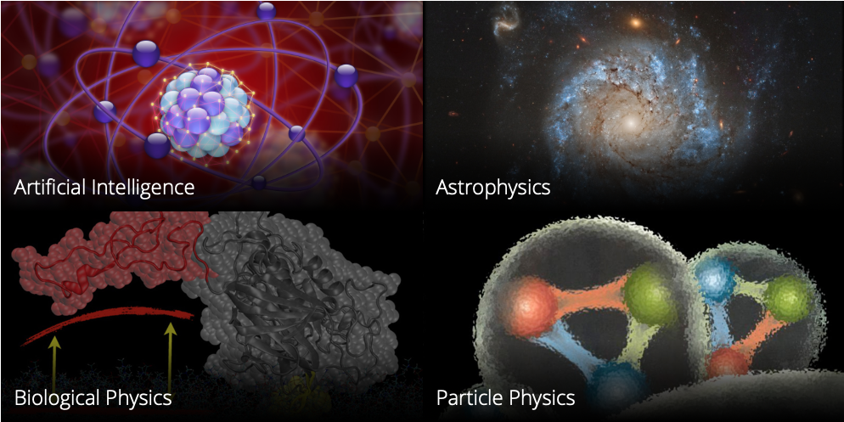
NSF AI Planning Institute
Carnegie Melon University. PI: Scott Dodelson
Two year award

Slide 26
Research Infrastructure

Slide 27
Research Infrastructure Opportunities
 | Project Cost (approx. in $million) |  | Funding Source
Solicitation | From | To | R&D/Planning | Operations | Scope of Competition
Individual program | 0 | ~1.0 | EPP or PA | EPP or PA | Program (within EPP or PA)
MRI (70%); University (30%) | ~0.2 | 5.7 | n/a | n/a | PHY (<1.0 M) NSF (>1.0 M)
Midscale RI-1 | 0.6-6.0 | 20 | EPP or PA or Midscale RI-1 | EPP or PA | NSF
Midscale RI-2 | 20 | 70 | EPP or PA or Midscale RI-1 | EPP or PA | NSF
MREFC | 70 | -- | EPP or PA | EPP or PA | NSF
First Awards in FY19
Four awards in FY21
Now 100

Slide 28
MSRI-II awards 2020
Mid-scale RI-2 Consortium: Biogeochemical-Argo: A global robotic network to observe changing ocean chemistry and biology Award Number:1946578; Principal Investigator:Kenneth Johnson; Co-Principal Investigator:Jorge Sarmiento, Stephen Riser, Lynne Talley, Curtis Deutsch, Susan Wijffels; Organization:Monterey Bay Aquarium Research Institute;NSF Organization:OCE Start Date:11/01/2020; Award Amount:$15,013,704.00; Relevance:48.0;
Mid-scale RI-2: Grid-Connected Testing Infrastructure for Networked Control of Distributed Energy Resources Award Number:1947050; Principal Investigator:Jan Kleissl; Co-Principal Investigator:Rajesh Gupta, Raymond De Callafon, Jorge Cortes, Sonia Martinez; Organization:University of California-San Diego;NSF Organization:ECCS Start Date:11/01/2020; Award Amount:$30,557,829.00; Relevance:48.0;
Mid-scale RI-2 Consortium: Network for Advanced NMR Award Number:1946970; Principal Investigator:Jeffrey Hoch; Co-Principal Investigator:Chad Rienstra, Arthur Edison, Katherine Henzler-Wildman; Organization:University of Connecticut Health Center;NSF Organization:DBI Start Date:07/01/2021; Award Amount:$20,048,344.00; Relevance:48.0;
Mid-scale RI-2: A first-of-its-kind X-ray facility for new science at the high magnetic field frontier Award Number:1946998; Principal Investigator:Joel Brock; Co-Principal Investigator:Carlos Cabrera, Eric Palm, Elke Arenholz; Organization:Cornell University;NSF Organization:DMR Start Date:01/01/2021; Award Amount:$8,391,000.00; Relevance:48.0;
Notes:
From the public NSF award search page.
Division of Ocean Sciences (OCE) | NSF

Slide 29
Mid-Scale Research Infrastructure
Webinar from Nov. 2020: weblink
Mid-Scale RI-1 Solicitation: 21-505
Preliminary Proposal Deadline Date: January 7, 2021
Full Proposal Deadline Date: April 23, 2021 (By Invitation Only)
Mid-Scale RI-1 Implementation projects Total cost: $6M - $20M
Mid-Scale RI-1 Design projects Total cost: $600k - $20M
Mid-Scale RI-2 Solicitation: 21-537
Letter of Intent Deadline Date: Feb.3, 2021 , Prelim proposal: Mar. 5, Full: Sept. 20, 2021
Mid-Scale RI-2 Projects Total cost: $20M - $100M
Consult the Major Facilities Guide NSF 19-068
Notes:
Shows the FY2021-22 process dates, don’t have any update.

