Slide 1
Detectors for e⁺e⁻ colliders
Maria Chamizo Llatas, Sridhara Dasu, Ulrich Heintz, Emilio Nanni, John Power, Stephen Wagner
(e+e- collider forum)

Slide 2
The e+e- forum report
Report
  https://drive.google.com/file/d/1hamAUhWyCd8dB9rUUBpD-JhHuA8TKoFe/view
Comments
  https://docs.google.com/document/d/12z7sF3Qhg0Xk54yp_s71IPPJCzKknkq9kxYQhQFLaXQ

Slide 3
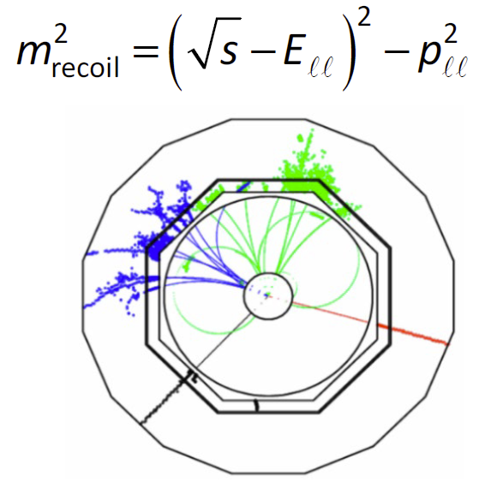
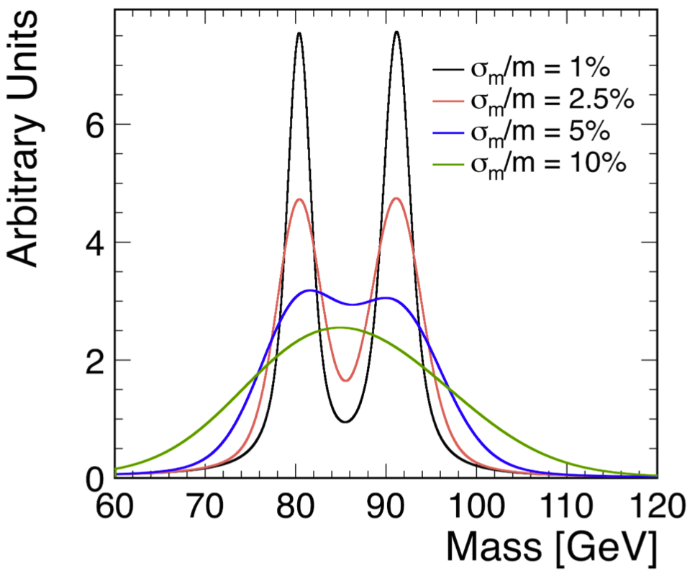
Physics requirements
Precisely reconstruct the Higgs recoil, Higgs decays to muons, new physics signals to leptons
Identify electrons and muons up to the highest energies
Tag jets with the flavor of their primary quark.
Distinguish hadronic decays of W and Z bosons.
Precise timing information for particle id and to reject out-of-time backgrounds.

Slide 4
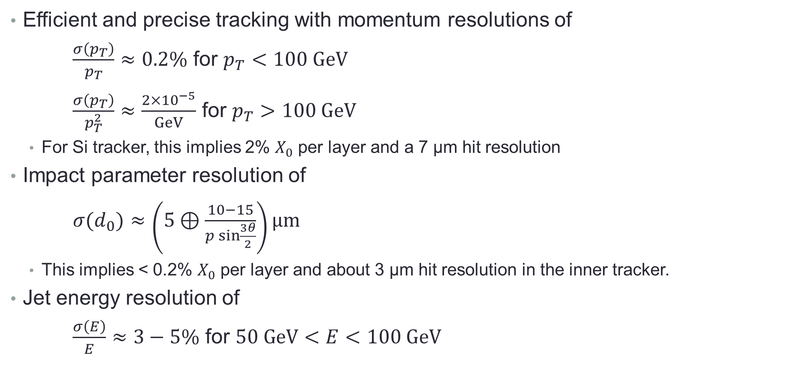
Detector requirements
Efficient and precise tracking with momentum resolutions of
$\frac{σ\left(p_{T}\right)}{p_{T}}≈0.2\%$ for $p_{T}<100 GeV$
$\frac{σ\left(p_{T}\right)}{p_{T}^{2}}≈\frac{2×{10}^{−5}}{GeV}$ for $p_{T}>100 GeV$
  For Si tracker, this implies 2% $X_{0}$ per layer and a 7 μm hit resolution
Impact parameter resolution of
$σ(d_{0})≈\left(5⊕\frac{10−15}{p\sin{\frac{3θ}{2}}}\right)μm$
  This implies < 0.2% $X_{0}$ per layer and about 3 μm hit resolution in the inner tracker.
Jet energy resolution of
$\frac{σ\left(E\right)}{E}≈3−5\%$ for $50 GeV<E<100 GeV$

Slide 5
The generic e⁺e⁻ detector
Inner tracker with the lowest possible mass and the smallest possible inner radius
Low-mass outer tracker for excellent momentum resolution at high energies
Highly segmented calorimeter to support particle flow reconstruction
A large superconducting solenoid
Muon system
Triggerless readout

Slide 6
Collider specific considerations
Linear colliders
  Beam divided into trains of closely spaced bunches separated by longer gaps ➔ power pulsing of readout electronics ➔ reduces or eliminates need for active cooling systems ➔ enables sufficiently low mass trackers
  Magnetic field >3T to curl up soft e+e− pair background. Inner radius of tracker limited to about 3 cm.
  Pileup of hadronic two-photon interactions increases with energy. At 3 TeV this deposits 20 TeV of energy in the detector over a 156 ns bunch train ➔ timing measurements with a resolution of order 10 ps are needed to reduce beam induced backgrounds.
Circular colliders
  High beam crossing rate makes power pulsing impossible ➔ active cooling ➔ makes achieving the required material budget in the tracker much harder.
  Running at the Z pole with maximum luminosity imposes the strongest requirements on the detector.
  Magnetic field ≤ 2T in order to preserve low beam emittance ➔ larger radius for the tracking system.
  Acceptances must be precisely known ➔ detector boundaries have to be known to microns.
  The DAQ system has to deal with a rather high event rate of almost 100 kHz.

Slide 7
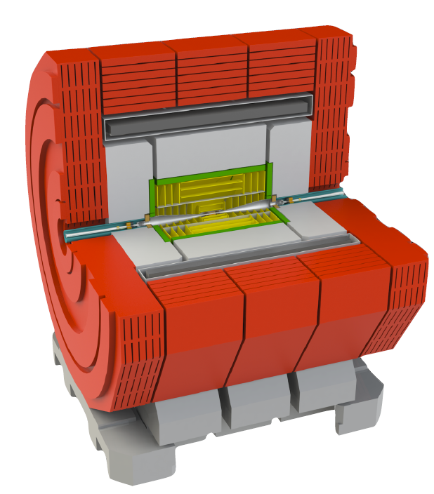
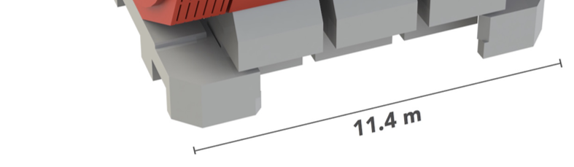
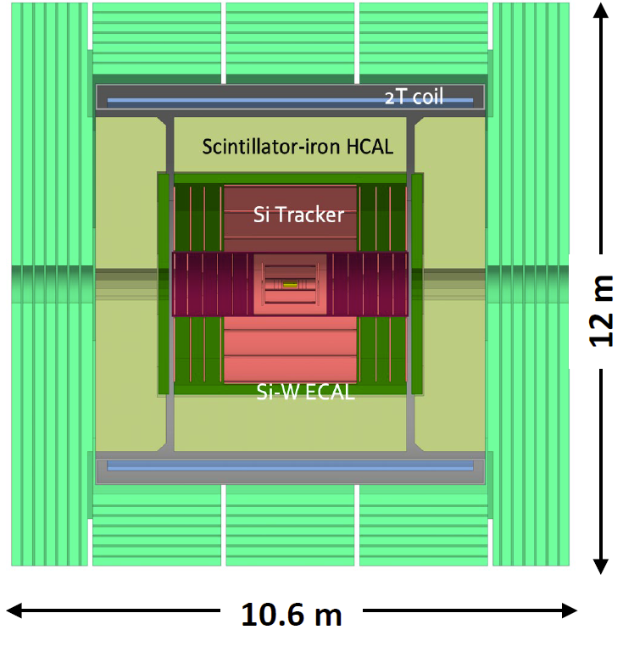

Specific detector models
ILD SiD
CLICdet CEPC baseline
CLD IDEA
ILC
  ILD – Si vertex and inner tracker, outer TPC, highly segmented calorimeter, 3.5-4T coil
  SiD – Si tracker, highly segmented calorimeter, 5T coil
CLIC
  CLICdet – All Si tracker, highly segmented calorimeter, 4T coil
FCC-ee
  CLD (based on CLIC detector) – All Si tracker, highly segmented calorimeter (CALICE), 2T coil
  IDEA – Si vertex, ultra light wire chamber with Si wrapper, 2T coil, dual readout calorimeter (RD-52)
CEPC
  Baseline (based on ILD) – Si vertex and inner tracker, outer TPC with Si wrapper, highly segmented calorimeter (CALICE), 3T coil

Slide 8
Tracker
Primary challenge is low material budget
Inner tracker
  Si based
Outer tracker
  Gas chambers (drift or TPC)
  Silicon strip trackers
Some R&D directions
  The further reduction of material to minimize multiple scattering is a continuing R&D goal
  Larger, multiretical sensors ➔ reduce the amount of material in the support structure.
  Low-Gain Avalanche Diodes (LGAD) ➔ reduce thickness of sensors and perform precise time measurements
  3D integration ➔ reduce material in pixelated sensor-readout assemblies
  Thin film detectors ➔ drastically reduce material and cost
  Monolithic Active Pixel Sensors (MAPS) implemented with CMOS technology ➔ push functionality into sensor and increase granularity
  Submicron pixels with a quantum well ➔ improve position resolution of vertex detectors

Slide 9
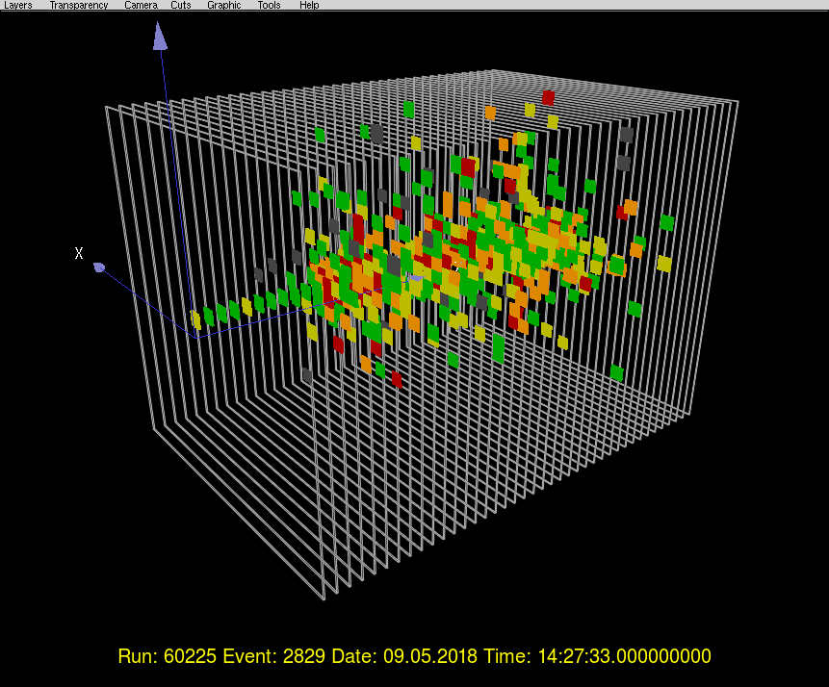
Calorimeter
Particle flow is essential to achieve the required jet energy resolution
  Requires fine granularity and consequentially large channel (CALICE collaboration)
EM section
  Active material: scintillator strips with SiPM readout, Si diodes
  Passive absorber: tungsten
  Granularity: typically ≈ 5 mm × 5 mm.
Hadronic section
  Active material: scintillator tiles with SiPM readout, RPCs
  Passive absorber: steel
  Granularity: typically ≈ 3 cm × 3 cm.
Dual readout calorimeters
  Read out scintillation light produced by hadrons and Cherenkov light emitted by relativistic electrons (RD-52/DREAM collaboration) ➔ overcome different responses to em and hadronic showers
100 GeV pion in CALICE prototype

Slide 10
Further R&D needs
Develop scalable production and assembly techniques to reduce manual steps
Readout systems for the large number of channels.
Efficiently distribute power and cooling to highly granular detectors
High resolution time measurements are useful to reject beam-related backgrounds and particle id
We need to continue to incorporate new and emerging technologies into existing detector designs.
R&D needs for HEP were outlined in the DOE Basic Research Needs (BRN) study
  https://science.osti.gov/-/media/hep/pdf/Reports/2020/DOE_Basic_Research_Needs_Study_on_High_Energy_Physics.pdf

Slide 11
Conclusions
In order to address remaining R&D questions and design and develop the detector concepts further, a strong R&D program is needed. This program should support work that goes beyond generic R&D to support the specific challenges posed by the detector required for e+e− colliders.
Such a program needs to start now for the technology to build a full scale e+e− collider detector to be ready when the HL-LHC program is completed. It can be seen from the HL-LHC detectors that the time between CD-0 (2016) to completion of the actual detectors (expected in 2027) can easily span over a decade.

