Slide 1
AF2: Accelerators for Neutrinos
Snowmass 2021 Community Summer Study
Gianluigi Arduini, John Galambos, Robert Zwaska
July 22, 2022

Slide 2
Outline
Status of the AF2 Effort
Contributed LOIs and White PapersNeutrino Program at Fermilab
  PIP II and Successors
Emerging themes
Summary Tables of Needs and Capabilities
Plan Forward
Open Discussion

Slide 3
Status of AF2 Accelerators for Neutrinos
Taking as input the anticipated needs of particle physics and the requirements for neutrino beams in terms of energy, flux, temporal and spatial characteristics, this group will discuss:
The proton (or other) beam requirements to meet the neutrino physics community needs
The capability of existing or planned accelerator facilities to satisfy the above requirements, and If not: the necessary upgrades or new facilities.
Enabling R&D, technologies, and test facilities necessary to develop upgrades and new facilities
Co-Conveners
  Gianluigi Arduini CERN Gianluigi.Arduini@cern.ch
  John Galambos ORNL galambosjd@ornl.gov
  Bob Zwaska Fermilab zwaska@fnal.gov
“Complete draft” tables of worldwide needs and capabilities of Accelerators for Neutrinos
Executive Summary and some notes in a draft report narrative. To be extensively updated after CSS
Soliciting comments here, or offline.
Mailing list for AF2 announcements:
  snowmass-af2-accel-for-nu@listserv.fnal.gov

Slide 4
AF2 Process
LOIs and White Papers
AF2 Plenary Sessions, Seminars, Town Hall
CPM Meeting (Joint Session with NF)
Attendance at ~ 12 workshops over two years
Coordination with AF5 and NF09 (especially tabulation of needs)
Sessions here at CSS
Report to be completed after CSS and put out for comment

Slide 5
LOIs & White Papers
17 Submitted LOIs to AF2
  Mix of facilities, concepts, and technologies
  Many relevant LOIs in other areas
  Several did not result in White Papers, but still provided valuable input
17 Directly Relevant White Papers
  Taken from AF, AF2, and AF5
  Some input was directly provided outside of white papers, especially for non-US facilities

Slide 6
White Paper Highlights: FPF / FASERx
Exciting use of a collider source of neutrinos
  Very high energy hadron collisions
Measure high-energy neutrinos, and dark sector searches
Neutrinos come “for free”, and require little intervention with accelerator
Jonathan L. Feng, Felix Kling, Mary Hall Reno, Juan Rojo, Dennis Soldin, et al. ”The Forward Physics Facility at the High-Luminosity LHC“, arXiv:2203.05090 [hep-ex] (pdf). (also under EF0, NF0, RF0, CF0, TF0, IF0)

Slide 7
White Paper Highlights: ESSnuSB
5MW Neutrino source evolved from ESS
  Upgrade Linac Energy, rate, H⁻
  Accumulator ring
  Split into 4x 1.25 MW beams
  New MT-scale detector and near detector
Illustrates the challenges of Multi-MW beams, and what might be the limit of horn-focused beams
Alekou, E. Baussan, N. Blaskovic Kraljevic, M. Blennow, M. Bogomilov, E. Bouquerel, et al. ”The European Spallation Source neutrino Super Beam“, arXiv:2203.08803 [physics.acc-ph] (pdf). (also under NF0, RF0, CF0, AF0, UF0)

Slide 8
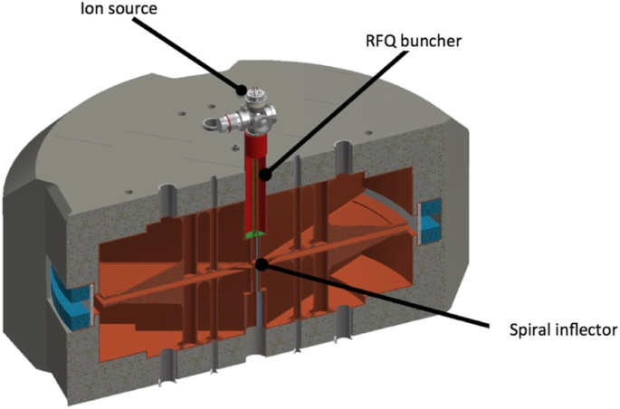
White Paper Highlights: IsoDAR
High-power compact cyclotrons
  Unique technologies employed
  IsoDAR -> DAEDALUS
Li⁷ decay neutrinos with IsoDAR
  Pion DAR neutrinos with higher-energy versions
To be deployed at Yemilab
J. R. Alonso, J. M. Conrad, Y. D. Kim, S. H. Seo, M. H. Shaevitz, J. Spitz, D. Winklehner. ”IsoDAR Overview”, arXiv:2203.08804 [hep-ex] (pdf). (also under NF0, AF0, CommF01)

Slide 9
White Paper Highlights: Neutrino Factory
Neutrino Factory remains an option for further neutrino experiments
Offers the possibility of more precise measurements and the investigation of anomalies that may emerge
Technical approach is mostly the same as previous designs
Synergy with Muon Collider options
Alex Bogacz, Vedran Brdar, Alan Bross, André de Gouvêa, Jean-Pierre Delahaye, Patrick Huber, et al. ”The Physics Case for a Neutrino Factory”, arXiv:2203.08094 [hep-ph] (pdf). (also under EF0, NF09)

Slide 10
White Paper Highlights: ENuBET
“Monitored” neutrino beam has improved flux determination, especially absolute
Synergy with NuSTORM and tagged neutrino beams
A. Longhin, F. Terranova (on behalf of the ENUBET Collaboration). ”Enhanced NeUtrino BEams from kaon Tagging (ENUBET)”, arXiv:2203.08319 [hep-ex] (pdf). (also under NF09)

Slide 11
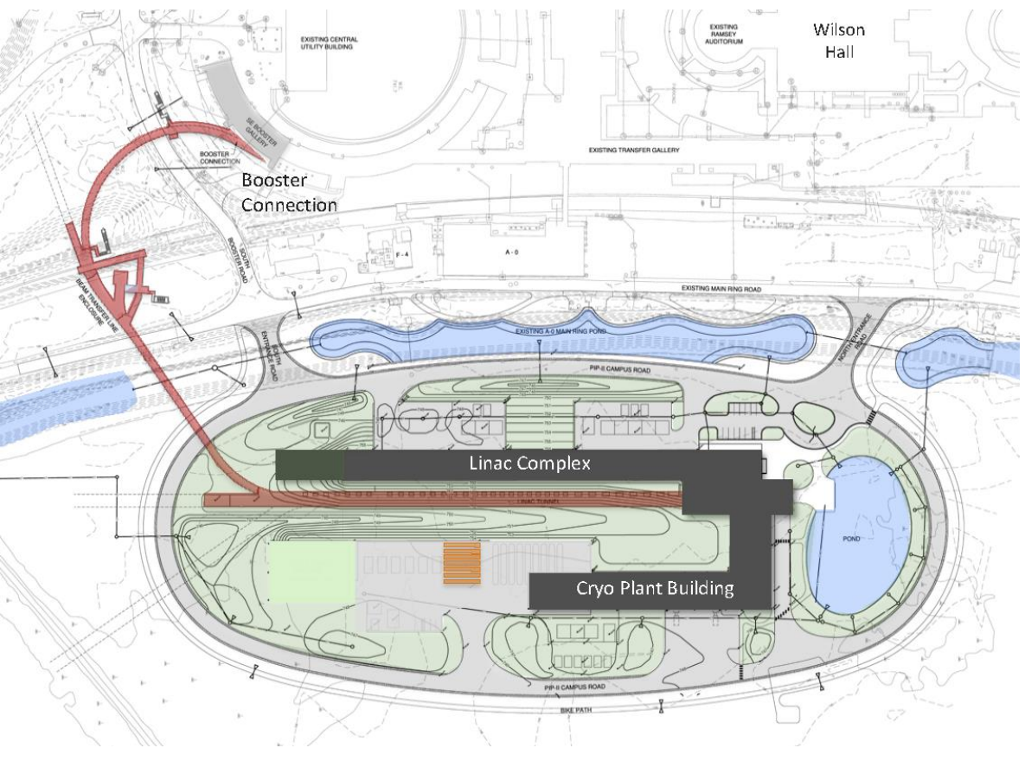
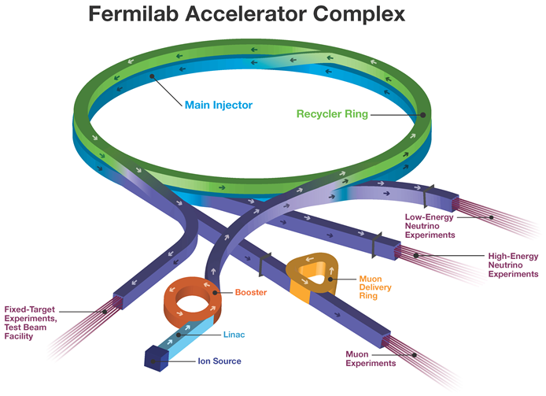
PIP-II Linac & Upgrades
Superconducting Linac (0.8 GeV) and Synchrotron upgrades
Provide 1.2 MW to LBNF
  8 GeV beam available to other experiments
  Up to 1.5 MW available at 800 MeV
Project is fully under construction, to be complete and commissioning in 2028

Slide 12
PIP-II Exploitation ?
A potential experimental build-out of PIP-II
  A large amount of beam will be available for use
  Beam delivery and formatting for experiments is quite limited
    PIP-II will initially only be connected to the Booster
PIP-II Potential Accelerator Development
  Low Duty Factor (High Compression) Running
  CW-compatible fast chopper
  High Peak Current Acceleration (~ 5 mA)
  RF Beam Splitting
  Fast Switching magnets
  Accumulator Ring (Compression? Formatting? Slow extraction?)
  Direct PIP-II Linac to Mu2e
  Transfer lines
  Many Other options
Needs input on experimental preferences

Slide 13
PIU: Proton Intensity Upgrade
Fermilab is aggressively starting the planning for a PIP-II successor upgrade that will provide 2.4 MW to LBNF, completing the vision from the previous P5
Questions remaining are the accelerator options and the desired other capabilities
Much, much more information in Wednesday’s session:
  https://indico.fnal.gov/event/22303/sessions/20651/#20220720

Slide 14
14
Rapid-Cycling Synchotron (RCS) Option
Main Injector
(MI)
Optional
Storage
Ring
RCS
Optional
Storage
Ring
PIP-II
Linac
Optional 1-3 GeV Linac Upgrade
H- Injection Location

Slide 15
15
8 GeV Linac Option
8 GeV storage ring (s)
Main Injector
(MI)
Optional
Storage
Ring
PIP-II
Linac
8 GeV Linac
H- Injection Location
Notes:
15
15
15

Slide 16
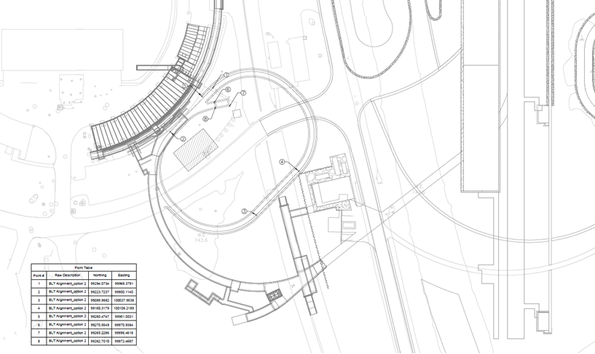
Present PAR layout with DS Blocks
Booster
Optional Det.
PIP-II Service Building
Det Main
Dump
Det front
Det Side
Service Bld.
BTL Service Bld.
BTL

Slide 17
Emerging Themes
At least one ring will certainly be necessary
  Accumulator, compressor, and/or RCS
  Need to develop beam dynamics, RF, and other issues
  Many experiments will require short bunches
  Can rings be upgraded/reused at higher energies?
  Stripping becomes a challenge at high rate
    Motivates Laser Stripping, foil development
Linac Current increase is potentially very useful
  Stripping, injection, experiments

Slide 18
Emerging Themes
A flexible power supply is preferable for an RCS
  FFA Options
MI Cycle Time could be further reduced
Energy Consumption must be considered
Higher energy injection into the MI could allow higher emittance beams
  Recycler could be replaced relatively inexpensively

Slide 19
Programmatic Considerations
Mu2e will certainly run at 8 GeV with PIP-II
  Use existing beam deliver
  Future depends on experimental options
BNB/SBN is presently not planned to run, but may need to depending on experimental results

Slide 20
PIU Conclusion
2.4 MW is highest priority and there are multiple ways to get there
Fermilab will rapidly develop machine designs over the next few years – cost is a primary driver
Other experimental options could play a role in design choices
  Understanding these could be very helpful

Slide 21
Existing and Near Future Neutrino Beams

Slide 22
Further Proposed Beam Facilities

Slide 23
Existing Accelerator Facilities

Slide 24
Planned Upgrades

Slide 25
AF2 Report Stats and Plans Forward
“Complete draft” tables of worldwide needs and capabilities of Accelerators for Neutrinos
Executive Summary of TG report and some notes in a draft report narrative. To be extensively updated after CSS
Soliciting comments here, or offline
Mailing list for AF2 announcements:
  snowmass-af2-accel-for-nu@listserv.fnal.gov
Report will be posted there with mechanisms for feedback

