Slide 1
https://bit.ly/3vdLF8D
Intersections with Astrophysics Gravitational Wave Astronomy
Will M. Farr (Stony Brook / CCA) 25 July 2022
@farrwill
farr

Slide 2
Intersections
QCD at T=0 and high density.
Tests of General Relativity at high curvature.
Propagation tests of gravity.
Calibrated cosmological distances.

Slide 3
Intersections
QCD at T=0 and high density.
Tests of General Relativity at high curvature.
Propagation tests of gravity.
Calibrated cosmological distances.
TODAY

Slide 4
Intersections
QCD at T=0 and high density.
Tests of General Relativity at high curvature.
Propagation tests of gravity.
Calibrated cosmological distances.
TODAY … and in the FUTURE

Slide 5
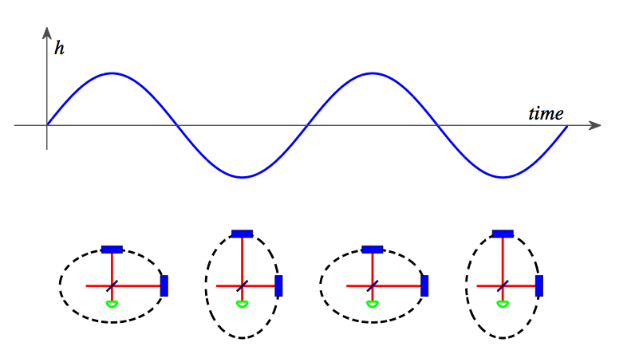
Gravitational Waves

Slide 6
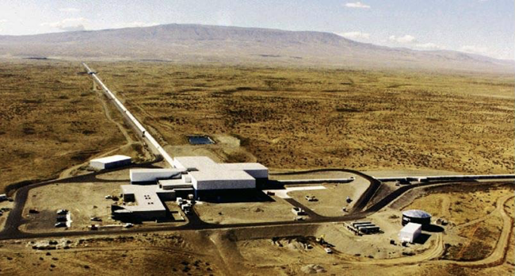
LIGO
LIGO

Slide 7
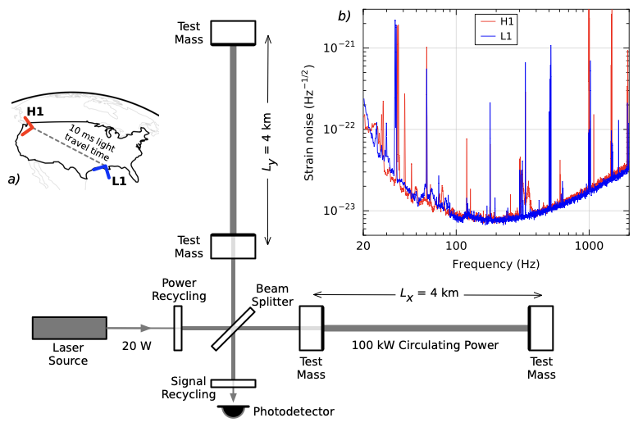
LIGO
Abbott, et al. (2016)

Slide 8
LIGO
Abbott, et al. (2016)

Slide 9
Abbott, et al. (2016)

Slide 10
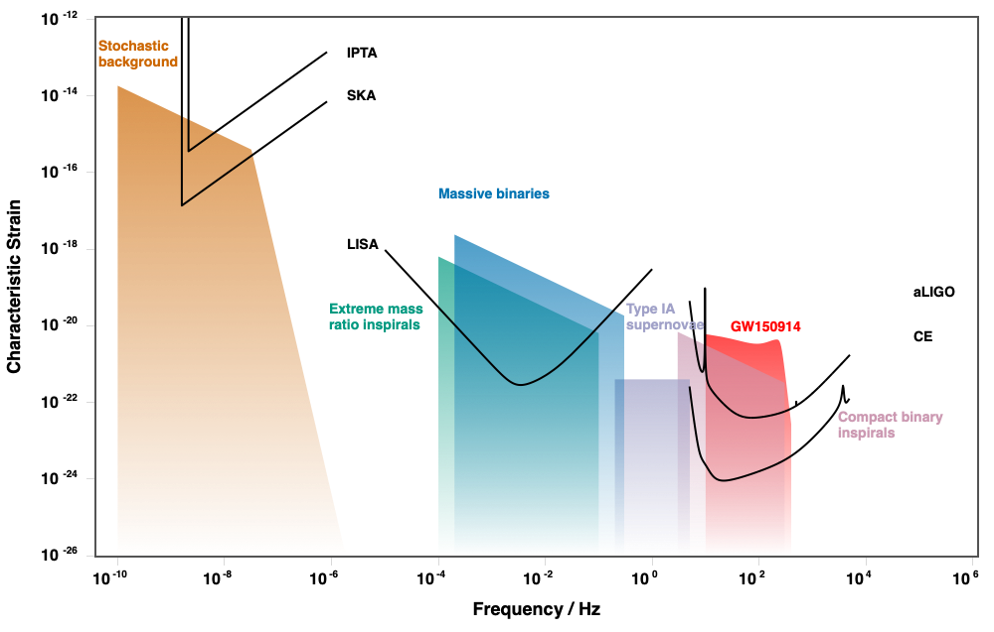
GW Landscape
http://gwplotter.com
Moore, Cole, & Berry (2014)

Slide 11
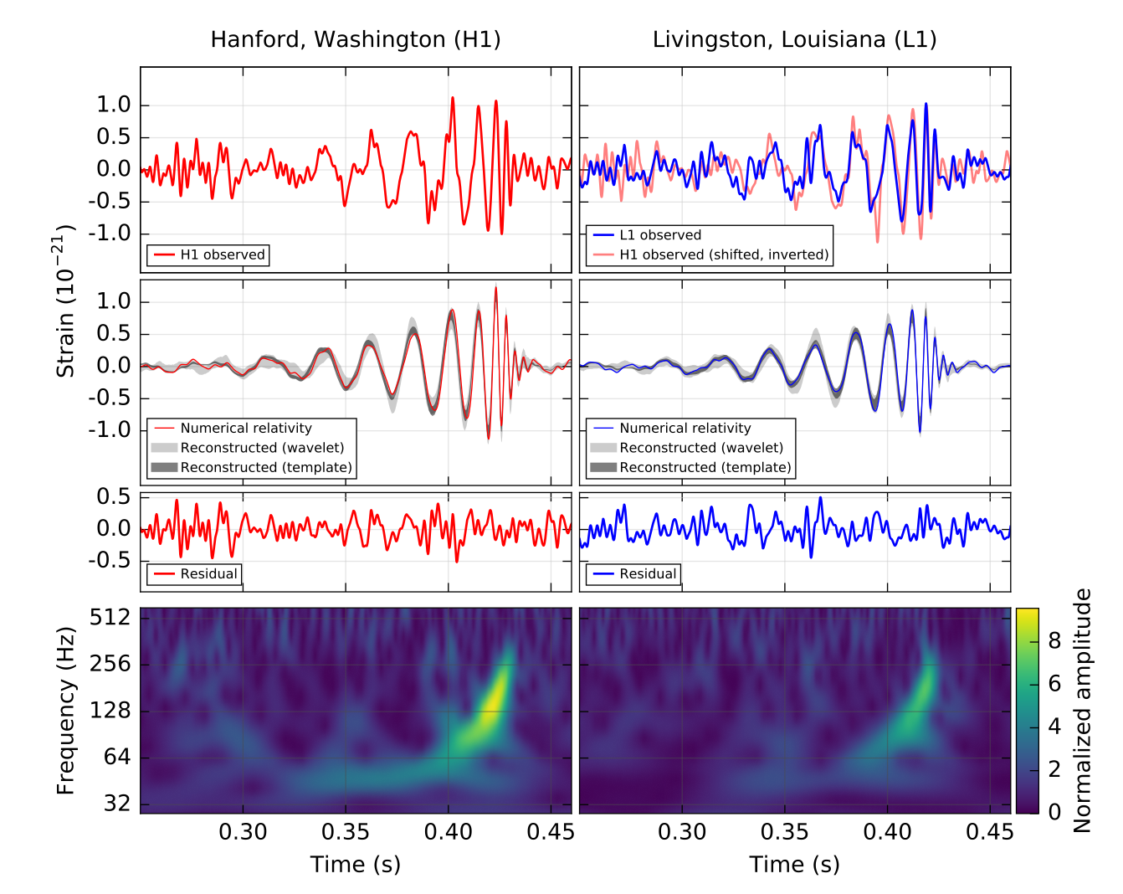
GW150914
Abbott, et al. (2016)

Slide 12
GW170817
1-c_g/c_ɣ ~ 2 sec / 120 Myr ~ 1e-15
Ezquiaga & Zumalacárregui (2017)
Abbott, et al. (2017)

Slide 13
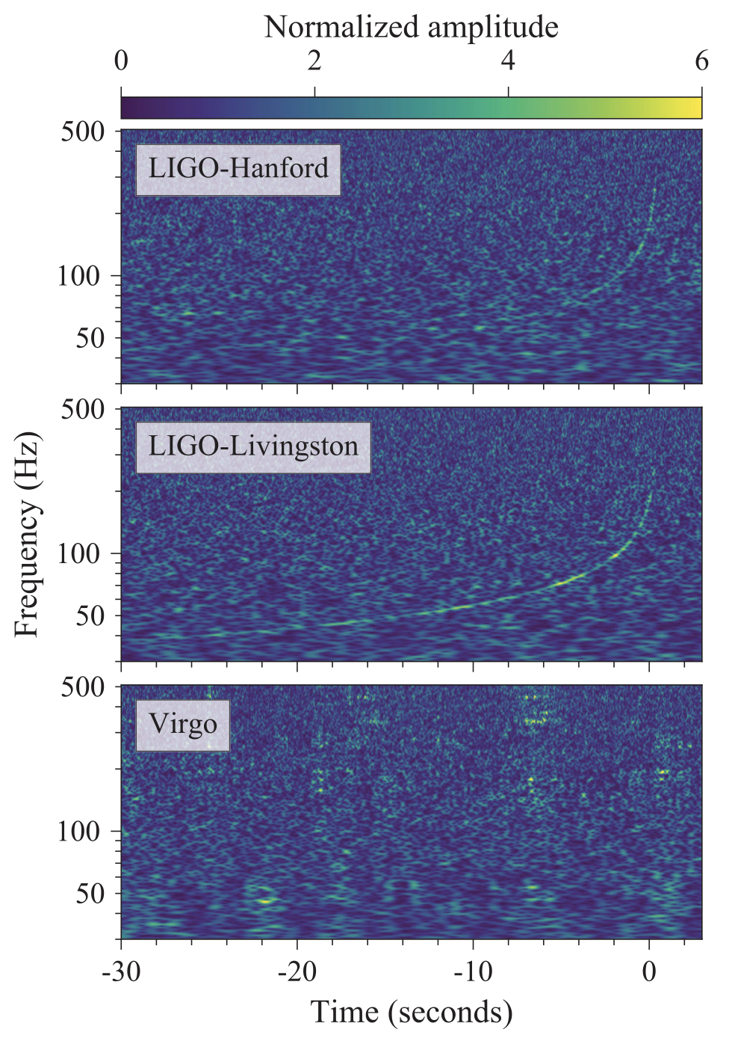
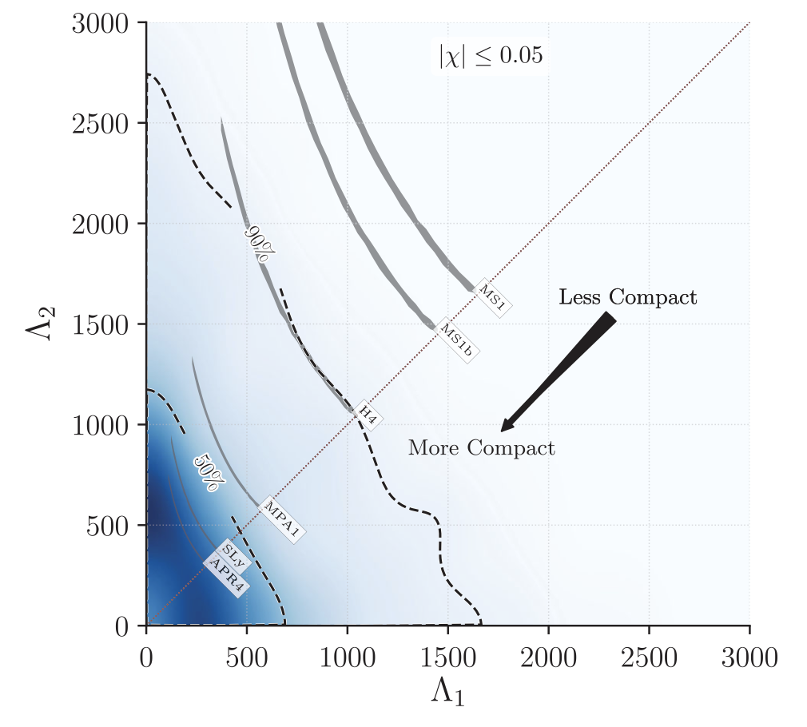
GW170817: QCD at high density.
Abbott, et al. (2017)

Slide 14
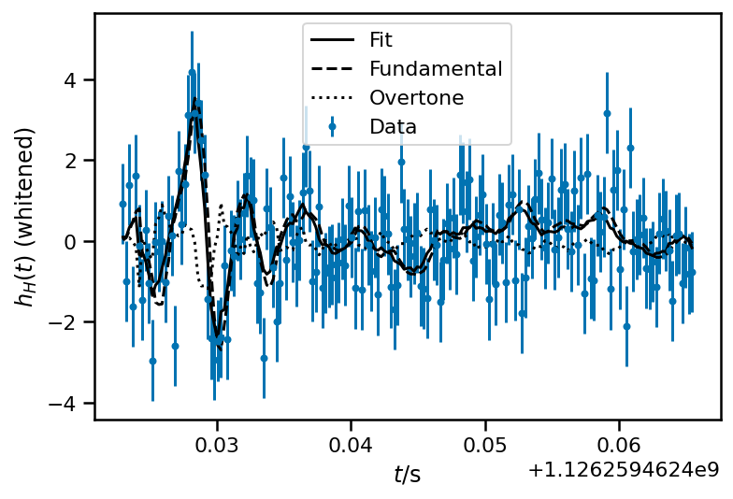
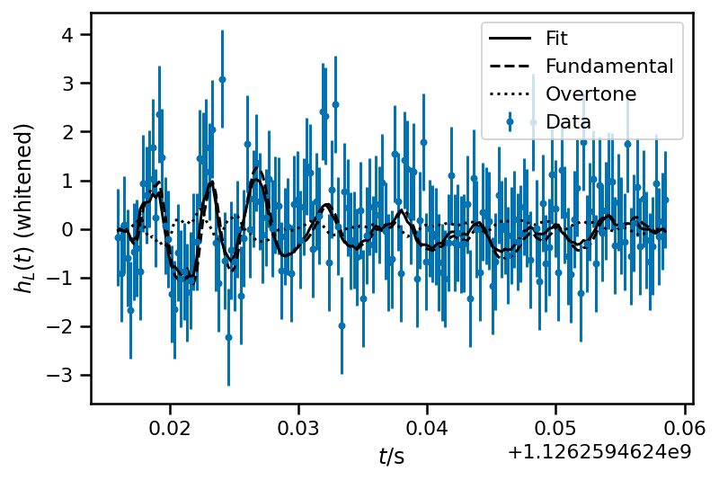
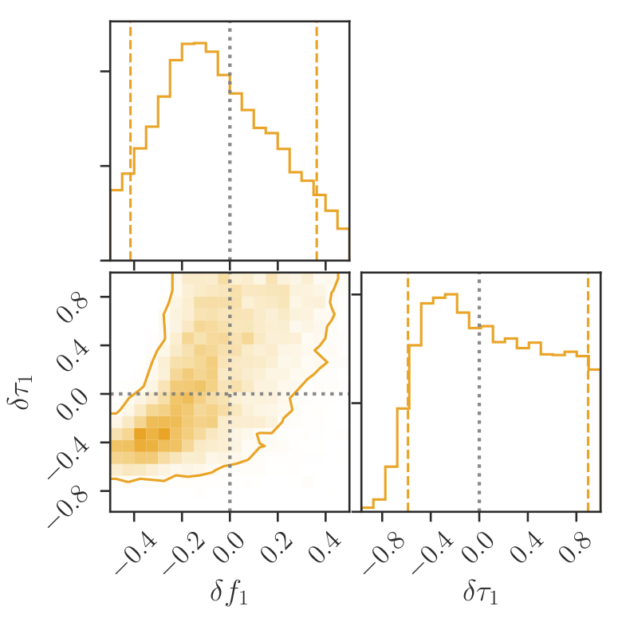
GW150914: Tests of GR in strong field
Isi, et al. (2019)
Abbott, et al. (2016)

Slide 15
Distances

Slide 16
Redshifts are Hard

Slide 17
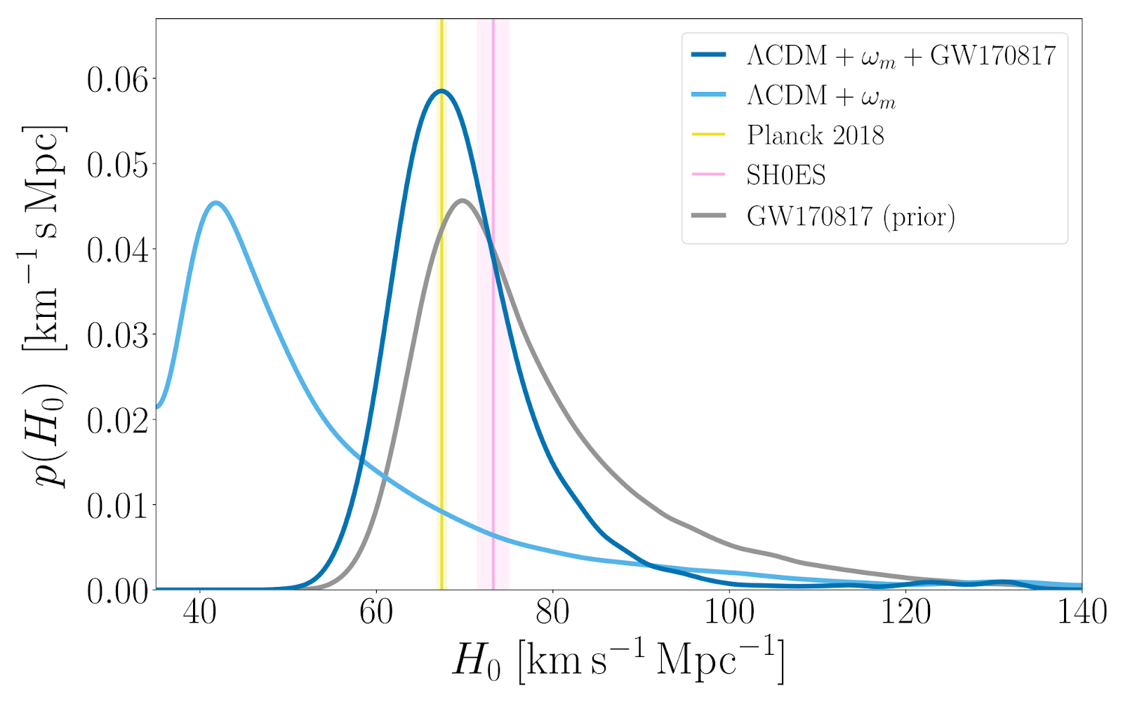
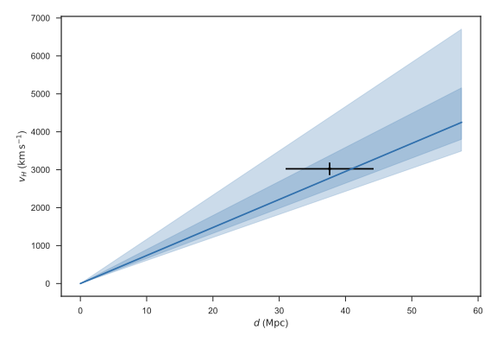
Easy Mode: GW + EM Measurements
Abbott, et al. (2017)
Chen, et al. (2020)

Slide 18
Redshifts Without EM Observations

Slide 19
Redshifts Without EM Observations
If I know this

Slide 20
Redshifts Without EM Observations
If I know this
Then I can measure this.
Chernoff & Finn (1993)
Taylor & Gair (2012)

Slide 21
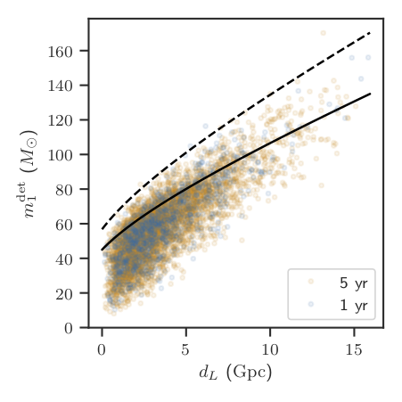
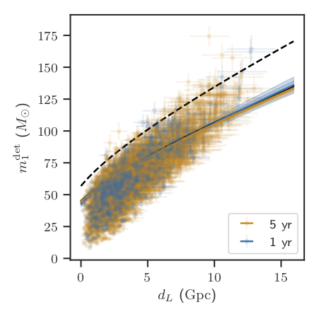
What It Might Look Like This Decade
3% at z ~ 0.8 (H0: +/- 2 km/s/Mpc)!
Farr, et al. (2019)

Slide 22
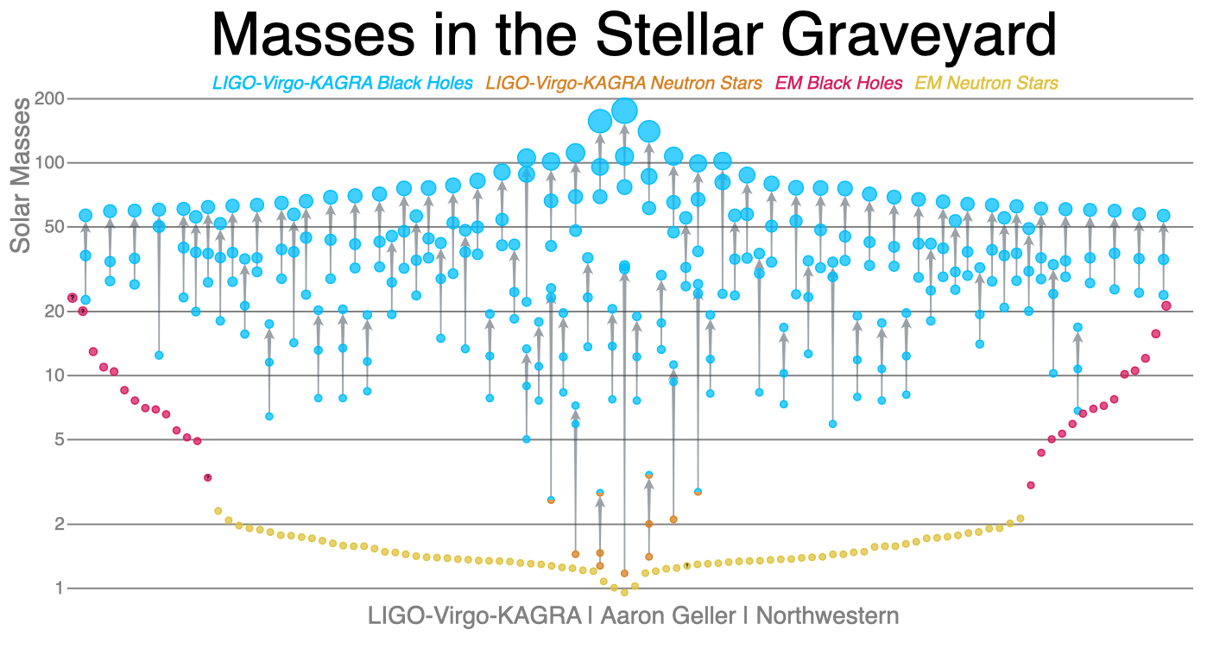

Slide 23
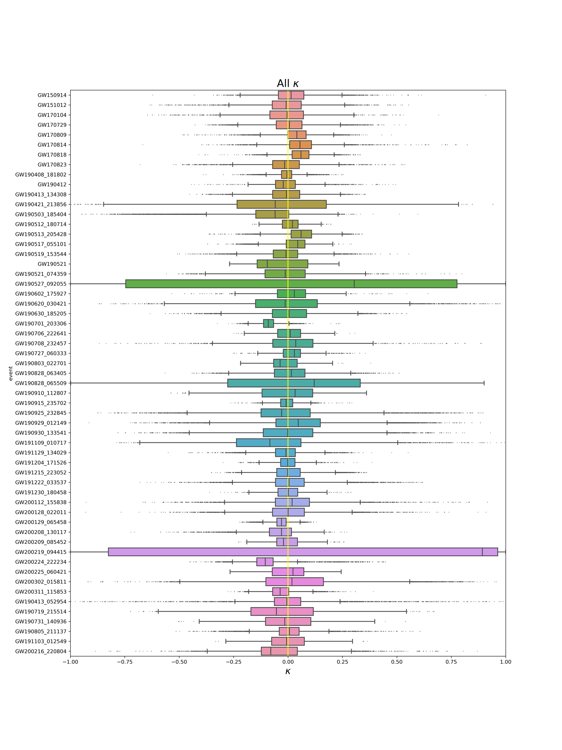
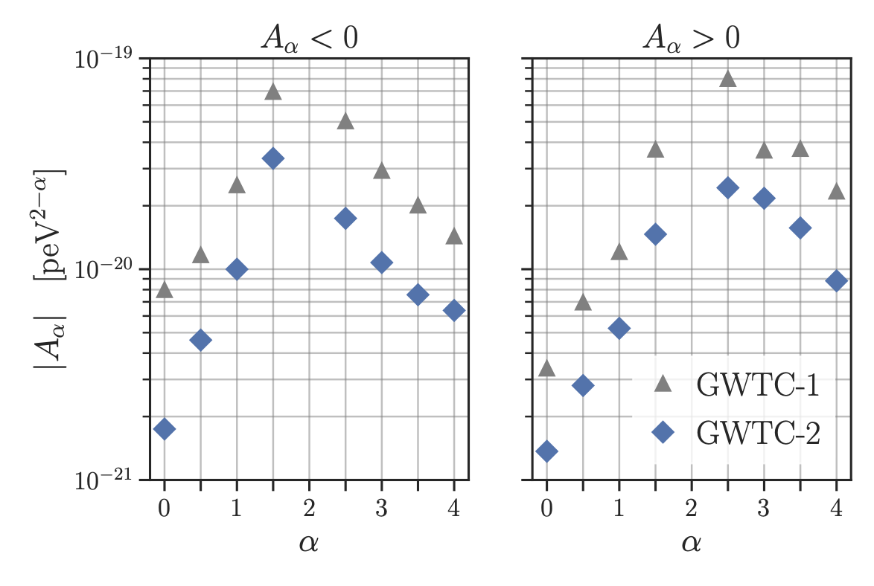
Propagation Tests
Birefringent Opacity:
CCA GW Group, in prep.
Abbott, et al. (2020)

Slide 24
Propagation Tests
Birefringent Opacity:
CCA GW Group, in prep.
Abbott, et al. (2020)

Slide 25
The Future (Ground-Based, 2035)
Cosmic Explorer
LIGO

Slide 26
GW Landscape
http://gwplotter.com
Moore, Cole, & Berry (2014)

Slide 27
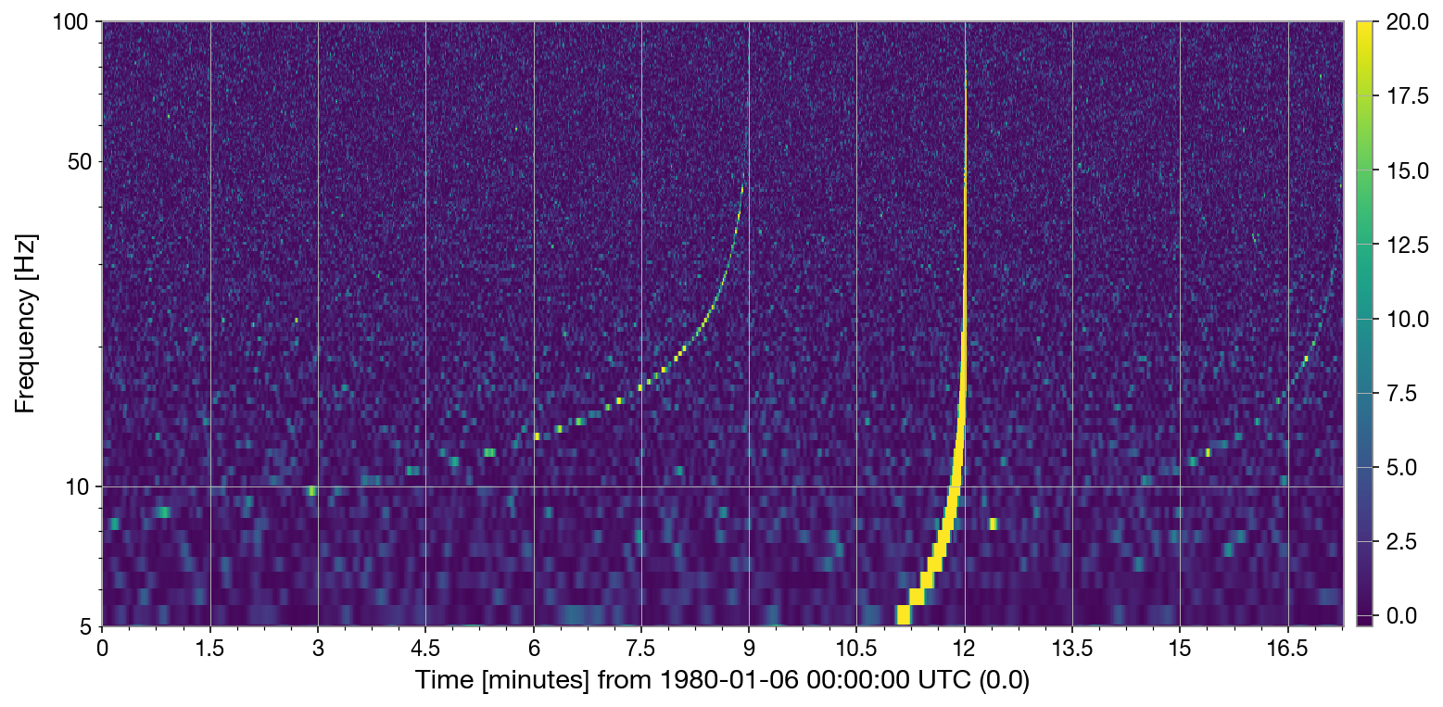
A Lazy Tuesday Afternoon at Cosmic Explorer…
Farr, W. M. & Farr, B.

Slide 28
A Lazy Tuesday Afternoon at Cosmic Explorer…
10-10, z=1.5, S/N=128
1.4-1.4, z = 1, S/N=38
1.4-1.4, z=2, S/N=23
Farr, W. M. & Farr, B.

Slide 29
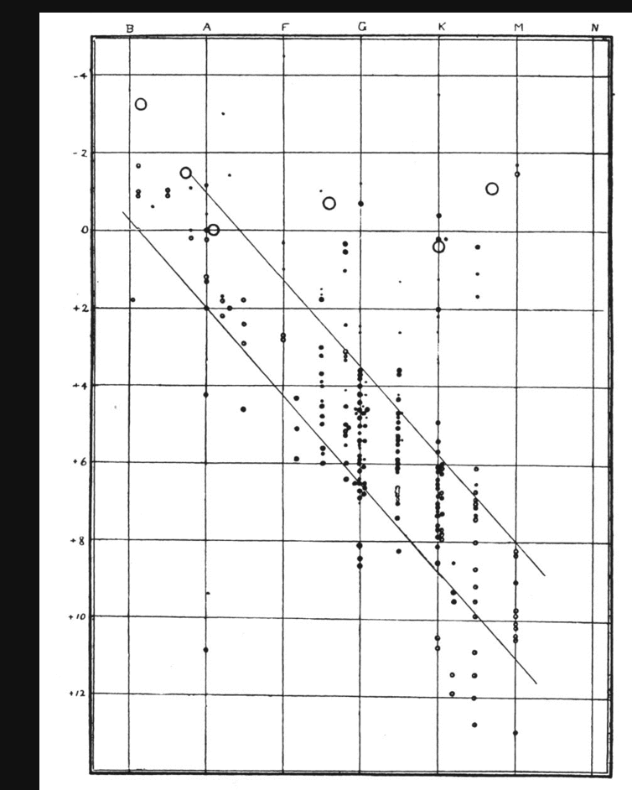
Analogy: The Present
Russell (1914)

Slide 30
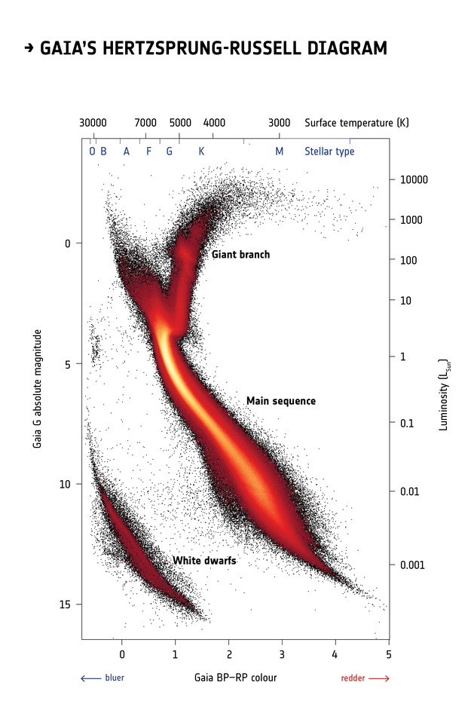
Analogy: The Future
ESA/Gaia/DPAC

Slide 31
Intersections
QCD at T=0 and high density.
Tests of General Relativity at high curvature.
Propagation tests of gravity.
Calibrated cosmological distances.
These all get better with:
250k sources / yr (!)
S/N >> 100 sources
The future is BRIGHT!
ESA/Gaia/DPAC

