Slide 1
American Physical Society
Engaging and Serving Physicists Worldwide
International Activities: Challenges & Opportunities
Jonathan Bagger
American Physical Society
July 25, 2022
Notes:
Dr

Slide 2
American Physical Society Mission & Values
APS Mission
… To advance and diffuse the knowledge of physics for the benefit of humanity, to promote physics, and to serve the physics community … [since 1899]
APS Values
The Scientific Method
Truth and Integrity
Diversity, Inclusion, and Respect
Partnering, Cooperation, and Open Collaboration
Speaking Out
Education and Learning
Many dimensions!

Slide 3
American Physical Society Activities & Priorities, consistent with Mission & Values
APS Activities
Advance & Advocate. Communicate & Collaborate. Convene & Disseminate. Enable & Include. Inspire & Integrate. Lead & Listen. Partner & Prod ….
APS Priorities
Strengthen scientist-to-scientist connections by
Hosting meetings (March, April, DPF, Snowmass …)
Fostering communication (U.S.-China, Global Physics Roundtable …)
Speaking out (China Initiative, Russia …)
Ensuring mobility (Visas, Ukraine …)
We are one international physics community!

Slide 4
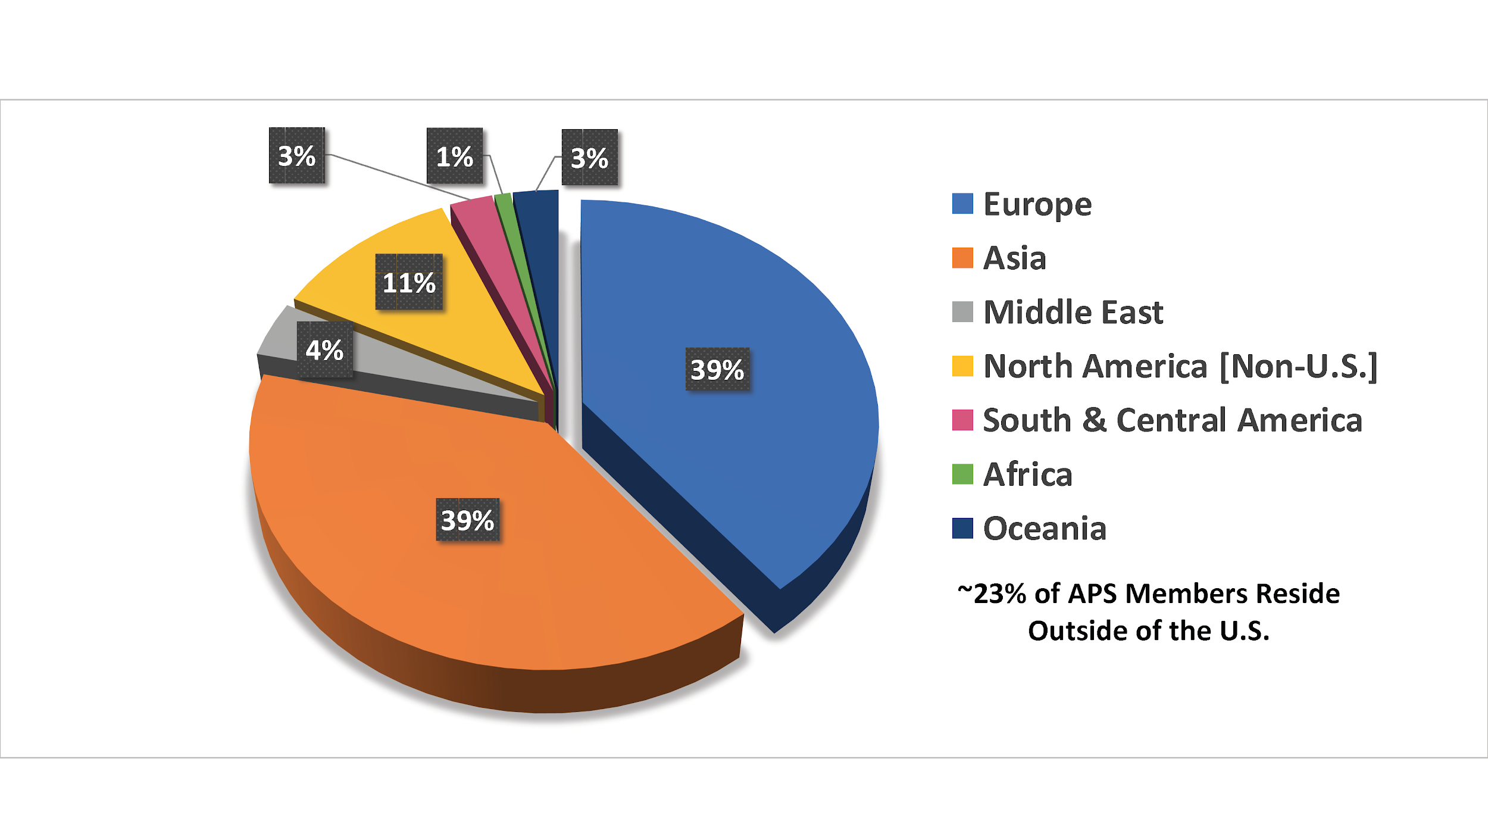
American Physical Society International Engagement
APS membership
Nearly 1/4 of the 50,000 APS members live outside the U.S.
APS meetings
Close to 1/3 of the 13,500 March Meeting attendees come from outside the U.S.
Hybrid and satellite meetings enable more international participation
APS journals
Over 85% of published articles have a non-U.S. author or co-author
APS Members Residing Outside of United States

Slide 5
American Physical Society Example: Science Diplomacy
U.S. – China Physics Roundtable
Face-to-face dialogue among small high-level group, with members from Chinese Academy of Sciences, China Association of Science and Technology, U.S. National Academy of Sciences
Open conversations about challenges to cooperation. Follow-on discussions with U.S. government
Global Physics Roundtable
Virtual summit of leaders of national physics societies & other international organizations to discuss shared interests and concerns
Physics and Society: “The Role of Physics in the Green Economy”
Physics and Policy: “Research Security”

Slide 6
Convening Global Communities Understanding Visa Challenges
American Physical Society Example: Scientific Mobility
BUT we can’t convene global communities and welcome physicists worldwide if they can’t get visas to come to the United States!
APS advocates for visa policies that enhance scientific mobility
Our message is simple
Physics across the globe advances physics in the U.S.
Physics in the U.S. advances physics across the globe
International collaboration advances physics worldwide

Slide 7
American Physical Society Example: Scientific Mobility
International students and researchers: Why they come, how they come, and what they provide to the United States
APS asked international members to share their stories on the importance of international mobility and scientific visas
Received more than 100 personal letters ranging from students and early career physicists to professors and Nobel laureates
Their stories help APS to influence U.S. policymakers
Foreign-born inventors account for 23% of all U.S. patents since 1976
Since 2000, 38% of all U.S. Nobel laureates have been foreign-born
As of 2018, immigrants had founded > 50% (50 of 91) of U.S. privately-held billion-dollar startup companies; 21 first came on J-1 visa
Personal Stories and Statistics
www.aps.org/policy/analysis/

Slide 8
American Physical Society Outlook
Going forward: APS will continue to convene and connect the global physics community
Continue U.S.-China discussions
Identify mutually beneficial joint projects
Address areas of regulatory and security concerns that emerge
Host Global Physics Roundtable
Agree on principles regarding research security
Explore establishing a standing body – a “P20” – for physics society conversations
Global Physics Society Roundtable?
Advocate for international scientific mobility. We need your help!
Reinforce historical U.S. role as a welcoming hub for the global physics community

Slide 9
American Physical Society FYI: Visa Resources
APS Visa Website
https://www.aps.org/programs/international/visa/
Visa Information - Learn about the visa application process, obtain information about visa interviews, and more
Visa Help - What to do if your visa application is delayed and tips to avoid problems
Traveling Abroad from the United States - Information for U.S. citizens and non-citizens traveling to meetings outside of the United States
Visa Processing - Estimated wait times for visa processing at Consular Offices worldwide

