Slide 1

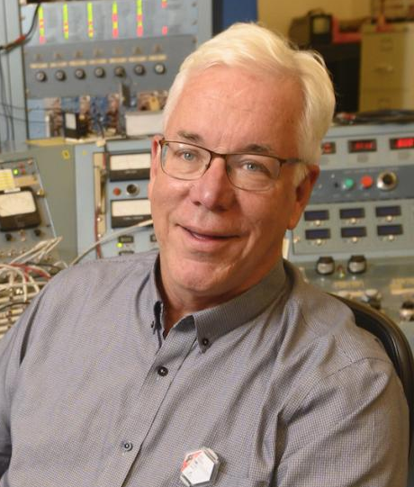
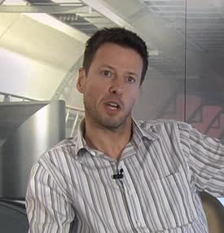

AF5: Accelerators for PBC and Rare Processes
  Eric Prebys
  UC Davis
  eprebys@ucdavis.edu
  Mike Lamont
  CERN Mike.Lamont@cern.ch
  Richard Milner MIT milner@mit.edu

Slide 2
Outline
Mission of the AF5 Working Group
Areas of Physics Interest
Overview and Process
Contributed LoIs
Contributed White Papers
Outline of Report
  PIP-II Opportunities
  Beam Dump experiments
  Other physics opportunities
  Synergistic R&D
Conclusions

Slide 3
AF5: Accelerators for PBC and Rare Processes
AF5 Description:
  A number of fundamental physics questions require exploration of rare processes and what is called Physics Beyond Colliders (PBC). These are similar in spirit to those addressed by high-energy colliders, but require different types of beams and experiments. Modifications of existing accelerator complexes and future dedicated scientific infrastructure are considered for the next two decades through projects complementary to the LHC/HL-LHC and other possible future colliders.
This efffort has greatly benefitted from the The Physics Beyond Collider study at CERN was set-up in 2016 and reported to the European Strategy for Particle Physics in 2019. Although it naturally had a CERN/European bent, it did attempt to evaluate things in a worldwide context. A couple of potentially interesting references follow.
  Beyond the Standard Model Working Group Report https://arxiv.org/abs/1901.09966
  Summary Report of Physics Beyond Colliders at CERN https://arxiv.org/abs/1902.00260

Slide 4
Low energy hidden sector searches
Motivated by the QCD axion as well as astrophysical hints, the low energy hidden sector is potentially accessible via number of sub-eV Axion/ALP search techniques. For example:
  Helioscopes (e.g. BabyIAXO/IAXO)
  Haloscopes using resonant cavities (e.g. ADMX) or other methods (e.g. MADMAX)
  Light-shining-through-walls experiments (e.g. JURA, STAX)
Many of these initiatives can profit from ongoing advances in accelerator technology e.g. high field superconducting magnets, superconducting RF.

Slide 5
Light Dark Matter searches
Light Dark Matter searches in the MeV - GeV mass range target a parameter space of the Hidden Sector of special relevance to open questions in cosmology. Options include:
  Direct detection WIMP searches (primarily addressed by the Cosmic Frontier).
  Proton beam dump experiment: new proposals (e.g. BDF/SHiP), re-purposed existing experiments (e.g. NA62, MiniBooNE, SeaQuest)
  Electron beam dump experiments: NA64, LDMX, BDX… Proposals could include use of novel use of existing facilities (LCLS-II, CEBAF, FAST/IOTA) or the development of new facilities.
  Long lived particles at colliders (LHC, SuperKEKB)

Slide 6
Precision measurements and rare decays
Precision measurements and rare decays can probe higher masses than accessible with LHC direct searches, via searches for the possible influence of the contribution of loop diagrams in a number of scenarios. For example:
  Ultra-rare or forbidden decays/reactions:
    Kaon sector (NA62, KOTO, KLEVER}
    Lepton sector (TauFV, Mu3e, MEG,mu2e/mu2e-II)
  Precision measurements:
    Permanent EDM
      in protons/deuterons (CPEDM)
      in strange/charmed baryons (LHC-FT)
  Anomalous magnetic moment of muon (g-2)

Slide 7
Technologies
Use of existing accelerator technologies or accelerator technology under development for novel physics applications Technologies to be considered include:
  High field magnets
    e.g. axion and dark matter searches
  Superconducting RF
    e.g. axion searches
  ERLs
  Induction LINACs
    e.g. rare muon processes
  Quantum sensors, ultra-sensitive opto-mechanical force sensors (e.g. KWISP)
  Carbon Nanotubes (CNT) (e.g. directional detection of DM candidates)
Physics applications might include various types of axion/ALP searches (mentioned above), vacuum magnetic birefringence (VMB), exploration of Ultra-Light Dark Matter and Mid-Frequency Gravitational Waves (e.g. AION, MAGIS)

Slide 8
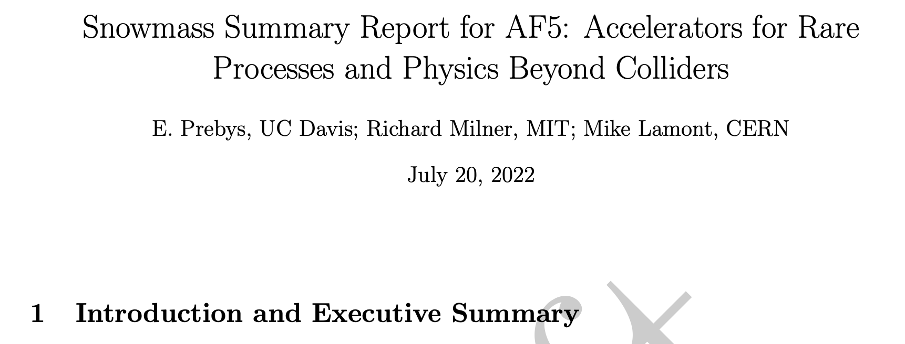
Draft Report/Solicitation
Drafts of this and all AF working group reports can be found at the AF Snowmass page
  https://snowmass21.org/accelerator/start
There are certainly improvements to be made.
We encourage the community to read it and send comments and additions to me and the other authors.
  Don’t worry about typos yet!

Slide 9
Scope of AF5
Focus on areas that require accelerator or accelerator-related technology that would not naturally be addressed in the pursuit of the energy or intensity frontiers.
Do not include experiments that are purely parasitic on experiments in those frontiers.

Slide 10
Key Meetings and Workshops
6/22/20: AF5 Brainstorming Session
7/15/20: AF/EF/RP Cross-frontier Meeting
7/23/20: Muon-based and other beam-dump based dark matter/dark sector searches
9/23/21: Joint AF2/AF5/AF7/RP/NP Targetry Workshop
12/15/21: Booster Storage Ring Workshop
1/14/22: Muon Workshop
Numerous Mu2e-II and CLFV workshops throughout

Slide 11
AF5 LoIs
Tagged AF5:
  Dark Sector, beam based, facility: 13
  Dark Sector/axion, cosmic: 5
  Dark Sector, beam based, parasitic: 4
  Rare processes: 4
  Technology: 4
  EDM: 2
  Nuclear: 1
  Total: 33
Additional LoIs that probably should have been tagged AF5
  Dark Sector Studies at High Intensities: 19
  Charged Lepton Flavor Violation 9
  Dark Matter: Wave-like 6
  Fundamental Physics in Small Experiments 4
  BSM Neutrino Frontier 1
  EF: BSM - More general explorations 1
  Dark Matter: Particle-like 1
  Total: 41
Grand total 74

Slide 12
Role of AF5?
Most of the topics that fall under this banner are already being addressed within the context of the of the appropriate physics group.
We chose to focus on
  Development of facilities to service multiple physics groups.
    Emphasis on PIP-II opportunities
  Advertising capabilities of various facilities.
  Experiments that require significant or unique accelerator development to achieve their physics goals.
  Identifying cross-cutting technology development

Slide 13
Apologies to Belle-II
We realized until very recently that Belle-II kind of fell between the cracks
  We thought they were under AF3
  AF3 thought they were under AF5
  They kind of fell through the cracks of our discussions
After some discussion, we decided they belonged in AF5 and have included some information about them in the report.
  Happy to add more.

Slide 14
AF05 Tagged White Papers
A. Natochii, T. E. Browder, L. Cao, K. Kojima, D. Liventsev, et al. ”Beam background expectations for Belle II at SuperKEKB“, arXiv:2203.05731 [hep-ex] (pdf).
M. Toups, R.G. Van de Water, Brian Batell, S.J. Brice, Patrick deNiverville, et al. ”PIP2-BD: GeV Proton Beam Dump at Fermilab's PIP-II Linac”, arXiv:2203.08079 [hep-ex] (pdf). (also under NF03, RF06)
Matt Toups, R.G. Van de Water, Brian Batell, S.J. Brice, Patrick deNiverville, et al. ”SBN-BD: O(10 GeV) Proton Beam Dump at Fermilab's PIP-II Linac”, arXiv:2203.08102 [hep-ex] (pdf). (also under NF03, RF06)
William Pellico, Chandra Bhat, Jeffrey Eldred, Carol Johnstone, et al. ”FNAL PIP-II Accumulator Ring“, arXiv:2203.07339 [physics.acc-ph] (pdf). (also relevant to AF02)
R.G. Van de Water, S.G. Biedron, E.-C. Huang, A.J. Hurd, W.C. Louis, et al. ”LANSCE-PSR Short-Pulse Upgrade for Improved Dark Sector Particle Searches with the Coherent Captain Mills Experiment”, arXiv:2204.01860 [physics.ins-det] (pdf). (also under NF03, RF06)
Swagato Banerjee, J. Michael Roney (for the US Belle II Group and the Belle II/SuperKEKB e- Polarization Upgrade Working Group). ”Upgrading SuperKEKB with a Polarized Electron Beam: Discovery Potential and Proposed Implementation”, pdf available here . (also under EF04, RF0)

Slide 15
Other Contributions Related to AF05
RF (General)
  John Arrington, Joshua Barrow, Brian Batell, Robert Bernstein, Nikita Blinov, et al. ”Physics Opportunities for the Fermilab Booster Replacement”, arXiv:2203.03925 [hep-ph]
  REDTOP Collaboration. ”The REDTOP experiment: Rare η/η′ Decays To Probe New Physics”, arXiv:2203.07651 [hep-ex]
  D.M. Asner, H. Atmacan, Sw. Banerjee, J.V. Bennett, M. Bertemes, et al. ”Belle II Executive Summary“, arXiv:2203.10203 [hep-ex]
  Belle II Collaboration. ”Belle II physics reach and plans for the next decade and beyond“,

Slide 16
RF02: Weak decays of strange and light quarks
  E. Goudzovski, D. Redigolo, K. Tobioka, J. Zupan, et al., “New Physics Searches at Kaon and Hyperon Factories”, arXiv:2201.07805 [hep-ph] (pdf).
  Nora Salone, Patrik Adlarson, Varvara Batozskaya, Andrzej Kupsc, Stefan Leupold, Jusak Tandean. ”Study of CP violation in hyperon decays at Super Charm-Tau Factories with a polarized electron beam“, arXiv:2203.03035 [hep-ph] (pdf).
  Thomas Blum, Peter Boyle, Mattia Bruno, Norman Christ, Felix Erben, et al. ”Discovering new physics in rare kaon decays”, arXiv:2203.10998 [hep-lat] (pdf). (also under TF05, CompF02)
  Jason Aebischer, Andrzej J. Buras, Jacky Kumar. ”On the Importance of Rare Kaon Decays“, arXiv:2203.09524 [hep-ph] (pdf).
  The KOTO, LHCb, NA62/KLEVER Collaborations, and the US Kaon Interest Group. ”Searches for new physics with high-intensity kaon beams”, arXiv:2204.13394 [hep-ex] (pdf)

Slide 17
RF03: Fundamental physics in small experiments (axions, EDMs, precision muon measurements)
  W. Altmannshofer, H. Binney, E. Blucher, D. Bryman, L. Caminada, et al. (PIONEER Collaboration). ”Testing Lepton Flavor Universality and CKM Unitarity with Rare Pion Decays in the PIONEER experiment”, arXiv:2203.05505 [hep-ex] (pdf).
  Ricardo Alarcon, Jim Alexander, Vassilis Anastassopoulos, Takatoshi Aoki, et al. ”Electric dipole moments and the search for new physics”, arXiv:2203.08103 [hep-ph] (pdf).

Slide 18
RF05: Charged lepton flavor violation (electrons, muons, and taus)
  K. Byrum, S. Corrodi, Y. Oksuzian, P. Winter, L. Xia, A. W. J. Edmonds, et al. ”Mu2e-II: Muon to electron conversion with PIP-II”, arXiv:2203.07569 [hep-ex] (pdf).
  M. Aoki, R. B. Appleby, M. Aslaninejad, R. Barlow, R. H. Bernstein, C. Bloise, L. Calibbi, et al. ”A New Charged Lepton Flavor Violation Program at Fermilab”, arXiv:2203.08278 [hep-ex] (pdf).

Slide 19
AF5 Report Outline
Maximum exploitation of PIP-II
  This has been most of the cross-cutting work in this area.
  Mu2e-II and beyond
  Other physics opportunities at PIP-II
  Booster compressor ring(s)
Beam dump opportunities
  Proton beam dumps
  Electron beam dumps
  Summary of facilities’ capabilities
    Also largely summarized in Bob Zwaska’s report
Other Opportunities and Their Challenges
  Belle-II
  EDM measurements
  Rare Kaon experiments
  Etc
Synergistic opportunities with other WGs
  Target development
  RF
  Magnet development

Slide 20
Role of PIP-II in Snowmass Planning
PIP-II is the higher energy linac upgrade to the Fermilab Proton Source, from 400 to 800 MeV.
The ostensible motivation for PIP-II is to increase the beam power to the high energy neutrino program (LBNF/DUNE), but that will only use a tiny fraction of the available neutrinos from PIP-II.
There are many accelerator challenges facing the rare process community, but we consider PIP-II to be a particularly important opportunity for the Snowmass process to contribute to effectively planning the use of the additional beam power at 800 MeV.
We consider this an important responsibility of the AF5 WG.

Slide 21
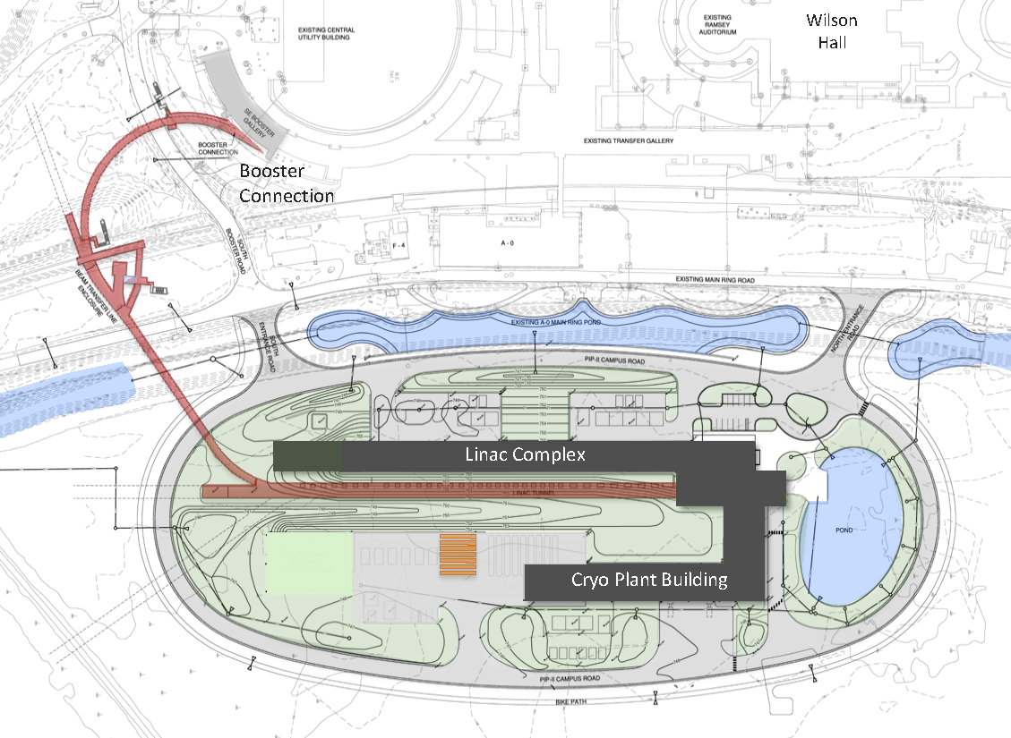
Review: PIP-II Scope Overview
To mu2e
800 MeV H− linac
  Up to 165 MHz bunches
  Up to 2 mA CW
  Up 1.6 MW
Upgraded Booster
  20 Hz, 800 MeV injection
  New injection area
Upgraded Recycler & Main Injector
  RF in both rings
Protons for the High Energy Program
  .55 ms injection into Booster at 20 Hz
  Only ~1% of available beam!
Additional beam
  Up to 1.6 MW
  All the beam to one experiment?
  3-way beam split?
The PIP-II scope enables the accelerator complex to reach 1.2 MW proton beam on LBNF target, but still leave most of the beam for other users!

Slide 22
Beam Switching*
Beam for muon production could be provided by this line (162.5 MHz)
or one of these lines
(40.125 or 80.25 MHz)
PIP-II Linac
*Lia Merminga, CD-2 Refresh

Slide 23
RF Beam Splitting
The Beam will go through an RF deflector running at 162.5/4=40.625 MHz
Individual beam lines are selected by choosing which bunches to populate.

Slide 24
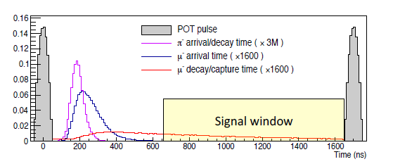
Example: Mu2e Beam Requirements
The Mu2e experiment searches for the conversion to an electron of a muon that has been captured by an Aluminum nucleus.
The most important backgrounds are prompt with respect to the proton that produces the muons.
Solution: pulsed beam
“Straggling” through solenoids (put a pin in that!)

Slide 25
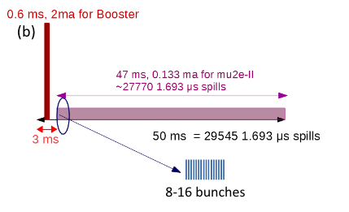
Example: Mu2e-II Beam Formation
Possible beam structure (100 kW):
  10 bunch burst @ 600 kHz
  1.4x10⁸ protons/bunch
  600 kHz repetition rate
  = 100 kW
  3% duty factor
  0.12 mA
  These numbers are
  independent from the
  instantaneous bunch rate!
    ie, which line we’re in
The bunch rate only affects the pulse width
  162.5 MHz = 60 ns
  81.25 MHz = 120 ns
  40.625 MHz = 240 ns
All of these numbers would double for 200 kW
~275 162.5 MHz buckets
That’s all that would be needed from the accelerator end!

Slide 26
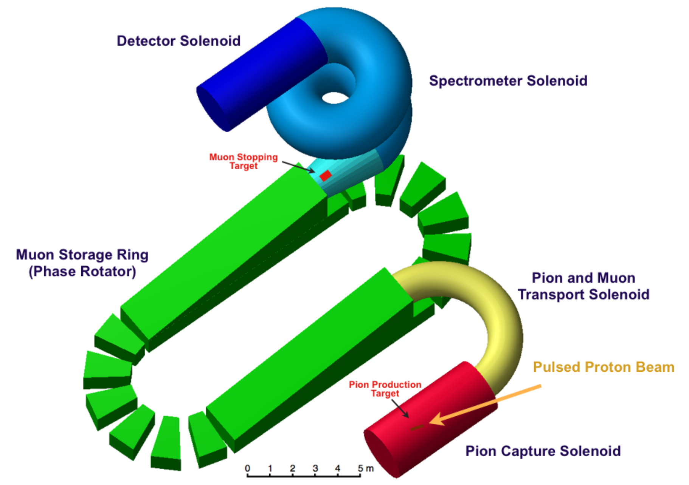
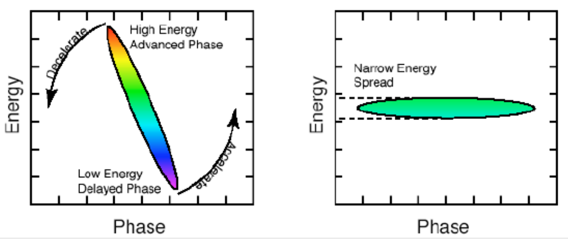
Beyond Mu2e-II
To go beyond the Mu2e-II goals, or to go to heavier targets (shorter lifetimes), it’s necessary to adopt another means to allow pions to decay to avoid “straggling”
Solution: FFA
Problem: cannot fill this ring directly from PIP-II beam
Need a “compressor ring” to provide short, intense pulses at 100-1000 Hz.

Slide 27
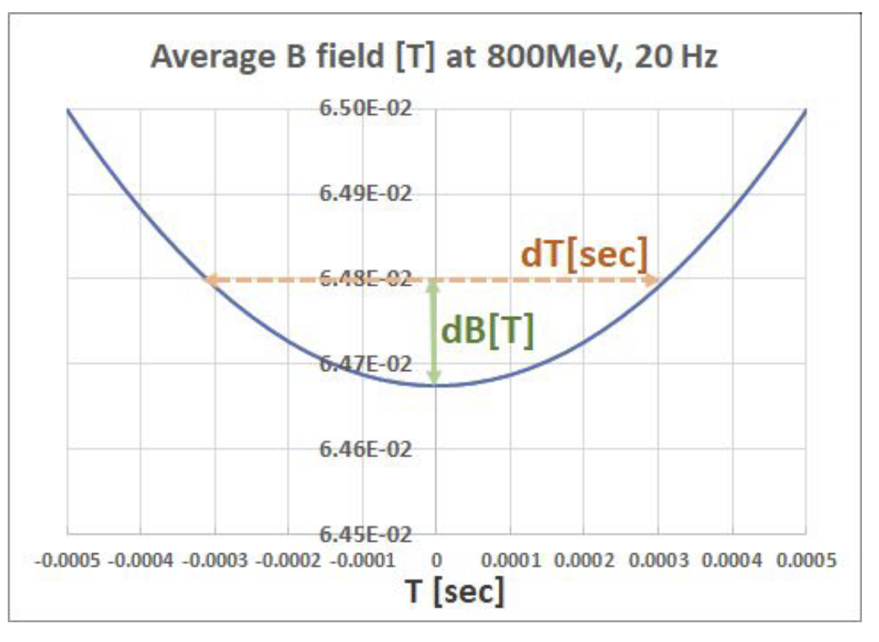
Competing Priorities
The neutrino program
  The Booster magnets will run at a 20 Hz
  offset sine wave.
    Initially, it will be flattened at the lower end during
    injection using the Booster corrector magnets.
  Injecting more beam into the booster will
  require a longer injection pulse, going
  beyond the ability of the corrector magnets to flatten the field.
  The Booster Storage Ring (BSR) would allow the protons to be pre-loaded, the way we preload protons in the Recycler for the Main Injector.
  It therefore must be at least the same circumference as the Booster!
  Might be other ways to solve this problem.
Muons (and others?)
  Want the shortest, most intense pulses we can get.
  Space charge effects drive us to the smallest possible ring to achieve this.

Slide 28
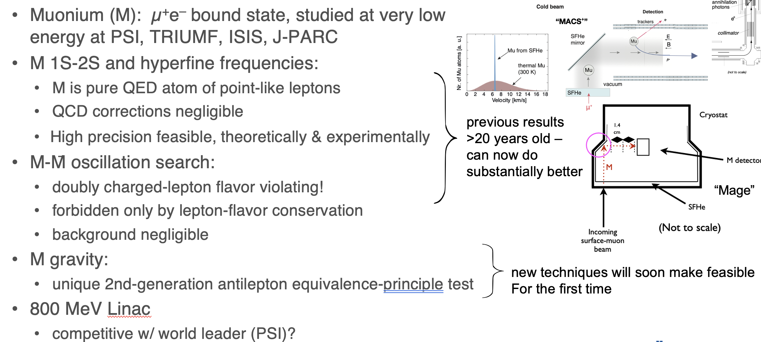
Slow Muonium Experiments*
*Matt Toups, “Physics Opportunities with Booster Replacement Options”, this conference

Slide 29
PIP-II Discussions for Snowmass and Beyond
Organize potential users
  This is happening at this workshop
Compressor ring decisions
  Discussed a bit in “Booster Replacement Option” Session
  Several designs being considered
  When and what ring to build?

Slide 30
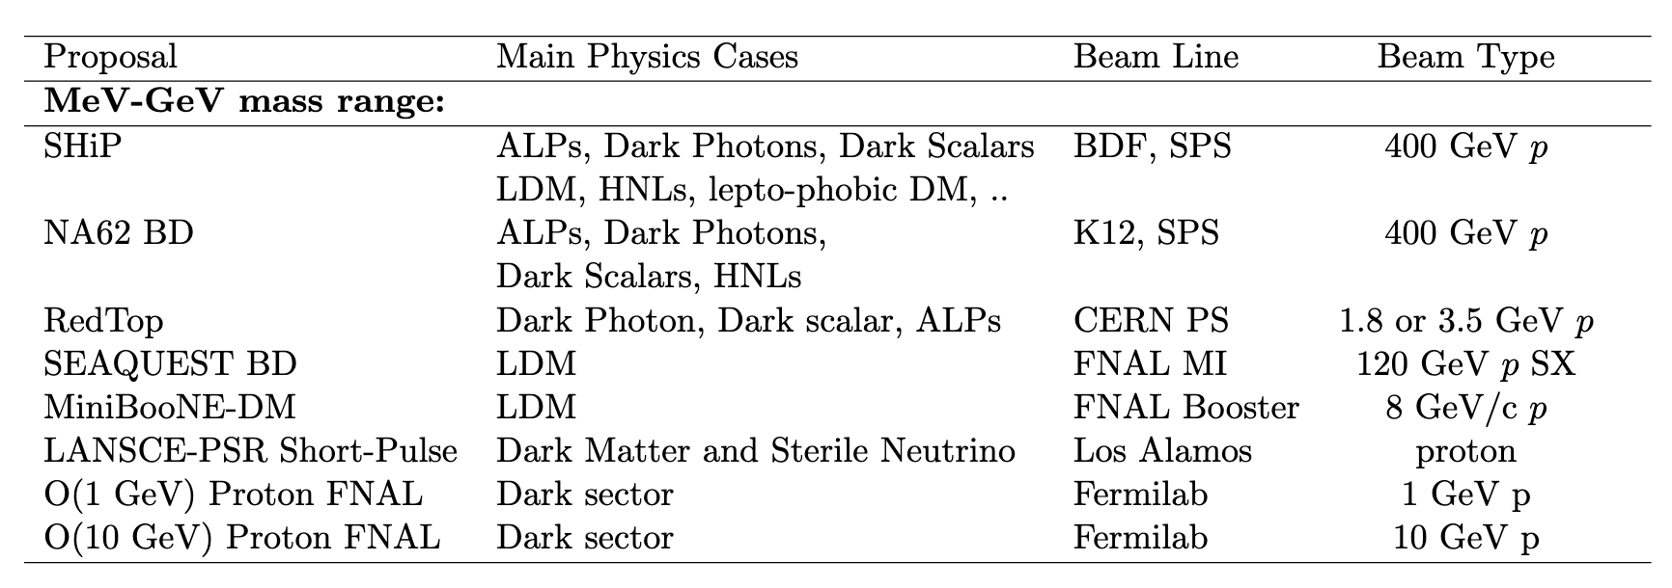
Beam Dump Experiments
Intense beam dump experiments are broadly sensitive to dark sector and other rare process searches, and are fairly ubiquitous at physics facilities
Existing or proposed proton beam dump experiments

Slide 31
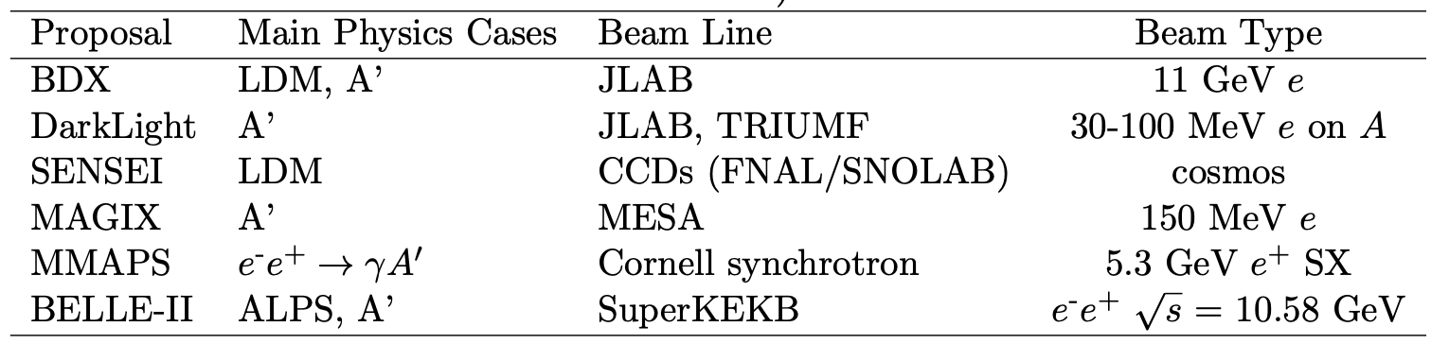
Proposed or existing electron beam dump experiments

Slide 32
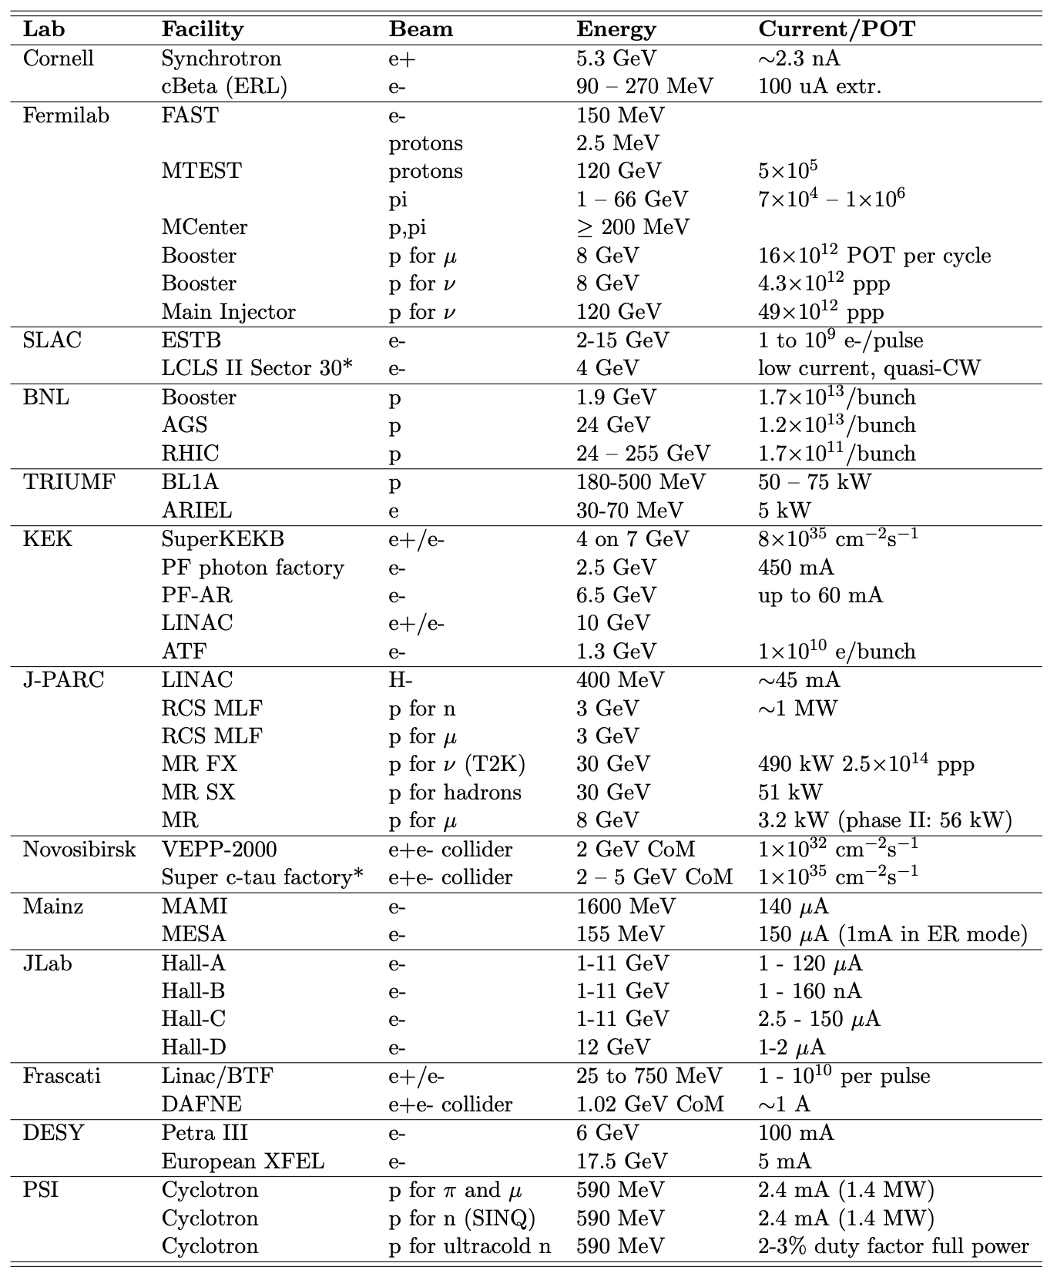
World-wide Beam
Dump Capabilities
(* means proposal)

Slide 33
EDM Measurement
EDM Measurements
  These experiments typically involve unique storage ring designs, including electrostatic storage rings, which present very interesting accelerator physics challenges.

Slide 34
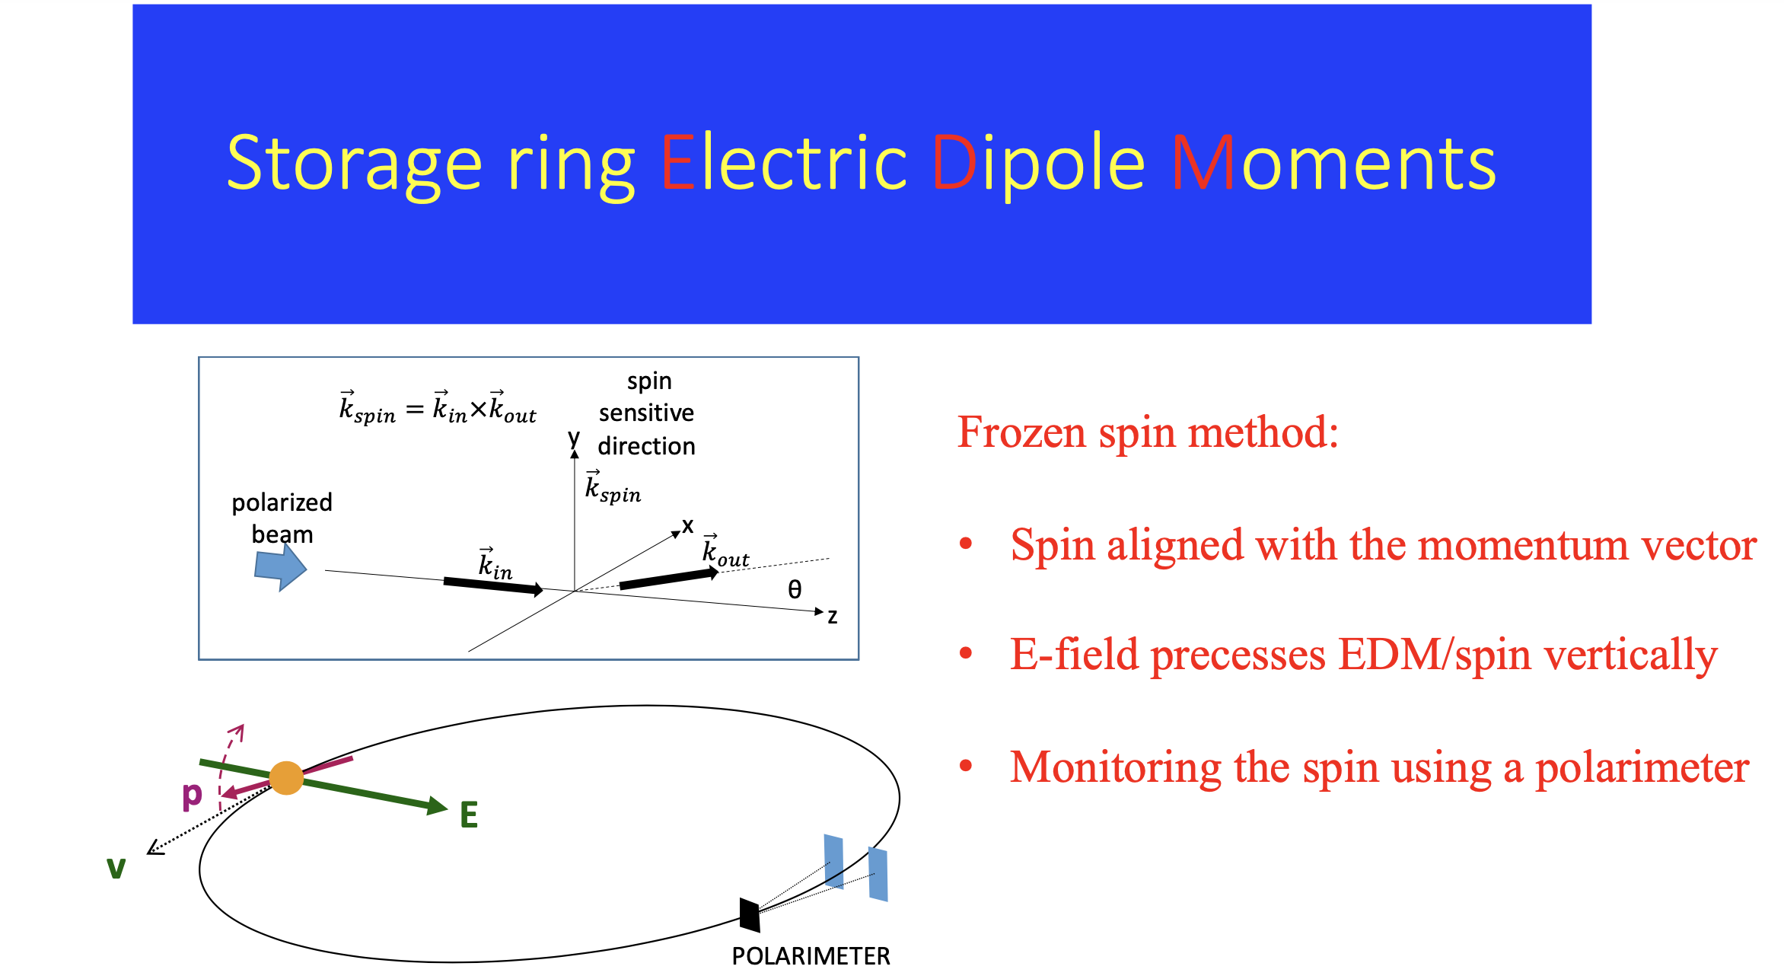
Example: Proton EDM*
*see talk by Y. Semertzides, on Thursday

Slide 35
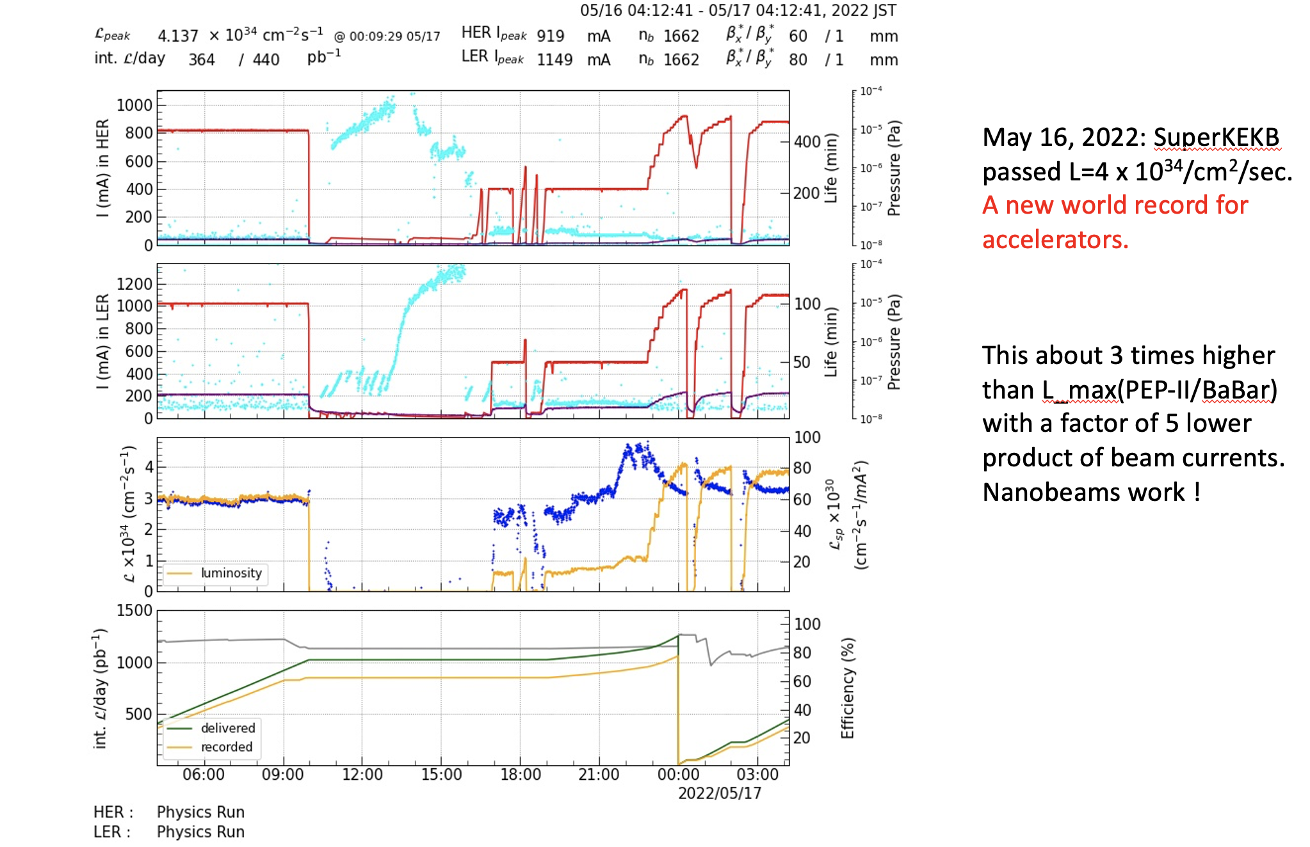
Belle-II
SuperKEKB continues to push the boundaries of precision physics, and just broke the luminosity record.

Slide 36
Announcement from Belle-II KEKB*
An ITF (International Task Force) has been formed to help improve SuperKEKB luminosity on the long term.
There is collaboration now with a number of major accelerator labs.
These include CERN (FCC-ee), IHEP, BINP, ESRF, BNL, SLAC.
Early successes include ideas and suggestions for beam dynamics,
optics and TMCI.
The initial charge is to make a plan to go beyond 2 x 10³⁵ and get
to 6 x 10³⁵. But the ITF may discuss plans and R&D for even higher luminosity as soon as the initial problem is solved.
This is an extremely helpful and fruitful development from KEK.
Stay tuned.
*Tom Browder

Slide 37
Synergies with other AF groups
The technologies of interest to this area are primarily in AF7
  AF7-T: Targets
    Target development for the neutrino and muon collider efforts can benefit beam dump experiments
    Rad-hard target instrumentation might also be of interest.
  AF7-M: High field magnets
    e.g. axion and dark matter searches
  AF7-R: RF
    e.g. axion searches

Slide 38
Conclusions
Lots of interesting physics out there!
Snowmass should seek a key role in planning for the PIP-II physics program at Fermilab.
Very important to understand the capabilities of various labs and accelerators and facilities.
Synergy with technical R&D for other experimental areas should be nurtured.

