Slide 1
US Beam Test Facilities
Community Summer Study
AF1: Beam Physics, Education and Outreach
John Power on behalf of coauthors
Argonne National Laboratory
July 21, 2022, Seattle, WA

Slide 2
ACKNOWLEDGEMENTS
Whitepaper: https://arxiv.org/abs/2203.11290
Beam Test Facilities for R&D in Accelerator Science and Technologies
Christine Clarke,1 Michael Downer,2 Eric Esarey,3 Cameron Geddes,3 Mark J. Hogan,1 Georg Heinz Hoffstaetter,4 Chunguang Jing,5, 6 Steven M. Lund,7 Sergei Nagaitsev,8, 9 Mark Palmer,10 Philippe Piot,11, 6 John Power,6 Carl Schroeder,3 Donald Umstadter,12 Navid Vafaei-Najafabadi,13, 10 Alexander Valishev,8 Louise Willingale,14 and Vitaly Yakimenko
¹ SLAC National Accelerator Laboratory, Stanford University, Stanford, CA 94309 U.S.A.
² Lawrence Berkeley National Laboratory, Berkeley, CA 94720, U.S.A.
³ Fermi National Accelerator Laboratory, Batavia, IL 60510, U.S.A.
⁴ The University of Chicago, Chicago, IL 60637, U.S.A.
⁵ Brookhaven National Laboratory, Upton, NY 11973, U.S.A.
⁶ Northern Illinois University, DeKalb, IL 60115, U.S.A.
⁷ Argonne National Laboratory, Argonne, IL 60439, U.S.A.
⁸ University of Nebraska-Lincoln, Lincoln, NE 68588, U.S.A.
⁹ Stony Brook University, Stony Brook, NY 11794, U.S.A.
¹⁰ University of Michigan, Ann Arbor, MI 48109, U.S.A.
¹¹ Cornell University, Ithaca, NY 14853, U.S.A.
Author affiliations

Slide 3
The Beam Test Facility mission
Demonstrating the viability of emerging accelerator science ultimately relies on experimental validation.
Providing experimental test beds to carry out basic research in advanced accelerators and beam physics.
Developing the S&T needed to enable the next generation of energy-frontier and intensity frontier science facilities and societal accelerator applications. Support the GARD Roadmap
Educating and training future scientists and engineers.
Note: While limited R&D can be done in User Facilities dedicated to non-accelerator science (e.g. LHC), typically these facilities have a dedicated user base that cannot tolerate interruption. Their limited beam availability is used for near-term accelerator technology to improve operations. These facilities are ill-suited for exploring and developing advanced accelerator science.
The ultimate goal is to enable the next generation of SC-HEP science facilities and train scientists with the skills to design, build and run ​those facilities

Slide 4
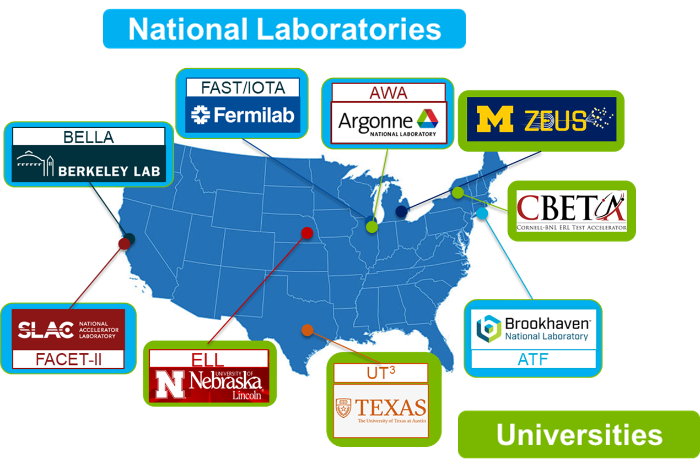
The Beam Test Facilities
Demonstrating the viability of emerging accelerator science ultimately relies on experimental validation.
Universities
Texas Petawatt Laser, University of Texas at Austin
The Cornell-BNL ERL Test Accelerator (CBETA)
Extreme light laboratory, Lincoln, Nebraska
ZEUS user facility, University of Michigan
National Laboratories
Accelerator Test Facility (ATF) at BNL
The Argonne Wakefield Accelerator (AWA) at ANL
The Berkeley Lab Laser Accelerator (BELLA) Center at LBNL
The Fermilab Accelerator Science and Technology facility (FAST) at FNAL
The Facility for Advanced Accelerator Experimental Tests II (FACET-II) at SLAC
(O(100) MeV energy drive beams, O(10) Petawatt drive lasers, O(1) Gigawatt RF power sources

Slide 5
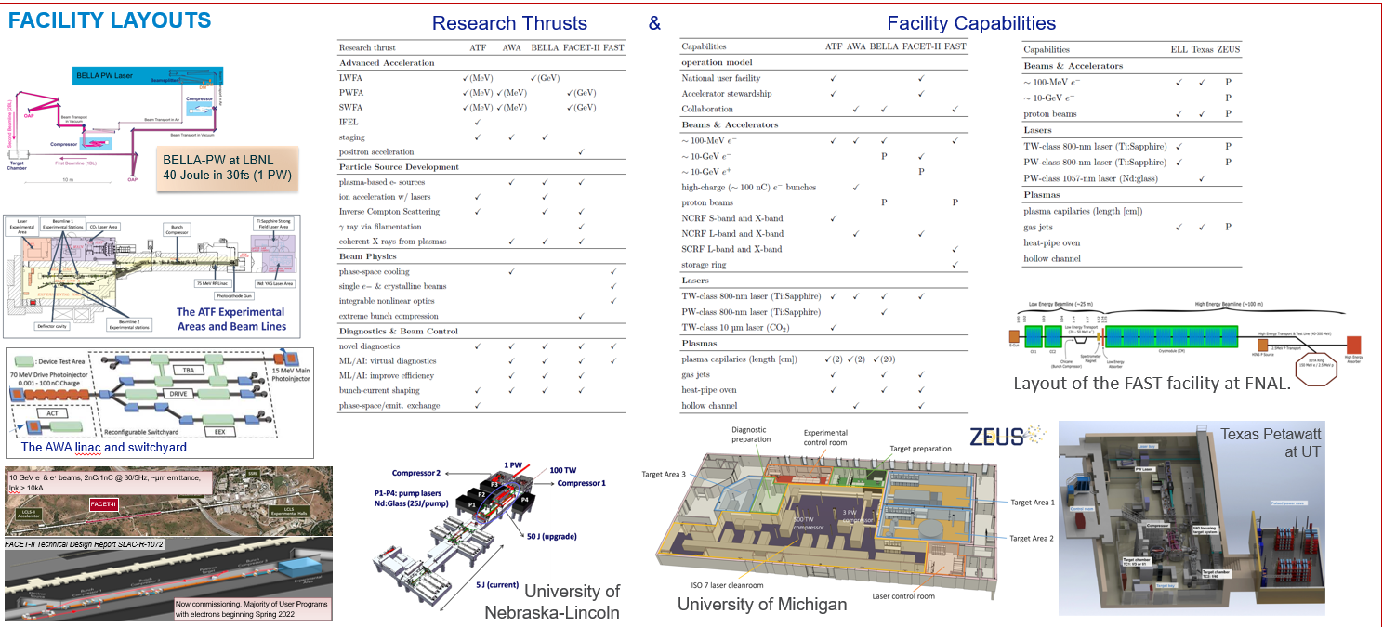
Beam Test Facilities: Research Thrust & Capabilities
(O(100) MeV energy drive beams, O(10) Petawatt drive lasers, O(1) Gigawatt RF power sources

Slide 6
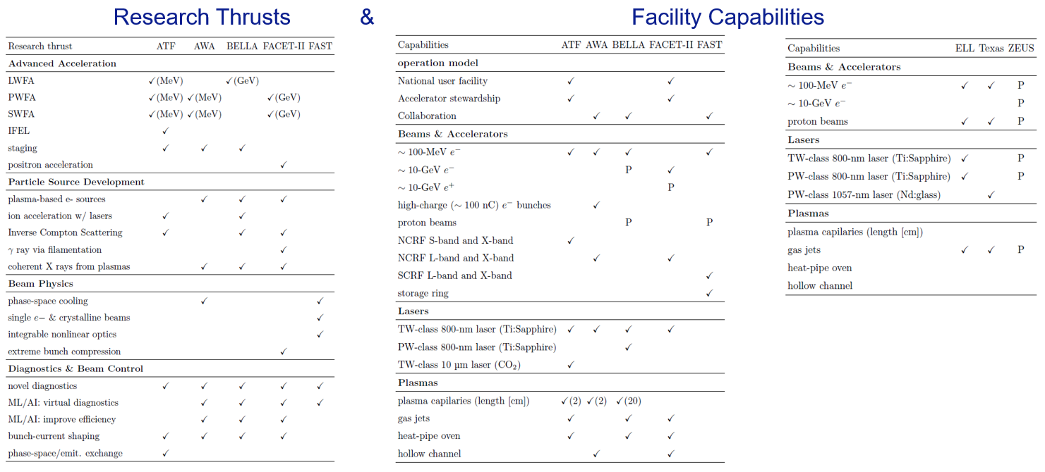
DOE-HEP Beam Test Facilities Council: ANL-AWA, BNL-ATF, FNAL-FAST, LBL-BELLA, SLAC-FACET, Collaboration has been meeting since 2019

Slide 7
Impact oUS beam test facilities since the previous Snowmass Process.
Progress was made by US beam test facilities since the previous Snowmass Process. In 2015, the P5 strategic plan [1] made multiple recommendations to the HEP General Accelerator R&D (GARD) program and the beam test facilities were instrumental in addressing many of these. Most importantly, various GARD roadmaps were successfully formulated by the GARD community in response to P5 to clearly articulate the long-term research needed to develop the next generation of energy-frontier and intensity-frontier machines. For example, the 2016 Advanced Acceleration Concepts (AAC) Roadmap identified a series of milestones, many of which were demonstrated at the US beam test facilities. Milestones achieved include multi-GeV/m accelerating gradients,

Slide 8
​R&D spinoffs developed and/or demonstrated, at least in part, at US-ANA facilities.
Photoinjector R&D that enabled high brightness sources for X-ray Free Electron Lasers (XFELs)
SASE/FEL R&D demonstrating that the self-amplied spontaneous emission (SASE) instability would work at progressively shorter wavelengths from optical to X-rays
Inverse Free Electron Laser (IFEL) techniques that are basis for the laser heaters used to mitigate instabilities in XFELs
LWFA research that gave rise to betatron X-ray probes at the LCLS Matter in Extreme Conditions (MEC) Instrument
Laser scattering from plasma accelerated beams to generate X-ray and gamma ray probes
Wakefield studies that then were applied to create de-chirpers for XFELs and passive deflectors for UED facilities
Bunch compression studies that informed compressor design for higher peak current and shorter gain length at XFELS
Thomson scattering to measure electron beam emittance and bunch length
Paricle (electron, proton and ion) beams from laser plasma accelerators for probing matter

Slide 9
Upgrades to US beam test facilities
Upgrades to US beam test facilities will require significant investment by USDOE-HEP to ensure the US GARD program remains internationally competitive. In turn, upgraded beam test facilities are needed to enable DOE-HEP to build a cutting-edge program in the energy and intensity frontiers. For example, the European Strategy for Particle Physics has committed considerable funds to accelerator R&D in Europe. All USDOE GARD beam test facilities have near-term upgrades underway and have developed proposals for mid-term upgrades to continue progress on the previously developed roadmaps and support from DOE-HEP is needed to realize these plans. In the long-term, several options are under consideration ranging from a greenfield beam test facility to re-using the infrastructure of next-generation facilities such as ILC, CLIC, FNAL site linac, C3. . . etc with Advanced Acceleration technology. Once again, long-term plans require serious study and support. In the long term, the US community is exploring a possible greenfield beam test facility to enable a large-scale demo of the application to AAC and possibly support medium-energy research in elementary particle physics

Slide 10
Recommendations
Continue to hold monthly meetings of the GARD Beam Test Facilities Council to ensure DOE has the capabilities to meet HEP mission needs.
Support upgrades to US beam test facilities to enable the next generation of SC-HEP science facilities and train the accelerator scientists with the skills to design, build and run ​those facilities. Support is needed to maintain US leadership considering the strong Worldwide competitiveness (e.g. Eupraxia $400M).

