Slide 1
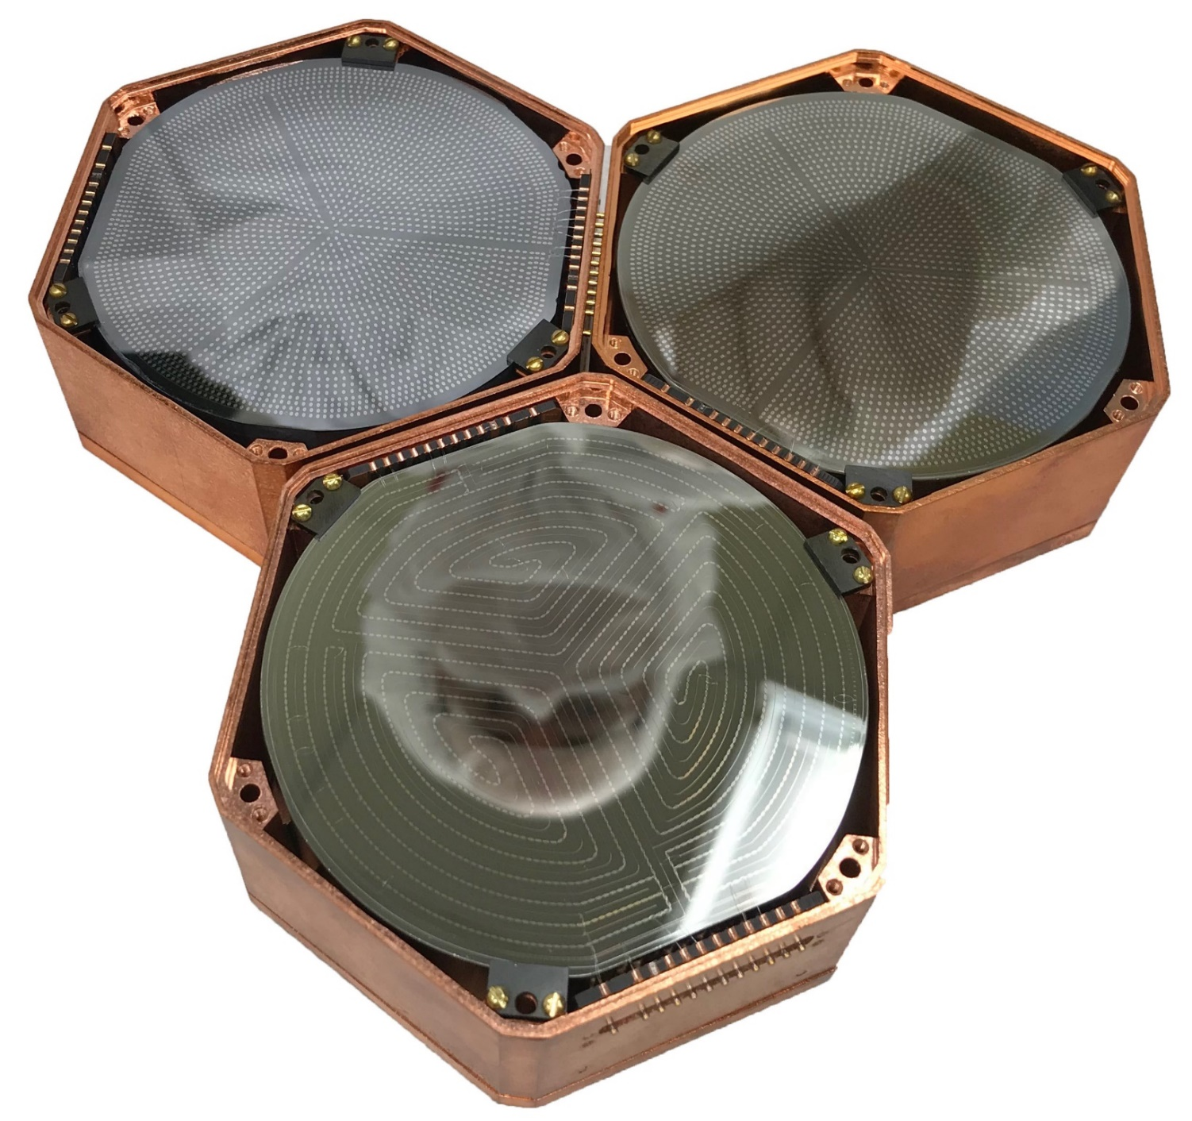
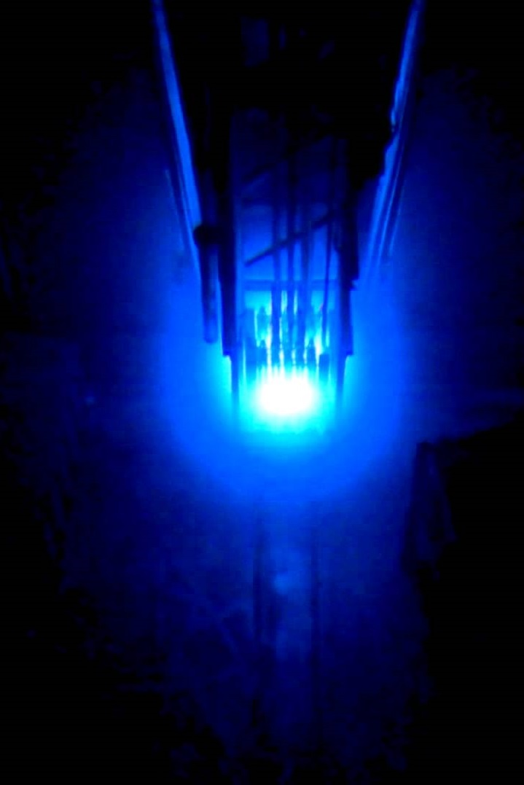
Low-threshold Cryogenic Phonon Detectors for Reactor CEνNS
Rupak Mahapatra, Texas A&M

Slide 2
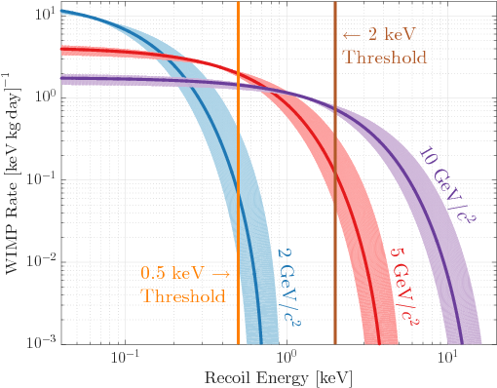
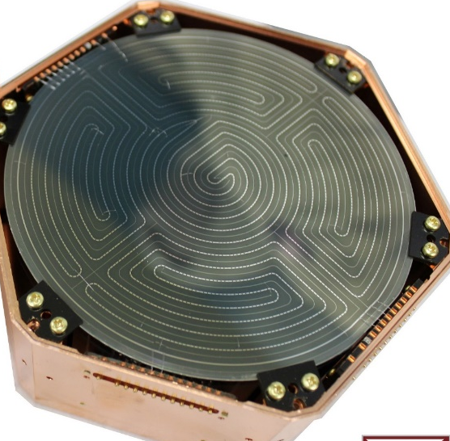
Coherent Neutrino Scattering: Connection to WIMPs
Integrated rate/kg-year
Requirements: Low Threshold and Low-background
Background
CEνNS observed at SNS (~50 MeV ν), thus accessible by many detector technologies: E_{max}∝E _{ν}²
CEνNS process is yet to be discovered at a reactor! E_{ν}~MeV hence need low threshold detectors
Recoil energy in eV

Slide 3
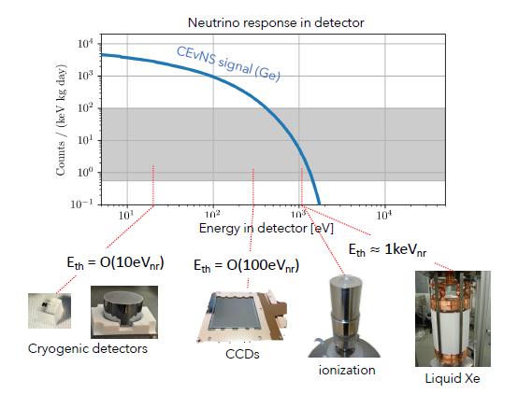
CEνNS Detector Thresholds
DRU

Slide 4
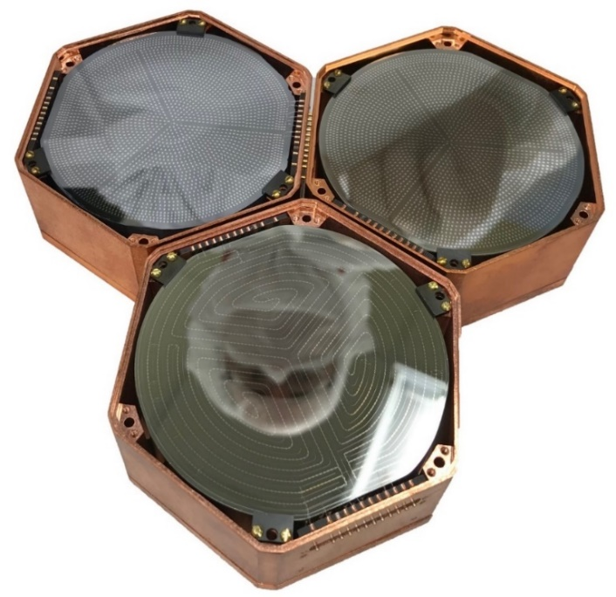
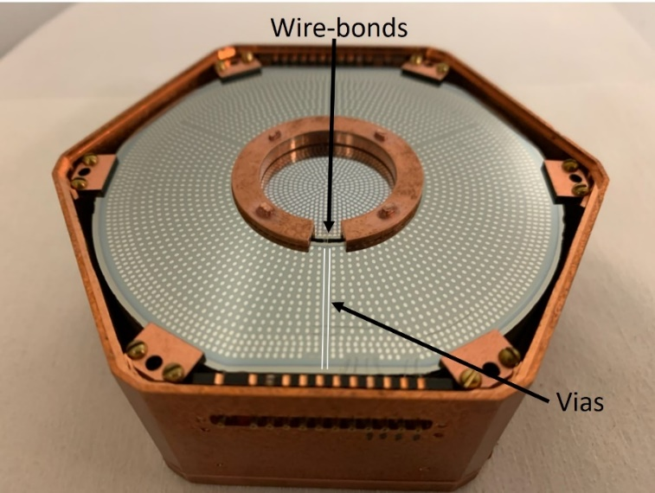
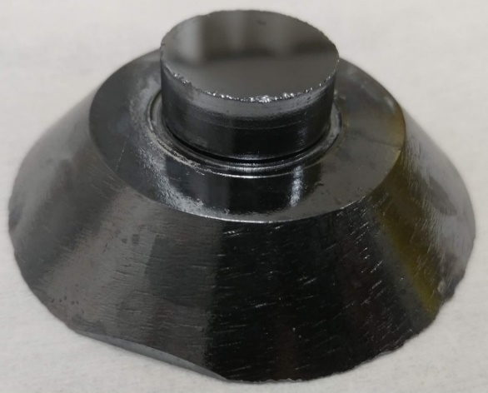
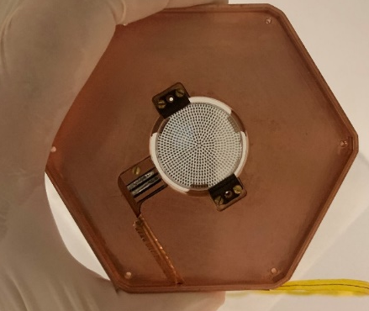
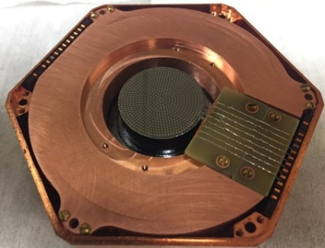
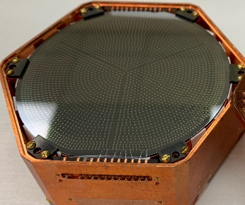
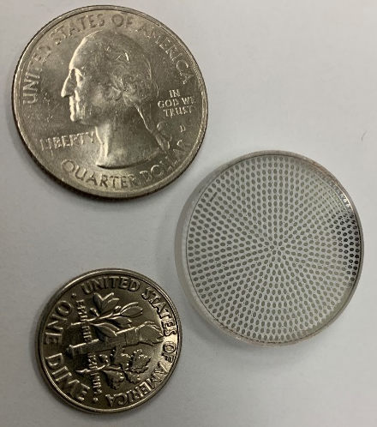
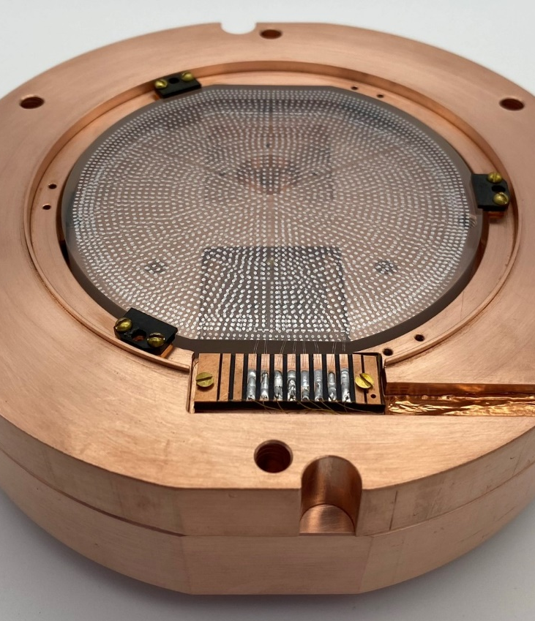
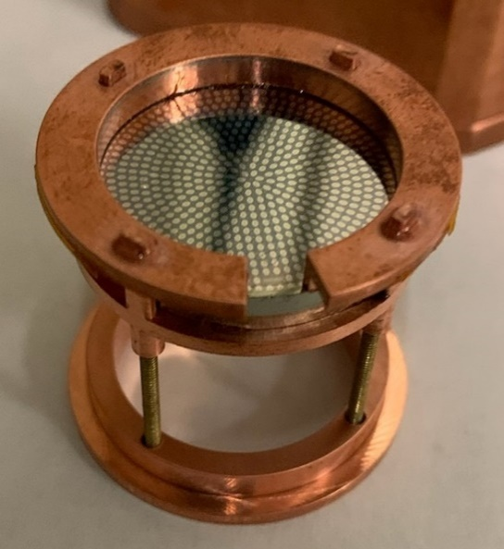
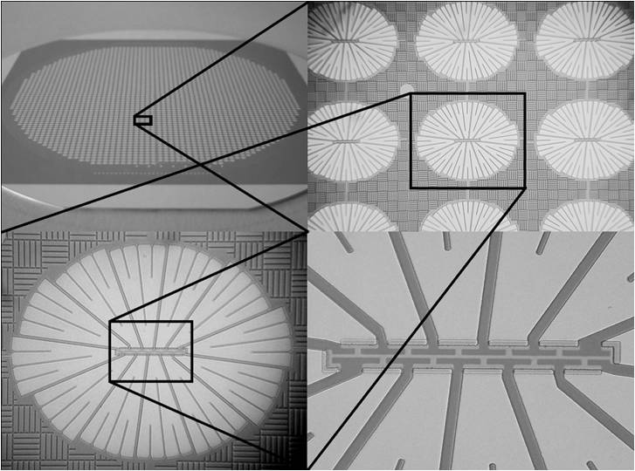
gm-kg scale MINER Detectors
Ge, Si, Al2O3
0V, LV (few V), HV (400V)
Smallest – 10 gm Si
Largest – 1.5 kg Ge
Athermal phonon sensor

Slide 5

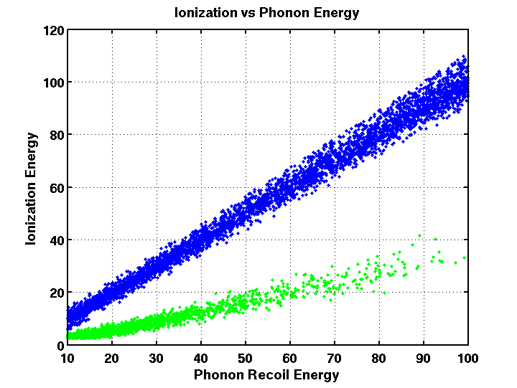
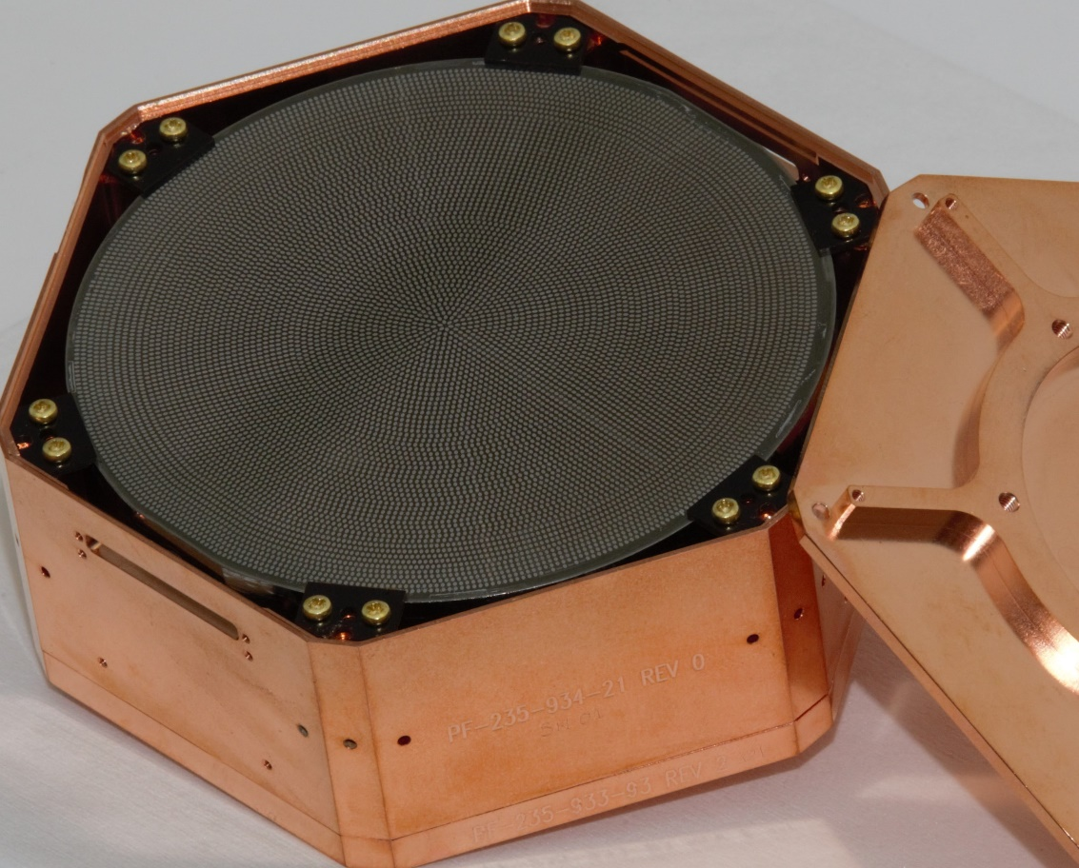
Detector Technology Developed for SuperCDMS
iZIP Detector with ionization and phonon sensors for ER/NR discrimination (>keV)
First SNOLAB Ge iZIP (fabricated at TAMU)
(More in Kurinsky talk on SuperCDMS)
Phonon
Ionization
High Voltage Detector with NTL gain. Give up discrimination in favor of low threshold (~100eV).
First SNOLAB Si HV (fabricated at TAMU)

Slide 6
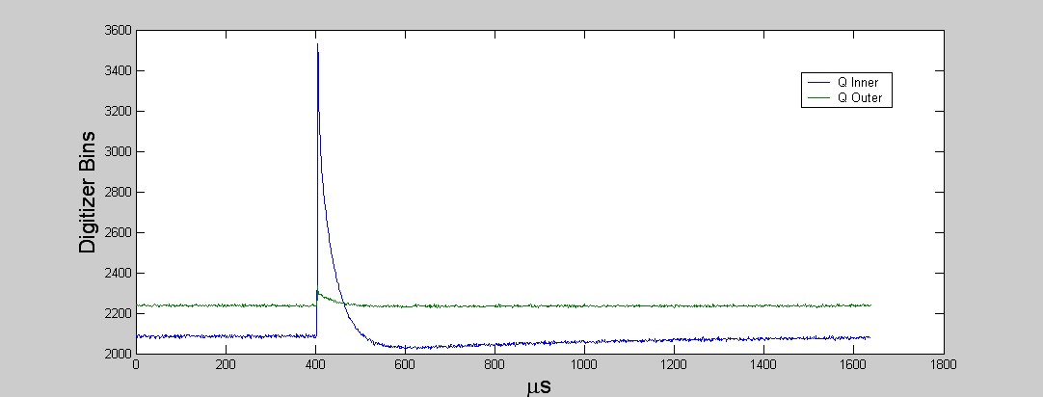
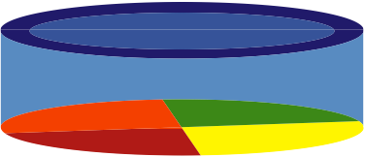
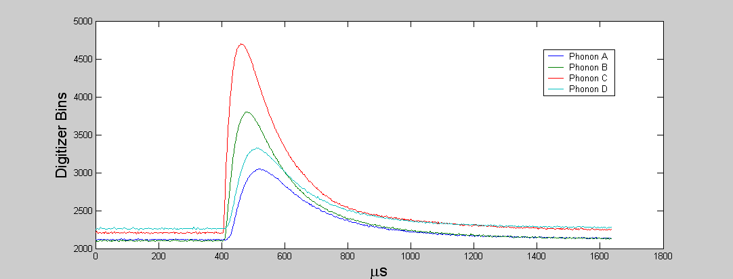
Anatomy of an event
Ionization Energy
Electron Recoil
Q inner
Q outer
Nuclear Recoil
Phonon Energy (Recoil)
-3V
Hot charge carriers (3eV/pair)
h⁺
e⁻
0V
Quasi-diffusive THz phonons
Sensor A
Sensor B
Sensor C
Sensor D
Ballistic Neganov-Luke phonons
Ballistic low-frequency phonons
Total Phonons = Direct Phonons + Luke Phonons

Slide 7
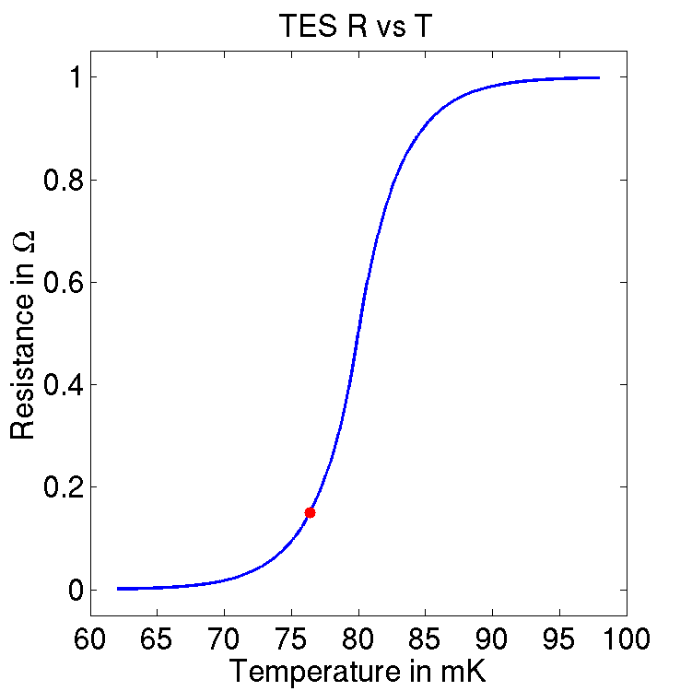
Phonon Sensors
Quasi-particle assisted athermal phonon sensors provide much faster μs timing than ms timing from thermal phonon sensors like used in EDELWEISS/CRESST
1 μm TES
Superconducting Al Collector
W Transition Edge Sensor (TES)
Al
Cooper Pair
ΔR
R₀
ΔT
Ge or Si
T₀
phonons
Athermal phonons are collected by superconducting Al fins (Δ=~meV), creating quasi particles that are then trapped by the W Transition Edge Sensors (TES), held in equilibrium between Normal and Super Conducting temp using Electro-Thermal Feedback (ETF). SQUIDs measure change in current

Slide 8

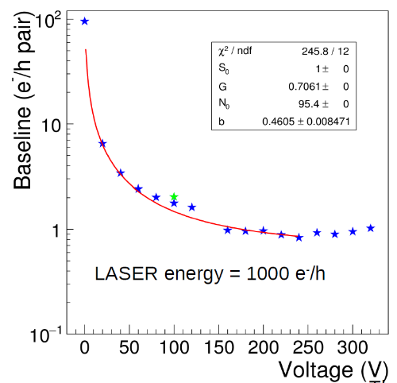
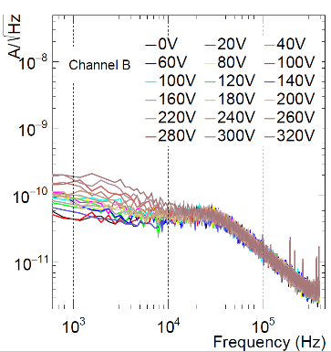
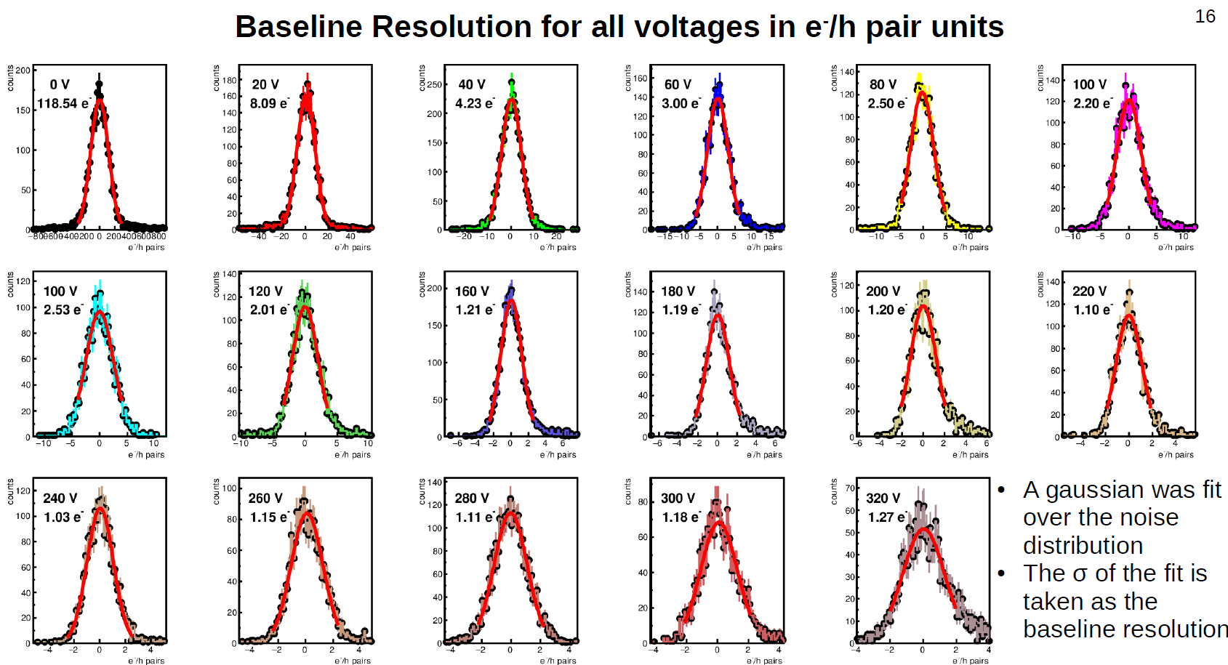
Contact-Free High Voltage Detectors
100-gm single-e sensitive Contact Free Si HV Detector. Signal amplification observed without increase in leakage up to 300 V. Laser calibration done.
Initial demo with 250 gm Ge with σ=7 eV
https://doi.org/10.1016/j.nima.2017.02.032
Single-e/h pair 100 gm Si :
10.1016/j.nima.2021.165489

Slide 9
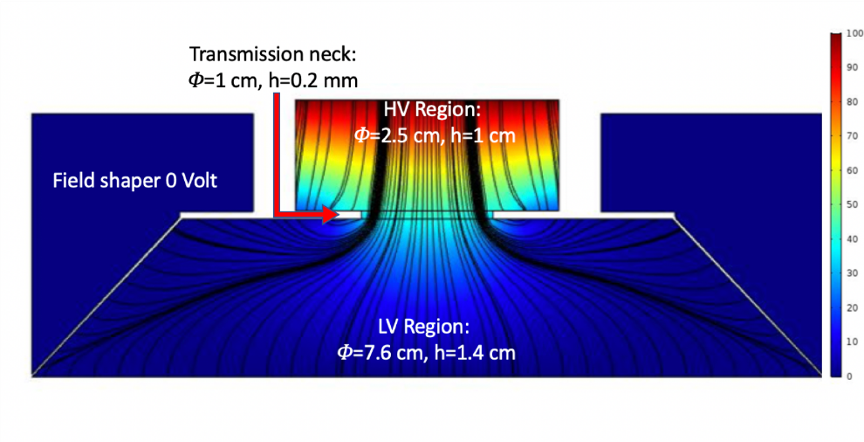
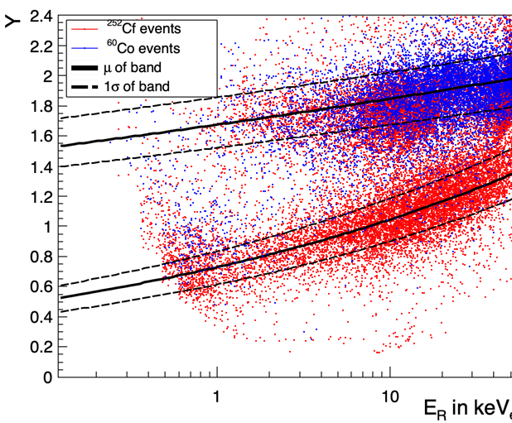
Hybrid HV Detector
⁵⁵Fe
Main idea: Monolithic detector with a LV and a HV side – LV to measure primary phonons like iZIP and HV to measure NTL phonons. Do it without significant NTL pollution from HV to LV. ~100gm
²⁴¹Am
Charge transport from LV region to HV almost 100%
Discrimination improves at low energies. Funded by DOE to push the DM and CEνNS discovery potential – background is key to discovery
Phonon-mediated High-voltage Detector with Background Rejection for Low-mass Dark Matter and Reactor Coherent Neutrino Scattering Experiments: https://inspirehep.net/literature/1802528

Slide 10
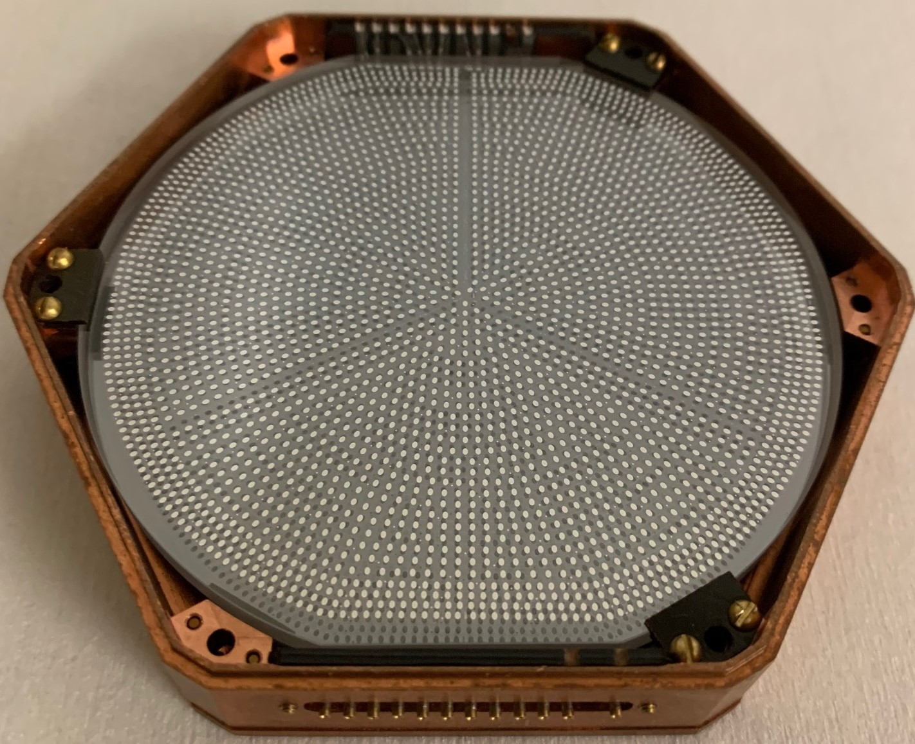
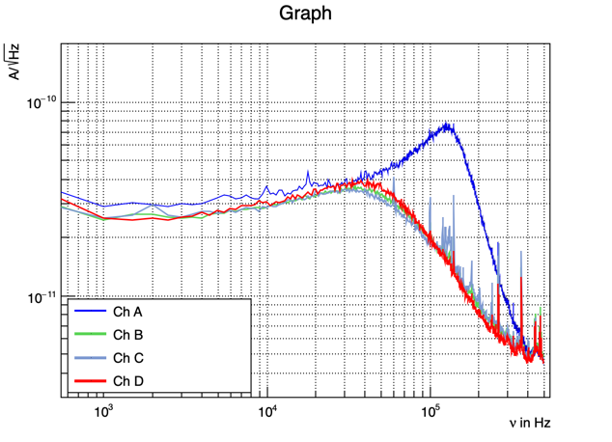
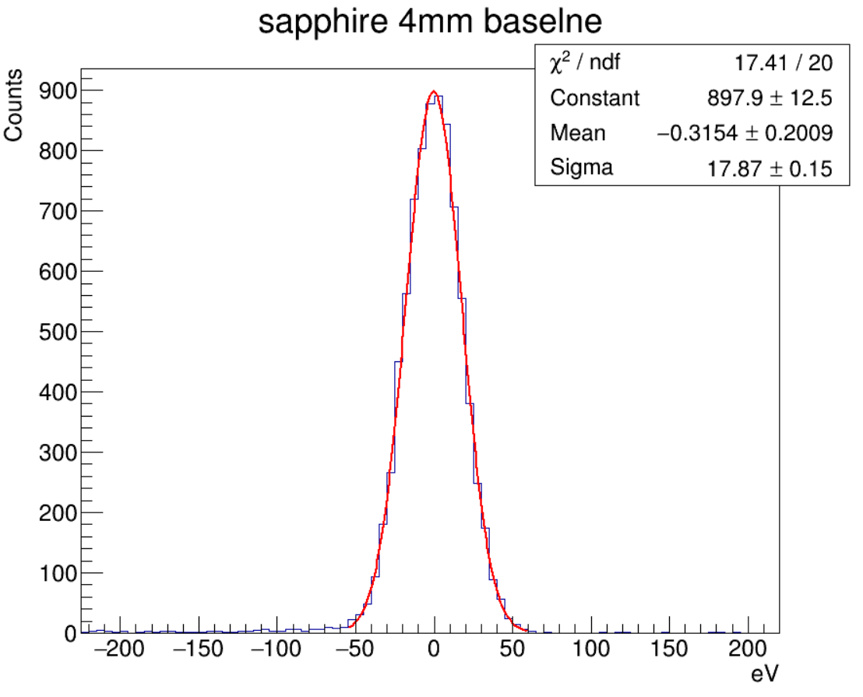
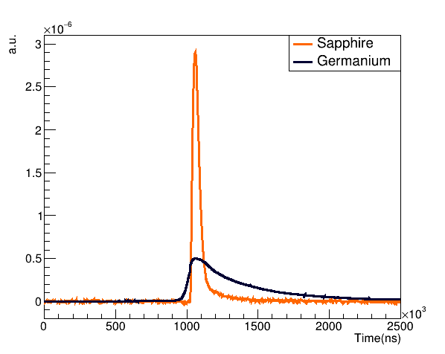
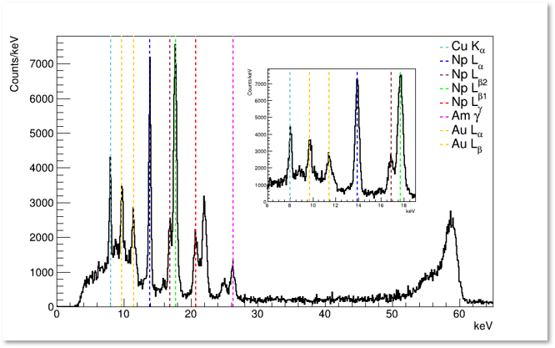
~100gm 0-V sapphire detector with ~17 eV_{NR} σ baseline resolution
Calibrated based on 13.9KeV line. Exact value is within 15-18 eV, based on peak
~100 gm 3”x 4mm sapphire detector shown
~200 gm 3”x1cm sapphire detector also used
https://arxiv.org/abs/2203.15903
Faster phonon pulses provide better position information, background rejection
Calibration: Internal ⁵⁵Fe, ²⁴¹Am and external ⁵⁷Co, ²⁵²Cf, AmBe.

Slide 11


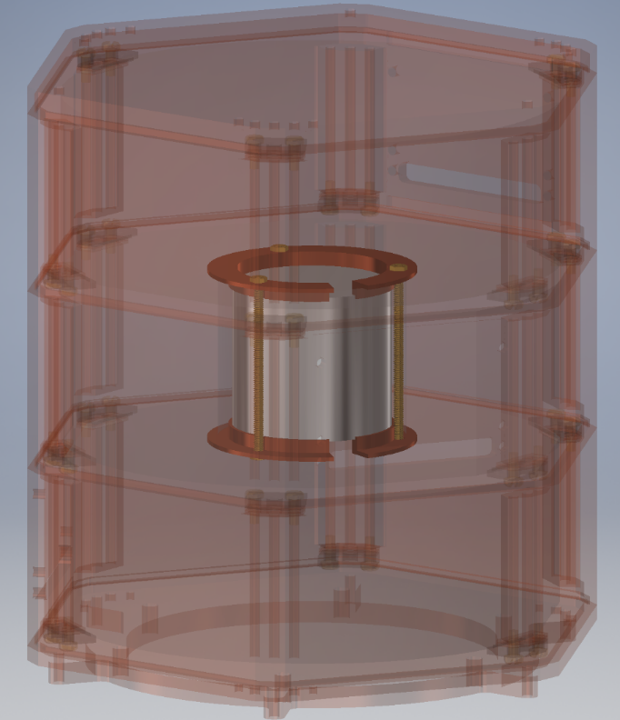
Low-Threshold Ge Detector inside Fully Hermetic Ge Shielding
Ge 3”x1” G15
12gm Ge coin. Next runs with~30-75 gm Ge coins
Ge donut 3”x1”
Ge 3”x1” G22
Inner active veto for highly effective (~100%) background rejection from Radon (and other) decays on detector sidewall and nearby copper in addition to reduction of Compton background by ~90%
MINER has several detector technologies in place, some focused towards establishing robust background models and some focused on signal detection

Slide 12
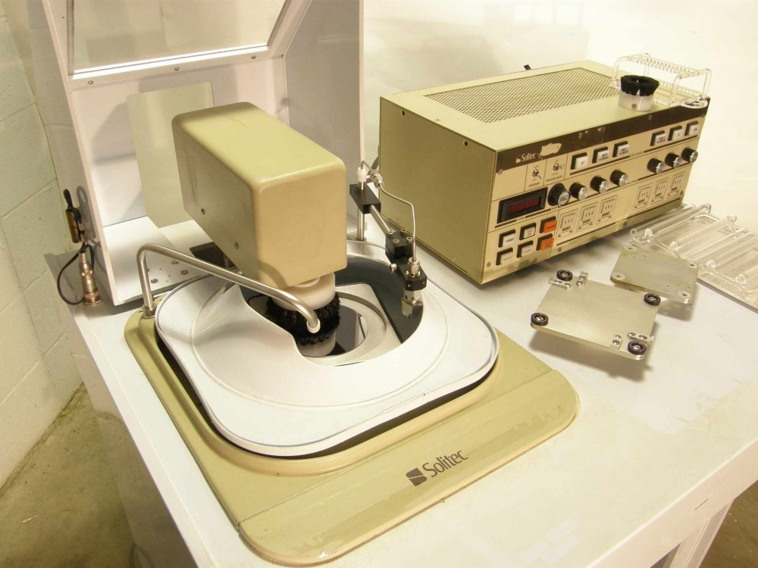
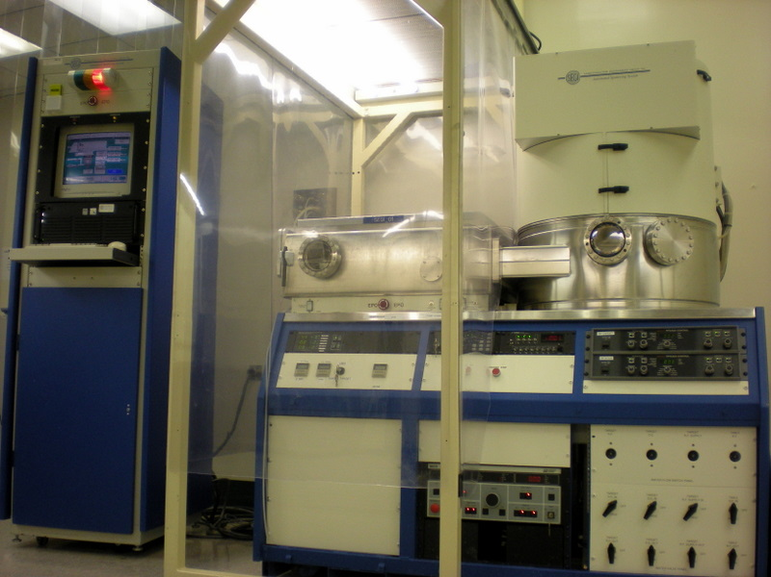
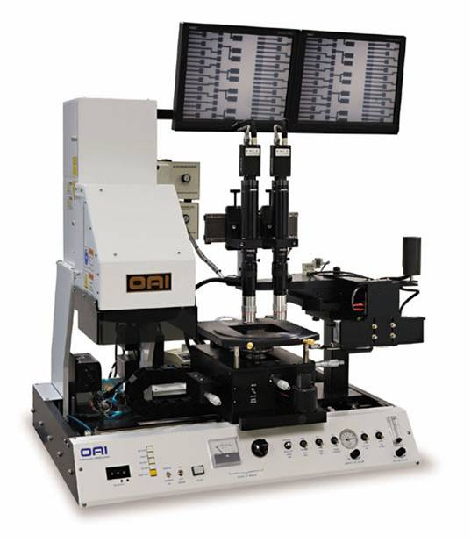
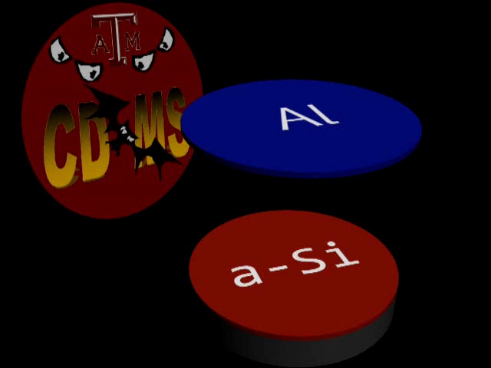
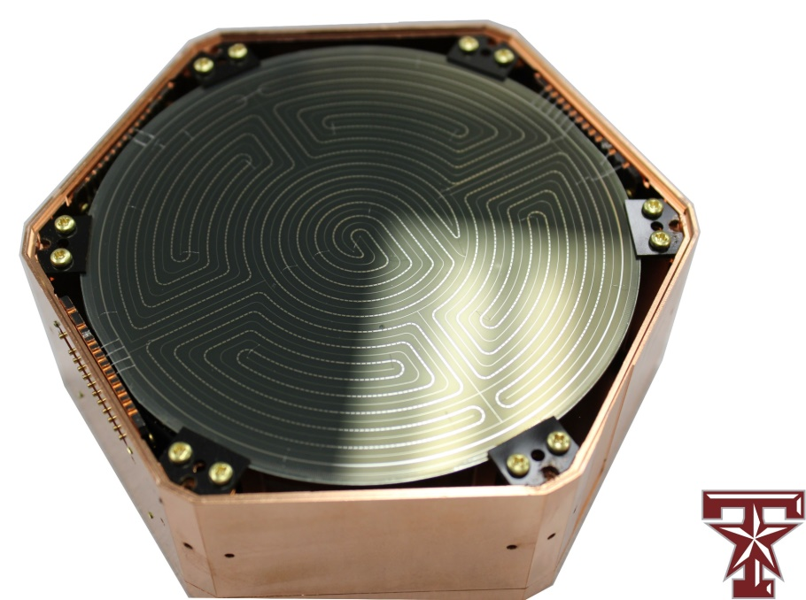
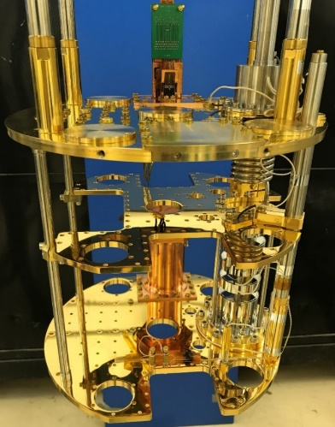
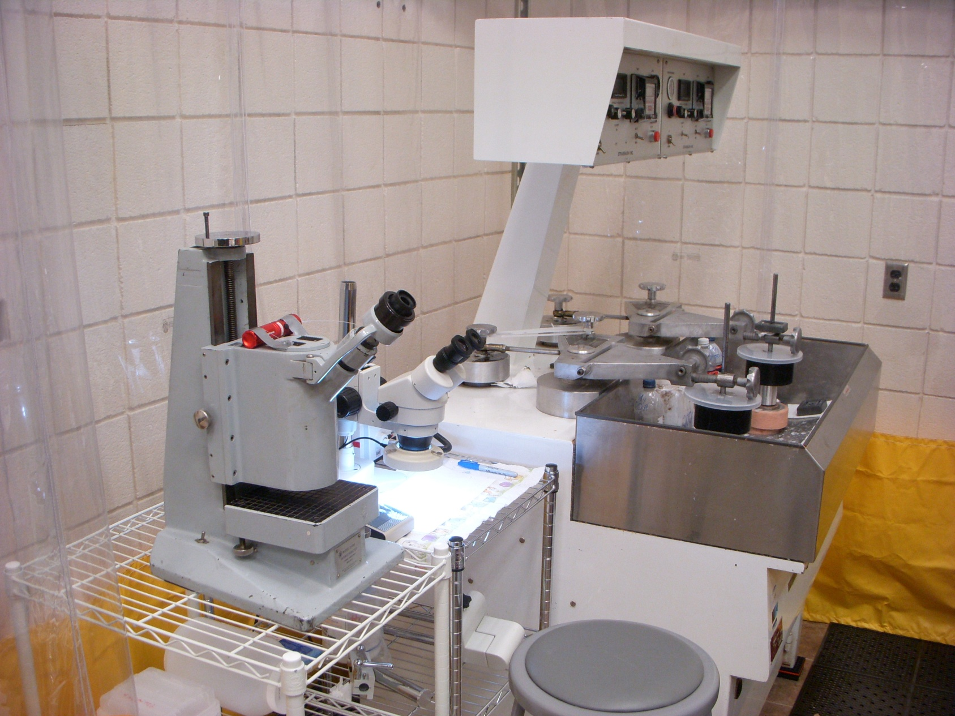
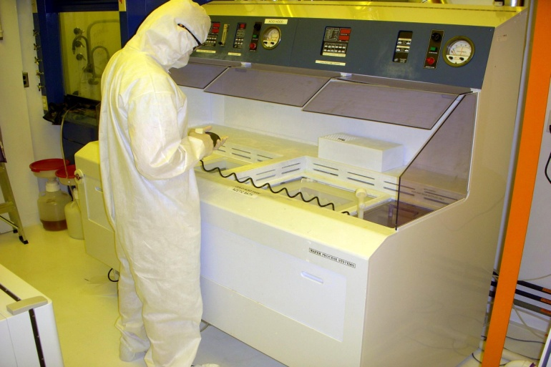
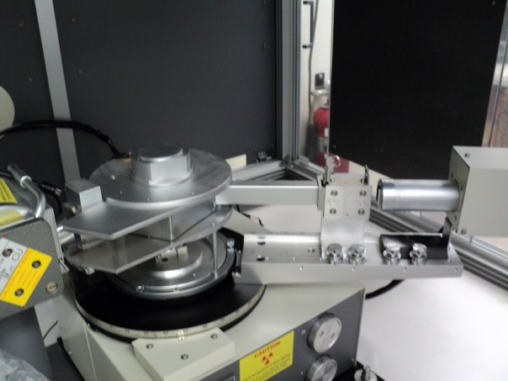
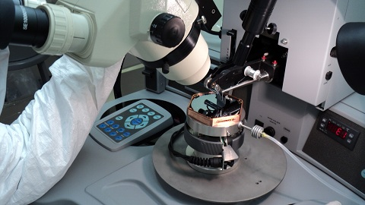

$5M Dedicated Fab @ TAMU
1st SNOLAB Tower Completed!
Multi-step process repeatable for high quality detectors
Photo Coat
Deposition
Circuit Mask Exposure
Polish
XRD
Inspect and Package
Chemical Etch

Slide 13
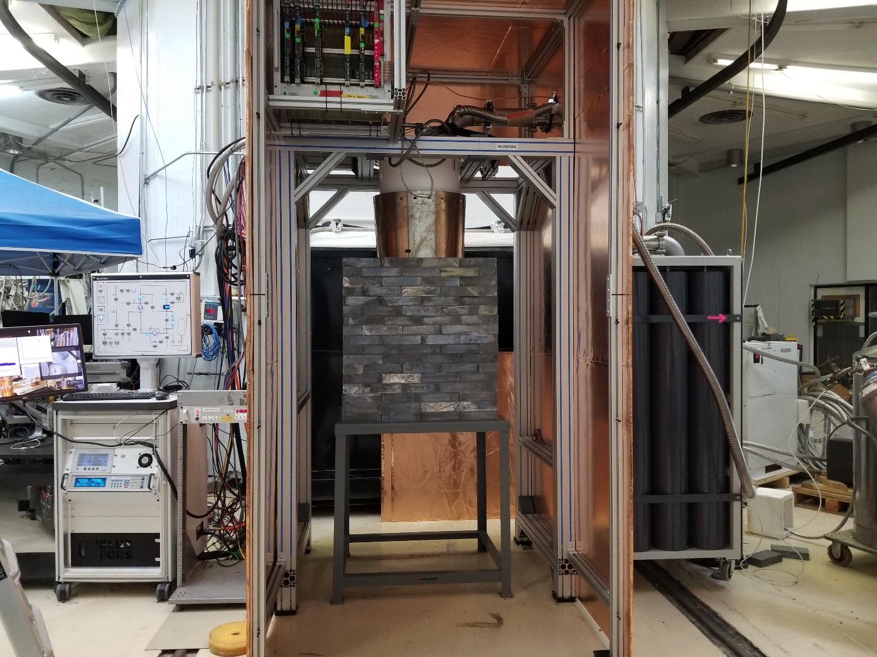
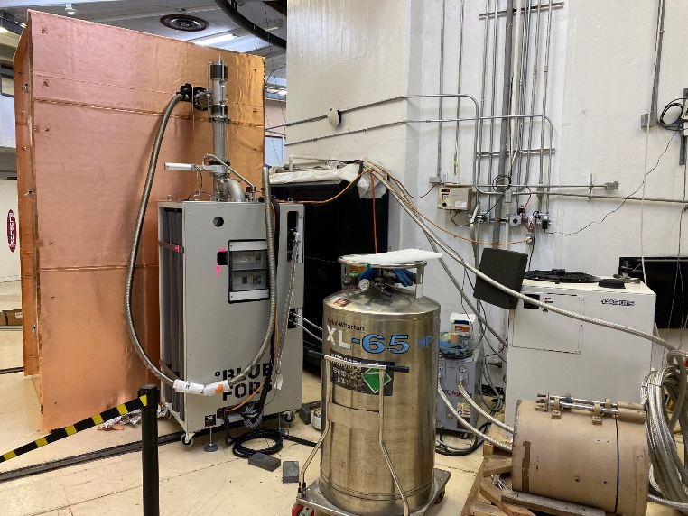
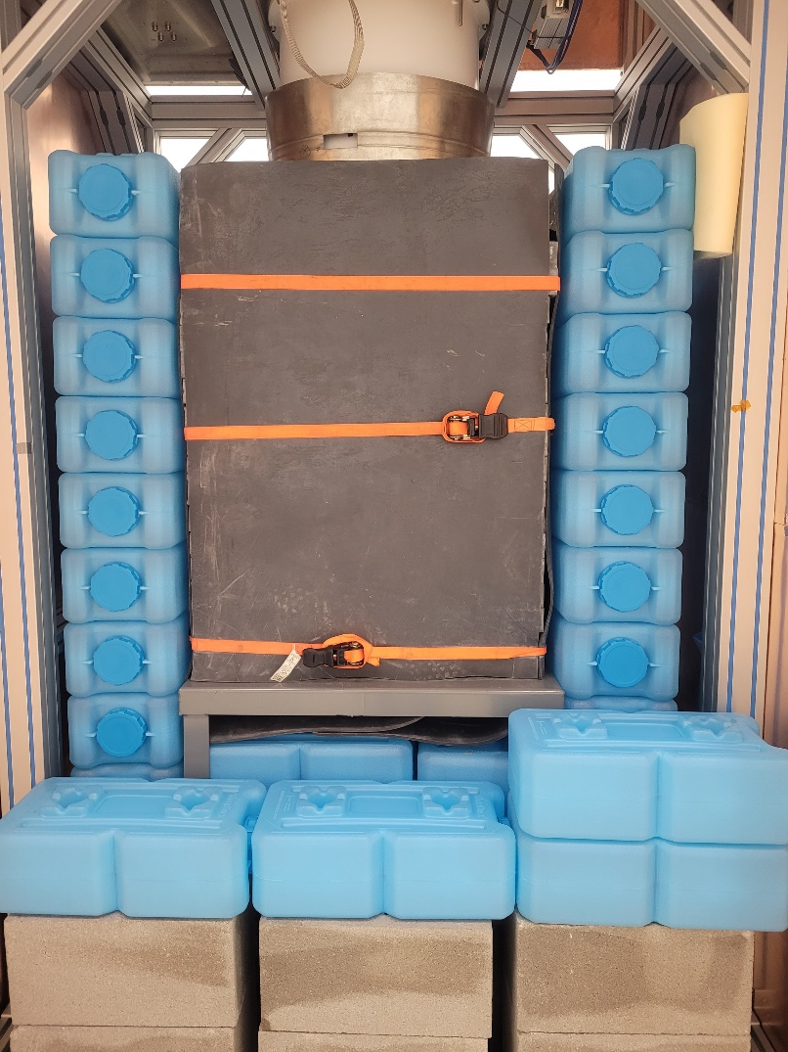
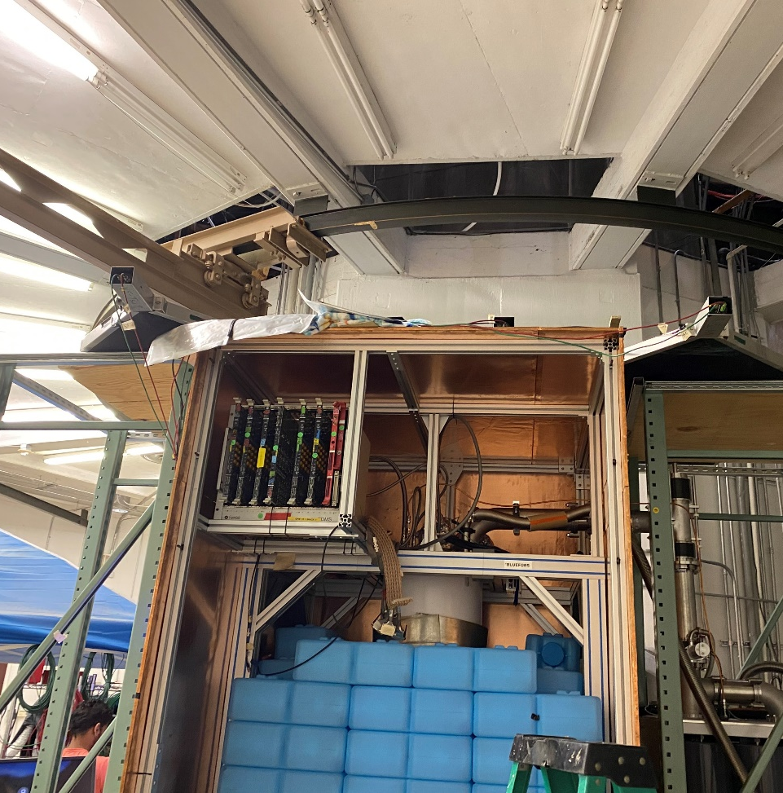
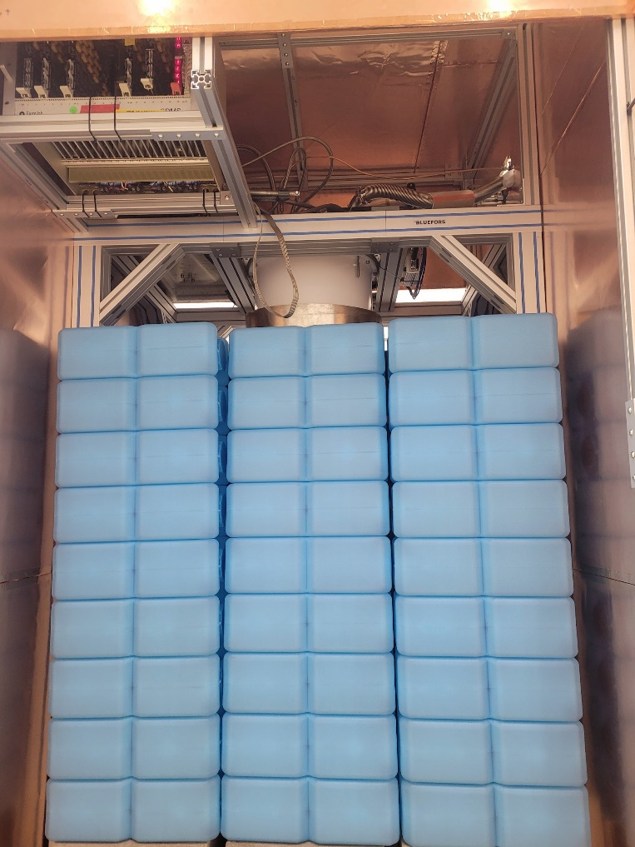
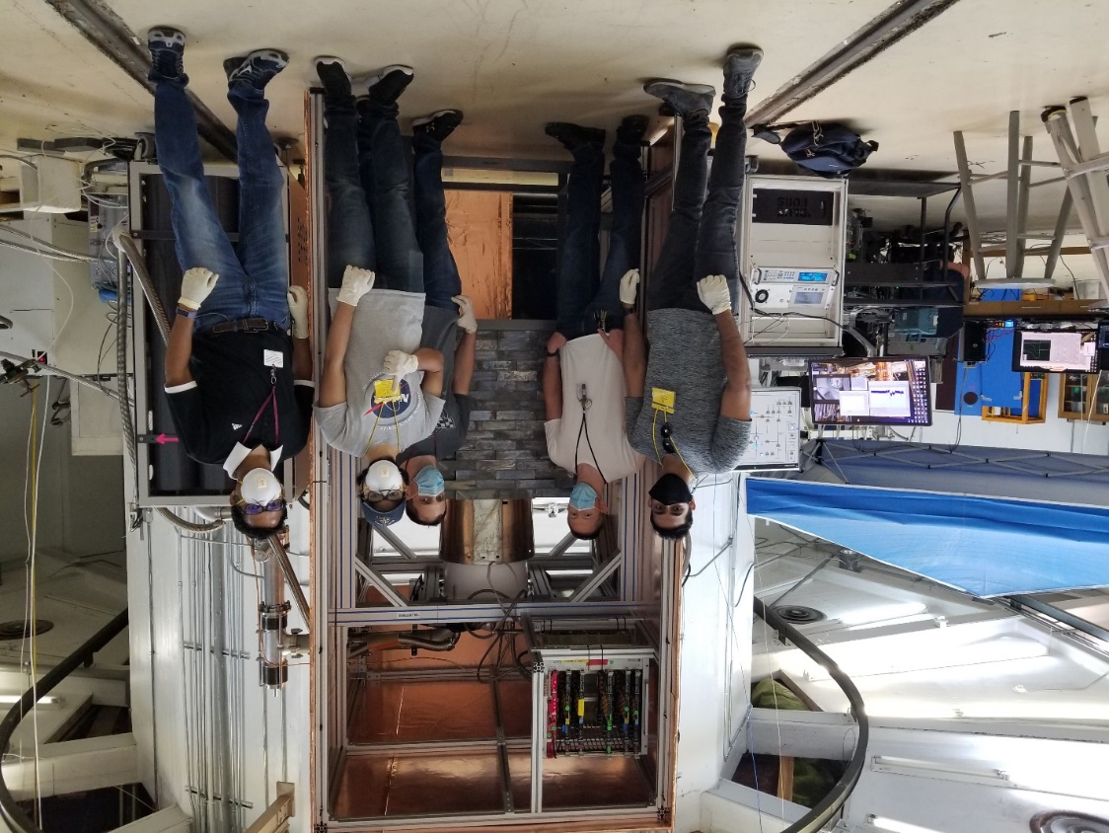
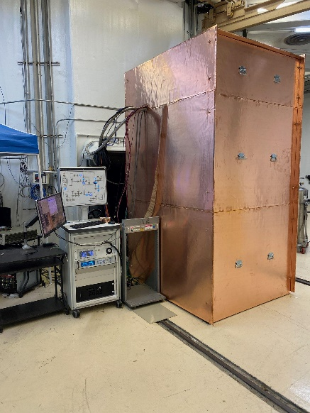
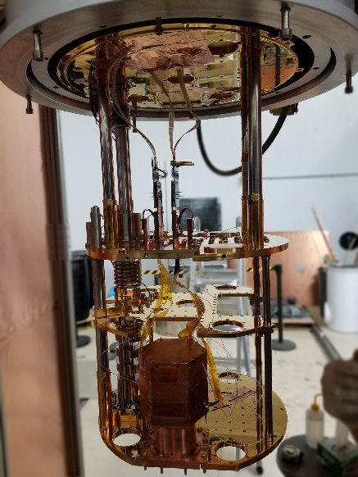
External muon scintillation veto in place recently

Slide 14





Gm-Scale NUCLEUS calorimeter with thermal phonon sensors
Thermometer
Transition-edge-sensor
Measured heat pulses (ms time constant compared to μs for MINER)
SQUID output, V
0.3
0.25
SQUID output [V]
Δ𝑇 = ^{Δ𝐸}
0.2
𝐶
0.15
0.1
0.05
0
−20
0
20
40
60
80 100
time, ms
based on CRESST technology
CaWO₄ and Al₂O₃ crystals read-out with W-TES
Based on CRESST technology
Al₂O₃ prototype with threshold E_{th} = (19.7 $±$0.8) eV_{nr}
CaWO₄
Al₂O₃
CaWO₄
CaWO₄ and Al₂O₃ crystals
Arrays before cutting with
W-TES (20x20x5) mm³

Slide 15



The NUCLEUS detector concept
Target crystals:
Two 3x3 arrays with a total mass of
6g (CaWO₄) + 4g (Al₂O₃)
Inner veto: TES-instrumented holder to reject surface backgrounds and holder-related events
Germanium outer veto for active γ/n background rejection
Si wafer
+ W-TES
Holding plates with electrical & thermal contacts
NUCLEUS slides from R. Strauss
Notes:
- Reference to proof of concept?
- IV: detector support + 4pi veto
COV: 6 individual crystals with total mass of about 4 kg Ge, charge read-out

Slide 16


O(100 counts/ (keV kg d)) seems to be in reach
Extensive GEANT4 Monte Carlo simulations of the full NUCLEUS setup have been performed
Assembly has started at TUM
PRELIMINARY
Estimated rate budget in CaWO₄ (10-100 eV)
Muon veto
²¹⁰Pb*
ambient γ’s**
atmospheric μ’s
Outer veto
atmospheric
neutrons
Inner veto
CEνNS
* 1 kBq/kg
Anti-coincidence
** γ-bck based on measurements @ VNS
NUCLEUS slides from R. Strauss
Notes:
Does the capture in the b4c produce any gammas or similar?
What does reduces impact of secondary neutrons mean?

Slide 17







Nearly finished the experimental design and are preparing the NUCLEUS blank assembly.
2023
Design phase
Blank assembly & Commissioning
On-site installation
@ TUM
Performance
Calibration
Background
@ Chooz
2023
Towards a CEνNS precision measurement
stat+sys
Physics Run
NUCLEUS-10g
Towards
NUCLEUS-1kg
stat
stat+sys
stat
NUCLEUS slides from R. Strauss

Slide 18







Ricochet
DETECTORS
Ge (semi-conductor) & Zn (super-conductor)
Ge: 22 eV RMS (heat). Target 10 eV heat, 20 eV charge
Gamma/recoil discrimination
1000 grams: 3x3x3 arrays of Ge & 3 x 3 Zn
(1) LOW ENERGY THRESHOLDS:
(2) BACKGROUND REJECTION:
(3) SIGNIFICANT TARGET MASS:
Target Crystal
Demonstrator Holder
Cryocube
RICOCHET slides from J. Formaggio

Slide 19



Ricochet
REACTORS:
ILL Grenoble Reactor
(1)HIGH OUTPUT
58 MW power
(2)HIGH FLUX
~1.2 x 10¹² ν/cm²/s
(3)BACKGROUND REDUCTION:
15 m.w.e overburden; heavy shielding
RICOCHET slides from J. Formaggio

Slide 20

Ricochet
RICOCHET slides from J. Formaggio

Slide 21



Q-Array TES Chip Testing
Recent R&D run at UMass Amherst in December 2021
Operated “Gen 2” TES chips coupled to a 1 gram silicon target
  Chips designed at Northwestern, fabricated at Argonne
Baseline resolution of 55 eV, calibrated with an ⁵⁵Fe X-ray source
Future tests: resolution improvements, move to a superconducting target
Absorber
TES
“Meander” Impedance
Thermal Bath
4
RICOCHET slides from J. Formaggio

Slide 22


Sharp Increase in Background: Non-Ionizaiton
Lowered sub-keV thresholds among DM/CEνNS experiments reveal a new signal of unknown origin. Typically starting at energies below 1 keV, the signal rises exponentially towards lower energies.
The signal is observed in various experiments with different detector materials, sensors and holding structures, below and above ground, at different temperatures and background levels.

Slide 23

Sharp Increase in Background: Ionizaiton
An understanding of the observed background below 1 keV has a top priority for current low-threshold experiments, since this energy region is a crucial part of the DM/CENNS ROI
Uncovering the origin and whether it is a common effect among all the experiments, is a difficult task. Needs further collaborative work
Due to variations in the shape, rate and time dependence of the signal among experiments, detectors and measurements, a dark matter (DM) explanation seems unlikely.

Slide 24
Summary
Reactor CEνNS is yet to be discovered – can open doors to new fundamental physics and applied nuclear non-proliferation programs
MIνER, NUCLEUS and RICOCHET (and others) use many different low-threshold detectors developed for both DM and CEνNS experiments
Rich collection of targets (Ge, Si, Al₂O₃, CaWO₄, Zn) and detection methods (0V, low-voltage, HV) with athermal/thermal phonon sensors
Required threshold (sub-keV and down to 100 eV) achieved in multiple detectors on MINER, NUCLEUS and RICOCHET
~100DRU backgrounds appear possible for multiple experiments using active inner veto (NUCLEUS, MINER). ~1000DRU already achieved with passive shielding only (MINER).
Sharply rising background observed in multiple detectors (MINER, NUCLEUS) at low (sub-250 eV) energies. Problematic for DM searches but can live with it for CENNS searches.

