Slide 1
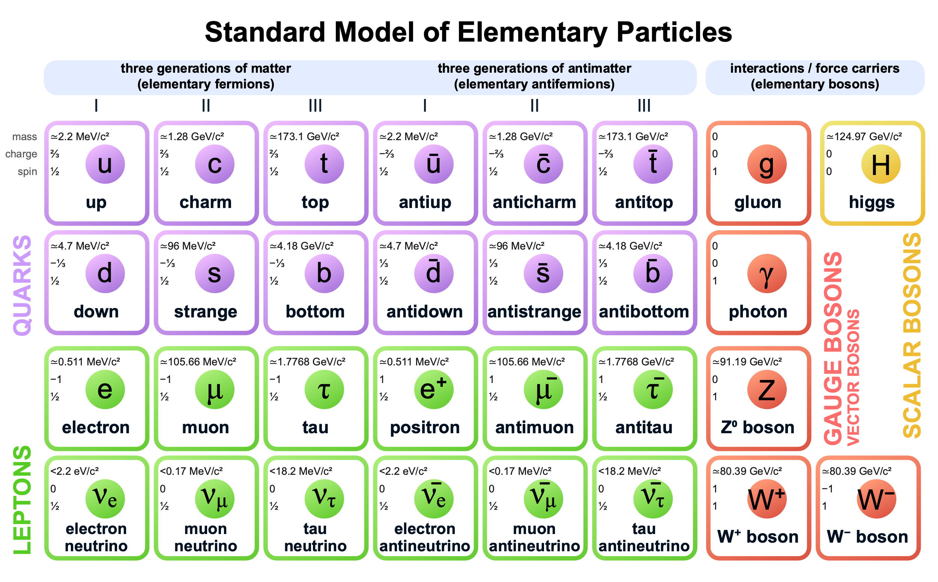
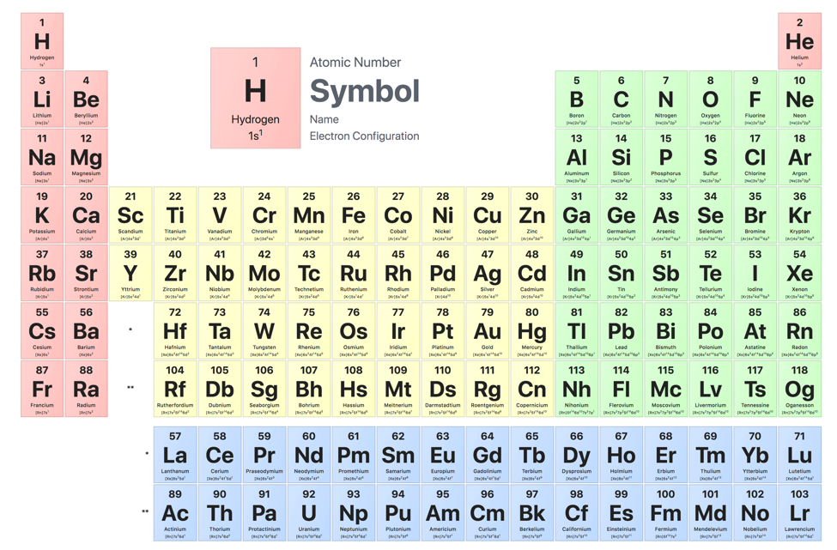
$$HEP∩or ∪or ⊗or … BES$$
Periodic Table of The Elements
Assignment (I think)
In 20 minutes, describe
Commonalities (where we speak the same language)
Potential common interests
Key investments
No way to be comprehensive
My personal slant (presenter-dependent biases)
Me: (a) GeV→TeV [… LEP, LHC] (b) keV → meV
Disclaimer: The views herein are solely those of the author and do not imply…

Slide 2

BES Grand Challenges
An elucidation of key questions
1 How do we control material processes at the level of electrons?
2 How do we design and perfect atom-and energy-efficient synthesis of revolutionary new forms of matter with tailored properties?
3 How do remarkable properties of matter emerge from complex correlations of the atomic or electronic constituents and how can we control these properties?
4 How can we master energy and information on the nanoscale to create new technologies with capabilities rivaling those of living things?
5 How do we characterize and control matter away—especially very far away— from equilibrium?
2007

Slide 3




Basic Research On…
and many more…

Slide 4
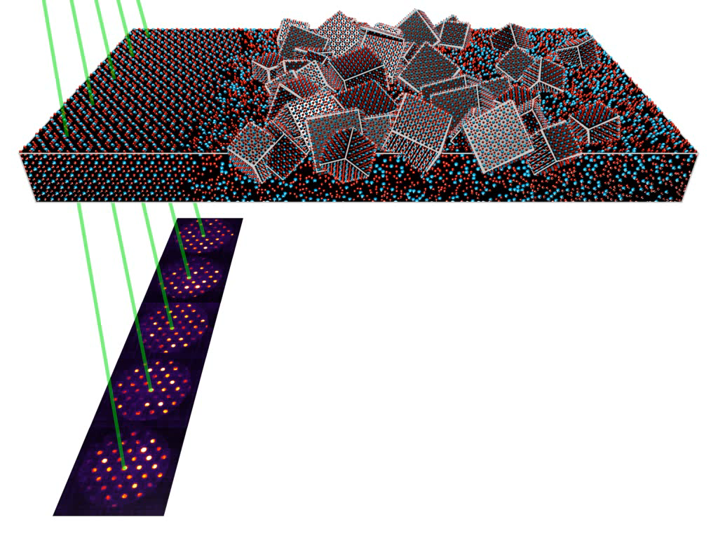





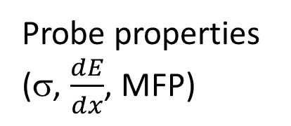
How to See Small Things
Static (structure)
Dynamic / Environment (function)
Atom ~Å
Speed of sound
~1 Atom/100 fs
meV (spectroscopy)
chemical sensitivity
σ
Probe properties
(σ, $\frac{dE}{dx}$, MFP)
Field of view
~10⁻⁶ .. 10⁰ m
B Savitzky et al., Microscopy and Microanalysis (2021).

Slide 5

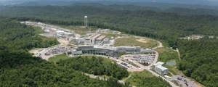
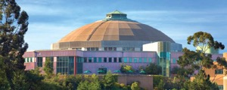
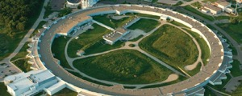
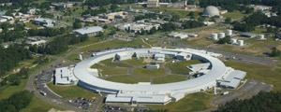
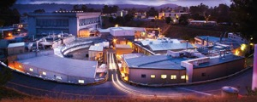
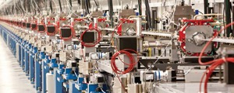
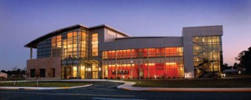
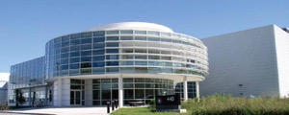
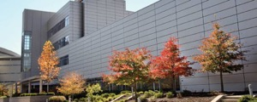
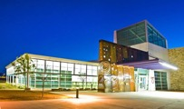

Probes: electrons, photons, neutrons
Probe | σ | δx | δt | Flavors
 | barn | nm | s
n | 10¹ | 10⁶ | 10⁻³ | Reactor, Spallation sources
γ | 10² | 10⁰⁻¹ | 10⁻⁹ | Storage rings
 |  |  | 10⁻¹⁵ | FELs
e⁻ | 10⁵ | <0.05 | 10⁻⁵ | TEM, STEM, ...
Details!
σ: Carbon - 1Å n, γ 300 keV e

Slide 6

User Facilities

Slide 7
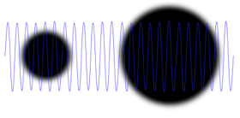


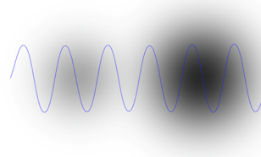
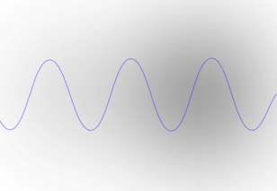
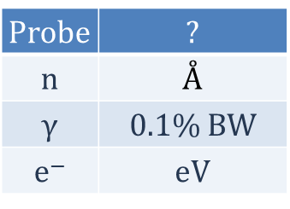



Seeing Small Things
Flux
Brightness
d
$$\frac{Probes/s}{Area} [s^{−1}m^{−2}]$$
$$\frac{Flux}{Solid Angle} [s^{−1}m^{−2}{sr}^{−1}]$$
λ
Brilliance or Spectral Brightness
Some experiments need flux
Some need brightness
Some need spectral brightness
in 1 dimension
Factor 2 in 2D resolution needs 2⁴=16 x Brightness
$$\frac{Brightness}{Energy or Wavelength or …} [s^{−1}m^{−2}{sr}^{−1}?^{−1}]$$

Slide 8
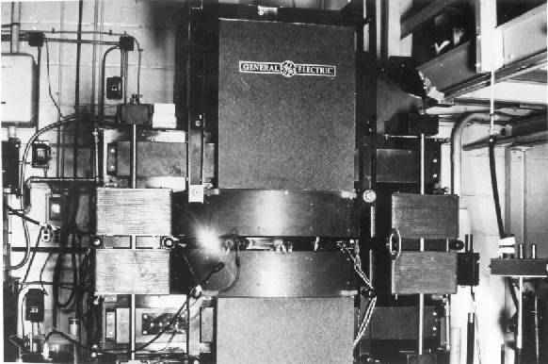
Accelerator-based Characterization Tools
Annoying Synchrotron Radiation

Slide 9

Synchrotron X-ray Light Sources (1st – 3rd Generation)
1st generation – parasitic use of synchrotron radiation [1960s – 1970s]
2nd generation – dedicated sources (bend magnet) [1980s]
3rd generation – insertion devices [1990s]
$$λ_{RADIATED}∝\frac{λ_{U}}{E^{2}}$$
⬆10⁴
David Attwood, UCB 2007

Slide 10
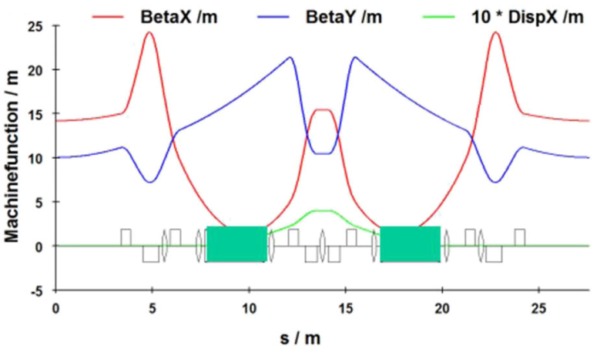
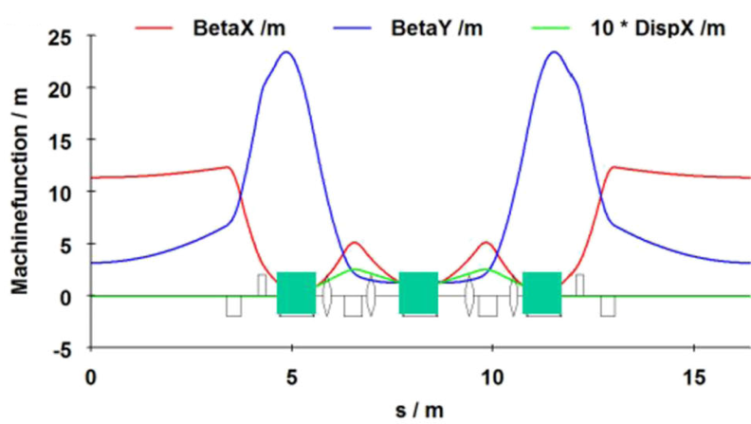
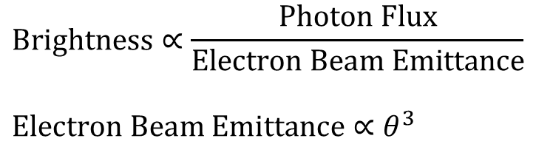
Synchrotron X-ray Light Sources → Diffraction Limit
Double Bend Achromat
$$Brightness∝\frac{Photon Flux}{Electron Beam Emittance}$$
$$Electron Beam Emittance∝θ^{3}$$
Multi Bend Achromat
Triple Bend Achromat
Hybrid MBA: SuperB design
Shin AAPPS Bulletin 2021

Slide 11
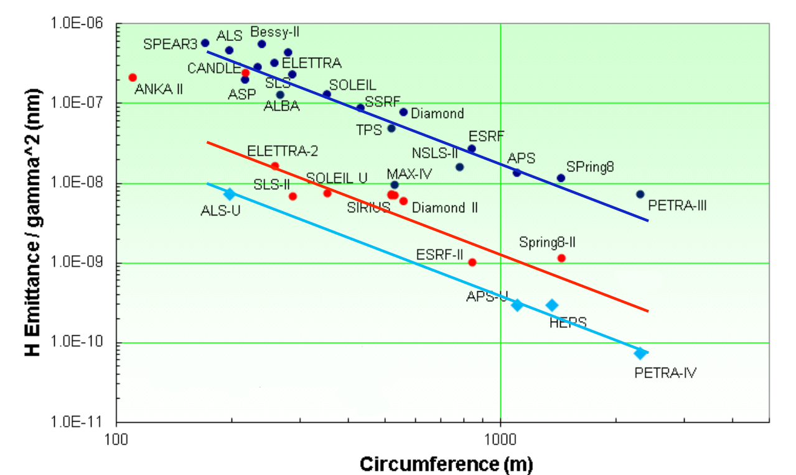
MBA Storage Rings
Existing (not MBA)
Upgrade/New
Construction
Bartolini 2017

Slide 12
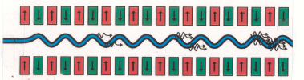
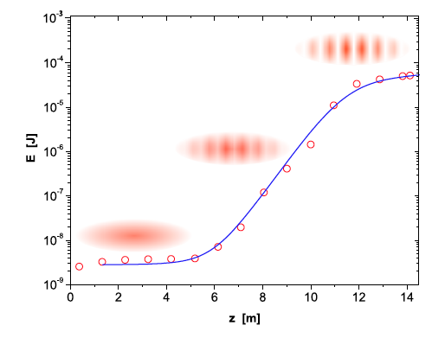
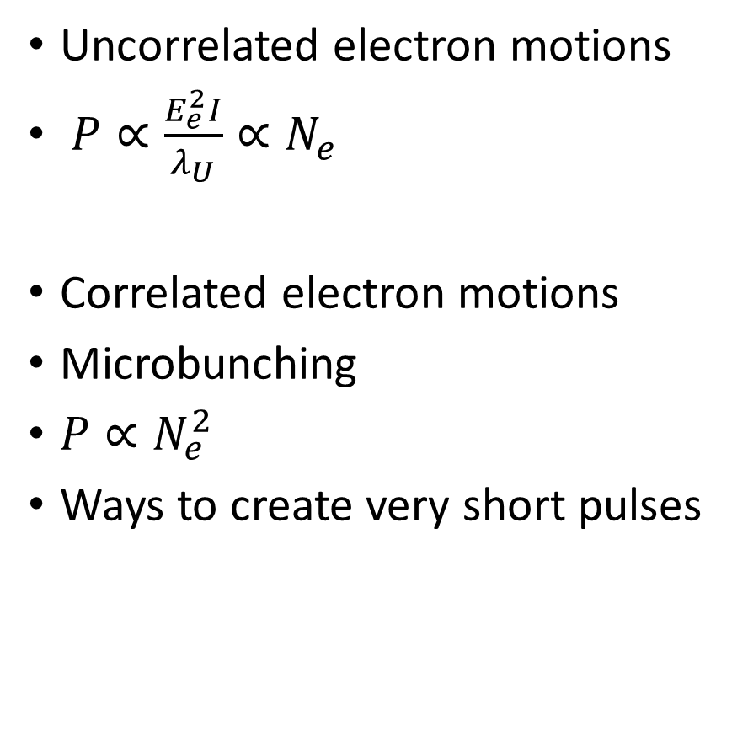
Free Electron Lasers
Uncorrelated electron motions
$P∝\frac{E_{e}^{2}I}{λ_{U}}∝N_{e}$
Correlated electron motions
Microbunching
$P∝N_{e}^{2}$
Ways to create very short pulses

Slide 13
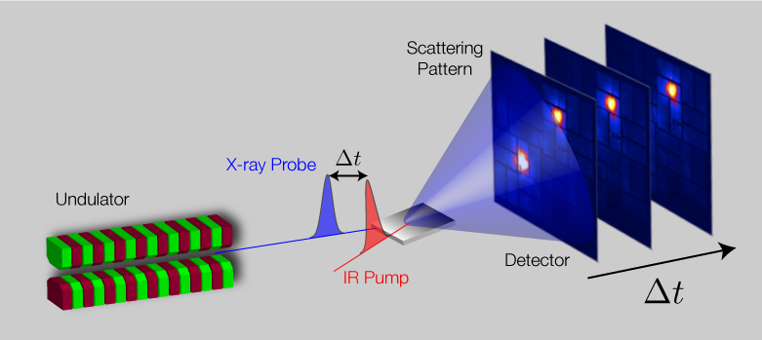
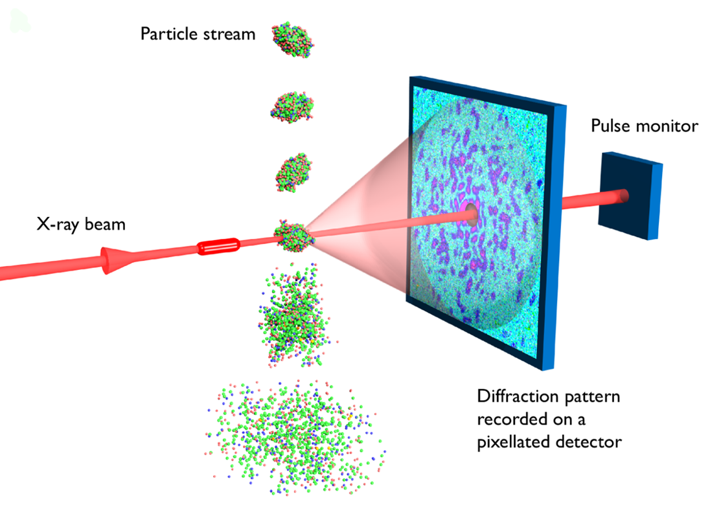
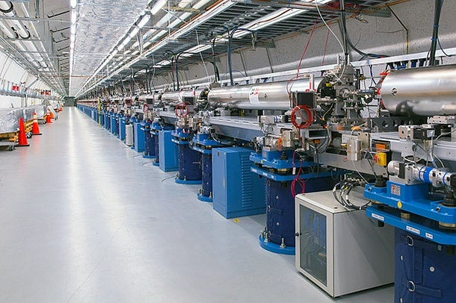
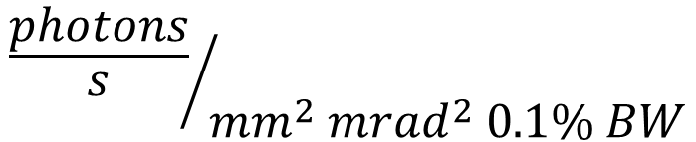
FELs vs Storage Rings
1,000,000,000
1/10,000
SR
FEL
Femtosecond Pump-Probe
$${\frac{photons}{s}}/{{mm}^{2}{ mrad}^{2} 0.1\% BW}$$
LCLS – 1st Hard X-ray FEL (2009)
what a laser buys you
Diffract Before Destroy

Slide 14
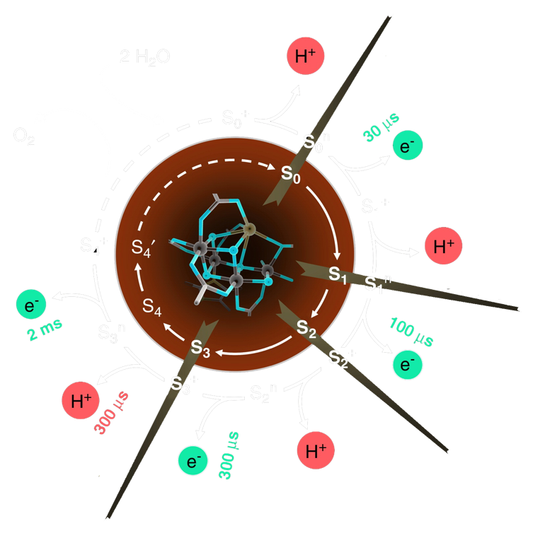
Towards an Understanding of Photosynthesis
Observing the Oxygen Evolving Complex with
Diffract Before Destroy + X-ray Emission Spectroscopy at LCLS
Splitting water with 4 photons
(→Artificial photosynthesis)
Kern et al. Nature 2018

Slide 15


Peak and Average Brightness
ns
Storage Rings
ps
nJ
ms
fs
mJ
LCLS-I
10⁶
$$\frac{mJ}{ms}$$
Peak brightness
(per pulse)
1/10⁴
10^{huge}
1
Average brightness
$$\frac{nJ}{ns}$$
1
1

Slide 16
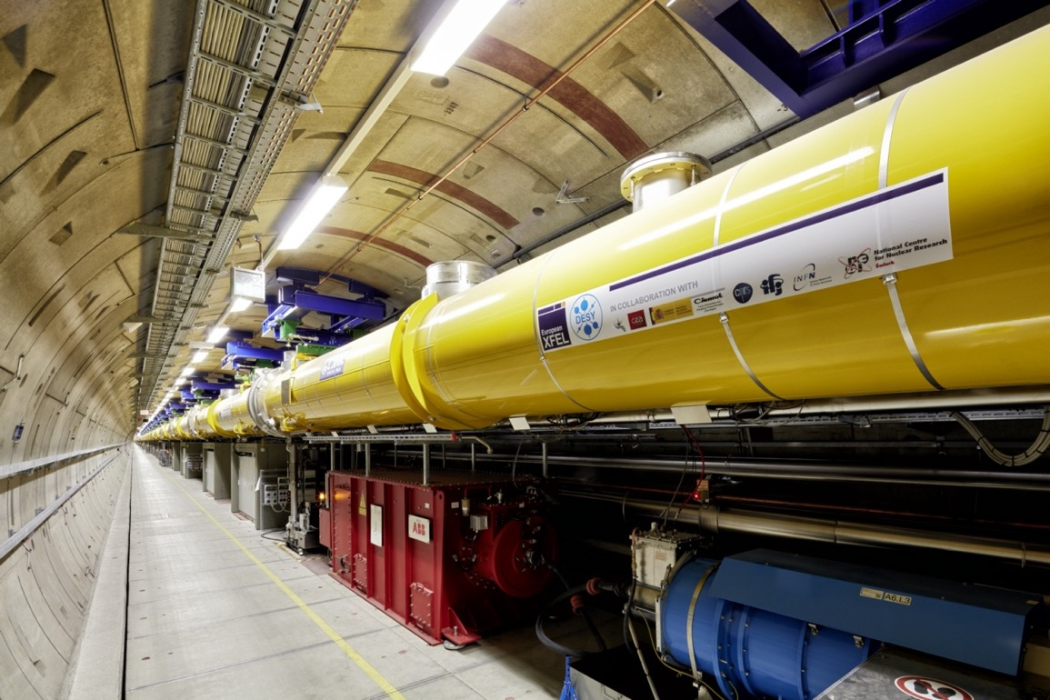
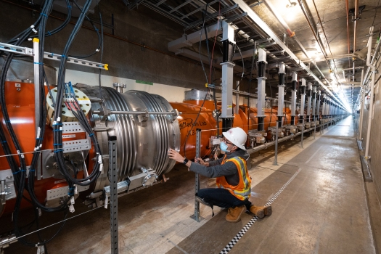
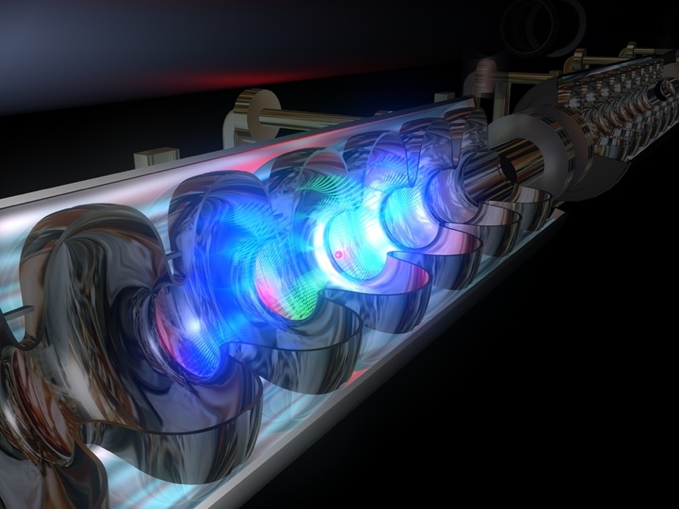
High Repetition Rate FELs
Overcome the power limitations of warm linacs with superconducting RF
European XFEL
LCLS-II
SCRF: NP | HEP | BES

Slide 17
Reactor and Spallation Neutron Sources
Anderson 2021

Slide 18
Improving the Internal Combustion Engine
Monitoring strain evolution of an alloy in a cylinder head
in an operating engine using SNS
Wissink et al. PNAS 2020

Slide 19
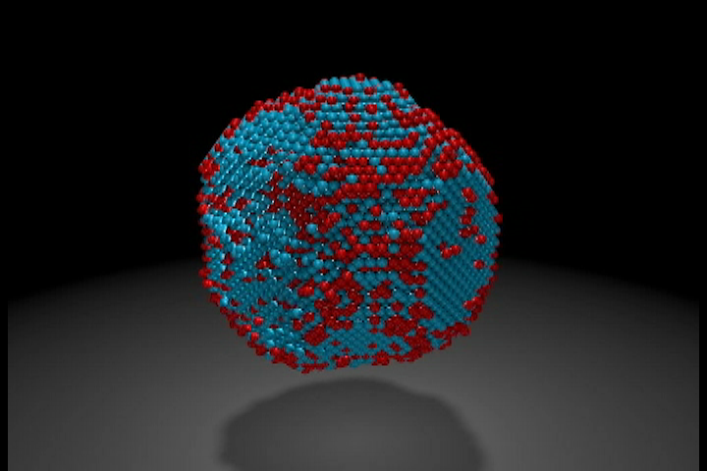
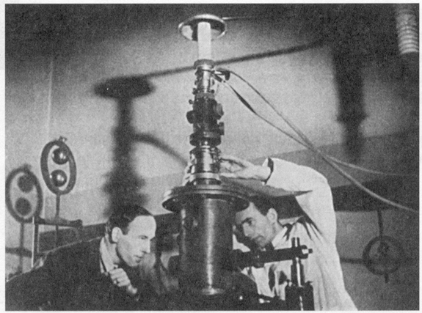

Ultra-High Brightness Electron Linac
The Electron Microscope
We can now see and identify every atom in a nanoparticle
Here: 6,569 iron and 16,627 platinum atoms in an iron-platinum nanoparticle
“It would be very easy to make an analysis of any complicated chemical substance; all one would have to do would be to look at it and see where the atoms are. The only trouble is that the electron microscope is one hundred times too poor … I put this out as a challenge: Is there no way to make the electron microscope more powerful?”
– Richard P. Feynman, 1959,
“There’s Plenty of Room at the Bottom”
Y Yang, et al., Nature 2017

Slide 20
Computer-Readable X-ray and Electron Detectors
Canonical X-ray Detector
Canonical e⁻ Detector
Until ~10 years ago
Phosphor fiber-optically coupled to a CCD
Fiber-optic ← radiation damage
QE (multiple conversions)
PSF (poor spatial resolution)
Speed (slow CCD readout)
Computer readable!
Phosphor
Phosphor
Fiber Optic
Fiber Optic
CCD
CCD

Slide 21
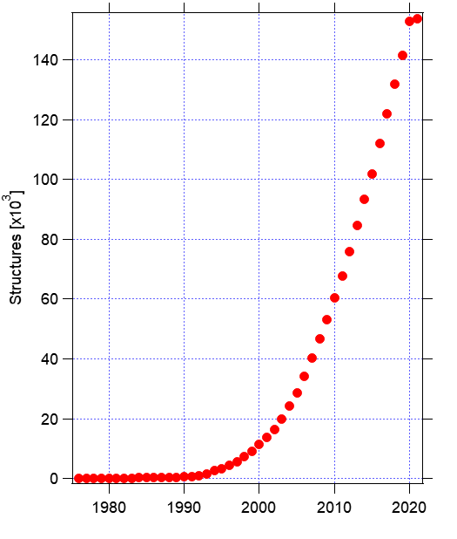
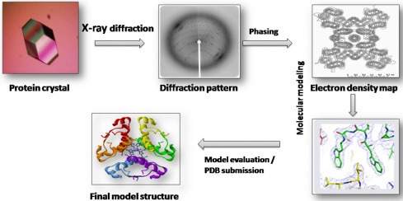

Hybrid Pixel X-ray Detectors
e.g. macromolecular crystallography
Connection: LHC (and before)

Slide 22
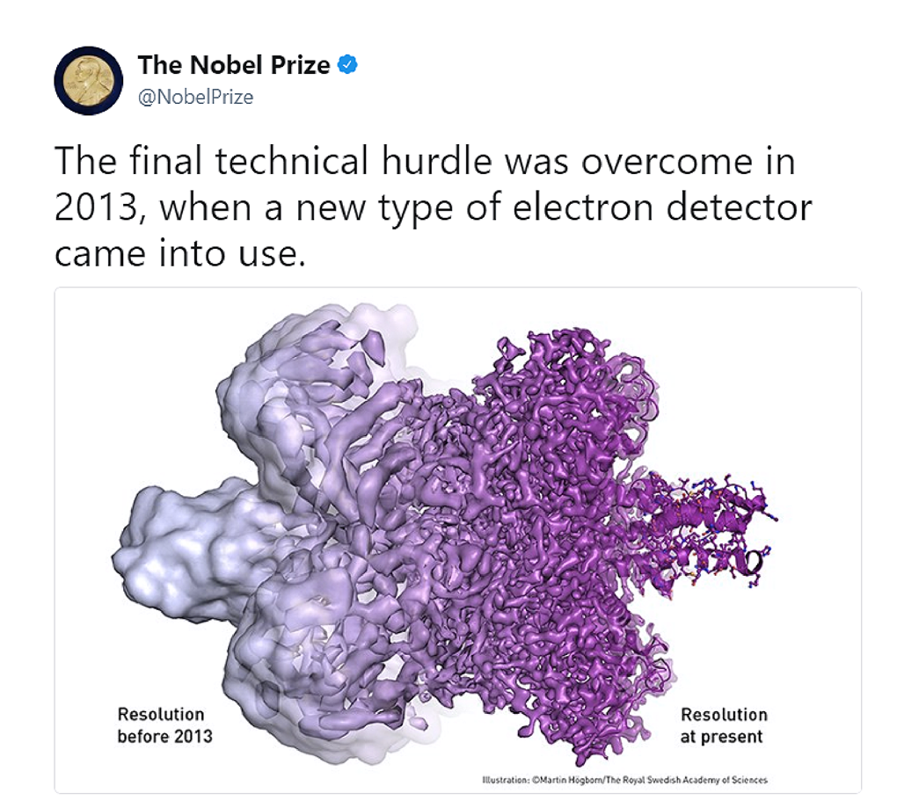
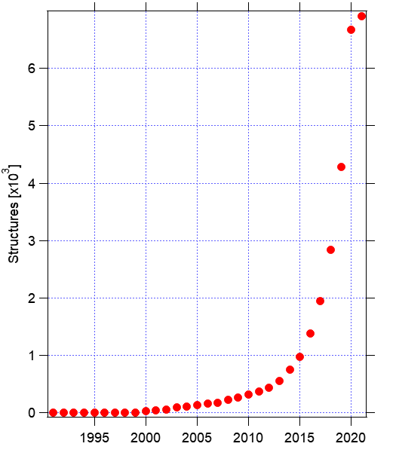
CMOS Image Sensor-based Electron Detectors
Connection: ILC

Slide 23
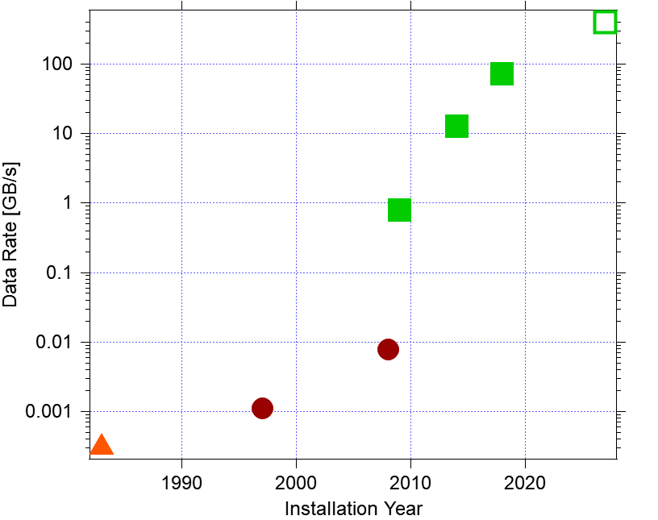
Data – Parochial Example
Data rates for cameras at the
National Center for Electron Microcopy
Per microscope rates today
~100 GB/s
x N microscopes
More generally (across facilities):
  Data volumes ⬆
  Desire: data → information
  No (yet) obvious way to trigger
  History of serendipity
Opportunity?
CIS
CCD
Film

Slide 24
BES Accelerator and Detector Research Program
How BES supports improving the state of the art
Slides thanks to Eliane Lessner / ADR program manager
Mission: Sustain research in accelerators and detectors to provide support for BES scientific user facilities
Support of existing facilities to guarantee their continued performance excellence and provide improved operating capabilities
Support of future electron, light, and neutron sources through innovative concepts, modeling, and design and testing of accelerator component prototypes.
Support of detectors capable of acquiring electrons, x-ray and neutron scattering data that will match the requirements of the fast advancement of electron, x-ray, and neutron sources
Support of next generation of x-ray optics instruments to advance photon-based science

Slide 25
Some Supported Research Areas
High-repetition rate photo-injector: 1 MHz, CW injector
    Feasibility demonstration of a VHF SC RF Injector
SC undulator system that will increase hard X-rays brightness at APS –possible precursor to an FEL SCU system
High repetition-rate electron, neutron, and photon detectors covering a wide energy space
Development of seeding and pulse tailoring techniques for next-generation FELs
On-axis swap-out injection studies for optimizing the performance of diffraction-limited storage rings
Development of ultrafast x-ray optics with nanosecond temporal resolution for time-resolved x-ray science
Ultrafast structural dynamics at the nanoscale in MeV-UED
Machine Learning methods applied to beam-based optimization in circular machines and surrogate modeling for XFELs

Slide 26
Funding Distribution: 8% University; 92 % Facilities

Slide 27
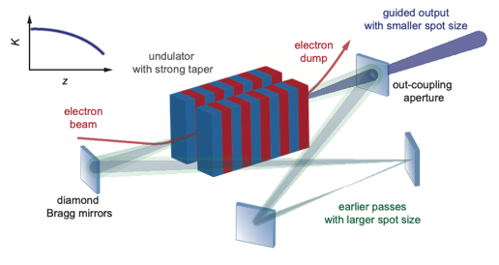
Current Research I
Feasibility Demonstration of Cavity-based X-ray FELs:
CBXFELs will offer very high longitudinal coherence and the ability
to trade off peak and average power, pulse duration and bandwidth
Superconducting Undulator R&D: FEL performance of multiple
planar niobium titanium superconducting undulators
Development of Sub-fs Capabilities at FELs: Two-color attosecond soft X-rays based on a double chirp/taper scheme, as well as isolated TW pulses using superradiance in a modulated electron beam.
High-Power, High-Repetition-Rate THz Capabilities for High-repetition Rate FELs: Accelerator-based terahertz (THz) source driven by high-repetition rate superconducting linacs
Machine Learning for Improving Accelerator and Target Performance: Extend and integrate Machine ML techniques to enable timely and reliable condition monitoring, failure prediction, and parameter optimization of a high-current proton accelerator and target equipment

Slide 28
Current Research -II
Very High-Speed EELS Detector: High-speed detector for electron energy loss spectroscopy, complement to a 100 K frame/second electron detector for use in “4D” Scanning Transmission Electron Microscopy
SparkPix-RT: An Edge Computing Engine for Ultra-Fast Photon Science Detectors: Address data transfer bottleneck in megapixel 100 kHz-1 MHz rate, high pixel occupancy X-ray detectors to the data acquisition system
Neutron detector development for high-rate neutron reflectometry: Scintillator-based, 2D positive-sensitive, large-area neutron detector with exceptional count rate capability
Evaluation of High-X Materials for Photon Sciences: Investigate different candidate materials of High -Z (high x-ray stopping power), for use in hybrid pixel array detectors (PAD) for imaging applications
X-ray Diffractive Optics for Accelerator Science: X-ray diffractive optics technology to measure the X-ray beam both spatially (beam size) and temporally (beam pulse duration) with high precision

Slide 29
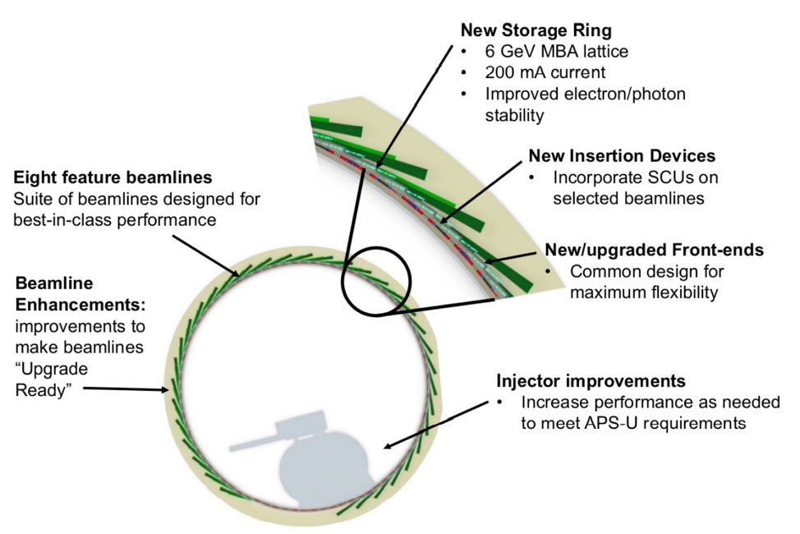
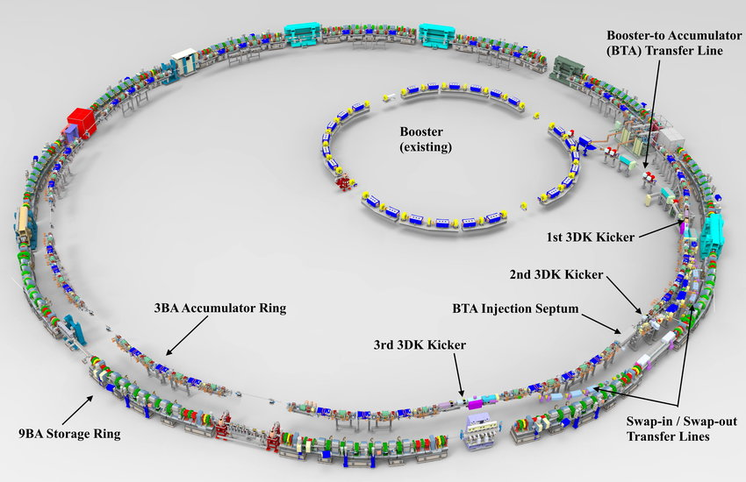
Current Construction Projects – X-ray SR Upgrades
APS Upgrade
ALS Upgrade
TPC: $815M
CD-4: 2QFY26
TPC: $590M
CD-4: 4QFY29

Slide 30
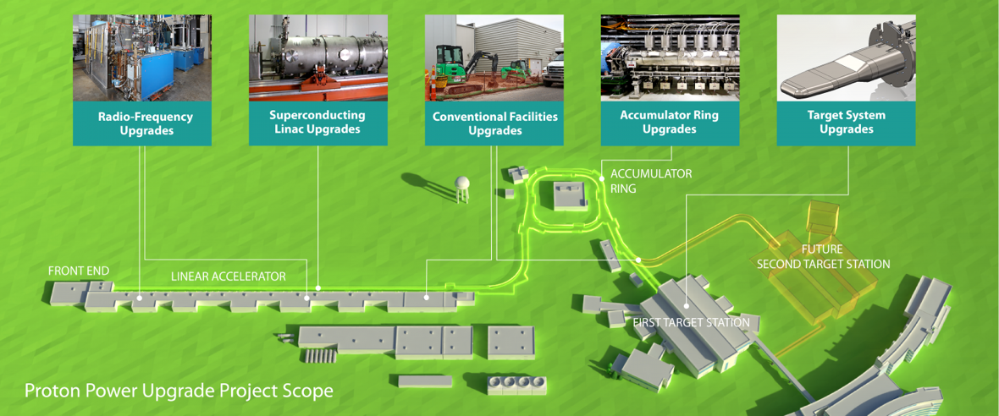
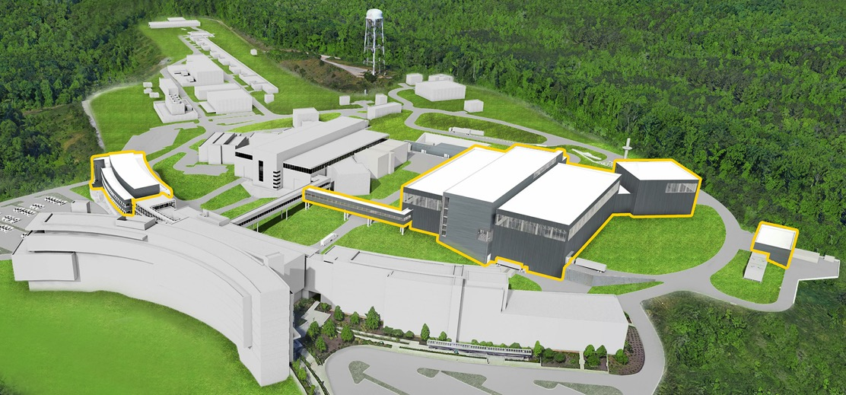
Current Construction Projects – SNS Upgrades
Power Upgrade
TPC: $272M
CD-4: 4QFY28
Second Target Station
TPC: $1,800-3,000M
CD-2: 2QFY25

Slide 31
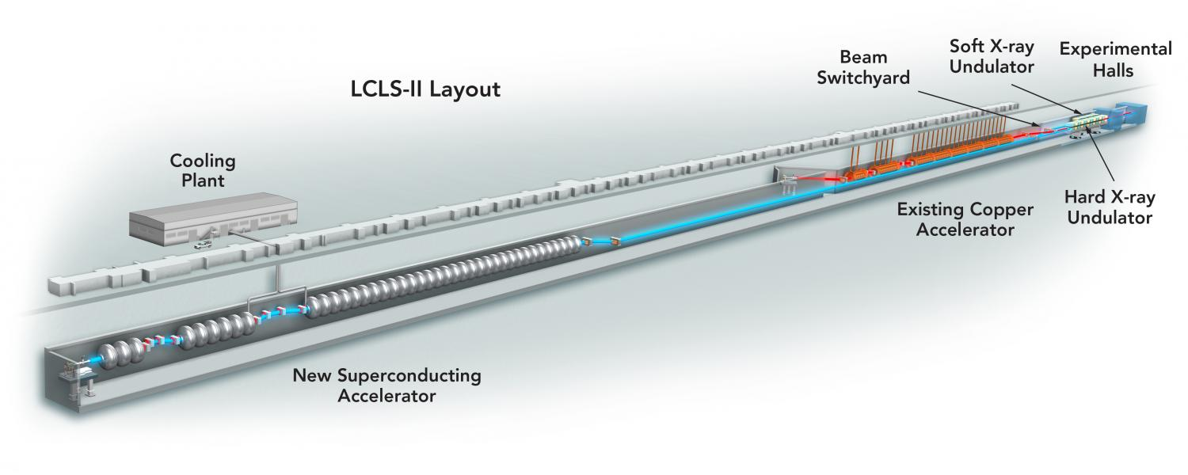
Current Projects – LCLS Upgrades
LCLS-II
TPC: $1,136M
CD-4: 1QFY24
LCLS-II- HE
TPC: $660M
CD-4: 2QFY31
CRMF
TPC: $70-98M
CD-4: 2QFY23

Slide 32


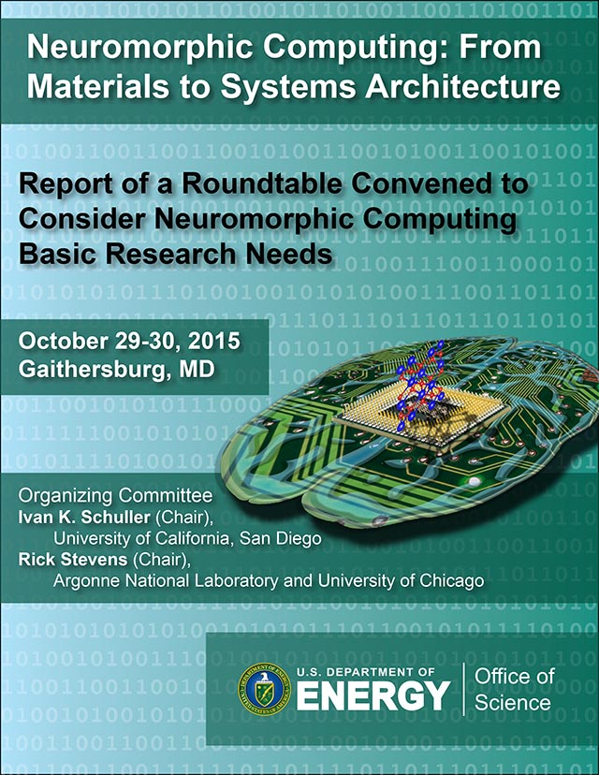
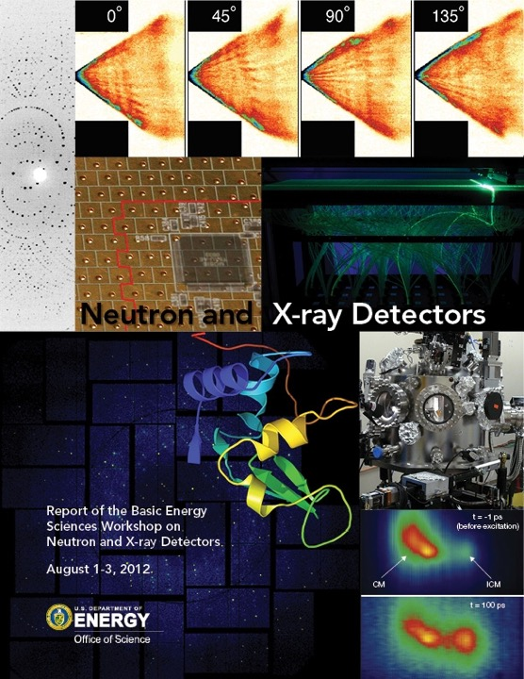


Overlaps

Slide 33
Amuse Bouche
Accelerator-based probes
  (with concomitant detector advances)
  Blurry snapshots → movies
Broad common interests
  Technology, QIS, Microelectronics, …
Materials science towards HEP goals
BES facilities for HEP experiments?
…?

Slide 34
Community Inputs

Slide 35
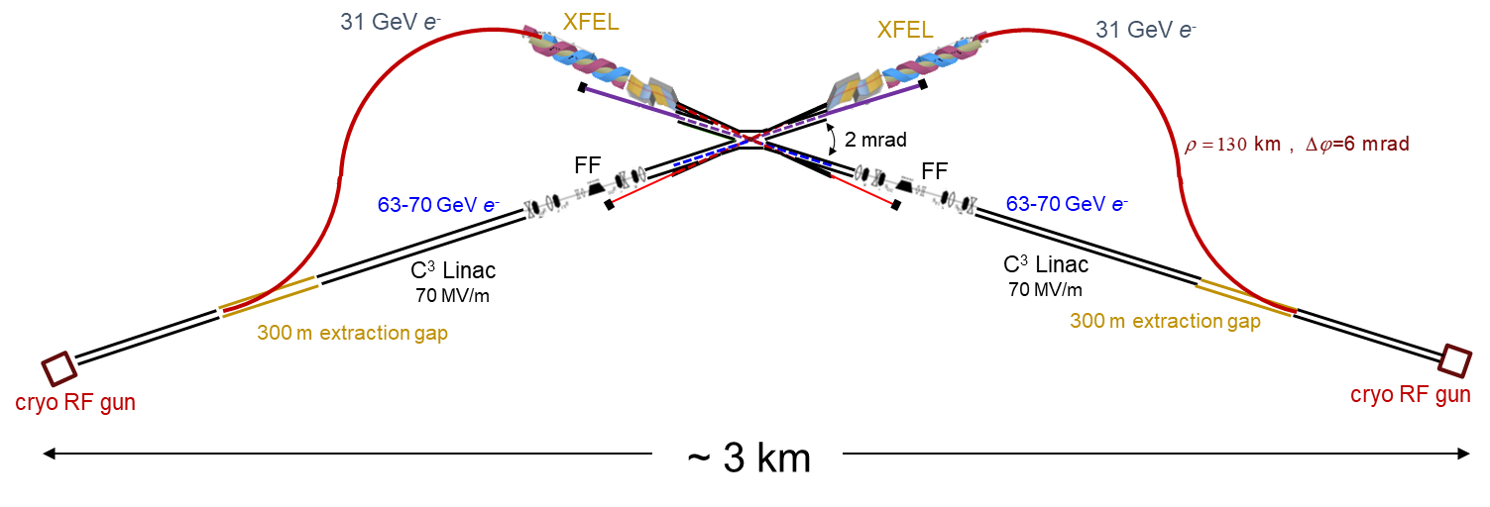
XCC -- XFEL Compton Collider γγ Higgs Factory
From: Tim Barklow (SLAC)
Coupling precision
ILC vs XCC
0.5 x 10⁶ Higgs events

Slide 36



XCC -- XFEL Compton Collider γγ Higgs Factory
From V. Shiltsev’s Accelerator Frontier Vision talk on Thursday:
From: Tim Barklow (SLAC)
100 mJ soft x-ray production and focusing Demo concurrent with C3 Demo:
C³ Demo:
100 nm Cryo Cu RF Injector
LCLS-X:
100 mJ LCLS-NC soft x-ray
Research on XCC high energy/pulse XFEL production and focusing can lead to new opportunities in photon science.

