Slide 1
CERN’s vision and plans
Fabiola Gianotti (CERN)
Snowmass-Seattle, 25 July 2022

Slide 2
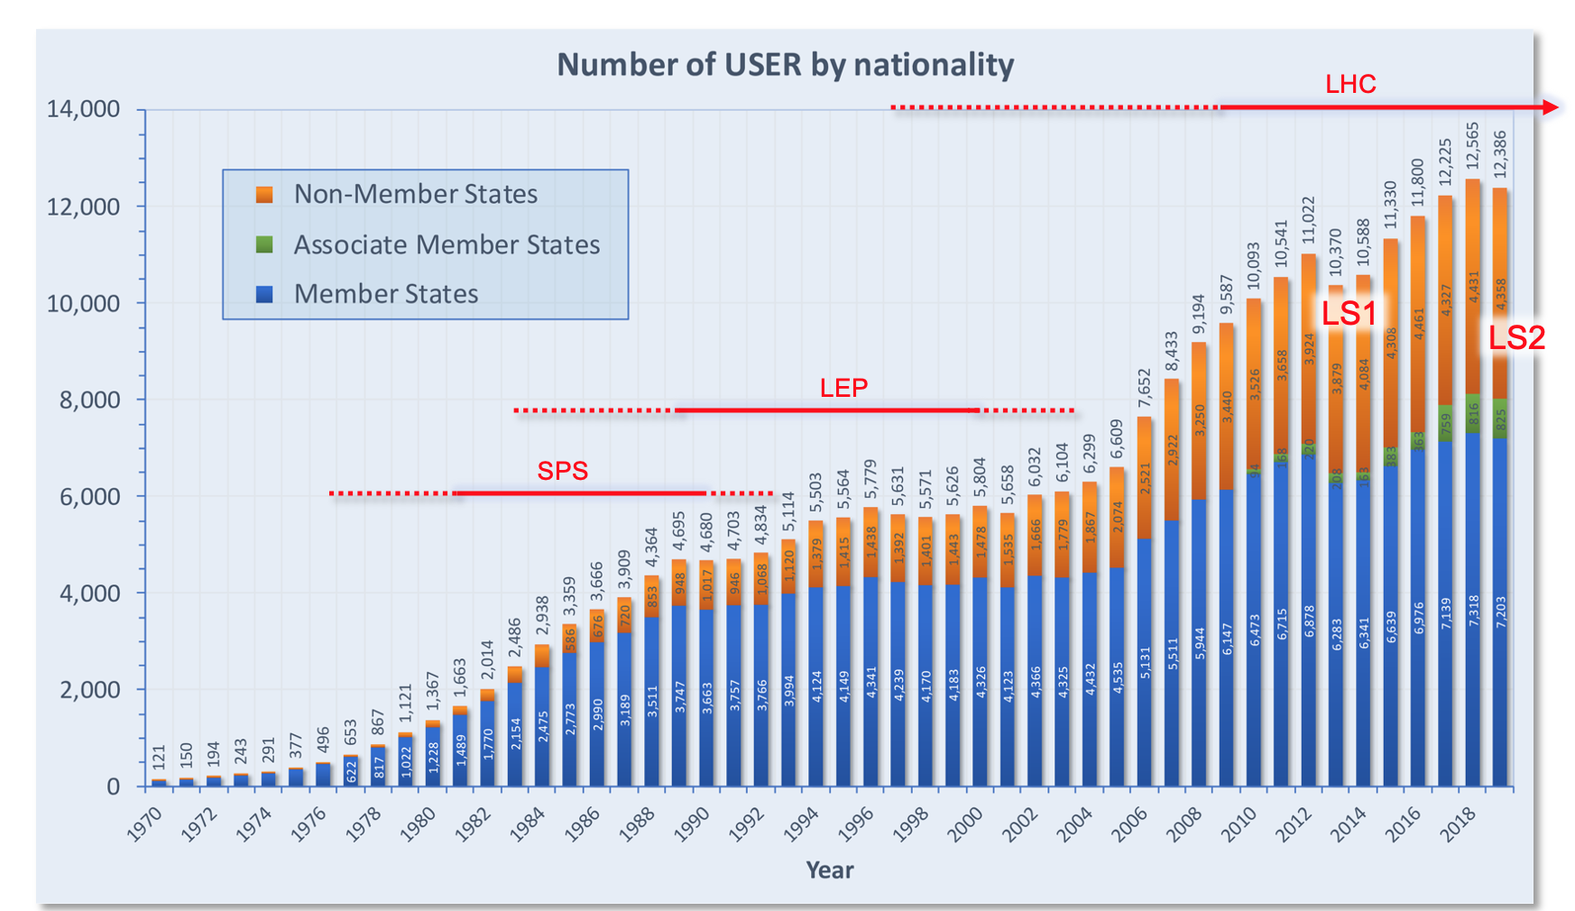
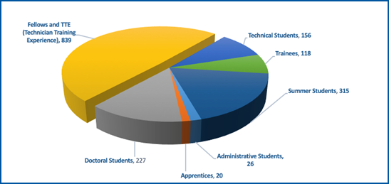
CERN in few numbers
Funded in 1954; intergovernmental treaty
23 Member States, 10 Associate Member States, 4 Observers (including US)
~ 50 International Cooperation Agreements with non-Member States
Every year (pre-Covid-19):
150000 visitors to CERN
4 million visitors to CERN website
150000 press cuttings
2 million mentions on social media
Annual Budget: 1.3 BCHF (shared by Member States based on net national income)
~ 580 MCHF spent annually for procurements (supplies, services)
2 main sites in CH and France, 15 smaller satellite sites
630 hectares, 700 buildings
70 km underground tunnels, > 30 caverns
1000 km technical galleries/trenches
500 hotel rooms, 3000 meals served daily
4000 contractors’ personnel
9000 people on site everyday (before Covid-19)
CERN’s community: > 16000 people (> 110 nationalities)
2700 staff
800 post-doctoral fellows
12700 users and other associates
3000 PhD students from all over the world
4500 young people trained at CERN at any time
US population: 2045 scientists from 142 Institutes
~ 40%
~ 25%
~ 20%

Slide 3
Initial remarks
The contributions of DOE, NSF and US scientists (~17% of CERN’s users),
in particular the intellectual contributions of the young scientists,
have been crucial to the success of the LHC and CERN more generally.
They will continue to be crucial also in the future for HL-LHC and beyond.
In particular, FCC (or any other future collider at CERN) will only be possible with the strong participation
of the US community (ideas, technologies, resources).
Likewise, CERN is committed to support LBNF/DUNE and open to discuss collaboration
on future projects in the US.

Slide 4
CERN’s scientific strategy and programme based on 3 pillars
Full exploitation of the LHC:
successful Run 3: √s =13.6 TeV; integrated luminosities: 250 fb⁻¹ (ATLAS and CMS), 25-30 fb⁻¹ (LHCb), 7 nb⁻¹ (ALICE, Pb-Pb)
High-Luminosity LHC upgrade (construction underway) → starts in 2029 ends ~ 2042 (goal is 3000 fb⁻¹ to ATLAS and CMS)
“Scientific diversity” programme complementary to LHC experiments:
current experiments and facilities at Booster, PS, SPS and their upgrades (recently AD/ELENA, East Area)
participation in accelerator-based neutrino projects outside Europe (presently mainly LBNF/DUNE) through Neutrino Platform
future opportunities discussed within “Physics Beyond Colliders” study group
Preparation of CERN’s future:
intense accelerator R&D programme (including superconducting high-field magnets, RF, plasma wakefield, etc.)
Future Circular Collider (FCC) Feasibility Study → final report end 2025
R&D and design studies for other scenarios: CLIC, muon colliders
Based on 2020 update of the European Strategy for Particle Physics (ESPP)
Note: next ESPP update expected in ~ 2026-2027 → assume input to be submitted end 2025

Slide 5
LHC and HL-LHC

Slide 6
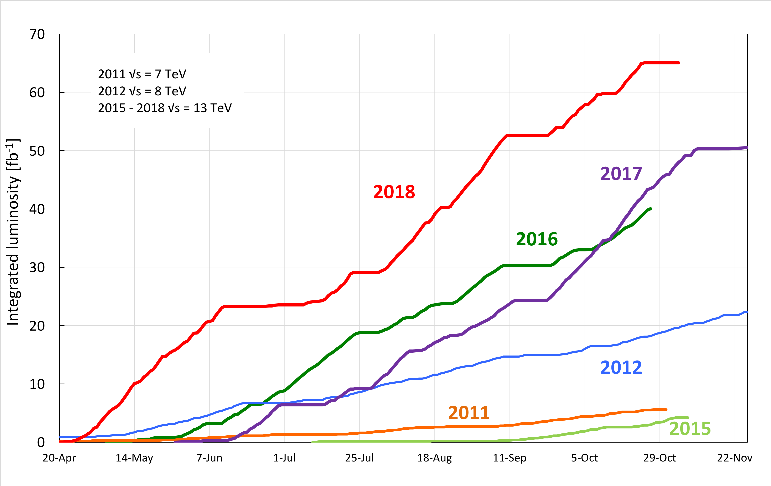
LHC : a success story
Delivered to ATLAS and CMS
Run 3 started on 5 July with first collisions at 13.6 TeV
Achieved peak luminosity Run 2 : 2x10³⁴ cm⁻² s⁻¹ (x2 design value)
Run 1 (2010-2012) delivered: ~ 30 fb⁻¹ at 7-8 TeV
Run 2 (2015-2018) delivered: ~ 160 fb⁻¹ at 13 TeV
Run 3 (2022-2025) expected: ~ 250 fb⁻¹ at 13.6 TeV
Run 1+2 luminosity (189 fb⁻¹) is only 6% of total integrated luminosity
expected at the end of HL-LHC

Slide 7
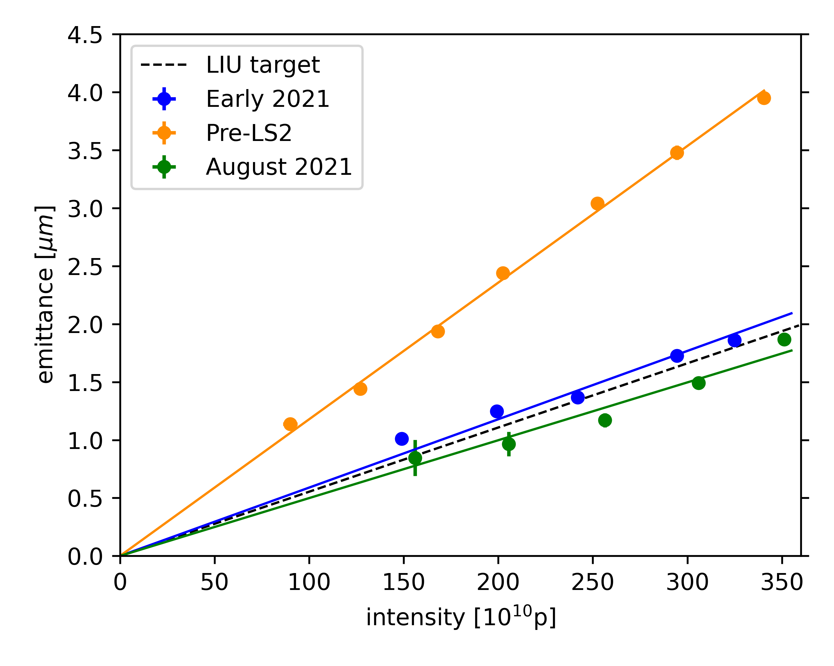
High-Luminosity LHC (HL-LHC)
LS2
LHC Injectors Upgrade (LIU) completed
Phase-1 upgrades: major for LHCb and ALICE
LS3
Installation of HL-LHC machine
Phase-2 upgrades of ATLAS and CMS
LHCb and ALICE plan
major upgrades in LS4
(2033-2034)
Injectors upgrade in LS2: to provide beams of intensity and brightness
needed for HL-LHC: 2.3x10¹¹ p/bunch, ε~ 2.1 μm at LHC injection
Excellent performance upon restart in 2021 → target parameters
needed for HL-LHC already achieved/exceeded in some cases
Required brightness for
multi-bunch LHC beams
already achieved (exceeded!)
at the Booster

Slide 8
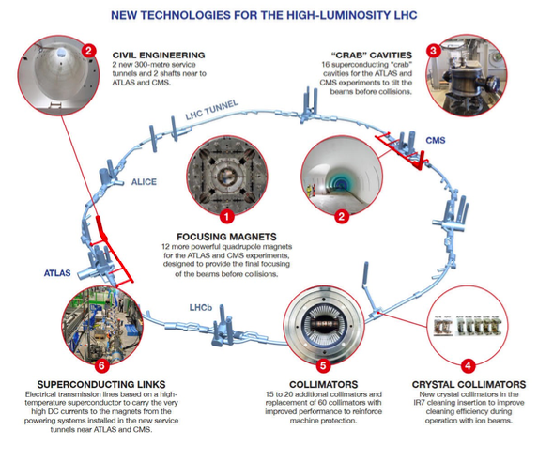
HL-LHC
~ 1.2 km of machine being upgraded with
many novel technologies.
~ 50% of the project completed
In particular, all underground civil engineering
work completed during LS2.
Prototypes completed and production started
for many components
New Nb₃Sn quadrupoles (12 T) for final focus:
4 full-length (4.2 m) magnets successfully built
and tested in the US;
2 full length (7.2 m) magnets did not achieve
nominal current at CERN (learned a lot from work
done over past months to understand causes)
Essential step towards ~ 16T magnets for future
hadron colliders and other applications in our
field and beyond

Slide 9
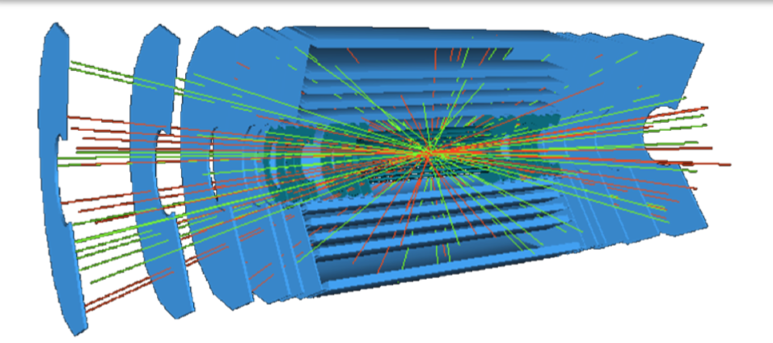
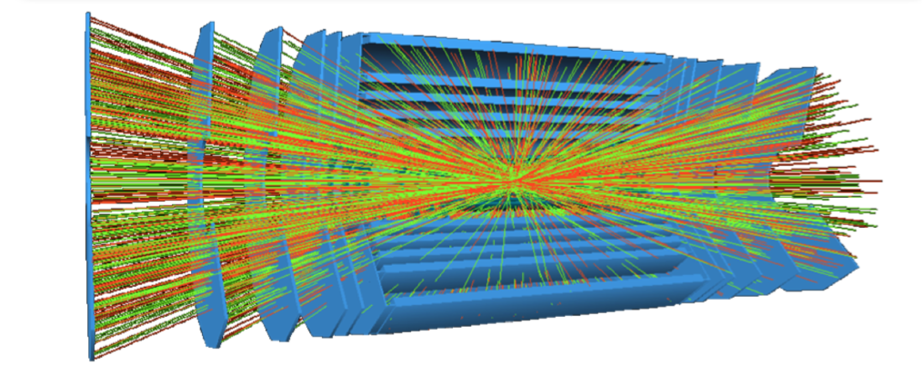
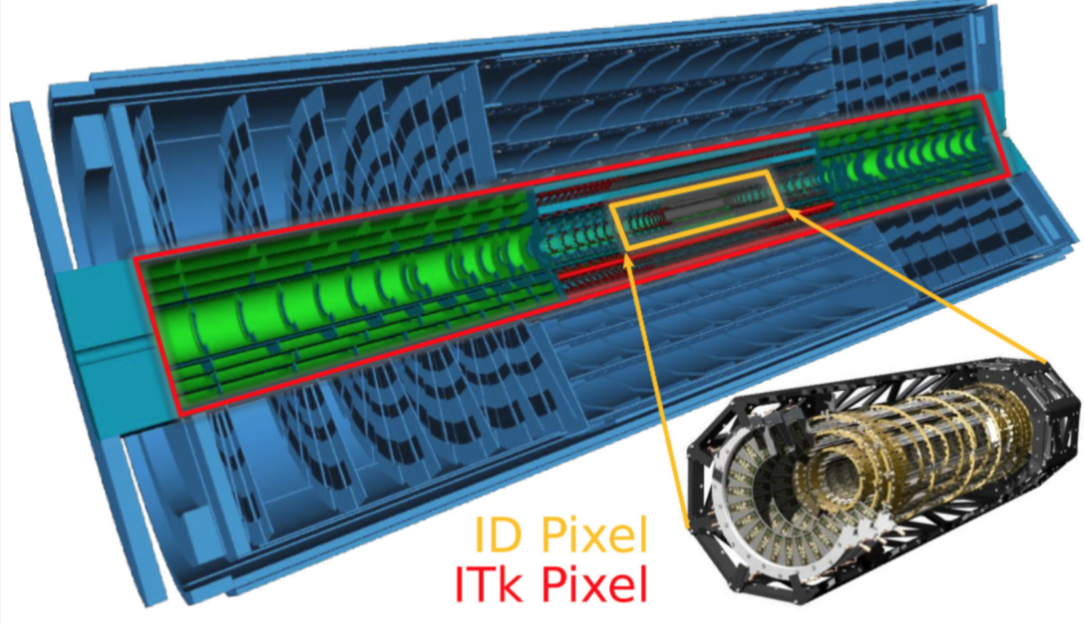
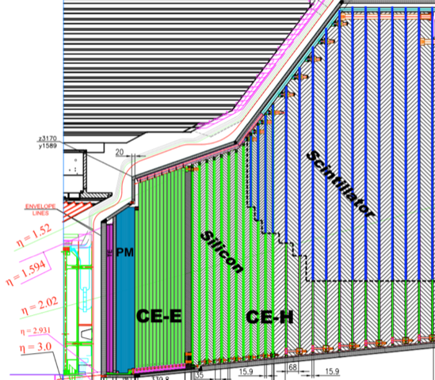
Challenging Phase-2 upgrades of ATLAS and CMS
Higher peak luminosity and larger pile-up (from ~ 30 to 140-200 events/x-ing) require: increased radiation hardness and granularity,
dedicated (timing) detectors, larger bandwith, faster and more granular readout electronics, improved triggers, etc.
LHC: ~ 30 evts/x-ing
HL-LHC: ~ 140-200 evts/x-ing
|𝜼| < 4
Low mass, rad hard
Barrel: 5 pixel + 4 strip layers
End-cap: up to 23 pixel + 6 strip rings
Pixel size: 25 x 100 µm² and 50 x 50 µm²
Strip size (barrel): ~ 75 µm x 24-42 mm
Total Si area: ~ 180 m²
Total # of channels: ~ 5 billion (50 x today)
CMS end-cap calorimeter (HGCAL)
ATLAS tracker (ITk)
1.5 < |𝜼|< 3
Unprecedented lat. and long. segmentation
Time resolution ~ 30 ps
EM (CE-E): Si pads, Cu/CuW/Pb absorber, 26 layers
HAD (CE-H): Si and scintillator, steel absorber, 21 layers
~ 600 m² of Si pads (0.5-1 cm²) 10⁶ channles
Today Pixels
HL-LHC Pixels

Slide 10
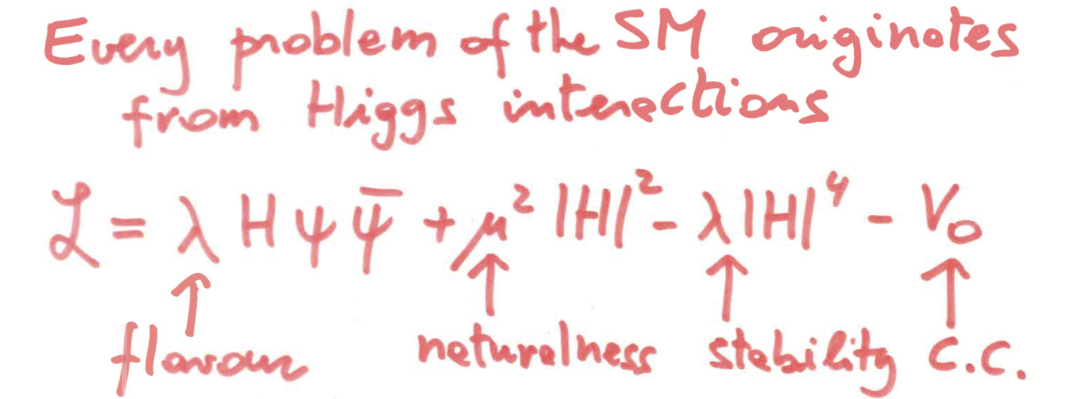
Higgs boson physics at current and future colliders
Discovery of the Higgs boson: monumental step forward in our understanding of fundamental physics, with wide-ranging implications
for particle physics and beyond
Higgs boson is profoundly different from all elementary particles discovered previously (first
elementary scalar?), is related to the most obscure sector of the Standard Model and linked
to some of the deepest structural questions (flavour, naturalness/hierarchy, vacuum, ...)
G. Giudice
Higgs boson is an extraordinary discovery tool and calls for a compelling and broad
experimental programme which will extend for decades at the LHC and beyond.
“Study it to death” – N. Arkani-Hamed
Note: Higgs boson can only be studied at colliders
Current Higgs boson knowledge from LHC
(numbers are per experiment).
Note: some of these measurements were
not expected to be possible in Run 2
All main Higgs boson production modes (ggF, VBF, VH, ttH+tH) established at > 5σ
Couplings to gauge bosons (established in Run 1) measured to 6-8%
Couplings to 3rd generation fermions, top, b and 𝜏 (established in Run 2) measured to 7-11%
Couplings to 2nd generation fermions: 3σ evidence for H→ µµ; first constraints on H→ cc
Rare decays (e.g. H→ Z𝛾; H→ ll𝛾 at ~ 3σ level). Limits on invisible and exotic decays
HH production: sensitivity x 3 SM cross-section
Mass measured to ~ 0.1%; width measurement from off-shell/on-shell production demonstrated (3.6σ evidence for H off-shell production)
J^{CP}=0⁺⁺ (large number of alternative hypotheses excluded > 99.9% C.L.)
Inclusive studies complemented by increasing variety of differential/exclusive measurements (useful to constrain theory;
provide additional constraints on couplings; sensitive to new physics in quantum loops affecting kinematic distributions)
Searches for additional Higgs bosons (no sign yet …)
Etc. etc.

Slide 11
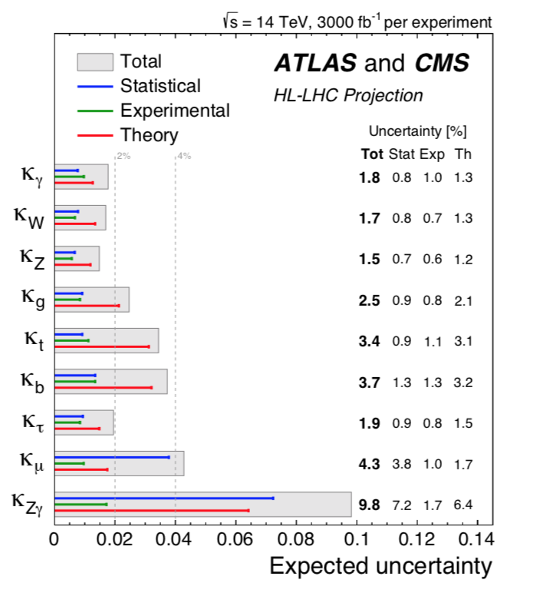
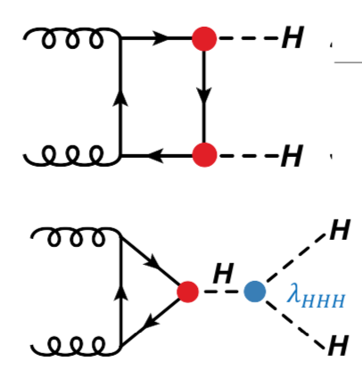
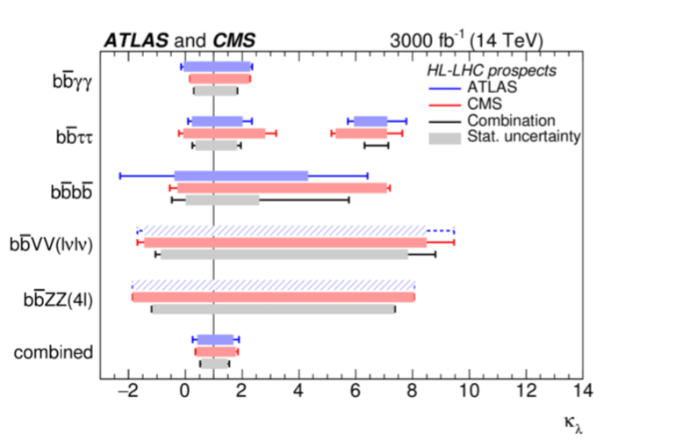
Higgs boson at HL-LHC
Factor ~ 20 larger data sample than today (3000 fb⁻¹, ~180 M Higgs produced per experiment) and improved detectors
→ significant increase in sensitivity
Higgs couplings measurements
First observation of HH production (~ 5σ level)
0.1 < k_{λ} < 2.3 95% C.L.
Global fit assuming no BSM contributions to Γ_{H.}
3-4 times more precise than today
first 5σ observation of H→ Z𝛾 (H→ μμ already in Run 3)
experimental precision challenges theory
Today:
ATLAS : cross-section < 2.4 x SM (2.9 expected), - 0.6 < k_{λ} < 6.6 95% C.L.
CMS : cross-section < 3.4 x SM (2.5 expected), - 1.24 < k_{λ} < 6.49 95% C.L.

Slide 12
Scientific diversity

Slide 13
Scientific diversity programme
~20 projects, ~ 2000 physicists
AD/ELENA: Antiproton Decelerator for antimatter studies
CAST, OSQAR: axions
CLOUD: impact of cosmic rays on clouds → implications on climate
COMPASS: hadron structure and spectroscopy
ISOLDE: radioactive nuclei facility
NA61/Shine: heavy ions and neutrino targets
NA62: rare kaon decays
NA63: interaction processes in strong EM fields in crystal targets
NA64: search for dark photons
NA65: 𝜏-neutrino production from D_{s} decays
Neutrino Platform: 𝛎 detectors R&D for experiments in US, Japan
n-TOF: n-induced cross-sections
UA9: crystal collimation
Exploits unique capabilities of CERN’s injectors; complementary to LHC experiments and to other efforts in the world.
Future opportunities being explored within “Physics Beyond Colliders” Study Group.

Slide 14
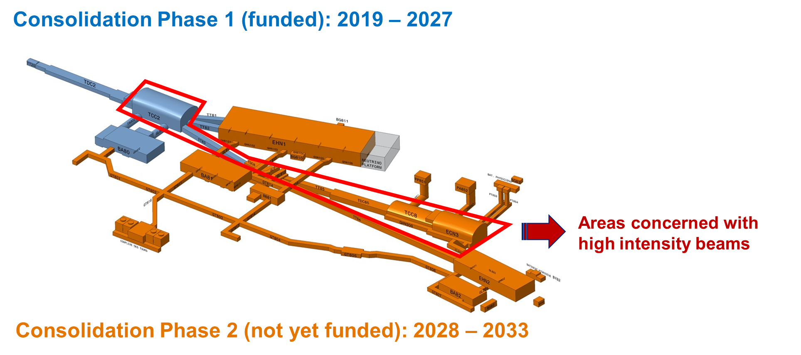
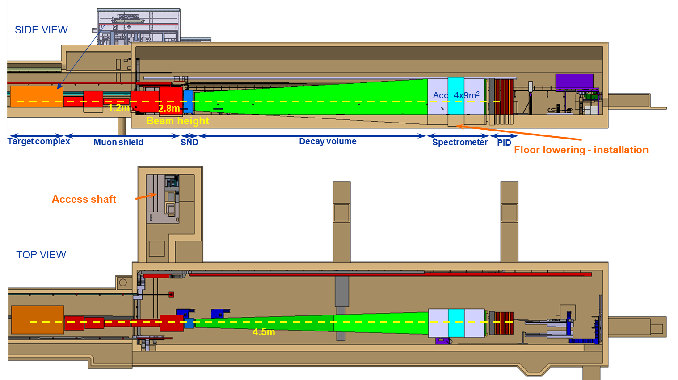
Future opportunities being explored: one example
North Area upgrade to higher-intensity beams:
up to ~ 4 x 10¹⁹ POT/year (slow extraction) possible post-LS3
Current interest: kaon physics (HIKE), beam dump experiments for dark sector and
other studies (SHADOW, SHiP), τ → 3μ (TauFV), …
SHiP@ECN3

Slide 15
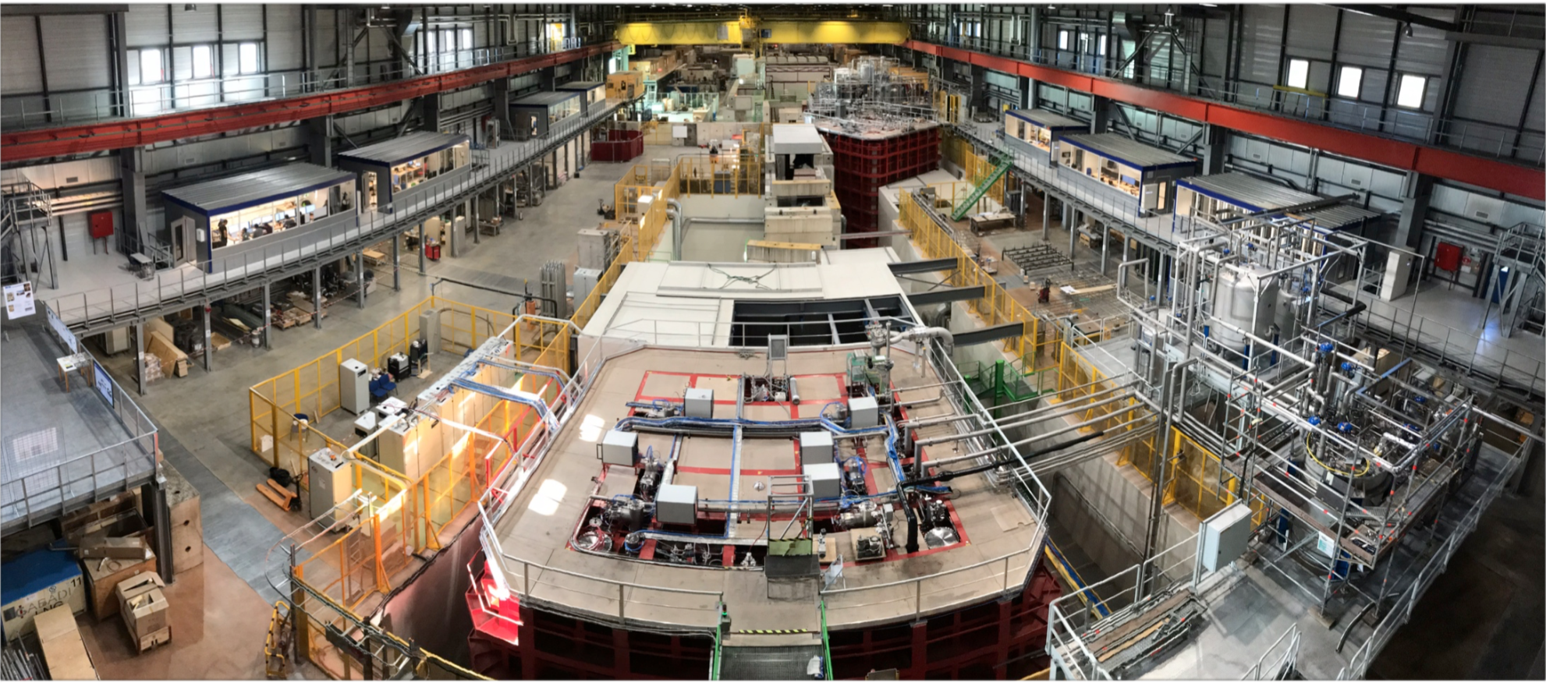
CERN Neutrino Platform
Established in 2014, following 2013 update of ESPP:
“CERN should develop a neutrino programme to pave the way for a substantial European role in future long-baseline experiments.
Europe should explore the possibility of major participation in leading long-baseline neutrino projects in the US and Japan.”
Main activities at the NP since the beginning
Extensions of EHN1 hall at North Area to provide space and beam facility for 𝝂 detectors
Refurbishment of ICARUS detector for short-baseline neutrino programme at Fermilab
Construction and operation of two prototypes for DUNE (single-phase; dual-phase → vertical-drift technology)
crucial to establish detector feasibility, validate technology and finalise technical choices
Construction of cryostats for two (out of four) modules of DUNE
Construction of Baby-Mind and ND280 upgrade detectors for the T2K experiment in Japan
With ~ 900 collaborators from ~30 countries
dual-phase
proto-DUNE
Construction and test of two DUNE detector
prototypes at CERN’s Neutrino Platform:
11x11x11 m³ cryostat
~750 tons LAr each
1 DUNE module: x 20 proto-DUNE
single-phase proto-DUNE

Slide 16
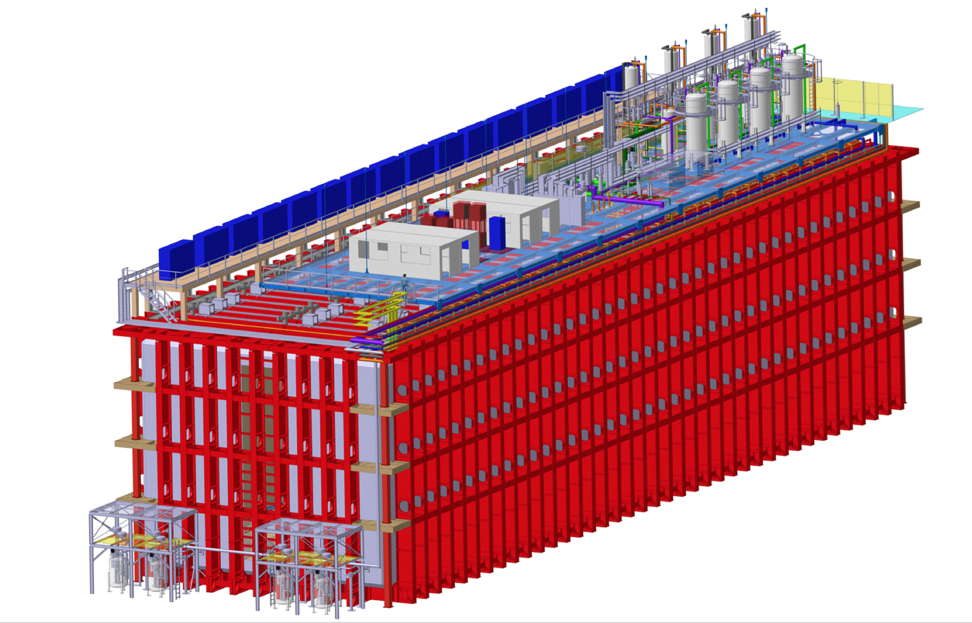
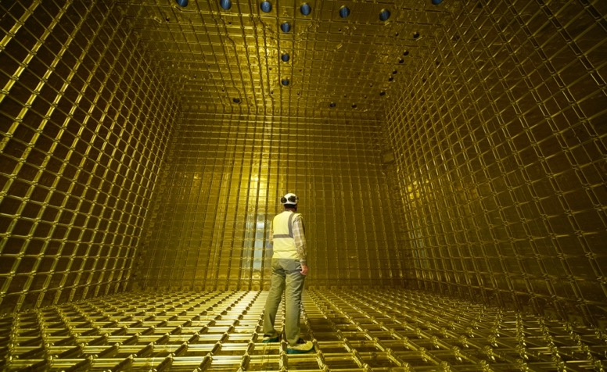
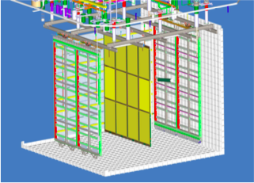
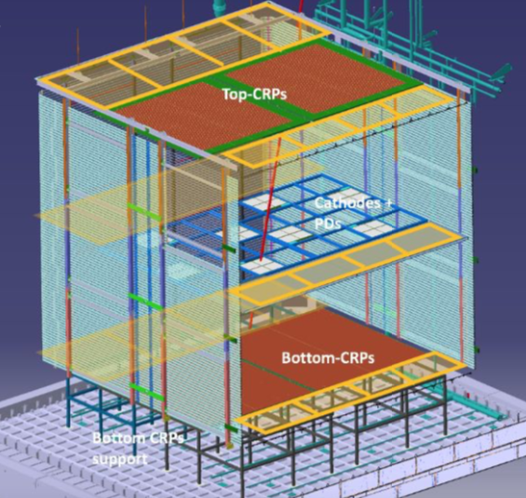
CERN Neutrino Platform: current LBNF-related activities
Construction of two cryostats for LBNF/DUNE based on membrane
technology (used for over sea transport of liquid natural gas).
Design completed, procurement and manufacturing started
→ in situ installation at SURF 2024-2027
19 m
66 m
18 m
Single-phase proto-DUNE II “module zero” : horizontal drift.
To test final component designs (APA, cold electronics, cryogenics,
calibration, etc.) → beam test in NP04 cryostat Autumn 2022-Spring 2023
Vertical-drift module zero’s construction and test:
Successful test of HV=300 kV in NP02 cryostats and of
charge readout planes in small cold box.
Module-zero beam test in NP02 cryostat second half 2023

Slide 17
Preparation of CERN’s future

Slide 18
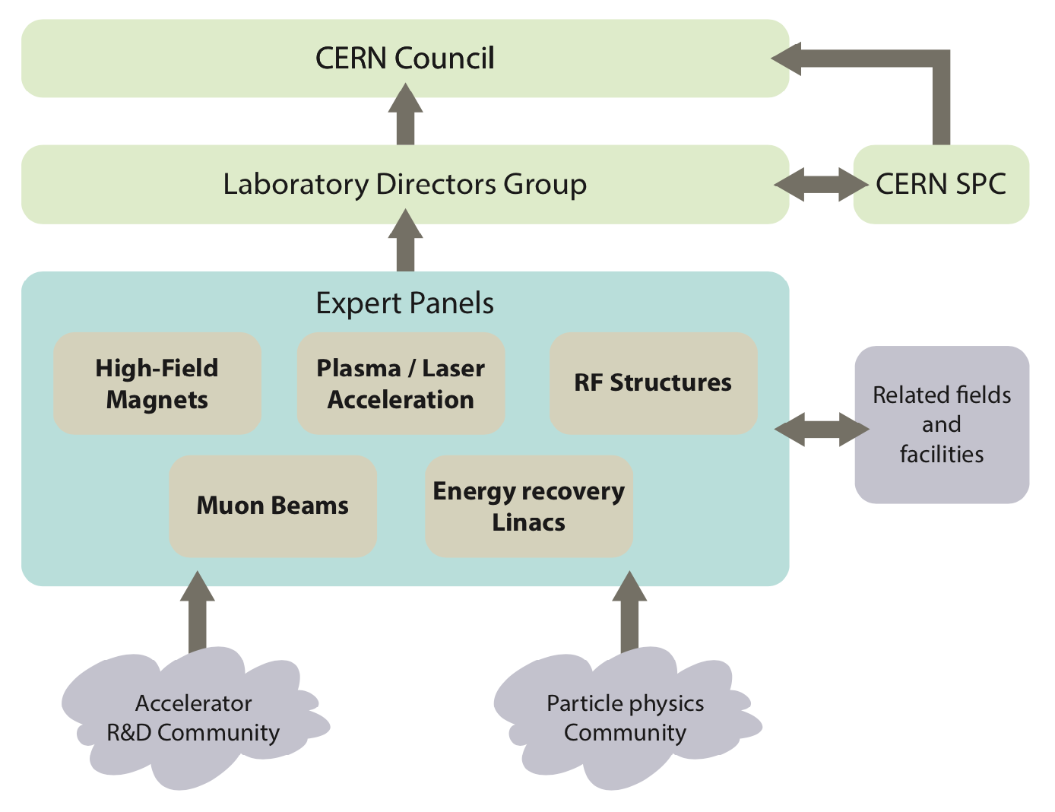
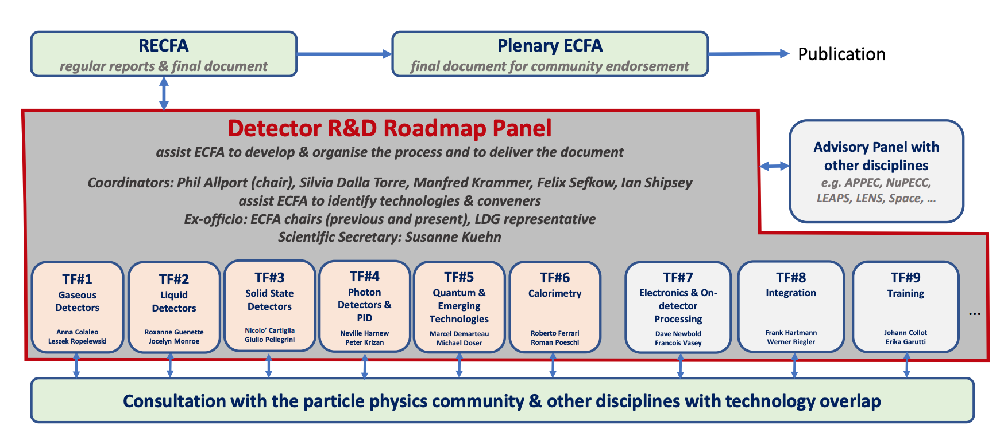
Accelerator and Detector R&D
Following ESPP recommendation, roadmaps developed in Europe (with US participation) → approved by CERN’s Council Dec. 2021
Implementation plans being developed and organizational structures
being established (US participation in these collaborations would be
very much welcome).
Investment in R&D is essential for the future of the field!

Slide 19
FCC Feasibility Study 2021-2025
2020 ESPP update
“An electron-positron Higgs factory is the highest-priority next collider.
For the longer term, the European particle physics community has the ambition to operate
a proton-proton collider at the highest achievable energy.”
“Europe, together with its international partners, should investigate the technical and
financial feasibility of a future hadron collider at CERN with a centre-of-mass energy of at least
100 TeV and with an electron-positron Higgs and electroweak factory as a possible first stage.”
“Such a feasibility study of the colliders and related infrastructure should be established as a global
endeavour and be completed on the timescale of the next Strategy update.”
FCC Feasibility Study (FS) started in 2021 → will be completed in 2025

Slide 20
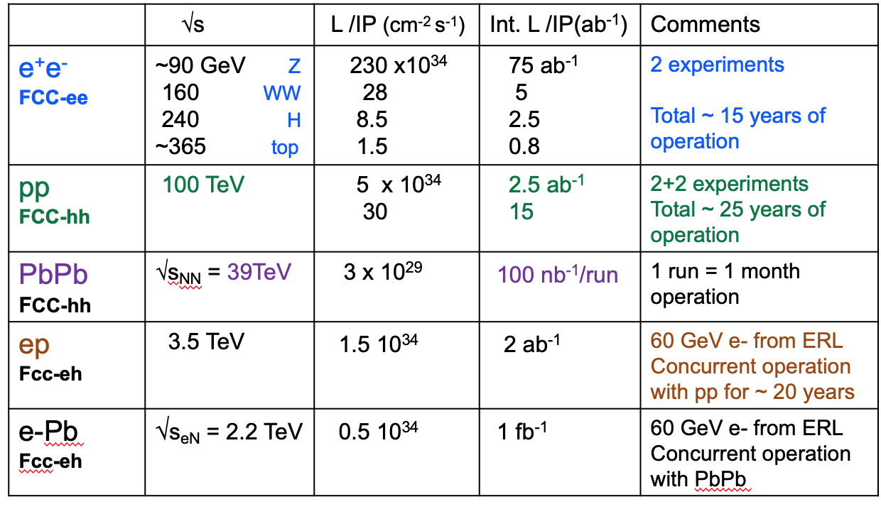
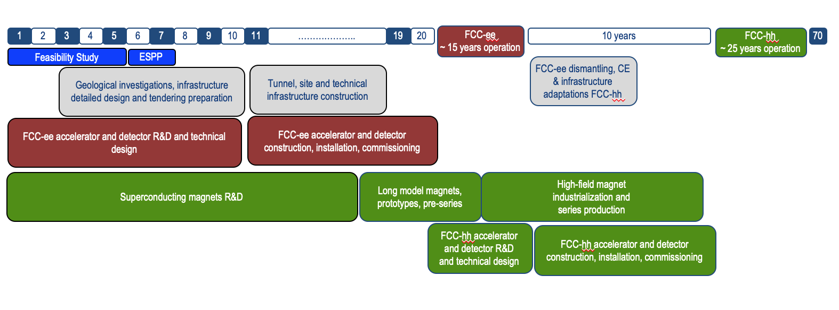
FCC Feasibility Study 2021-2025
Numbers are for 100 km ring
2-4 experiments
Potentially a multi-stage facility with immense physics potential
(energy and intensity).
20-30
Feasibility Study:
Focus is on FCC-ee and magnet R&D
~ 40 MCHF/year from CERN budget (half for magnet R&D)
Additional funding from EU and collaborating institutes (e.g. CHART)
Results will be summarised in Feasibility Study Report end 2025
Possible schedule
(taking into account resources constraints):
project’s approval by end of decade
construction’s start early 2030s
FCC-ee operation: 2048-2063
(10 years Z, W, H and 5 years tt)
Technical schedule: operation starts early 2040s
Purely technical schedule

Slide 21
FCC Feasibility Study 2021-2025: main objectives
Demonstration of the geological, technical, environmental and administrative feasibility of the tunnel and surface areas
and optimisation of placement and layout of the ring and related infrastructure
Pursuit, together with the Host States, of the preparatory administrative processes required for a potential project approval
to identify and remove any showstopper
Optimisation of the design of FCC-ee and FCC-hh colliders and their injector chains, supported by R&D to develop the needed
key technologies
Elaboration of a sustainable operational model for the machine and experiments in terms of human and financial resource needs,
as well as environmental aspects and energy efficiency
Development of a consolidated cost estimate, as well as the funding and organisational models needed to enable the project’s technical design completion, implementation and operation (emphasis on FCC-ee)
Identification of substantial resources from outside CERN’s budget for the implementation of the first stage project
(tunnel and FCC-ee)
Consolidation of the physics case and detector concepts (in particular FCC-ee detector requirements and technologies)
FCC Collaboration: 147 Institutes (12 from US) from 34 countries
Plenty of opportunities for interesting work (new detector concepts, accelerator technologies,
environmental impact and sustainability, etc.)
→ more collaborators from the US would be very much welcome!

Slide 22
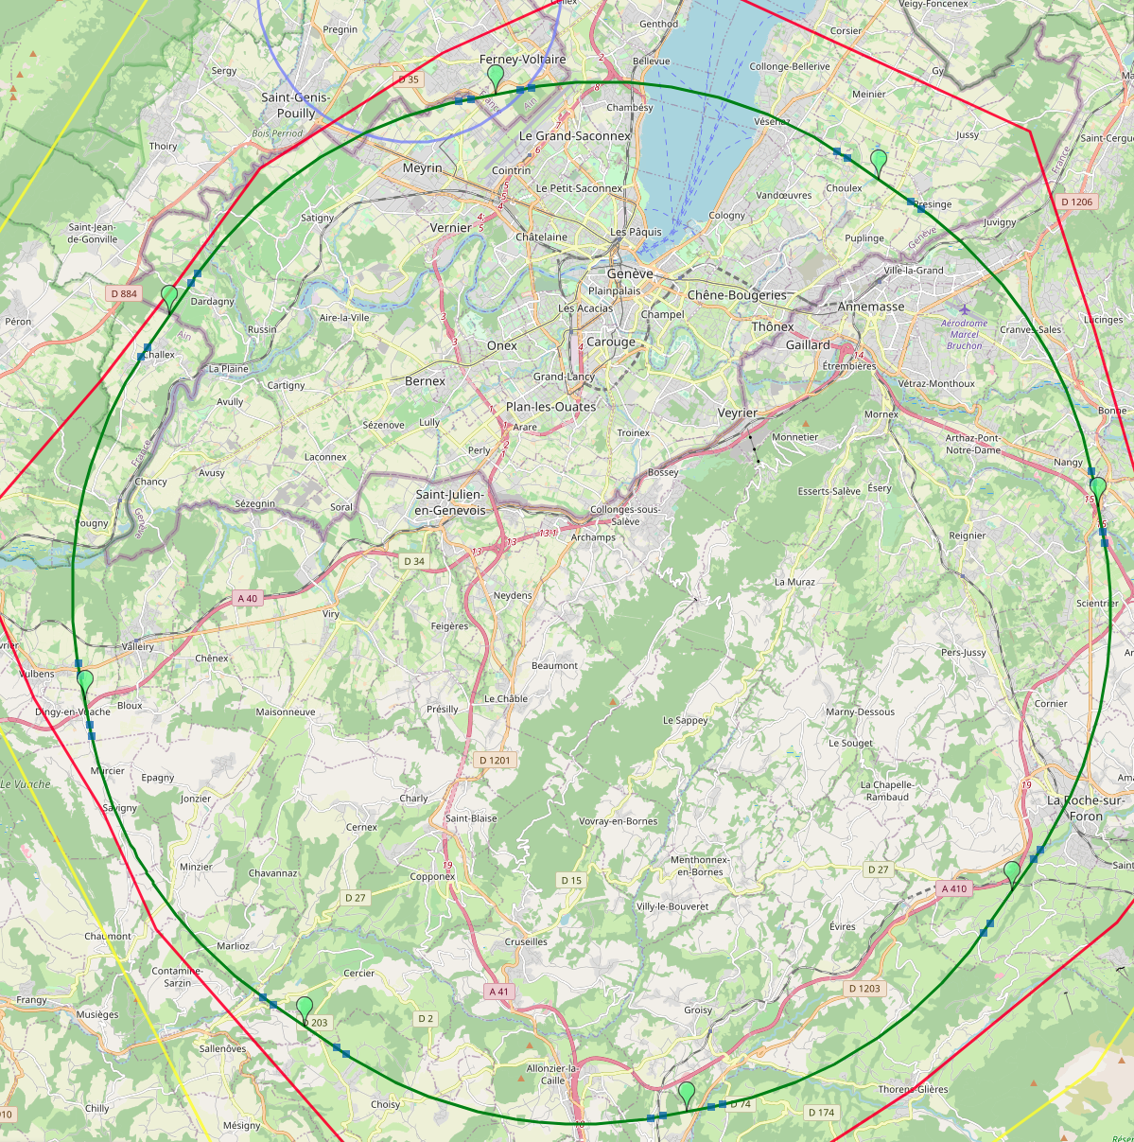
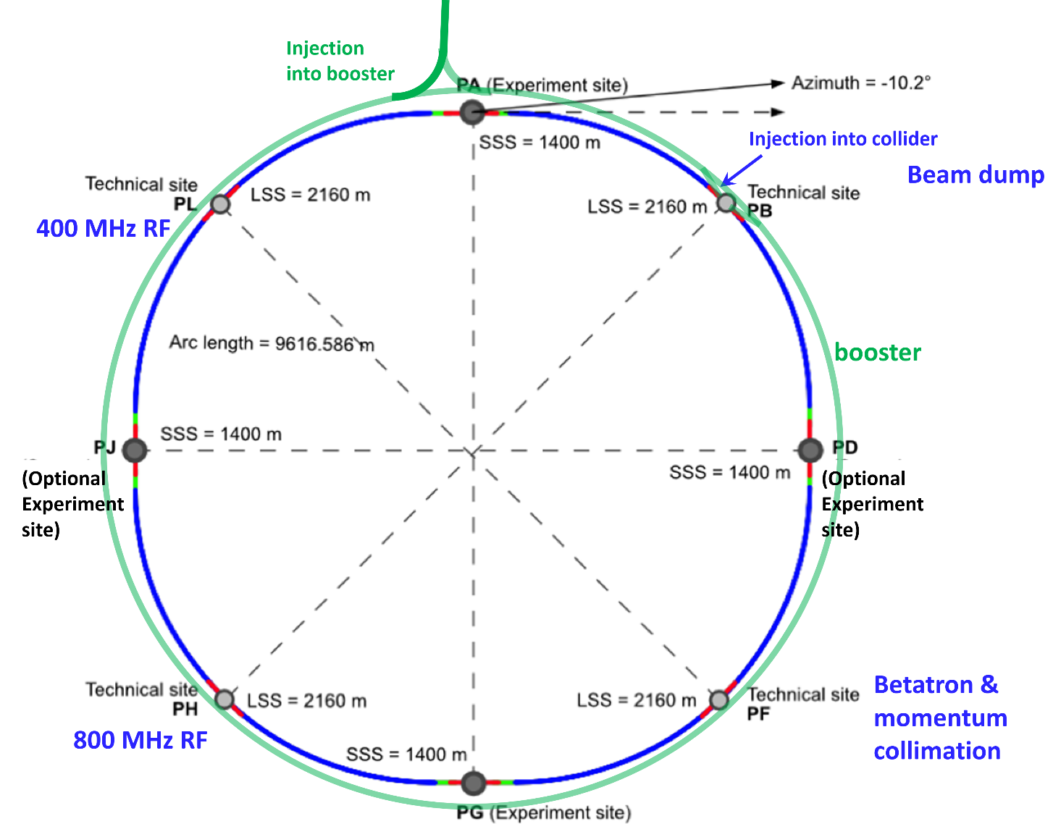
FCC Feasibility Study 2021-2025
Major recent milestone: optimization of ring placement.
Out of ~ 50 initial variants, based on geology and surface constraints
(land availability, access to roads, etc.), environment (protected zones),
infrastructure (water, electricity, transport), etc.
“Éviter, reduire, compenser” principle of EU and French regulations
PA: Experiment
PB: technical
Baseline ring: 91.1 km ring, 8 surface points
Whole project now being adapted to this placement
Site investigation: 9 high-risk areas identified
(to be further investigated with ~40 drillings and 100 km of seismic lines)
PL: technical
PD: experiment
PJ: experiment
FCC-ee layout
PF: technical
PH: technical
22
PG: experiment

Slide 23
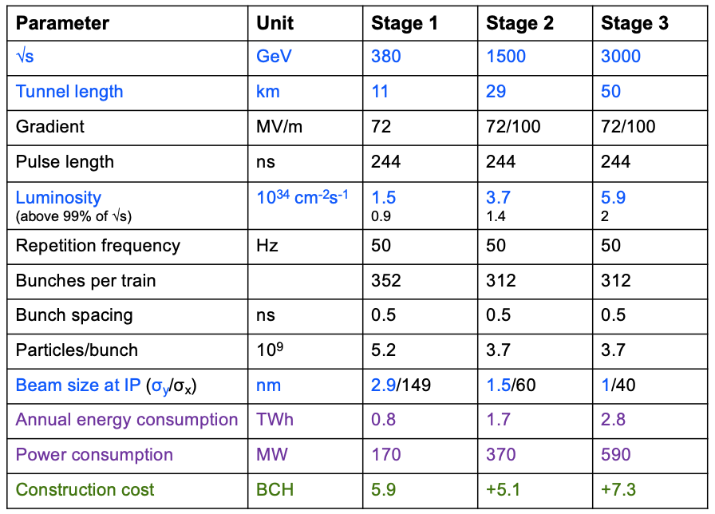
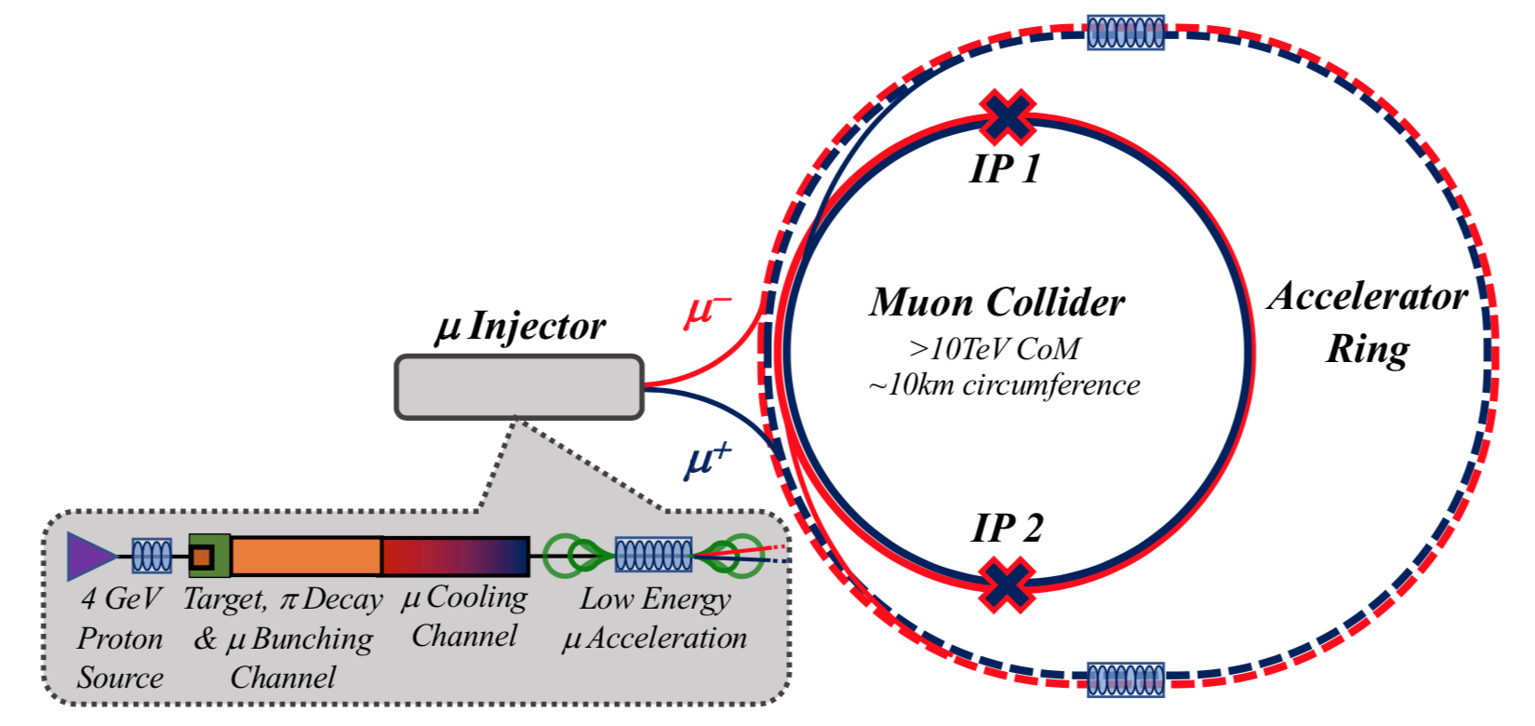
CLIC and muon colliders goals 2021-2025
CLIC goals:
finalise X-band technology towards construction readiness
(accelerating structure’s conditioning and manufacturing)
improve power efficiency (e.g. klystrons)
optimise luminosity for first-stage machine (beam dynamic studies,
machine alignment and stability, etc.)
“Project Readiness Report” by end 2025 (as input to next ESPP)
Muon collider’s goals: work on main challenges, including
muon source and cooling, fast-ramping magnets, accelerator
and collider rings, neutrino background and civil engineering
determine by end 2025 (as input to next ESPP) if investment
in muon collider test facility and CDR is justified from
a scientific perspective.
Study initially hosted by CERN; CERN resources allocated.

Slide 24
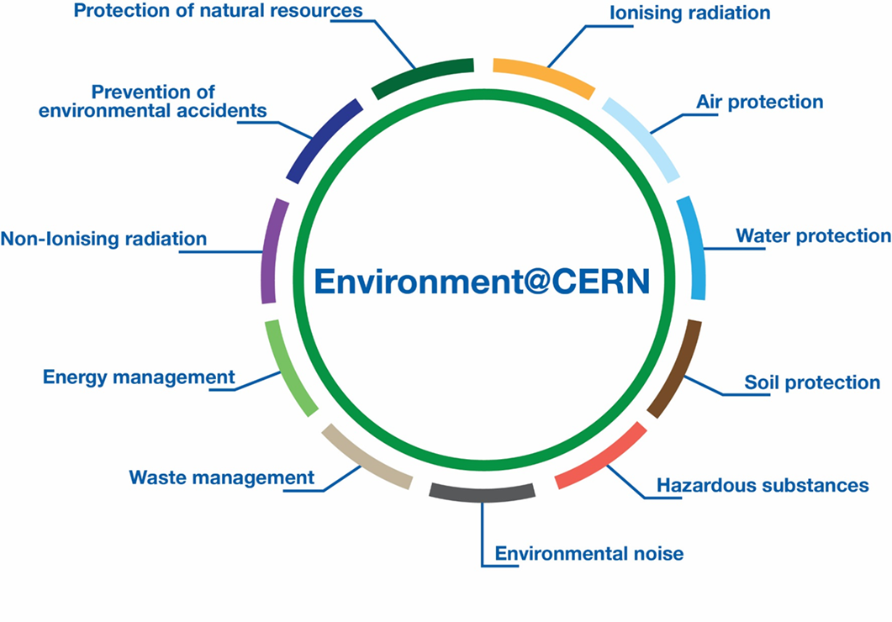
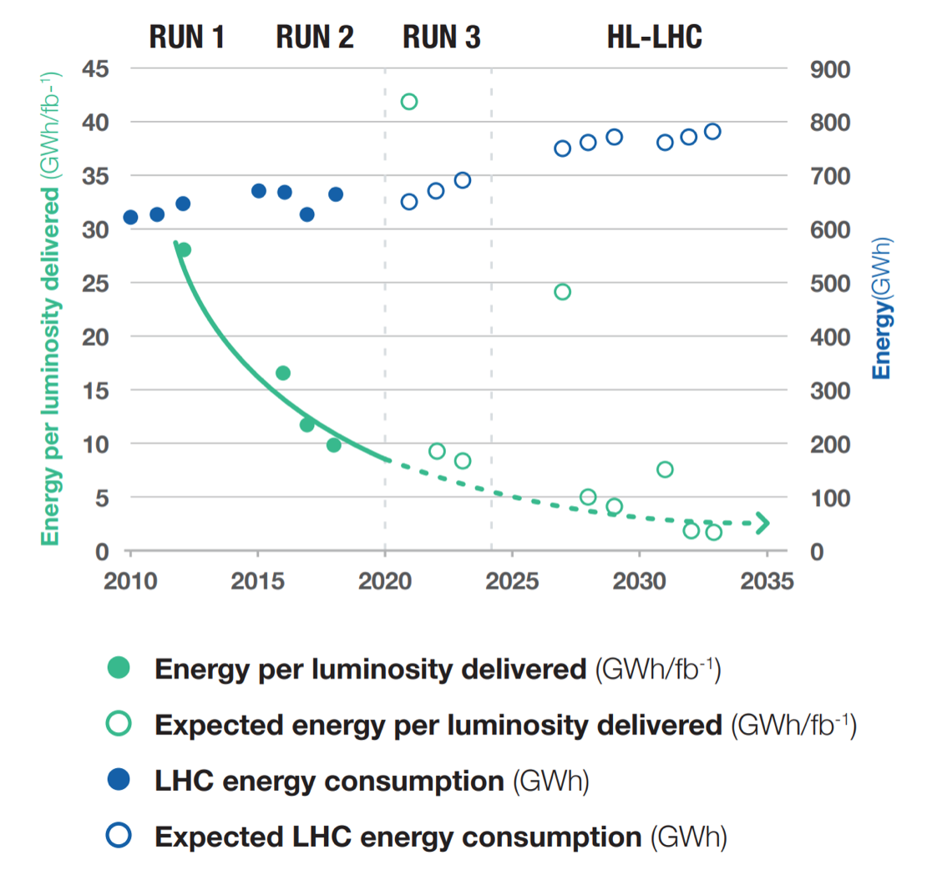
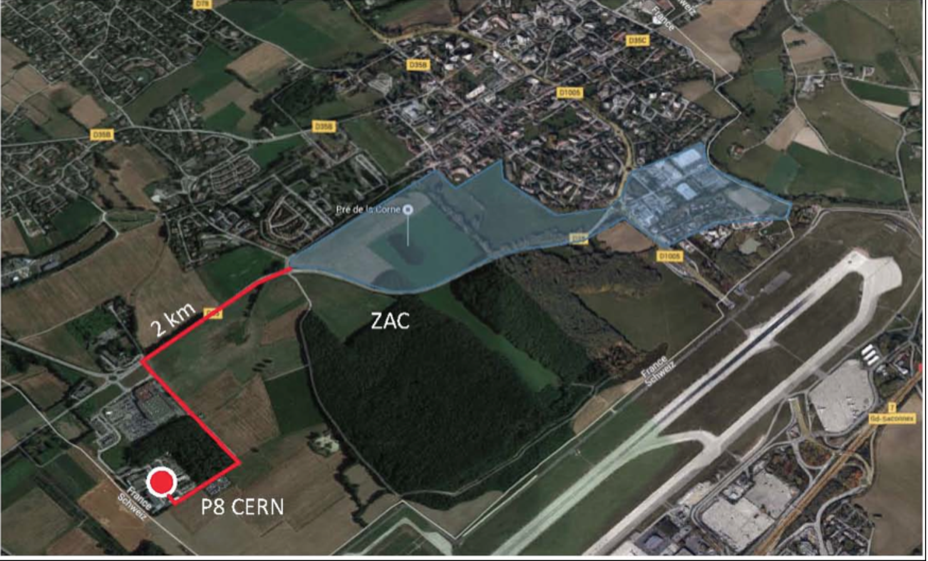
Environment and sustainability
2 public Environment Reports released: https://hse.cern/environment-report
Describe current status for 11 domains and set goals to minimise CERN’s impact on environment
(e.g. reduction of emissions by 28% by 2024, compared to 2018)
> 70 MCHF investment from CERN’s budget on environmental projects over 2016-2026
3 projects underway to recover waste energy from CERN
infrastructure (LHC cooling towers, new Data Centre in Prévessin)
and heat CERN sites and nearby village in France
→ energy savings/re-use and reduction of emissions.
Significant improvement with time in scientific performance
(→ physics output) for ~ same amount of electricity consumption
Energy recovery from LHC Point 8 to heat a new
residential village in the town of Ferney-Voltaire, France
(~ 8000 people)
Run 2: ~ 10 GWh/fb⁻¹
HL-LHC : ~ 2.5 GWh/fb⁻¹

Slide 25
Conclusions
CERN has a compelling and broad scientific programme:
LHC will be operating at the E-frontier until ~ 2042
facilities and experiments at injectors, complementary to the collider, serving a broad community (including neutrinos)
vigorous R&D and design studies for future facilities
The 2020 ESPP has identified the Future Circular Collider as the preferred option for a future post-LHC collider at CERN.
Immense physics potential, but also a very challenging and ambitious project.
Feasibility Study started and will be completed at the end of 2025. Substantial resources allocated.
Focus is on FCC-ee and magnet R&D.
Alternative options being pursued as well
To maintain interest in CERN and motivate the community (esp. the young people!), it is crucial to:
avoid too-long gap between end of HL-LHC in ~ 2042 and beginning of physics at a new facility (hopefully mid-2040s)
build new facility in parallel to HL-HLC operation → young people can work on HL-LHC data analysis and R&D for or
construction of new facility
The contributions of DOE, NSF and US scientists (~17% of CERN’s users), in particular intellectual contributions of the young
scientists, have been crucial to the success of the LHC and CERN more generally.
They will continue to be crucial also in the future: in particular, FCC will only be possible with the strong participation of the US
(ideas, technologies, resources).
Likewise, CERN is committed to support LBNF/DUNE and open to discuss collaboration on future projects in the US.
So many intriguing questions in particle physics and so many nice opportunities to address them
→ global, worldwide coordination and collaboration are needed to cover all of them … the future of the field is BRIGHT!

Slide 26
EXTRAs

Slide 27
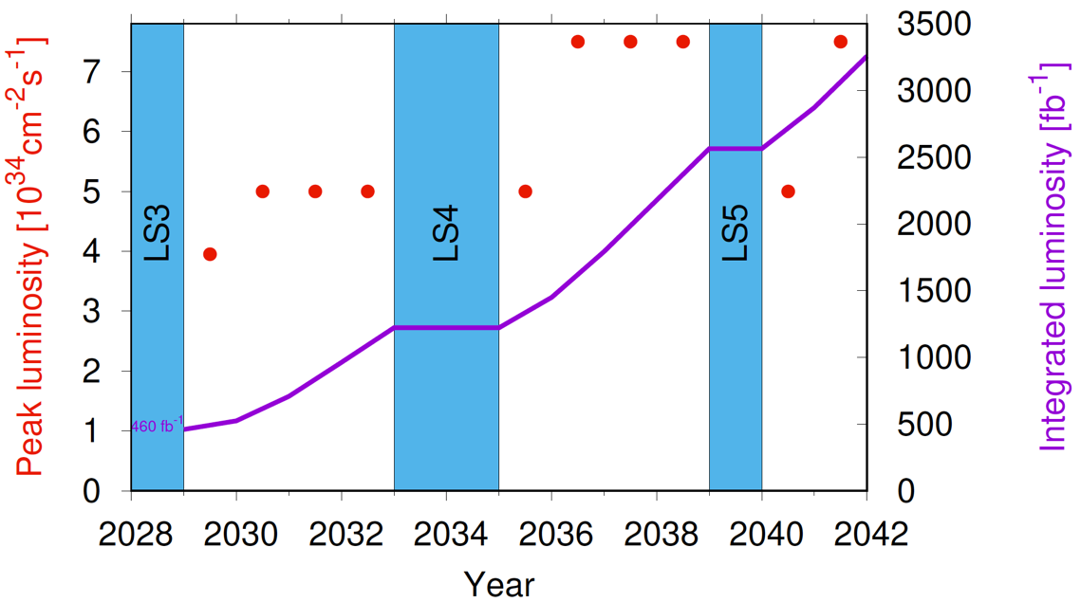

Slide 28
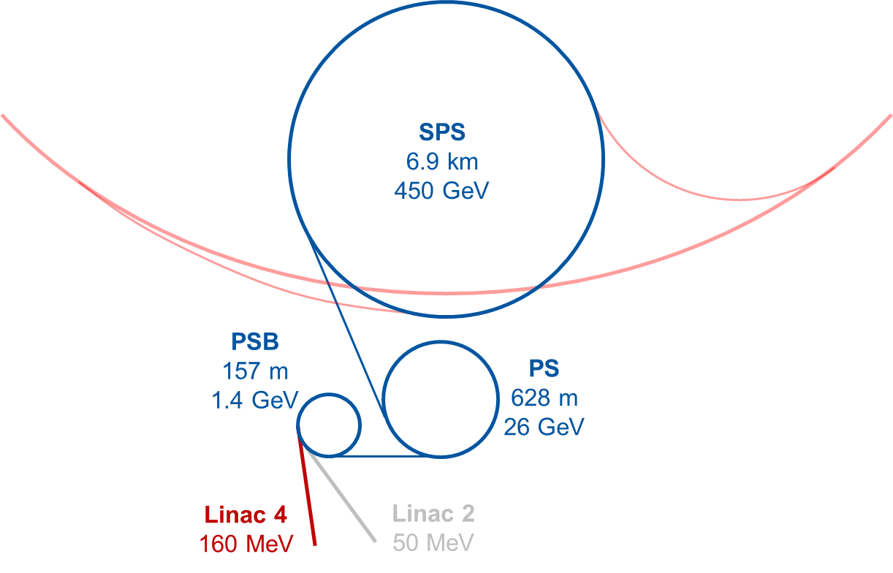
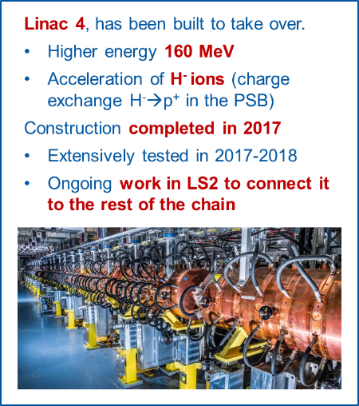
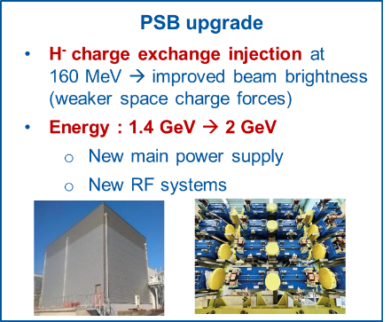
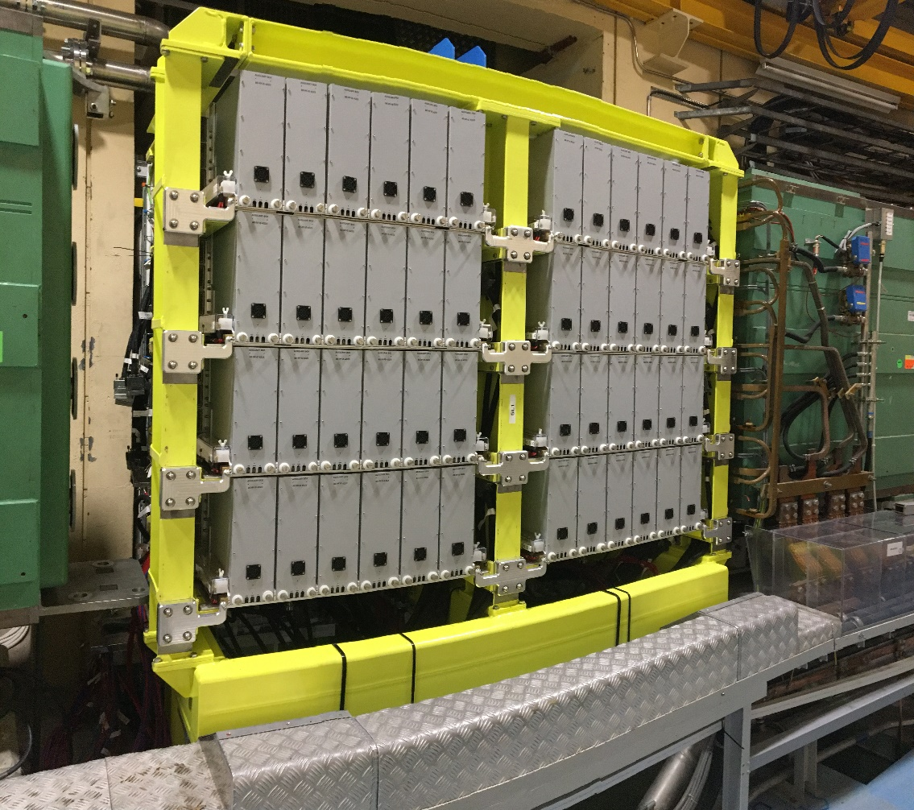
LHC Injectors Upgrade (LIU)
Provide beams of the intensity and
brightness needed for HL-LHC:
2.3x10¹¹ p/bunch, ε~ 2.1 μm
at LHC injection
Linac 4: 160 MeV H⁻
PSB: 1.4→ 2 GeV
PS: new injection and feedback systems
SPS: new 200 MHz RF system
200 MHz RF upgrade (SSPA)
Finmet RF cavities
Injection system

Slide 29
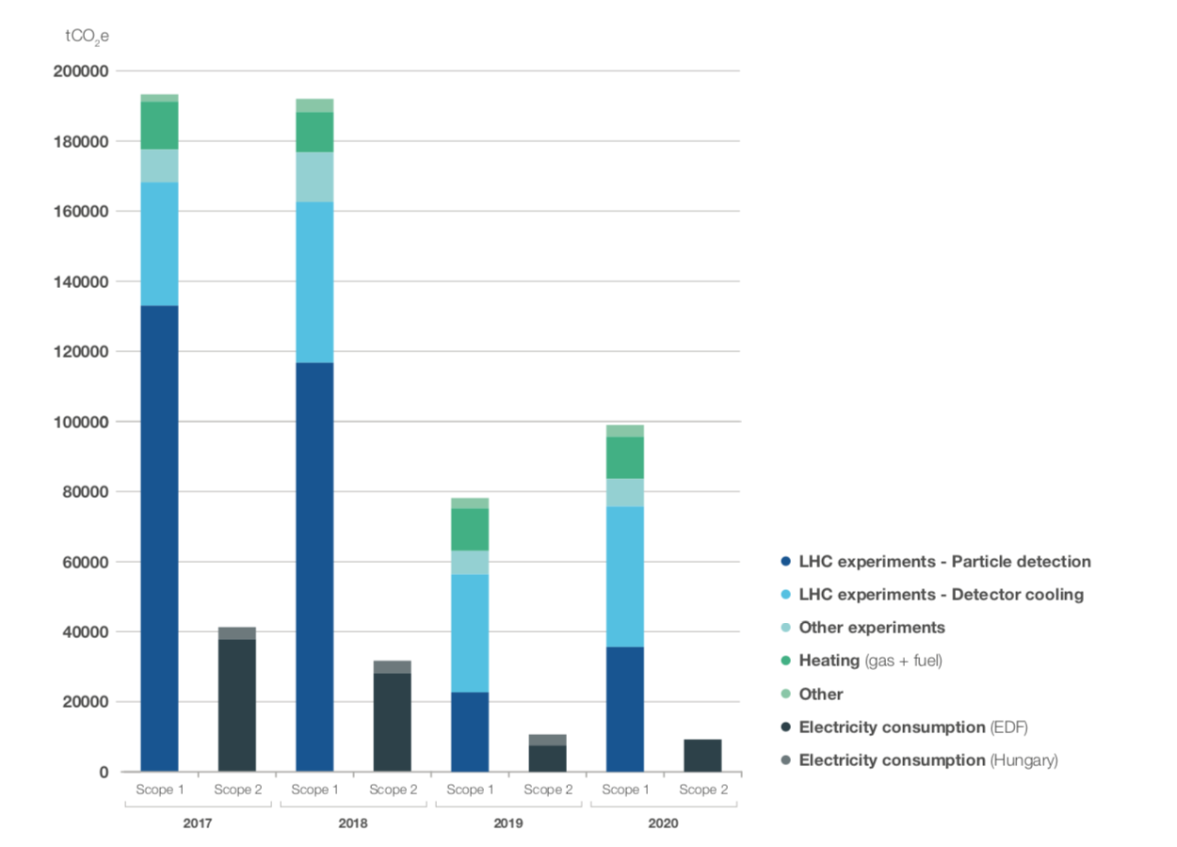
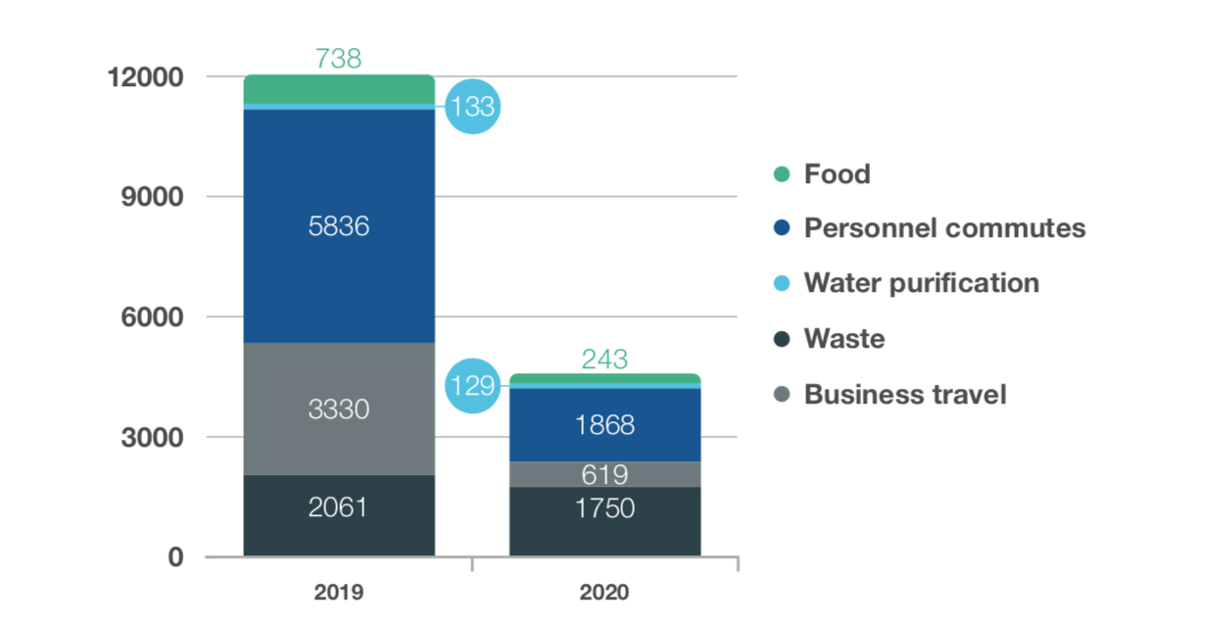
CERN’s 2nd Environment Report (public)
New in 2021 report: first assessment of Scope 3 emissions
2019-2020
are shut-down
years
Emission arising from procurement not included.
“Sustainable procurement project” started
Goal is to reduce emissions by 28% by 2024 (baseline 2018)

